Slide 1

Recognizing:
Importance of VPCs in Africa
Constraints caused by diseased seed
Constraints caused by limited access to seed
Opportunities to leverage improved varieties
Need for more functional seed systems
Need to migrate from campaign approaches to the development of sustainable, reliable, re-useable systems

Slide 2
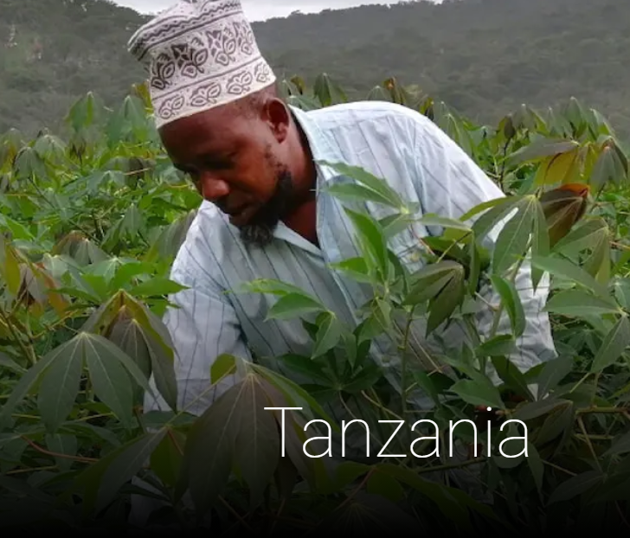



Building
BEST -- Building an Economically Sustainable Seed System for Cassava in Tanzania
BASICS – Building an Economically Sustainable Seed System in Nigeria
YIIFSWA --Yam Improvement for Incomes and Food Security in West Africa
SweetGains
RAPID Banana

Slide 3
Building
BEST -- Building an Economically Sustainable Seed System for Cassava in Tanzania
BASICS – Building an Economically Sustainable Seed System in Nigeria
YIIFSWA --Yam Improvement for Incomes and Food Security in West Africa
SweetGains
RAPID Banana

Slide 4
Innovation
Technical Innovation
Institutional Innovation
Marketing Innovation

Slide 5
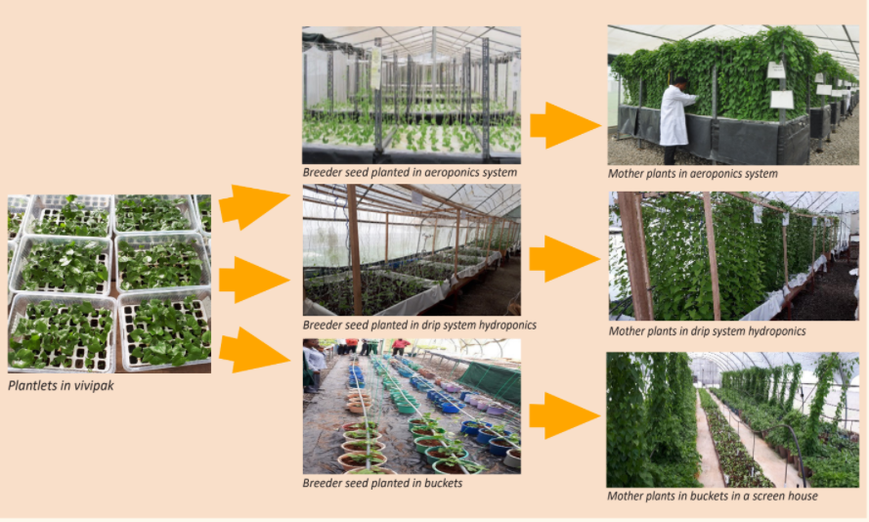
Technical Innovation

Slide 6
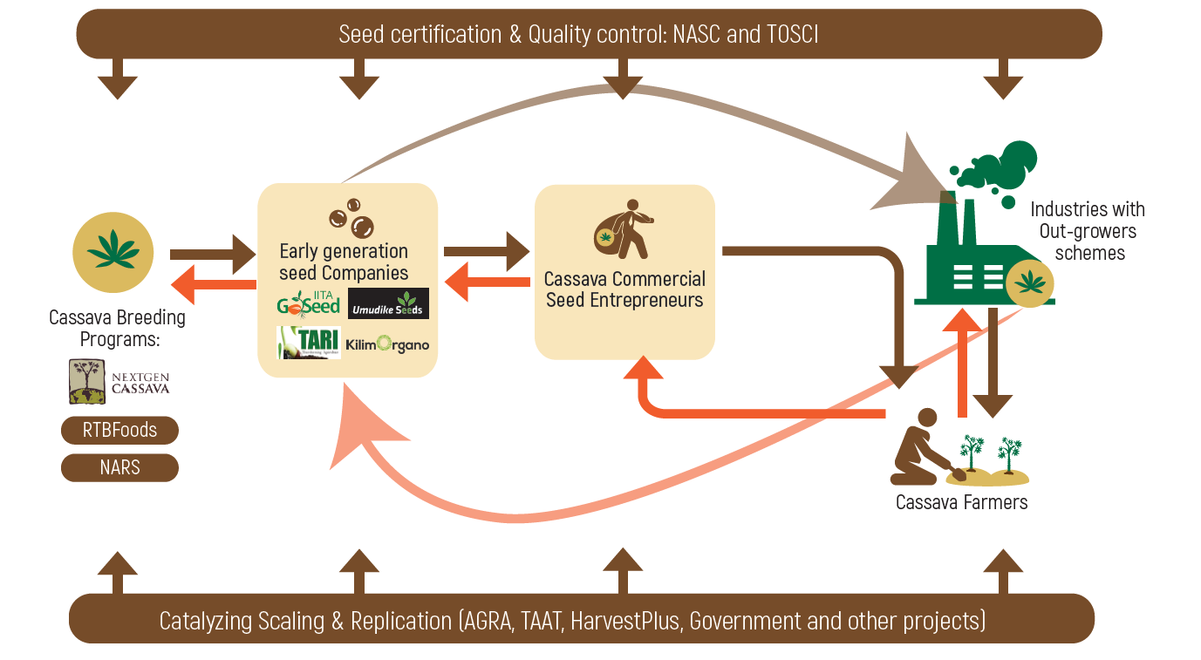
Institutional Innovation

Slide 7
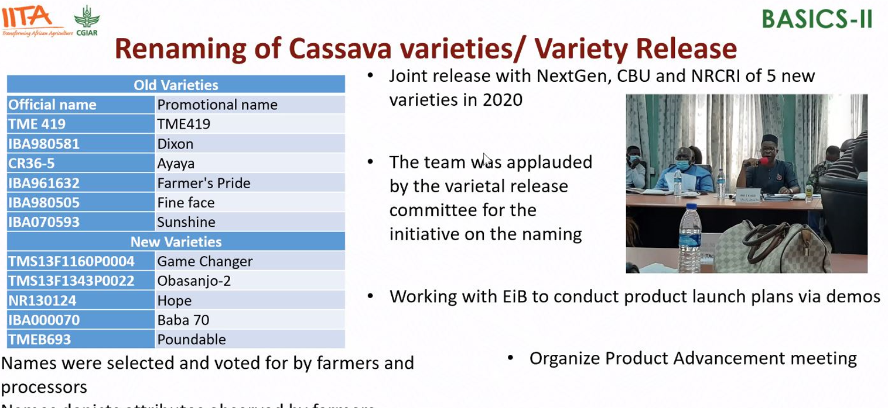
Marketing Innovation

Slide 8

WP3
SeEdQUAL
Initiative of One CGIAR
RAPID-Banana
African Centre of Innovation for VPC Seed Systems
And more…
Scaling partners
Private sector
Governments
TAAT, AGRA

Slide 9
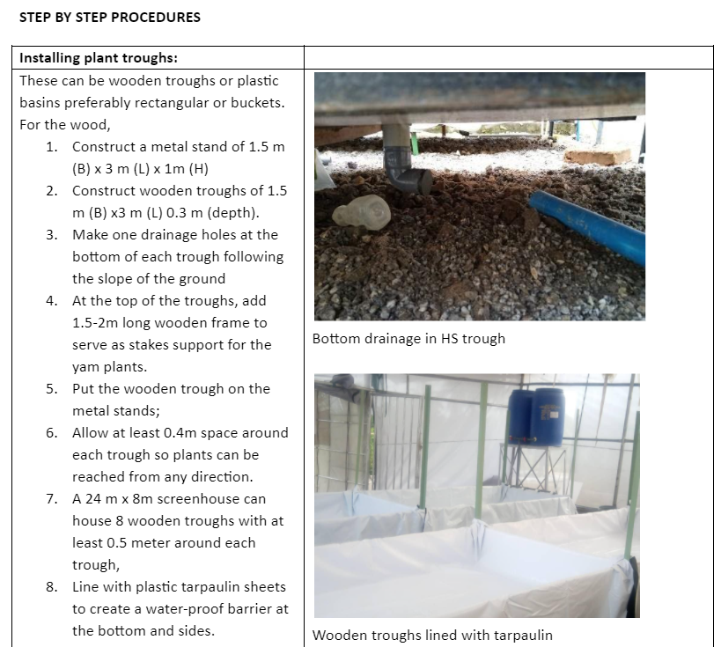
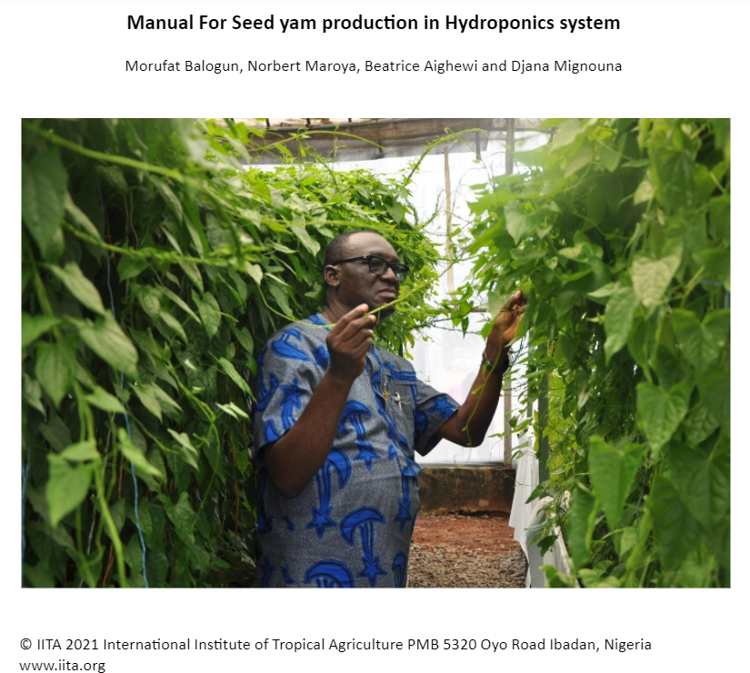
Tools for replication

