Slide 1
Brief overview of the Africa RISING project in the Ethiopian Highlands: Pre-scaling and scaling initiatives in 2017/2018
Addisu Asfaw, ILRI
Bale Zonal Agriculture Development Partners Linkage Advisory Council (ADPLAC) meeting, Bale, 10 January 2018

Slide 2

Introduction
Africa RISING Program
Research (R4D) program operational in West Africa, Southern and Eastern Africa & Ethiopian Highlands,
The Ethiopian highland project of AR: operational in 4 regions, 4 districts and 8 kebeles,
  Oromia->Bale->Sinana->Selka & Ilu-Sanbitu
Supported by USAID and lead by Scientists from ILRI,
Temporal coverage: Phase2 from 2017- 2021,
Notes:
asdfghjkl

Slide 3
Major Goal:
To identify production constraints, implement on-farm research that could improve HH level food security and farm income diversification through SI of crop-livestock system.
Intensification, action research, food security, income diversification and nutrition are pillars of the project.
Notes:
asdfghjkl

Slide 4
Major objective of this presentation:
To share a brief overview of Africa RISING program, Research approach, proven technology pre-scaling, scaling and R4D initiative in and outside the target district for our stakeholders.
Notes:
asdfghjkl

Slide 5

Research and Development Methodologies:
Problem identification through participatory approaches,
HH characterizations & typologies,
Participatory planning and evaluation of interventions,
Knowledge sharing amongst multiple stakeholders and via various channels.
Notes:
asdfghjkl

Slide 6
Key Stakeholders:
Model farmers,
Government Extension: Regional, Zonal, Woreda,
Researchers: IARI (>8), EIAR, OARI- Sinana Agricultural Research Center (SARC), Higher institution-MWU,
Policy Makers/decision makers: Federal, Regional, Zonal, Woreda & Kebele,
Oromia Seed Enterise Bale Branch (OSE),
In phase1 we had Woreda IPs and now will grow to Zonal IPs.

Slide 7
Proven technologies in phase-1:
A total of about 79 technologies tested: 9 crop types of 44 varieties with management practices,
35 other trials like highland fruit, animal feed technologies, soil fertility, 2WT with irrigation facility & trailer etc.

Slide 8
Various livestock feed related technologies and management practices,
Root crops and highland fruit,
Over 12 crop varieties and management practices verified in 1st phase went for wider scaling in 2nd phase.
Others continued and being tested (ex. 2WT)
The total beneficiaries reached 843 households with 25% female participation.
Total area covered was more than 40 ha.

Slide 9
Table 1: Scaling up of Africa RISING validated technologies by local partners from 2015-2016.
No. | Technologies scaled | Area coverage (ha) | No of hhs addressed | Year of implementation | Implementing institutions
1 | Potato-gudane and belete varieties | 8.75 | 72 | 2015 | MWU, Bale Zone and Sinana district extension
 |  | 500 – 600 | 1500–2000 | 2016 | Farmers in Ilu-Sanbitu
2 | Apple | 0.096 | 240 (2400 seedlings) | 2015 | Madda Walabu University
3 | Durem wheat-Utuba variety | 75-80 ha | 33 | 2016 | Africa RISING, ICARDA, Sinana woreda extension
4 | Bread wheat-Hidase and Huluka varieties | 12,941 | 42,771 | 2016 | GOs, NGOs, agro dealers, farmers
5 | Tree Lucerne | 1800 seedlings | 25 | 2015 | Woreda extension
Total |  | 13,573.35 | 44,911
Notes:
asdfghjkl

Slide 10
The total number of farmers who applied these technologies before launching of phase2 was 44,911 households.
Including the direct beneficiaries, the number would close to 45,754 households.
The total area covered was more than 13,600 ha in 2016.
For this achievement the role played by our key local partners including model farmers, GOs and NGOs was tremendously high and also continued with full commitment in phase2.
Notes:
asdfghjkl

Slide 11

Table 2: Africa RISING proven technologies under scaling by partners in Bale Zone in 2017 main cropping season.
No. | Technology under scaling | # of district | # of Kebele | Participant farmers by Sex |  |  | Area coverage (ha) | Implementing Institutions
 |  |  |  | Male | Female | Total
1 | Durum wheat Utuba | 2 | 15 | 805 | 109 | 914 | 1,470 | Individual farmers
2 | Bread wheat-Hidase | 7 | 27 | 5886 | 857 | 6743 | 4,730.6 | CIMMYT, MWU, primary coop, OSE
3 | Bread wheat-Huluka | 3 | 25 | 3357 | 737 | 4094 | 3,758.5 | Farmer to farmer
4 | Faba bean-Gebelcho | 3 | 12 | 278 | 14 | 292 | 86.45 | ICARDA-USAID, primary coop.
5 | Chick pea-habru | 1 |  |  |  |  | 16.5 | Farmer to farmer
6 | Oat + vetch | 9 | 100 | 10,905 | 1,283 | 12,188 | 662.74 | Zone and woreda livestock and FRD office and Africa RISING.
7 | Tree Lucerne | 4 | 40 | 575 | 123 | 698 | 44,482 seedlings | Zone and woreda livestock and FRD office and Africa RISING.
Total |  |  |  | 21,806 | 3,123 | 24,929 | 10,724.75
Notes:
asdfghjkl

Slide 12

Table 2 indicates commitment of government extension and other GOs in moving these technologies forward in phase2.
Both crop and livestock feed technologies are being scaled in Bale highlands.
By this year, the number of farmers applied these technologies reached more than 25, 000 hhs including R4D trials.
The total area covered by these technologies close to 11, 000 ha.
We observed that quality seed shortage is a major challenge that hinders the scaling up of these technologies.
Notes:
asdfghjkl

Slide 13
Table 3: Seed multiplication of proven technologies on farmers’ field as pre-scaling which is to be used as a source of seed for further scaling by government extension in 2018 and beyond.
No. | Technology & seed class | # of district | # of Kebele | Participant farmers |  |  | Area (ha) | Expected seed (ton) | Implementing Institutions
 |  |  |  | Male | Female | Total
1 | Durum wheat Utuba-Pre basic | 2 | 3 | 8 | 4 | 12 | 9 | 50.4 | Sinana & Agarfa Agri. Offices, OSE
2 | Bread wheat-Hidase-Pre basic | 4 | 5 | 7 | 1 | 8 | 8.8 | 44 | Sinana, Agarfa, Goba & Dinsho Agri. & NRM offices
3 | Faba bean- Dosha-Basic | 4 | 4 | 8 | 1 | 9 | 4 | 17.4 | Sinana, Agarfa, Dinsho and Goba Agri. & NRM offices
4 | Malt barley-Behati-C1 | 4 | 5 | 5 | 1 | 6 | 4.5 | 10.6 | Sinana, Agafa, Dinsho and Goba Agri. And NRM offices
5 | Food barley – HB1307-C1 | 4 | 5 | 3 | 3 | 6 | 4.5 | 17.1 | Sinana, Agafa, Dinsho and Goba Agri. And NRM offices
6 | Chick pea-habru Basic | 4 | 4 | 9 | 3 | 12 | 4.08 | 11 | Sinana, Agarfa, Goba and Dinsho Agri.& NRM offices
7 | Lentil- Derash-Basic | 4 | 4 | 15 | 2 | 17 | 4.93 | 9.86 | Sinana, Agarfa, Goba and Dinsho Agri.& NRM offices
8 | Field pea-Bilalo-Basic | 3 | 2 | 4 | 2 | 6 | 1.99 | 11.4 | Sinana, Goba & Dinsho Agri. NRM offices
9 | Oat + vetch | 4 | 4 | 15 | 10 | 25 | 4 | 25-50% for seed | Sinana, Agarfa, Dinsho and Goba livestock & Fishery RD offices
Total |  | 4 | 5 | 59 | 17 | 76 | 45.8 | 171.76
Notes:
asdfghjkl

Slide 14

Under the control of Zonal and woreda extension:
Multiplication of seed for more than eight crop varieties as well as fodder crops had already done in five kebeles of 4 districts of the zone as part of pre-scaling work of Africa RISING project.
A total of 76 hhs and Oromia Seed Enterprise Bale branch have been directly engaged in seed multiplication of these crops,
Under good weather condition we expect seed that could raise the number of farmers to be addressed by more than three fold.
Notes:
asdfghjkl

Slide 15
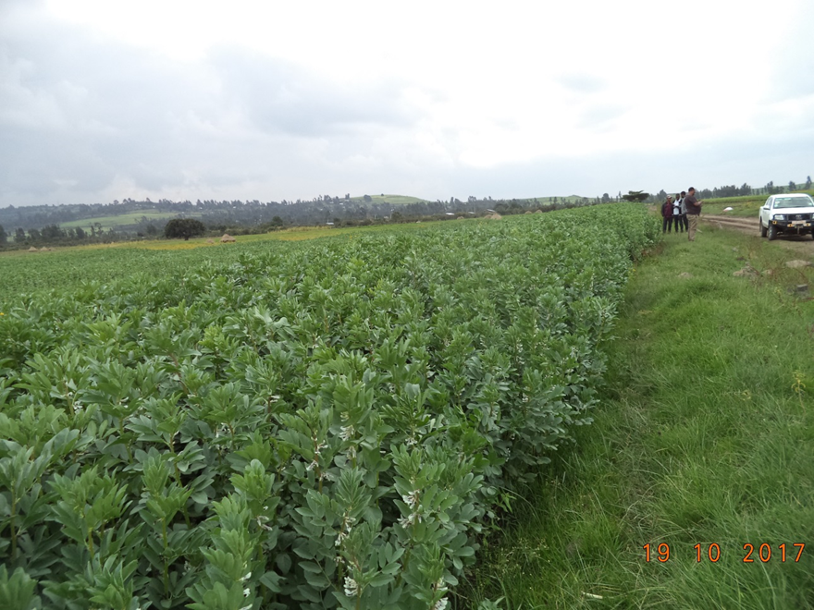
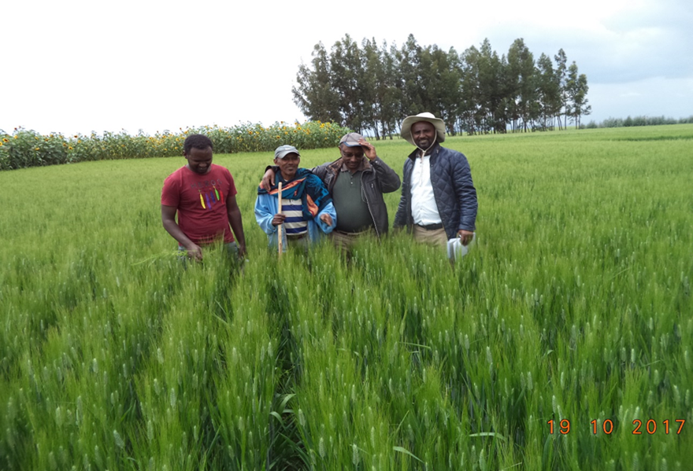
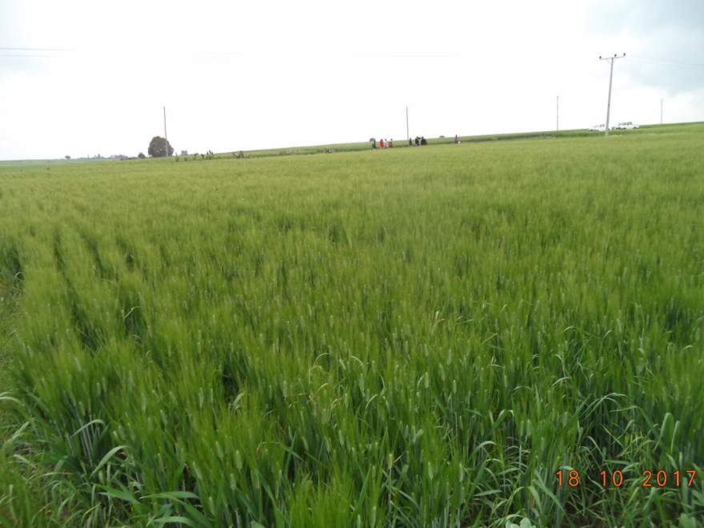
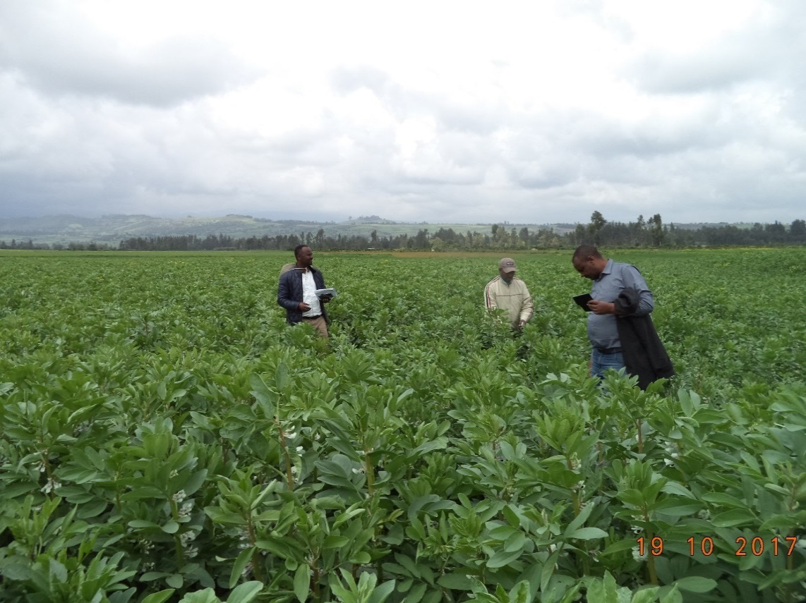
Faba bean -Dosha Seed Multn: Dinsho
D/wheat Seed-utuba Multn: Sinana
D/Wheat –utuba Seed Multn: Agarfa
Faba bean-Dosha Seed Multn: Goba

Slide 16
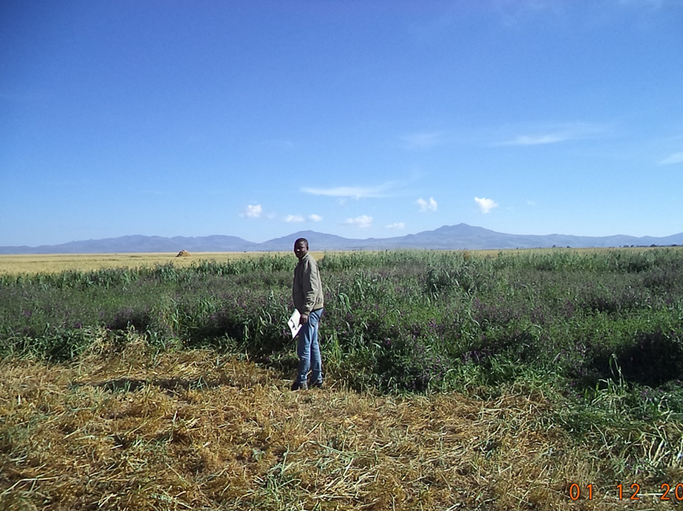
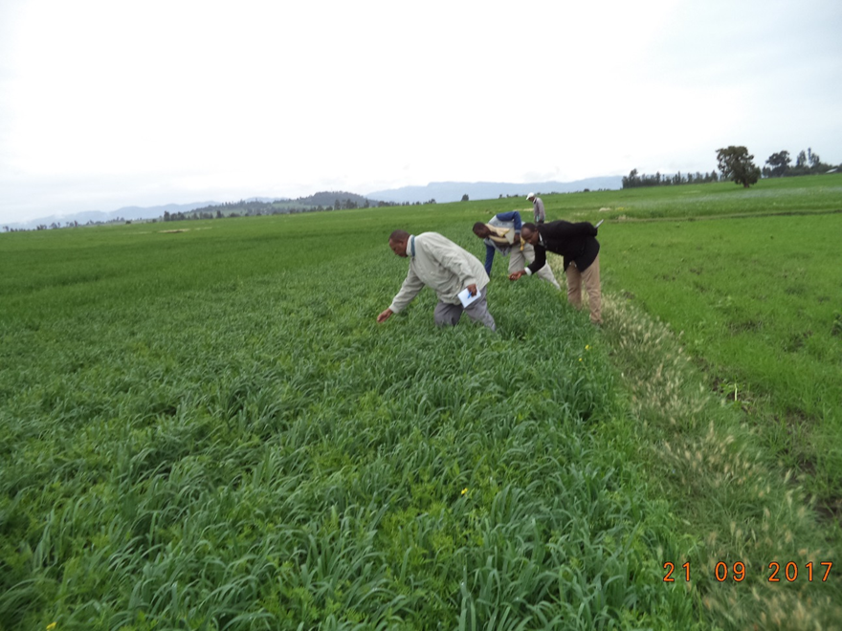
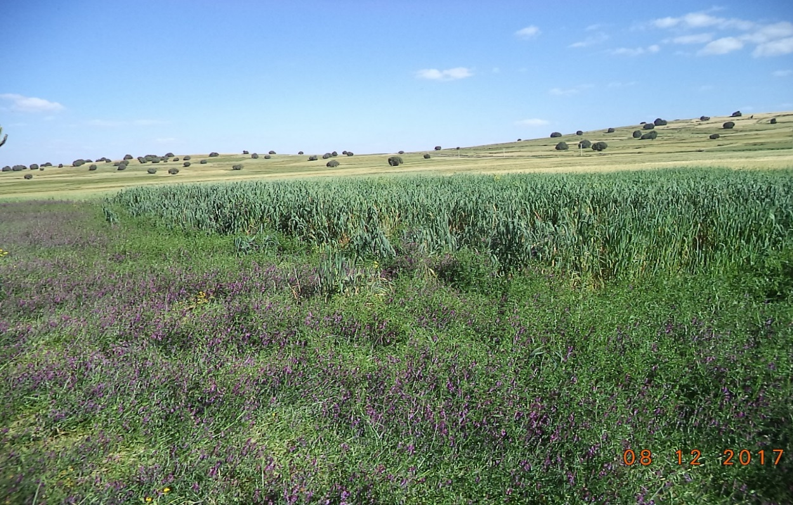
Oat-vetch pre-scaling in Sinana
Oat-vetch pre-scaling in Agarfa
Oat-vetch pre-scaling in Goba district

Slide 17
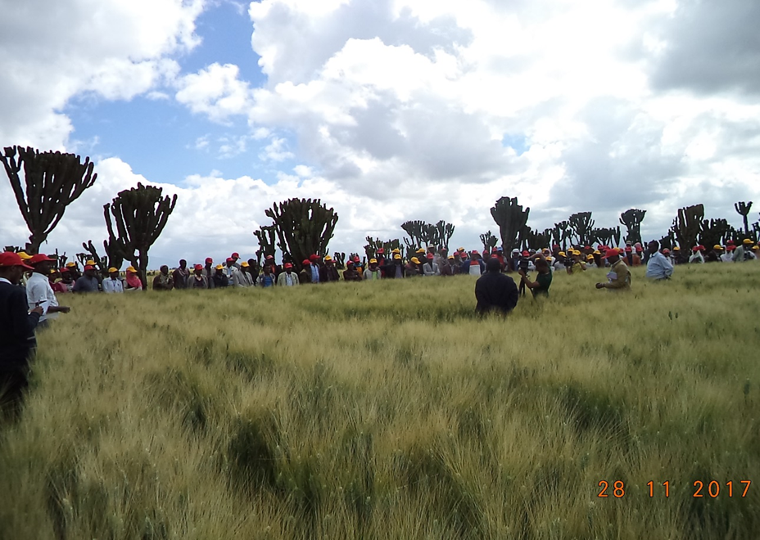
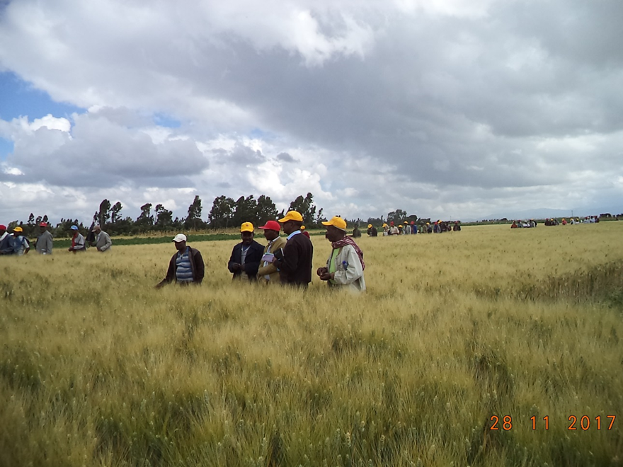
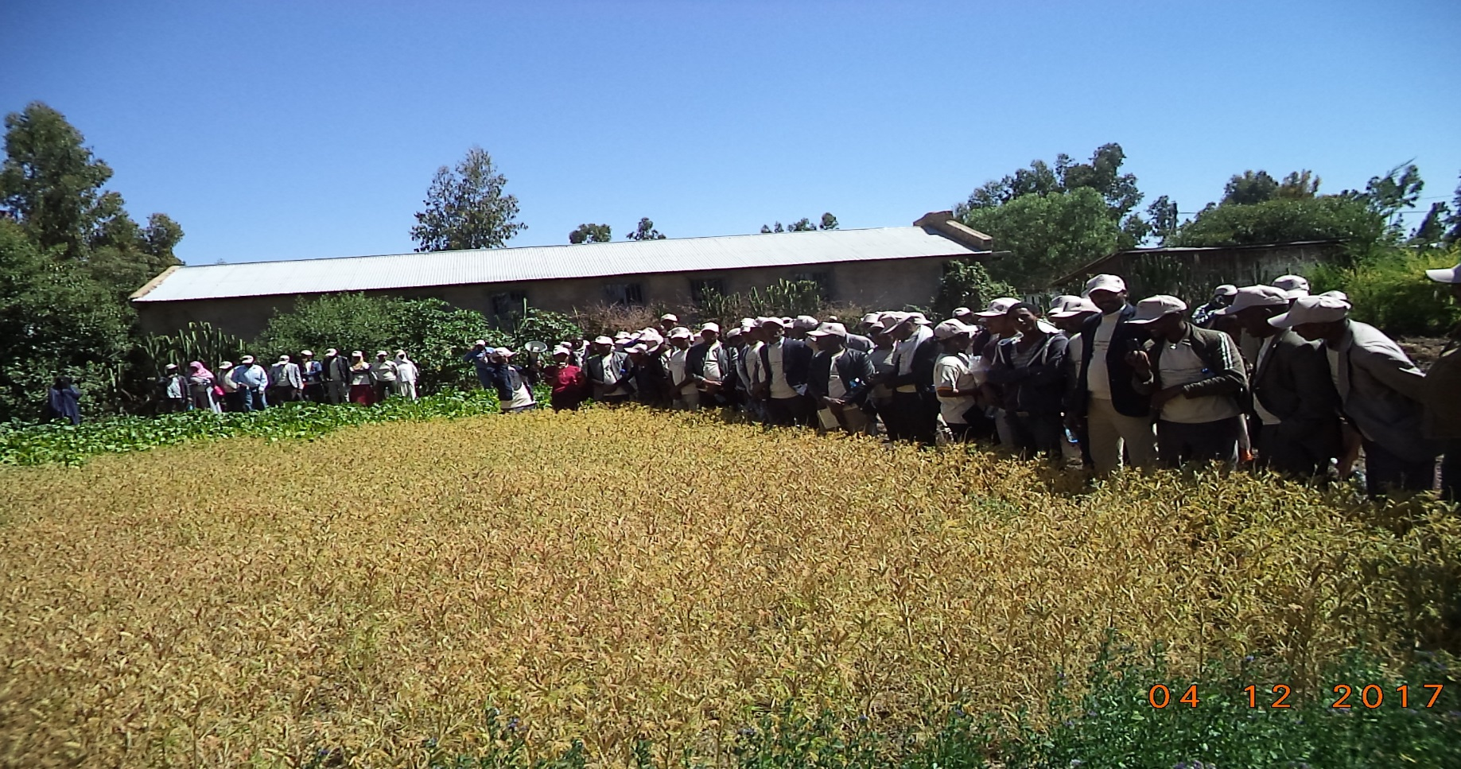
Field days in Besaso Kebele while visiting our seed multiplication on 7ha of land
Field days in Ilu-Sanbitu kebele while visiting the various fodder intervention

Slide 18

Table 4: Action oriented on-farm R4D undergoing in 2017 at Selka and Ilu-Sanbitu kebeles.
No. | Action R4D | Number of Kebele | Participant farmers by Sex |  |  | Area coverage (ha)
 |  |  | Male | Female | Total
1 | Feed technologies (Fodder beet, s/lupin, alfalfa, desho grass, elephant grass, feeding trough) | 2 | 18 | 31 | 49 | 0.28
2 | Crops (faba bean, chick pea and malt barley PVS) | 2 | 11 | 1 | 12 | 1.88
Total |  | 2 | 29 | 32 | 61 | 2.16
In 2017, R4D work continued in the two Africa RISING kebeles.
We can not relay only on these proven technologies and management practices.
Farmers request new technology year by year.
Hence, action oriented on-farm R4D work has to continue side by side with scaling process.
Notes:
asdfghjkl

Slide 19
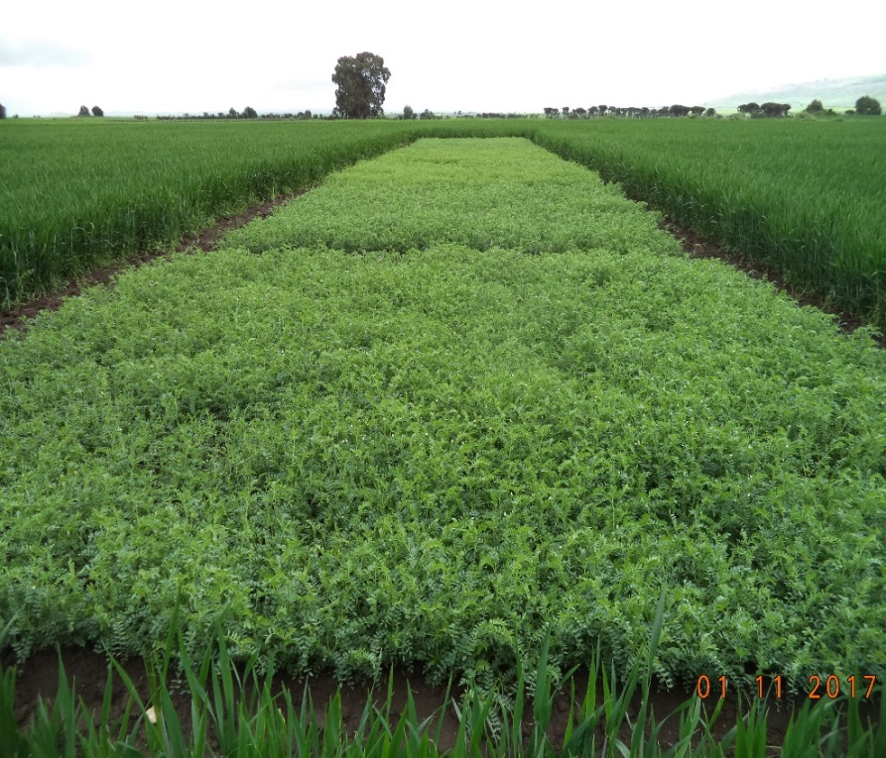
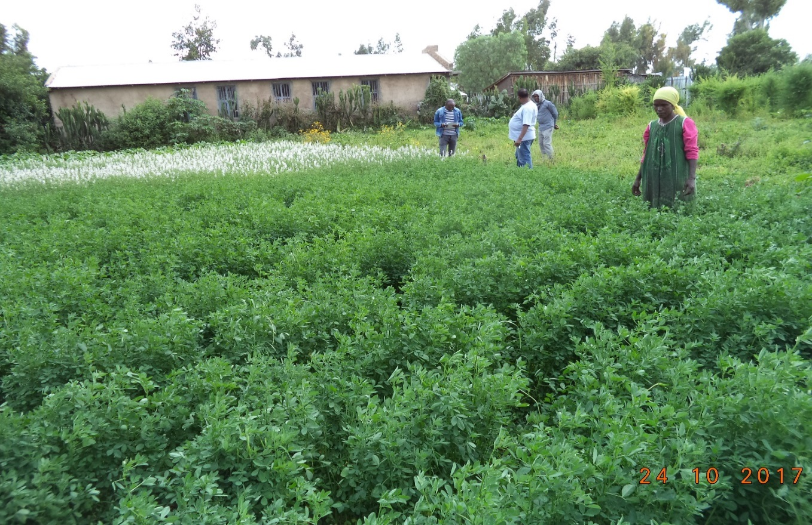
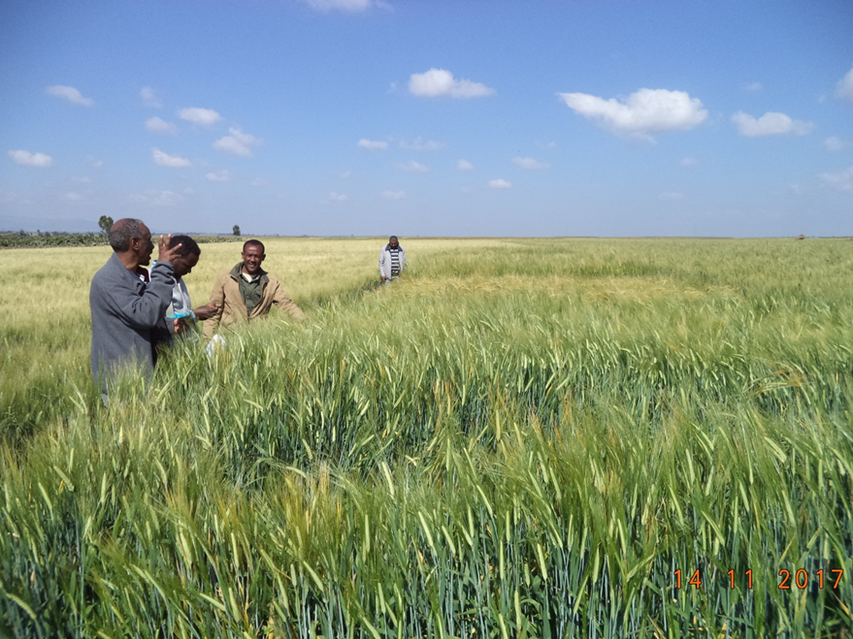
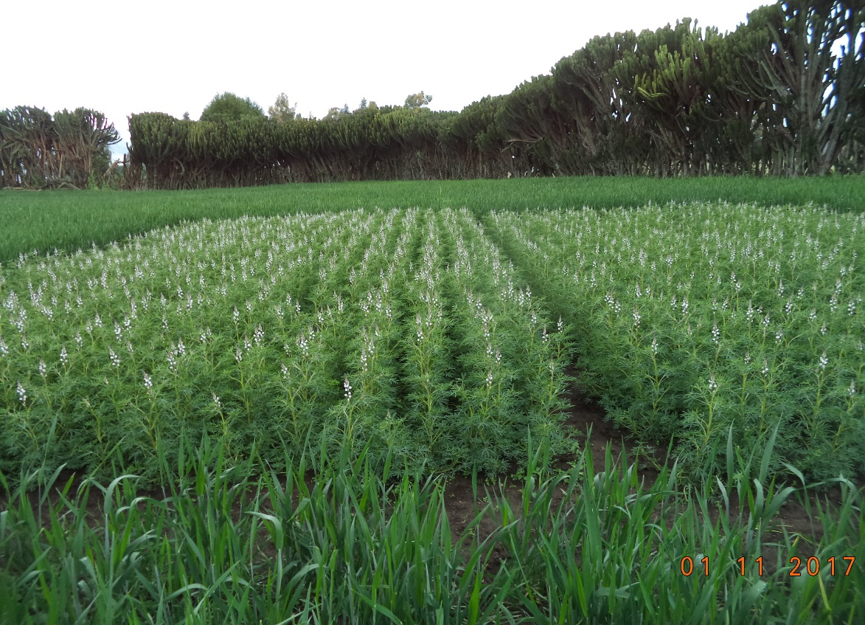
Animal feed on-farm trial: S/Lupine, Alfafa, F/beet,
Chick pea PVS trials in Selka
Malt Barley PVS trials in Ilu-Sanbitu
Sweet Lupine at Selka

Slide 20
In addition to technologies under scaling, three crops and more than five animal feed technologies are being demonstrated,
Out of these, best performing technologies are expected to go for scaling in the coming year and beyond.
Notes:
asdfghjkl

Slide 21
Monitoring and Follow up of Scaling initiatives:
  We have one contact persons from zone and each woreda,
  Frequent monitoring and follow up had been done with zonal extension heads/v/heads,
  Frequent field visits organized for higher officials and scaling partners,
Notes:
asdfghjkl

Slide 22
Challenges and Opportunities:
Major Challenges:
Dependency of farmers on wheat/single crop/ due to mechanization (mono-cropping),
Lack of interest among farmers to engage themselves in labor intensive farming activities,
Lack of interest among farmers to rotate pulse crops with cereals,
Wider prevalence of pests (weeds, disease, insects, etc) resulted in a declining trend of crop productivity,
Notes:
asdfghjkl

Slide 23
Post harvest management problems reduced quality of seed and even grain quality (combine harvester, storage, etc),
Absence of well established seed certification system with model farmers,
Lack of market and incentives mechanisms for seed producer farmers,
Marginalizing animal feed technologies (low attention given to this sector),
Absence of sustainable animal feed seed production and marketing system,
Notes:
asdfghjkl

Slide 24
Absence of well established market linkage for industrial crops (D/wheat, M/Barley) & potato,
Considering ILRI/Africa RISING/ as AID organization and high expectancy for free input supply, e.t.c,
Notes:
asdfghjkl

Slide 25
Opportunities:
Availability of potential partners,
Good working environment,
Willingness and strong network established among each other to share experience through innovation platforms,
Availability of bimodal rainfall in most parts of Bale highlands,
Model farmers engagement,
Suitability of the zone (soil, micro-climate, land holding size, etc) to produce diverse crop types, vegetables and fodder crops.
Notes:
asdfghjkl

Slide 26
Lesson Learned
  Through cooperation and collaboration with potential partners, we could address the problems of the community on time,
Notes:
asdfghjkl

Slide 27
The Way Forward:
  IPs will be established at Zonal level so as to bring all actors together in a regular basis for creating common goals to design, implement and communicate integrated system R4D intervention and facilitating scaling in the zone and even beyond as deemed necessary .
  Back stopping research in scaling,
  R4D activities will continue,
  Capacity building (training, experience sharing, field visit)
Notes:
asdfghjkl

Slide 28










Africa RISING CGIAR partners in Ethiopia
Notes:
Ethiopia

Slide 29

Local partners
Academic institutions:
  Wachemo, Mekelle, Madawalabu, Debre Berhan and Hawassa universities; Maichew Agricultural College
Regional research organizations:
  Amhara Regional Agricultrural Research Institute, Southern Agricultural Research Institute, Tigray Agricultural Research Institute, Oromia Agricultural Research Institute
Federal research organizations:
  Ethiopian Institute for Agricultural Research, Ethiopian Health and Nutrition Research Institute
Offices of Agriculture:
  Endamekoni (Tigray), Basona Worena (Amhara), Lemo (SNNRP) and Sinana (Oromia)
Agricultural Transformation Agency

Slide 30
Africa RISING program communication tools:
Website: africa-rising.net
Wikispace: africa-rising.wikispaces.com
Photos: flickr.com/photos/africa-rising/sets
Presentations : slideshare.net/africa-rising
Documents: cgspace.cgiar.org/handle/10568/16498

