Slide 1
Gender Transformative Approaches in agrifood systems
A course in four modules
Version 1 (2024)
Anjalee Kohli, Elizabeth Costenbader, and Steven Cole

Slide 2
Welcome

Slide 3
COURSE Learning Objectives
Objective 1
Objective 2
Objective 3
Objective 4
Understand the value of using gender transformative approaches in agrifood systems
Understand concepts important to gender transformative approaches
Understand how gender transformative approaches are operationalized
Understand how to measure gender transformative change
Notes:
Remind the participants of the course learning objectives.

Slide 4

Our Roadmap
We are here!
1
2
3
4
Gender transformative approaches
in agrifood systems
Characteristics important to gender transformative approaches
Operationalizing gender transformative approaches
Measuring gender transformative change
Notes:
Let the participants know where we are in the course.

Slide 5

RECAP
In chat:
Share one thing you learned in Module 1
Notes:
Ask people to share in chat (if virtual) and/or verbally one thing they learned in module 1. This is a way to help remind the group of the different topics we covered.

Slide 6
RECAP
In chat:
Are there any lingering questions or comments before we dive into Module 2?
Notes:
Read the slide. Ask people to share in chat or verbally. Address any questions before advancing. You can ask participants to help answer questions.

Slide 7
characteristics important to gender transformative approaches
Module 2
Notes:
Read the slide – this is the beginning of Module 2.

Slide 8
Learning Objectives
1
Describe the key characteristics of gender transformative approaches
2
Discuss ethical considerations when using gender transformative approaches
Notes:
Read the slide.

Slide 9
Structure of Today’s Session
1
Key characteristics of gender transformative approaches
2
Case studies that exemplify the key characteristics of gender transformative approaches
3
Ethical considerations when using gender transformative approaches
Notes:
Read the slide.

Slide 10
Key Characteristics of gender transformative approaches
Section 1
Notes:
We are going to discuss 5 key characteristics of gender transformative approaches. These are relevant to program design, implementation and research. All the characteristics are (equally) important.

Slide 11
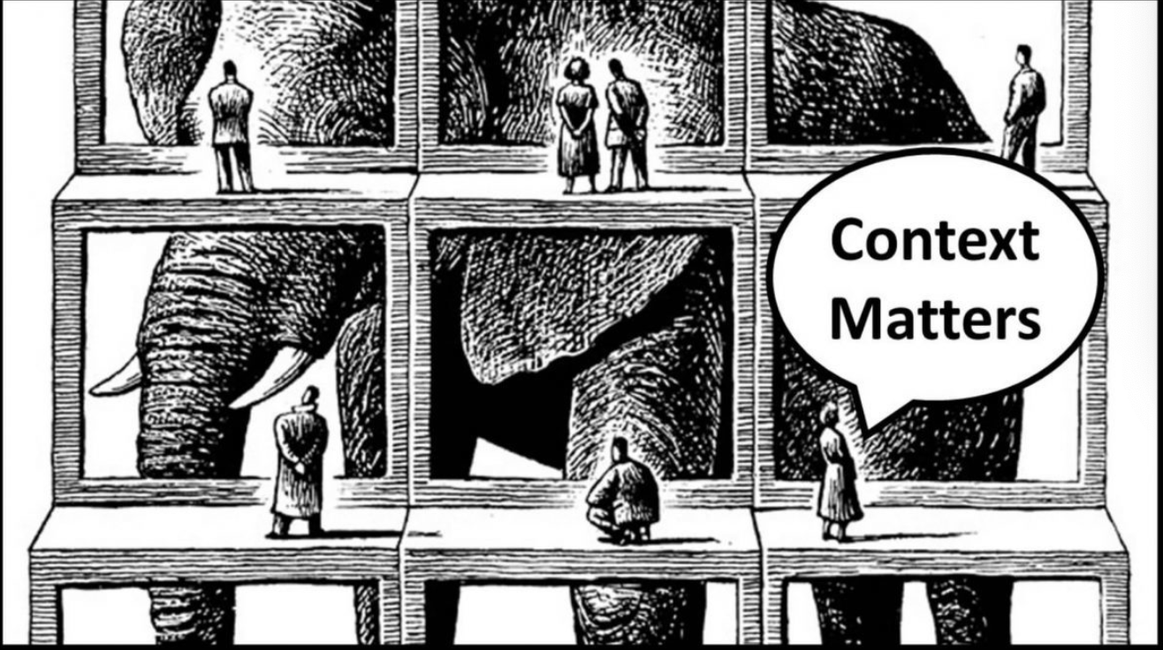
Characteristic One
Prioritize a deep understanding of people in their context and the way social inequalities intersect to affect choices, opportunities and outcomes
Image source: https://content.tattooprojects.com/blog/placeholder
Source: Kantor 2015
Notes:
Read the slide.
Characteristic 1 focuses on two important aspects of understanding a place, its structures and its people: through a deep understanding of context and the use of an intersectionality framework to learn about people, their lived experiences, and their needs and opportunities.

Slide 12

A deep understanding of context
Examine the individual, relational, social and structural context.
Gain a deep understanding of poverty and inequality.
Examine areas in which gender discrimination is pronounced.
Learn about the broader context.
Sources: Kantor 2015; FAO 2024
Image source: https://www.dreamstime.com/illustration/ explorer-safari-kids-cartoon.html
Notes:
This slide describes what is meant by a deep understanding of context. It involves
Examining the individual, relational, social, and structural context to learn essential information about the social and gender differences and work on the agrifood system
Gaining a deep understanding of poverty and inequality, the underlying drivers, and unequal power relations
Examining areas in which gender discrimination is pronounced, potential opportunities for programming, and challenges to GTA
Learning about the broader context including political and institutional environments and the incentives and obstacles to gender equality and women's empowerment

Slide 13
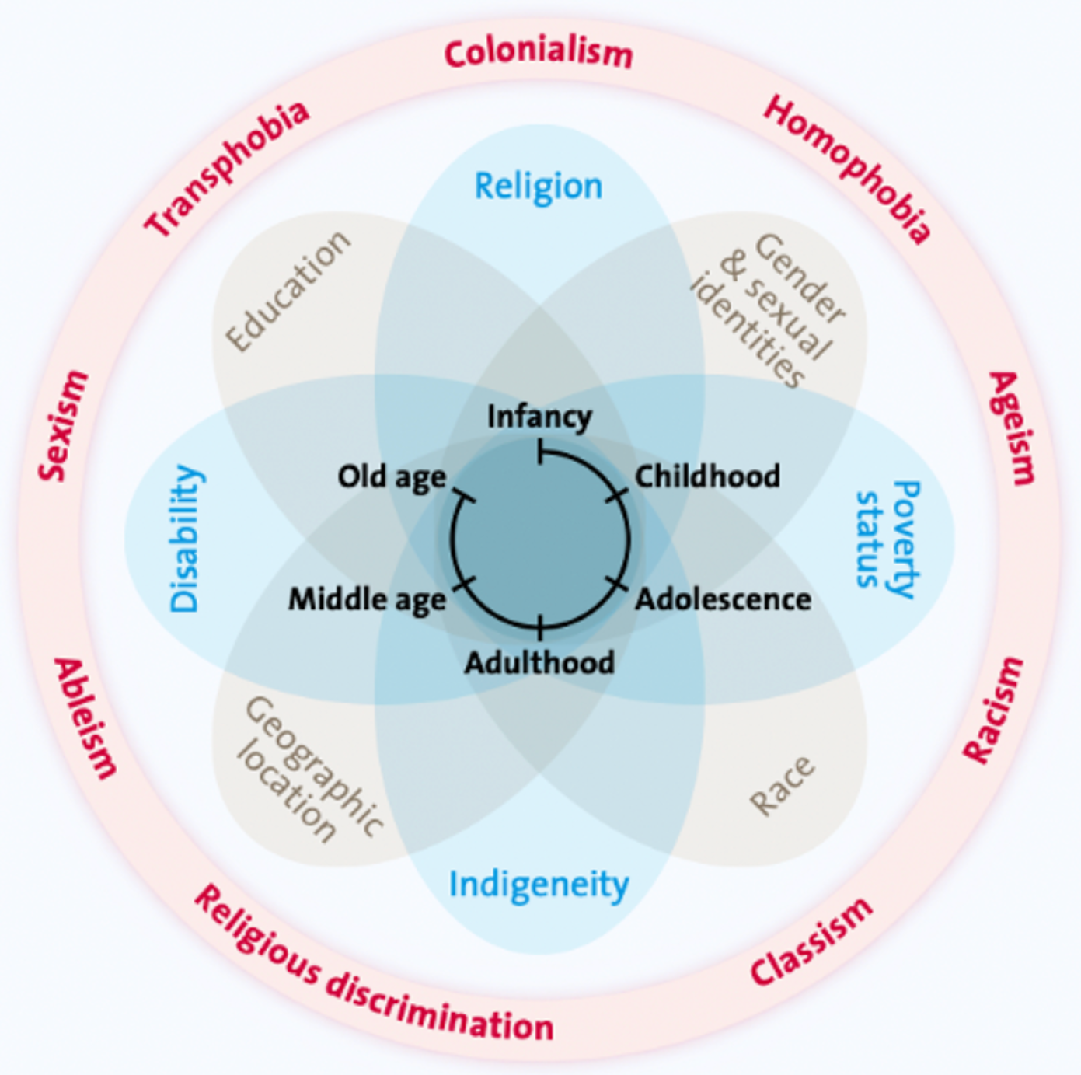
Intersectionality
“…intersectionality offers the potential to analytically leverage the lens of social power relations (such as gender, age, ethnicity, race, and class) in ways that highlight how different systems of discrimination and advantage interact. These social power relations are co-constructed together in ways that shape the experiences of different people living at the various intersections of identity and relative levels of power within society.”
— Tavenner 2022
Sources: Crenshaw 1989; Tavenner 2022; UNWomen 2021
Image source: Tavenner 2022
Notes:
Intersectionality theory comes from Black feminist thinkers and was first defined by Kimberle Crenshaw in 1989. The definition on this slide comes from Tavenner’s (2022) article on intersectionality in gender and agriculture.
Read the slide.
By applying intersectionality, we can learn that power dynamics are complex and are not explained by a single aspect of a person’s identity. Intersectionality is not just about gender. It asks us to examine and understand how social power relations work and how they interact with gender.
On this slide, we see the Intersectionality Wheel, which comes from the Tavenner paper. It shows three circles of interconnectivity.
• The inner circle describes a person’s unique circumstances. For example, here we see life stages – infancy, childhood, adolescence for example.
• The second circle shows aspects of a person’s identity. For example, we see race, poverty status, gender, and sexual identities.
• The third circle shows different types of discrimination, inequalities, and attitudes that impact identity.

Slide 14
Intersectionality
People face multiple and intersecting forms of marginalization.
Adopt a more systems-oriented and complexity-aware lens.
Learn about who may be excluded or affected by development and research activities, and develop strategies to address this.
Different oppressions and power dynamics interact.
Oppressions are not additive.
The researcher/team should engage with their own assumptions and positionality.
Sources: Tavenner 2022; Wilkins
Notes:
This slide describes intersectionality. Read the slide.
Intersectionality is relevant in all the places we exist – in our communities, institutions, and places of work.

Slide 15
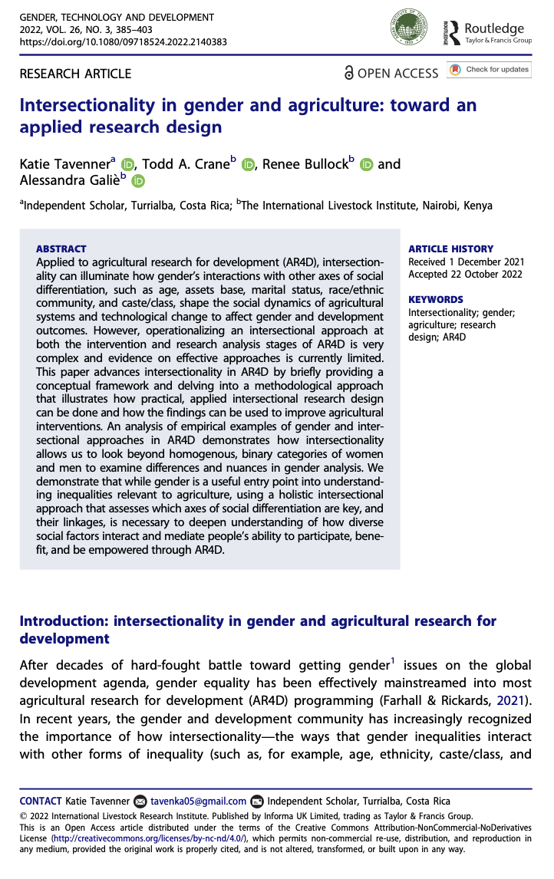
Intersectionality and social embeddedness in agrifood systems
Applying intersectionality in a meaningful and rigorous way in agrifood systems practice and research:
Group-centered: “placing multiple marginalized groups and their perspectives at the center”
Process-centered: “intersectionality as a process, highlights power as relational, seeing the interactions among variables as multiplying oppressions”
System-centered: “intersectionality as shaping the entire social system”
Sources: Choo 2010; Tavenner 2022
Notes:
Intersectionality is about complexity, seeing how systems and identities interact, and how history and the present determine how things are.
So instead of looking at a specific inequality as unique to a particular institution, we see it as shaping the entire social system.
There are three ways to understand intersectionality in practice. This is shown on the slide. Read the slide: group-centered, process-centered, and system-centered.
While we don’t discuss it here, Tavenner’s article shares a 5-step process on how to operationalize this framework in research design.

Slide 16

Characteristic TWO
Engage with both men and women
Image source: Shutterstock Gender Balance
Source: Kantor 2015
Notes:
Characteristic 2 describes how programs cannot only focus on just men or just women. Or place the burden on women to fix the system that results in gender inequities.

Slide 17
Masculinity
The “quality and characteristics describing what it means to be manly” (Equimundo 2023)
Context and culture-dependent: there is no one version of masculinity at any point in time
Influenced and reinforced by local, national, and global representations of manhood
A person can exhibit aspects of healthy masculinity and harmful masculinity
Definition:
Masculinity
Source: Equimundo 2023
Notes:
Let’s start with a look at masculinity. Read the slide.

Slide 18
HEALTHY Masculinity
All cultures have healthy masculinities.
Includes ways of being boys or men that include:
Expressions of a wide range of emotions;
Being vulnerable and being comfortable to be that way;
Asking for help;
Feeling comfortable in caregiving and nurturing roles;
Sharing care work and domestic labor;
Developing open, kind, and honest communication skills;
Promoting and advocating for gender equality and encouraging the same of other men;
Bravery is also a positive characteristic – for any gender – along with those listed above.
Source: Equimundo 2023
Notes:
Masculinity is a broad term. One way to think of masculinity is in terms of “healthy” and “harmful” masculinities.
All cultures have healthy masculinities. Examples of this are shown on this slide. Read a few of the bullets.

Slide 19
Harmful Masculinities
Boys and men are socialized or raised in ways that are harmful—to themselves, other boys and men, girls and women, and their families and communities.
Sanctions and pressures make it difficult for boys and men to act in other ways, though it is possible.
Boys and men are taught and pressured to behave in certain ways such as being dominant, not asking for help: “be a real man”, “toughen up”.
Expression of this type of masculinity is associated with perpetration and experience of violence and other harmful behaviors (and therefore sometimes called harmful masculinity).
They learn these expectations with their families and friends, in relationships and institutions, and through media, etc.
Harmful masculinity is associated with poor health outcomes for men and women.
Sources: Heilman 2019; WHO 2019
Notes:
Some aspects of masculinity are included under harmful masculinities. These encourage and enforce a limited understanding of what it is to be a boy or a man– “that involves taking risks, being strong, not seeking help, feeling entitled, and exerting power and dominance over women”
Read the slide.
Men experience the harmful consequences of gender inequality. It is evident in the health outcomes of boys and men and in the health of women and girls. Gender transformative approaches seek to broaden the understanding of masculinity and how it can be expressed in ways that promote health and well being.

Slide 20
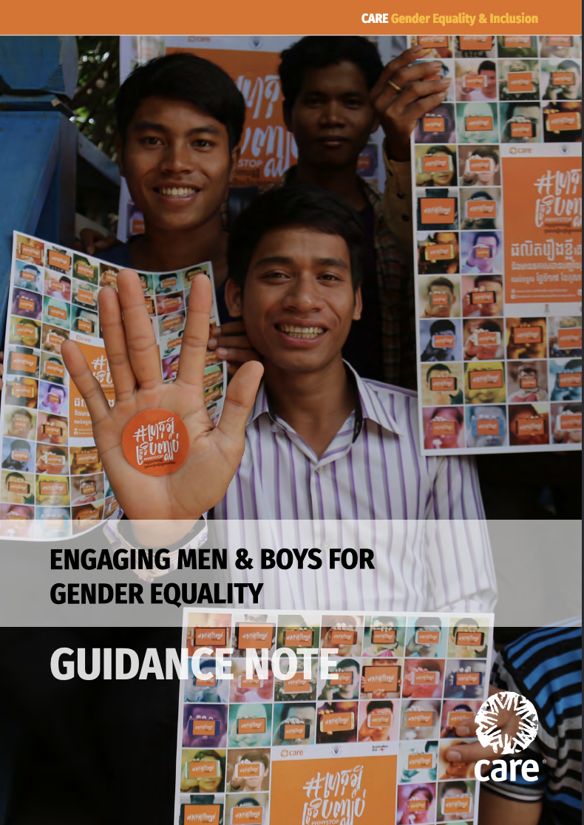
Engaging men and boys for gender equality
Shift beliefs, behaviors and practices at the household and community levels.
Encourage men to abandon harmful stereotypes and embrace respectful healthy relationships.
Men can be allies or obstacles for gender equality. And they experience their own vulnerabilities due to their identities.
Reflect on power dynamics, gender relationships and gendered expectations, and take action.
Source: CARE 2021
Notes:
Programs that engage men and boys may do the following: Read the slide.

Slide 21



Engaging men and boys for gender equality
Participants within program activities
Supporters of gender
equality within families, communities and workplaces
Allies and champions of gender equality within communities and workplaces
Participants within a broader program considering power relations related to a specific issue.
Supporters of gender equality, proactively take action for equitable power dynamics.
Allies and champions within communities and workplaces, proactively act and speak out.
Source: CARE 2021
Notes:
Men and boys may be engaged in different ways in programming: as participants, as supporters, and as allies and champions.
As participants in a program, this is often the first time that men and boys have been involved in considering power relations on this or any issue. Their involvement may be limited in time or format.
Supporters may informally take actions to challenge discriminatory norms and structures and speak out to encourage gender equality within their circle of influence.
Allies and champions take intentional action to ensure women and girls have the same opportunities, access to services, and rights. Men hold themselves accountable for their actions and those of other men. These programs may work in partnership with feminist movements.

Slide 22

Characteristic THREE
Work across multiple levels of the socio-ecological model
Image source: SBCC and Gender: Models and Frameworks
Source: Kantor 2015
Notes:
Characteristic three stresses the need to work across multiple levels of the socio-ecological model.

Slide 23
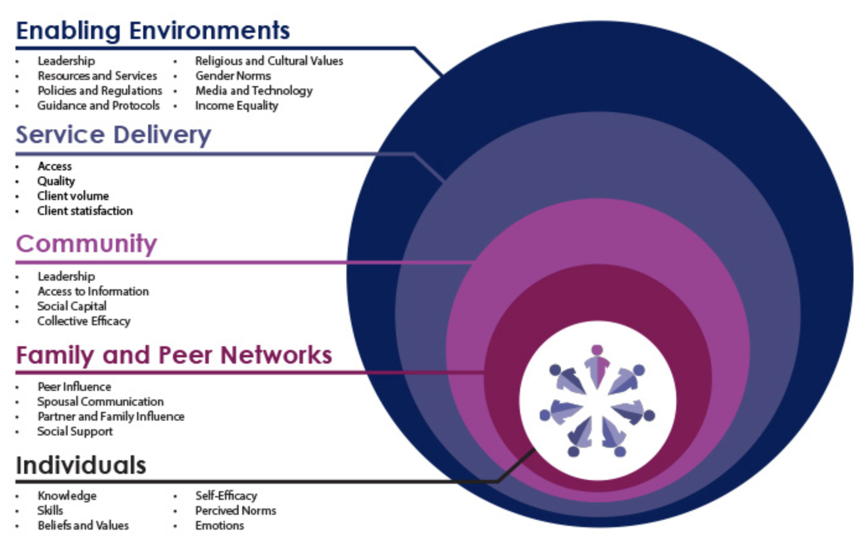
Socio-Ecological Model
Source: SBCC and Gender: Models and Frameworks
Notes:
The socio-ecological model was developed by Bronfenbrenner in the late 1970’s. We know that behavior is influenced by many factors. The socio-ecological model helps us understand how different levels influence behavior and illustrates how different levels of programs can work to influence change.
It also makes clear that work needs to take place at many levels to support change.
Read the names of the different levels.

Slide 24
Individual Level
Possible entry points for supporting change:
Clubs or groups to empower individuals
Individual counseling
Life skills training
Notes:
Read the slide

Slide 25
Family and Peer Networks
Possible entry points for supporting change:
Parenting programs
Economic/ livelihood programs
Group dialogue
Communication skill building
Notes:
Read the slide

Slide 26
Community Level
Possible entry points for supporting change:
Facilitated group dialogue sessions organized by sub-groups (e.g., men’s group, women’s group) or inter-group dialogue (e.g., intergenerational groups, community dialogue)
Role modeling
Safe spaces
Drama
Community campaigns
Community mobilization
Notes:
Read the slide

Slide 27
Service Delivery
Possible entry points for supporting change:
Staff training
Quality improvement
Improving accessibility for specific groups
Notes:
Read the slide

Slide 28
Enabling Environment
Possible entry points for supporting change:
Engaging opinion, government and local leaders
Social media campaigns
Policy and law
Media (radio, television, social media, etc) programming
Staff training and policies
Media advocacy
Notes:
Read the slide

Slide 29
Internalize and practice gender equality principles in organizations
At the organizational level, facilitating agencies—including staff, partners, institutions—should take time to self-reflect, understand and embrace gender transformative approach principles in their work and organizational culture.
Walk the talk on gender equality.
Identify, understand and reconcile biases.
Source: Lau 2021
Notes:
Another aspect of gender transformative programming, in addition to working across the different levels of the socio-ecological framework, is for organizations working in this area to internalize and practice gender equality principles in their organizations.
Read the slide.

Slide 30
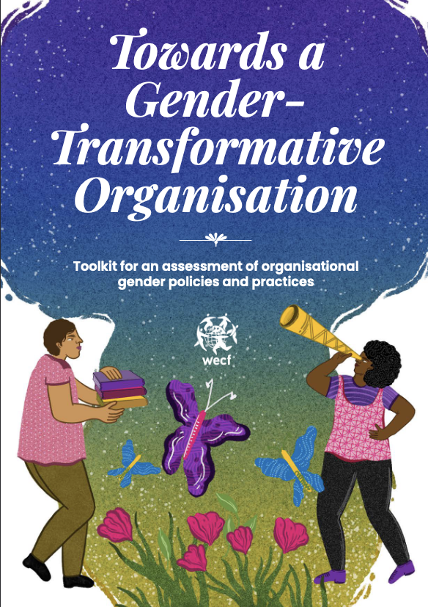
Internalize and practice gender equality principles in organizations
Conduct organizational self-assessments and team reflection meetings.
Develop and implement an organizational gender action plan.
Increase congruence between organizational culture and values and those they seek to implement.
Increase congruence between organizational and personal values.
Sources: Cavill 2020; Kennedy 2022
Notes:
This type of organizational work can involve… Read the slide.
The image on this slide is a toolkit for an assessment of organizational gender policies and practices.

Slide 31
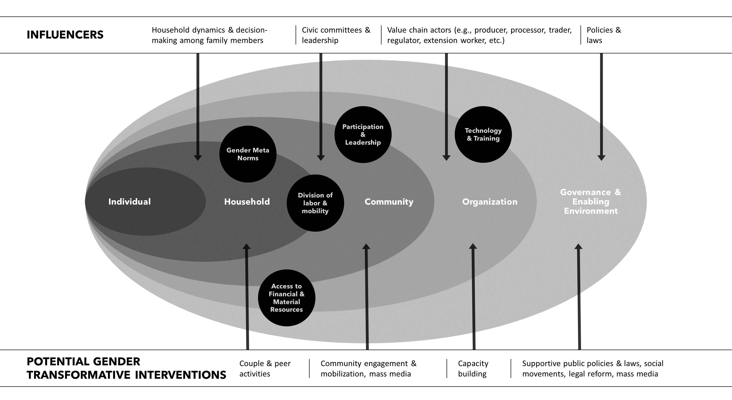
Works across multiple levels
Source: Seymour 2024
Notes:
This figure places the socio-ecological model in the context of gender transformative approaches.
Here we see the individual level on the left. It is nested in these other levels.
Formative research, consultations with the community, and reviews of existing data show opportunities at different levels that a program can support through gender transformative approaches. And it can identify barriers that need to be addressed to realize change.
The top line of the image shows influencers. There are influencers of norms at each level of the socio ecological model. They are distinct at each level. Read some examples.
The line at the bottom describes potential gender transformative interventions. These are not comprehensive, but they are illustrative of possible interventions. Read some examples.

Slide 32
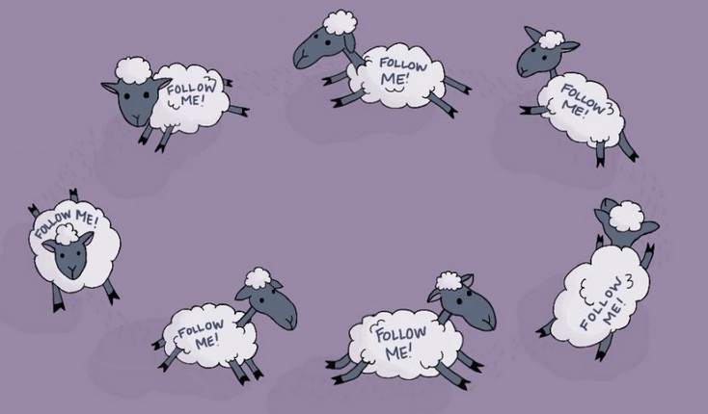
Characteristic FOUR
Address unequal power relations, and challenge oppressive norms, behaviors and structures
Illustration: Jene Rigaud
Source: Kantor 2015
Notes:
Read the slide.

Slide 33
Power
Notes:
We’ll start with power.

Slide 34
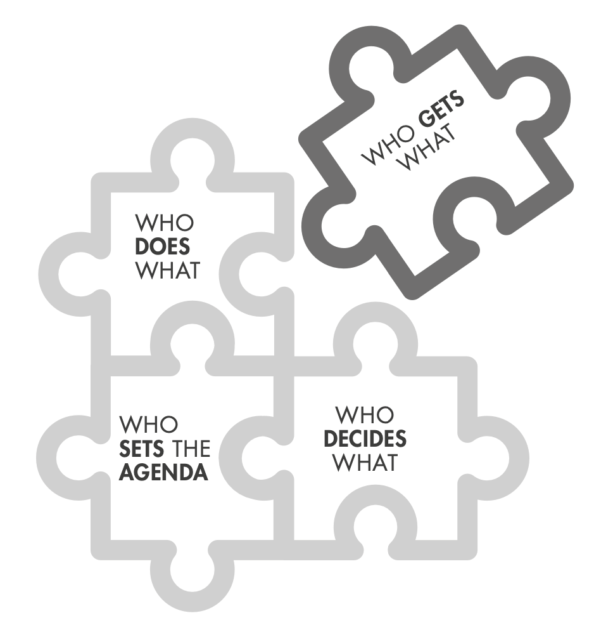
What is power?
Power is about control and capacities (opportunities, rights, privileges).
Power exists and operates across the levels of the socio-ecological framework.
Institutions and spaces of decision-making power can be in conflict or counteract one another.
Power is visible, invisible and hidden.
POWER is the capacity of individuals or groups to decide or influence who does what, who gets what, who sets the agenda, who decides what.
Image source: Batliwala for CREA, with thanks to Rao and Kelleher 2002
Source: Batliwala for CREA
Notes:
Read the slide, starting with the part in dark pink and then the bullets.
• Visible power occurs in public and private spaces. ”It is the capacity to control people’s choices, access to resources, voice in decision making and frame rules that regulate societies and govern countries.”
• Hidden power is about who influences decisions or sets agendas behind the scenes. It is the voices who are heard or consulted on a particular issue.
• Invisible power is the most difficult to challenge or confront because we have to see it to know it and respond to it. It shapes how people think and feel about themselves, creates attitudes and biases, and influences our desires and needs.

Slide 35
How power operates
Between individuals
Between social groups
Between political and economic formations
Within the self
Power often shows up as violence, discrimination and control.
Power creates and enforces social hierarchies.
Power works within and between countries or institutions.
Individuals (and groups) organize, act and confront those more powerful.
Source: Batliwala for CREA
Notes:
Power operates in different places and ways. Read the slide.
• Power between social groups are the social power structures that allocate power, privilege, and rights to some and deny it to others.
• Power within – is the power we all have, whether we recognize it or not. It can’t be taken away, even if we don’t know we have it.

Slide 36
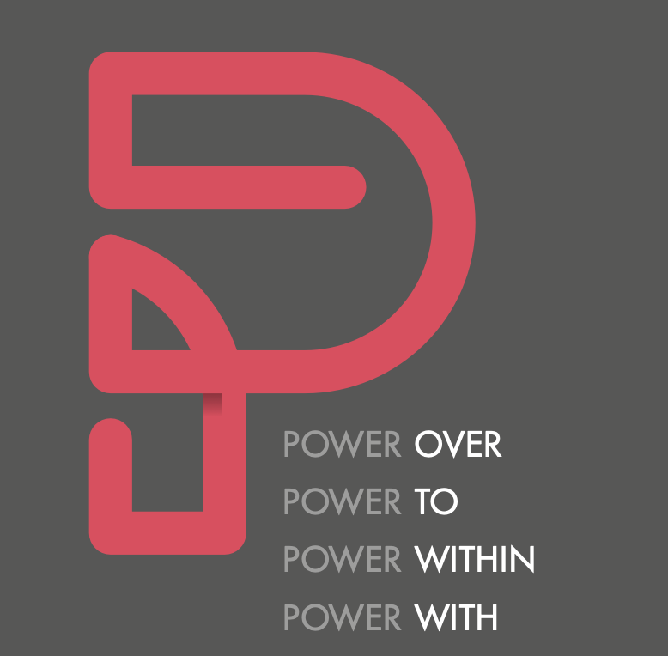
Expressions of power
Power over is who decides what. It is expressed in indirect and direct control over others.
Power to is the capacity to act for ourselves and others.
Power within is the self as a source of power. Though hard to explain, it’s impossible for someone to take away.
Power with is collective power to confront and challenge injustice.
Source: Batliwala for CREA
Image source: Batliwala for CREA
Notes:
We can think of four expressions of power. Read the slide.
Ask participants to share examples of the different expressions of power.
Power with is the most potent expression of power and has been used to end injustices. It can also be used to keep people oppressed.

Slide 37
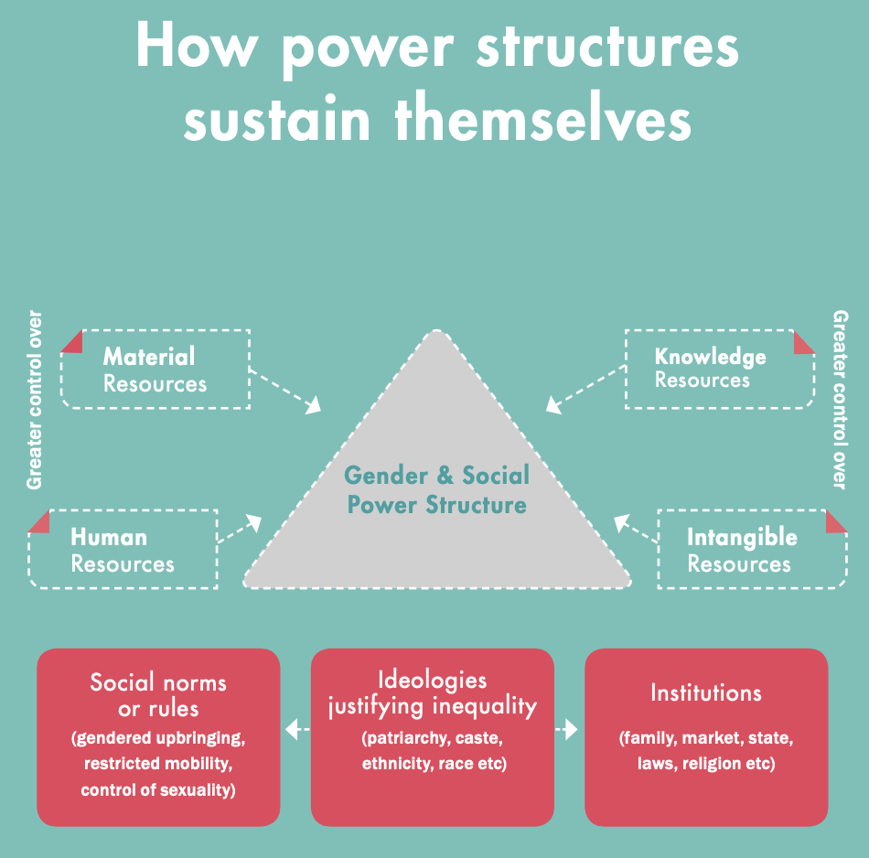
Power structures sustain themselves
Clever, effective and evolving mechanisms are put in place to protect and sustain power structures.
Source: Batliwala for CREA
Image source: Batliwala for CREA
Notes:
Power structures sustain themselves. Clever, effective, and evolving mechanisms are put in place to protect and sustain power structures.
• In the image, we see gender and social power structures in the center. Different types of resources interact with these power structures, meaning they are distributed differently.
• The three red boxes include social norms or rules, ideologies that justify inequality, and institutions. These are factors that justify, enforce and reproduce gender and social power structures.
Ideologies include patriarchy, racism, colonialism, etc. They are a set of ideas that justify power structures no matter how inequitable or unjust they are. People learn ideologies and can be taught to accept and live within them and they can be untaught ideologies.

Slide 38
Social and gender norms
Notes:
Now we’ll talk about social and gender norms.

Slide 39
Social norms
Social norms are the often implicit, informal rules that most people accept and abide by. They are influenced by belief systems, perceptions of what others expect and do, and sometimes by perceived rewards and sanctions.
Norms are embedded in formal and informal institutions and produced and reproduced through social interaction.
— ALIGN, ODI
Source: Align, ODI
Notes:
Read the slide.

Slide 40
Social norms
Definition:
Social
norms
are
What people in a group believe is typical and appropriate behavior.
Different from individual attitudes or beliefs—not what I believe, rather what I think that others believe.
Source: Passages Curriculum
Notes:
Read the slide

Slide 41
GENDER norms
Definition:
Gender
norms
are
A type of social norm.
The expectations and perceived rules for how one should behave based on one’s biological sex and social perceptions of gender.
Source: Passages Curriculum
Notes:
Read the slide

Slide 42
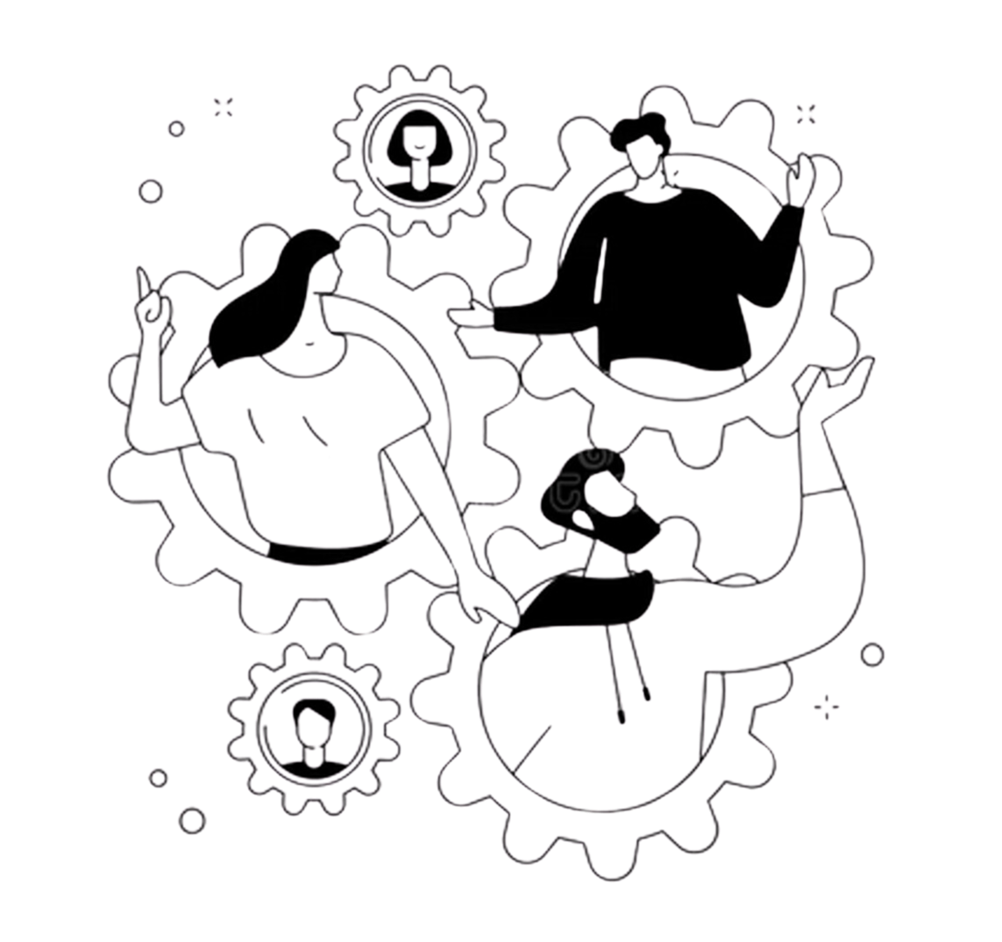
REFERENCE GROUPS
Definition:
Reference groups
are
A group of people whose behavior and beliefs shape one’s own behaviors and beliefs.
Those who pass on and enforce social norms.
Image source: Dreamstime.com
Source: Passages Curriculum
Notes:
Read the slide

Slide 43
What is the difference between
a norm and an attitude or belief?
Attitudes and beliefs are personal and are individual and internally motivated.
Social norms are social or interdependent and are collective and extrinsically motivated.
Attitudes and beliefs can conflict with social norms (but not always).
Source: Passages Curriculum
Notes:
What is the difference between a norm and an attitude or belief?
• We can think of attitudes and beliefs as personal, individual, and internally motivated. They are influenced by social factors, but they are held internally.
• Social norms are social or interdependent. They are collective and extrinsically motivated.
Attitudes and beliefs can conflict with social norms. They don’t always, but they can.

Slide 44

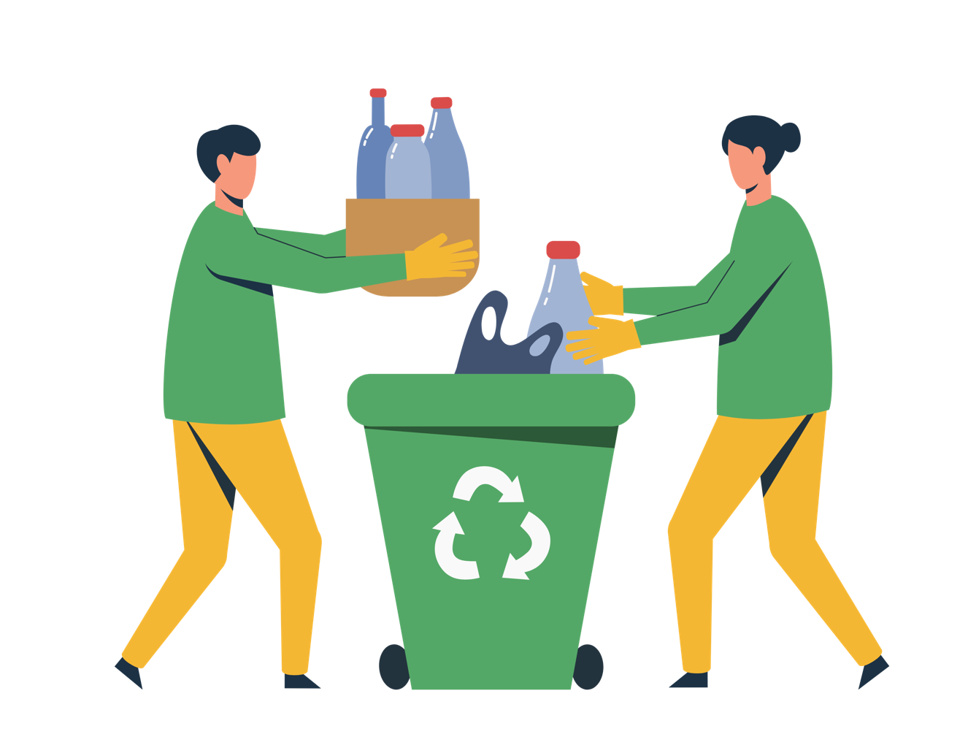
Types of Social Norms
    Descriptive norms
    Perceptions of what others do.
    Injunctive norms
    Perceptions of what others expect me to do.
Image source: Canva
Source: Passages Curriculum
Notes:
There are different ways to understand social norms. One way is to divide them into descriptive and injunctive norms. Read the definitions of each.

Slide 45
Norms are different from attitudes
Example 1:
I want to be a truck driver (attitude) but there are no women truck drivers where I live (descriptive norm) and I think others would make fun of me (injunctive norm) if I were a truck driver.
Example 2:
I would like to go to university (attitude), but I don’t know of any women in my community who have gone to university (descriptive norm) and it is not considered appropriate in my community (injunctive norms) for girls to leave the house alone much less go to university alone.
Notes:
Here are a few examples of descriptive and injunctive norms and attitudes.
Read each example.
In these examples, the person's attitude is different from the social norm. If they follow their preference, they will go against the norm and if they follow the norm, they go against their preference.
Ask the group why people may choose to follow a norm if it goes against their attitudes.

Slide 46
Why do people comply with norms even if they disagree?
Norms are often hidden and unexamined.
There is a desire to conform to their sense of social identity.
Norms are enforced by the reference group.
People have insufficient power to resist.
Source: Passages Curriculum
Notes:
There are different reasons a person may comply with norms even when they disagree with them.
• Norms are often hidden and unexamined. Some people may follow norms without realizing they are following a norm, or they may not be able to explain why they follow it. ”it’s just how things are”
• Others may follow a norm because they want to conform to a social identity. They might be because others do it, or it’s what people like me do or are expected to do. It can be a way to stay within one’s community, rather than face repercussions like judgment or exclusion.
• Norms are reinforced by reference groups. People may follow norms because of the advice or pressure they receive from their reference group. People may follow norms because they have insufficient power to resist. They may want to act differently but recognize that the consequences of acting differently are not manageable given their power in relation to others.

Slide 47
Structures

Slide 48
Structural Determinants
Social structures form the complex and stable framework of society that influences all individuals or groups through the relationship between institutions (e.g. economy, politics, religion) and social practices (e.g. behaviors, norms and values), or the ways social institutions are related and interact in a given society.
— Bell 2015; FAO 2023b
Source: FAO 2023b
Notes:
Read the slide.
• They create the environment in which individuals make choices and enact behaviors.
• They are the social, economic, and political contexts that shape individual and community outcomes.
• They include the systems and structures in a society, such as socioeconomic status, education, neighborhood conditions, policy, etc.
• And they impact the access to resources and opportunities, leading to inequities across population groups.

Slide 49
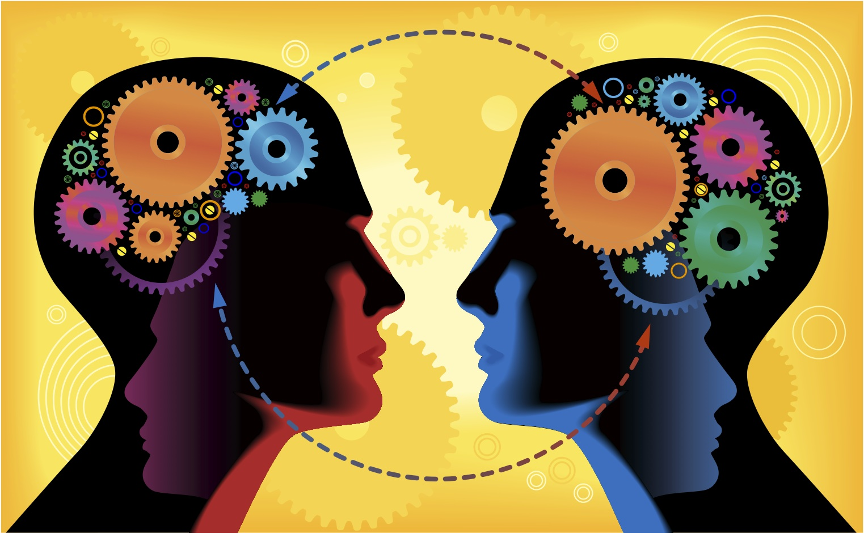
Characteristic FIVE
Foster iterative cycles of critical reflection and action, and build a critical consciousness
Image source: swscmedia.com
Source: Kantor 2015
Notes:
Read the slide

Slide 50
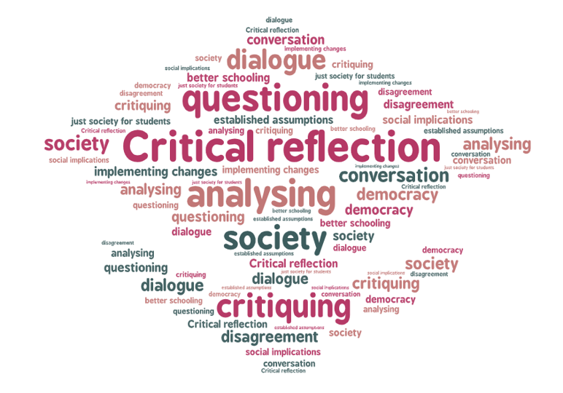
Gender transformative approaches involve critical reflection
These are iterative cycles of reflection, where learning in one session builds in the next. People may be in mixed or single groups depending on the purpose and structure.
Critical reflection is important for institutions, organizations, and research and program design and implementation teams in addition to work with participants.
Image source: Edurad.eu
Sources: Lau 2021; FAO 2024
Notes:
Read the slide.
Critical reflection is an opportunity for people of different backgrounds and identities to examine their own beliefs, attitudes, values and norms. Unpacking these and how they relate to research and program design is important. Through reflection and discussion, people may identify new behaviors or norms that better align with their values.

Slide 51
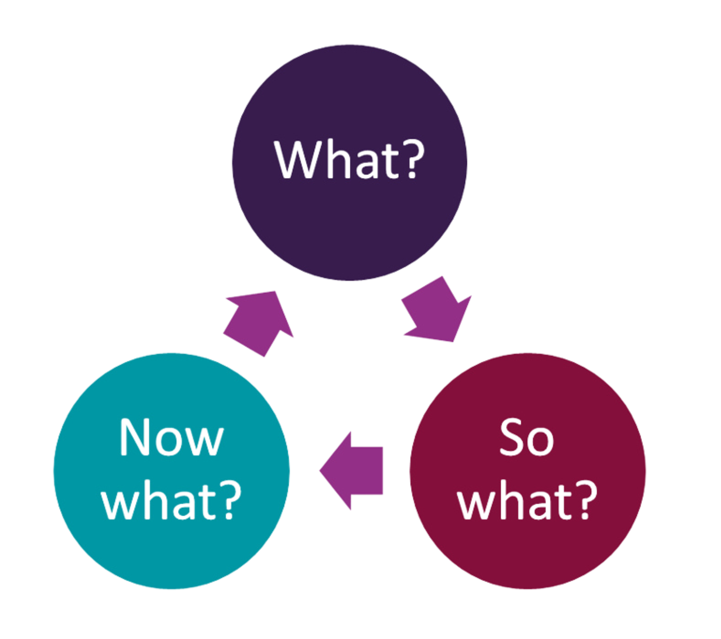
Gender transformative approaches involve critical reflection
Conduct reflective discussions to help create critical consciousness through social dialogue and learning.
Enhance awareness of norms, dynamics and their influence on own and others lives.
Reflect on values, behaviors and where there are alignment and opportunities for change.
Strategize together to support change.
Challenge unequal power relations and dynamics across spheres of influence.
Image source: McLeod 2024
Sources: Lau 2021; FAO 2024
Notes:
Read the slide.

Slide 52
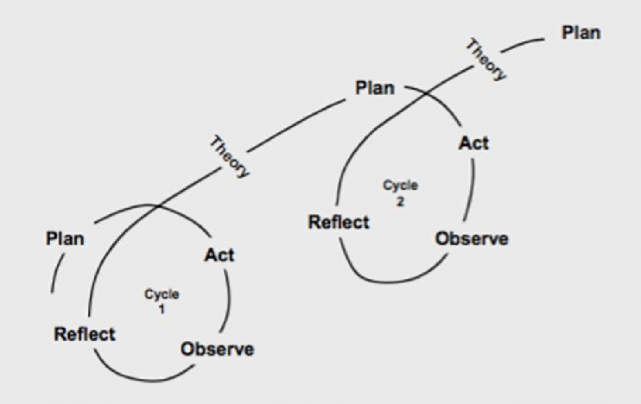
Gender transformative approaches are iterative
Gender considerations and learnings in one stage inform the next phase of the project and evaluation cycle.
Embedding learning throughout while remaining nimble allows programs to adjust and respond to changes as they happen.
Image source: Powell 2016
Source: Lau 2021
Notes:
Read the slide

Slide 53
Summary: Key Characteristics of gender transformative approaches
Characteristic One
Prioritize a deep understanding of people in their context and the way social inequalities intersect to affect choices and outcomes.
Characteristic Two
Engage with both men and women.
Characteristic Three
Work across multiple levels of the socio-ecological model.
Characteristic Four
Address unequal power relations, and challenge oppressive norms, behaviors and structures.
Characteristic Five
Foster iterative cycles of critical reflection and action, and build a critical consciousness.
Notes:
Pause for any questions or reflections on the characteristics before advancing to case study.

Slide 54
Food for thought
Can you think of other characteristics that should be considered important when describing gender transformative approaches?
Notes:
The characteristics we discussed are not an exhaustive list. There may be others that are important. Can you think of other characteristics that should be considered important when describing gender transformative approaches?

Slide 55
Case studies that exemplify the key characteristics of gender transformative approaches
Section 2
Notes:
We will discuss two case studies that exemplify key characteristics of gender transformative approaches.

Slide 56
Homestead-based fish harvesting technology combined with
a gender transformative approach
Case study
Source: Lau 2021
Notes:
Read the slide.

Slide 57
Homestead-based fish harvesting technology combined with a gender transformative approach
PROJECT
Homestead-based harvesting technology + GTA/ Aquaculture for Income and Nutrition (AIN)
AIM
In Bangladesh, homestead-based polyculture fish production is an important source of nutrients in rural communities, yet women do not engage in the activity.
Improve fish productivity of household ponds, food nutrition and security, and gender equity.
ORGANISATIONS
WorldFish, USAID (Funding organization)
FOCUS AND LOCATION
Management of household ponds systems, Southern Bangladesh, 10,000 households trained over the duration
DATE
Source: Lau 2021
2011-2016
Notes:
Homestead-based fish harvesting is an important source of nutrients in rural communities in Bangladesh.
These fish are an important source of nutrients in rural communities. Fishery is considered a men’s job and women are criticized if they engage in this activity. Women do not engage in this activity because they are reluctant to get wet when using the pond.
The project sought to introduce technological innovations to improve fish productivity of the household. They integrated gender in the technical training.
Read the aim.

Slide 58
Homestead-based fish harvesting technology combined with a gender transformative approach
Characteristics of gender transformative approaches included in the project:
Characteristic 2. Engage with both men and women.
Characteristic 3. Work across multiple levels of the socio-ecological model [household, community].
Characteristic 4. Foster iterative cycles of critical reflection and action, and build a critical consciousness.
Characteristic 5. Address unequal power relations, and challenge oppressive norms, behaviors and structures.
Source: Lau 2021
Notes:
The program design describes the four characteristics of gender transformative approaches shown here. They may have included the first characteristic too but we did not see it in the case study description.
• The program works at the household and community level. It involves working with spouses and community members in critical reflection and on power dynamics. These reflections are designed to engage with household inequities and gender discrimination that prevent women from taking on new technologies, like homestead-based fish harvesting.
• They also worked with women on gender training to build their self-confidence, negotiate skills, and develop their assertiveness.

Slide 59
How did they employ critical reflection?
Engaged women and men in critical reflection of gender norms at the household and community levels
Discussed gender dynamics (power, food distribution) to challenge intrahousehold inequalities and discrimination
Created a safe space for engagement and reduced fears of backlash
Built women’s agency
Source: Lau 2021
Notes:
Read the slide to share how the program employed critical reflection.

Slide 60
What changed as a result?
Outcomes
Gender equity
Resilience
Women’s self-confidence, decision-making, pond management understanding increased.
Women’s respect from household and community members increased.
Household barriers for women’s participation decreased.
Gender behavior and attitude increased (e.g., recognition of wife’s sacrifices and opinions).
Access to nutritious fish increased.
Household income increased.
Other community members were encouraged to look for pond management support and advice.
Sources: Lau 2021; Douthwaite 2015; Castine 2017
Notes:
So how well did this work? The program evaluation measured change in gender equity and resilience. Read the slide.

Slide 61
DImitra Clubs
FAO
2008-ongoing
Source: FAO 2020
Notes:
A second case study that used gender transformative approaches are the Dimitra Clubs, implemented by FAO and ongoing since 2008.

Slide 62
DImitra Clubs: Program Overview
Purpose The program has a community-driven approach that facilitates socio- economic empowerment, women’s leadership and self-help.
Sectors Clubs are embedded in a range of development issues (nutrition, resilience, climate change, gender equality, peace-building, social protection).
Population All community members are invited to join.
Countries Burkina Faso, Burundi, Chad, CAR, DRC, Ghana, Madagascar, Mali, Niger and Senegal.
Source: FAO 2020
Notes:
Read the slide.
• Dimitra clubs are informal groups of rural men and women who decide to work together voluntarily to identify their common problems and solve them using local resources.
• The approach is dynamic and based on community mobilization and engagement, communication, dialogue, and collective action.
• It focuses on developing social capital and promoting human development to ensure no one is left behind. In this process, rural women and men are the main drivers of their development.

Slide 63
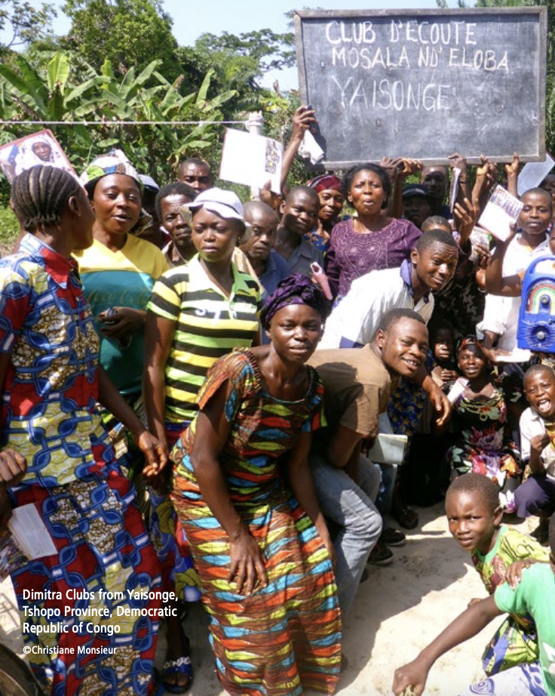
DImitra Clubs
Characteristics of gender transformative approaches included in the project:
Characteristic 1. Prioritize a deep understanding of people in their context and the way social inequalities intersect to affect choices and outcomes.
Characteristic 2. Engage with both men and women.
Characteristic 3. Work across multiple levels of the socio-ecological model.
Characteristic 4. Foster iterative cycles of critical reflection and action, and build a critical consciousness.
Characteristic 5. Address unequal power relations, and challenge oppressive norms, behaviors and structures.
Source: FAO 2020
Notes:
Dimitra clubs include the 5 characteristics described.
The clubs work across levels. Change at the community level is thought to strongly influence gender dynamics in the household and organizational levels.
The process involves:
• sensitization and group formation. In this phase, members learn about the clubs. Each group decides its governance, ways of functioning, themes to focus on, and strategies to adopt and implement
• Training and coaching of club leaders
• Life of clubs – members engage in discussion, prioritize problems, and take action. They involve member-led discussions where members highlight the consequences of discrimination, identify local opportunities that can be implemented by the community to collectively challenge discriminatory norms and behaviors, and legitimize positive norms.
• They receive regular support over 18 months.
• Clubs come together to learn and reflect after one year.

Slide 64
DImitra Clubs have an impact on gender transformative change
Dmitra Clubs trigger social transformations that gradually lead to changes in behaviors and norms that prevent women from progressing on an equal basis as men. These changes include:
Boosting the self-esteem and leadership of rural women
More equitable power relations between men and women
Improved quality of life for rural households and smallholder farmers
Reduced harmful practices and increased access of rural women to decision-making processes at the local level
Adoption of gender transformative approaches in policies, strategies and programs
Source: FAO 2020
Notes:
Read the slide to share the impact of the clubs on gender transformative change.

Slide 65
Ethical considerations when using gender transformative approaches
Section 3
Notes:
Gender transformative approaches are important to transforming the underlying structures and systems that result in gender inequality. Still, working on inequalities comes with ethical considerations to help planning and monitoring to prevent, mitigate and respond to harm.

Slide 66
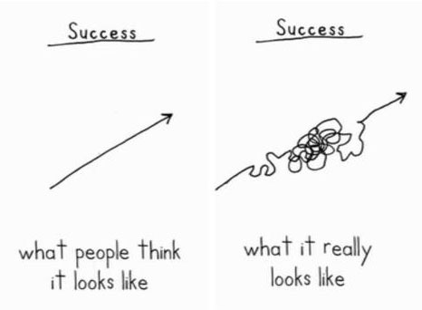
Social change is not linear
Programming can produce intended and unintended consequences.
Unintended consequences can be positive or negative.
Understanding, planning for and responding to negative unintended consequences is important for efforts to do no harm and to maximize benefits for women, families and communities.
Source: Prevention Collaborative 2018
Image source: ClimateAccess.org
Notes:
Social change is not linear. While we talk about programs as if they are linear, change often moves in starts and stops.
Read the slide.

Slide 67
Backlash: A definition
Backlash is the ”active resistance, opposition, or pushback against program efforts to build gender equality” (Flood 2021).
“A common response by dominant groups who feel threatened by challenges to their privilege and power by disadvantaged groups” (Sithole 2023).
Definition:
Backlash
Sources: Flood 2021; Sithole 2023
Notes:
Backlash is also called resistance or pushback. Read the slide.
Backlash can be a response to efforts to transform gender and power inequities.

Slide 68

Backlash: Types and Sources
There are many forms of backlash:
  verbal response, abuse, or ridicule
  denial of resources, services
  co-option of programming
  threats of violence
  violence
Sources of backlash are many including media, community members, leaders, family members, peers, etc.
It includes actions against participants, members of a vulnerable group, staff and organizations.
Source: Sithole 2023
Image source: Canva
Notes:
Read the slide.

Slide 69
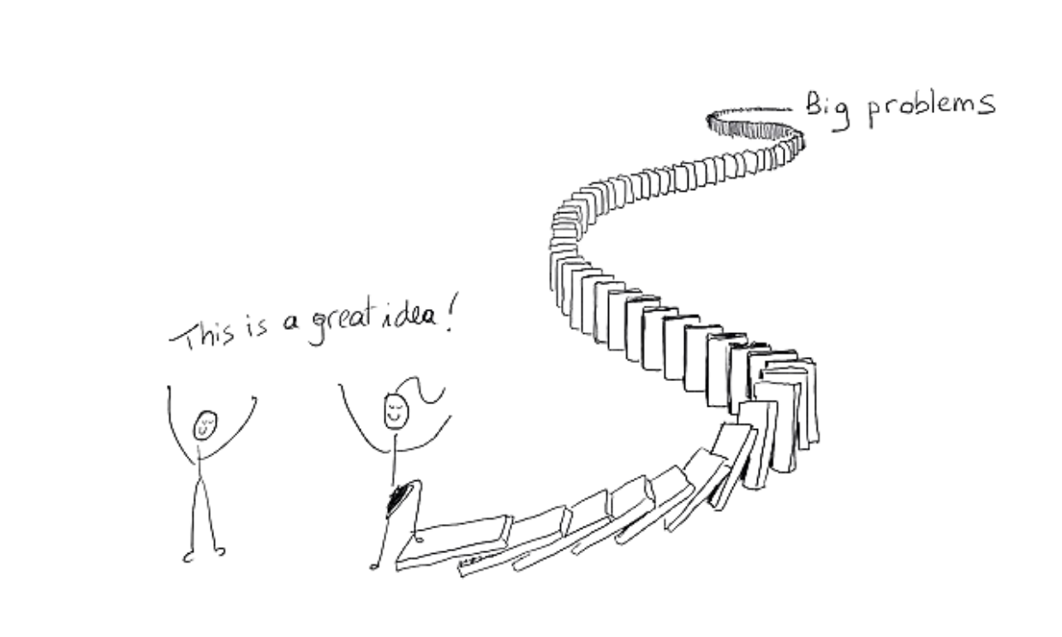
Examples of unintended consequences
Resistance and backlash from men
Subversion and co-option
Shifting, not reducing, violence
Aggravating tensions, exclusion and marginalization
Increasing burden of labor on women
Creating unmet demand for support services
Positive effects from improved relationship dynamics
Source: Prevention Collaborative 2018
Image source: Wikimedia Commons
Notes:
There are many possible examples of unintended consequences. The ones on this slide come from programming to prevent violence against women. They can show up in gender transformative programming.
Ask participants if they can think of other examples of unintended consequences.
As needed, share examples from the list below.
• Resistance and backlash from men – some men may verbally resist programming, distract from the issue at hand, use more violence or controlling behaviors in an effort to regain power they fear losing.
• Subversion and co-option – may take phrases used in the program and reframe them to harm women or co-opt resources (such as loans given to women)
• Shifting, not reducing violence – one form of violence decreases and another increases, for example violence in private spaces increases, could be more insidious and less perceptible
• Aggravating tensions, exclusion and marginalization – excluding members of marginalized groups can further exacerbate their marginalization.
• Increasing burden of labor on women – women work more and generate income and are expected to do the same amount of domestic and care work. Men may even reduce their economic contribution
• Creating unmet demand for support services – attitude and norm shift is successful but services are not available to support increased demand
• The pace of change may be too rapid – acting too rapidly can provoke tension and backlash from those in the community not ready to change – unintentionally sabotaging what is an incremental change process
• Improved relationship dynamics can have positive effects – a positive outcome, programs who seek to reduce violence and promote positive conflict resolution may see changes in communication and relationship dynamics that have spillover effects in the family & with children

Slide 70

Lessons Learned
Assess, mitigate, monitor and respond
Let people speak
Proactively engage those leading the backlash
Incorporate creative activities
Use framing strategies
Share examples
Support staff and early adopters
Step back, regroup, strategize
Backlash can be a sign of progress
Sources: Sithole 2023; Viswanathan 2021
Image source: iStock
Notes:
Programs have learned how to assess, prevent, mitigate, monitor and respond to backlash.
• Learning from other programs shows that thinking ahead – to assess potential harm and plan how to mitigate it – can ensure that programs are taking an active role in prevention and response. Doing this in partnership with those most at risk and with staff working most closely in the community is important.
• Letting people speak even when their views are controversial can help people feel heard. This isn’t to let them dominate a conversation or drive the future direction of programming, but to create space to be heard. When managed, this can allow people to be open to new ideas.
• Ensuring that messages are framed in ways that are contextually relevant, acceptable, and persuasive can help ensure that people are more open to messages.
• Sharing examples of how cultures change over time can be helpful. Sometimes groups can think that cultures stay stable, but they do change. Role modelling new behaviors and practices can inspire others to change.
• Ensuring that staff and participants are supported in their efforts is important.

Slide 71
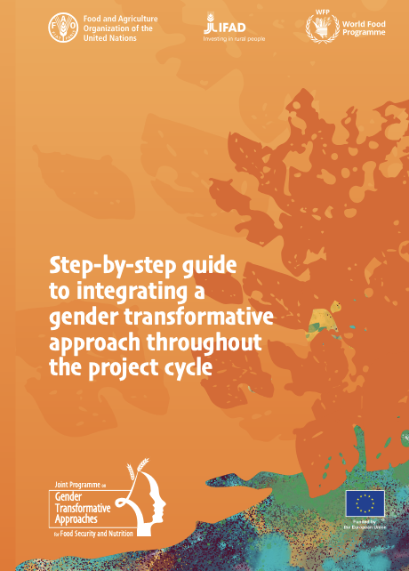
Safeguarding in Projects
Of particular interest to agrifood systems are gender equality and prevention of gender-based violence.
Protect, reduce or eliminate potential adverse impacts to all persons.
Identify and assess the social and gender risks associated with the project.
Assess and anticipate the possible response, consequences and impacts on women, girls and vulnerable groups.
Source: FAO 2024
Notes:
The Step-by-Step guide, shown here, from FAO shares guidance on safeguarding in projects. Read the slide.

Slide 72
Closing

Slide 73


TakeAways
What is one new thing you learned today?
What are you still curious about?
Notes:
We are at the end of module 2. Before closing, ask participants to share in chat or verbally one new thing they learned today.
Then ask participants to share what they are still curious about.

Slide 74
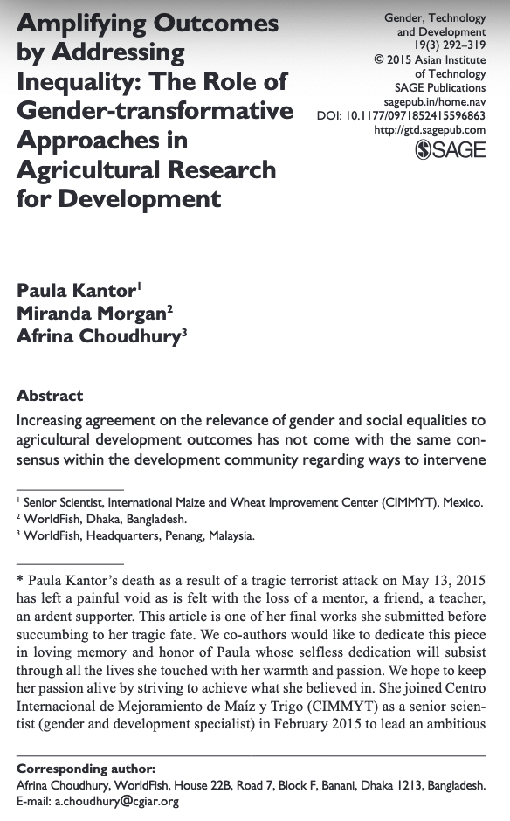

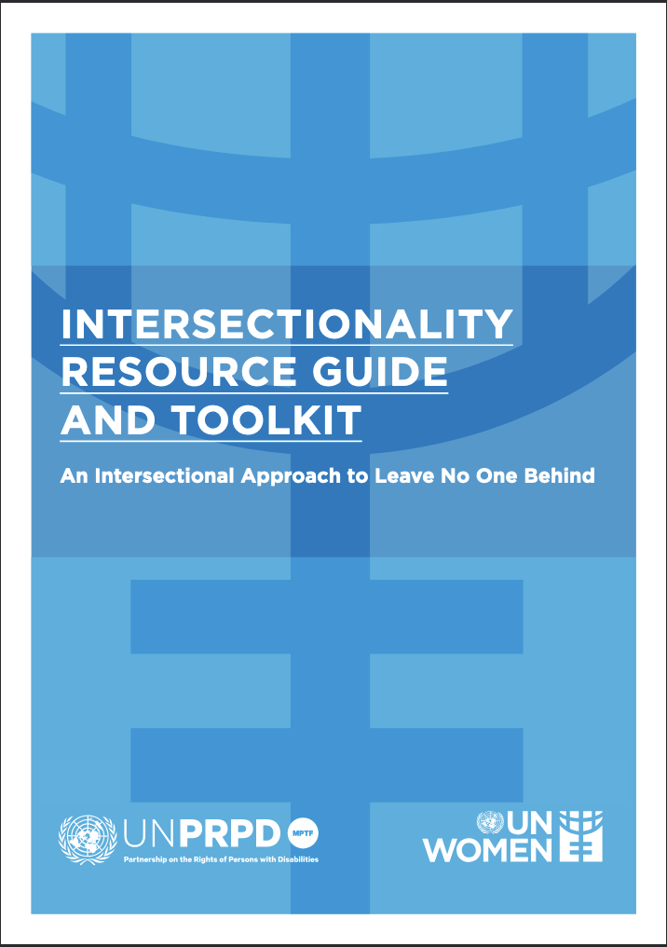
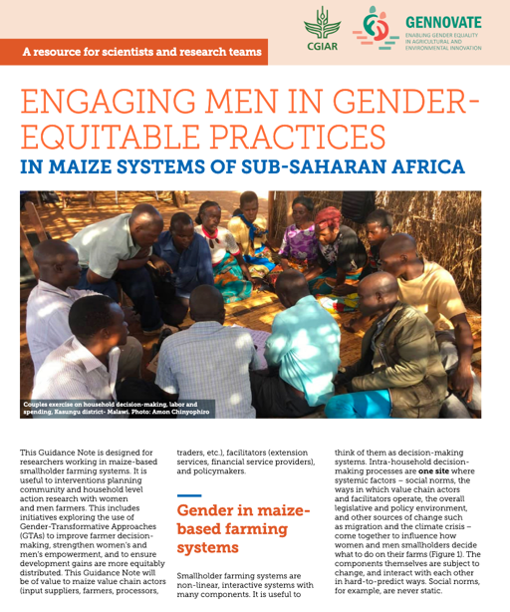
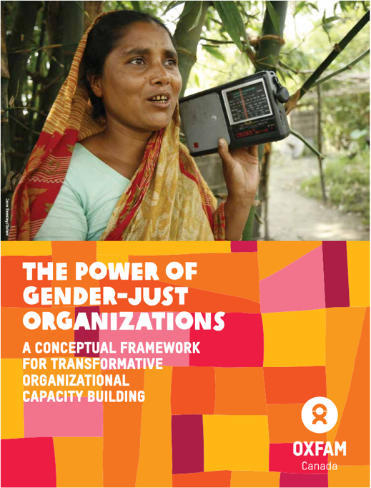
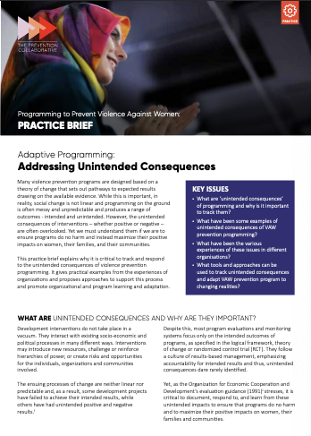
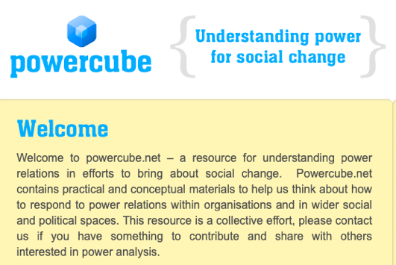
FURTHER READING
Engaging men in gender equitable practices
The power of gender-just organizations
Adaptive Programming: Addressing Unintended Consequences
Practical guide for the incorporation of the intersectionality approach in sustainable rural development programs and projects
Intersectionality Resource Guide and Toolkit
Learn more about principles of GTA
Learn more about intersectionality in gender and agriculture
Powercube

Slide 75
Glossary
Gender equality Gender equality is the concept that women and men, and girls and boys have equal conditions, treatment and opportunities for realizing their full potential, human rights and dignity, and for contributing to (and benefitting from) economic, social, cultural and political development. Gender equality is, therefore, the equal valuing by society of the similarities and the differences of men and women, and the roles they play. It is based on women and men being full partners in the home, community and society. Equality does not mean that women and men will become the same but that women’s and men’s rights, responsibilities and opportunities will not depend on whether they are born male or female. Gender equality implies that the interests, needs and priorities of both women and men and girls and boys are taken into consideration, recognizing the diversity of different groups and that all human beings are free to develop their personal abilities and make choices without the limitations set by stereotypes and prejudices about gender roles. Gender equality is a matter of human rights and is considered a precondition for, and indicator of, sustainable people-centered development. (UNICEF 2017).
Gender equity Gender equity is the process of being fair to men and women, and boys and girls, and importantly the equality of outcomes and results. Gender equity may involve the use of temporary special measures to compensate for historical or systemic bias or discrimination. It refers to differential treatment that is fair and positively addresses a bias or disadvantage that is due to gender roles or norms or differences between the sexes. Equity ensures that women and men and girls and boys have an equal chance, not only at the starting point, but also when reaching the finish line. It is about the fair and just treatment of both sexes that takes into account the different needs of the men and women, cultural barriers and (past) discrimination of the specific group (UNICEF 2017).
Gender norms A subset of social norms, gender norms are informal rules and shared social expectations that determine and assign socially acceptable roles, behaviors, responsibilities and expectations to male and female identities. By influencing expectations for masculine and feminine behavior that is considered socially acceptable and appropriate, gender norms directly affect individuals’ choices, freedoms and capabilities (FAO 2021).

Slide 76
Glossary
Gender stereotypes Gender stereotypes are widely held, generalized assumptions whereby women and men are assigned attributes, characteristics and roles. Descriptive stereotypes refer to beliefs about specific characteristics that a person possesses based on their gender. Prescriptive stereotypes are beliefs about specific characteristics that a person should possess based on their gender (Stewart, 2013). Stereotypes about women are the result of deeply engrained attitudes, values, norms and prejudices against women. They are used to justify and maintain the historical power relations by which men dominate women (EIGE 2016).
Intersectionality Intersectionality refers to how different social identities, such as gender, socioeconomic status, age, ethnicity, geographical location, marital status and physical abilities, intersect to shape experiences of discrimination and oppression.
Masculinities/femininities These are dynamic socio-cultural categories used in everyday language that refer to certain behaviors and practices recognized within a culture as being “feminine” or “masculine,” regardless of which biological sex expresses them. These concepts are learned and do not describe sexual orientation or biological essence. They change with culture, religion, class, over time and with individuals and other factors. The values placed on femininities and masculinities vary with culture also. Any person may engage in forms of femininity and masculinity. As an example, a man can engage in what are often stereotyped as “feminine” activities, such as caring for a sick parent or staying home to raise children. (UNICEF 2017).
Patriarchy Patriarchy is a social system of masculine domination over women (EIGE 2016).
Sanctions Sanctions indicate social approval (positive sanctions) or disapproval (negative sanctions) for one’s actions (Nguyen 2020).

Slide 77
References
CARE. (2021). Engaging men and boys for gender equality: A guidance note. https://www.care.org/resources/engaging-men-boys-for-gender-equality-guidance-note/
Cavill, S., Francis, N., Grant, M., et al. (2020). A call to action: Organizational, professional, and personal change for gender transformative WASH programming. Waterlines, 39(2&3).
Choo, H. Y., & Ferree, M. M. (2010). Practicing intersectionality in sociological research: A critical analysis of inclusions, interactions, and institutions in the study of inequalities. Sociological Theory, 28(2), 129–149.
Batliwala, S. (n.d.). Understanding social power and power structures. Primer 1 in CREA’s Feminist Leadership for Social Transformation Series. CREA.
Food and Agriculture Organization (FAO), International Fund for Agricultural Development (IFAD), & World Food Programme (WFP). (2020). Gender transformative approaches for food security, improved nutrition, and sustainable agriculture – A compendium of fifteen good practices. FAO.
Food and Agriculture Organization (FAO), International Fund for Agricultural Development (IFAD), World Food Programme (WFP), & CGIAR Gender Impact Platform. (2023). Guidelines for measuring gender transformative change in the context of food security, nutrition, and sustainable agriculture. FAO, IFAD, WFP, & CGIAR. https://doi.org/10.4060/cc7940en
Food and Agriculture Organization (FAO), International Fund for Agricultural Development (IFAD), & World Food Programme (WFP). (2024). Step-by-step guide to integrating a gender transformative approach throughout the project cycle. FAO. https://doi.org/10.4060/cd2629en
Flood, M., Dragiewicz, M., & Pease, B. (2020). Resistance and backlash to gender equity. Australian Journal of Social Issues, 56(3), 393–408.

Slide 78
References
Harper, C., Marcus, R., George, R., D’Angelo, S., & Samman, E. (2020). Gender, power and progress: How norms change. ALIGN/ODI. https://www.alignplatform.org/gender-power-progress
Heilman, B., Guerrero-López, C. M., Ragonese, C., Kelberg, M., & Barker, G. (2019). The cost of the man box: A study on the economic impacts of harmful masculine stereotypes in the United States. Promundo-US & Unilever.
Institute for Reproductive Health (IRH). (2022). Passages social norms training curriculum. https://www.irh.org/social-norms-training-curriculum/
Faas, S., Makhija, S., Bryan, E., Go, A., & Malapit, H. (2022). Considering gender in research: An ethics and standards toolkit. CGIAR Gender Impact Platform.
Kantor, P., Morgan, M., & Choudhury, A. (2015). Amplifying outcomes by addressing inequality: The role of gender-transformative approaches in agricultural research for development. Gender, Technology and Development, 19(3), 292–319.
Kennedy, A., Ledanois, A., Sequeira, J., et al. (2022). Towards a gender-transformative organization: Toolkit for an assessment of organizational gender policies and practices. WECF. https://www.wecf.org/wp-content/uploads/2024/04/EN_OGAP-Toolkit_WECF_2024.pdf
Social and Behavior Change Communication (SBCC) Implementation Kits. (n.d.). SBCC and gender: Models and frameworks. https://sbccimplementationkits.org/gender/sbcc-gender-models-and-frameworks/
Seymour, G., Cole, S., Costenbader, E., Mwakanyamale, D., Adeyeye, O., Feleke, S., Ferguson, N., & Heckert, J. (2024). A guide to developing quantitative tools for measuring gender norms in agrifood systems (IFPRI Discussion Paper 02279). International Food Policy Research Institute (IFPRI).

Slide 79
References
Sithole, T., & Udeme, E. (2023). IGWG members take the mic series: Addressing community backlash to male engagement in sexual and reproductive health and gender-based violence interventions. IGWG Blog. https://www.igwg.org/2023/12/addressing-community-backlash-to-male-engagement-in-sexual-and-reproductive-health-and-gender-based-violence-interventions/
Tavenner, K., Crane, T. A., Bullock, R., & Galiè, A. (2022). Intersectionality in gender and agriculture: Toward an applied research design. Gender, Technology and Development, 26(3), 385–403.
UNICEF. (2017). Glossary of terms and concepts. UNICEF Regional Office for South Asia.
UN Women. (2021). Intersectionality resource guide and toolkit: An intersectional approach to leave no one behind. UN Women Headquarters Office. https://www.unwomen.org/en/digital-library/publications/2022/01/intersectionality-resource-guide-and-toolkit
Viswanathan, R. (2021). Learning from practice: Resistance and backlash to preventing violence against women and girls. United Nations Trust Fund to End Violence against Women. https://prevention-collaborative.org/wp-content/uploads/2024/07/Synthesis-Review-7-resistance-and-backlash_v2_compressed.pdf
Wilkins, D., Brown, J., & Akagwu, O. (n.d.). Compass for SBC: Gender and intersectionality. https://thecompassforsbc.org/trending-topics/gender-and-intersectionality
World Health Organization (WHO). (2019). Engaging men, addressing harmful masculinities to improve sexual and reproductive health and rights. https://www.who.int/news/item/26-09-2019-engaging-men-addressing-harmful-masculinities-to-improve-sexual-and-reproductive-health-and-rights

