Slide 1


The roles of livestock and farmed wildlife in preventing the next pandemic: Current One Health efforts in Southeast Asia
Hung Nguyen-Viet, International Livestock Research Institute (ILRI)
With contributions from Delia Grace, Bernard Bett, Johanna Lindahl and Dieter Schillinger (ILRI)
Presented at a virtual workshop on countering zoonotic spillover of high consequence pathogens
12 July 2022

Slide 2
Content
Importance of livestock sector for food and nutrition security
Livestock and health issues
What to do to prevent the pandemic

Slide 3
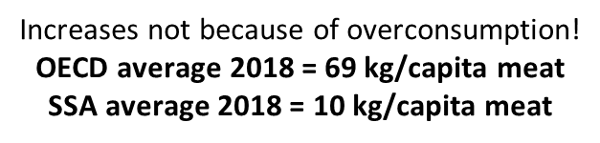
Percentage growth in demand for livestock products to 2030
Beef
Pork
Poultry
Milk
Estimates of the % growth in demand for animal source foods in different World regions, comparing 2005 and 2030. Estimates were developed using the IMPACT model, courtesy Dolapo Enahoro, ILRI.
3
Notes:
FAO. 2011. Mapping supply and demand for animal-source foods to 2030, by T.P. Robinson & F. Pozzi.
Animal Production and Health Working Paper. No. 2. Rome.
IMPACT results generally suggested smaller changes in demand compared to FAO. Among other drivers of the results, the observed differences may be related to the underlying assumptions on how future demand will respond to prices and incomes. FAO projections could for example be assuming big shifts to Chicken Meat consumption (e.g., from pork) as incomes grow in Asia. IMPACT makes the same assumption in terms of direction, but with the expected shifts a bit more dampened.
High income countries include much of Europe. In fact, if one looks at individual European nations in many cases there is a DECLINE in demand (Switzerland for beef (-22%) and pork (-14%) for example)
Figures for meat consumption: https://data.oecd.org/agroutput/meat-consumption.htm

Slide 4
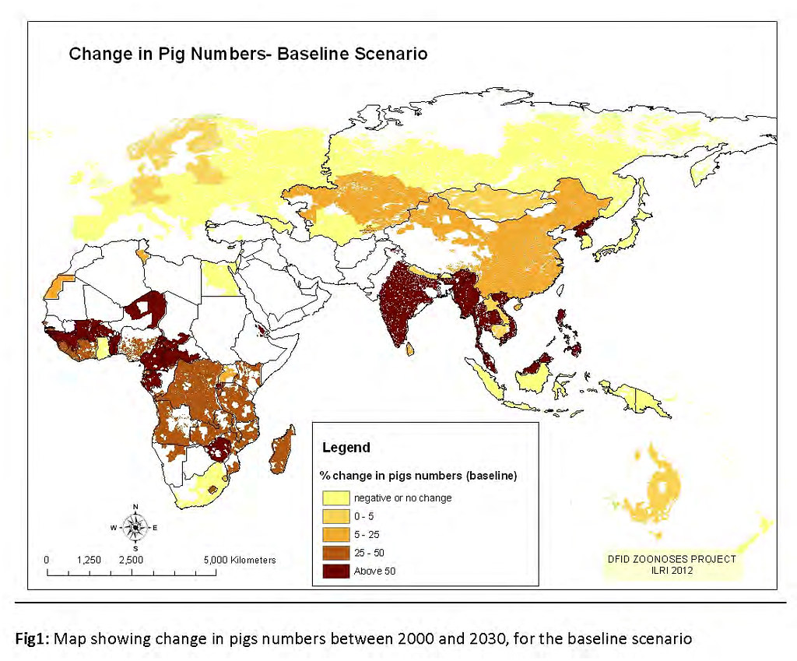
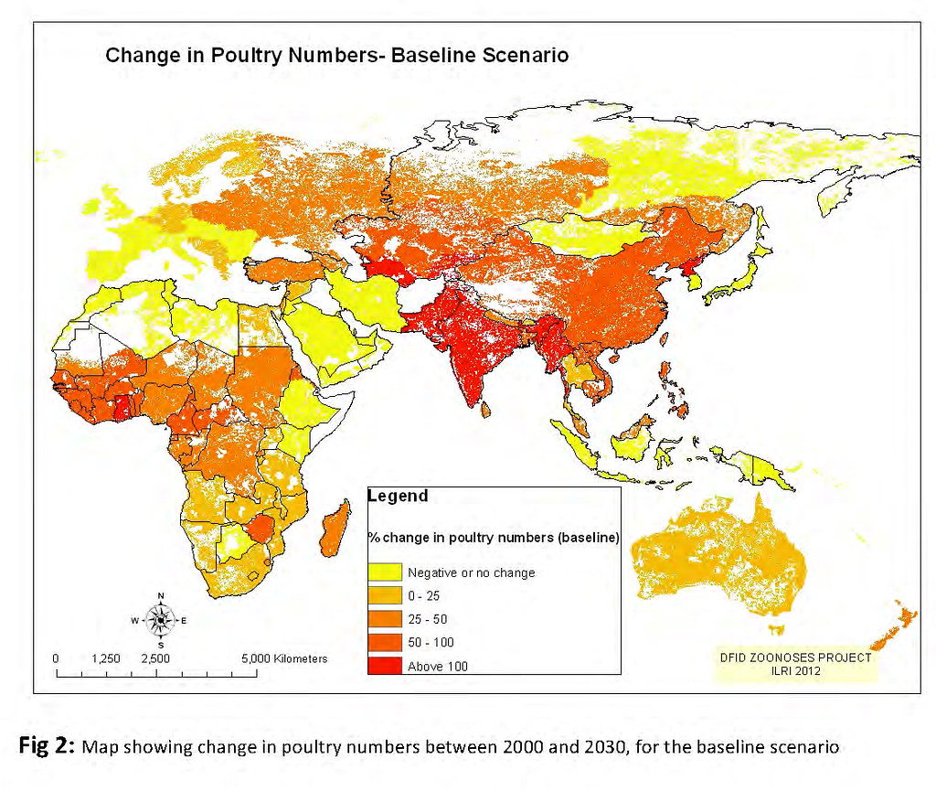
Livestock density projection

Slide 5
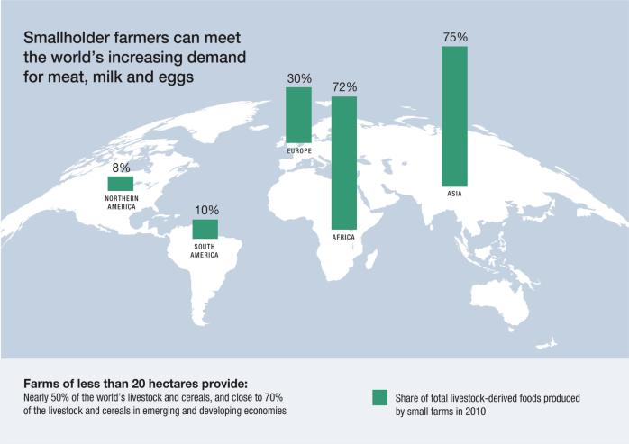

Slide 6
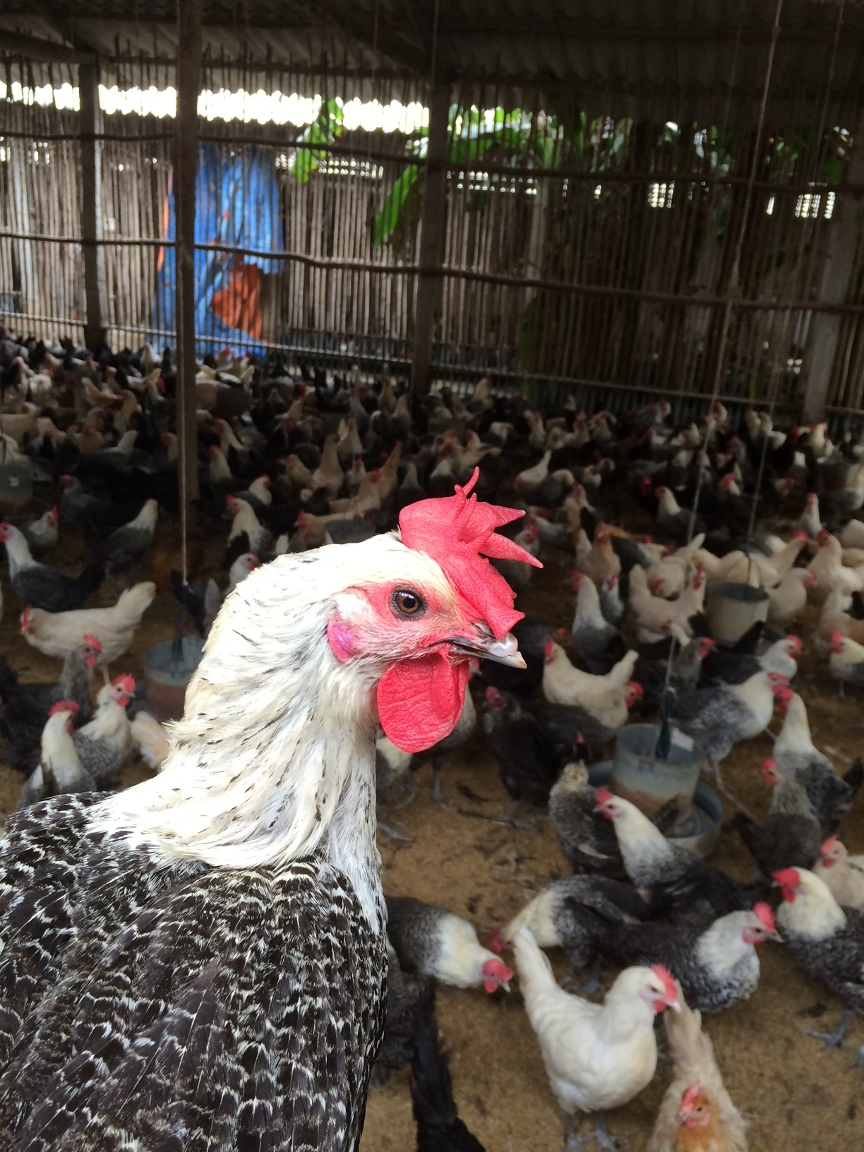
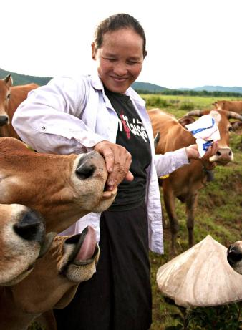
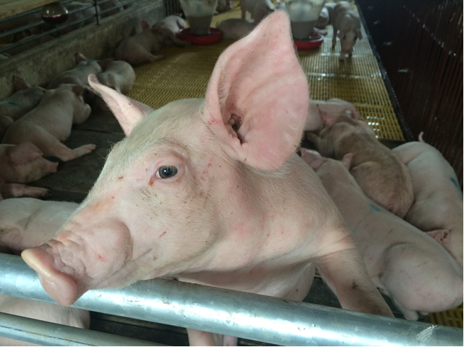
Health opportunities and challenges in the livestock sector
Nutrition, health and food security
  BUT animal-human/emerging diseases and unsafe food need to be addressed and overconsumption is often associated with obesity and non-communicable diseases
Environmental health and biodiversity
  BUT pollution, land/water degradation needs to be reduced
ILRI/Stevie Mann

Slide 7
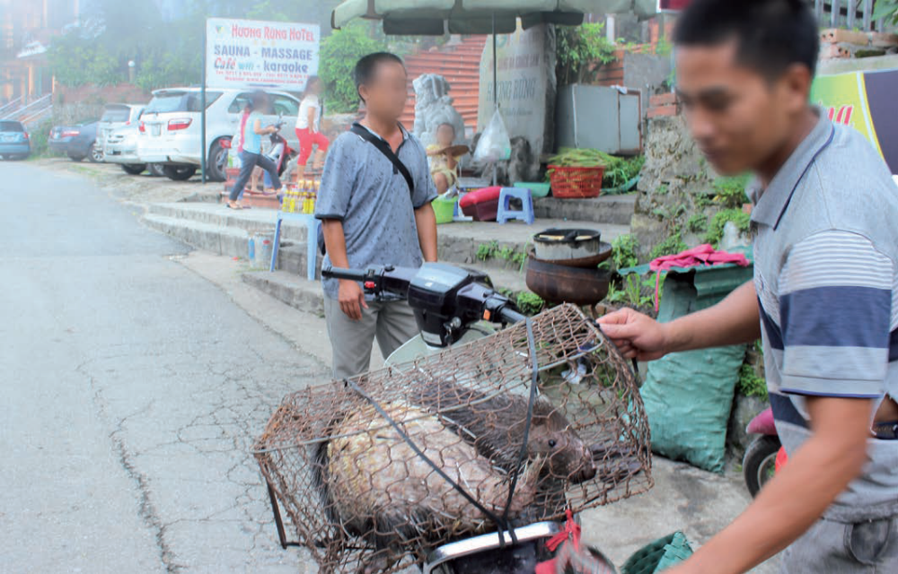
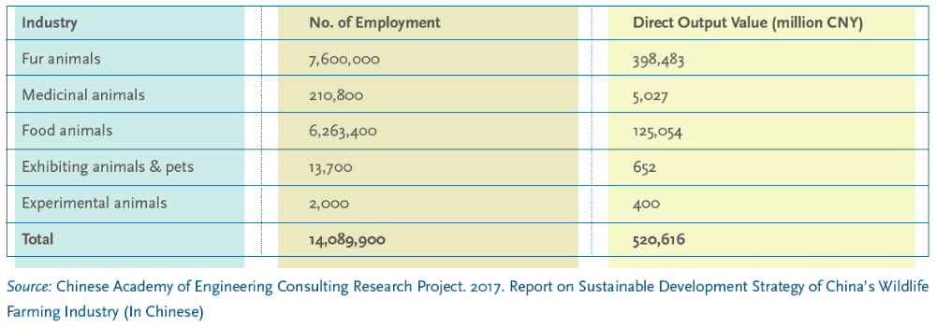
Employment and direct output value of wild animal industry in China, 2016
(US$ 73.4 billion)

Slide 8
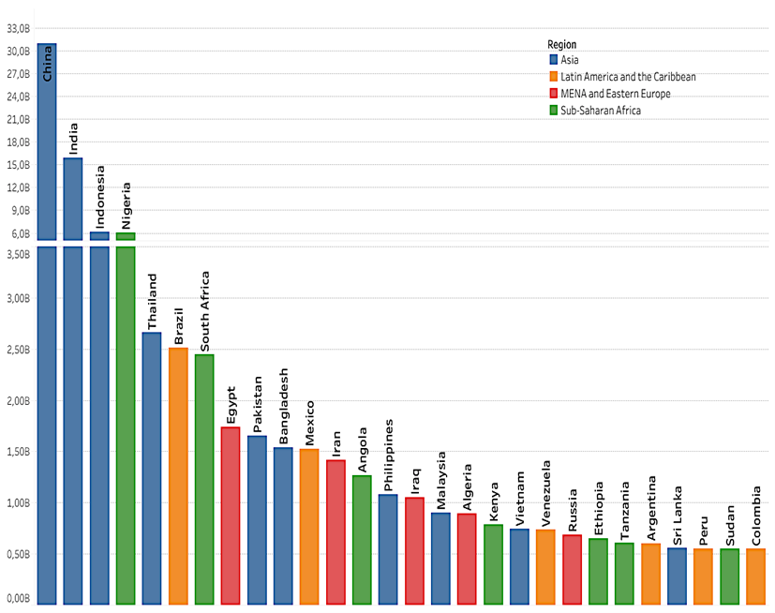
Foodborne disease: a new priority – much or most probably from animal-source food
Food safety
Millions DALYs lost per year (global)
31 hazards
600 mio illnesses
420,000 deaths
33 million DALYs
Domestic costs may be 20 times trade costs
Burden LMIC
Cost estimates for 2016 : > US$ 115 billion
Productivity loss | 95
Illness treatment | 15
Trade loss or cost | 5 to 7
Havelaar et al. (2015)

Slide 9
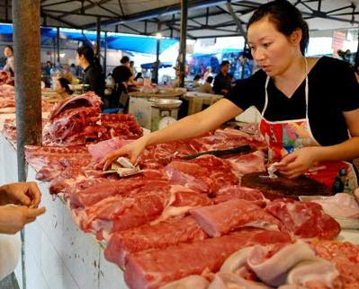
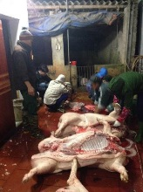
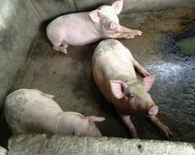
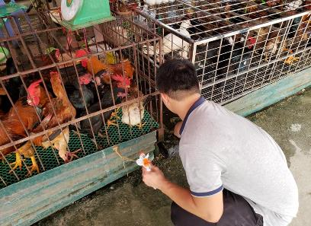
Traditional/wet markets and spillover

Slide 10
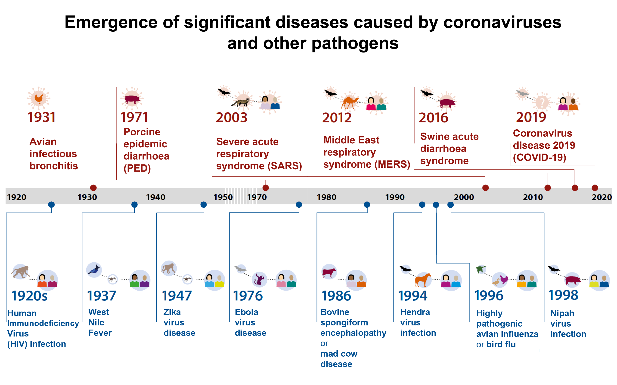

Warning! Increasing frequency of pandemics
Graphics: Annabel Slater, ILRI; adapted from United Nations Environment Programme and International Livestock Research Institute (2020). Preventing the next pandemic: Zoonotic diseases and how to break the chain of transmission. Nairobi, Kenya.

Slide 11
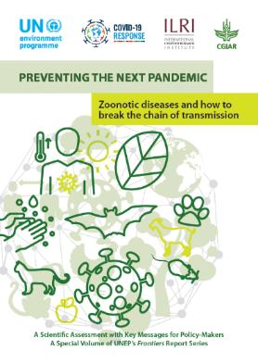
Preventing the next pandemic
Seven major anthropogenic drivers of zoonotic disease emergence
Increasing demand for animal protein
Unsustainable agricultural intensification
Increased use and exploitation of wildlife
Unsustainable utilization of natural resources
Travel and transportation
Changes in food supply chains
Climate change
United Nations Environment Programme and International Livestock Research Institute (2020). Preventing the next
pandemic: Zoonotic diseases and how to break the chain of transmission. Nairobi, Kenya.

Slide 12
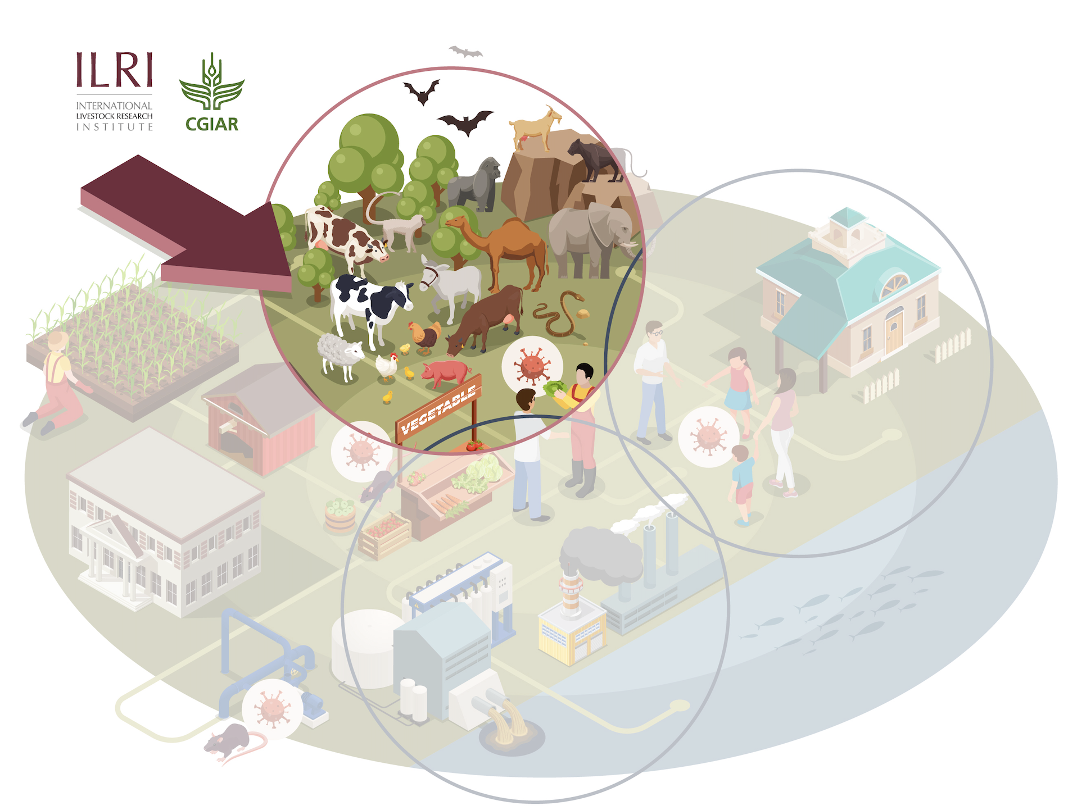
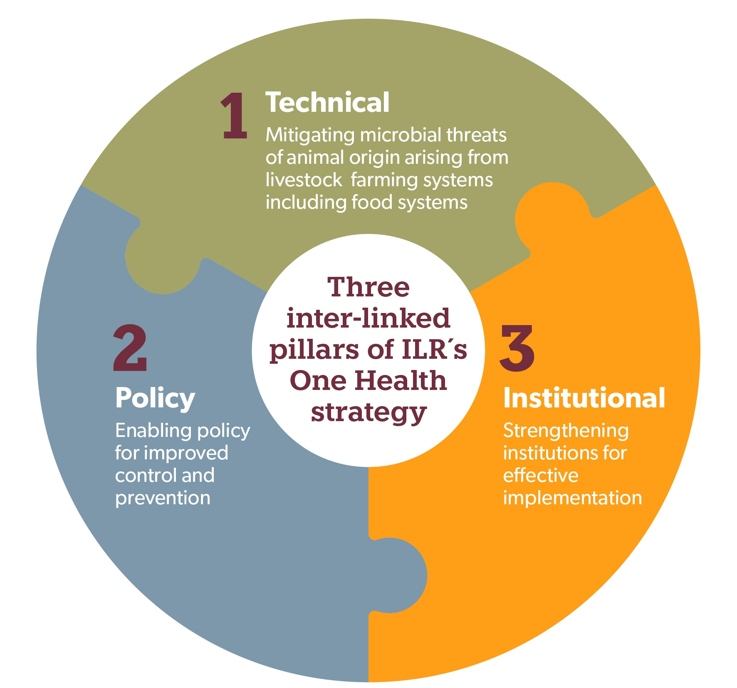
ILRI One Health strategy
A holistic approach to preventing pandemics and epidemics and other microbial threats from animals and the environment
Vision
To improve the lives, livelihoods and well being of people in the global south by building healthy, sustainable and resilient systems at the intersection of humans, animals and the environment.
Key thematic areas
  Epidemics and pandemics caused by (re)-emerging viruses
  Endemic zoonoses
  Foodborne diseases
  Antimicrobial resistance
Notes:
One Health: key elements: Prepare, Detect, Respond

Slide 13
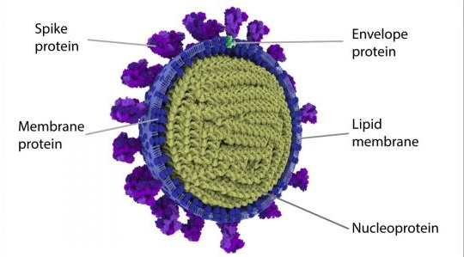
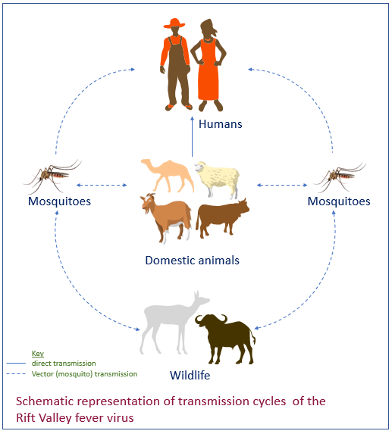
Zoonoses and emerging infectious diseases: surveillance, response, biosecurity
Understand viral populations
  Smart molecular surveillance
  Whole genome sequencing
Understand the process of infection
  Molecular interactions that permit host species jumps
  Identify potential animal reservoirs of pandemics
Develop universal vaccines to viral families with pandemic potential to control animal reservoirs
Epidemiology of zoonoses and emerging infectious diseases
Surveillance: response
Value chain analysis and exposure assessment (consumption, contact)
Outputs
Risk maps
Improved understanding on drivers, e.g. climate, land use change/variability
Livestock vaccination strategies
Notes:
Biosecurity is a strategic and integrated approach to analyzing and managing relevant risks to human, animal and plant life and health and associated risks for the environment.
The overarching goal of biosecurity is to prevent, control and/or manage skills to life and health as appropriate to the particular biosecurity sector.
INFOSAN Information Note No 1/210

Slide 14
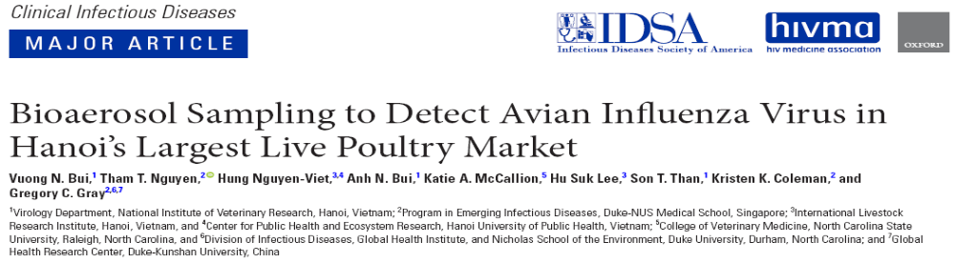
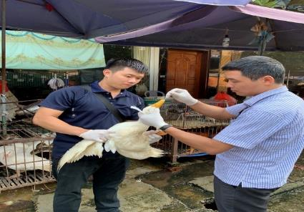
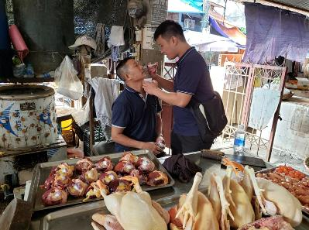

Slide 15
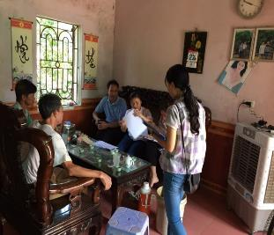
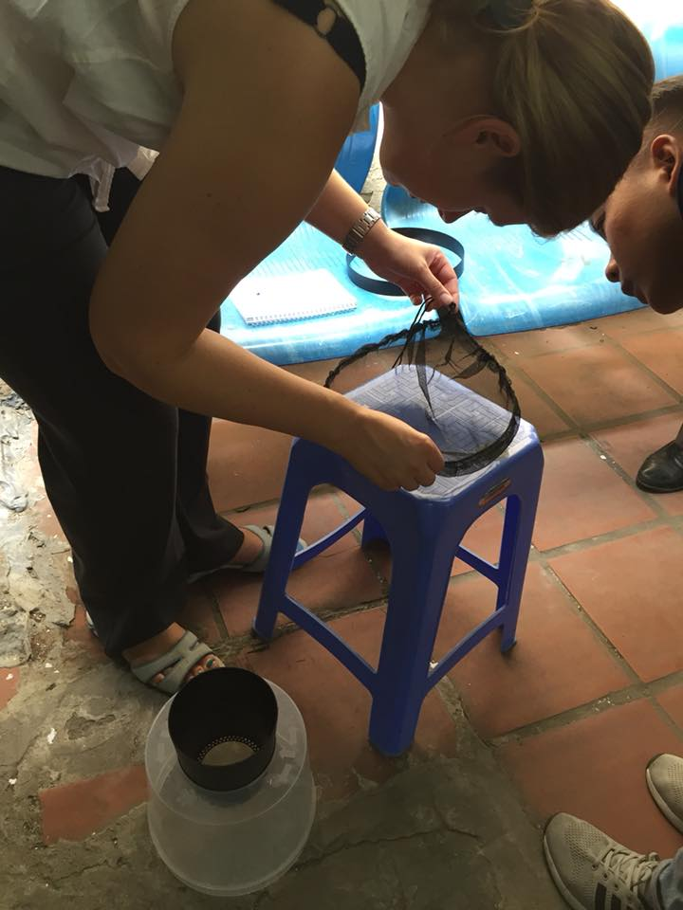
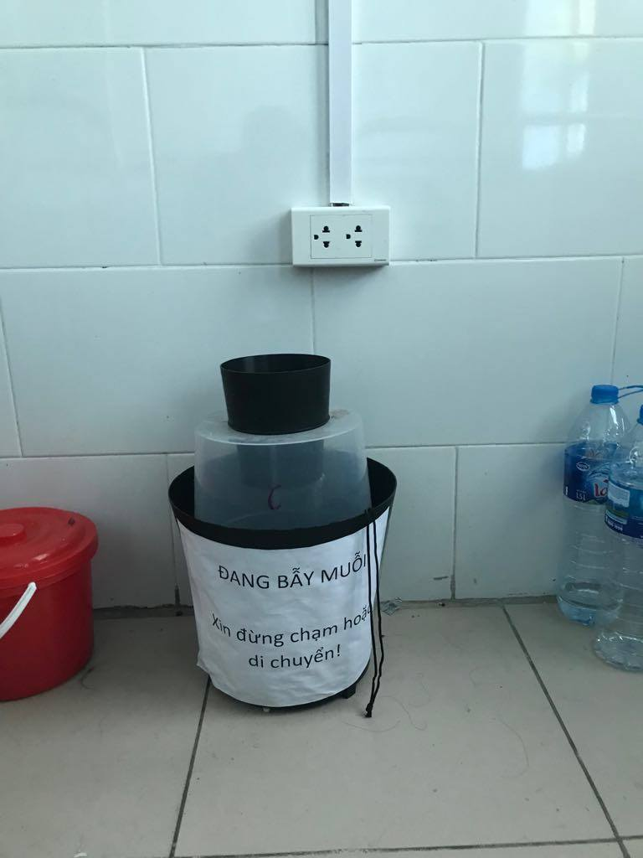
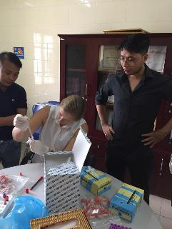
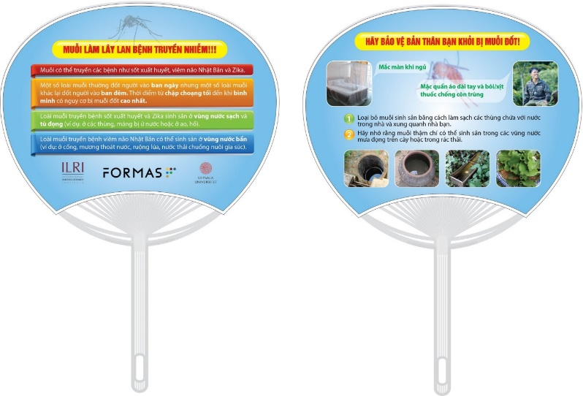
Urban livestock keeping in Hanoi city, Vietnam: Systems and the risks of flaviviral vector-borne diseases in humans
1. Knowledge, attitude and practice among urban inhabitants regarding risks and benefits of urban agriculture, and current knowledge on mosquito-borne disease transmission
2. The distribution of mosquitoes and flaviviruses (dengue, Japanese encephalitis and Zika virus) present in urban mosquitoes and its relationship to livestock keeping.
3. Risk factors of mosquito-borne flavivirus by investigating febrile patients in a national hospital
4. Intervention package
On-site training
Given fans with simple key messages
Weekly reminders through text messages

Slide 16
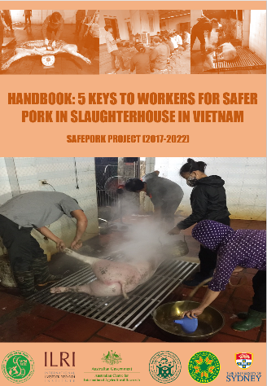
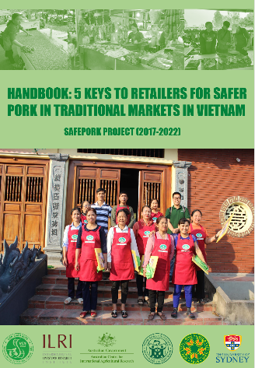
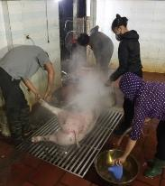
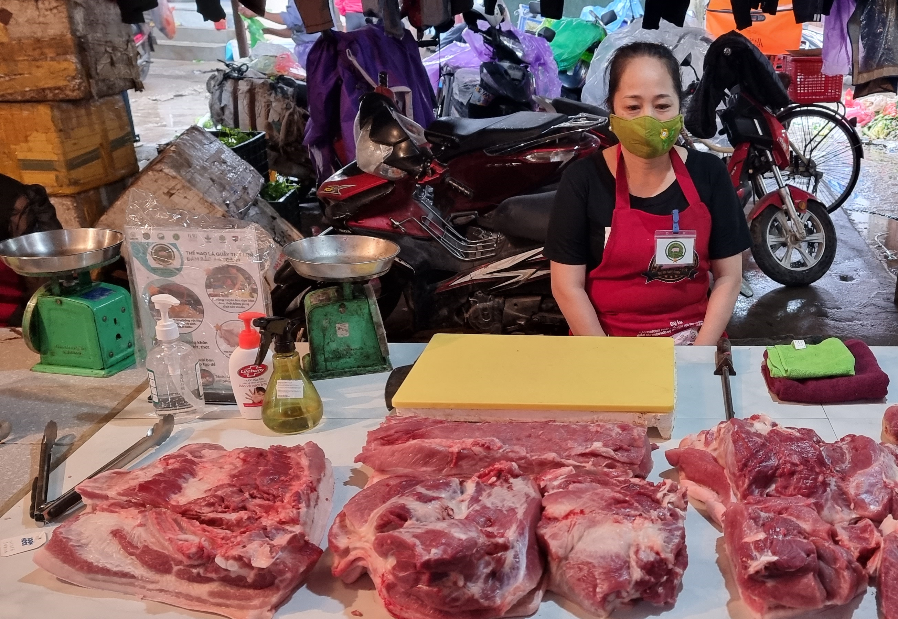
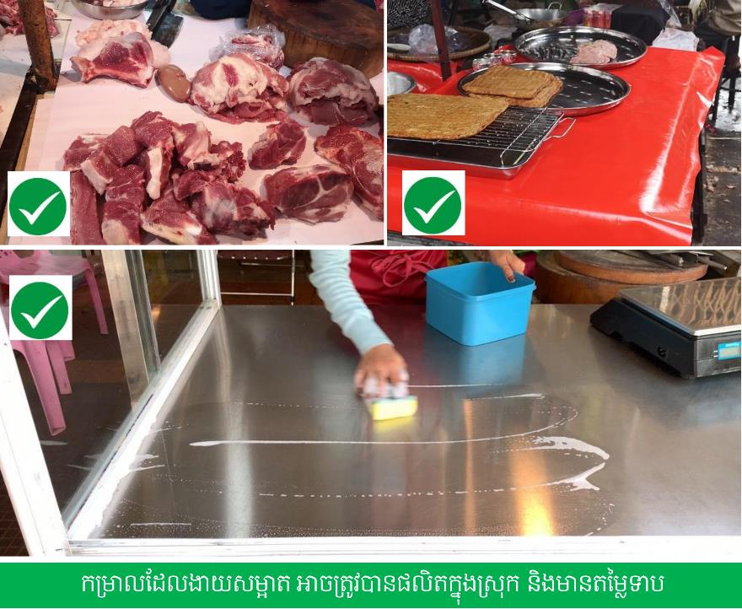
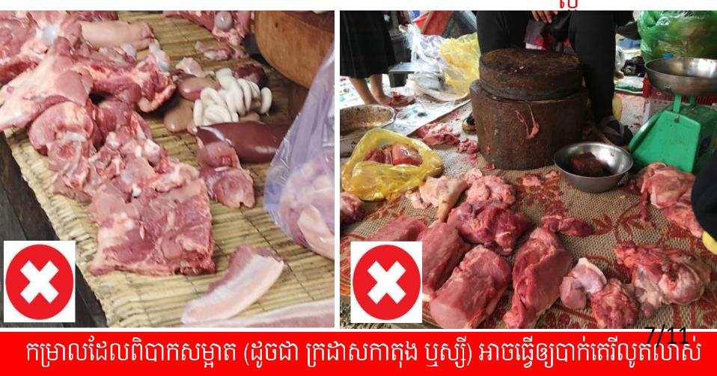
The 3-legged stool approach: Training, incentives and enabling environment
Vietnam
1. Training and minor equipment
Slaughter Retail
Slaughter: Grid, separate clean/dirty area, cleaning/disinfection (USD 300-1000)
Retail: Hygienic cutting board, separate (fresh/cooked), cleaning/disinfection (USD 35)
Cambodia
1. training and minor equipment
Retail
Hygienic cutting board, separate (fresh/cooked), cleaning/disinfection, easy to clean surface (USD 25)
Supporting tools:
Manuals, briefs, nudges
Formative research
2. Incentives: Scoring system, auction survey indicates 15% higher consumer willingness to pay for improved stalls
2. Incentives: Certificate and poster
3. Enabling environment
Limited support by local authorities
3. Enabling environment
Strong support by national and local authorities
Photo credits: ILRI/Fred Unger, Chi Nguyen, Rortana Chea
Improved food safety outcome (Salmonella) in both countries but more prominent in Cambodia due to stronger support by local authorities
Notes:
Here you can say we are testing similar approaches in other countries and other value chains, but that all seems to indicate that training + incentives + policy support can do the trick. OK

Slide 17
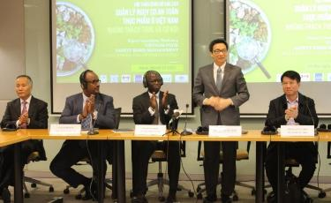
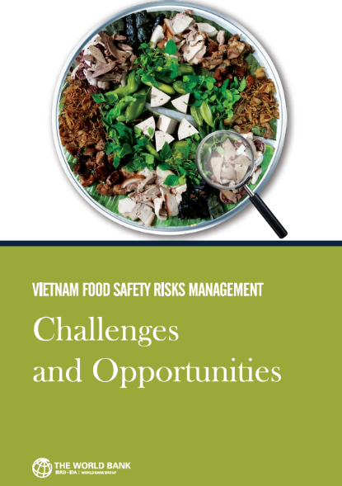




Policy impact: translational research for interventions in modernizing food system
CGIAR/ILRI niche: Risk assessment and policy/regulatory analysis for fresh foods in domestic markets
World Bank convened overall support to government; ILRI led the technical work
Government adopted the World Bank report for improving food safety in major cities in Vietnam

Slide 18
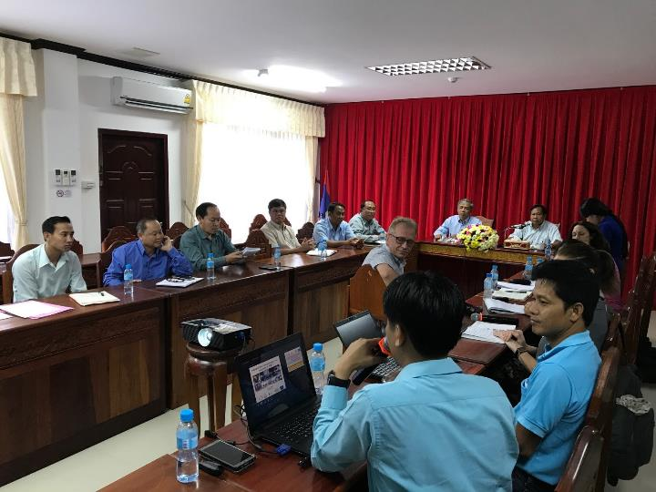

One Health, institutional commitment, investment
Decision makers
Public health (MD, army health)
Scientists
Vets
Savannakhet, Lao PDR on foodborne disease research, October 2017

Slide 19


























One Health and Ecohealth programs in Southeast Asia (not up to date)
INDOHUN
THOHUN
VOHUN
MYOHUN
EcoEID
EHRCs
GHI
Notes:
Some references on One Health situation in SE Asia:
Ecohealth research in Southeast Asia: past, present and the way forward - PMC (nih.gov)
Decades of emerging infectious disease, food safety, and antimicrobial resistance response in Vietnam: The role of One Health - ScienceDirect

Slide 20
Key messages
The importance of livestock for food and nutrition security, livestock sector in Southeast Asia is fast growing.
Spillover and health challenges linked to animal and farmed wildlife in the region.
One Health research and development agenda covers a wide spectrum from research, capacity development and stakeholder engagement across animal, human and environment health sectors to prepare, detect and respond.
There is a need for country investment in One Health.

Slide 21
Some references on One Health in Southeast Asia
Ecohealth research in Southeast Asia: past, present and the way forward
Decades of emerging infectious disease, food safety, and antimicrobial resistance response in Vietnam: The role of One Health

Slide 22
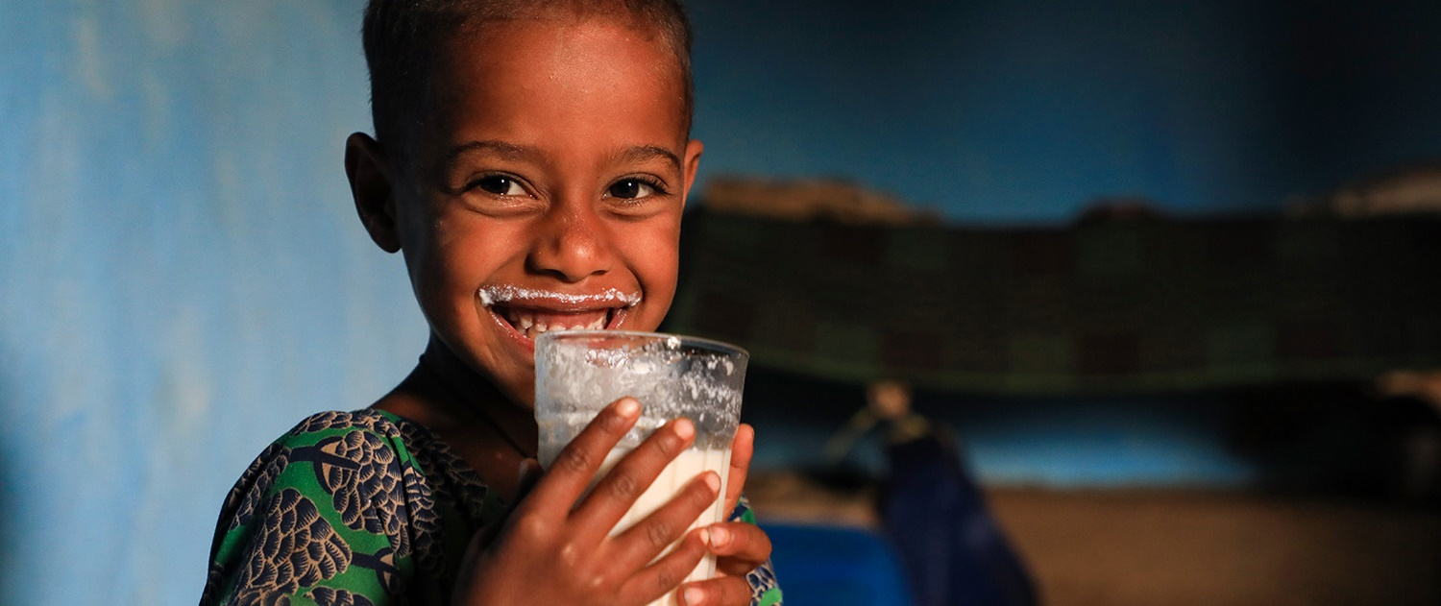
THANK YOU

