Slide 1
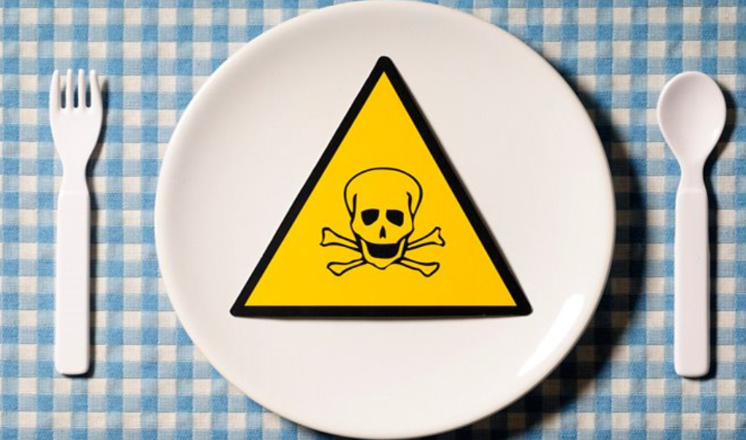
Why Food Safety Matters to Africa:
Making the Case for Policy Action
Steven Jaffee, Spencer Henson, Delia Grace,
Mateo Ambrosio, and Franck Berthe

Slide 2

Main Messages
Rapid urbanization and dietary change in Africa provide major commercial opportunities yet also major societal challenges. Perhaps the greatest challenge in the upcoming decade will pertain to mitigating widespread and emerging food safety risks.
Food safety has been on Africa’s development agenda almost solely as a trade and market access issue. Domestic food safety has featured a data void, policy gap, and systematic underinvestment.
Unsafe food is already yielding high public health and economic costs in Africa and these will grow enormously in the coming years in a ‘business as usual’ scenario (of reactive, uncoordinated measures)
Yet, many of these costs are avoidable. Through preventative public policy measures, smarter investment and a paradigm shift in food safety governance and stakeholder engagement - calibrated to all levels of economic development.

Slide 3
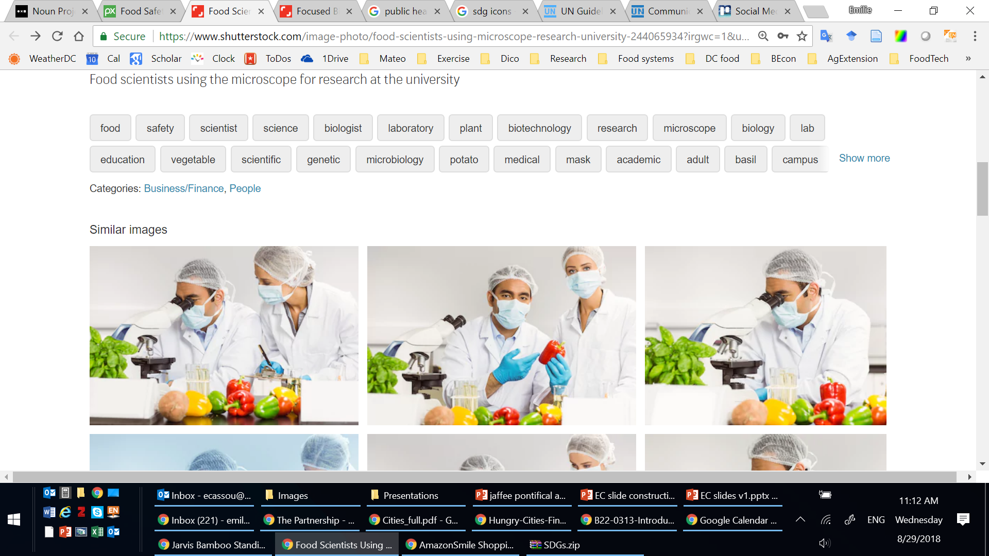
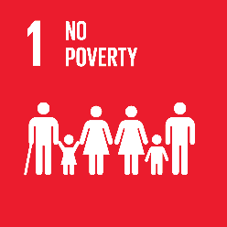
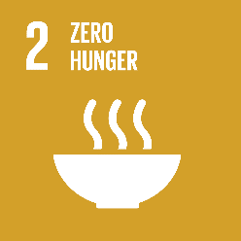
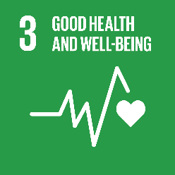

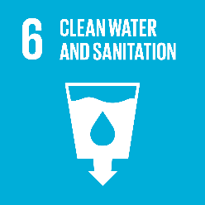
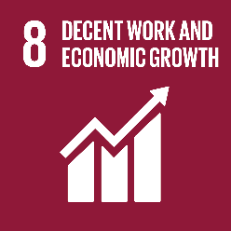
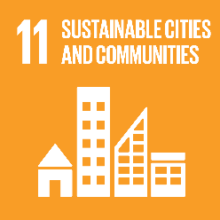
Food safety is a mainstream economic development issue for Africa
Traditional Image of Food Safety
Food Safety critical to ACHIEVING the SDGs
Food safety is foundational to:
Food safety is integral to:

Slide 4
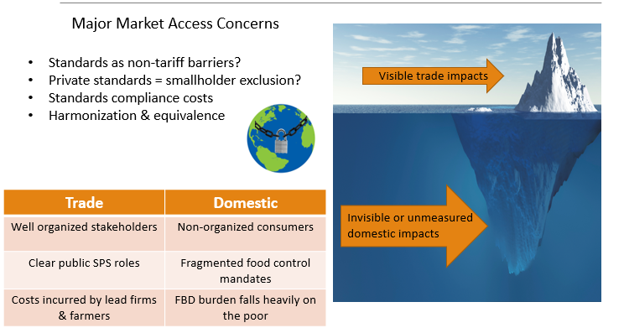
When food safety has been on Africa’s development agenda it has largely been in relation to trade and market access

Slide 5

There is a strong public health imperative for domestic food safety action
Burden
  Much of SSA: highest proportional burden of foodborne disease (FBD) in the world (i.e. DALYs per 100,000 people)
  Most vulnerable: young, old, malnourished, poor, pregnant and immunocompromised.
  2018 (est.) for Africa: 135 million cases of foodborne illness and 180,000 deaths (of which children <5: 60+ million cases and 60,000 + deaths)
Sources
  African populations exposed to a broad range of food safety hazards
  Most FBD is associated with microbial pathogens (e.g. salmonella; E.coli, etc); next in prominence are heavy metals; chronic exposure to aflatoxins
  Animal-sourced foods; fruits & vegetables; cereals

Slide 6
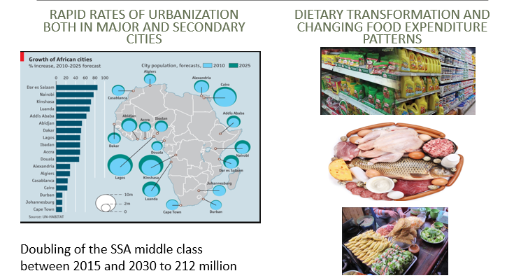
There is a strong commercial imperative for domestic food safety action

Slide 7
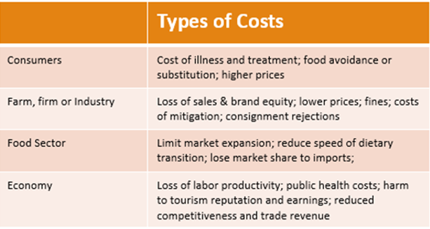
The economic costs of unsafe food take many forms with both short- and long-term dimensions

Slide 8
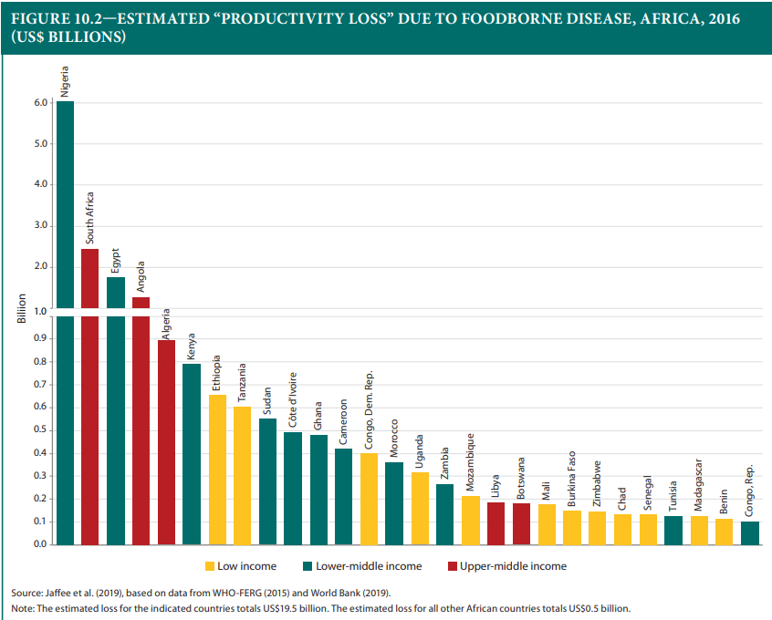
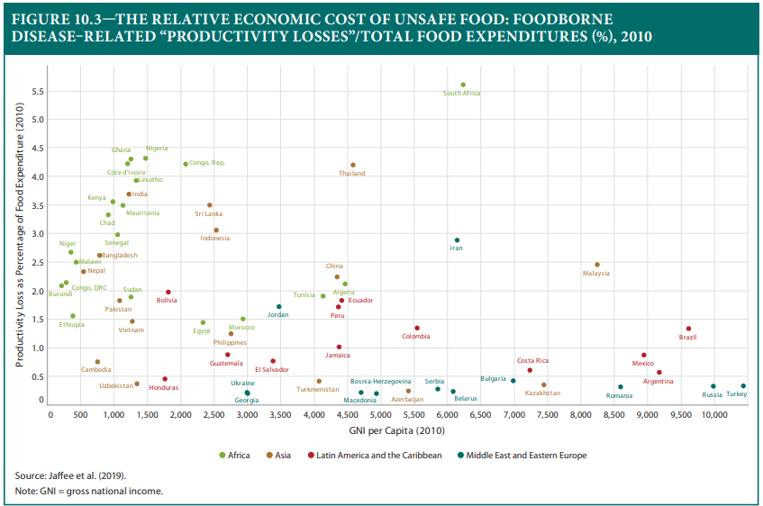
Productivity losses due to unsafe food cost Africa some $20 billion/year This is 40 to 50 times the trade-related costs
For some SSA countries these costs are proportionally amongst the highest in the world

Slide 9

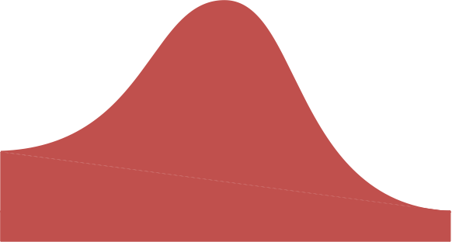


For many African countries, the economic costs of unsafe food will rise in the coming years in a ‘business as usual’ scenario:
The FOOD SAFETY LIFECYCLE
Traditional
Transitioning
Modernizing
Post-Modern
Many African countries are here
Avoidable costs and losses?
Food Safety Economic Burden
Rapid dietary diversity
Changing risks
Lagging capacity and
incentives
Formal sector responds
to consumer demands
Growing public capacity
Stronger incentives
Mature demand
Risks well-managed
Periodic failures lead
to rapid response
Low diet diversity
Weak incentives
Weak capacity
Level of Economic Development
Reflects the relationship or gap between food safety needs and actual capabilities and incentives

Slide 10

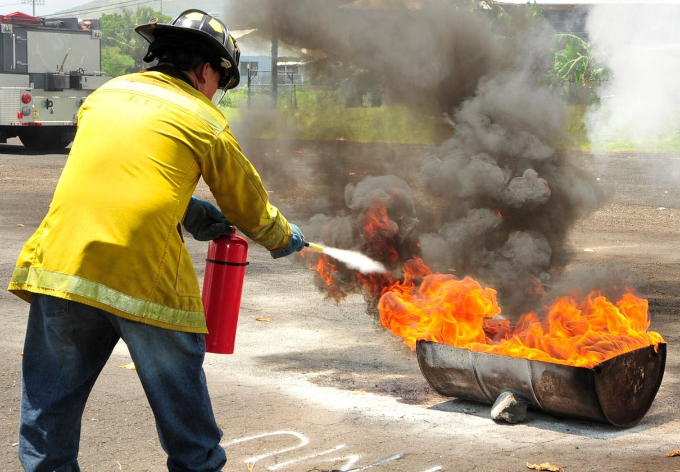

What is ‘business as usual’ in many African countries?
Investments and Institutions:
Fragmented and Uncoordinated
Timing:
Reactive Rather Than Preventive
Regulatory Delivery: Emphasis on Detecting Non-compliance, Not Leveraging Private Action

Slide 11
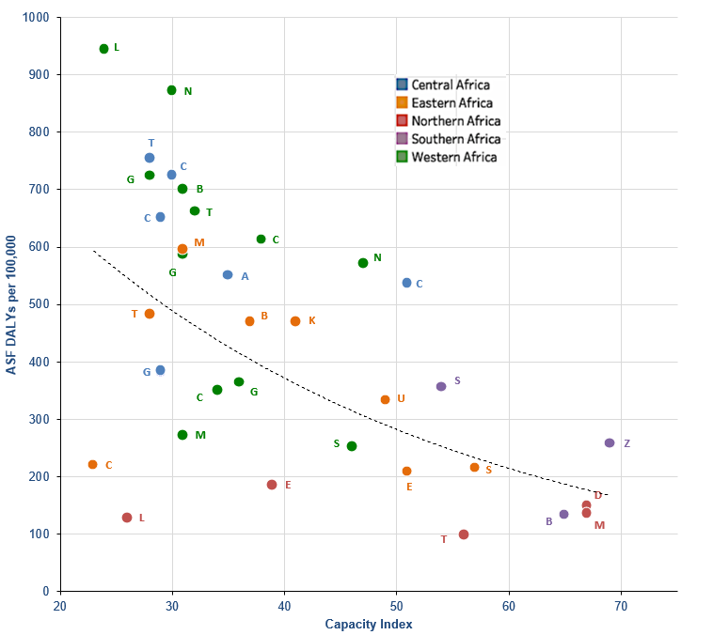
Capacity (and underinvestment) matters, a lot:
FBD from animal products differs greatly among African countries

Slide 12

Looking forward…
A significant share of Africa’s food safety problems and associated costs are avoidable if a concerted set of preventive measures are put in place (from farm to fork and at the overall food system governance level)
Yet, there are no simple solutions or quick fixes to the myriad of food safety challenges faced in Africa; this is a long-term collective agenda (at sub-national, national, regional and international levels)

Slide 13









To mainstream food safety in the development agenda we need to think holistically about what constitutes “investment in safer food” and better measure impacts
Food Control System
Quality Assurance
Food Trade
Facilitation
Application of
GAP, GAHP, GMP
Knowledge & Innovation
Clean Water & Sanitation
Market & Logistical Infrastructure
Consumer Education & Engagement

Slide 14


And combine generic strategies with varied priorities for countries at different stages of agro-food system transformation
Generic Areas
Different priorities between countries at Traditional, Transitional and Modernizing Stages*
Paradigm shift toward shared responsibility model
Approaches to invest more (smartly) in food safety
Emphasis on leveraging private investment and initiative
Regulatory delivery to focus on enabling compliance more than punishing non-compliance
Policy, strategy and regulations
Risk assessment
Risk management
Information, education, and communication
*Also see The Safe Food Imperative (2019)
https://openknowledge.worldbank.org

Slide 15
Thank you

