Slide 1
Introduction to Economics
Cristiano Rossignoli, PhD, MSc, MEL and Impact Assessment Research Leader at WorldFish
June 2022

Slide 2
What is Economics?
The English term ‘Economics’ is derived from the Greek word ‘Oikonomia’. Its meaning is ‘household management’.
Economics is a science, and just like other sciences, it deals with a fundamental problem of nature.
Economics is the branch of knowledge concerned with the production, consumption and transfer of wealth.
It is the study of how scarce resources are allocated to fulfill the infinite wants of consumers.
Notes:
The focus has moved from being about how to keep the family accounts into the wide-ranging subject of today.
Economics has grown in scope, very slowly up to the 19th century, but at an accelerating rate ever since.

Slide 3
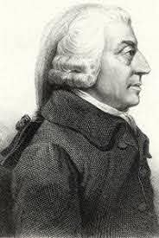
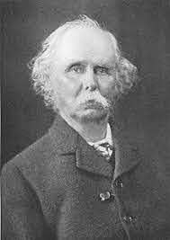
Quick history of economic definitions
Adam smith (1723 – 1790)
In 1776 he published “An Inquiry into Nature and Causes of Wealth of Nations”
He defined economics as the practical science of production and distribution of wealth.
Alfred Marshall (1842 - 1924)
In 1890 he published “Principles of Economics”
He defined Economics around the concept of welfare

Slide 4
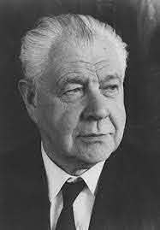
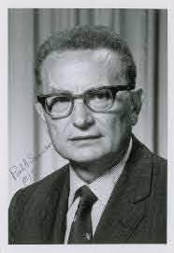
Lionel Robbins (1889 – 1984)
He provided the Scarcity definition of Economics.
In 1932 he published “An Essay on the Nature and Significance of Economic Science”.
Robbins thought that “economics is a science which studies human behaviour as a relationship between ends and scarce means which have alternative uses”
Prof. Paul Samuelson (1915 – 2009)
He defined economics as “the study of how men and society choose, with or without the use of money, to employ scarce productive resources which could have alternative uses, to produce various commodities over time, and distribute them for consumption, now and in the future among various people and groups of society” - Growth definition.

Slide 5
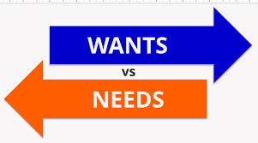
Needs and wants
Economics is the social science that studies the interactions of humans in the commercial realm.
Economists examine the way societies allocate their scarce resources towards competing wants and needs:
NEEDS: are the basic necessities that a person must have in order to survive
e.g. food, water, warmth, shelter and clothing
WANTS: are the desire that people have
e.g. things that people would like to have, such as bigger homes, smart phones, etc.

Slide 6
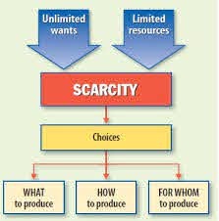
The Economic Problem
Unlimited Wants
Scarce Resources – Land, Labour, Capital
Resource Use
Choices

Slide 7
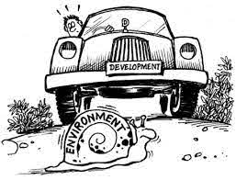

What goods and services should an economy produce? – should the emphasis be on agriculture, manufacturing or services, should it be on sport and leisure or housing?
How should goods and services be produced? – labour intensive, land intensive, capital intensive? Efficiency?
Who should get the goods and services produced? – even distribution? more for the rich? for those who work hard?

Slide 8
Scarcity: the basic economic problem
The problem that Economics aims to resolve is that of Scarcity.
Scarcity arises when something is
both limited in quantity yet desired
Some facts about scarcity
Not all goods are scarce, but most are
Some goods that humans consume are infinite, such as air
The excess of wants resulting from having limited resources (land, labor, capital and entrepreneurs) in satisfying the endless wants of people.
It is a universal problem for societies – it is not limited to poor countries.
To the economist, all goods and services that have a price are relatively scarce. This means that they are scarce relative to people’s demand for them.
Notes:
What makes something scarce?

Slide 9

The diamond-water paradox
Nobody needs diamonds. Diamonds are considered extremely valuable
Everybody needs water. Water is considered extremely cheap
The answer lies in the fact that economic value is derived from scarcity
The more scarce an item, the more valuable it is
The less scarce the less value it has in society

Slide 10
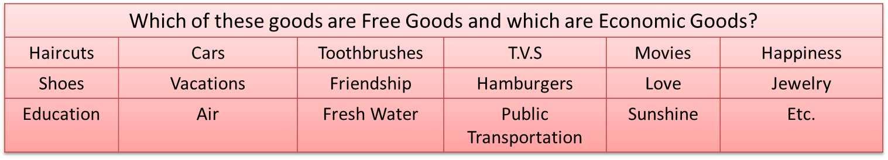
Free Goods and Economics Goods
Goods in Economics are those things we like to consume. They are called “goods” because consuming them makes us feel good!
Free goods are those things that we desire but that are not limited
Economic goods are those that we desire but that ARE limited

Slide 11

Microeconomics
Studies the behaviors of INDIVIDUALS within an economy: Consumers and producers in particular markets.
Examples of microeconomic topics:
The fish market in Scotland,
the market for fish in Stirling,
the market for airline tickets between the US and Europe,
the market for vacations to Italy,
the market for international aquaculture experts.

Slide 12
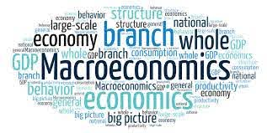
Macroeconomics
Studies the total effect on a nation's people of all the economic activity within that nation.
The four main concerns of macroeconomics are:
total output of a nation,
the average price level of a nation,
the level of employment (or unemployment) in the nation and
distribution of income in the nation
Examples of macroeconomic topics:
Unemployment in Canada, inflation in Zimbabwe, economic growth in China, the gap between the rich and the poor in the United States

Slide 13
Micro vs Macro
Microeconomics examines | Macroeconomics examines
Individual markets the behavior of firms (companies) and consumers the allocation of land, labor and capital resources Supply and demand The efficiency of markets Product markets Supply and Demand Profit maximization Utility maximization Competition Resource markets Market failure | National markets Total output and income of nations Total supply and demand of the nation Taxes and government spending Interest rates and central banks Unemployment and inflation Income distribution Economics growth and development International trade

Slide 14
Fundamental Concepts
Scarcity: | Economics is about the allocation of scarce resources among society’s various needs and wants.
Resources: | Economics is about the allocation of resources among society’s various needs and wants.
Tradeoffs: | Individuals and society as whole are constantly making choices involving tradeoff between alternatives. Whether it’s what goods to consume, what goods to produce, how to produce them, and so on.
Opportunity Cost: | “The opportunity cost is the opportunity lost”. In other words, every economic decision involves giving up something. NOTHING IS FREE!!

Slide 15
Factors of Production
Land
- natural resources available for production
- renewable resources: those that replenish
- non-renewable resources: cannot be replaced
Labor
- physical and mental effort of people used in production
Capital
- all non-natural (manufactured) resources that are used in the creation and production of other products
Enterprise (Entrepreneurship)
- refers to the management, organization and planning of the other three factors of production
Notes:
Land: Land resources are those things that are "gifts of nature". The soil in which we grow food, wood, minerals such as copper and tin and resources such as oil, goal, gas and uranium are scarce
Labor: Labor refers to the human resources used in the production of goods and services. Labor is the human work, both physical and intellectual, that contributes to the production of goods and services
Capital: Capital refers to the tools and technologies that are used to produce the goods and services we desire. Since more and better tools enhance the production of all types of goods and services, from cars to computers to education to haircuts, yet the amount of capital in the world is limited, capital is a scarce resource
Entrepreneurship: This refers to the innovation and creativity applied in the production of goods and services. The physical scarcity of land, labor and capital does not apply to human ingenuity, which itself is a resource that goes into the production of out economic output.

Slide 16
Factors of production: payments and values
Factors of Production
Land
Labor
Capital
Enterprise
Rent
Wages
Interest
Profit
INCOME
Notes:
For Land: Rent
Firms pay households RENT. Landowners have the option to use their land for their own use or to rent it to firms for their use. If the landowner uses his land for his own use, the opportunity cost of doing so is the rent she could have earned by providing it to a firm.
For Labor: Wages
Firms pay households WAGES. To employ workers, firms must pay workers money wages. If a worker is self employed, the opportunity cost of self-employment is the wages he could have earned working for another firm.
For Capital: Interest
Firms pay households INTEREST. Most firms will take out loans to acquire capital equipment. The money they borrow comes mostly from households' savings. Households put their money in banks because they earn interest on it. Banks pay interest on loans, which becomes the payment to households. If a household chooses to spend its extra income rather than save it, the opportunity cost of doing so is the interest it could earn in a bank.
Entrepreneurship: Profits
Households earn PROFIT for their entrepreneurial skills. An entrepreneur who takes a risk by putting his creative skills to the test in the market expects to earn a normal profit for his efforts.

Slide 17
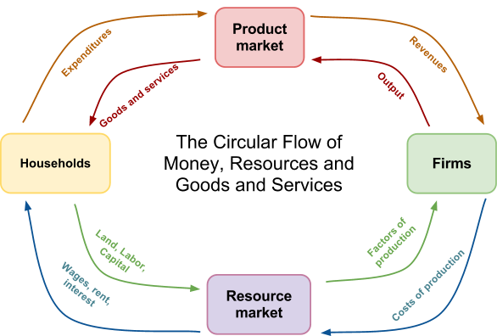
The Circular Flow
Market economies are characterized by a circular flow of money, resources, and products between households and firms in resource and product markets. Notice:
Money earned by households in the resource market is spent on goods and services in the product market
Money earned by firms in the product market is spent on resources from households in the resource market.
The Circular Flow
of Resources
The incentives of Households: Maximize Utility
The incentive of Firms: Maximize Profits!

Slide 18
The Price Mechanism
Prices are how resources are allocated between competing interests in a market economy. Without tradition or command determining the allocation of resources, prices send the signals to producers and consumers regarding what should be produced, how it should be produced, and for whom.
Examples of how prices allocate resources: Imagine a city with two types of fishes, seabream and seabass. How would price assure that the right amount of these two fishes is cultured and marketed based on consumer demand.
At present,
The price of a seabream is $USD 2
The price of a seabass is $USD 3
Due to a report on the negative effects of seabream on the environment, consumers now demand more seabass. How will each of the two systems assure that the increased demand for seabass is met?
Prices are signals from buyers to sellers!
As the demand for seabass, they will become more scarce, causing the price to rise. Aquaculture firms (Sellers) will realize there are more profits in seabass and seabream farmers will switch to seabass.
The price mechanism led to a reallocation of resources!

Slide 19
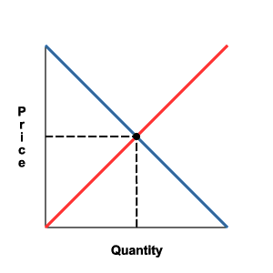
Demand and supply curves
Describe the relationship between quantity of demand or supply, and price, for a specified good or product.
The 'product' described may be a specific single class of item - eg for aquaculture, output such as a particular brand, size of frozen shrimp tails,
Similar application for markets for inputs - land, water, seed, feeds, labour
Demand and supply curves may relate to a specific defined market - eg a village or town, a national market, or an international one.

Slide 20
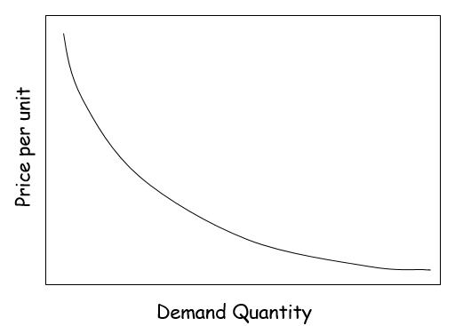
Demand curve
The demand curve is a graphical representation of the relationship between the price of a good or service and the quantity demanded for a given period of time. In a typical representation, the price will appear on the left vertical axis, the quantity demanded on the horizontal axis.
The demand curve will move downward from the left to the right, which expresses the law of demand — as the price of a given commodity increases, the quantity demanded decreases, all else being equal.
Note that this formulation implies that price is the independent variable, and quantity the dependent variable.

Slide 21
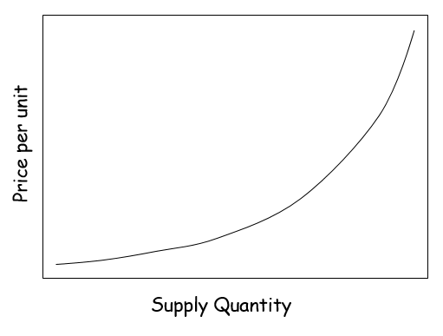
Supply Curve
The supply curve is a graphic representation of the correlation between the cost of a good or service and the quantity supplied for a given period. In a typical illustration, the price will appear on the left vertical axis, while the quantity supplied will appear on the horizontal axis.
The supply curve will move upward from left to right, which expresses the law of supply: As the price of a given commodity increases, the quantity supplied increases (all else being equal).
Note that this formulation implies that price is the independent variable, and quantity the dependent variable.

Slide 22
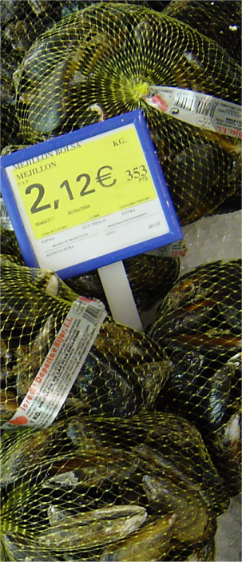
Price determination
The market is in equilibrium when demand = supply, and the price at which this occurs is the equilibrium price which will remain until either or both the demand and supply schedule shifts (see figure).
Price
per
unit
P(x)
Quantity per period (Qx)

Slide 23
Demand
Supply
Price per unit
Equilibrium
Quantity

Slide 24
Curve Shifts
D₂
D₁
Quantity per period
Quantity per period
a) Shifts in demand curves b) Shifts in supply curves
causes of shifts in the supply curve are:
- increased efficiency
- falling labour costs
- falling raw material costs
- building of new production capacity with different costs
if the supply increases for non‑price reasons, and demand remains the same, then prices will fall and more will be bought and sold.
similarly if supply decreases, prices will rise and less will be bought and sold. If both curves shift, the outcome will depend on the combined effect of the shifts.

Slide 25
Curve shift to right
Price per unit
P1
Q1
Q2
Demand Quantity

Slide 26
Curve shift to right
P3
Price per unit
P2
P1
Q1
Q2
Q3
Supply Quantity

Slide 27
Production Possibility Frontier (PPF) Theory
A simplified economic model which portrays scarcity, choice and opportunity cost
The Static Production Possibility Frontier
Analyses the economy at a fixed point in time
Is based on the following assumptions:
  There is a fixed quantity of resources
  The economy only produces two products
  Resources can be used interchangeably
  All resources within the economy are used
  Resources are used at maximum efficiency

Slide 28
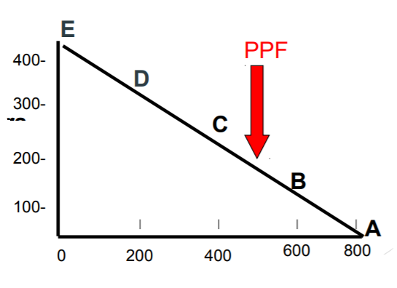
The PPF graph - Maximum Output Levels
Carp
Tilapia
Notes:
The PPF shows the maximum output of the economy. If the economy devotes all of its resources to the production of Tilapia it is able to produce 800 (+ zero carp)—Production Possibility A Alternatively, if the economy chooses Production Possibility C it is able to produce 200 carp and 400 tilapia

Slide 29
Opportunity Costs in the Production Possibilities Model
The PPF shows that to produce more of one product means producing less of another
Opportunity costs of production can be measured e.g. if the economy moves from point C to D (along the PPF) it will produce an extra 100 kg of carps BUT 200 kg of tilapia must be sacrificed;
Hence the opportunity cost is 200 kg of tilapia

Slide 30
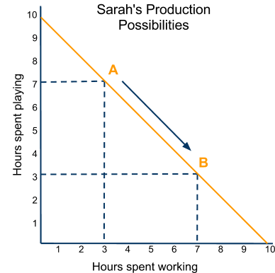
Tradeoffs in the PPC: Sarah faces two tradeoff. She can either work or play with her limited amount of time.
The opportunity cost of an hour of work is an hour of play
As she goes from 3 hours of work to 7 hours of work, she gives up 4 hours of play.
She cannot spend 10 hours working AND 10 hours playing, so Sarah has to make CHOICES
This basic model can be used to illustrate the economic challenges faced by individuals, firms, states, countries or the entire world…

Slide 31
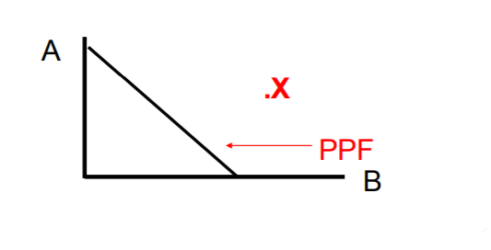
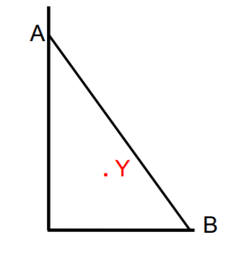
Points Outside and Inside the Static PPF
Points outside the PPF (e.g. X) are not possible using existing technology and resources
At point Y, the economy is satisfying fewer needs and wants than is possible. This is due to: i) Resources not being fully employed and/or ii) Resources not being used in the most efficient way

Slide 32
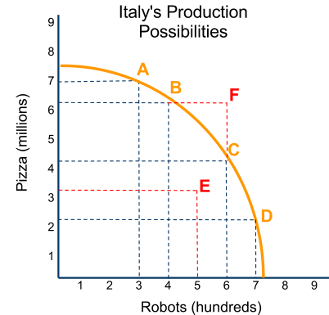
Consider the hypothetical PPC for the country of Italy
This model shows that Italy can produce:
Either 7.5 million of pizzas,
OR 750 robots for healthcare
Note, however, that Italy can NOT produce 7.5 ton of pizzas AND 750 robots
Italy faces a tradeoff in how to use its scarce resources of land, labor and capital. As the country moves along its PPC from point A to point D:
It gives up more and more pizza to have more robots
It gives up current consumption of food for production of robots, which themselves are capital goods, and therefore will assure that Italy’s economy will grow into the future.
Notes:
A point ON the PPC is attainable only if a nation achieves full-employment of its productive resources
The nation's resources are fixed in quantity
The economy is closed, i.e. does not trade with other countries
Represents only one country's economy
Observations about points on or within the PPC
Points ON the PPC are attainable, and desirable, since a country producing on the line is achieving full employment and efficiency
Points inside the PPC (such as E) are attainable but undesirable, because a nation producing here has unemployment and is inefficient
Points outside the PPC (such as F) are unattainable because they are beyond what is presently possible given the country’s scarce resources. But such points are desirable because they mean more output and consumption of both goods.

Slide 33
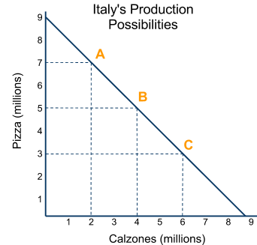
Straight –line versus curved PPCs
A PPC can be either straight (A) or bowed outwards from the origin (B).
A straight line PPC
Indicates that the two goods require similar resources to produce (like pizzas and calzones)
The opportunity cost of one pizza is one calzone, so Italy always gives up the same quantity of one good no mater where it is on its PPC
A bowed out PPC
Indicates that the two goods require very different resources to produce (like pizzas and robots)
As Italy increases its output of one good, the oportunity cost (in terms of the quantity of the other good that must be given up) increases.
(A)
(B)
The Law of Increasing Opportunity Cost:
As the output of one good increases, the opportunity cost in terms of other goods tends to increase

Slide 34
Key Concepts shown by the PPC
In addition to opportunity costs and tradeoffs, the PPC can be used to illustrate several other key Economic concepts, including…
Scarcity: Because of scarcity, society can only have a certain amount of output
Actual output: A country’s actual output is shown by where it is currently producing on or within its PPC
Potential output: A point on the PPC shows the potential output of a nation at a particular time
Economic growth: An increase in the quantity or the quality of a nation’s resources will shift its PPC out, indicating the economy has grown
Economic development: The composition of a nation’s output will help determine whether the standards of living of its people are improving over time

Slide 35
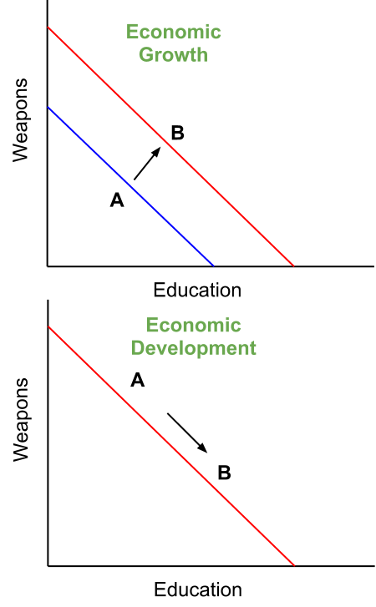
Economic Growth vs. Economic Development
Economic Growth: This refers to the increase in the total output of goods and services by a nation over time.
It is also sometimes defined as an increase in household income over time.
It is purely a monetary measure of the increases in the material well being of a nation.
On a PPC growth can be shown as an outward shift of the curve.
Economic Development: This refers to the improvement in peoples’ standard of living over time.
Measured by improvements in health, education, equality, life expectancy and so on
Incorporate income as well, but is a much broader measure than growth
On a PPC development can be shown by a movement towards the production of goods that improve peoples’ lives
Notes:
Two of the key areas of study in economics are those of growth and development. Sometimes these concepts are thought of as the same, but they are not.

Slide 36


Cost and Revenue
Cost – the total amount of money it takes to produce an item (to pay for ALL Factors of Production).
Revenues – the total amount of money a company or the government takes in.

Slide 37
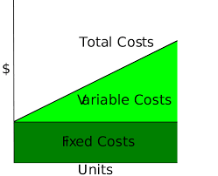
Costs
Fixed Costs – the amount of money a business MUST pay each month or year (like rent and Capital expenses).
Variable Costs – the amount of money a business pays that changes over time (Labor and Raw Materials).
Total Costs = Fixed + Variable Costs.
Marginal Costs – the additional Cost of the NEXT UNIT produced.

Slide 38

Profit
Profit – the difference between Total Costs and Revenues.
Profit=Revenues-Total cost – Profit

Slide 40
Reference
This presentation is a mashup of different sources.
Cristabol M. Pagoso, Rosemary P. Dinio, and George. A Villasis . (2011). The circular flow of economic activity http://www.slideshare.net/dienshMBA/dmydocspatricelourdescollegepowerpointsecon1thecircularflowofeconomicactivity-090331025031phpapp01
Faizan Chaudhry. (2011) Economic concepts and systems http://www.slideshare.net/HUKKAM/ch01-ppt-7484908
Van Diwata. (2013) http://www.slideshare.net/FairywithBraces/fiscal-and-monetary-policy
Michael Noel (2012). Introduction to Economics. https://www.slideshare.net/mikergo/introduction-to-economics-15041809
John Bostock (2006) Economics
http://welkerswikinomics.com/blog/

Slide 41
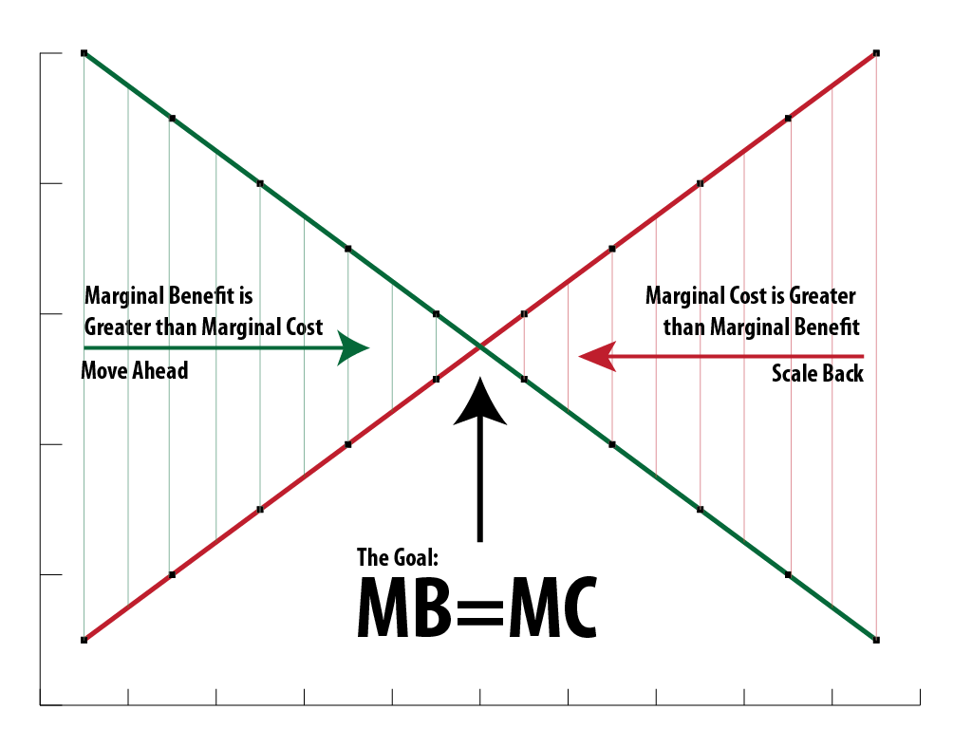
Cost Benefit Analysis
Cost Benefit Analysis – weighing the Marginal Costs vs. the Marginal Benefits of producing an item or making any economic decision.
If the Benefit is GREATER than the Cost, then business does it.
Notes:
Immediate or short term satisfaction can lead to missing the long-term benefits. For Example Immediate spending on cheap stuff instead of long-term savings will lead to lower economic prosperity.

Slide 42
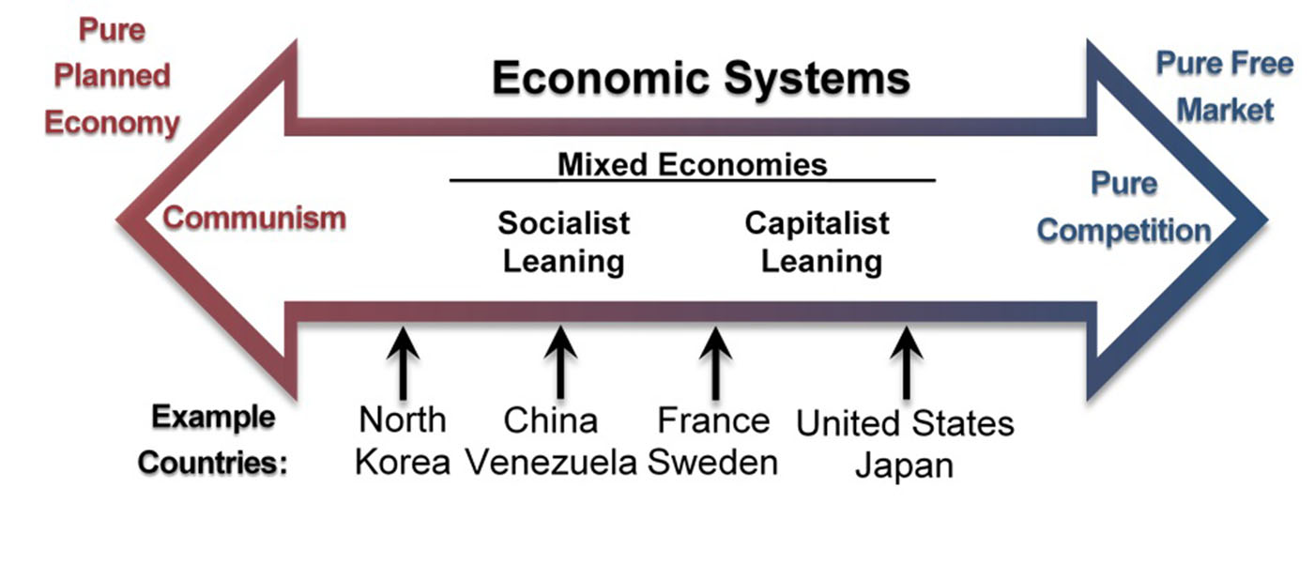
Implications….and/or lessons

Slide 43
Do you want to know more?
Some key topics from http://welkerswikinomics.com/blog/
Scarcity Resources Trade-offs Opportunity cost
Marginal analysis Factors of Production Exchange Rates
Cost/Benefit Analysis Utility maximization Price Theory
Taxes Market failure Public goods Financial markets
Environment Perfect competition Game Theory
Price discrimination Income distribution Recession
Supply and Demand Trade Markets Prices
Consumer behavior Firm behavior Free Trade

