Slide 1


Livestock in the horn of Africa:
An opportunity in waiting
IGAD Drought Resilience Platform General Assembly Meeting
Addis Ababa, Ethiopia. 27 March 2015
Jimmy Smith • Director General • ILRI

Slide 2
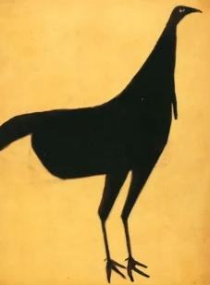
Africa’s food import bill:
US $ 44 billion
About one fifth is livestock (highest after cereals):
  Meat
  US $ 5 billion
  Milk
  US $ 4 billion
Notes:
Bill Traylor (1854-1949). Black Turkey. Pencil and Poster Paint on Cardboard. Circa 1939-1942.
Data from: Food Outlook BIANNUAL REPORT ON GLOBAL FOOD MARKETS. May 2014. Food and Agriculture Organization, Rome.

Slide 3
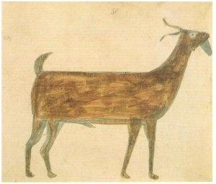
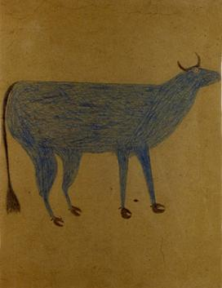
Demand to 2050 will soar
Triple for milk, especially East Africa
Six to seven fold for meat; about four fold in East Africa
Overall growth of livestock sector 2.7% per year (viz. 1.2 in North America)
Business as usual: the import bill doubles
Market value of animal source foods in 2050 in Africa: US$ 151 billion
Notes:
Bill Traylor (1854-1949). Brown Goat. Watercolour and Pencil on Paper. Circa 1939-1942. Found on mattingandframing.net
Bill Traylor (1854-1949). Blue Cow. Graphite and Colored Pencil on Poster Board. Circa 1939-1941. Found on jsaslowgallery.com
Data from:
Herrero M, Pavlik P, McIntire J, Palazzo A, and Valin H. 2014. African Livestock Futures. Realizing the potential of livestock for food security, poverty reduction and the environment in sub-Saharan Africa. Office of the special representative of the UN secretary general for food security and nutrition and the United Nations system influenza coordination unit (UNSIC), Geneva, Switzerland.
And
Business and livelihoods in African livestock. Investments to overcome information gaps. 2014. An output of the Livestock data innovation in Africa Project. Sponsored by the Bill and Melinda Gates Foundation and jointly implemented by the World Bank, the Food and Agriculture Organization of the United Nations, the International Livestock Research Institute and the African Union Interafrican Bureau for Animal Resources. World Bank Report no. 86093-AFR.

Slide 4
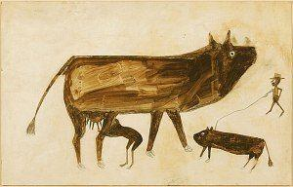
The opportunity:
Transforming today’s producers - smallholder crop-livestock, pastoral and agropastoral systems
Notes:
Bill Traylor / Farm Scene with Cow and Man / c. 1939-42 Found on foundationstaart.wordpress.com
Milk, meat and eggs in the IGAD region today come predominantly from smallholder crop-livestock farmers, pastoralists and agro pastoralists. There are opportunities to transform these systems with a potential to increase production of livestock products four to eight fold in the coming decades, whilst at the same time addressing issues of environment, equity and health.

Slide 5
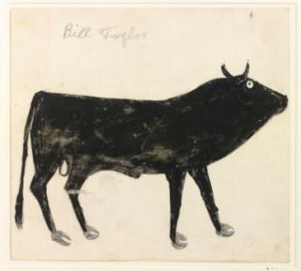
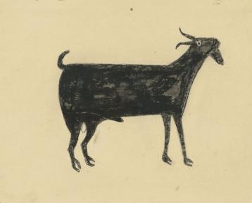
Grasping opportunities
Technology – production – efficiency ‘sustainable intensification’
Pastoral system development – markets; payment for ecosystem services
Market connections
Institutions
Food safety
Notes:
Bill Traylor (1854-1949). Black Bull. Watercolor and Pencil on Paper. Circa 1939-1942. Found on sothebys.com
Bill Traylor ~ black billy sothebys.com

Slide 6
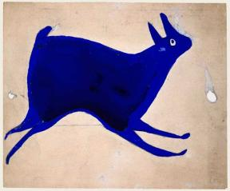
Regional partnership
Continental strategy:
  Livestock Development Strategy for Africa
Strong sub-regional bodies
  RECS, IGAD, ……etc……..
IGAD-ILRI MoU
  Enhancing ILRI participation in IDDRSI
  Regional and National Livestock Master Plans
  Climate Change and Sustainable Intensification in IGAD
  Development of Agricultural Development Master Plans along the Lamu Port
Notes:
Bill Traylor (c. 1854–1949) Montgomery, Alabama 1939–1942 Poster paint and pencil on cardboard 9 x 11 7/8 in. Found on folkartmuseum.org

Slide 7
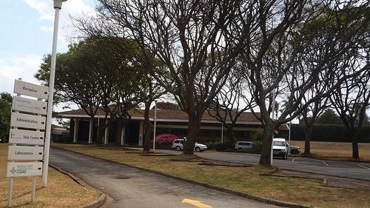
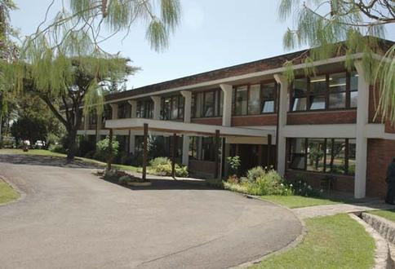
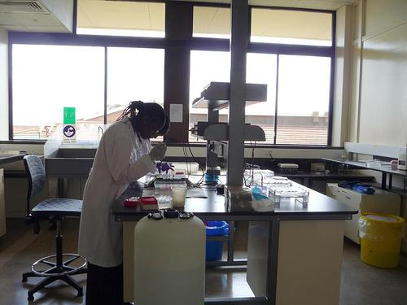
ILRI
Kenya
Member of CGIAR consortium
ILRI’s mission is to improve food and nutritional security and to reduce poverty in developing countries through research for efficient, safe and sustainable use of livestock—ensuring better lives through livestock.
Partnerships: undertake research; take to scale, develop capacity
Added value
Ethiopia
BecA-ILRI hub

Slide 8
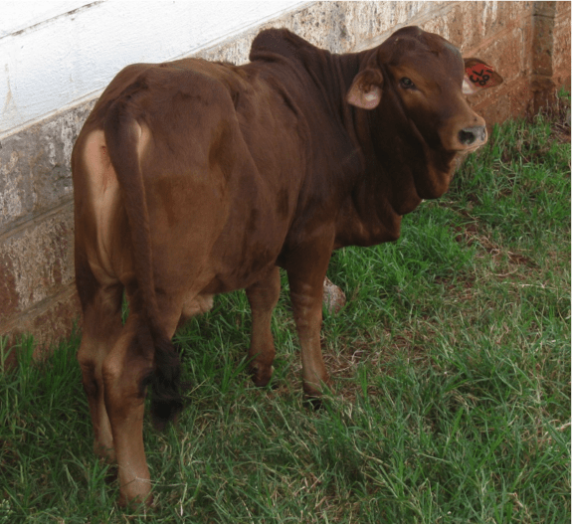
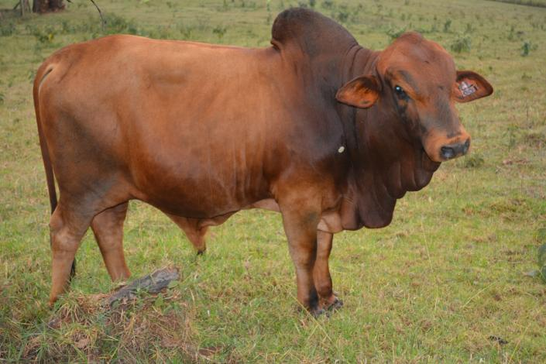
High-end biosciences
Vaccinology
Genetics and genomics
A first for sub-Saharan Africa: Tumaini (swahili for “Hope”): A cloned Kenya Boran calf made by somatic cell nuclear transfer from a Boran embryo fibroblast cell line. Not transgenic.
6 months
2 years

Slide 10
Livestock in the IGAD region
(2010 FAO figures)
133 million cattle
111 million sheep
121 million goats
16 million camels

