Slide 1

Antimicrobial resistance: Wicked challenge for livestock farmers in low- and middle-income countries
Arshnee Moodley and Delia Grace
5th International Conference on Responsible Antibiotic Use in Animals, 7–9 June 2021

Slide 2
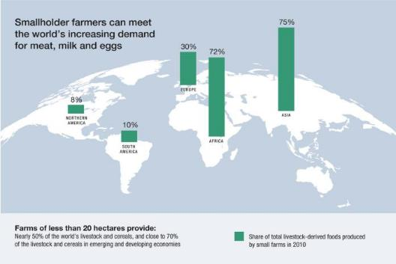


CGIAR and ILRI: Better lives through livestock!
Source: Options for the Livestock Sector in Developing and Emerging Economies to 2030 and Beyond. World Economic Forum White Paper January 2019
Improve food and nutrition security
Reduce poverty
Improve natural resources
Market value of Africa’s animal-source foods to grow to ∼$151 billion by 2050 (from ∼$37bn in 2019)
Most livestock products are sold locally and informally

Slide 3
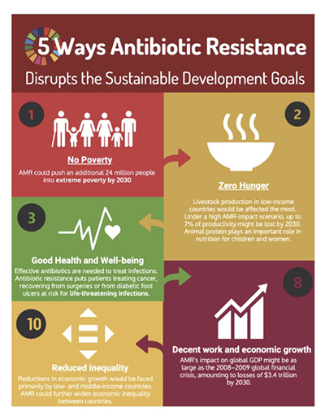
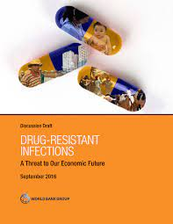
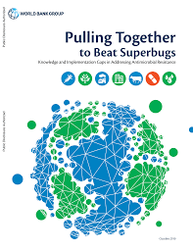
Disportionate effect in LMICs
2017
2019

Slide 4
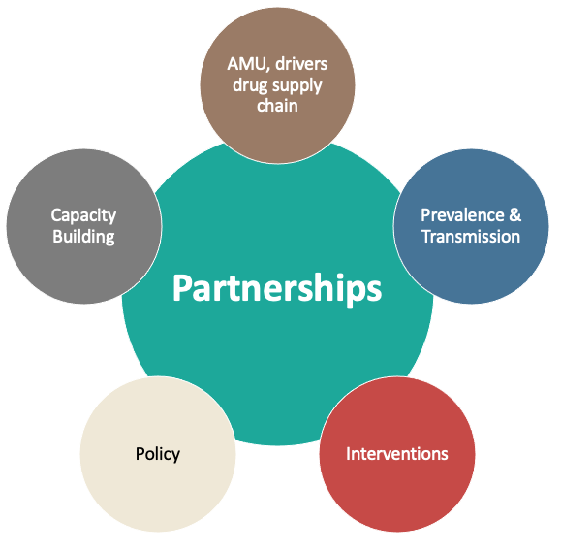
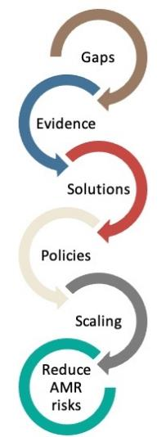







CGIAR AMR Hub mitigating agricultural associated AMR risks
www.amr.cgiar.org

Slide 5
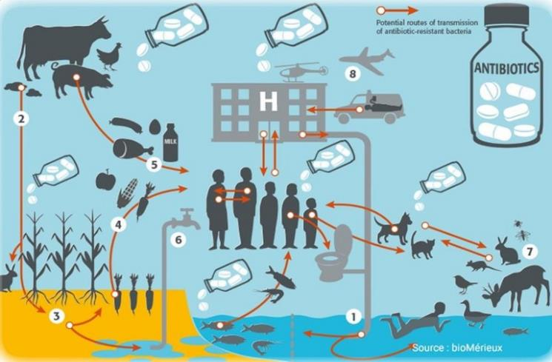

CGIAR AMR Hub
Strength – partnerships (Multi CG centres, external partners incl. governments

Slide 6

Hub project activities
Major activities
AMU, drivers, KAP
AMR Prevalence & Transmission (interfaces)
Cap. Building (lab capability and mentorship)
Interventions incl. pilot studies, economic analyses
Minor projects
AMU and AMR in crop systems
Fate and transport of AMR in water bodies
AMR in wildlife and bushmeat
AMR and manure
AMR Policy
ILRI alone: 2020-2025, AMR projects equal US$ 6.8 million
Notes:
Studies conducted In different value chains

Slide 7




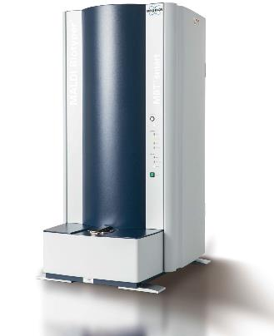
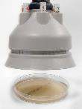




AMR lab at ILRI Kenya
MOU with ICARS and EUCAST
  AST knowledge center on the continent
  EUCAST trainings (EDL in Växjö and ILRI, Nairobi)
Genomics platform

Slide 8
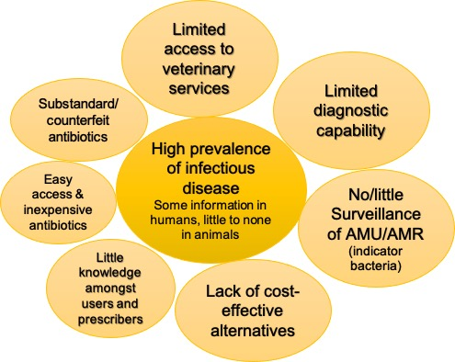
Fundamentals of reducing AMU and spread of AMR
Reduce use
AMU surveillance
Ban/restriction
Education-Awareness compaigns
Evidence based treatment decisions
Treatment guidelines
Vaccines use
Limiting profit of prescribers
Corruption
Low trust in authority
No financial subsidies
Reduce transmission
AMR surveillance
Biosecurity
Hygiene/decontamination
Challenges in LMICs

Slide 9
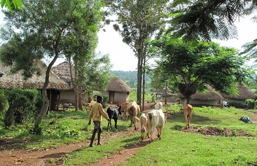
Livestock production in LMICs
https://www.flickr.com/photos/ilri/
Busia, Kenya
Nairobi, Kenya

Slide 10
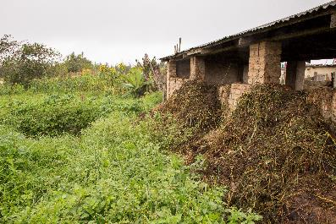
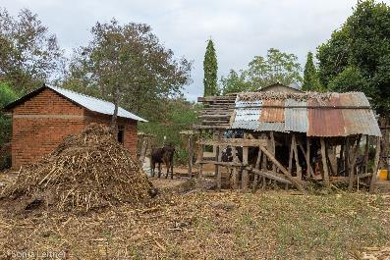
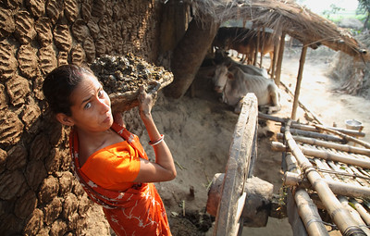
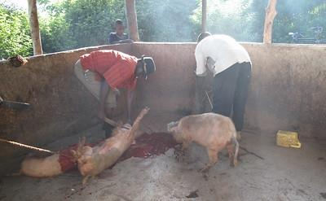
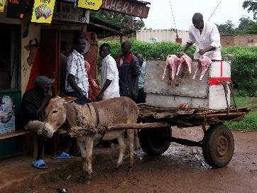
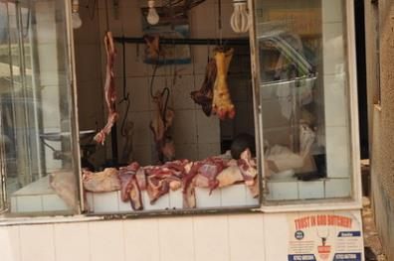
Manure “management?”
https://www.flickr.com/photos/ilri/
Iringa, Tanzania
Iringa, Tanzania
West Bengal, India
Livestock products slaughtered, transported and sold in informally
Busia, Kenya
Nairobi Kenya
Kampala, Uganda

Slide 11
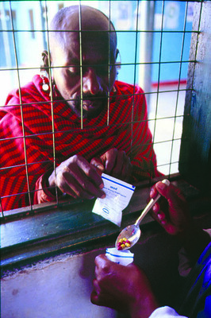
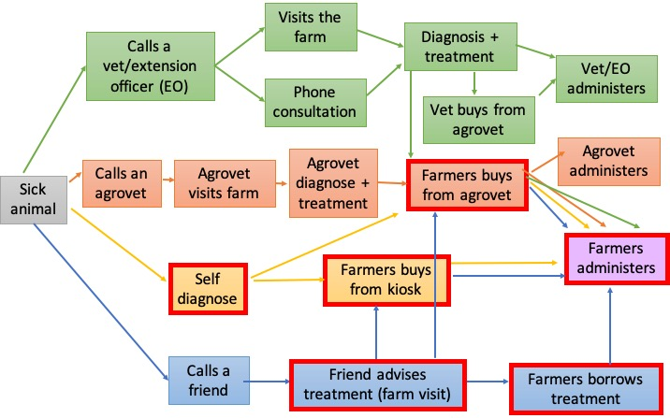
What happens if an animal is sick in a LMIC?
Tanzania
https://www.flickr.com/photos/ilri/
Notes:
Often vets are not consulted – too costly → unqualified people offering
82% will self diagnose and administer antibiotics without input/advice
25% of vets will make a diagnosis without seeing the animal
1% will confirm with a laboratory test
Farmers calls the vet when infections is severe/close to death especially beyond his/his friends experience
Vet-can be based at the agrovet, ambulatory/roaming vet, extension officer/ on the rare occasion vet surgeon in practice. Phone consultation if there is not vet in the vicinity. Vet visit is costly (consul. Fee+transport) and then the cost of treatment
The value of the animal also factors in. High value animals e.g. cow would warrant a call to the vet.
Self diagnosis- no vets around or too costly
Agrovet farm visit only if agrovet is a vet/paraprofessional
No back checking with vets for validity
No paper prescription-farmers are illterate
Unqualified people offering advice- cheaper rates than
82% of farmers will self+diagnose the problem and administer antibiotics without input from animal health person or advice from agrovet/drug store
low levels of awareness and knowledge around AMU, AMR risk perceptions and that AMU appears to be far from informed and prudent
Apart from treating sick animals and not always respecting the prescribed dosage, most farmers report using antimicrobials for disease prevention in an entire flock and/or as growth promoters
In Kenya: 25% of vets will make a diagnosis without seeing the animal, 1% will confirm with a laboratory test, 6-25% will sell a single dose/one time measurement based on farmer’s economy)
reuse old prescriptions
Wrong use of AM among at least 80% of livestock keepers
Cross-over use: including us of ARVs
Prescription vs. no prescription sales
37-100% of retailers provide antibiotics without prescription
Prohibited sales of antibiotics without a prescription but no mechanisms for monitoring non-compliance
Revenues from sale of antibiotics

Slide 12
2021
Manufacturer’s indication label
“stimulates egg production, increases growth, improves feed conversion”
44-69% of farmers reporting using the two combinations
5/7 commonly used are combination of antibiotics and multivitamins

Slide 13

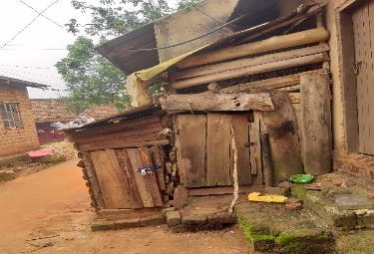

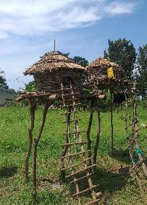
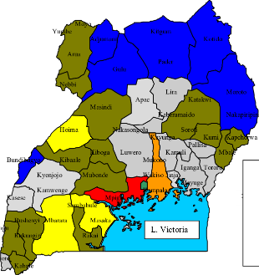
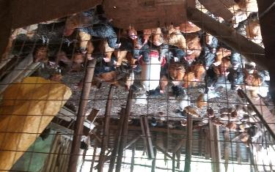
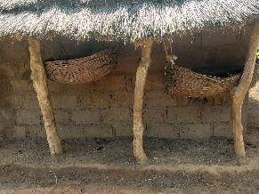
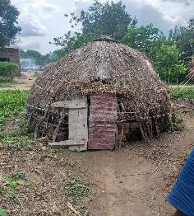

BUILD Uganda: Poultry value chain
Soroti
Wakiso

Slide 14
KAP survey amongst farmers
56% didn’t know that AMR was an issue in Uganda
60% didn’t know know that AMR could be transmitted
73% had little knowledge about AMR
77% didn’t know that resistant bacteria can be found in meat or eggs
70% don’t receive additional benefits if they observed the the withdraw period
https://hdl.handle.net/10568/107443
58% believed that AMR in chicken cannot affect clients (consumers)
65% farmers in Wakiso felt that the Government is to blame for AMR issues
65% didn’t think good biosecurity measures, hygiene and vaccinations could reduce AMR
81% believed it was OK to use expired drugs and it did not contribute to AMR

Slide 15
KAP survey amongst agrovets
11% had no previous training about poultry
62% thought that AMR does not contribute to treatment failure if a stronger antibiotic
77% did not know that AMR affects chickens in both poor and rich countries
58% did not have any AMR training
(68% in Wakiso)
In Soroti, 91%, did not believe that good biosecurity, hygiene and vaccinations could reduce infections in poultry
In Wakiso 81% believed that AMR is not associated with poor prescription practices
81% believed that the Government is to blame for AMR
42% thought vaccinations does not reduce AMR

Slide 16
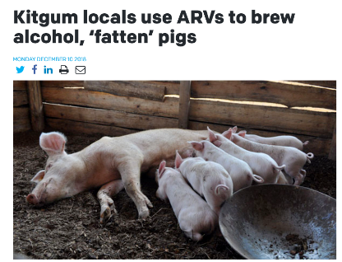
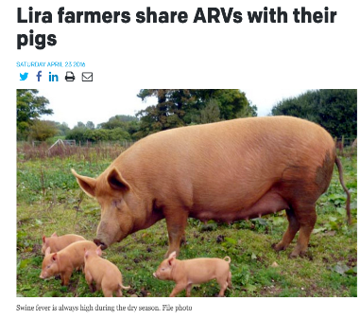
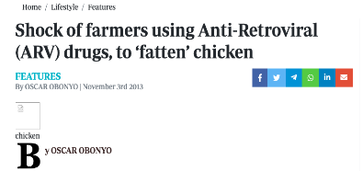
Use of ARVs in livestock production in Uganda
Slaughterhouse in Kampala and Lira
Blood samples: 27.4 % of test positive
Notes:
Transforming subsistence to commercial (National Povery Eradication Plan)

Slide 17
1.4 million people have HIV (2018), and ARVs are available for free
Farmer need to max. profits, max. market share but min. input and shortest turnaround time
  Low income country with 40 million people
  41% live below the poverty line, 25% food insecure, 39% have access to drinking water
  58% of households depend on livestock
    92% are subsistence smallholders farmers
Jan-Aug 2019 in 10 districts in Uganda
  Are ARVs being used? If so, why?
  Can ARV residues be detected in feed, blood or animal tissue destined for human consumption?
    Chicken liver, pig muscle and blood
Notes:
Transforming subsistence to commercial (National Povery Eradication Plan)

Slide 18
Are ARVs being use and if so, what are the drivers for use? YES
Mixed in feed or water ($0.2-2/tablet or in-kind)
Drivers of use:
  Growth promotion (increase appetite, accelerate growth and weight gain)
  Increase milk production (sows)
  Prevent or treat Newcastle disease virus, African swine fever virus, mycoplasma infections
  lack of good quality feed
  Cost of vaccine, lack of access to vaccines or other alternatives to prevent infections
  Veterinarian costs too high
ARVs administered by AHSPs as they supported the practice
Did we find residues? YES
9% of samples test positive for 2/4 ARVs in 7/10 districts
Significance? Risk to human health?
Consequence of agricultural misuse and low dose → ARV Resistance
Notes:
e.g. 30 tablets mixed with 100kg maize bran and given continously to pigs
“If it can treat HIV it should be able to treat animals diseases”
To increase appetite and body weight as seen in HIV patients on ARVs

Slide 19

We can’t regulate our way to reducing AMU and AMR: Regulation is needed but it’s not enough
Kenya: prescription only
Reality: Without prescriptions
Kenya: Agrovets are trained and registered with the KVB
Reality: Employ unqualified staff
to dispense drugs and advice
~80% of farmers either self diagnose or rely on
untrained animal health providers
Corruption and low trust in government
Limited resources to enforce regulations
Policy gaps
We can’t train our way to reducing AMU and AMR: Capacity building is useful if incentives are in place
Training not just about knowledge
transfer - not enough
To improve or change behaviour
coupled with incentives
Willingness to pay: consumers don’t have economic power
Need an enabling environment
New project: Exploring the use of behavioural “nudges”
Notes:
need follow up – to reinforce and have a behaviour change

Slide 20
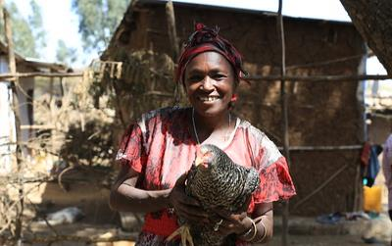
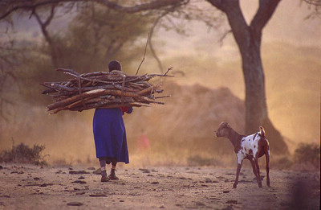
Need for gendered approach to reducing antibiotic use
“farmer” = man in the field or with his livestock
2/3 of 600 million poor mixed crop-livestock farmers are women
  5-10% of farms in NED, DK, DE are managed by females (Eurostat 2016)
Women do most of the day-to-day farm animal management plus household chores
Gender-blind intensification interventions can inadvertently cause women to lose their business
  Gender-dynamics can negatively affect willingness to adopt new vaccines → Increase workload for women
  Vaccine delivery systems tend to target men farmers, making it difficult for women to access them e.g. distance to a vaccination point
Effective interventions to reduce antibiotic use AND empower rural women livestock farmers?
Notes:
Meat, milk and eggs are key sources of nutrition for their families

Slide 21






























Mitigating agricultural associated AMR risks together!
Michel Dione, Barbara Wieland, Hu Suk Lee, Delia Grace, Kristina Roesel, Fred Unger, Bernard Bett, Hung Nguyen, Eric Fevre, Ulf Magnusson (SLU)

Slide 22
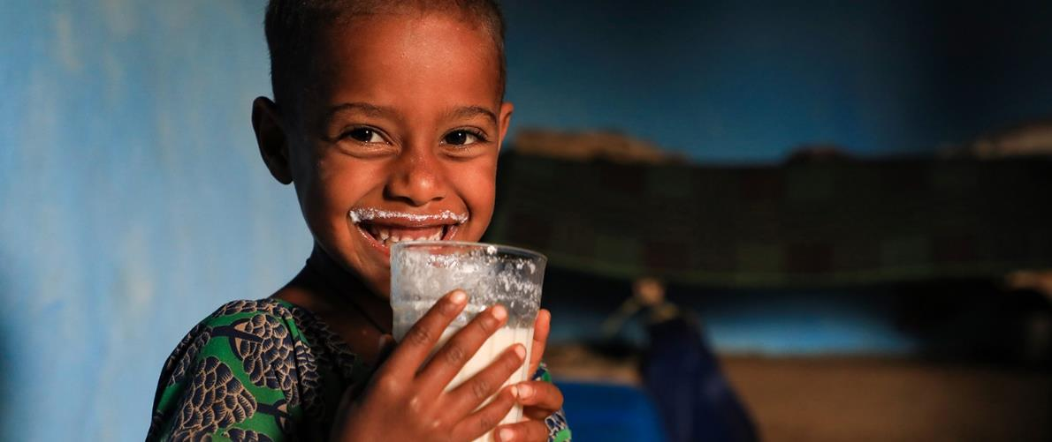
THANK YOU

