Slide 1




A professional course
Course Lead: Prof. Vishnu Prasad Pandey, Center for Water Resources Studies, Institute of Engineering, Tribhuvan University, Nepal
Email: vishnu.pandey@pcampus.edu.np
Water-Energy-Food-Ecosystems (WEFE) Nexus Approaches
Notes:
Provide the context of the course development, acknowledgements, people involved, etc.
Prof. Rajesh for Trends & Prof. Vishnu for WEFE Nexus concept

Slide 2
Contributors
Prof. Vishnu Prasad Pandey, Center for Water Resources Studies (CWRS), Institute of Engineering, Tribhuvan University, Nepal
Prof. Rajesh Kumar Rai, Institute of Forestry, Tribhuvan University, Nepal
Dr. Sanju Koirala, International Water Management Institute (IWMI), Nepal Office
Prof. Tri Ratna Bajracharya, Center for Energy Studies, Institute of Engineering, Tribhuvan University, Nepal
Dr. Bharat Kumar Pokharel, GREAT International
Dr. Nisha Onta, Governance Lab
Dr. Rishi Ram Kattel, Agriculture & Forestry University
Mr. Sabin Dangol, Center for Water Resources Studies (CWRS), Institute of Engineering, Tribhuvan University, Nepal
Dr. Manohara Khadka, International Water Management Institute (IWMI), Nepal Office
Dr. Marlene Elias, Alliance of Bioversity International & CIAT

Slide 3
Module 3
WEFE Nexus Assessment
Prof. Vishnu Prasad Pandey
Center for Water Resources Studies, Institute of Engineering, Tribhuvan University, Nepal
Prof. Rajesh Kumar Rai
Institute of Forestry, Tribhuvan University, Nepal
Dr. Sanju Koirala
International Water Management Institute (IWMI), Nepal Office
Notes:
Provide the context of the course development, acknowledgements, people involved, etc.
Prof. Rajesh for Trends & Prof. Vishnu for WEFE Nexus concept

Slide 4
Session Objectives and Contents
Objectives:
  Introduce inclusive methodological framework for WEFE Nexus assessment
  Highlight required types of data
  Provide insights on Nexus impact assessment
Contents:
  Inclusive framework for Nexus assessment and evaluation of interventions
  Nexus database: typology, data management, data dissemination
  Nexus modeling and impact assessment
Duration:
  10 hrs
Method of Delivery:
  Lecture
  Class Interaction
  Case Studies

Slide 5
3. WEFE Nexus Assessment
3.1 Framework [3 hrs, 30 mins]
Theoretical framework, components, indicators, parameters
Framework for inclusivity analysis in WEFE Nexus solutions/interventions
3.2 Database [1 hr, 15 minutes]
Data requirements and typologies
Data acquisition and pre-processing, data management and dissemination framework
3.3 Nexus modeling [2 hrs, 45 minutes]
Approaches, tools, techniques, and practical challenges
3.4 Impacts assessment [2 hrs, 30 minutes]
Evaluating impacts of contextual changes on the Nexus
Impacts of Nexus projects and interventions
Results framework for impact assessment

Slide 6
3.1 Nexus Assessment Framework
Theoretical framework – components, indicators, and parameters
Framework for inclusivity analysis in WEFE Nexus solutions

Slide 7
Session Delivery Plan [3 hrs, 30 minutes]
Time | Activity | Facilitator
20 minutes | Exercise 3-1: Open discussion: Baseline understanding of Nexus assessments | Prof. Vishnu Prasad Pandey
20 minutes | Lecture – Nexus assessment frameworks | Prof. Vishnu Prasad Pandey
20 minutes | Exercise 3-2: Open discussion: Reflection on missing aspects in the presented frameworks | Prof. Vishnu Prasad Pandey
20 minutes | Lecture – Indicators for Nexus assessment | Prof. Vishnu Prasad Pandey
60 minutes | Lecture – GESI-inclusivity assessment in the WEFE Nexus | Dr. Sanju Koirala
65 minutes | Exercise 3-3: Impact of an intervention on distribution of assets and efforts required for equitable distribution of benefits | Dr. Sanju Koirala
5 minutes | Summary of session | Prof. Vishnu Prasad Pandey

Slide 8
Exercise 3-1: Open Discussion [20 mins]
What do you understand by ‘Nexus assessment’?
What would a Nexus assessment look like?
  (e.g., methods, frameworks)?

Slide 9
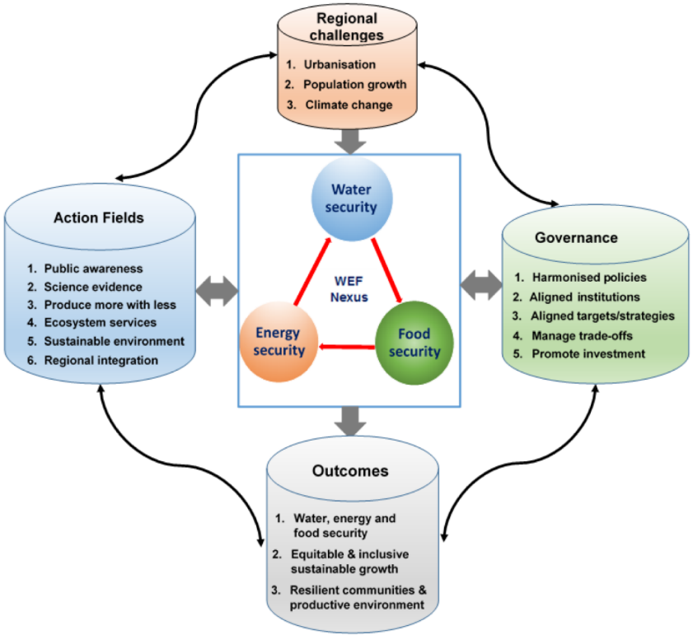
3.1 WEFE Nexus Assessment | Conceptual Framework
Conceptual models/frameworks serve as a theoretical foundation for understanding the interconnectedness of WEFE resources.
They provide key system specifics such as the changes in model state, scope/boundary, how the simulated system should work, the entities that it contains, and the interactions, rules, and equations that determine its behavior (Anandhi et al., 2023).
Why conceptual models?
  to collate, visualize, understand, and explain problems and their potential solutions through bringing together and summarizing information in a standard, logical, and hierarchical way (Anandhi et al., 2023).
  Figure: Regional framework for resource Nexus assessment (Source: Nhamo et al., 2018)
Notes:
Visualize overall context of the Nexus and outcomes from the figure – regional challenges (drivers) that influence sectoral actions; action fields related to the Nexus; role of governance; and outcomes…Nexus assessment should be able to quantify all those aspects.

Slide 10
3.1 WEFE Nexus Assessment | Conceptual Framework
Frameworks guide research to deliver the necessary insights into multiple key system aspects (Anandhi et al., 2023).
Effectiveness of a conceptual framework depends on a comprehensive understanding and translation of indicators, framings, and concepts used by different research traditions (Anandhi et al., 2023).
There is no single cookbook method for “modeling the Nexus”. Therefore, no common conceptual model/framework for the Nexus has emerged (Anandhi et al., 2023).
Examples of existing conceptual frameworks are:
  World Economic Forum, 2011
  Bonn2011
  Food and Agriculture Organization (FAO)
  WEF-PIK
  Texas A&M University (Daher & Mohtar)
  International Centre for Integrated Mountain Development (ICIMOD)
  International Institute for Sustainable Development (IISD)
  Footprint framework
  Water Evaluation and Planning Model (WEAP)
  Global Policy Dialogue Model
Notes:
Anandhi et al. (2023) and Shannak et al. (2018) contain details about these frameworks.

Slide 11
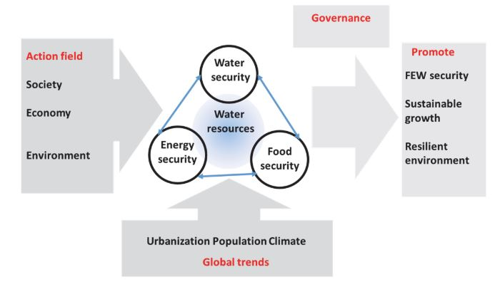
3.1 WEFE Nexus Assessment | Conceptual Framework
  Figure: Bonn2011 Nexus framework adapted from Bizikova et al. (2013) (Source: Anandhi et al., 2023)

Slide 12
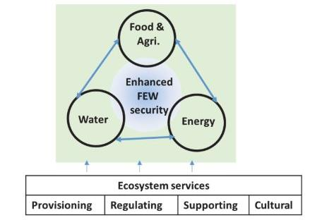
3.1 WEFE Nexus Assessment | Conceptual Framework
  Figure: Food and Agriculture Organization (FAO) framework (Source: Anandhi et al., 2023)

Slide 13
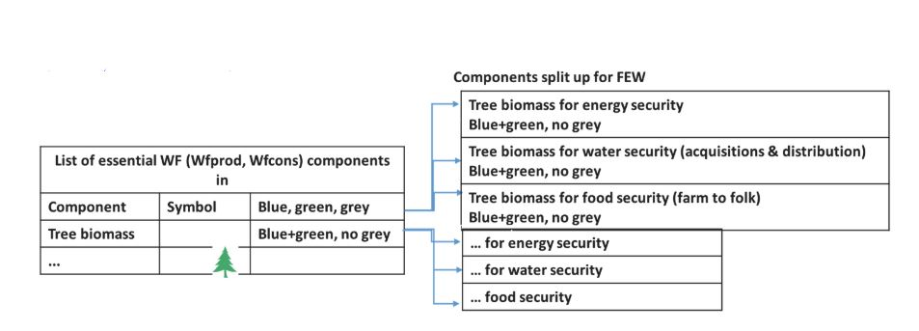
3.1 WEFE Nexus Assessment | Conceptual Framework
  Figure: Water footprint approach framework adapted from Vanham (2016) (Source: Anandhi et al., 2023)

Slide 14
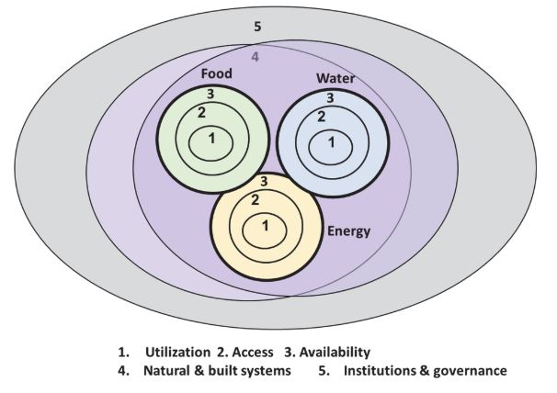
3.1 WEFE Nexus Assessment | Conceptual Framework
  Figure: International Institute for Sustainable Development (IISD) framework adapted from Lawford et al. (2019) (Source: Anandhi et al., 2023)
Notes:
Priority of focus, from 1 to 5

Slide 15
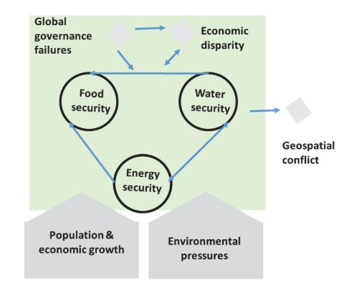
3.1 WEFE Nexus Assessment | Conceptual Framework
  Figure: World Economic Forum 2011 framework adapted from Bizikova et al. (2013) (Source: Anandhi et al., 2023)

Slide 16
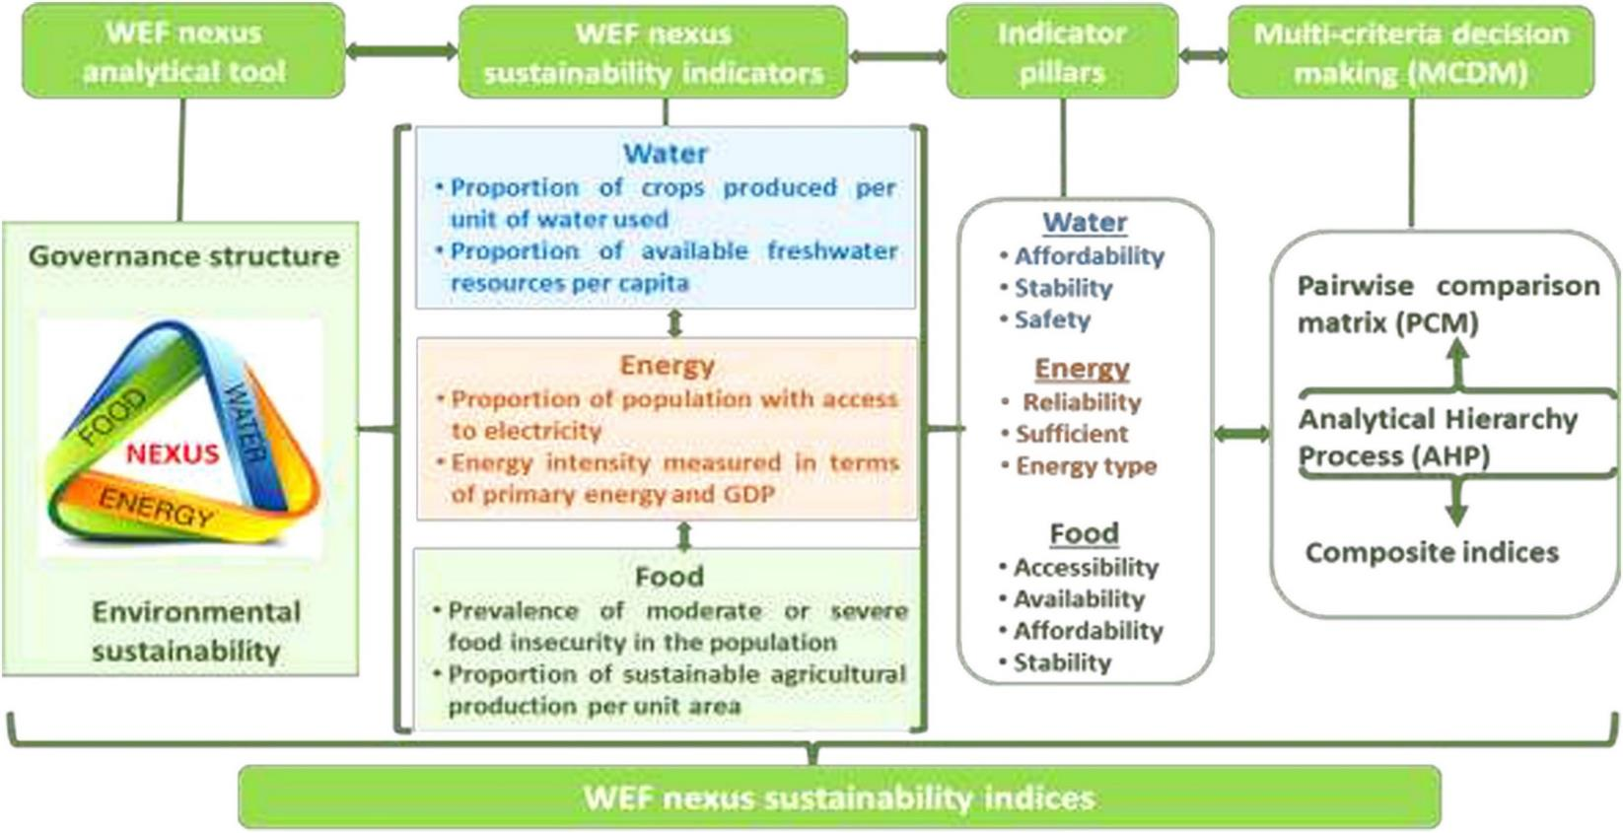
3.1 WEFE Nexus Assessment | Conceptual Framework
Figure: Conceptual framework to develop WEF Nexus indicators and indices
(Source: Nhamo et al., 2020)

Slide 17
3.1 WEFE Nexus Assessment | Conceptual Framework
Existing Nexus conceptualizations and frameworks often include elements such as:
1. Overall information
e.g., purpose, focus, starting point, overall approach
2. People/organizations involved
e.g., developers, users/stakeholders
3. Scales and disciplines used
e.g., spatial and temporal scales, disciplines and their interactions
4. WEF(E) Nexus definition elements
e.g., processes, ideas and/or objects, properties, perspectives, consequences
5. Assessment methods
e.g., modeling approach, tools, data
  Figure: Elements currently included in Resource Nexus conceptualizations and frameworks (Source: Anandhi et al., 2023)
Notes:
Details in Anandhi et al., 2023

Slide 18
Exercise 3-2: Open Discussion [20 mins]
Please reflect on the frameworks shared in this module. What is missing from these frameworks?
Notes:
People? Ecosystems? Other missing factors?

Slide 19
3.1 WEFE Nexus Assessment | Indicators/Parameters
Indicators/parameters provide information for evaluation or assessment and predict future conditions of a given phenomenon (Arthur et al., 2019).
Nexus indicators quantify the interdependencies between WEFE sectors and their related impacts at various scales (Arthur et al., 2019).
Types of indicators used in Nexus assessment as per Arthur et al. (2019):
  Resource flux indicators:
    Flow indicators to quantify/analyze movement of resources within a defined system
    Used to analyze the flows between two or more interdependent resources
    Tend to analyze the intensity of resources entering and leaving each system
Notes:
(Arthur et al., 2019)

Slide 20
3.1 WEFE Nexus Assessment | Indicators/Parameters
Types of indicators used in Nexus assessment as per Arthur et al. (2019), continued:
  Efficiency indicators
    Account resource use per unit inflows in a system
    Analyze the proficiency level of productive resources in the system
    Assess and compare WEF resources’ inputs and outcomes at the end of a production/processing cycle by economic sector
  Environmental indicators
    Analyze environment and health impacts associated with resource production/consumption within an urban system
    Serve as parameters to quantify negative externalities of the production or processing system (development, industrial activities) and use of environmental resources
    Investigate the consequences of human activities on the environment and human health
  Other indicators
    Indicators capturing population characteristics, dependency ratio, number and type of resources used in production, etc.
Notes:
(Arthur et al., 2019)

Slide 21
3.1 WEFE Nexus Assessment | Indicators/Parameters
The WEFE Nexus Index
  Composite index of indicators/parameters under different components/categories by normalizing indicator values and using proper weights to each index/component
  Easy to translate various aspects of a system into a single, easy to visualize value
  Easy to monitor/measure progress over time
  May include: pillars (water, energy, & food), sub-pillars (access and availability), and constituent indicators
Data Integration
  Emphasizes data integration from diverse sources
  Integration of ICT, hydro-climate modeling, energy, agriculture, ecosystem data for comprehensive insights
  Supports evidence-based decision-making

Slide 22
3.1 WEFE Nexus Assessment | Framework for Inclusivity Analysis
Equitable interventions
  Considers differential inclusion and impact based on gender, ability, socio-economic status, and vulnerable group status
  Collects and analyzes socially disaggregated data on access to resources, involvement in decision-making, etc., on various aspects of WEFE resources
  Integrates Gender Equity and Social Inclusion (GESI) in WEFE approaches
    CGIAR learning module focuses on integrating GESI in WEFE approaches
Shift from resource-centric to “people-centric” approach for equitable outcomes
  Resources for whom? Which group? Which category? (Intersectional analysis!)
Collaboration/cooperation
  Engage with a diverse range of stakeholders, conceptualize their (intersectional) voices/views to integrate with analysis
  Collaborate across groups for optimizing input resources (financial, human)

Slide 23
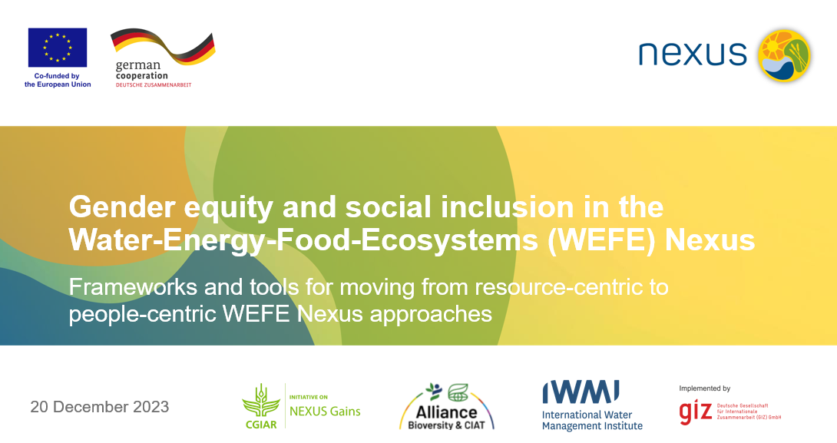
3.1 WEFE Nexus Assessment | Framework for Inclusivity Analysis
GESI-Inclusivity Analysis in the WEFE Nexus (Learning Module Developed by the Nexus Gains Initiative)
Notes:
The session is based on the module developed by CGIAR Nexus Gain Initiative and I was also in the module development team. You can also find this module online.

Slide 24
3.1 WEFE Nexus Assessment | Inclusivity Analysis | Outline
1: From resource- to people-centric WEFE Nexus approaches | Current WEFE Nexus thinking: focus on resources over people Gender equity and social inclusion: the missing links in WEFE Nexus approaches
2: A social equity framework for addressing gender equity and social inclusion in the WEFE Nexus | Recognition Representation Redistribution
3. Group Work | Reflection and discussion on the differential impacts of a hypothetical Nexus case
Notes:
This session is divided into three parts.
The first part provides the overview on the transition from resource-centric to people-centric WEFE Nexus approaches
The second part introduces the social dimension of resources access with a social equity framework for addressing gender equity and social inclusion in the WEFE Nexus
We end the session with interactive group work

Slide 25
3.1 Nexus Assessment | Inclusivity Analysis | Terminologies
Sex:
  Biological traits that society associates with being male or female
Gender:
  Socially constructed roles, behaviors, expressions and identities of girls, women, boys, men and gender-diverse persons (e.g., transgender, intersex, genderqueer)
Gender equality and social inclusion (GESI)
  Aims to foster equal rights, responsibilities and opportunities for men and women and others, independent of age, ethnicity, social status or other characteristics
WEFE Nexus
  Refers to the interactions between people and ecosystems across WEFE sectors
Notes:
Gender is not only about women, nor is it a synonym for women. Gender refers to socially constructed roles, behaviors, expressions and identities of girls, women, boys, men and gender-diverse persons.
From yesterday to today you must have heard of WEFE Nexus several times.
However, it’s important to note: the WEFE Nexus is not just about the Nexus between water, energy, food and environment sectors. It is also the interactions between people and these sectors.

Slide 26
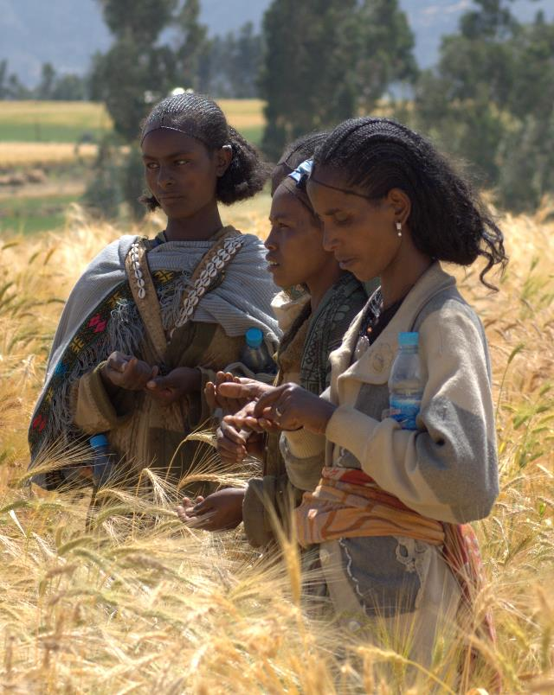
3.1 WEFE Nexus Assessment | Inclusivity Analysis | Focus
1: From resource- to people-centered WEFE Nexus approaches
Current WEFE Nexus thinking
Gender equality and social inclusion
© J.van de Gevel Bioversity International
Notes:
Let‘s now look at WEFE Nexus thinking and what it means for considering gender equality and social inclusion in designing and implementing Nexus interventions.

Slide 27



3.1 WEFE Nexus Assessment | Inclusivity Analysis | Focus
Current WEFE Nexus thinking focuses on resources > people.
WEFE Nexus approaches seek to manage trade-offs, reduce inefficiencies and increase synergies at a systems level among water, energy, food, ecosystems and other land use sectors.
Notes:
By now you all are clear that Nexus approaches differ from traditional, sector-specific policies and practices because they do not focus on gains within individual sectors.

Slide 28
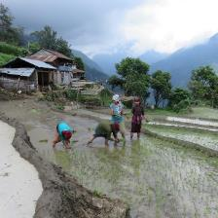
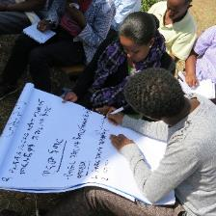
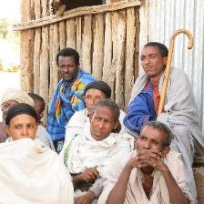
3.1 WEFE Nexus Assessment | Inclusivity Analysis | Focus
Gender equity and social inclusion: the missing links in WEFE Nexus approaches
Around the world, we see persistent gender inequalities in access to resources and decisions over how to use and manage these.
Too often, women are left out of development and environmental initiatives, since they are not seen as legitimate stakeholders.
By addressing these inequalities across sectors in policy and practice, Nexus approaches can enable more equitable access to WEFE decisions, services and benefits for all.
Women (and men) are heterogeneous groups and may have vastly different experiences based on other social factors.
Many categories of men also experience marginalization.
Top: © Subedi LI-BIRD. Middle and bottom: © CGIAR Research Program on Water, Land and Ecosystems
Notes:
Gender equity and social inclusion are currently the missing links in many WEFE Nexus approaches.
Around the world, we see persistent gender inequalities in access to resources and decisions over how to use and manage these. Rural women and men particularly rely on land and other natural resources for their livelihoods. But often, only men are recognized as the authorities, providers, farmers and resource managers of their households and communities – even though women, too, are responsible for providing and managing food, water, fuel, cash and other resources on a daily basis.
Too often, women are also left out of development and environmental initiatives, since they are not seen as legitimate stakeholders.
In reality, women have unique knowledge of and priorities for the management of resources in their communities. However, there are many gender- or inclusion-specific barriers that make it difficult for women to access and progress in decision-making spaces, for instance, time availability and mobility outside of the home hinder many rural women’s ability to participate in user groups. Likewise, in the workplace, the water, energy and food sectors are considered very technical and, thus, due to societal norms, these sectors are typically associated with men.
We should also know that-women (and men) are heterogeneous groups and may have vastly different experiences based on other social factors. For example, Dalit (low-caste) women from poor households in rural areas have different needs and realities with respect to energy or water use than better-off women in the cities. Or even, poor and better-off women in cities may have different needs and realities on these resources.
But overall, women (in all their diversity) have limited control over management decisions at all levels compared to men.
That said, many categories of men also experience marginalization. Men in disadvantaged groups (such as ethnic minorities, lower castes or landless men) may struggle to have their voices heard in their communities and in higher-level governance spaces that shape their local opportunities and resource access in significant ways.

Slide 29
3.1 WEFE Nexus Assessment | Inclusivity Analysis | Focus
Disability
Location
Ethnicity
Gender
Occupation
Community standing
Gender equity and
social inclusion
Culture
Caste
Land ownership status
Marital status
Parenthood
Age
Wealth
Notes:
This web shows many different aspects of a person’s identity that, together, can lead to their exclusion or inclusion in decision-making and benefit-sharing related to water, energy, food and ecosystems. Gender, in addition to the multiple identities such as caste, ethnicity, age, disability etc., can lead to an individual’s exclusion. Advancing gender equity and social inclusion in the WEFE Nexus requires recognizing who is excluded and on what basis, to challenge that discrimination.
By addressing these inequalities across sectors in policy and practice, Nexus approaches can enable more equitable access to resource decisions, services and benefits for all.

Slide 30
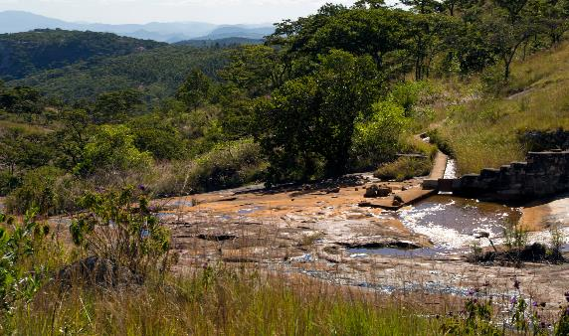

3.1 WEFE Nexus Assessment | Inclusivity Analysis | Focus
2: A social equity framework for addressing gender equity and social inclusion in the WEFE Nexus
© David Brazier IWMI
© Tom van Cakenberghe IWMI
Notes:
Next, let‘s look at a social equity framework that helps understand what the key considerations are for integrating gender and social inclusion considerations in WEFE Nexus interventions.

Slide 31

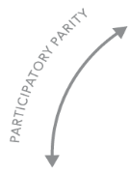
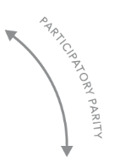


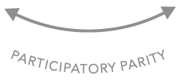
3.1 WEFE Nexus Assessment | Inclusivity Analysis | Focus
A social equity framework has three pillars
A) Recognition
Recognition refers to when people or social groups have equal opportunities to be valued as legitimate, respected and dignified participants in society.
WEFE Nexus initiatives must identify which social groups can affect, and be affected by, planned interventions. This helps design interventions to enable more equal participation and benefits.
RECOGNITION
Who is entitled to dignity and prestige?
REDISTRIBUTION
Who is entitled to capital and assets – natural, physical, human, financial, social?
REPRESENTATION
Who is entitled to claims of injustice?
Notes:
Gender equity and social inclusion strategies can help identify entry points for fostering equitable and sustainable resource access for diverse Nexus stakeholders at different scales. A social equity framework can help guide this process by drawing attention to “who”, “how” and “why” to achieve equitable outcomes in Nexus initiatives.
The first pillar, Recognition, refers to when people or social groups have equal opportunities to be valued as legitimate, respected and dignified participants in society.
For example, many rural women do as much or more farm work than their spouse but are not recognised as farmers in their own right, and their knowledge and skills are undervalued. As such, they are frequently not considered legitimate (justified or valued) stakeholders in agricultural interventions.
Nexus initiatives must identify which social groups will affect, and be affected by, Nexus interventions. This broad range of stakeholders may include:
Policymakers
Staff of national and local government agencies participating in the implementation of interventions
Intended beneficiaries in all their diversity
Persons or groups who may be affected adversely by the interventions in the short- or long-term, which includes private sector actors, interest groups, civil society organisations and donors.
Understanding the stakeholders, and their needs and roles, helps design interventions that enable more equal participation and benefits.

Slide 32



3.1 WEFE Nexus Assessment | Inclusivity Analysis | Focus
A) Recognition (continued)
Among stakeholder groups, there are highly unequal power relations. This means that the knowledge and priorities of some may be perceived as having more legitimacy than those of others.
Importantly, from the perspective of social equity, the needs, rights, knowledge systems and priorities of different groups– particularly those most marginalized – must be recognised and legitimized.
LOCAL RIGHTS-HOLDERS
LOCAL STAKEHOLDERS
NATIONAL STAKEHOLDERS
INTERNATIONAL STAKEHOLDERS
Notes:
Social equity principles dictate that the needs, rights, knowledge systems and priorities of different groups must be recognized and legitimized.
The stakeholders come from many levels – from local to national and international – and are not all usually present in the same water, energy, food and ecosystem decision-making spaces. Power relations among stakeholder groups can be highly unequal. This means that the knowledge and priorities of some may be perceived as having more legitimacy than those of others.
Typically, stakeholders with less social and financial capital are the ones who are left out. For example, a decision made in a capital city about rural resources may not include any spokespeople from the impacted rural area. If interventions do not intentionally seek to recognize all stakeholders genuinely, they risk ignoring specific communities and benefit other, more powerful groups.
From a rights-based perspective, those who live near the resources and whose livelihoods are directly linked to them deserve particular recognition and protection. This often includes Indigenous peoples and marginalized groups in local communities.
The initiatives must ensure a ‘do-no-harm’ principle – at a minimum – so that they do not pose undue risks to local people and marginalized community members (that is, rights-holders) and do not jeopardize their livelihoods and well-being.
Nexus initiatives will also have to be accountable to these rights-holders.

Slide 33

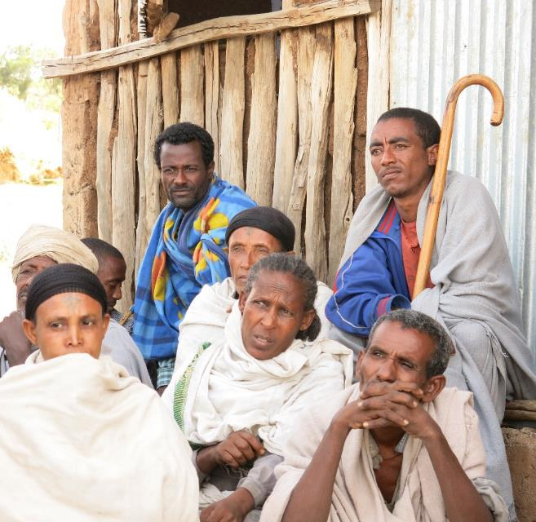
3.1 WEFE Nexus Assessment | Inclusivity Analysis | Focus
Recognition – Stakeholder Analysis
To make sure that all relevant groups are included in WEFE Nexus decision-making, intervention planning, start with a stakeholder analysis.
Stakeholder analysis = identifying social groups who may affect and be affected by WEFE Nexus interventions.
Consider all potential stakeholders, including those who may be affected negatively by the WEFE Nexus plans.
© CGIAR Research Program on Water, Land and Ecosystems
Notes:
To make sure that all relevant groups are included in WEFE Nexus decision-making, planning of interventions should begin with a stakeholder analysis.
It is important to consider all potential stakeholders, including who may be affected negatively by the WEFE Nexus interventions, and how. Even well-intended interventions typically have some negative impacts on some stakeholder groups, and overlooking these can undermine the implementation and the positive impacts of the interventions.
A basic stakeholder analysis should be done before interventions are designed. It should then be revisited and updated throughout the design process as more information is gained.

Slide 34
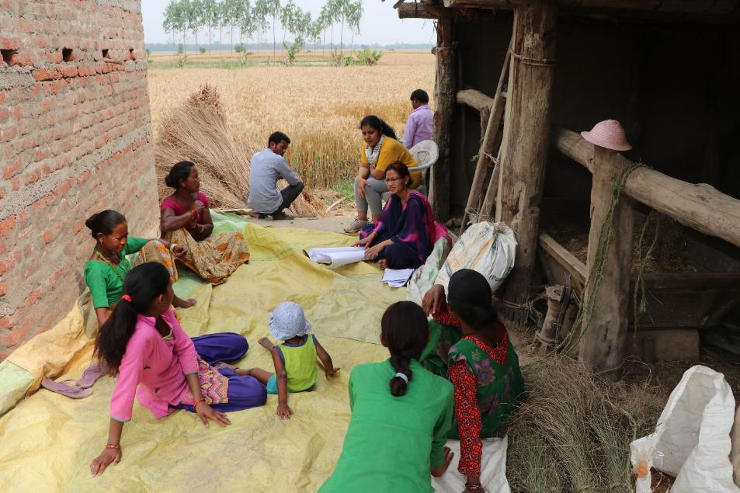
3.1 WEFE Nexus Assessment | Inclusivity Analysis | Focus
B) Representation
Representation relates to how different stakeholders can shape agendas and influence the critical decisions that impact their lives.
© Patrick Drown IWMI
Notes:
The second pillar of the social equity framework, Representation, relates to how different stakeholders can shape agendas in the community or society, and can influence the critical decisions that impact their lives.
Measures are needed in Nexus initiatives to ensure that the diverse stakeholders we were just discussing are adequately represented across all phases, from planning to implementation and monitoring. Again, this includes particularly the communities and their members whose livelihoods depend directly on WEFE resources.

Slide 35



3.1 WEFE Nexus Assessment | Inclusivity Analysis | Focus
B) Representation
A GESI approach should ensure that marginalized groups can have influence in decision-making at different levels.
Those with the most to gain or lose from WEFE Nexus interventions often have the most limited influence.
Notes:
A gender equity and social inclusion approach should ensure that women and marginalized social groups can have a voice and influence in the processes shaping resource access and use at the household, community and higher decision-making levels.

Slide 36
3.1 WEFE Nexus Assessment | Inclusivity Analysis | Focus
B) Representation: recognising and fostering higher forms of participation
Six levels of participation (adapted from Agarwal, 2001)
Form of participation | Characteristic features
Interactive (empowering) participation | Having voice and influence in the group’s decisions
Active participation | Expressing opinions, whether solicited or not, or taking other forms of initiative
Activity-specific participation | Being asked to (or volunteering to) undertake specific tasks
Consultative participation | Being asked an opinion in specific matters without guarantee of influencing decisions
Passive participation | Being informed of decisions ex post facto; or attending meetings and listening in on decision-making, without speaking up
Nominal participation | Membership in the group
Notes:
Not all participation in decision-making is equal in nature. There are many forms or levels of participation.
We should remember that achieving interactive or empowering participation requires ongoing negotiation and management of unequal power relations and conflicting interests. This is a challenging process, particularly as there are often limited resources, skills and trust among different participants.
Typology of participation adapted from:
Agarwal, B. (2001). Participatory exclusions, community forestry, and gender: An analysis for South Asia and a conceptual framework. World Development, 29(10), 1623-1648. https://doi.org/10.1016/S0305-750X(01)00066-3

Slide 37

3.1 WEFE Nexus Assessment | Inclusivity Analysis | Focus
B) Representation: recognizing and fostering higher forms of participation
Meaningful participation requires addressing context-specific barriers.
Empowering participation and bottom-up learning requires continuously asking…
What voices are being heard at the different stages of decision-making processes, and what is the weight and legitimacy given to diverse voices?
Notes:
Enabling marginalized groups to meaningfully participate in Nexus initiatives requires addressing the barriers they face, which depend on the group, place and time. To understand and lift these barriers, interventions must carefully consider the local context, including power relations and the history of water, energy, agriculture and environment sectors in the project area.
Targeted measures are needed to ensure that women and other less powerful actors can express their voices and priorities and that their views are meaningfully considered. Inviting these groups to attend a multi-stakeholder meeting is not enough, as they may not be able to express their views, influence the agenda, or engage on equal footing with other, more powerful groups. Participation then remains nominal, passive or consultative only. This happens in many irrigation user committees in Nepal., in which many women members participate only passively.
Empowering participation and bottom-up learning requires continuously asking: What voices are being heard at the different stages of decision-making processes, and what is the weight and legitimacy given to diverse voices?
Interactive (or empowering) participation can be supported, for example, by a combination of:
Centering meetings on issues that are important to women and other marginalized groups
Establishing quotas for women’s and men’s participation, consultation, decision-making and voting
Selecting safe and easily accessible meeting venues, organizing childcare and hygienic sanitary facilities
Giving enough space and time for collective learning, including in informal settings, smaller and single-gender groups, with safe space for expressing opinions and ideas
Allocating adequate financial and technical resources to supporting inclusion from the beginning
Strengthening local capacities for conflict mediation and negotiating power imbalances

Slide 38







3.1 WEFE Nexus Assessment | Inclusivity Analysis | Focus
C) Redistribution
Redistribution refers to an intentional effort to bring more equity to how rights and goods, as well as costs, risks and responsibilities, are distributed in a society. These rights and goods give power (including power over others) to those who control them.
Gender,
class structures & other social differences & inequalities
Resource access and control
Empower or marginalize
Notes:
Redistribution is the third and final pillar of the social equity framework. It refers to an intentional effort to bring more equity to how rights and goods, as well as costs, risks and responsibilities, are distributed in a society.
Rights to access and control resources shape - and are shaped by - gender, class structures and other social differences and inequalities that empower some people and groups while marginalising others. These rights over resources and goods give power (including power over others) to those who control them, and so they can feel either further marginalization or empowerment for different stakeholders.

Slide 39



3.1 WEFE Nexus Assessment | Inclusivity Analysis | Focus
C) Redistribution: understanding different types of livelihood assets
A Sustainable Livelihoods Framework can be used to examine the distribution of costs, benefits and risks in WEFE Nexus interventions, and help identify ways to achieve a more equal distribution.
Natural
Political
ASSETS
Human
Financial
Social
Physical
Notes:
The Sustainable Livelihoods Framework illustrates the different types of tangible and intangible assets that resource users can draw upon to secure their livelihoods, and how these assets interact with each other.
Assets can take many forms, including:
Natural capital such as land, water, fuelwood, wild food sources, or genetic resources
Physical capital such as irrigation and road infrastructure, transport, electricity, tools and machinery, storage, or production inputs like seed, fertilisers, and pesticides
Financial capital such as regular income, savings, liquid assets, or formal and informal credit facilities
Human capital such as knowledge and skills, education and training, health, nutrition, or capacity to work
Social capital such as membership in formal and informal groups like Water User Associations and producer groups, collaboration, or access to opportunities through social networks
Political capital such as citizenship, enfranchisement, or effective participation in governance
The framework helps understand how costs, benefits, and risks are distributed among different stakeholder groups. It also helps grasp the trade-offs and synergies among assets that may result from Nexus interventions.

Slide 40
3.1 WEFE Nexus Assessment | Inclusivity Analysis | Focus
C) Redistribution
Which groups would gain which types of assets or resources?
How do the planned interventions affect the availability, flows and distribution of different types of assets among diverse social groups?
Which groups would lose access to and control over assets or resources as a result of interventions?
To identify how WEFE Nexus interventions may affect the distribution of costs and benefits among different social groups, key questions include:
How do history and context (policies, norms, other institutions and markets) influence the distribution of costs, risks and benefits among social groups?
What structures, processes, checks and balances are needed to level the playing field and improve opportunities for women and marginalized social groups?
Notes:
We should ask these questions at the planning stage of an intervention, to shape intervention design. These questions should also be asked throughout the intervention to identify how WEFE Nexus interventions may affect the distribution of costs and benefits among different social groups.

Slide 41


3.1 WEFE Nexus Assessment | Inclusivity Analysis | Focus
What indicators can help understand the effects of interventions on gender equity and social inclusion?
C) Redistribution
What participatory monitoring approaches can support adaptive learning toward more equitable outcomes?
What alarm systems and safeguards are needed to mitigate and address unintended negative consequences?
Which trusted actors can play a part in these early warning systems to ensure interventions harm no one?
Monitoring and Evaluation (M&E)
Notes:
Systematic monitoring is needed to reduce risks of harm to women or other marginalized social groups that may arise from an intervention. These questions can help monitor how gender equity and social inclusion are realized during project or program implementation.

Slide 42




Exercise 3-3: Group Work [65 mins]
How can technology interventions affect the distribution of assets between stakeholder groups and what needs to be done?
Discuss in groups.
Imagine a multi-purpose dam project. It will generate electricity and supply to a far-away city. How will the intervention affect distribution of assets?
Each group represents a different type of stakeholder

Slide 43
Exercise 3-3: Group Work [65 mins]
Imagine a potential multi-purpose dam project located in remote area that will displace diverse people. The electricity is targeted to be supplied to a distant city. How will the intervention affect the distribution of assets between stakeholder groups and what needs to be done to equally distribute the benefits from the project ?
Group 1: Focus on the displaced people – Which stakeholders will be displaced? How will they be affected, and how will the impact vary over different social groups? How they can be represented? How resources could be redistributed to them?
Group 2: Focus on those who have farmland downstream from the dam – Which stakeholders are in this group? How will they be affected, and how will the impact vary over different social groups? How they can be represented? How resources could be redistributed to them?
Group 3: Focus on others who are affected but not displaced – Which other community members are affected by such a project? How will they be affected, and how will the impact vary over different social groups? How they can be represented? How resources could be redistributed to them?
Notes:
Guide: Form groups. Ask each group to select a representative to present in plenary. Allocate 30 minutes for discussion and preparing presentation. Allocate 5 minutes for each group to present. Then use remaining time for discussion on presentation, including summarizing by the facilitator/resource person.
Encourage groups to identify a broad range of stakeholders and to reflect on their GESI dimensions. For example, if jobs are generated by the dam (a consideration for group 3), who will likely benefit from those jobs and who will likely lose out?

Slide 44
3.1 WEFE Nexus Assessment | Sources and Further Reading
Anandhi, A., Srivastava, P., Mohtar, R. H., Lawford, R. G., Sen, S., & Lamba, J. (2023). Methodologies and principles for developing Nexus definitions and conceptualizations: lessons from FEW Nexus studies. Journal of the ASABE, 66(2), 205–230.
Arthur, M., Liu, G., Hao, Y., Zhang, L., Liang, S., Asamoah, E. F., & Lombardi, G. V. (2019). Urban food-energy-water Nexus indicators: A review. Resources, Conservation and Recycling, 151(February), 104481. https://doi.org/10.1016/j.resconrec.2019.104481
Bizikova, L., Roy, D., Swanson, D., Venema, H. D., & McCandless, M. (2013). The water-energy-food security Nexus: Towards a practical planning and decision-support framework for landscape investment and risk management. Winnipeg, MB, Canada: International Institute for Sustainable Development.
Lawford, R., Pahl-Wostl, C., & Boisvert, A.-A. (2019). Synthesis report for the future earth water-energy-food (W-E-F) Nexus cluster project: Assessing the contributions of improved governance and integrated data and information to the sustainability of the W-E-F Nexus. Winnipeg, MB, Canada: Self- published by Lawford’s Environmental Consulting.
Nhamo, L., Mabhaudhi, T., Mpandeli, S., Dickens, C., Nhemachena, C., Senzanje, A., Naidoo, D., Liphadzi, S., & Modi, A. T. (2020). An integrative analytical model for the water-energy-food Nexus: South Africa case study. Environmental Science and Policy, 109(December 2019), 15–24. https://doi.org/10.1016/j.envsci.2020.04.010
Nhamo, L., Ndlela, B., Nhemachena, C., Mabhaudhi, T., Mpandeli, S., & Matchaya, G. (2018). The water-energy-food Nexus: Climate risks and opportunities in Southern Africa. Water (Switzerland), 10(5), 1–18. https://doi.org/10.3390/w10050567
Vanham, D. (2016). Does the water footprint concept provide relevant information to address the water-food-energy-ecosystem Nexus? In Ecosystem Services (Vol. 17, pp. 298–307). https://doi.org/10.1016/j.ecoser.2015.08.003

Slide 45
3.2 Nexus Database
Data requirements (and typologies) for Nexus assessment
Data acquisition and pre-processing
Data management and dissemination framework

Slide 46
Session Delivery Plan [1 hr, 15 mins]
Time | Activity | Facilitator
20 minutes | Lecture – Data needs and availability | Prof. Rajesh K. Rai
30 minutes | Exercise 3-4: Demonstration of existing database and participants reflection on strategies for better management of an inclusive WEFE Nexus database | Prof. Rajesh K. Rai
20 minutes | Lecture – Data management and dissemination | Prof. Rajesh K. Rai
5 minutes | Summary of session | Prof. Rajesh K. Rai

Slide 47
3.2 Database | Data Requirements and Typologies
Data used in a WEFE Nexus assessment depends on the elements (W-E, W-F, W-E-F, W-E-F-E, etc.) chosen for the study (Anandhi et al., 2023).
Data for WEFE Nexus assessment can be obtained by various means:
  In-situ observations
  Interviews
  Focus group discussions
  Model outputs
  Survey data
  Expert knowledge
  Meta-analysis of published literature
  Global data repositories

Slide 48
3.2 Database | Examples of Existing Databases
Joint Research Centre Data Catalogue of the European Commission includes WEFE Nexus (Joint Research Centre Data Catalogue).
  Covers energy projections, power system flexibility, water-power Nexus analysis
The Nexus Resource Platform is a global knowledge hub for Water, Energy, and Food Security (Water-Energy-Food) .
  Features a wide range of resources, tools, and databases to support the WEFE Nexus approach
FAOSTAT (https://www.fao.org/faostat/en/#home)
  Free access to food and agriculture data for over 245 countries and territories covering all regional groupings from 1961 to the most recent year available
  World Input-Output Database (WIOD)
  Initiated by the European Commission under the seventh Framework Program and developed by eleven European research organizations (Egilmez et al., 2020)
  Advantages → created specifically for time-series studies containing high-quality data; publicly available free of charge (Egilmez et al., 2020)
Notes:
Open those databases on computer and give an impression/visualization of how those data look like? What capabilities do those dataset has? Use RA to get prepared and demonstrate [15 minutes]

Slide 49
3.2 Database | Examples of Existing Databases
Three major sources of data:
  Multinational statistical databases
    World Bank, FAO, WMRI, AQUASTAT, USDA, EUROSTAT, etc.
  National statistical books
    Chinese Government Yearbooks
    Ministry of Economic Affairs of Egypt
    National Bureau of Statistics of China
    US Energy Information Administration, etc.
  Survey data
    Field investigations, following specific designs from different research projects

Slide 50
3.2 Database | Examples of Existing Databases | Multinational
Data Source | Domain |  |  | Frequency
 | Food | Energy | Water | Frequency
Central Agency for Public Mobilization and Statistics (CAPMAS) 2010. https://edirc.repec.org/data/capgveg.html | √ |  |  | 1
AQUASTAT – (http://www.fao.org/nr/water/aquastat/water_use_agr/index.stm) | √ |  | √ | 1
FAO- (www.fao.org/faostat/) | √ | √ |  | 6
World Bank database (http://data.worldbank.org/indicator/) | √ |  |  | 1
Eurostat (https://ec.europa.eu/eurostat) | √ |  | √ | 1
Multinational statistical databases (https://www.gtap.agecon.purdue.edu/databases/v9/), Municipal livestock statistics | √ |  |  | 1
Water Footprint Network – (www.waterfootprint.org/) |  | √ | √ | 1
World Bank database (http://data.worldbank.org/indicator/AG.CON.FERT.ZS). |  | √ |  | 2
Central Agency for Public Mobilization and Statistics (CAPMAS) 2010. https://edirc.repec.org/data/capgveg.html |  |  | √ | 1
Multinational statistical databases (http://www.tongji.cnki.net/kns55/Navi/YearBook) |  | √ |  | 3
USDA database - (https://www.agcensus.usda.gov/) | √ | √ | √ | 2
Multinational statistical databases. (www.stats.gov.cn/english/statisticaldata/annualdata/) |  |  | √ | 1
US Geological Survey data- (https://data.usgs.gov/datacatalog) |  |  | √ | 2
International life cycle inventory databases- Eco invent- (https://www.ecoinvent.org/) |  | √ |  | 8
Water Management Research Institute (WMRI) - (https://edirc.repec.org/data/capgveg.html) |  |  | √ | 3

Slide 51
3.2 Database | Examples of Existing Databases | National
Data Source | Domain |  |  | Frequency
 | Food | Energy | Water | Frequency
National Bureau of Statistics of China (http://www.stats.gov.cn/english/) | √
National Agricultural Statistics Service (NASS)- (https://www.nass.usda.gov/Publications/) | √ |  |  | 1
Agricultural Ministry of Iran. (https://theiranproject.com/blog/tag/irans-minister-of-agriculture/) | √ |  |  | 1
Council of Agriculture (COA) (https://eng.coa.gov.tw/) | √ |  |  | 1
Ministry of Economic Affairs of Egypt |  | √ |  | 1
Chinese Government Yearbooks (https://www.ncbi.nlm.nih.gov/pmc/articles/PMC6080495/) | √ | √ | √ | 8
National Bureau of Statistics of China (http://www.stats.gov.cn/english/) |  | √ |  | 5
US Energy Information Administration (www.eia.gov) |  | √ |  | 1
National Electrical System Operator – ONS |  | √ |  | 2
Department of Environmental Protection – (www.nyc.gov/html/dep/pdf/hwqs2012.pdf) |  | √ |  | 1
Statistical reports from local Government (https://www.statista.com) |  | √ |  | 3
Statistics Bureau (http://data.cma.cn/) |  | √ |  | 7
The Department of Environmental Protection, (www.nyc.gov/html/dep/pdf/hwqs2012.pdf) |  |  | √ | 1
Central Weather Bureau- https://www.cwb.gov.tw/V7e/ |  |  | √ | 1
National Environnemental Sanitation Secrétariat database (SNSA) (www.sanitationandwaterforall.org/) |  |  | √ | 1
National Department for Mineral Production |  | √ |  | 1

Slide 52
3.2 Database | Examples of Existing Databases | Survey Sources
Data Source | Domain
 | Food | Energy | Water | Frequency
Goiás’ Input-Output table (https://opus.lib.uts.edu.au/handle/10453/125670) | √ | √ | √ | 1
Survey data (from local investigations) | √ | √ |  | 18
Report of Water Supply Department (https://www.wsd.gov.hk/filemanager/common/) |  |  | √ | 1
[Source, for all three types of data sources: Arthur et al., (2019)]

Slide 53
Exercise 3-4: Demonstration of Selected Database [30 mins]
Demonstration some of the selected Nexus database by showing in computer. Then discuss on participants thoughts on strategies for better management and dissemination of WEFE Nexus data?

Slide 54
3.2 Database | Data Acquisition & Pre-Processing
Data acquisition
Date integration
Data pre-processing
  Techniques: Remote sensing, Field surveys, Official statistics, research paper (data extraction from reports, papers)
  Sources: Gather information from multiple sources/disciplines
  Integrate data from different disciplines and ensure dataset compatibility
  Prepare metadata: parameter name, their description, units, data source etc.
  Data Cleaning: Remove duplicates, errors and inconsistencies for accuracy
  Data Transformation: Convert data into a uniform format for compatibility
  Feature Extraction: Identify relevant characteristics for analysis

Slide 55
3.2 Database | Data Management
What is data management?
  Acquiring, storing, harmonizing, organizing and maintaining collected data
  Ensuring data integrity or quality control with regular updates and version control
Metadata should be included for better understanding
Data sharing and collaboration
  Sharing data and collaborating with stakeholders are vital for WEFE Nexus success
  Data sharing agreements and protocols for smooth exchange between organizations and sectors
Data security and privacy
  Data security and privacy are essential for building trust in the WEFE Nexus approach
  Appropriate security measures to protect against unauthorized access and disclosure of sensitive information

Slide 56
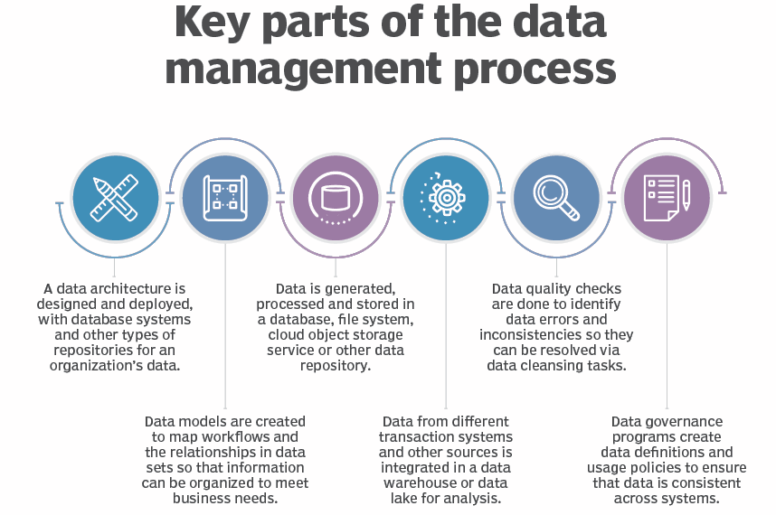
3.2 Database | Data Management
  Figure: Key parts of the data management process
  (Source: https://www.techtarget.com/searchdatamanagement/definition/data-management)

Slide 57
3.2 Database | Data Dissemination | Key Components
Establish
Define
Select
Market
Evaluate
Establish communication message:
  Clearly define the message to be communicated.
  Ensure that the message is concise, accurate, and relevant to the target audience.
  Use clear and straightforward language to convey the information effectively.
Define the audience:
  Identify the target audience for the data dissemination.
  Understand their needs, interests, and level of understanding.
  Tailor the message to suit the specific characteristics of the audience.
Select communication channel:
  Choose the appropriate communication channel to reach the target audience.
  Consider various platforms such as websites, social media, emails, workshops, or public events.
  Ensure that the selected channel aligns with the preferences and accessibility of the audience.
Market the message:
  Promote the data dissemination through various means to increase visibility.
  Use marketing strategies to create awareness and interest in the information being shared.
  Collaborate with relevant stakeholders to amplify the reach of the message.
Evaluate the impact:
  Measure the effectiveness of the data dissemination efforts.
  Assess whether the message reached the intended audience and if it was understood.
  Use feedback and data analytics to improve future data dissemination strategies.

Slide 58
3.2 Database| Sources and Further Reading
Anandhi, A., Srivastava, P., Mohtar, R. H., Lawford, R. G., Sen, S., & Lamba, J. (2023). Methodologies and principles for developing Nexus definitions and conceptualizations: lessons from FEW Nexus studies. Journal of the ASABE, 66(2), 205–230.
Arthur, M., Liu, G., Hao, Y., Zhang, L., Liang, S., Asamoah, E. F., & Lombardi, G. V. (2019). Urban food-energy-water Nexus indicators: A review. Resources, Conservation and Recycling, 151(February), 104481. https://doi.org/10.1016/j.resconrec.2019.104481
Egilmez, G., Oztanriseven, F., & Gedik, R. (2020). The Energy Climate Water Nexus: A Global Sustainability Impact Assessment of U.S. Manufacturing. EMJ - Engineering Management Journal, 32(4), 298–315. https://doi.org/10.1080/10429247.2020.1758539
TechTarget. (2022). What is data management and why is it important? Blog. https://www.techtarget.com/searchdatamanagement/definition/data-management

Slide 59
3.3 Nexus Modeling
Nexus modeling approaches
Nexus modeling tools and techniques
Practical challenges in Nexus modeling

Slide 60
Session Delivery Plan [2 hrs, 45 mins]
Time | Activity | Facilitator
60 minutes | Lecture – Modeling requirements, approaches, and availability of tools | Prof. Vishnu Pd. Pandey
60 minutes | Exercise 3-5: Demonstration of a Nexus Modeling Tool | Prof. Vishnu Pd. Pandey
25 minutes | Exercise 3-6: Open Discussion – Challenges and ways forward for Nexus modeling | Prof. Vishnu Pd. Pandey
15 minutes | Lecture – Practical challenges of Nexus modeling | Prof. Vishnu Pd. Pandey
5 minutes | Summary of session | Prof. Vishnu Pd. Pandey

Slide 61
3.3 Nexus Modeling | Concepts
The main objective of Nexus modeling is to minimize resource consumption and maximize the gains from those depleting resources
  Quantify trade-offs and synergies
    In general, Nexus modeling tools should be able to support (Miralles-Wilhelm, 2016):
  Policy assessments/evaluation (trade-offs and synergies)
  Technology assessment
  Scenario evaluation/assessment
  Information/evidence for decision-making on sustainable resource management
Modeling frameworks should be able to:
  Identify limits of resource consumption along with environmental, technical and social impacts that may arise during operation (Rodríguez-Gutiérrez et al., 2022).

Slide 62
3.3 Nexus Modeling | Approaches
Nexus modeling involves using various approaches, tools, & techniques to analyze trade-offs and synergies between water, energy, food, and ecosystems.
  Approach depends upon scale: system scale, stakeholder scale, etc.
Some considerations required on models/tools selection are (Albrecht et al., 2018):
  Potential for capturing interactions among WEFE resources
  Capability to integrate both quantitative and qualitative approaches
  Capability to calculate quantitative results for both biophysical and socio-economic aspects (i.e., no disciplinary silos)
  Specific and reproducible methods for assessment

Slide 63
3.3 Nexus Modeling | Approaches
Some of the Nexus modeling Approaches (Anandhi et al., 2023):
  Mathematical modeling
  Ontology-based modeling
  Indicator-based approach
  Scenario-based approach
  Footprint analysis, Life Cycle Assessment (LCA), supply chain analysis
  Trade-off analysis
  Integrated modeling approach

Slide 64
3.3 Nexus Modeling | Tools & Techniques
    Optimization models
  Mathematical models that find the best solution within given constraints
  Optimization models to help identify the most efficient allocation of resources
    Considering trade-offs and synergies of different allocation strategies
    System dynamics models
  Capture feedback loops and interactions in complex systems
  Useful for understanding long-term behavior and policy effects
    Agent-based models
  Can model individual entities and their interactions in the system
  Particularly useful for the Institutional Change perspective

Slide 65
3.3 Nexus Modeling | Tools & Techniques
    Integrated assessment models
  Integrate various sectors to analyze synergies and trade-offs
  Provide a comprehensive view of Nexus dynamics
    Scenario analysis
  Explores and evaluates different future scenarios
  Helps assess impacts of resource management strategies
  Decision-makers can analyze various scenarios to make informed choices
    Geospatial analysis
  Uses GIS and other tools to analyze spatial data
  Helps map and visualize interconnections and trade-offs in the WEFE Nexus
  Offers insights at different scales for effective resource management

Slide 66
3.3 Nexus Modeling | Tools & Techniques
    Life Cycle Assessment (LCA)
  Systematic set of procedures for compiling and examining the inputs and outputs of materials and energy and the associated environmental impacts directly attributable to the functioning of a product or service system throughout its life cycle
    Hybrid models
  Integrate high-level models with sub-sectoral level models to better capture interconnections among WEFE sectors and provide useful and practical decisions for stakeholders
    Input-output models
  Describe physical flows of materials within an economy, including material extraction from nature, material processing, waste to nature, and stock changes

Slide 67
3.3 Nexus Modeling | Tools & Techniques
    World Trade Model (WTM)
  Instrumental in developing and analyzing scenarios of global production, trade, consumption, technologies, environmental threats, use and endowment of resources, and constraints
  WTM-based studies have shed light on the economic and environmental implications stemming from challenges of food, energy, and water security
  A useful model, not only to study trade flows, but also to explore population needs and pressures on WEFE under different scenarios, both for the present and the future
Mannschatz et al. (2016) have developed a Nexus tools platform allowing users to:
  search through existing Nexus tools and models
    to determine which tools may be best suited for their problem
    to avoid recreating an existing tool

Slide 68
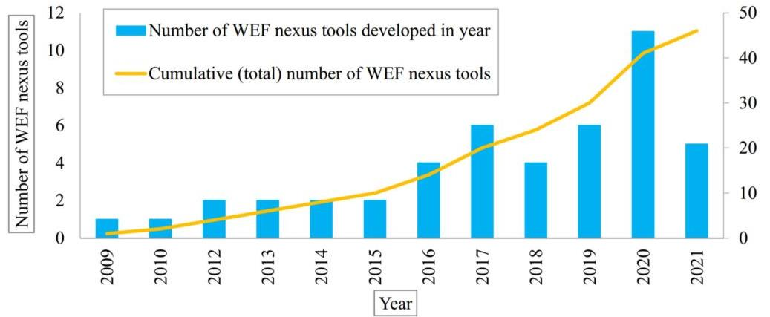
3.3 Nexus Modeling | Tools & Techniques
Modeling tools (Taguta et al., 2022)
  General availability: 39% available to public users while 61% cannot be found on public domain
  Figure 1: Trend in the development of WEF Nexus tools (Source: Taguta et al., 2022)

Slide 69
3.3 Nexus Modeling | Tools & Techniques | Q Nexus Model
Nexus modeling tool: Q-Nexus model (Karnib, 2017)
Capabilities:
  Evaluation of scenarios based on changing demand, technology and resource allocation
Input data requirements (inflows):
  Total water, energy and food use
  Intensities and allocation ratios

Slide 70
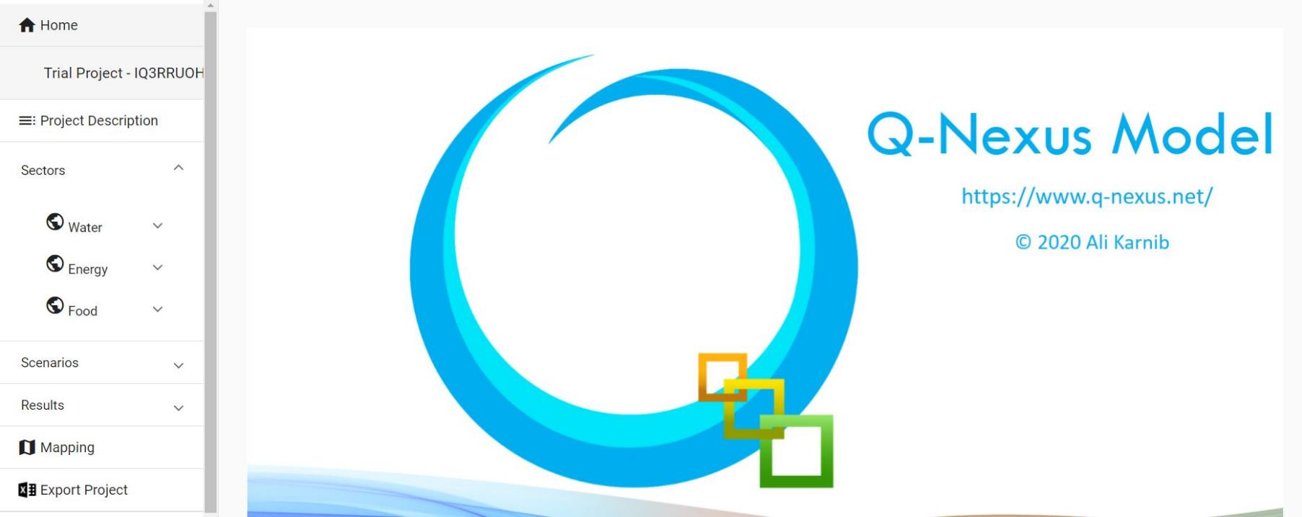
3.3 Nexus Modeling | Tools & Techniques | Q Nexus Model
  Figure: Interface of Q-Nexus Modeling Tool (Source: https://www.q-Nexus.net/)

Slide 71
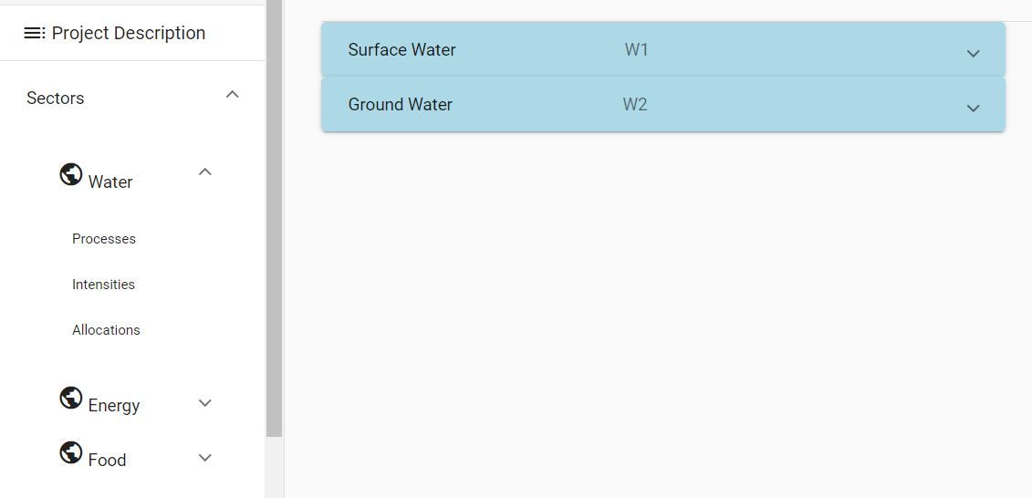
3.3 Nexus Modeling | Tools & Techniques | Q Nexus Model
Notes:
Figure: Interface of Q-Nexus Modeling Tool (Source: https://www.q-Nexus.net/)

Slide 72
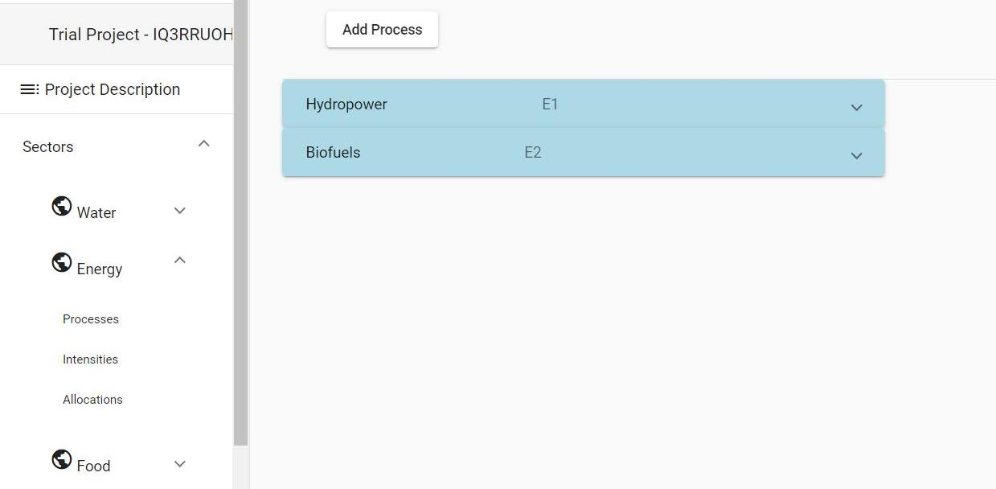
3.3 Nexus Modeling | Tools & Techniques | Q Nexus Model
Notes:
Figure: Interface of Q-Nexus Modeling Tool (Source: https://www.q-Nexus.net/)

Slide 73
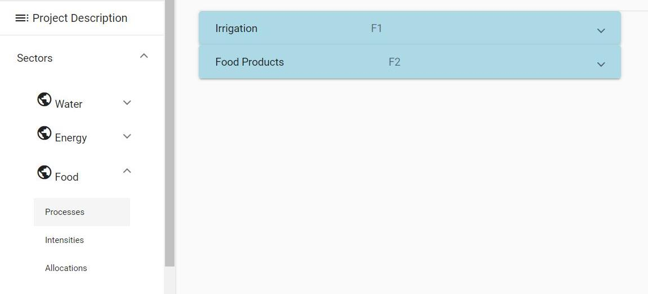
3.3 Nexus Modeling | Tools & Techniques | Q Nexus Model
Notes:
Figure: Interface of Q-Nexus Modeling Tool (Source: https://www.q-Nexus.net/)

Slide 74
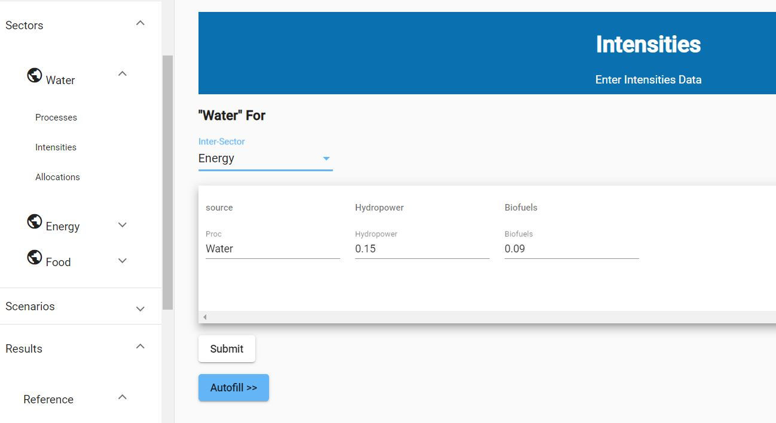
3.3 Nexus Modeling | Tools & Techniques | Q Nexus Model
Notes:
Figure: Interface of Q-Nexus Modeling Tool (Source: https://www.q-Nexus.net/)

Slide 75
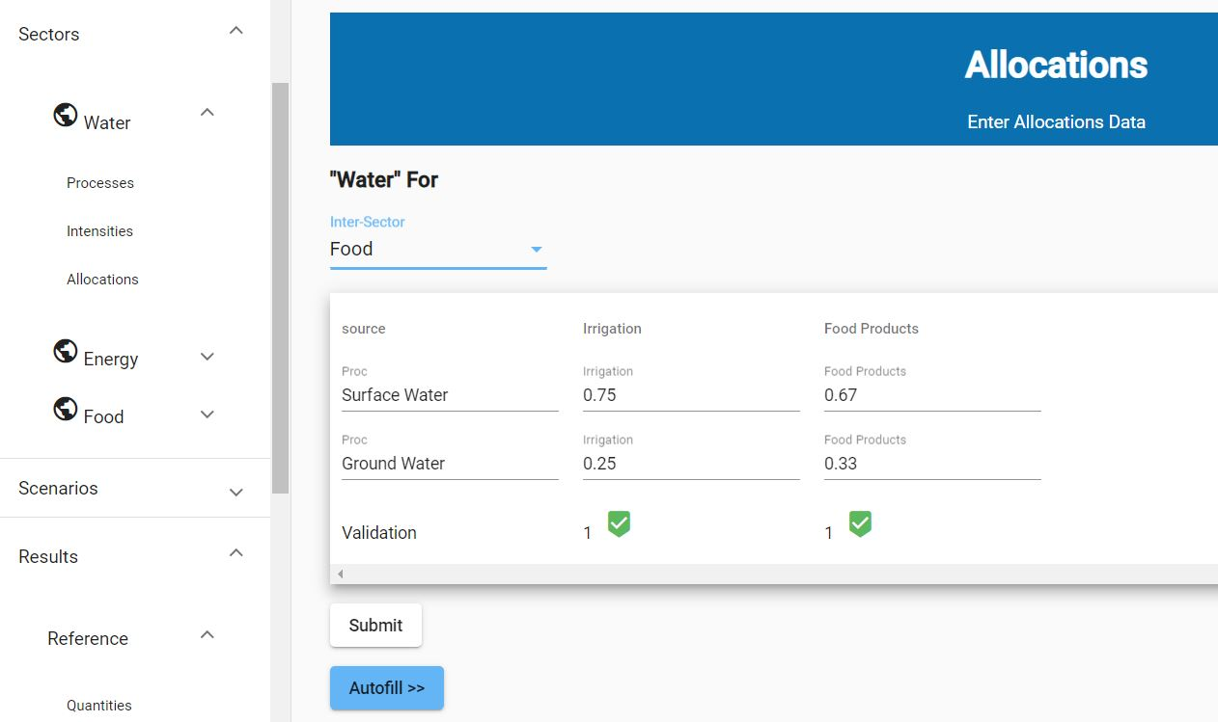
3.3 Nexus Modeling | Tools & Techniques | Q Nexus Model
Notes:
Figure: Interface of Q-Nexus Modeling Tool (Source: https://www.q-Nexus.net/)

Slide 76
3.3 Nexus Modeling | Tools & Techniques | Q Nexus Model
Outputs:
  Inter-sectoral use (W-E, W-F, E-W, E-F, F-E, F-F) and quantities (direct and/or indirect)
  Estimation of deficit in direct/indirect water and energy resources to fulfil new demand requirement
Limitations:
  Only 3-day trial version is available with limited function
  Could be extended towards resource efficacy and analyzing sustainable development policies in more effective way

Slide 77
3.3 Nexus Modeling | Tools & Techniques
Nexus modeling tool: WEF Nexus Tool 2.0 (Daher and Mohtar, 2015)
Capabilities:
  Creation and assessment of different scenarios and consists of inputs that reflect national food, water and energy strategic options of Qatar
  Input data requirements (inflows):
  % of self-sufficiency of food products
  % of food products grown in open agriculture conditions
  % for each of the different water sources for the given scenario
  % of energy sources for the scenario
  % of the imported food products and respective country
Notes:
‘Self-sufficiency’ is used as a representation of the ratio of a specific food product produced locally to the total national consumption of the same food product.

Slide 78
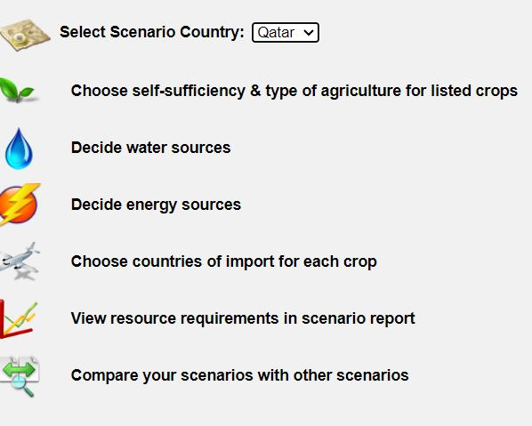
3.3 Nexus Modeling | Tools & Techniques | WEF Nexus Tool 2.0
  Figure: Interface of WEF Nexus Tool 2.0 (Source: http://hf.wefnexustool.org/login.php)
Notes:
Figure: Interface of WEF Nexus Tool 2.0 (Source: http://hf.wefnexustool.org/login.php)

Slide 79
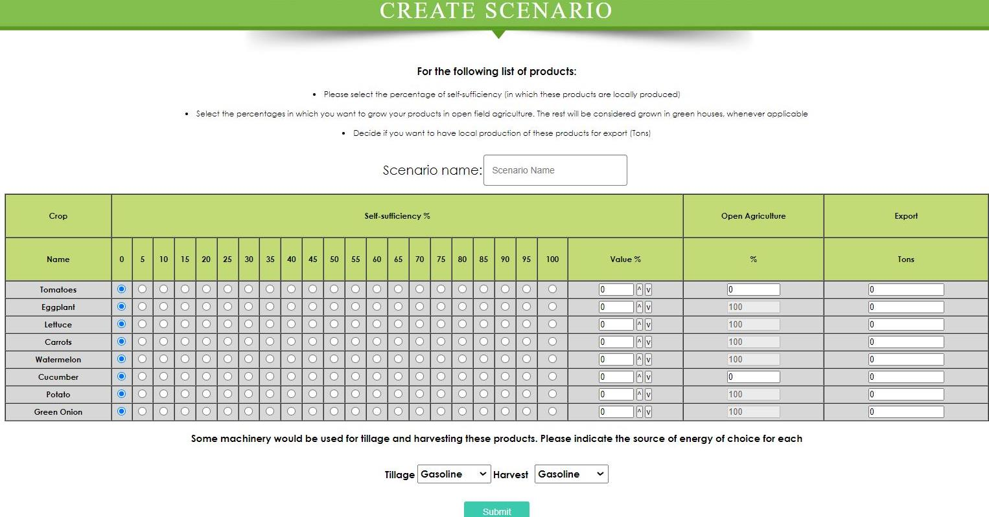
3.3 Nexus Modeling | Tools & Techniques | WEF Nexus Tool 2.0
Notes:
Figure: Interface of WEF Nexus Tool 2.0 (Source: http://www.wefNexustool.org/)

Slide 80
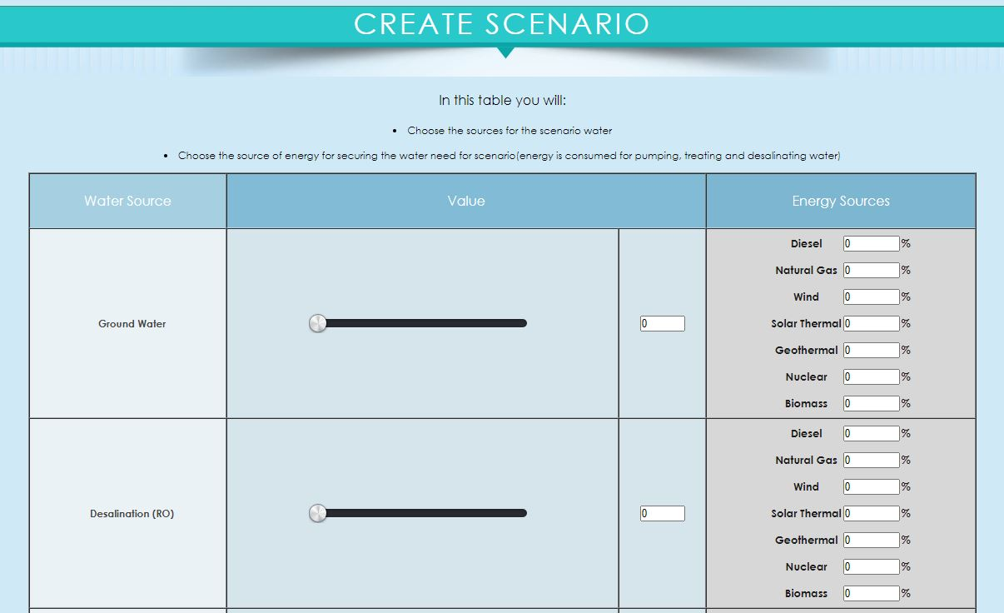
3.3 Nexus Modeling | Tools & Techniques | WEF Nexus Tool 2.0
Notes:
Figure: Interface of WEF Nexus Tool 2.0 (Source: http://www.wefNexustool.org/)

Slide 81
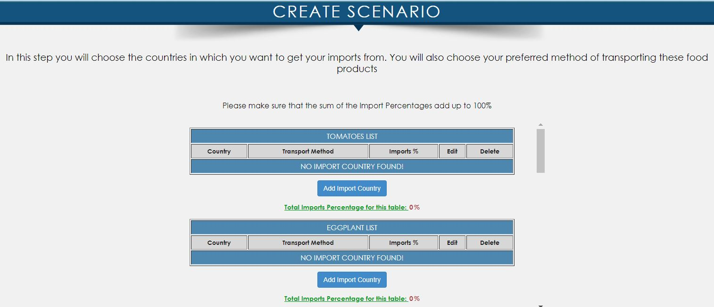
3.3 Nexus Modeling | Tools & Techniques | WEF Nexus Tool 2.0
Notes:
Figure: Interface of WEF Nexus Tool 2.0 (Source: http://www.wefNexustool.org/)

Slide 82
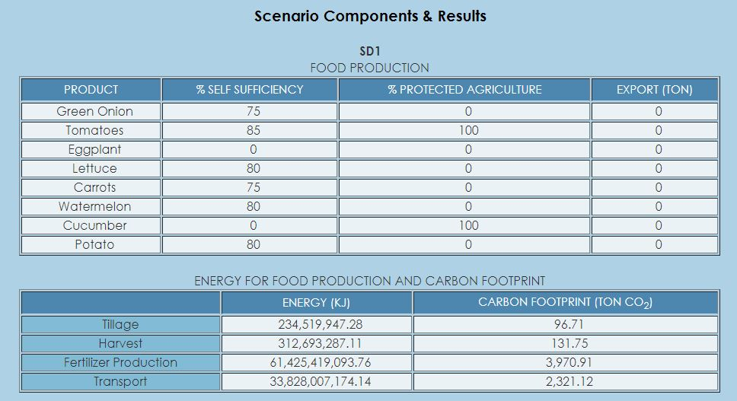
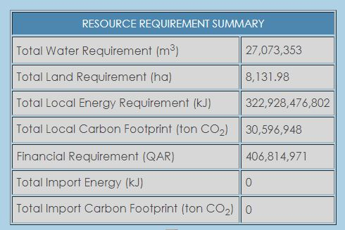
3.3 Nexus Modeling | Tools & Techniques | WEF Nexus Tool 2.0
Notes:
Figure: Interface of WEF Nexus Tool 2.0 (Source: http://www.wefNexustool.org/)

Slide 83
3.3 Nexus Modeling | Tools & Techniques | WEF Nexus Tool 2.0
Outputs:
  Total water requirement W (m3) | Total land requirement L (ha)
  Local energy requirement E (kJ) | Local carbon footprint (ton CO2)
  Financial cost F (US$)
  Energy consumed through import EIMP (kJ) | Carbon emissions through import CIMP (ton CO₂)
  Limitations:
  Limited agricultural crops; does not include meat, dairy products, processed foods, etc.
  Assesses a scenario of carbon emissions only
  Current tool assumes linear relationships between systems, which may not reflect reality
  Current tool does not capture future projections of prices, population increase, demand and resources; simulates a static point in time with defined attributes
  Current framework addresses resources needed for a proposed strategy from a national context only

Slide 84
Exercise 3-5: Demonstration of Nexus Modeling [60 mins]
Identify one of the Nexus modeling tools (e.g., WEF Nexus Tool 2.0)
Demonstrate the tool’s capabilities, limitations, input data requirements, ways of extracting outputs, etc.
Then:
  Show selected results and their interpretation
  Scenario analysis
  Ask participants on which aspects of the Nexus are visualized and which are not?

Slide 85
Exercise 3-6: Open Discussion [25 mins]
Participant reflection – What could be the challenges and ways forward for implementing Nexus modeling?

Slide 86
3.3 Nexus Modeling | Practical Challenges
The WEFE Nexus involves intricate interdependencies and trade-offs
Scale and scope of analysis
Stakeholder engagement
  Representing these complex systems in a model is a challenge, and a degree of simplification is required.
  Understanding interconnections is crucial for effective resource management.
  Nexus modeling can be challenging due to scale and scope variations.
  Analysis can range from local to global levels.
  The scope depends on the research question or policy under consideration.
  Engaging stakeholders is vital for successful Nexus modeling.
  Stakeholders' involvement from problem formulation to analysis is crucial.
  Challenges include reconciling differing perspectives and interests.

Slide 87
3.3 Nexus Modeling | Practical Challenges
Data availability, quality, and access
Model uncertainty
Interdisciplinary collaboration
  Accessing reliable and comprehensive data can be challenging.
  Ensuring data accuracy and compatibility across sectors is essential.
  Data must be shared for sectors to cooperate.
  Models might involve uncertainties due to complex interdependencies.
  Acknowledging and addressing uncertainties is crucial for robust analysis.
  Nexus modeling requires expertise from multiple disciplines.
  Collaborating across sectors can be challenging but vital for holistic insights.

Slide 88
3.3 Nexus Modeling | Practical Challenges
  Some of the challenges and solutions for implementing Nexus systems are (Abdi et al., 2020):
Challenges | Solutions
Lack of integrated policy and legislation for the system | Integrated policy-making, such as integrated pricing in water and energy fields, developing a model of agricultural complex and industry proper allocation
Data uncertainty | Implementing the appropriate uncertainty modeling such as stochastic programming, scenario generation, etc.
Large numbers of data for subsystems | Applying data-mining techniques
System boundary | Accurate detection of cases using precise and rapid identification of subsystems
Lack of sufficient standards and laws | Forming committees comprising sub-discipline specialists to address this gap
Lack of efficient software platforms | Presenting multi-domain software

Slide 89
3.3 Nexus Modeling | Reading Materials
Abdi, H., Shahbazitabar, M., & Mohammadi-Ivatloo, B. (2020). Food, energy and water Nexus: A brief review of definitions, research, and challenges. Inventions, 5(4), 1–14. https://doi.org/10.3390/inventions5040056
Albrecht, T. R., Crootof, A., & Scott, C. A. (2018). The Water-Energy-Food Nexus: A systematic review of methods for Nexus assessment. Environmental Research Letters, 13(4). https://doi.org/10.1088/1748-9326/aaa9c6
Anandhi, A., Srivastava, P., Mohtar, R. H., Lawford, R. G., Sen, S., & Lamba, J. (2023). Methodologies and principles for developing Nexus definitions and conceptualizations: lessons from FEW Nexus studies. Journal of the ASABE, 66(2), 205–230.
Howarth, C., & Monasterolo, I. (2016). Understanding barriers to decision making in the UK energy-food-water Nexus: The added value of interdisciplinary approaches. In Environmental Science and Policy (Vol. 61, pp. 53–60). https://doi.org/10.1016/j.envsci.2016.03.014
Mannschatz, T., Wolf, T., & Hülsmann, S. (2016). Nexus Tools Platform: Web-based comparison of modeling tools for analysis of water-soil-waste Nexus. Environmental modeling and Software, 76, 137–153. https://doi.org/10.1016/j.envsoft.2015.10.031
Miralles-Wilhelm, F. (2016). Development and application of integrative modeling tools in support of food-energy-water Nexus planning—a research agenda. In Journal of Environmental Studies and Sciences (Vol. 6, Issue 1, pp. 3–10). https://doi.org/10.1007/s13412-016-0361-1
Rodríguez-Gutiérrez, J. E., Castillo-Molar, A., & Fuentes-Cortés, L. F. (2022). A multi-objective assessment for the water-energy-food Nexus for rural distributed energy systems. Sustainable Energy Technologies and Assessments, 51(January). https://doi.org/10.1016/j.seta.2022.101956

Slide 90
3.4 Impact Assessment
Impacts of changed context on the Nexus situation
Impacts of Nexus projects and interventions
Results framework for impact assessment

Slide 91
Session Delivery Plan [2 hrs, 30 mins]
Time | Activity | Facilitator
25 minutes | Exercise 3-7: Open discussion – What aspects need to be considered for impact assessment in the WEFE Nexus context? | Prof. Rajesh K. Rai
60 minutes | Lecture – Aspects of an impact assessment | Prof. Rajesh K. Rai
60 minutes | Exercise 3-8: Group Work – Developing a theory of change for an “Inclusive WEFE Nexus Solution” | Prof. Rajesh K. Rai
5 minutes | Summary of session | Prof. Rajesh K. Rai

Slide 92
Exercise 3-7: Open Discussion [25 mins]
Participant reflection – What aspects need to be considered in an impact assessment study? How can those approaches be customized in the context of a Nexus assessment?
  Participants have 5 minutes to reflect and write down their thoughts
  Next, participants may share their ideas

Slide 93
3.4 Impact Assessment | Perspectives
Impact of contextual changes on the current Nexus status
  Changed context: institutional changes, climate/environmental/socio-economic changes, policy changes
  Nexus status: sustainability of resources, their allocation, trade-offs and synergies
Impacts of Nexus approaches/interventions on broader goals
  Economic
    Value of resources (e.g., water, energy, etc.), sustainability of resources
  Environmental
    Ecosystem, externalities, sustainability of resources
  Social
    Access to resources (water, energy, etc.)

Slide 94
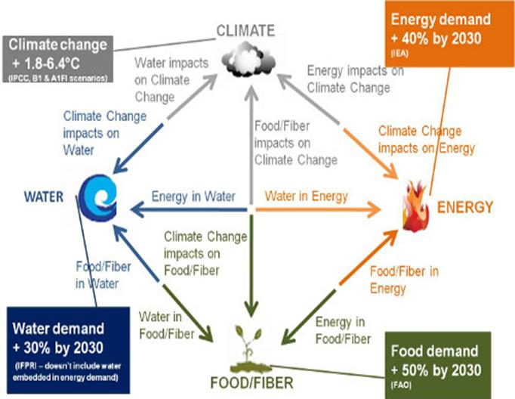
3.4 Impact Assessment | Perspectives | Climate Impact on Nexus
How to assess the impact of climate change on the Nexus
  Look into potential linkage of climate change with changes in resources, as shown in example figure
  Quantify those linkages using appropriate means/approaches
  Evaluate trade-offs and synergies
Figure : The Climate Change, Energy, Water and Food Production Nexus.
(Source: Nwagbara & Smith, 2016)
Notes:
We can apply a climate change perspective, energy perspective, water perspective or food perspective on an impact assessment. The facilitator can think from different angles and present/elaborate the spirit of this diagram with illustrative examples.

Slide 95
3.4 Impact Assessment | Perspectives for Evaluating Impacts
Five perspectives used to view WEFE Nexus (Proctor et al., 2021)
  Ecosystems perspective
    Prioritizes environmental health as a ’primary constraint’ alongside WEFE resource security
    Dictates that if a WEFE action harms the environment above a pre-determined threshold, the action must be withdrawn, even if it increases WEFE resource availability
  Waste management perspective
    Emphasizes the critical role of nutrient recovery and waste elimination on the Nexus
    Focuses on reducing demand and increasing waste recycling instead of aiming to increase the supply of resources
Notes:
Multiple governments have already developed policies to encourage waste management to move towards a “circular economy” like “Circular Economy Promotion Law of the People's Republic of China” and the EU's “Circular Economy Strategy” (Geissdoerfer et al., 2017).

Slide 96
3.4 Impact Assessment | Perspectives for Evaluating Impacts
  3. Institutional change perspective
    Focuses on the inclusive governance and institutional changes, including inclusive actions of institutions
    Studies how policies impact the Nexus historically and currently for planning beneficial future strategies
    Encourages siloed institutions to create new bridges between WEFE sectors and to develop new methods for collaboration
  The stakeholder trust perspective
    Explores public opinions of the Nexus via stakeholder engagement
    Attempts to predict how opinions may shift in the future
  The learning process perspective
    Seeks to understand how public opinions towards the WEFE Nexus develop over time and how this understanding is shaped by outside forces.
    Important for ensuring the ground implementation of WEFE Nexus policies.
Notes:
Organizations like the US National Science Foundation (NSF), China NSF, EU's Common Agricultural Policy (CAP) and Energy Strategy, and Water Framework Directive (WFD) has started WEF initiatives to accelerate research in the WEF sectors in combination with a circular economy strategy.
Understanding the Nexus has also been highlighted as critical for achieving the United Nations' Sustainable development goals (SDG) in particular goals 2, 6, and 7, which focus on food, water, and energy respectively (UN General Assembly, 2015).

Slide 97
3.4 Impacts Assessment | Perspectives for Evaluating Impacts
The scope/scale of an impact assessment encompasses (Egilmez et al., 2020):
  Domestic-onsite impacts
    Occur to people in a sector as a result of economic activities within that sector
    Analysis of differentiated impacts across different gender, types of households (with an intersectionality approach), etc. should be considered
  Domestic-supply chain impacts
    Occur as a result of industrial activities in upstream supply chains
  Global supply chain impacts
    Occur as a result of industrial activities in upstream supply chains in other countries where the product is manufactured

Slide 98
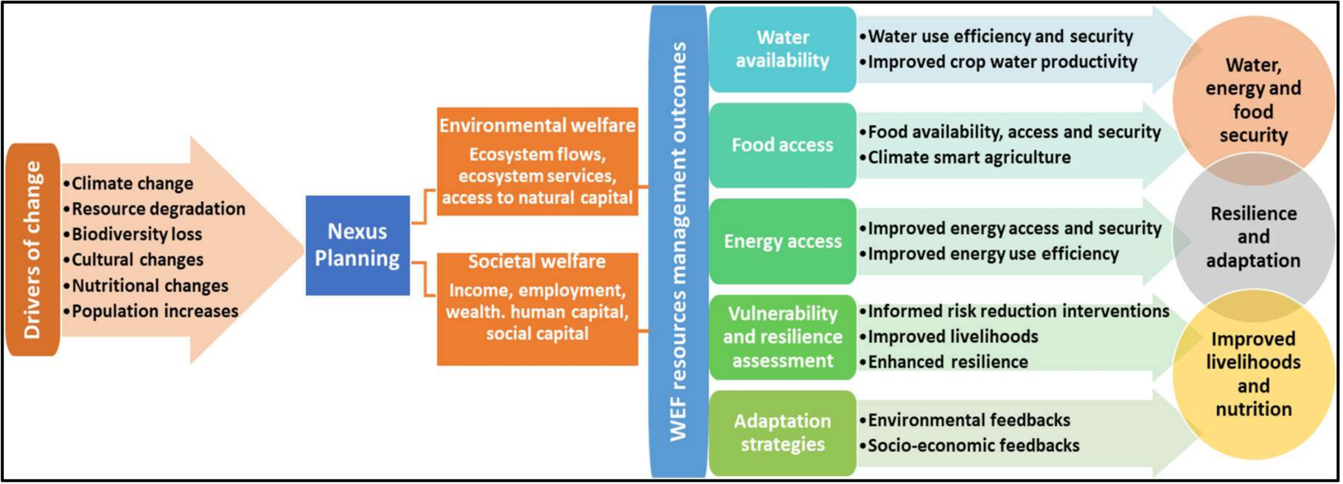
3.4 Impacts Assessment | Results Framework
Figure: A water-energy-food (WEF) Nexus methodological framework illustrating the processes and interactions involved in achieving sustainability and resource security at local/community level. (Source: Nhamo et al., 2020)

Slide 99
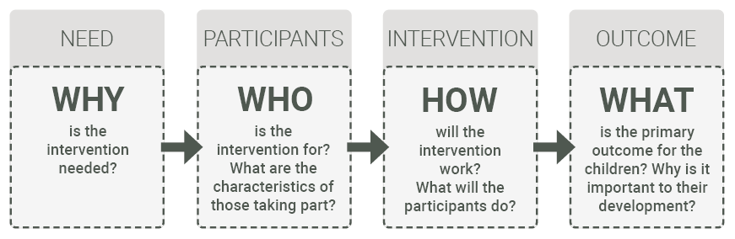
3.4 Impacts Assessment | Results Framework | Theory of Change
A theory of change captures crucial details about why an intervention (program) or service is necessary, and what it aims to achieve.
Figure: The core elements of a theory of change: why, who, how and what
(Source: https://evaluationhub.eif.org.uk/theory-of-change/)

Slide 100
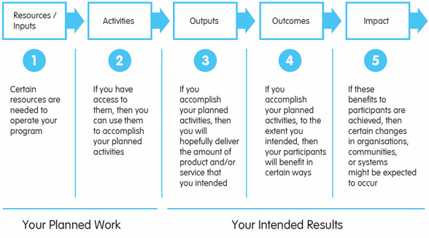
3.4 Impacts Assessment | Results Framework | Theory of Change
Figure: A tool to develop your Theory of Change
(Source: https://innovationforsocialchange.org/en/a-tool-to-develop-your-theory-of-change/)

Slide 101
Exercise 3-8: Group Work [60 mins]
Preparing a result framework or theory of change related to a selected inclusive WEFE Nexus solution
  Assume a hypothetical case. Identify any type of “inclusive Nexus intervention” and develop a theory of change for that intervention
    Alternatively, facilitator can give 3 different types of inclusive WEFE Nexus solutions
  Develop your theory of change
Guidance Notes
  Form 3 groups
  Discuss and develop a theory of change [30 minutes]
  Present it [5 minutes/group]
  Discussion and conclusion of session by facilitator

Slide 102
3.3 Impacts Assessment | Sources and Further Reading
Early Intervention Foundation. (n.d.) Step 1: Creating a theory of change. https://evaluationhub.eif.org.uk/theory-of-change/
Egilmez, G., Oztanriseven, F., & Gedik, R. (2020). The Energy Climate Water Nexus: A Global Sustainability Impact Assessment of U.S. Manufacturing. EMJ - Engineering Management Journal, 32(4), 298–315. https://doi.org/10.1080/10429247.2020.1758539
Geissdoerfer, M., Savaget, P., Bocken, N.M.P., Hultink, E.J., 2017. The circular economy – a new sustainability paradigm? J. Clean. Prod. 143, 757–768.
Innovation for Social Change. (2018). A tool to develop your Theory of Change. https://innovationforsocialchange.org/en/a-tool-to-develop-your-theory-of-change/
Nhamo, L., Ndlela, B., Mpandeli, S., & Mabhaudhi, T. (2020). The water-energy-food Nexus as an adaptation strategy for achieving sustainable livelihoods at a local level. Sustainability (Switzerland), 12(20), 1–16. https://doi.org/10.3390/su12208582
Nwagbara, G., & Smith, M. H. (2016). DEVELOPING COUNTRIES – CLIMATE RESILIENT PATHWAYS. November 2014. https://doi.org/10.13140/RG.2.1.3240.8569
Proctor, K., Tabatabaie, S. M. H., & Murthy, G. S. (2021). Gateway to the perspectives of the Food-Energy-Water Nexus. Science of the Total Environment, 764, 142852. https://doi.org/10.1016/j.scitotenv.2020.142852

