Slide 1
COVID-19 mitigation and effects on food safety
Florence Mutua¹, Erastus Kang’ethe¹ and Delia Grace^{1,2}
¹International Livestock Research Institute
²Natural Resources Institute, University of Greenwich
Food Safety Conference for Africa
10 November 2021

Slide 2
Introduction
Currently no evidence that COVID-19 can be transmitted through food
The measures put in place to contain the disease have affected several aspects of the food value chain
We designed a study to understand how these affected food safety in East Africa

Slide 3
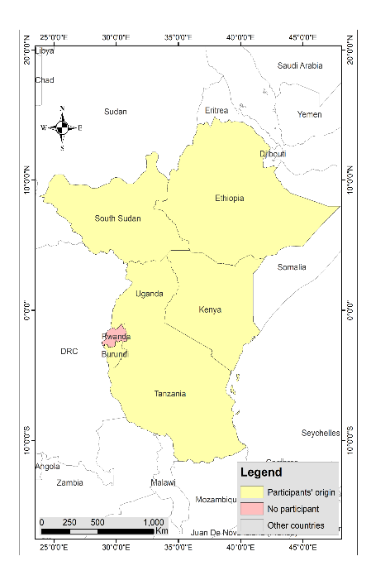
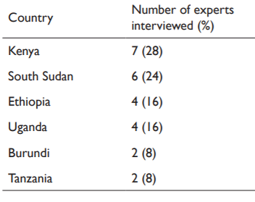
Data collection [1]
Added activity under an ongoing food safety project https://cgspace.cgiar.org/handle/10568/108287
Interviewed food safety experts (n = 25) engaged in the project

Slide 4
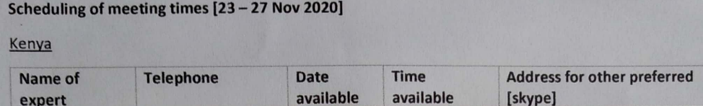
Data collection [2]
Checklist developed for the interviews
Prior appointments: 30–60-minute interview sessions
Consent obtained prior to the discussion [telephone and online meetings]

Slide 5
Observations [1]
Food markets continued to operate and expected to comply with COVID-19 mitigation measures.
Enforcement a problem in informal markets: congestion, irregular water supplies, no detergents == infrequent hand washing
Hygiene is critical in reducing the spread of pathogens of public health importance

Slide 6
Observations [2]
Fear of stricter control measures [lock down] led to panic and bulk purchasing of food
Space/storage concerns: absence of refrigeration especially a concern for fresh products [vegetables, animal-source foods]
Cereals can last long and were preferred but contamination with mycotoxins is a problem

Slide 7
Observations [4]
Increased demand for food: everyone was at home, increased budget allocation to food.
Exploitation by untrustworthy suppliers: sale of products nearing or past the expiry date
A concern in settings where traceability and recall systems are limited

Slide 8
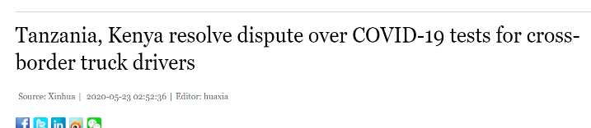
Observations [5]
Stricter controls applied at the border points [COVID-19 testing and validation]
Delay of food and feed trucks and increased risks of spoilage [e.g. aflatoxins]
Avoidance of inspection and opened room for illegal movement of food products

Slide 9
Observations [6]
Concerns over disposal of spoilt products: farms, homes, border points, contamination of the environment, and possible entry back to the food chain
Because of working from home and in shifts, routine monitoring and inspection capabilities, privately and at the regulator level, was affected.
Food testing for compliance and supply of reagents for this were also affected

Slide 10
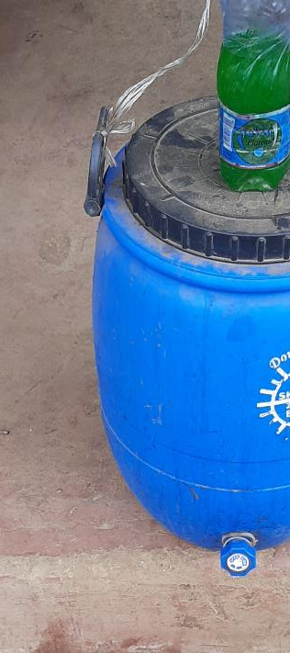
Conclusion
COVID-19 mitigation disrupted food systems in multiple ways.
A One Health approach can help reduce future impacts.
Hand hygiene is key in food safety and should be continued even after COVID-19.

Slide 11
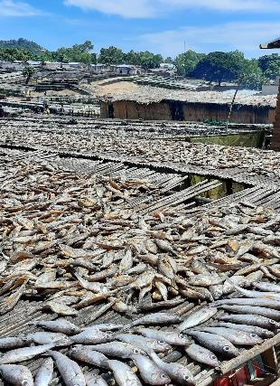
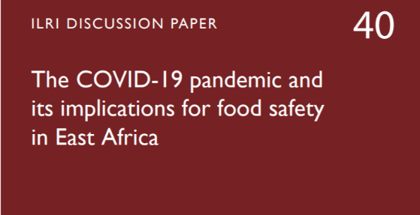
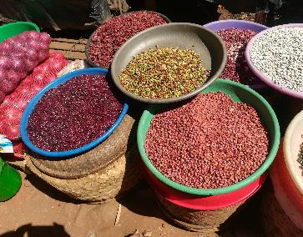
The food value chain was affected in several other ways
https://hdl.handle.net/10568/113789

Slide 12

THANK YOU

