Slide 1


TOWARD UNIFIED RESEARCH ANALYTICS FOR AGRIFOOD INITIATIVES
Task Team on Transitional Digital Capabilities for Research

Slide 2


“CGIAR will make the digital revolution central to its way of working.”
Data and digital technologies are enablers of rapid research innovation and an important part of building new pathways for research delivery and impact amid rapidly digitizing societies and economies.
-- 2030 Research and Innovation Strategy

Slide 3
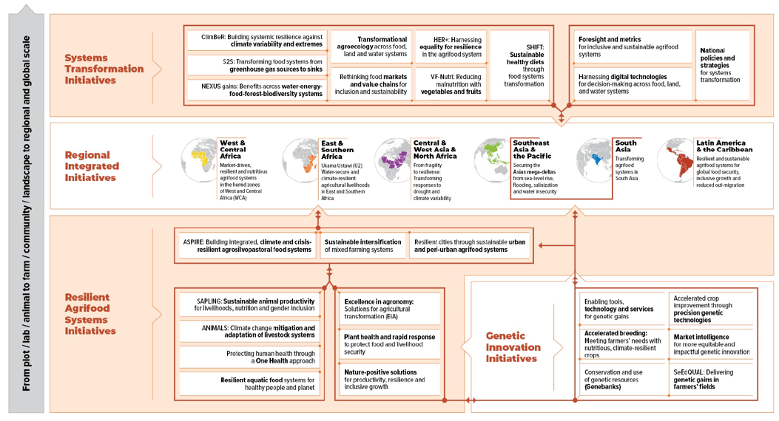
The One CGIAR portfolio encompasses 33 research initiatives leveraging CGIAR global footprint and deep domain expertise; this may give rise to new investments in information systems and services.

Slide 4
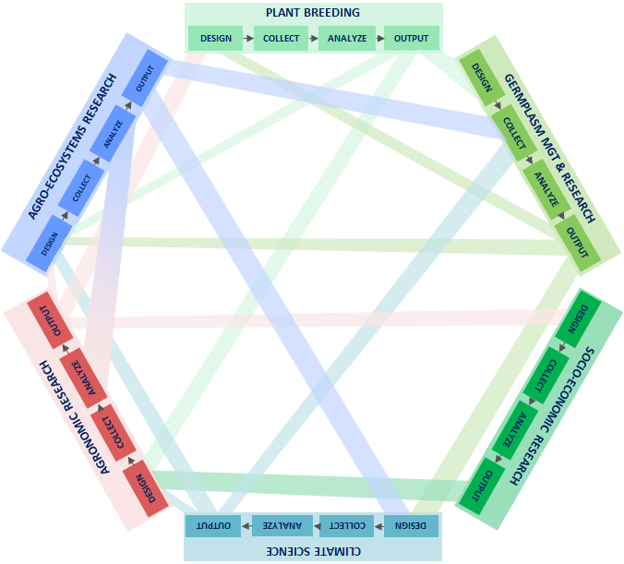

Delivering the multidisciplinary research in the 2030 Research and Innovation Strategy will require linking data and analytic capabilities across research domains

Slide 5
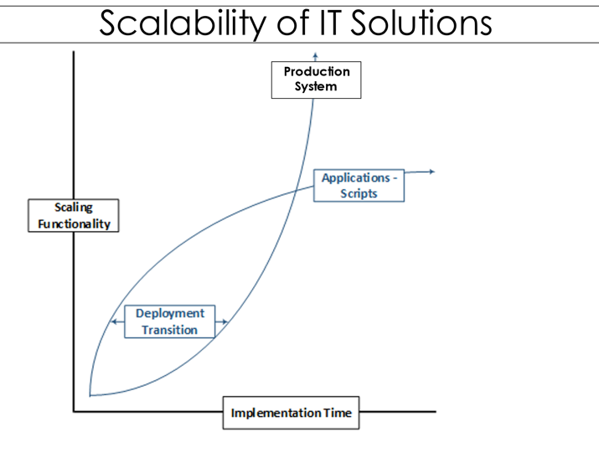

Development funding has driven a proliferation of siloed information systems for research.
Coordinating these investments across the new portfolio will support implementing systems at scale.
Notes:
Disparate investments can make sense in terms of discovery, research, and development. Continued disparate investment however, can hinder progress towards implementing information systems at meaningful scale

Slide 6
Building a unified view of analytics spanning stages of the research cycle will help CGIAR to better align investments and progress towards more scalable systems.
STAGE | SOURCE DATA | INGEST/ TRANSFORM DATA | ORGANIZE/ INTEGRATE DATA | DATA PREPARATION | ANALYSIS | DIGITALLY-ENABLED RESEARCH DELIVERY
DATA CAPABILITIES | Source High frequency Data (e.g. satellite, IoT, streaming data, images) Source Operational systems data Source internal data Source external data Leverage 3rd Party Data Services Data collection (surveys, trials) | Staging Ingestion Transformation | Annotation Aggregation Integration | Pre-processing Training & testing | Discovery Modeling Simulation Prediction Planning Reporting | Data delivery Visualization Embedded Analytics Dashboards Reporting
ENABLING CAPABILITIES | Data Governance
ENABLING CAPABILITIES | Storage & Archiving
 |  | Transfer of large datasets
 | Consent & permission management |  |  |  | Consent & permission management
 |  |  |  | Compute Services
 | Security
 | Scalability

Slide 7
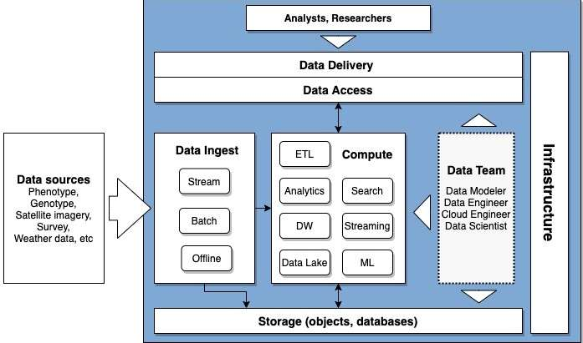
​
A unified view of analytics will inform a common blueprint for CGIAR analytics infrastructure.
This will guide how we best leverage the offerings of global IT firms for intensive, scalable research computing and delivery while averting vendor lock-in.
Research Data and Analytics Architecture: Build a Common CGIAR Blueprint
There are multiple offerings from “Big IT” for building scalable infrastructure for analytics; CGIAR must define the guiding blueprint that is right for it to be able to make the most of these offerings while averting “vendor lock-in.”

Slide 8
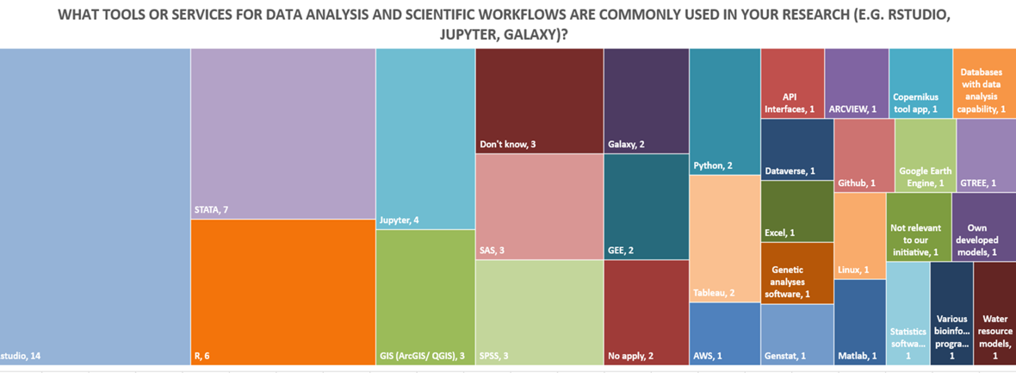
A survey of Initiative Design Teams identified most commonly used digital tools and services at stages of the research cycle (n=70)

Slide 9
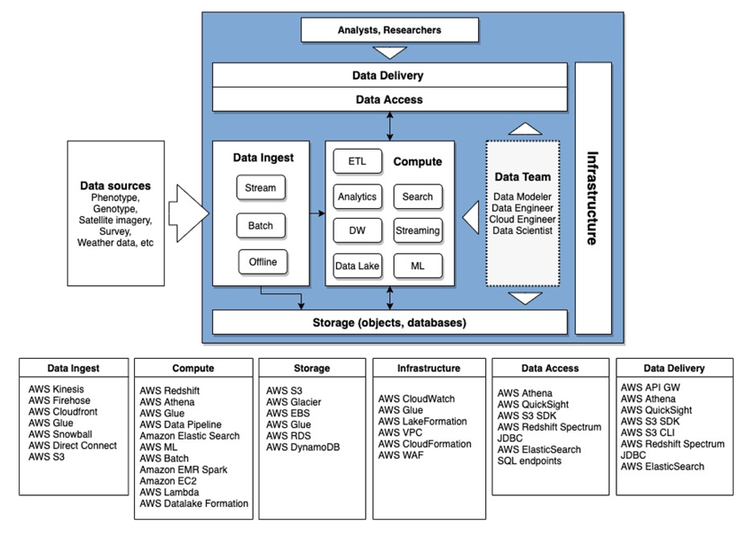
Recommendation: Develop one (multi)instance implementing the architecture in AWS, mapping AWS services to desired services.

Slide 10
Recommendation: The service should be able to support capabilities across the cycle from sourcing data all the way through to analysis and visualization, and accommodate projects that need all or part of these capabilities.
 |  |  |  | High Level Architecture
 |  | System Capabilities
Workflow |  | 1 | 2 | 3 | 4 | 5
 |  | Implementation Priority
Implementation Phases |  |  | 3 | 2 | 1 | 4
Project | Several Project Scenarios | Operational Logic | Data Management Logic | Compute Logic | Compute Engine Logic | Representation Logic
1 | A | yes | yes | yes | yes | yes
2 | B | yes | no | no | no | no
3 | C | yes | yes | no | no | no
4 | D | yes | no | yes | no | yes
5 | E | yes | no | yes | yes | yes
6 | F | yes | yes | no | no | yes

Slide 11
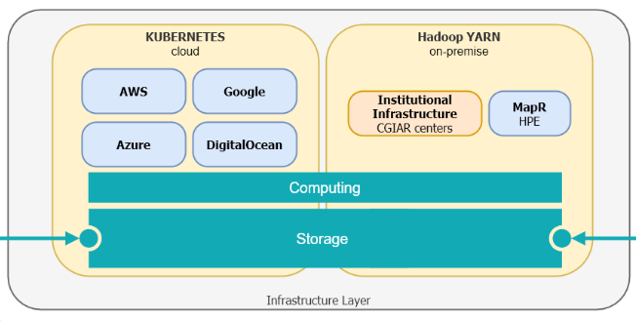
Recommendation: Build more unified execution for analyses leveraging existing information systems
Compute Execution
Per System Data
Genebank Operational
EBS
Production Analytics
CGLabs Exploratory Analytics
Breeding Operational
Research
Other Tools
Agronomy Operational
Shared Data
Other Operational
Semantic
HTP
RS
Image
Genotype
Soil
Satellite
Analyses
GARDIAN

Slide 12
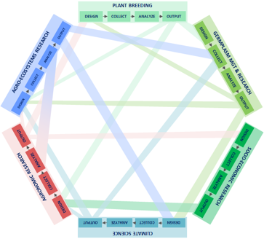
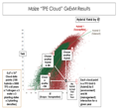
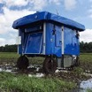
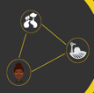

UNIFIED ANALYTICS FOR MULTIDISCIPLINARY RESEARCH
Data from breeding trials leveraged in on-farm research and for target environment analysis
Common analytic pipelines leveraged to predict shifts and help target interventions.
How will cowpea suitability zones and demand shift, and how should we target breeding products and information services to help stakeholders manage this shift?
Farm, landscape, and socioeconomic data leveraged for understanding shifts in suitability and demand.
Data sharing and consent management localizes analysis and enables new digital services.
Sources – Center: CGIAR cross-platform workshops on enterprise architecture. Top left: X-Mineral.
Bottom left: CGIAR Platform for Big Data, Bottom right: Digital Green. Top right: Excellence in Breeding.

Slide 13
INTEGRATION ACROSS AGRIFOOD INITIATIVES
Building a unified view of analytics and developing a common blueprint for information infrastructure will help CGIAR leverage data and pipelines for analysis that bridge the Genetic Innovation, Resilient AgriFood Systems, and Systems Transformation Action Areas.
This approach can also help foster greater integration and scalability across CGIAR partner investments in information systems(e.g.):
Excellence in Agronomy​
Excellence in Breeding
Enabling Crop Analytics at Scale​​
FarmStack​
1,000 Farms​
…

