Slide 1
ICT for One Health
Hung Nguyen-Viet, Elizabeth Cook, Bernard Bett, Florence Mutua, Thang Nguyen, Hu Suk Lee, Nam Luong, Sinh Dang and ICT4HEALTH team

Slide 2
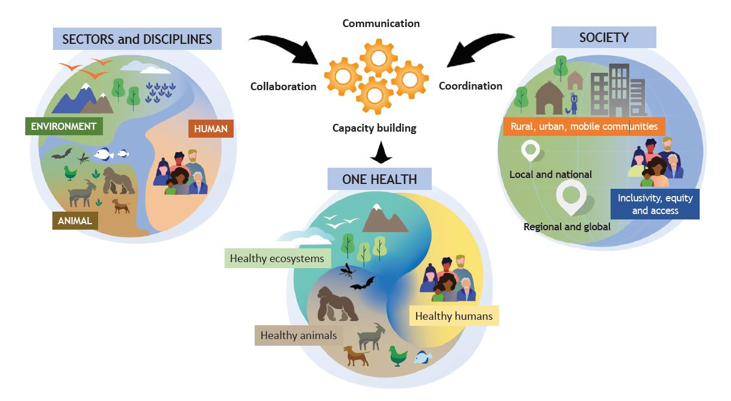
One Health concept
OHHLEP, 2021
Notes:
ILRI One Health strategy to position our works on the global OH landscape

Slide 3
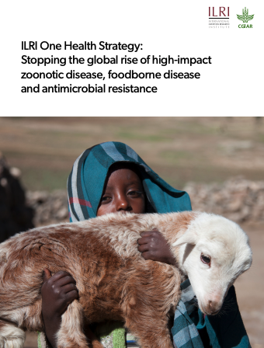
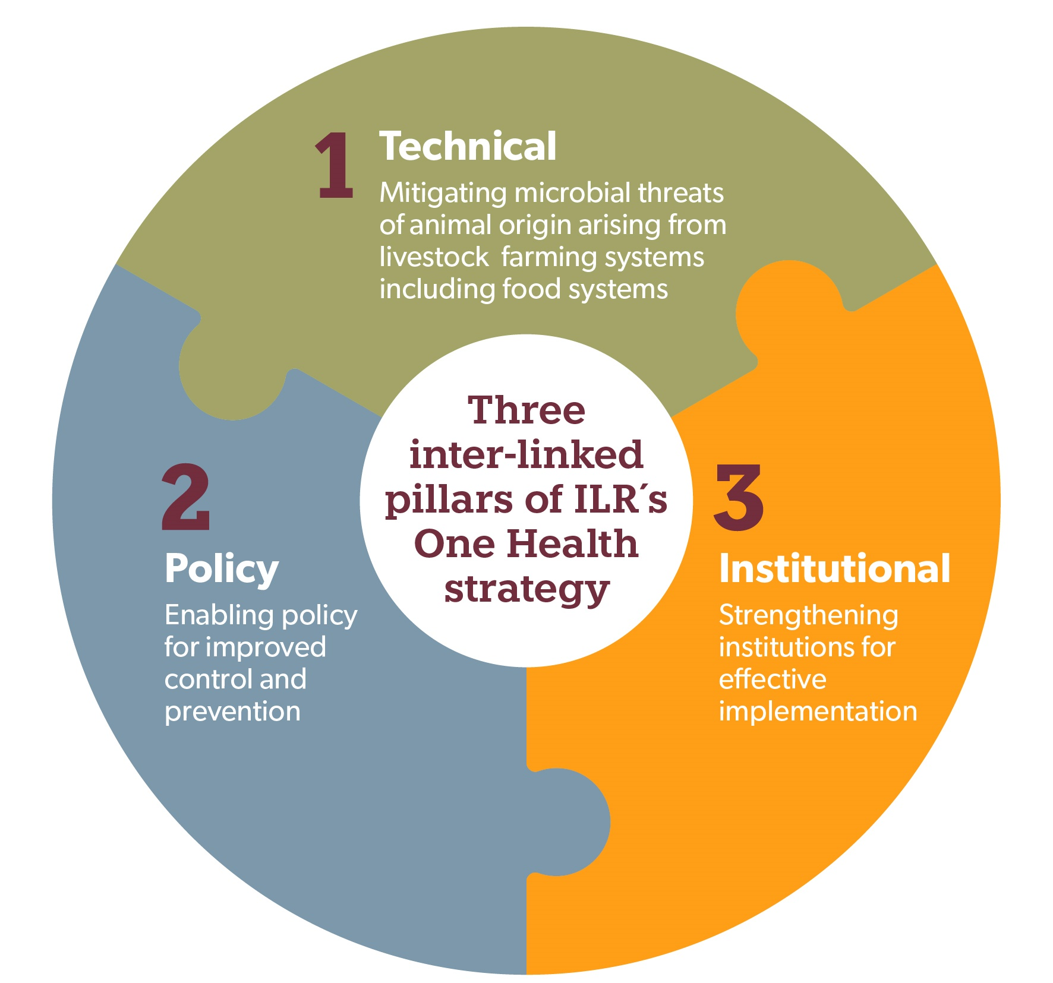
ILRI One Health strategy
A holistic approach to preventing pandemics/epidemics and other microbial threats from animals/environment
Vision
  To improve the lives, livelihoods and well-being of people in the global south by building healthy, sustainable and resilient systems at the intersection of humans, animals and the environment.
Key thematic areas
  Epidemics and pandemics & endemic zoonoses
  Food-borne diseases
  Antimicrobial resistance
wildlife
More on One Health @ILRI: ilri.org/one-health
Notes:
ILRI One Health strategy to position our works on the global OH landscape

Slide 4



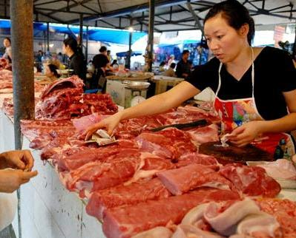

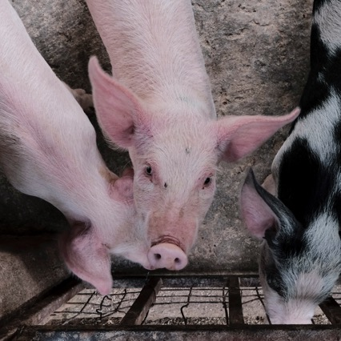
Key achievements of One Health work at CGIAR
One Health research to strengthen country capacities to control neglected and emerging zoonotic diseases in several countries in the LMICs including COVID 19
A decade of One Health incentive-based & behavior change interventions in traditional markets & meat/ fish processing sectors
cultivating an environment of improved food safety & reduced foodborne diseases benefiting million consumers.
Interventions to reduce antimicrobial use (AMU) and resistance (AMR)
including behavioural nudges for semi-intensive poultry farmers and good animal husbandry practices and vaccination
Notes:
Here are some highlight of One Health work achievement at CGIAR:
1) We have used outputs and technical knowledge on One Health research to strengthen countries capacities to control neglected and emerging zoonotic diseases in several countries in the LMICs. We have been more successful on these efforts in Kenya and Vietnam, given the large portfolio of research work being implemented in these countries, demonstrated by the development of a strategy for brucellosis control, supporting the refinement of the Rift Valley fever contingency plan and providing support in outbreak investigations, including repurposing our labs for COVID-19 screening among others.
2) A decade of One Health incentive-based & behavior change interventions in traditional markets & meat/ fish processing sectors in Vietnam, Cambodia, Kenya, & Uganda is cultivating an environment of improved food safety & reduced foodborne diseases.
3)Reducing antimicrobial use (AMU) in agri-food systems is essential for curbing antimicrobial resistance and sustaining agricultural production. Technological interventions such as vaccines and diagnostics are helpful in reducing the use of antimicrobials, however, the adoption and adaptation requires a change in human behaviour amongst prescribers and users. We developed 14 behavioural nudges for semi-intensive poultry farmers to reduce AMU and are focused on good animal husbandry practices and vaccination.

Slide 5

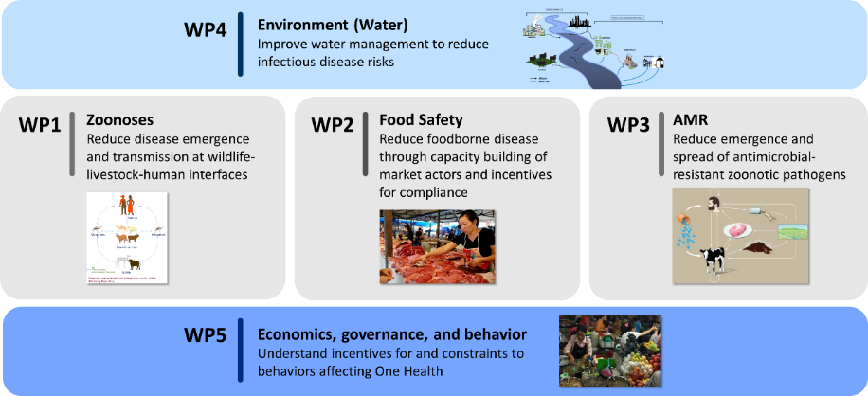



One Health science, capacity building and operationalization
More on One Health @ILRI: ilri.org/one-health

Slide 6






Farmvetcare mobile application
Improving human health through sustainable value chains in human-animal-environmental interactions using ICT in Vietnam (ICT4Health)
Thang Nguyen, Hu Suk Lee, Hung Nguyen-Viet and ICT4HEALTH team
ILRI Vietnam & CNU, Korea

Slide 7







Objective and Components
To improve human health through strengthen the capacity of the government and community to prevent, control or eliminates risks of TAEZDs under a One Health approach and using ICT
Component 1:
To conduct gap analysis on TAEZDs
Component 2:
To establish surveillance working groups
Component 3:
To conduct a pilot study for e- surveillance & training
Component 4:
To develop method tools for improving health along the VC
Component 5:
To implement community-based interventions
- TAEZDs prioritization through participatory approach
- Communication and information sharing
- Institutional capacity
- Integrated surveillance and diagnosis along the VC
- Assessment of cost-effective control & prevention strategies
- Developing mobile application and systems
- Training workshops for e- surveillance system
- Developing risk map and transmission models
- Risk assessment and preparedness tools
- Cost-effective strategies
- Low-cost interventions (e.g., livestock management and biosecurity)
- Capacity building (e.g., outbreak investigation, vaccines and drug use)
Cross cutting aspects: ICT, E-training, Gender & equity, Climate change, and Animal welfare
Link to the SDGs:
TAEZDs: Transboundary Animal and Emerging Zoonotic Diseases

Slide 8

Mobile application developed by AIDKOREA
Vet /
Animal Health Workers
Sub – DAH /
Local authority
Users
01
Farm owner
02
03
03
Ask a vet & Call
Call each other
Answer & Call
Flow
&
Main
Features
The farm owner
(Farmhouse)
Vet/AHWs
Sub-DAH
Local authority
Ask a Vet (describe symptoms and share images)
Call to Vet/sub-DAH (only after receiving the answer)
Manage all inquires from dedicated farmers
Provide Q&A answers
Call farmers only after registering their inquiries
Call sub-DAH (default)
View all inquiries from dedicated vets
Provide Q&A answers (support vet)
Call to farmers (only after registering the inquiry
Call to vets (default)

Slide 9
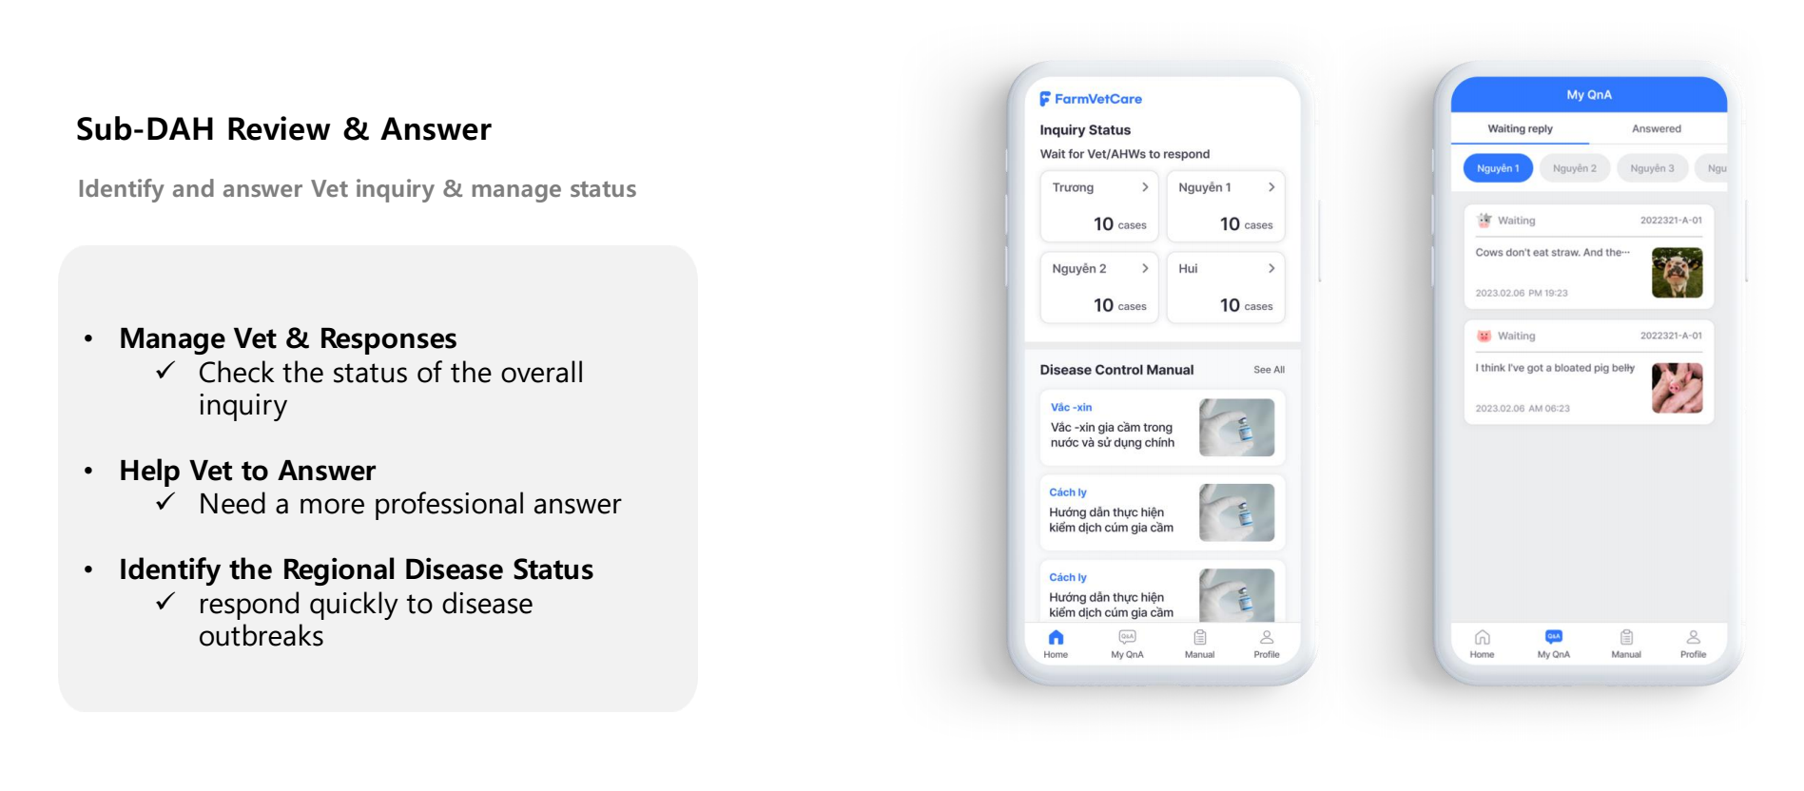
Mobile application developed by AIDKOREA

Slide 10
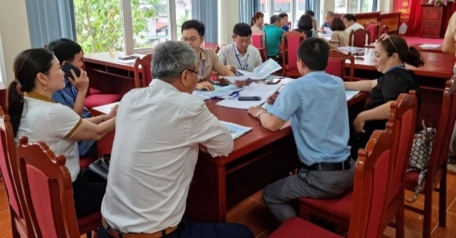
Prioritization of diseases
Identified TAEZDs prioritization
(I) Develop ranking criteria
(III) Scoring individual disease
(IV) Aggregating scores
(II) Assigning weights
(V) Disscussion and actions
Diseases | Animals | NIVR | Prioritization |  |  | Project
 |  |  | FGD | KII | Case
AI | Chicken Duck | X | X | X | X | X
ASF | Pig | X | X | X | X | X
FMD | Cattle Buffalo Pig | - | X | X | X | X
LSD | Cattle | X | X | Vet Farmer | X | X
S. suis | Pig | X | X | X | X | X
Leptospirosis | Pig | X | LC | Vet | - | X
Bovine virus | Cattle | X | - | - | - | X
PRRS | Pig | - | - | Vet HB | - | -
Anthrax | Cattle | - | - | LC vet | - | -
Trichinella | Pig | - | - | HB vet | - | -
Malaria | Vector | - | - | HB cdc | - | -
Prioritized diseases
1st:
2nd:
3rd:
4th:
…
Severity of disease transmitted between animals and humans (0.4), Epidemiological profile (incidence and exposure rate) (0.22), Transmissibility (potential pandemic) (0.17), Ability to intervene (0.13), Economic-social- Environmental impact (0.08)

Slide 11
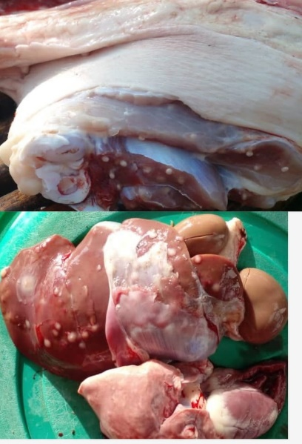
Using mobile syndromic surveillance at slaughter to understand the incidence and distribution of important animal and zoonotic diseases in Kenya and Uganda Elizabeth Cook, Denis Mugizi, Innocent Obilil, Kristina Roesel, Bernard Bett
BACKGROUND
Abattoirs are key sources of data on livestock diseases
      Diseases of public health importance (tuberculosis)
      Diseases of economic importance (FMD)
      Compliance with legislation on drug residues
      Animal welfare
Accuracy and timeliness of recorded data is key
Paper based surveillance systems are common in East Africa
      Bulky, slow, and poor retrieval of data
AIM
Pilot an electronic mobile syndromic surveillance system as an alternative model of collection, storage and retrieval of data on livestock diseases at abattoirs

Slide 12
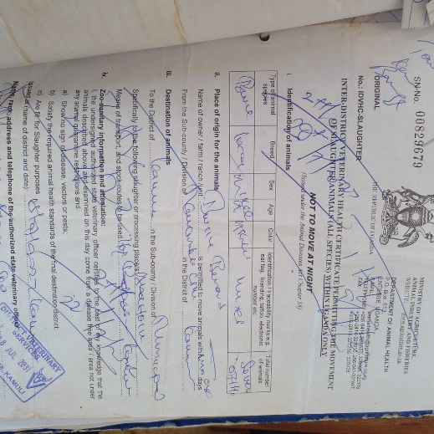

Using mobile syndromic surveillance at slaughter to understand the incidence and distribution of important animal and zoonotic diseases in Kenya and Uganda
METHODS
Mobile app developed using current paper-based tools
Mobile phones provided to meat inspectors
Meat inspectors attended 1 week in person training
      Meat hygiene and food safety
      Digital syndromic surveillance
FINDINGS
Identified diseases of public health importance – tuberculosis, cysticercosis
Geographical distribution of diseases with hot spots identified
CHALLENGES
Variable reporting by meat inspectors
      Need a better understanding of the motivations for reporting
      Plan to embed the system in national reporting mechanisms
Inconclusive diagnosis - further diagnostics required for confirmation

Slide 13
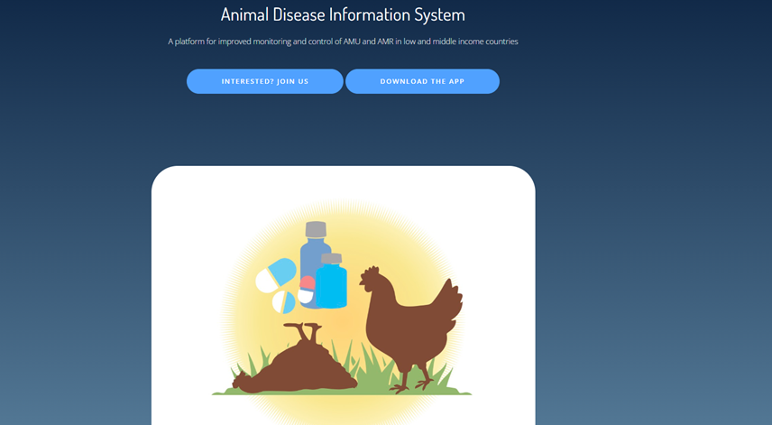
Develop and pilot an ICT framework to monitor AMU and support delivery of animal health services
Florence Mutua, Joshua Onono, Sofia Boqvist, Lawrence Mugisha
Susanna Sternberg Lewerin
Characterize veterinary drug use in selected urban / peri-urban poultry systems
Develop and pilot an ICT framework to monitor AMU and support delivery of animal health services
Analyse the short-term impact of improved monitoring of AMU and animal health support

Slide 14
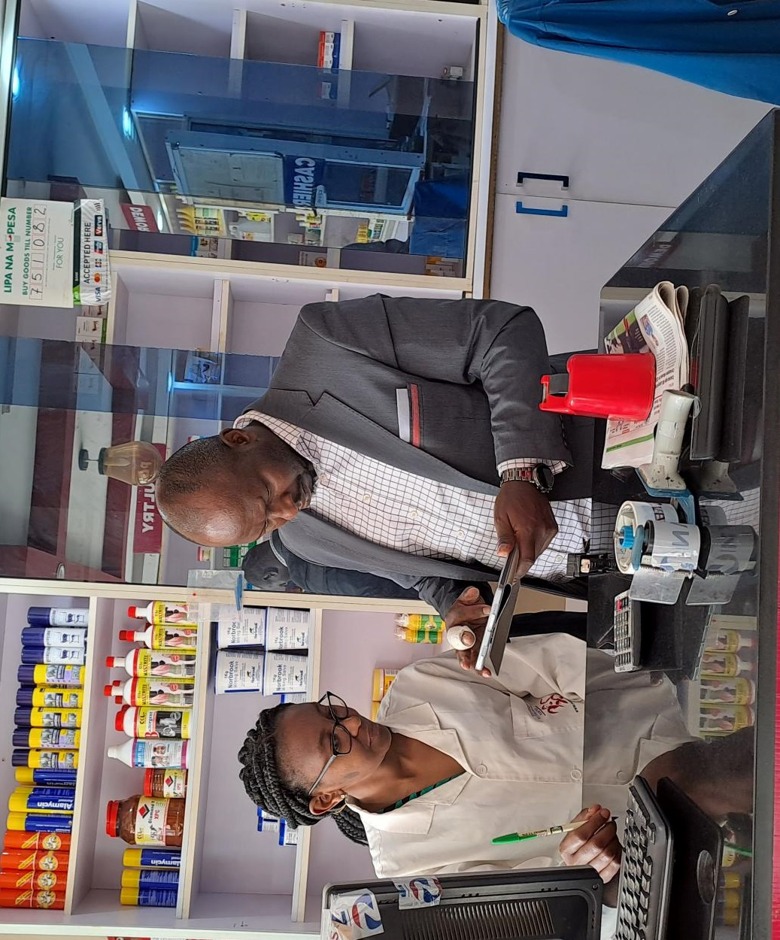
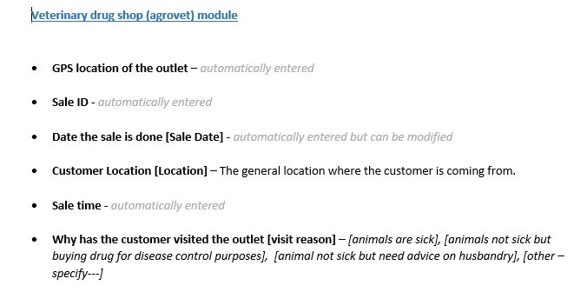
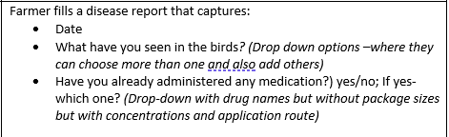
Intervention activities
System designed by the consortium and discussed with stakeholders in Kenya and Uganda.
System finalized and piloted in the field.
Agrovet attendants issued with tablets and compensated for their time; internet bundles provided farmers and agrovets

Slide 15
Conclusion and next steps
ICT offers good tools for One Health in disease, AMU and AMR surveillance
But challenging depending on contexts for operationalization
Validation and scaling

Slide 16

THANK YOU

