Slide 1

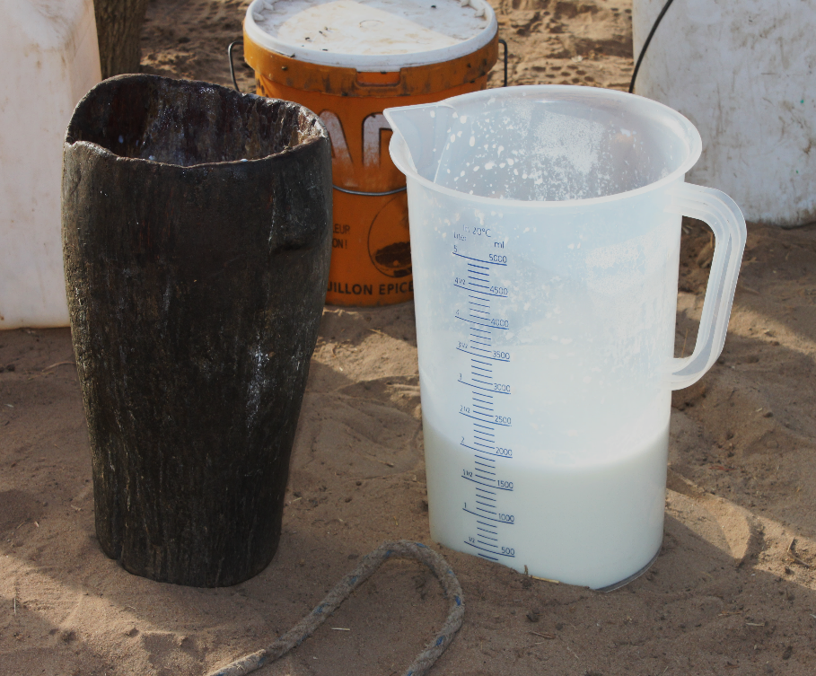
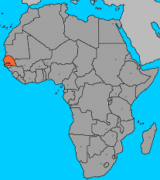

Senegal Dairy Genetics /
Sénégal Génétique Laitière
Karen Marshall
BecA-ILRI Hub-Rothamsted Research Collaborative Workshop, Nairobi,
8-9 February 2017

Slide 2
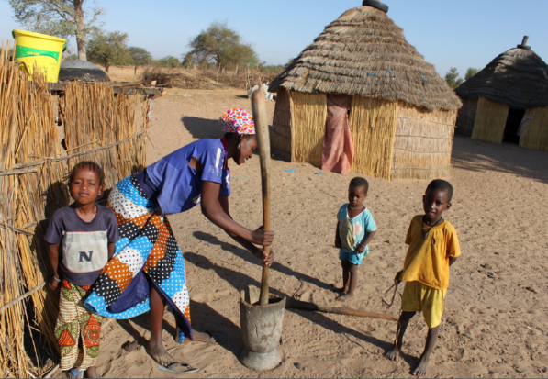
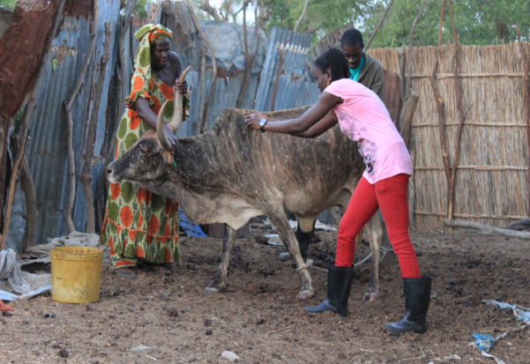
The importance of dairy
Food security
milk = high-quality food which supplies protein, energy & essential micronutrients
consumption of even small amounts of milk can significantly increase nutritional security
Livelihoods
cattle keeping / dairy is an important livelihood activity to rural households in Senegal

Slide 3
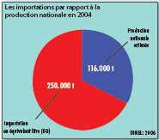
Dairy in Senegal
Senegal is a net importer of dairy products
The government is supporting dairy production including through the use of genetically improved animals
public AI campaign
local semen production center
– but no evidence base on the most appropriate type of dairy animal
Imports relative to domestic production, 2004
From: Atlas de l'élevage au Sénégal

Slide 4
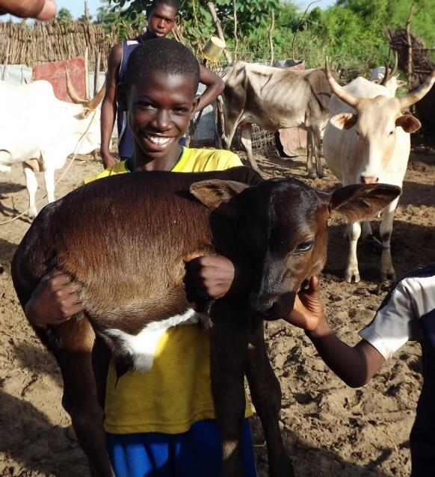
Project objectives
To identify and promote utilisation of the most appropriate dairy breed-types for smallhold dairy systems in Senegal –
trade-off analysis

Slide 5
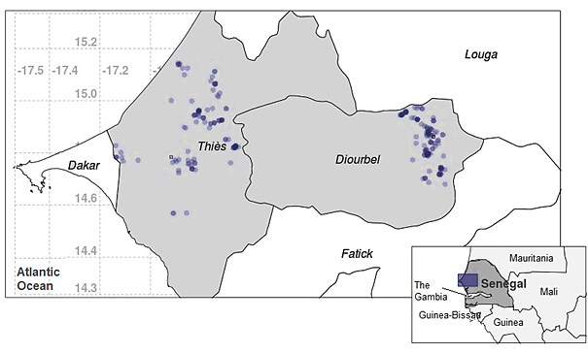
Key methodology: Longitudinal field survey on dairy
Collect socio-economic data (gendered) + animal-level data
→ customized database
220+ households with ~3500 dairy animals in two sites, monitored over 2 year period

Slide 6
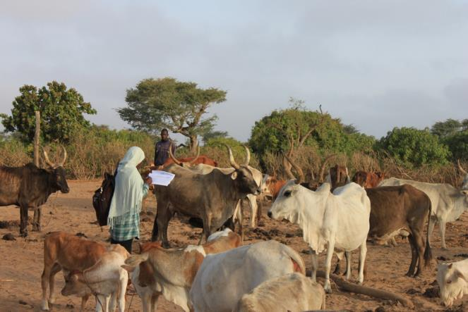
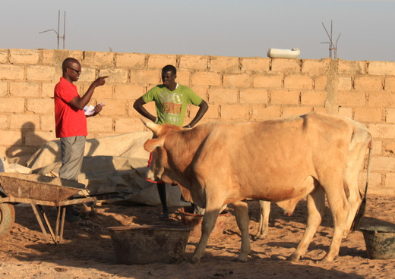
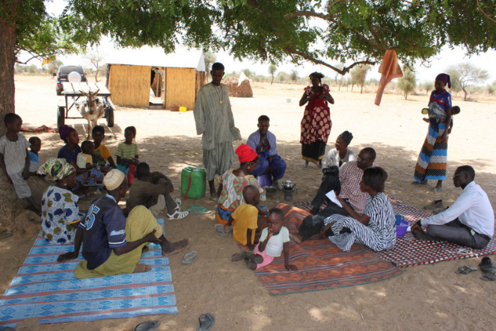
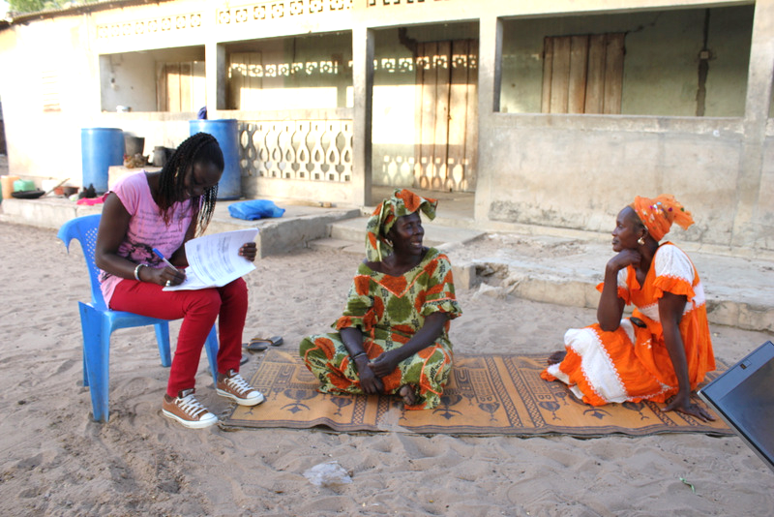
Data collection

Slide 7
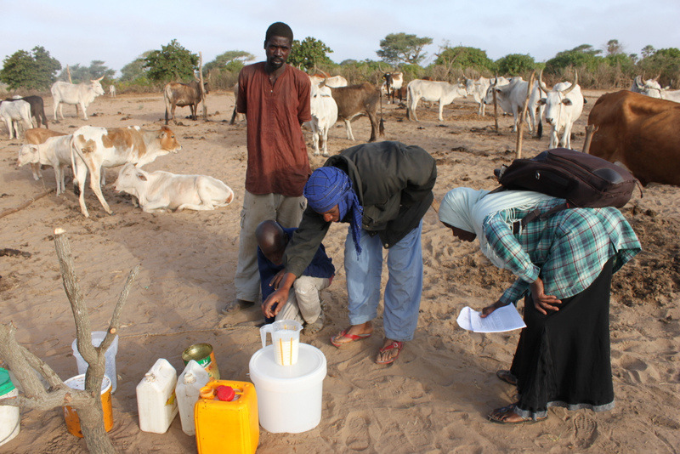
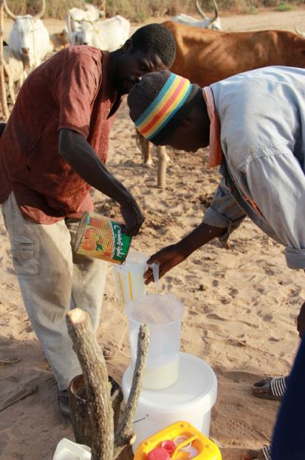
Data collection

Slide 8
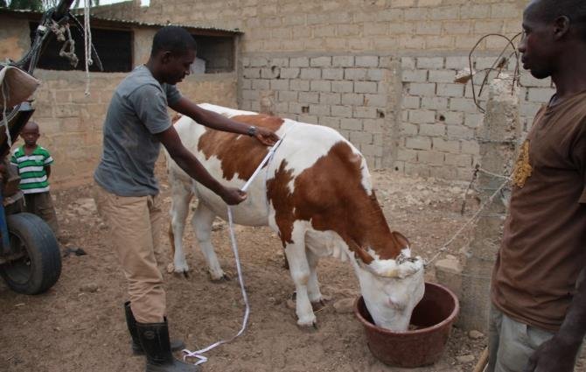
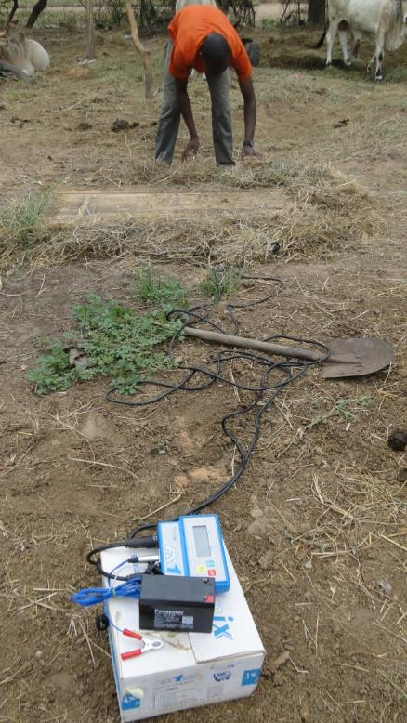
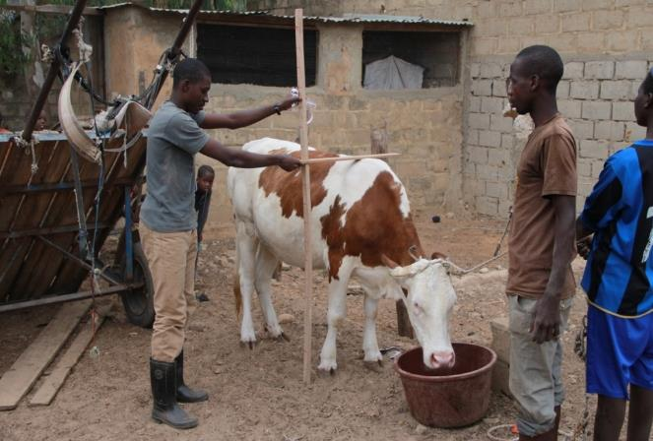
Data collection

Slide 9
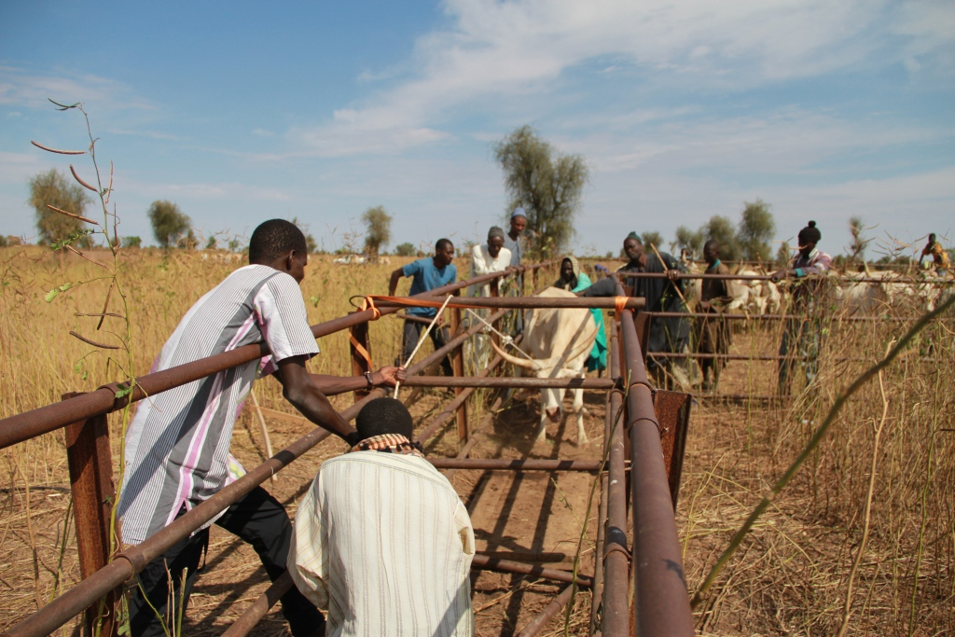
… but not always so easy

Slide 10
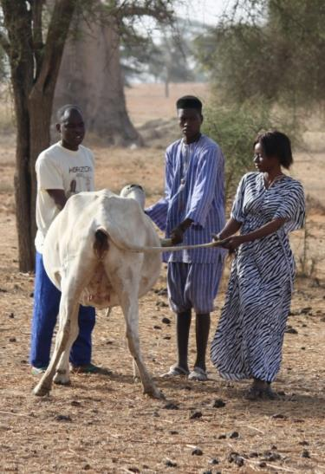
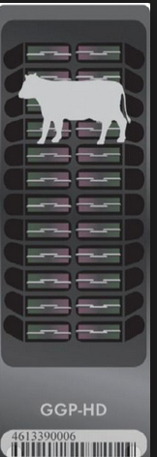
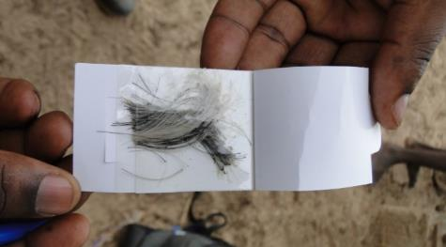
Key result – Dairy breeds defined
Individual animals assigned a breed-type using a genomic based approach

Slide 11
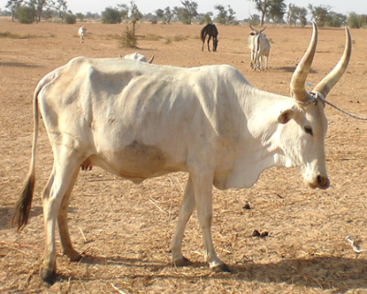
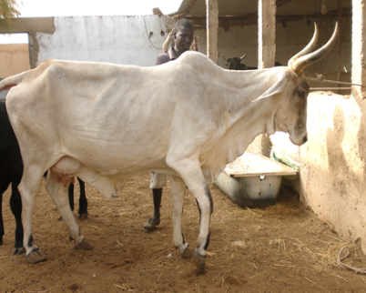
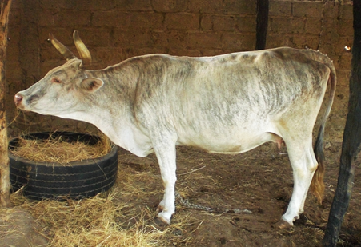
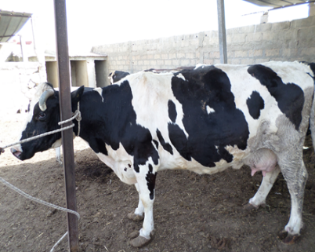
Key result – Dairy breeds defined
Herds comprised a variety of different cattle breed-types
Indigenous Zebu by
Guzerat
Indigenous Zebu
Indigenous Zebu by
Bos Taurus
High Bos Taurus

Slide 12
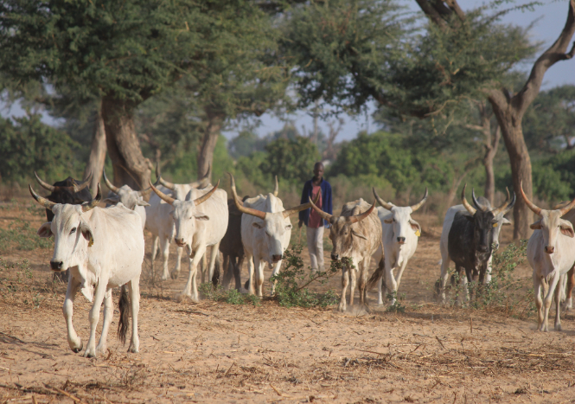
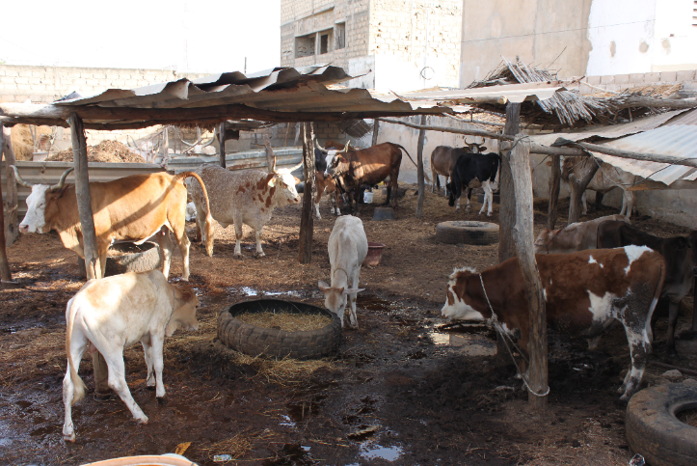
Key result – Management practices understood
Households applied different levels of management practices

Slide 13
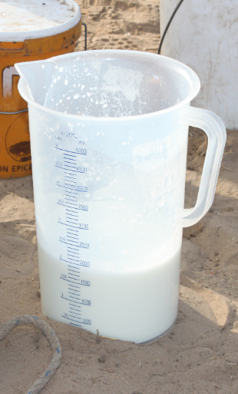
Key result – Milk yields determined
Versus ~8000 liters in Finland
Lactation milk off-take per cow, in liters, for a 365 day lactation

Slide 14
Key result – Household income from keeping different breeds determined
8.0 fold difference
2.4 fold difference
Herd size of 8 cows; non-transhumant; public AI

Slide 15
Key result – Revenue in dairy
Main benefit is from milk–
milk (suckled by calves & offtake) account for 61% - 77% of revenue

Slide 16
Key result – Costs in dairy
Main cost is feed –
milk suckled by calves & feed account for 80% - 92% of total costs

Slide 17
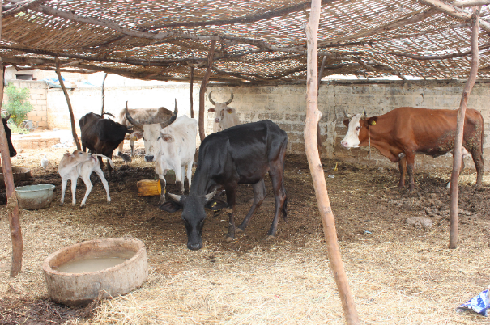
Key result – Livelihoods can be improved through combining good genetics with good animal management practices
Adapted
Productive
Profitable
Investment cost
(housing, feed)
Access issues
Farmer capacity
Indigenous Zebu by Bos Taurus
crossbred animals under good management.

Slide 18
Key result – Gender
Labour division
Gender | Who | Weekly labour hours | Main activities
Male | Household adult | 30 | Herding / animal care / milking
 | Hired adult | 55
 | Household boy | 21
Female | Household adult | 7 | Processing & sale of milk
 | Hired female | 7
 | Household girl | 2
Intra-household / gendered information on:
Decision making
Labour
Payment of costs
Control of benefits

Slide 19
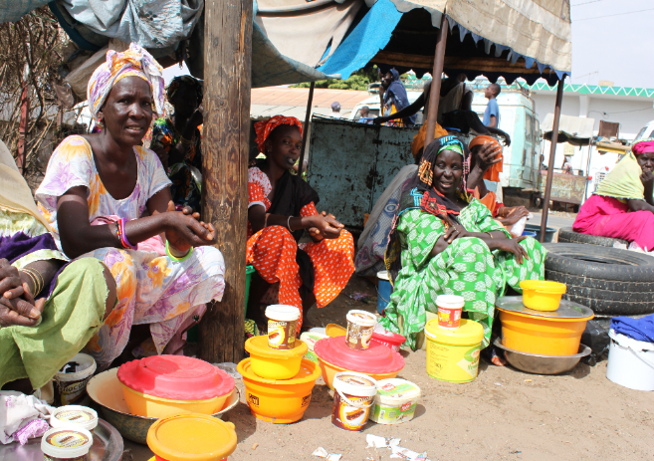
Key result – Gender
Control of income from the sale of milk can shift from women to men as market orientation increases
Level of market orientation | Control of income from the sale of milk
 | % Women | % Men | % Joint
Low | 72% | 27% | 1%
Medium | 45% | 50% | 5%
Follow-on projects may need to address this e.g. by gender transformative approaches

Slide 20
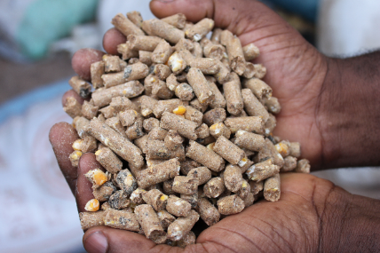
Key result – Aflatoxin in cattle feeds
In collaboration with WP5
Purchased concentrate
Groundnut hay
Wheat bran
Millet bran
Rice bran
Groundnut cake
Many samples above WHO limit of 5ppb –
may affect milk safety

Slide 21


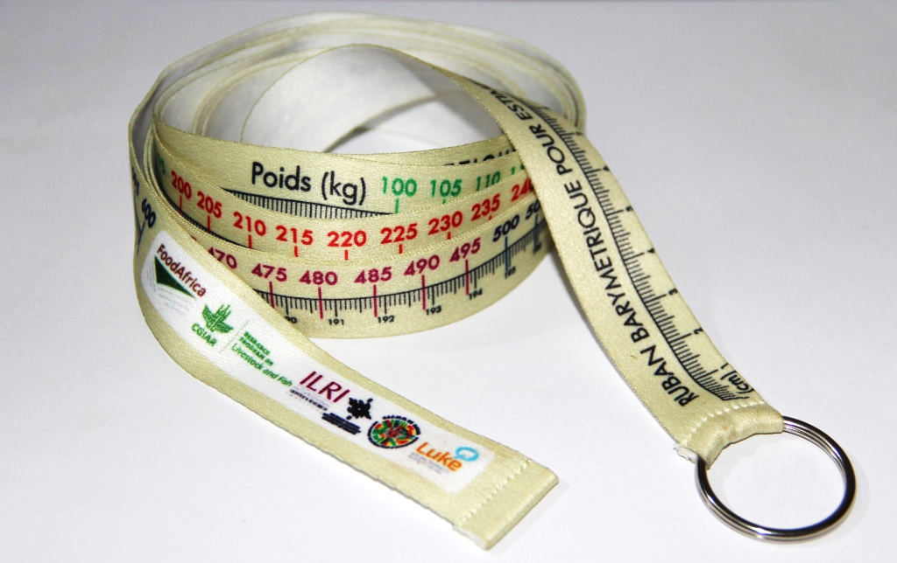
Key result – Prediction of cow body weight

Slide 22
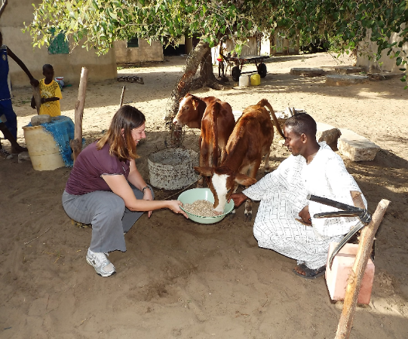

Key result – Dairy germplasm policy and value chain assessed
Supporting policy exists, but not always well implemented
Dairy germplasm value chain growth potential exists, should some limitation be addressed
  Weak demand for private AI
  Low success of public AI
Various recommendations drawn – for further discussion with stakeholders
Rare twin calves born to AI

Slide 23
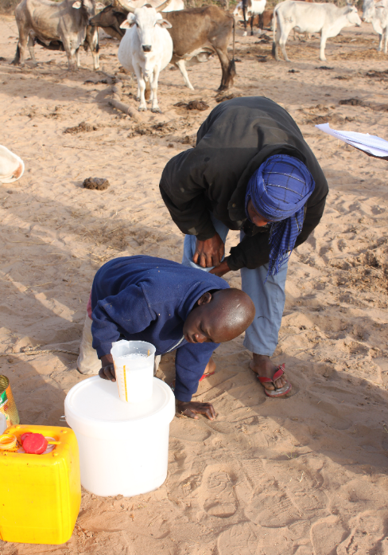
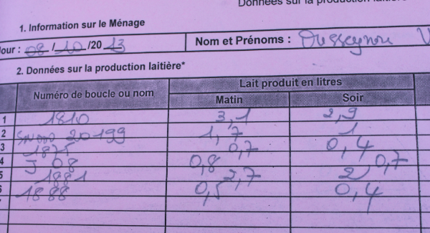
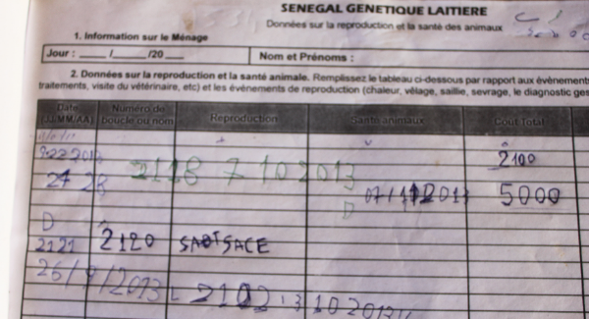
Key result – Farmers capacity built
Farmers trained on measuring milk and use of recording sheets

Slide 24
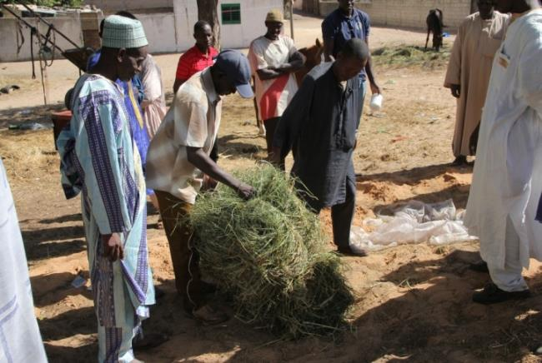
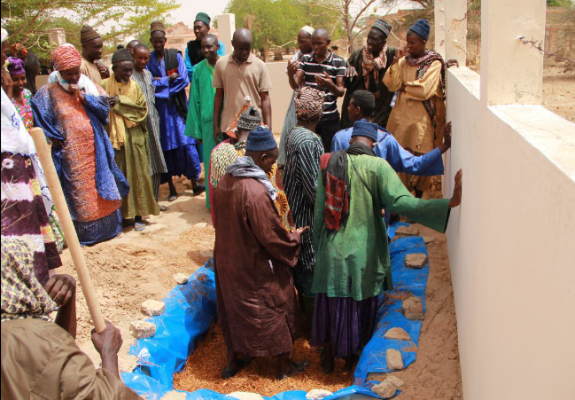
Key result – Farmers capacity built
Farmers received training on 7 topics selected by them

Slide 25
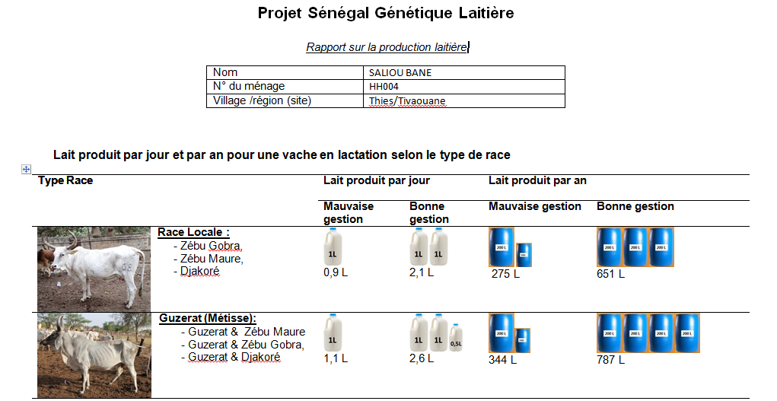
Key result – Farmers capacity built
Farmers received information on milk yields of the different breeds as well as their own animals
N° Vache | Race | Lait produit par jour (L) | Lait produit par an (L)
P1122 | Métisse | 5 | 1525
P1124 | Métisse | 5 | 1579
P0097 | Race Locale | 2 | 610

Slide 26
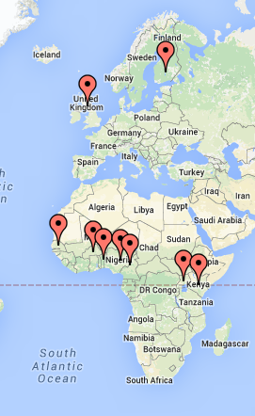
Key result – Researcher capacity built
10 higher degree students received training through the project
4 PhD students
5 Masters
1 Thesis component DVM
8 students were African nationals!

Slide 27

Next steps
Dissemination & capacity building:
Extension material developed and delivered to farmers and other stakeholders by a variety of means
Implementation phase:
access to cross-bred semen;
access to credit;
strengthened policy and value chain governance;
public-private partnerships;
access to inputs and markets
Technology adoption

Slide 28
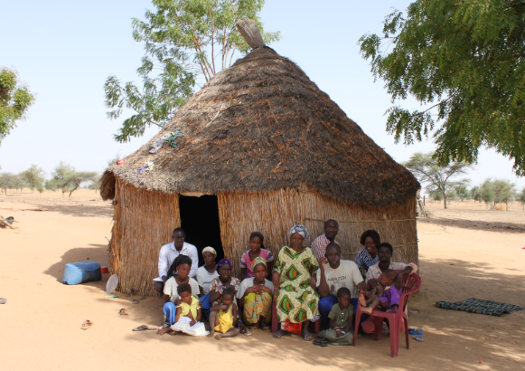
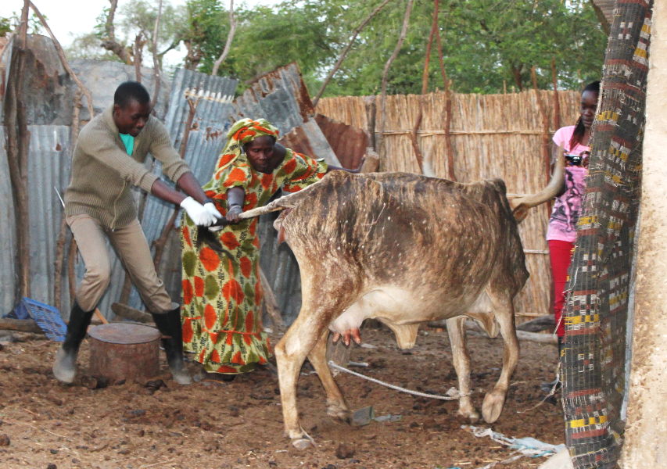




Special thanks to:
Our donors
Our project farmers
The research team
Our
field staff

