Slide 1




A professional course
Course Lead: Prof. Vishnu Prasad Pandey, Center for Water Resources Studies, Institute of Engineering, Tribhuvan University, Nepal
Email: vishnu.pandey@pcampus.edu.np
Water-Energy-Food-Ecosystems (WEFE) Nexus Approaches
Notes:
Provide the context of the course development, acknowledgements, people involved, etc.
Prof. Rajesh for Trends & Prof. Vishnu for WEFE Nexus concept

Slide 2
Contributors
Prof. Vishnu Prasad Pandey, Center for Water Resources Studies (CWRS), Institute of Engineering, Tribhuvan University, Nepal
Prof. Rajesh Kumar Rai, Institute of Forestry, Tribhuvan University, Nepal
Dr. Sanju Koirala, International Water Management Institute (IWMI), Nepal Office
Prof. Tri Ratna Bajracharya, Center for Energy Studies, Institute of Engineering, Tribhuvan University, Nepal
Dr. Bharat Kumar Pokharel, GREAT International
Dr. Nisha Onta, Governance Lab
Dr. Rishi Ram Kattel, Agriculture & Forestry University
Mr. Sabin Dangol, Center for Water Resources Studies (CWRS), Institute of Engineering, Tribhuvan University, Nepal
Dr. Manohara Khadka, International Water Management Institute (IWMI), Nepal Office
Dr. Marlene Elias, Alliance of Bioversity International & CIAT

Slide 3
Module 5
WEFE Nexus For Future Security
Prof. Vishnu Prasad Pandey
Center for Water Resources Studies, Institute of Engineering, Tribhuvan University, Nepal
Prof. Tri Ratna Bajracharya
Center for Energy Studies, Institute of Engineering, Tribhuvan University, Nepal
Prof. Rajesh Kumar Rai
Institute of Forestry, Tribhuvan University, Nepal
Dr. Rishi Ram Kattel
Agriculture & Forestry University
Notes:
Provide the context of the course development, acknowledgements, people involved, etc.
Prof. Rajesh for Trends & Prof. Vishnu for WEFE Nexus concept

Slide 4
Session Objectives and Contents
Objectives:
  Enhance understanding on ways of strengthening cooperation and coordination
  Highlight potential ways of addressing bottlenecks in implementing inclusive Nexus solutions
  Introduce MEL framework
Contents:
  Strengthening cooperation and coordination
  Streamlining the WEFE Nexus as a common agenda
  Addressing bottlenecks in implementing inclusive Nexus solutions
  MEL framework
Duration:
  8 hrs
Method of Delivery:
  Lecture
  Class Interaction
  Case Studies

Slide 5
5. WEFE Nexus for Future Security
5.1 Strengthening cooperation and coordination [3 hrs, 15 mins]
Role of cooperation/coordination across government sectors and scales for future WEFE security
Different diplomacy tracks in a transboundary context
Institutional arrangements, shared goal setting, and regular review/monitoring in federal contexts
Capacity strengthening
5.2 Streamlining the WEFE Nexus as a common agenda [1 hr, 15 mins]
Promoting cross-sectoral dialogue on WEFE Nexus solutions
Contribution of Nexus solutions in achieving national goals and SDGs
5.3 Addressing bottlenecks for implementing inclusive WEFE Nexus solutions [2 hrs]
Technical/engineering solutions
Nature-based solutions
Governance solutions
Ensuring equitable sharing of Nexus benefits, etc.
Market-based solutions
Demand-based solutions
5.4 Monitoring, evaluation and learning (MEL) framework for inclusive WEFE Mexus solutions [1 hr, 30 mins]

Slide 6
5.1 Strengthening Cooperation & Coordination
Cooperation and coordination across government sectors and scales
Different diplomacy tracks in transboundary contexts
Institutional arrangements, shared goal setting, and regular review in a federal context
Capacity strengthening

Slide 7
Session Delivery Plan [3 hrs, 15 minutes]
Time | Activity | Facilitator
30 minutes | Lecture – Role of cooperation and coordination; different tracks of diplomacy in a transboundary context | Prof. Tri Ratna Bajracharya
60 minutes | Exercise 5-1: Characterize the status of horizontal, vertical and transboundary cooperation in Nepal | Prof. Tri Ratna Bajracharya
60 minutes | Exercise 5-2: Potential strategies for improving coordination/cooperation | Prof. Rajesh K. Rai
40 minutes | Lecture – Institutional arrangements; capacity strengthening | Prof. Rajesh K. Rai
5 minutes | Summary of session | Prof. Rajesh K Rai

Slide 8
5.1 Coordination and Cooperation
Achieving security:
Cooperation and coordination among sectors and governments are crucial for ensuring the security of water, energy, food, and environmental resources.
Integrated decision-making:
Integrated decision-making across sectors fosters synergistic approaches that address interdependencies and minimize trade-offs.
Sustainable outcomes:
Collaboration helps optimize resource use and promote sustainable outcomes that benefit communities and ecosystems.

Slide 9
5.1 Coordination and Cooperation | Diplomacy Tracks
Track 1 Diplomacy
  Means: Official discussions, typically involving high-level political and military leaders
  Activities: Heads of states meet, discuss issues and release joint statements
  Actors: Government and political elites
Track 2 Diplomacy
  Means: Unofficial dialogue and problem-solving activities aimed at building relationships
  Actors: Influential academic, religious and NGO leaders and other civil society actors
Track 3 Diplomacy
  Means: People-to-people diplomacy undertaken by individuals and private groups
  Actors: Community/grass-roots individuals or role models

Slide 10
5.1 Coordination & Cooperation | Diplomacy Tracks
Diplomacy tracks:
Different diplomacy tracks, such as bilateral and multilateral dialogues, are instrumental in addressing transboundary challenges.
01
02
Shared interests:
Identifying shared interests and common goals among countries with shared and/or overlapping resources and needs can promote mutual benefits and foster cooperation.
Conflict resolution:
Diplomatic approaches are vital for conflict resolution and promoting stability in shared water, energy, and food resources.
03

Slide 11
Exercise 5-1: Group Work [60 mins]
Divide participants into 3 groups
Each group discusses on the following two questions [30 mins]
  How do you characterize the current status of cooperation and coordination across governments in Nepal?
    Horizontal cooperation/coordination [Group 1]
    Vertical cooperation/coordination [Group 2]
    Transboundary cooperation/coordination [Group 3]
  What are the drivers of this status (positive and negative)?
Each group presents on their findings [4-5 mins each]
Facilitator moderates discussion and synthesizes key messages

Slide 12
Exercise 5-2: Group Works [60 mins]
Identify key issues with coordination from Exercise 5-1
Divide participants into 3 groups (different composition than in Ex 5-1)
Each group discusses the following questions [30 minutes]:
  How can we improve different forms of cooperation and coordination (in the context of WEFE Nexus)?
    Horizontal cooperation/coordination [Group 1]
    Vertical cooperation/coordination [Group 2]
    Transboundary cooperation/coordination [Group 3]
Each group presents on their findings [4-5 mins each]
Facilitator moderates discussion and synthesizes key messages

Slide 13
5.1 Coordination and Cooperation | Institutional Arrangements
Effective Mechanisms
  Establishing effective institutional mechanisms facilitates intersectoral and intergovernmental coordination.
Cross-Sectoral Platforms
  Multi-stakeholder platforms (MSPs) provide spaces for dialogue and collaboration among diverse actors in the WEFE Nexus.
International Agreements
  Transboundary cooperation is often supported by international agreements and treaties that outline shared responsibilities.

Slide 14
5.1 Coordination and Cooperation | Shared Goals, Regular Review
Shared vision
  Establishing shared goals and visions among stakeholders encourages collective action towards a sustainable WEFE Nexus.
  How can we establish shared goals and visions?
Monitoring and review
  Regular monitoring and review processes ensure progress tracking and help in adapting strategies as needed.
Adaptive management
  Flexibility and adaptive management enable responses to changing circumstances and emerging challenges.

Slide 15
5.1 Coordination and Cooperation | Capacity Strengthening
Building capacities:
  Investing in capacity strengthening enhances the ability of stakeholders to engage effectively in Nexus cooperation and coordination.
Knowledge exchange:
  Facilitating knowledge exchange and learning fosters better decision-making and promotes best practices.
Empowering local communities:
  Empowering local communities to participate in decision-making enhances ownership and sustainability.

Slide 16
5.2
Streamlining the WEFE Nexus as a Common Agenda
Promoting cross-sectoral dialogue for WEFE Nexus solutions
Contribution of Nexus solutions in achieving national goals and SDGs

Slide 17
Session Delivery Plan [1 hr, 15 mins]
Time | Activity | Facilitator
20 minutes | Exercise 5-3: Open Discussion – What could be the entry point to streamline the WEFE Nexus as a common agenda? | Dr. Rishi Ram Kattel
30 minutes | Lecture/presentations | Dr. Rishi Ram Kattel
20 minutes | Exercise 5-4: How can we foster public-private partnerships (PPPs) to implement inclusive WEFE Nexus solutions? | Dr. Rishi Ram Kattel
5 minutes | Summary of session | Dr. Rishi Ram Kattel

Slide 18
Exercise 5-3: Open Discussion [20 mins]
What could be the entry point to make the WEFE Nexus a common agenda? How can we materialize it?
Notes:
Entry points could be: i) climate action; ii) SDGs – as all related sectors and actors are integrated in this endeavor.

Slide 19
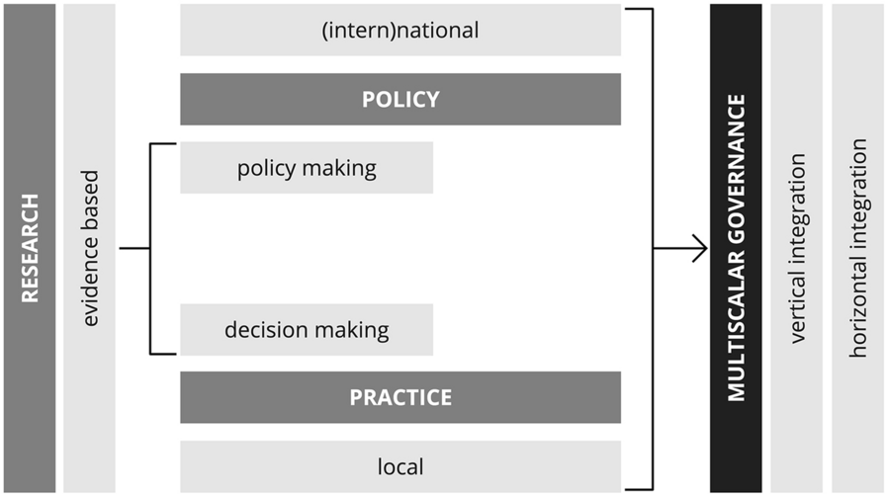
5.2 Streamlining the WEFE Nexus | Dialogue
Streamlining a concept or approach starts with generating evidence [SCIENCE], adoption in policy [POLICY], translation into action [PRACTICE]
A schematic of potential integration of these three components is shown in the context of multi-scalar governance
Figure: Multiscalar governance (Source: Caldarice et al, 2021)
Notes:
Proper functioning of these three components in close coordination/cooperation can help streamline a new approach/concept.

Slide 20
5.2 Streamlining the WEFE Nexus | Dialogue
Vertical integration must answer to two questions:
  1. How does local action contribute to achieving (int)national policy objectives (e.g., specific targets for emission reduction)?
  2. How do national governments support local action (e.g., through financial, technology and institutional capacity)?
Horizontal integration must ensure:
  Consistent cooperation between national governments ministries and related departments (e.g., environment/climate, finance, etc.)
Key message:
  Dialogue among science, policies and practice spheres should not be horizontal but circular to function properly and achieve sustainable impact.

Slide 21



3.2 Dialogue – Science, Policy, Practice, Industry and Private Sector
Knowledge integration:
Fostering dialogue between scientists, policymakers, practitioners, industries, and the private sector promotes the integration of diverse knowledge and expertise.
Co-designing solutions:
Collaborative dialogue helps co-design and implement effective WEFE Nexus solutions that are informed by both scientific insights and practical realities.
Addressing trade-offs:
Engaging multiple stakeholders enables identifying and addressing trade-offs between water, energy, food, and ecosystem needs.
Notes:
Multi-sectoral dialogue is required for: i) knowledge integration, ii) co-designing solutions, iii) addressing trade-offs.

Slide 22
5.2 Contribution of Nexus Solutions to National Goals & SDGs
Projected population by 2030 → ~ 8.5 billion → demands for food will increase by 35%, energy by 50% and water by 40% (Mai et al., 2023)
  Critical challenge: fulfill water, energy, & food needs for all human beings while staying within environmental limits (Das & Cabezas, 2018)
The WEFE Nexus has gained global recognition as a viable strategy to solve the complicated interdependencies of these challenges (Platts et al., 2022).
WEFE Nexus approach → solution for reaching SDG targets, ensuring security and sufficiency of resources (e.g., water, energy, food) and upgrading quality of ecosystems alongside human societies (Abdi et al., 2020)
Out of 17 SDGs, the WEFE Nexus has a direct link with: SDG2 (Zero Hunger)
  SDG6 (Clean water and sanitation)
  SDG7 (Affordable and clean energy)
  As well as indirect links to most other SDGs

Slide 23
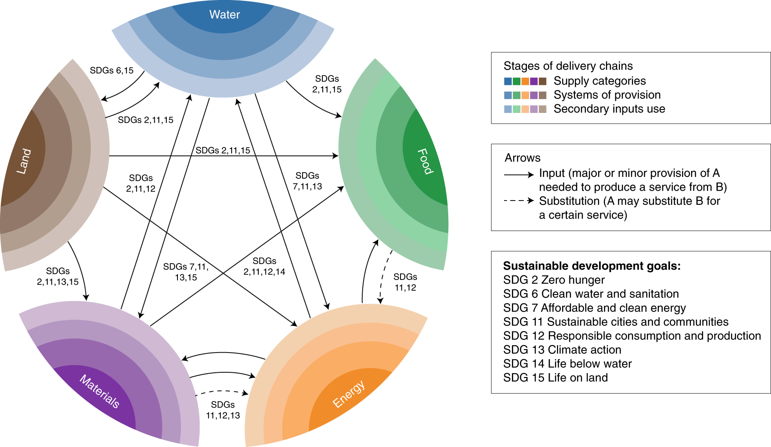
5.2 Contribution of Nexus Solutions to National Goals & SDGs
Figure: The Nexus: interlinkages across resources and the SDGs
(Source: Bleischwitz et al., 2018)

Slide 24
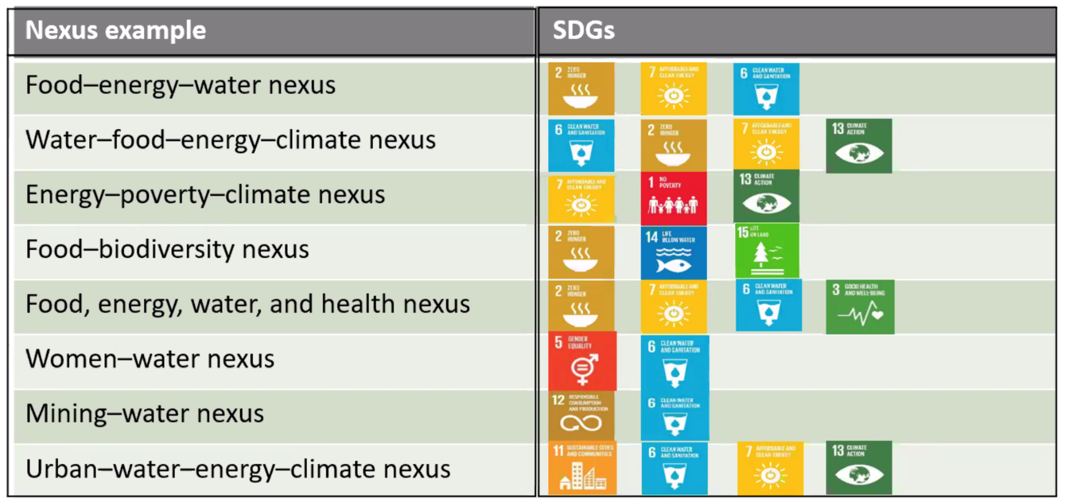
5.2 Contribution of Nexus Solutions to National Goals & SDGs
Examples of several Nexus configurations and linkage with SDGs

Slide 25
5.2 Contribution of Nexus Solutions to National Goals & SDGs
SDGs acknowledge the inter-linkages between human wellbeing, economic prosperity, and a healthy environment → this covers a wide range of topical issues including water, energy and food security, poverty eradication, economic development, climate change, health, among others (Mabhaudhi et al., 2021).
Linking Nexus planning and SDGs has many advantages, and Nexus planning is proposed as a “fitting approach” for integrating and assessing SDG implementation (Mabhaudhi et al., 2021).
5 key areas of Nexus/SDG integration (Mabhaudhi et al., 2021):
  Description of Nexus analytical tool
  Defining WEFE Nexus sustainability indicators
  Linking Nexus planning and related SDG indicators
  Periodic assessment and monitoring of SDG performance
  Benefits of periodic SDG monitoring

Slide 26
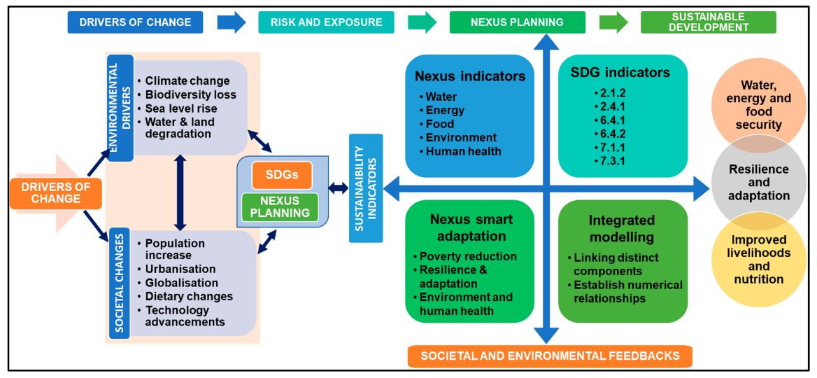
5.2 Contribution of Nexus Solutions to National Goals & SDGs
Figure: A conceptual framework linking Nexus processes with SDGs (Source: Mabhaudhi et al., 2021)

Slide 27
5.2 Contribution of Nexus Solutions to National Goals & SDGs
National priorities:
Aligning WEFE Nexus solutions with national development goals ensures their relevance and contribution to the country's broader priorities.
SDG alignment:
WEFE Nexus solutions can directly contribute to achieving various SDGs, including those related to poverty eradication, clean water, renewable energy, and sustainable agriculture.
Co-benefits:
Implementing Nexus solutions often results in co-benefits, where actions to improve water, energy, and food security also enhance ecosystem health and social well-being.

Slide 28
5.2 Advancing Integrated Policies & Strategies
Nexus thinking:
Promoting Nexus thinking encourages policymakers and practitioners to consider interlinkages between sectors while developing policies and strategies.
Policy coherence:
Integrated policies and strategies foster policy coherence, minimizing conflicts between different sectors and maximizing synergies.
Adaptive approaches:
Flexible and adaptive policy approaches allow for adjustments to emerging challenges and changing circumstances.

Slide 29



5.2 Public-Private Partnership
Leveraging the private sector:
Engaging the private sector in the WEFE Nexus fosters innovative and sustainable solutions, leveraging their resources and expertise.
Investment opportunities:
Public-private partnerships can unlock investment opportunities for projects that contribute to the Nexus goals while supporting economic growth.
Sustainable business practices:
Collaboration with the private sector encourages the adoption of sustainable business practices that benefit society and the environment.

Slide 30
Exercise 5-4: Open Discussion [20 mins]
What could be an opportunity for the private sector to invest in inclusive WEFE Nexus solutions? What kind of solutions could result from private sector engagement?
How can public-private partnerships (PPPs) be fostered to advance inclusive WEFE Nexus solutions?

Slide 31
5.2 Streamlining WEFE Nexus | Sources and Further Reading
Abdi, H., Shahbazitabar, M., & Mohammadi-Ivatloo, B. (2020). Food, energy and water Nexus: A brief review of definitions, research, and challenges. Inventions, 5(4), 1–14. https://doi.org/10.3390/inventions5040056
Bleischwitz, R., Spataru, C., VanDeveer, S. D., Obersteiner, M., van der Voet, E., Johnson, C., Andrews-Speed, P., Boersma, T., Hoff, H., & van Vuuren, D. P. (2018). Resource Nexus perspectives towards the United Nations Sustainable Development Goals. Nature Sustainability, 1(12), 737–743. https://doi.org/10.1038/s41893-018-0173-2
Caldarice, O., Tollin, N., & Pizzorni, M. (2021). The relevance of science-policy-practice dialogue. Exploring the urban climate resilience governance in Italy. City, Territory and Architecture, 8(1). https://doi.org/10.1186/s40410-021-00137-y
Das, T., & Cabezas, H. (2018). Tools and concepts for environmental sustainability in the food-energy-water Nexus: Chemical engineering perspective. Environmental Progress and Sustainable Energy, 37(1), 73–81. https://doi.org/10.1002/ep.12763
Mabhaudhi, T., Nhamo, L., Chibarabada, T. P., Mabaya, G., Mpandeli, S., Liphadzi, S., Senzanje, A., Naidoo, D., Modi, A. T., & Chivenge, P. P. (2021). Assessing progress towards sustainable development goals through Nexus planning. Water (Switzerland), 13(9), 1–13. https://doi.org/10.3390/w13091321
Mai, Q., Yu, D., & Li, X. (2023). Coupling characteristics of China ’ s food-energy-water Nexus and its implications for regional livelihood well-being. Journal of Cleaner Production, 395(19), 136385. https://doi.org/10.1016/j.jclepro.2023.136385
Platts, E. J., Kerner, B., Adams, N., & Archer, J.-M. M. (2022). FEW and Far Between: Rebalancing Research and Training Priorities at the Food-Energy-Water Nexus. Science and Education, 31(5), 1383–1397. https://doi.org/10.1007/s11191-022-00344-0
Zhang, J., Wang, S., Pradhan, P., Zhao, W., & Fu, B. (2022). Mapping the complexity of the food-energy-water Nexus from the lens of Sustainable Development Goals in China. Resources, Conservation and Recycling, 183(April), 106357. https://doi.org/10.1016/j.resconrec.2022.106357

Slide 32
5.3
Addressing Bottlenecks for Implementing Inclusive WEFE Nexus Solutions
Technical/engineering solutions
Nature-based solutions
Governance solutions
Ensuring equitable sharing of benefits, etc.)
Market-based solutions
Demand-based solutions

Slide 33
Session Delivery Plan [2 hrs]
Time | Activity | Facilitator
60 minutes | Exercise 5-5: Group Work – Potential inclusive WEFE Nexus solutions, bottlenecks for addressing them, and ways forward | Prof. Vishnu Pd. Pandey
50 minutes | Lecture – Various typologies of solutions | Prof. Vishnu Pd. Pandey
10 minutes | Summary of session | Prof. Vishnu Pd. Pandey

Slide 34
Exercise 5-5: Group Works [60 mins]
Divide participants into 3 groups
Each group discusses the following questions [40 mins]:
  What could be different types of potential solutions for inclusive WEFE Nexus gains & bottlenecks for implementing them?
  How can those bottlenecks be resolved?
Each group presents on their findings [4 mins each]
Facilitator moderates discussion and synthesizes key messages

Slide 35

5.3 Addressing Bottlenecks | Technical/Engineering Solutions
Innovative technologies:
Leveraging advanced technologies can enhance water efficiency, renewable energy generation, sustainable agriculture, waste management, and ecosystem restoration.
Smart water management:
Implementing smart water infrastructure, real-time monitoring, precision agriculture, efficient irrigation systems, and water reuse technologies.
Energy-efficient systems:
Adopting energy-efficient lighting, appliances, industrial processes, combined heat and power systems, and renewable energy integration.

Slide 36



5.3 Addressing Bottlenecks | Nature-Based Solutions
Ecosystem restoration:
Restoring and conserving wetlands, forests, mangroves, and green spaces to improve water quality, regulate water flow, sequester carbon, and enhance biodiversity
Sustainable agriculture:
Promoting agroforestry, organic farming, agroecology, and soil conservation practices to support ecosystem health while ensuring food security
Green infrastructure:
Implementing green roofs, permeable pavements, rain gardens, and natural flood management techniques to manage storm-water runoff and reduce flooding

Slide 37


5.3 Addressing Bottlenecks | Governance Solutions
Policy alignment:
Harmonizing policies and regulations across sectors; integrating the WEFE Nexus approach into national and regional policies
Cross-sectoral coordination:
Strengthening coordination mechanisms among different government agencies, ministries, and stakeholders
Transparent decision-making:
Ensuring transparency in decision-making processes and engaging the public in resource management discussions

Slide 38
5.3 Addressing Bottlenecks | Market-Based Solutions
Sustainable investment:
Encouraging investment in sustainable water, energy, and food projects through green bonds, impact investing, and sustainable finance mechanisms
Carbon markets:
Implementing carbon trading and pricing mechanisms to incentivize businesses to reduce emissions and invest in green technologies
Water and energy pricing:
Implementing progressive pricing models for water and energy to encourage efficient resource usage and discourage wasteful consumption
01
02
03

Slide 39
5.3 Addressing Bottlenecks | Demand-Based Solutions
Behavioral change:
Raising awareness and promoting behavioral change among consumers to foster responsible resource use and conservation
Education and capacity building:
Enhancing public awareness and knowledge about the Nexus through educational campaigns, workshops, and capacity-building programs
Integrated education:
Integrating Nexus concepts into educational curricula to foster a future generation committed to sustainable resource management and conservation
01
02
03

Slide 40
5.3 Addressing Bottlenecks | Ensuring Equitable Sharing of Benefits
Gender equity:
Promoting gender-sensitive policies and programs to ensure equal participation and benefits for women and girls in water, energy, and agriculture sectors
Social inclusion:
Addressing the needs of differently-abled individuals, ethnic minorities, and other vulnerable communities to promote social justice
Socio-economic status:
Equitably distributing resources and opportunities to empower marginalized groups and reduce inequalities in access to water, energy, and food

Slide 41
5.4 MEL Framework for Inclusive WEFE Nexus Solutions
Fundamentals of Monitoring, Evaluation & Learning (MEL)
MEL Framework
Importance/Benefit of a robust MEL framework
Elements of a MEL assessment

Slide 42
Session Delivery Plan [1 hr, 30 mins]
Time | Activity | Facilitator
25 minutes | Lecture – Elaboration of a MEL framework | Prof. Rajesh K Rai
60 minutes | Exercise 5-9: Developing MEL frameworks for inclusive WEFE Nexus solutions | Prof. Rajesh K Rai
5 minutes | Summary of session | Prof. Rajesh K Rai

Slide 43
5.4 MEL for Nexus Gains | Concepts
  Monitoring (M) refers to:
  Routine monitoring of resources, activities and results, and analysis of the information to guide project implementation
  Evaluation (E) refers to:
  Periodic (mid-term, final) assessment and analysis of an ongoing or completed project
Learning (L) refers to:
  The process through which information generated from M&E is intentionally used to continuously improve a project’s ability to achieve results
MEL measures and tracks the progress and impact of programs and projects. It promotes an “evaluative culture” within the WEFE Nexus program.
The lack of clarity about what a ‘successful’ Nexus approach looks likes in practice and how this can be achieved, monitored and evaluated creates significant challenges for planners, policymakers and other stakeholders tasked with developing Nexus-orientated strategies (Leck et al., 2015).

Slide 44
5.4 MEL for Nexus Gains | Concepts
Monitoring – Examples (Checking/ Documenting) | Quantitative (Numbers) | Qualitative (Narrative)
 | Attendance (headcounts) Surveys Registration forms | Interviews and quotes Social media, blog posts Surveys Photos and videos Focus group discussions (FGDs)
Evaluation – Examples (Assessing/ Interpreting) | Donor reporting Annual reports Participant success stories Strategic planning meetings
Learning – Examples | Program planning and design MEL planning and design Implementing findings from quality control checks Trainings

Slide 45
5.4 MEL for Nexus Gains | Objectives of Monitoring & Evaluation
Focusing on users, utilization of monitoring, and evaluation and accountability
Emphasizing learning through monitoring and evaluation activities
Encouraging adaptive management
Allowing blurred boundaries
[Source: Schuetz et al., (2014)]

Slide 46
5.4 MEL for Nexus Gains | Development of MEL Framework
Conduct a needs assessment
Define program indicators
Develop a data collection plan
Establish a data management system
Develop a reporting plan
Ensure accountability
Monitor and evaluate the MEL system
Figure: Designing and implementing MEL system
(Source: https://www.evalcommunity.com/career-center/meal/)

Slide 47
5.4 MEL for Nexus Gains | Components of MEL Framework
Components of a MEL Framework
Data collection methods
Data quality
Data analysis
Reporting
Use of technology
Ethics and privacy
Figure 5: Components of MEL framework
(Source: https://www.evalcommunity.com/career-center/meal/)

Slide 48
5.4 MEL for Nexus Gains | Importance of MEL Framework
[Source: https://www.evalcommunity.com/career-center/meal/]
Evidence-based decision-making:
By collecting and analyzing data on program activities and outcomes, organizations can make informed decisions about program design, implementation, and resource allocation.
1
Program improvement:
Through ongoing monitoring and evaluation, organizations can identify areas for improvement, and make adjustments to their programs to ensure that they are meeting the needs of the communities they serve.
2
Accountability:
MEL ensures that organizations are accountable to their stakeholders, including funding agencies, program participants, and the communities they serve, by providing evidence of program impact and transparency in program management.
3
Learning and adaptation:
By reflecting on program results, organizations can learn from their experiences, identify best practices, and make changes to their programs based on feedback and evidence.
4
Sustainability:
MEL helps organizations to design and implement programs that are sustainable over the long term, by identifying factors that contribute to program success and sustainability, and addressing challenges that may impede program effectiveness.
5

Slide 49
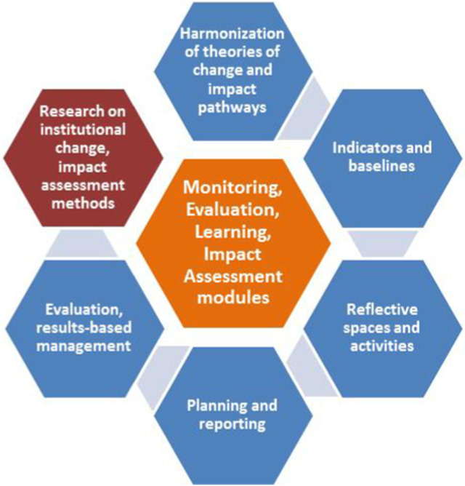
5.4 MEL for Nexus Gains | Elements of MEL Assessment
MEL Components:
  Components/ elements of MEL vary by project type
  See Figure for an example
MEL Indicators:
  Indicators are essential in M&E as they provide measurable and observable evidence of progress and success.
  Indicators help assess different aspects of a program or project and evaluate its success in achieving its goals and objectives.
Figure 6: Elements of monitoring, evaluation, learning and impact assessment (Source: Thornton et al., 2017)
Notes:
Details are in (Thornton et al., 2017)

Slide 50
5.4 MEL for Nexus Gains | Types of Nexus indicators
Input indicator
Process indicator
Outputs indicator
Outcomes indicator
Overall impact indicator
The resources and inputs that are required to deliver a program or project.
The activities, steps, or processes that are required to implement a program or project.
The immediate products or services that result from a program or project.
The specific and measurable changes in behavior, knowledge, skills, attitudes, or condition that result from a program or project.
The long-term and sustainable effects of a program or project on its target population or environment.
(Source: https://www.evalcommunity.com/career-center/type-of-indicators/)

Slide 51
5.4 MEL for Nexus Gains | Benefits of a Robust MEL Framework
1
Enables stronger project design
2
Leads to better outcomes and more effective programs
Keeps programs on track to meet desired outcomes
3
Ensures money and resources are spent efficiently and effectively
4
([Source: https://www.resonanceglobal.com/blog/what-is-monitoring-evaluation-and-learning-mel )
Provides accurate data
5
Creates opportunities for adaptive project management throughout implementation
6
Gives beneficiaries and key stakeholders a voice
7
Improves motivation and focus of people implementing the program
8

Slide 52
Exercise 5-6: Group Works [60 mins]
Divide Participants into 3 groups
Assign a different inclusive WEFE Nexus solution to each group
Each group develops a MEL framework for the assigned inclusive WEFE Nexus solution [30 minutes]
Each group presents its framework [4-5 mins]
Discussion and synthesis of key messages

Slide 53
5.4 MEL for Nexus Gains | Sources and Further Reading
EvalCommunity. (n.d.) Monitoring, Evaluation, Accountability, and Learning (MEAL). https://www.evalcommunity.com/career-center/meal/
EvalCommunity. (n.d.) Types of Indicators in Monitoring and Evaluation (M&E) | Examples. https://www.evalcommunity.com/career-center/type-of-indicators/
Leck, H., Conway, D., Bradshaw, M., & Rees, J. (2015). Tracing the Water-Energy-Food Nexus: Description, Theory and Practice. Geography Compass, 9(8), 445–460. https://doi.org/10.1111/gec3.12222
Resonance. (2023). What is Monitoring, Evaluation, and Learning (MEL)? https://www.resonanceglobal.com/blog/what-is-monitoring-evaluation-and-learning-mel
Schuetz, T., Förch, W., & Thornton, P. (2014). CCAFS Monitoring and Evaluation Strategy. 7.
Thornton, P. K., Schuetz, T., Förch, W., Cramer, L., Abreu, D., Vermeulen, S., & Campbell, B. M. (2017). Responding to global change: A theory of change approach to making agricultural research for development outcome-based. Agricultural Systems, 152, 145–153. https://doi.org/10.1016/j.agsy.2017.01.005

