Slide 1
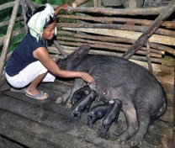
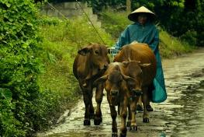
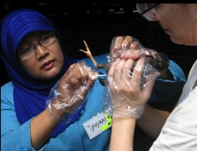
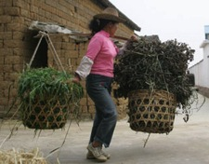
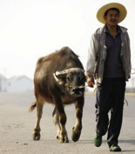










Epidemiological investigations of leptospirosis in pigs in Vietnam
Hu Suk Lee
First national stakeholder workshop, ECOMORE 2 project
Hanoi, Vietnam
7 August 2018

Slide 2
Overview
Introduction of leptospirosis
Research I
Research II
Conclusion
Future directions

Slide 3
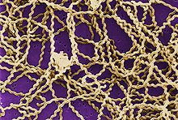
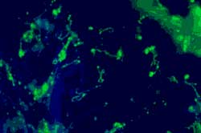
What is leptospirosis?
A bacterial zoonotic disease
The genera Leptospira contains three species, namely L. interrogans, L. biflexa and L. parva
Pathogenic: L. interrogans
Contains 24 serogroups
More than 250 serovars
Source: CDC’s Public Health Image Library)

Slide 4
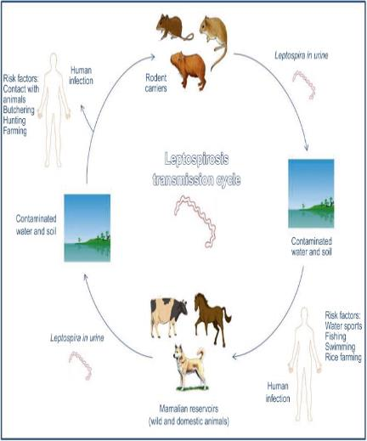
Modes of transmission
Transmitted to humans from domestic/wild animals (e.g. rats, dogs, pigs and raccoon)
Transmitted though breaks in the skin or intact mucus membranes
Indirect contact (soil, water, feed) with infected urine
Occupational disease of animal handling
Source: Chapter 107 - Leptospira and Leptospirosis
Molecular Medical Microbiology (Second Edition)

Slide 5
Host animals
Species | Common infections | Possible others
Dogs | Canicola, Icterohemorrhagiae, Grippotyphosa, Pomona | Bratislava
Cats | rarely infected
Cattle and deer | Hardjobovis, Pomona, Grippotyphosa, Icterohemorrhagiae | Australis, Autumnalis, Canicola, Bataviae, Hebdomadis, Krematosis, Tarassovi, Sejroe, Bratislava
Pigs | Pomona, Bratislava, Canicola, Tarassovi, Icterohemorrhagiae | Grippotyphosa, Sejroe
Sheep | Pomona, Grippotyphosa, Bratislava, Hardjo
Horses | Pomona, Bratislava, Canicola, Icterohemorrhagiae, Sejroe
Reference: Bharti, A.R., Nally, J.E., Ricaldi, J.N., Matthias, M.A., Diaz, M.M., Lovett, M.A., Levett, P.N., Gilman, R.H., Willig, M.R., Gotuzzo, E., 2003. Leptospirosis: a zoonotic disease of global importance. Lance Infect. Dis. 3, 757-771.

Slide 6
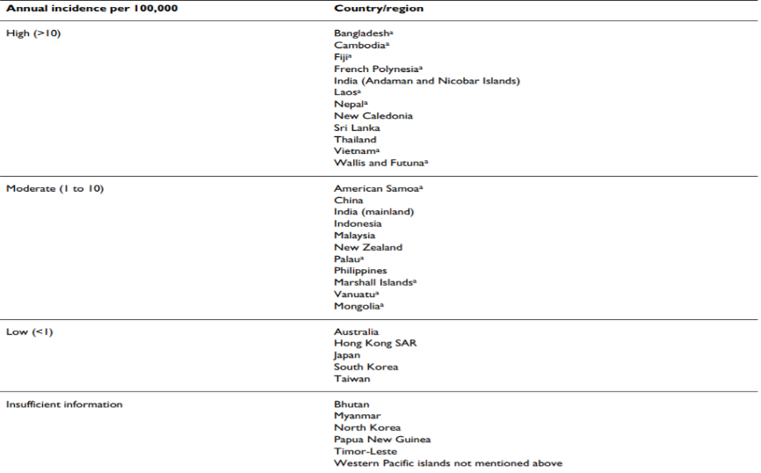
Incidence rate in the Asia Pacific region
Reference: Victoriano, A. F. B., Smythe, L. D., Gloriani-Barzaga, N., Cavinta, L. L., Kasai, T., Limpakarnjanarat, K., ... & Yanagihara, Y. (2009). Leptospirosis in the Asia Pacific region. BMC infectious diseases, 9(1), 147.

Slide 7
Research I

Slide 8









Early Warning and Forecasting System concept
Main objectives
To develop early warning systems of zoonotic diseases (prediction/disease models and risk maps)
To conduct epidemiological investigations of diseases
To support capacity building for public health
Decision support tools
Notification
to farmers
Climate Data
Responses
Vaccination
- Movement control
Quarantine
…
Zoonotic/livestock diseases
- Surveillance Data
- Field surveys

Slide 9
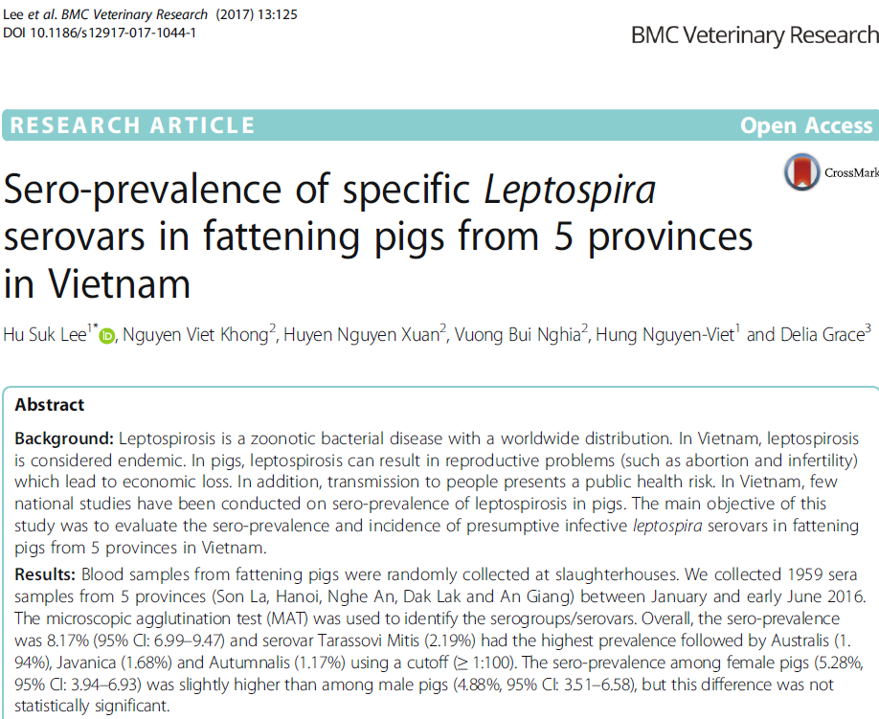
Leptospirosis paper

Slide 10
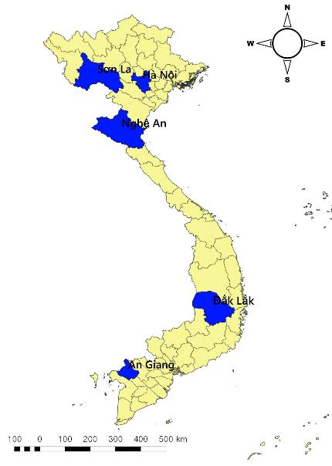
Introduction of study
To evaluate the sero-prevalence of leptospirosis in pigs in Vietnam
National Partner: National Institute of Veterinary Research (NIVR)
Swine blood samples from 5 provinces (Jan- Jun 2016)
- 385 samples* / province
- Total sample: 1,925
- Slaughterhouses (6-9 months)
- Sampling information &
Questionnaires (252 people)
*Sample size (each province): 50% prevalence,
95% CI and precision 5%

Slide 11
Laboratory diagnosis
All samples were analyzed at NIVR in Hanoi
Microscopic Agglutination Test (MAT)
- National standard of animal leptospirosis in Vietnam
- 15 serovars of Leptospira used as antigens
- Cut-off level: ≥ 1:100 titer (~ 800)
- Positive titer is the greatest serum dilution (2-fold from
1:100) agglutinating >50% of live leptospires
*Sample size (each province): 50% prevalence,
95% CI and precision 5%

Slide 12
List of leptospira antigens used in the MAT
No. | Genomospecies | Serogroup | Serovar
1 | L. interrogans | Australis | Australis
2 | L. interrogans | Autumnalis | Autumnaliss
3 | L. interrogans | Bataviae | Bataviae
4 | L. interrogans | Australis | Bratislava
5 | L. interrogans | Canicola | Canicola
6 | L. kirschneri | Grippotyphosa | Grippotyphosa
7 | L. interrogans | Hebdomadis | Hebdomadis
8 | L. interrogans | Icterohaemorrhagiae | Icterohaemorrhagiae
9 | L. borgpetersenii | Javanica | Javanica
10 | L. noguchii | Panama | Panama
11 | L. interrogans | Pomona | Pomona
12 | L. interrogans | Pyrogenes | Pyrogenes
13 | L. borgpetersenii | Sejroe | Hardjo
14 | L. borgpetersenii | Sejroe | Saxkoebing
15 | L. biflexa | Semaranga | Patoc
16 | L. borgpetersenii | Tarassovi | Tarassovi

Slide 13
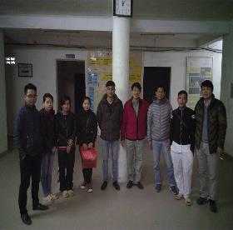
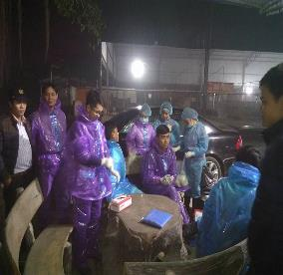

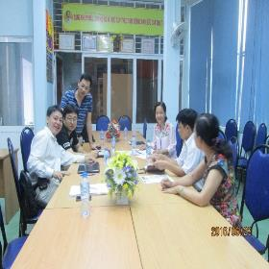
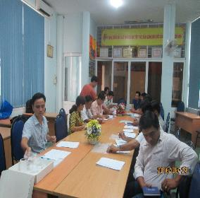
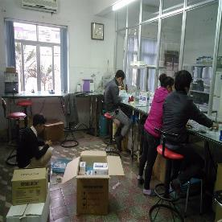
Research team

Slide 14
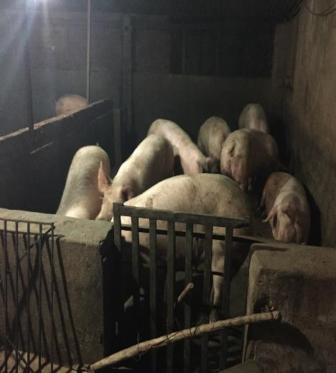
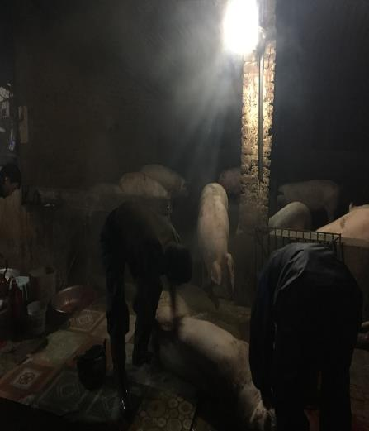
Blood sampling

Slide 15
Sero-prevalence for Leptospira serovars in fattening pigs
Province | Total tested samples | Sero-positive samples (a titer≥1:100 for any serovars) | Sero-positive (%) with 95% CI
Hanoi | 390 | 37 | 9.49 (6.77-12.84)
Son La | 384 | 27 | 7.03 (4.68-10.07)
Nghe An | 380 | 33 | 8.68 (6.05-11.98)
Dak Lak | 385 | 27 | 7.01 (4.67-10.04)
An Giang | 420 | 36 | 8.57 (6.08-11.67)
Total | 1,959 | 160 | 8.17 (6.99-9.47)

Slide 17
MAT results for leptospira serovars in pigs by using 4 cutoff titers
Sero-positive results
 |  | ≥ 1:100 |  | ≥ 1:200 |  | ≥ 1:400 |  | ≥ 1:800
Seorvar | n | n | % (95% CI) | n | % (95% CI) | n | % (95% CI) | n | % (95% CI)
Australis | 1,959 | 38 | 1.94 (1.37-2.65) | 16 | 0.82 (0.42-1.22) | 7 | 0.36 (0.09-0.62) | 4 | 0.20 (0.001-0.40)
Autumnalis | 1,959 | 23 | 1.17 (0.75-1.76) | 7 | 0.36 (0.09-0.62) | 2 | 0.10 (0-0.24) | 1 | 0.05 (0-0.15)
Canicola | 1,959 | 2 | 0.10 (0-0.24) | 1 | 0.05 (0-0.15) | 0 | Null | 0 | Null
Grippotyphosa | 1,959 | 21 | 1.07 (0.62-1.53) | 9 | 0.46 (0.16-0.76) | 4 | 0.20 (0.001-0.40) | 4 | 0.20 (0.001-0.40)
Hardjo | 1,959 | 1 | 0.05 (0-0.15) | 1 | 0.05 (0-0.15) | 0 | Null | 0 | Null
Hebdomadis | 1,959 | 2 | 0.10 (0-0.24) | 1 | 0.05 (0-0.15) | 0 | Null | 0 | Null
Icterohaemorrhagiae | 1,959 | 2 | 0.10 (0-0.24) | 2 | 0.10 (0-0.24) | 2 | 0.10 (0-0.24) | 1 | 0.05 (0-0.15)
Javanica | 1,959 | 33 | 1.68 (1.11-2.25) | 8 | 0.41 (0.13-0.69) | 3 | 0.15 (0-0.33) | 1 | 0.05 (0-0.15)
Tarassovi Mitis | 1,959 | 43 | 2.20 (1.55-2.84) | 11 | 0.56 (0.23-0.89) | 3 | 0.15 (0-0.33) | 1 | 0.05 (0-0.15)

Slide 18
Sero-positive samples by serovar using cutoff titer ≥1:100

Slide 19
Research II

Slide 20
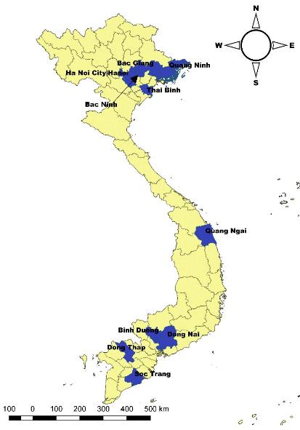
Introduction of study
To evaluate the sero-prevalence of leptospirosis in pigs in Vietnam
National Partner: National Center for Veterinary Diagnostics (NCVD)
Swine blood samples from 10 provinces (Mar-Apr 2017)
- 200 samples / province
- Total sample: 2,000
- Small/medium size farms
Microscopic Agglutination Test was used for diagnosis

Slide 21
Sero-positive (%) for Leptospira serovars by province
Province (no.) | Sero-positive samples (a titer≥1:100 for any serovars) | Sero-positive (%) with 95% CI
Bac Giang (200) | 61 | 30.5 (24.20-37.39)
Bac Ninh (200) | 45 | 22.5 (16.91-28.92)
Binh Duong (200) | 65 | 32.5 (26.06-39.47)
Dong Nai (200) | 38 | 19.0 (13.81-25.13)
Dong Thap (200) | 23 | 11.5 (7.43-16.75)
Hanoi (200) | 23 | 11.5 (7.43-16.75)
Quang Ngai (200) | 75 | 37.5 (30.77-44.61)
Quang Ninh (200) | 43 | 21.5 (16.02-27.85)
Soc Trang (200) | 20 | 10.0 (6.22-15.02)
Thai Binh (200) | 28 | 14.0 (9.51-19.59)
Total (2,000) | 421 | 21.05 (19.28-22.90)

Slide 22
MAT results by using 3 cutoff titers
Serovar | Total samples | ≥ 1:100 | ≥ 1:200 | ≥ 400
 |  | N (%, 95% CI) | N (%, 95% CI) | N (%, 95% CI)
Australis | 2,000 | 45 (2.25, 1.65-3.00) | 4 (0.2, 0.005-0.05) | 0
Autumnalis | 2,000 | 1 (0.05, 0.0001-0.28) | 0 | 0
Bataviae | 2,000 | 10 (0.5, 0.24-0.92) | 1 (0.05, 0.0001-0.28) | 0
Bratislava | 2,000 | 193 (9.65, 8.39-11.03) | 39 (1.95, 1.39-2.66) | 8 (0.4, 0.17-0.79)
Canicola | 2,000 | 45 (2.25, 1.65-3.00) | 2 (0.1, 0.01-0.36) | 0
Grippotyphosa | 2,000 | 18 (0.9, 0.53-1.42) | 2 (0.1, 0.01-0.36) | 0
Icterohaemorrhagiae | 2,000 | 22 (1.1, 0.69-1.66) | 3 (0.15, 0.03-0.44) | 0
Javanica | 2,000 | 13 (0.65, 0.35-1.11) | 4 (0.2, 0.005-0.05) | 0
Panama | 2,000 | 87 (4.35, 3.50-5.34) | 15 (0.75, 0.42-1.23) | 2 (0.1, 0.01-0.36)
Pomona | 2,000 | 31 (1.55, 1.06-2.19) | 3 | 0
Pyrogenes | 2,000 | 122 (6.1, 5.09-7.24) | 8 (0.4, 0.17-0.79) | 0
Hardjo | 2,000 | 0 | 0 | 0
Sakoebing | 2,000 | 0 | 0 | 0
Tarassovi | 2,000 | 91 (4.55, 3.68-5.56) | 8 (0.4, 0.17-0.79) | 1 (0.05, 0.0001-0.28)
Patoc | 2,000 | 5 (0.25, 0.08-0.58) | 1 (0.05, 0.0001-0.28) | 0
Notes:
Panama: horse
Pyrogenes: rodents

Slide 23
Sero-positive samples by serovar using cutoff titer ≥1:100

Slide 24
Sero-positive by age group in pigs using cut off titer ≥ 1:100

Slide 25
Conclusion
Leptospirosis in pigs may be a useful indicator of the human/animal burden in Vietnam
Wildlife may play an important role in the transmission of leptospirosis to domesticated pigs in Vietnam

Slide 26
Future directions
Currently, which types of serovars are commonly detected in humans and wildlife?
Possible transmission of leptospirosis between wildlife and domestic animals/humans
To evaluate the association between leptospirosis and potential environmental risk factors (e.g. climate factors, rural vs urban)
To evaluate the seasonal and temporal patterns of leptospirosis in humans and animals

Slide 27
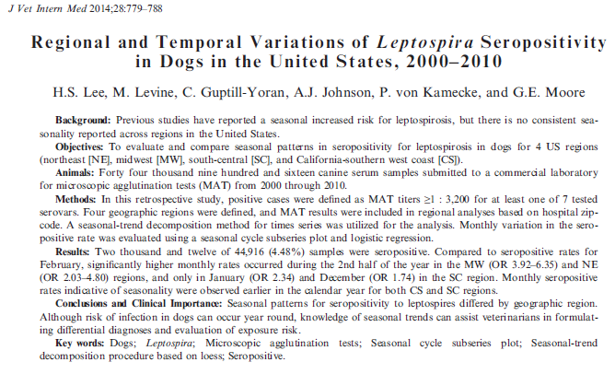
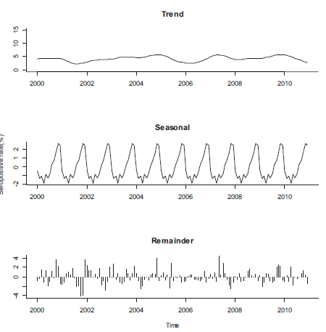
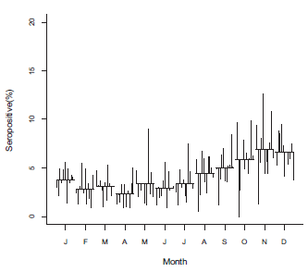
Example: seasonality of leptospirosis

