Slide 1



Viral Disease Control Strategies’ Effect on Technical Efficiency of Layer Farmers in the Bono Region of Ghana
Desmond Ayertey – MPhil student
Supervisors : Dr. Freda E. Asem – University of Ghana; Dr. Charles Yaw Okyere – University of Ghana; Dr. Dolapo Enahoro - International Livestock Research Institute (ILRI)
EEID Mini-Symposium - US-UK Collab: Combined influence of imperfect vaccines and vaccination practices, host genetics, and pathogen mutation rates on the epidemiological-evolutionary dynamics of infections diseases. Roslin Institute, 10-11 March 2025

Slide 2
Problem
Though vaccination schedules are adhered to according to (Okata & Al-Hassan, 2023), layer farmers are not strictly adhering to biosecurity measures.
Less emphasis on biosecurity practices’ effect on efficiency levels.
Research Objective
The main objective is to assess the effect of viral disease control strategies on technical efficiency of layer farms

Slide 3
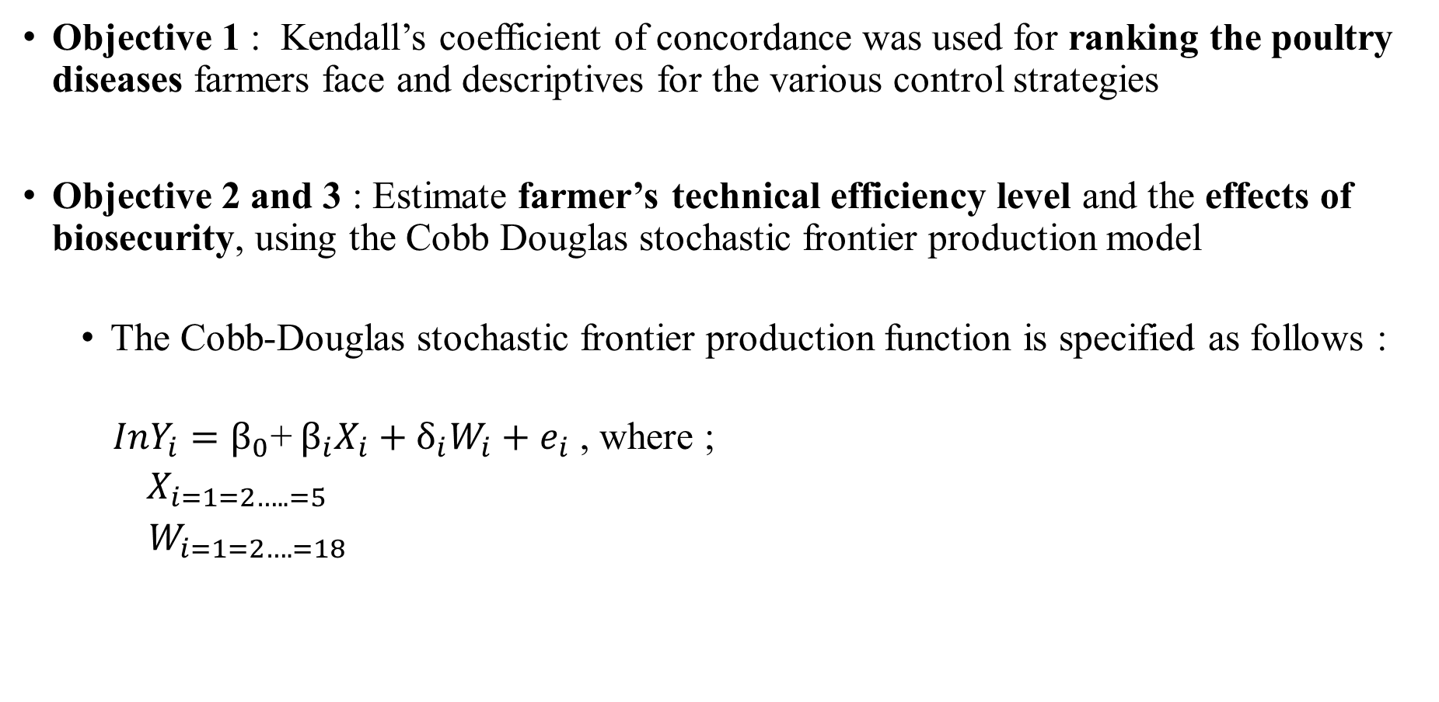
Methodology
Objective 1 : Kendall’s coefficient of concordance was used for ranking the poultry diseases farmers face and descriptives for the various control strategies
Objective 2 and 3 : Estimate farmer’s technical efficiency level and the effects of biosecurity, using the Cobb Douglas stochastic frontier production model
The Cobb-Douglas stochastic frontier production function is specified as follows :
$InY_{i}=β_{0}$+ $β_{i}X_{i}+δ_{i}W_{i}+e_{i}$ , where ;
$X_{i=1=2…..=5}$
$W_{i=1=2….=18}$

Slide 4
Variables Included in the Analysis
X- Variables (Inputs of production) |  | W- Variables (factors influencing technical efficiency) | W- Variables (factors influencing technical efficiency) | W- Variables (factors influencing technical efficiency)
Feed amounts /1,000 birds |  | District | Scale of production (based on # birds) | Use of footbaths
Water used in the production cycle / 1,000 birds |  | Farmer’s age | Culling (of diseased or crowded) birds | Veterinary visits
Vaccines in a production cycle / 1,000 birds |  | Farmer’s gender | Control of human traffic in/out of farm | Regular deworming
Deworming (drugs) |  | Experience (no. years in layer farming) | Monthly cleaning | Monthly disinfection
Labour |  | Number of years of formal education | Use of protective clothing | Rearing other animals
 |  | Member of farmer-based association | Litter change (monthly) | Performing at least five (biosecurity) practices

Slide 5
Socio-economic characteristics
% Farmers by categories

Slide 6
Results
Viral diseases that affect the farmers the most
Viral Diseases | Observations | Mean Rank | Disease Ranking
Infectious Bronchitis | 161 | 1.53 | 1st
Infectious Bursal virus (Gumboro) | 161 | 2.55 | 2nd
New Castle | 161 | 3.28 | 3rd
Fowl_pox | 161 | 3.49 | 4th
Avian Influenza | 161 | 4.17 | 5th
Marek’s Disease | 161 | 5.97 | 6th
Test Statistics
N | 161
Kendall's Wª | .653
Chi-Square | 525.535
df | 5
Asymp. Sig. | .000

Slide 7
Results

Slide 8
Results

Slide 9
Results
Stochastic Frontier Model
Quantity of eggs (crates) | Parameters | Coefficient | p-value
Total feed consumed per 1000 birds | β₁ | 0.288 *** | 0.000
Total Vaccines given per 1000 birds | β₂ | 0.318** | 0.035
Total water consumed per 1000 birds | β₃ | -0.058*** | 0.002
Deworming and other drugs per 1000 birds | β₄ | 0.229*** | 0.000
Labour | β₅ | 0.007 | 0.342
Constant |  | 0.076*** | 0.000
***, **, * are significant at 1%, 5%, 10% levels, respectively

Slide 10
Results

Slide 11
Results
Variable | Parameter | Coefficient | p-value
Member of Farmer-Based Organization | W ₅ | 1.1131* | 0.072
Monthly deworming | W₁₅ | -1.9031* | 0.063
Monthly disinfection | W₁₆ | -2.9493** | 0.001
Rearing of other birds | W₁₇ | 1.7469** | 0.045
Doing at least five practices | W₁₈ | 1.3899 | 0.177
Constant |  | -3.9543** | 0.032
Factors influencing technical efficiency levels
***, **, * are significant at 1%, 5%, 10% levels, respectively

Slide 12
Conclusions
Biosecurity control strategy mostly practiced among these farmers were wearing of protective clothing, monthly disinfection and traffic control
All farmers have experienced at least one of the viral diseases that affect layer chickens
The mean technical efficiency value estimated is 92.40%. Majority (over 76%) of the farmers are operating efficiently.
Biosecurity practices that influenced the technical efficiency level are monthly disinfection and rearing of other birds
Notes:
1. There were 85%, 40% and 38% respectively.

Slide 13
Recommendations
Education on biosecurity, currently provided by the Veterinary Services and Animal Health departments should be done more routinely.
Routine sensitization and enforcement of biosecurity control strategies should be done by both Veterinary Services and the Animal Production Directorate of MoFA.
Farmers should confine and separate other animals they rear on the farm from layer chicken to avoid the transfer of viral disease to these birds
Notes:
Coping strategies play a role in the production of layer chicken positively in terms of egg production and health of birds aside vaccination schedule. It is therefore important to increase the level of biosecurity practices through constant education and strict adherence by the Veterinary Services and Animal Production Directorate.

Slide 14
What’s Next?
Study on technology adoption, to understand:
what factors drive farmers’ choice of breeds, uptake of vaccination, and adoption of biosecurity measures
interactions of the influencing factors
key areas for policy interventions to influence farmer behaviors.

Slide 15
Acknowledgement
The work was funded by the Biotechnology and Biological Science Research Council (BBSRC), Project US-UK Collab: Combined influence of imperfect vaccines, host genetics and non-genetic drivers on virus transmission and virulence evolution, award reference (BB/V017411/1).
Notes:
Coping strategies play a role in the production of layer chicken positively in terms of egg production and health of birds aside vaccination schedule. It is therefore important to increase the level of biosecurity practices through constant education and strict adherence by the Veterinary Services and Animal Production Directorate.

Slide 16
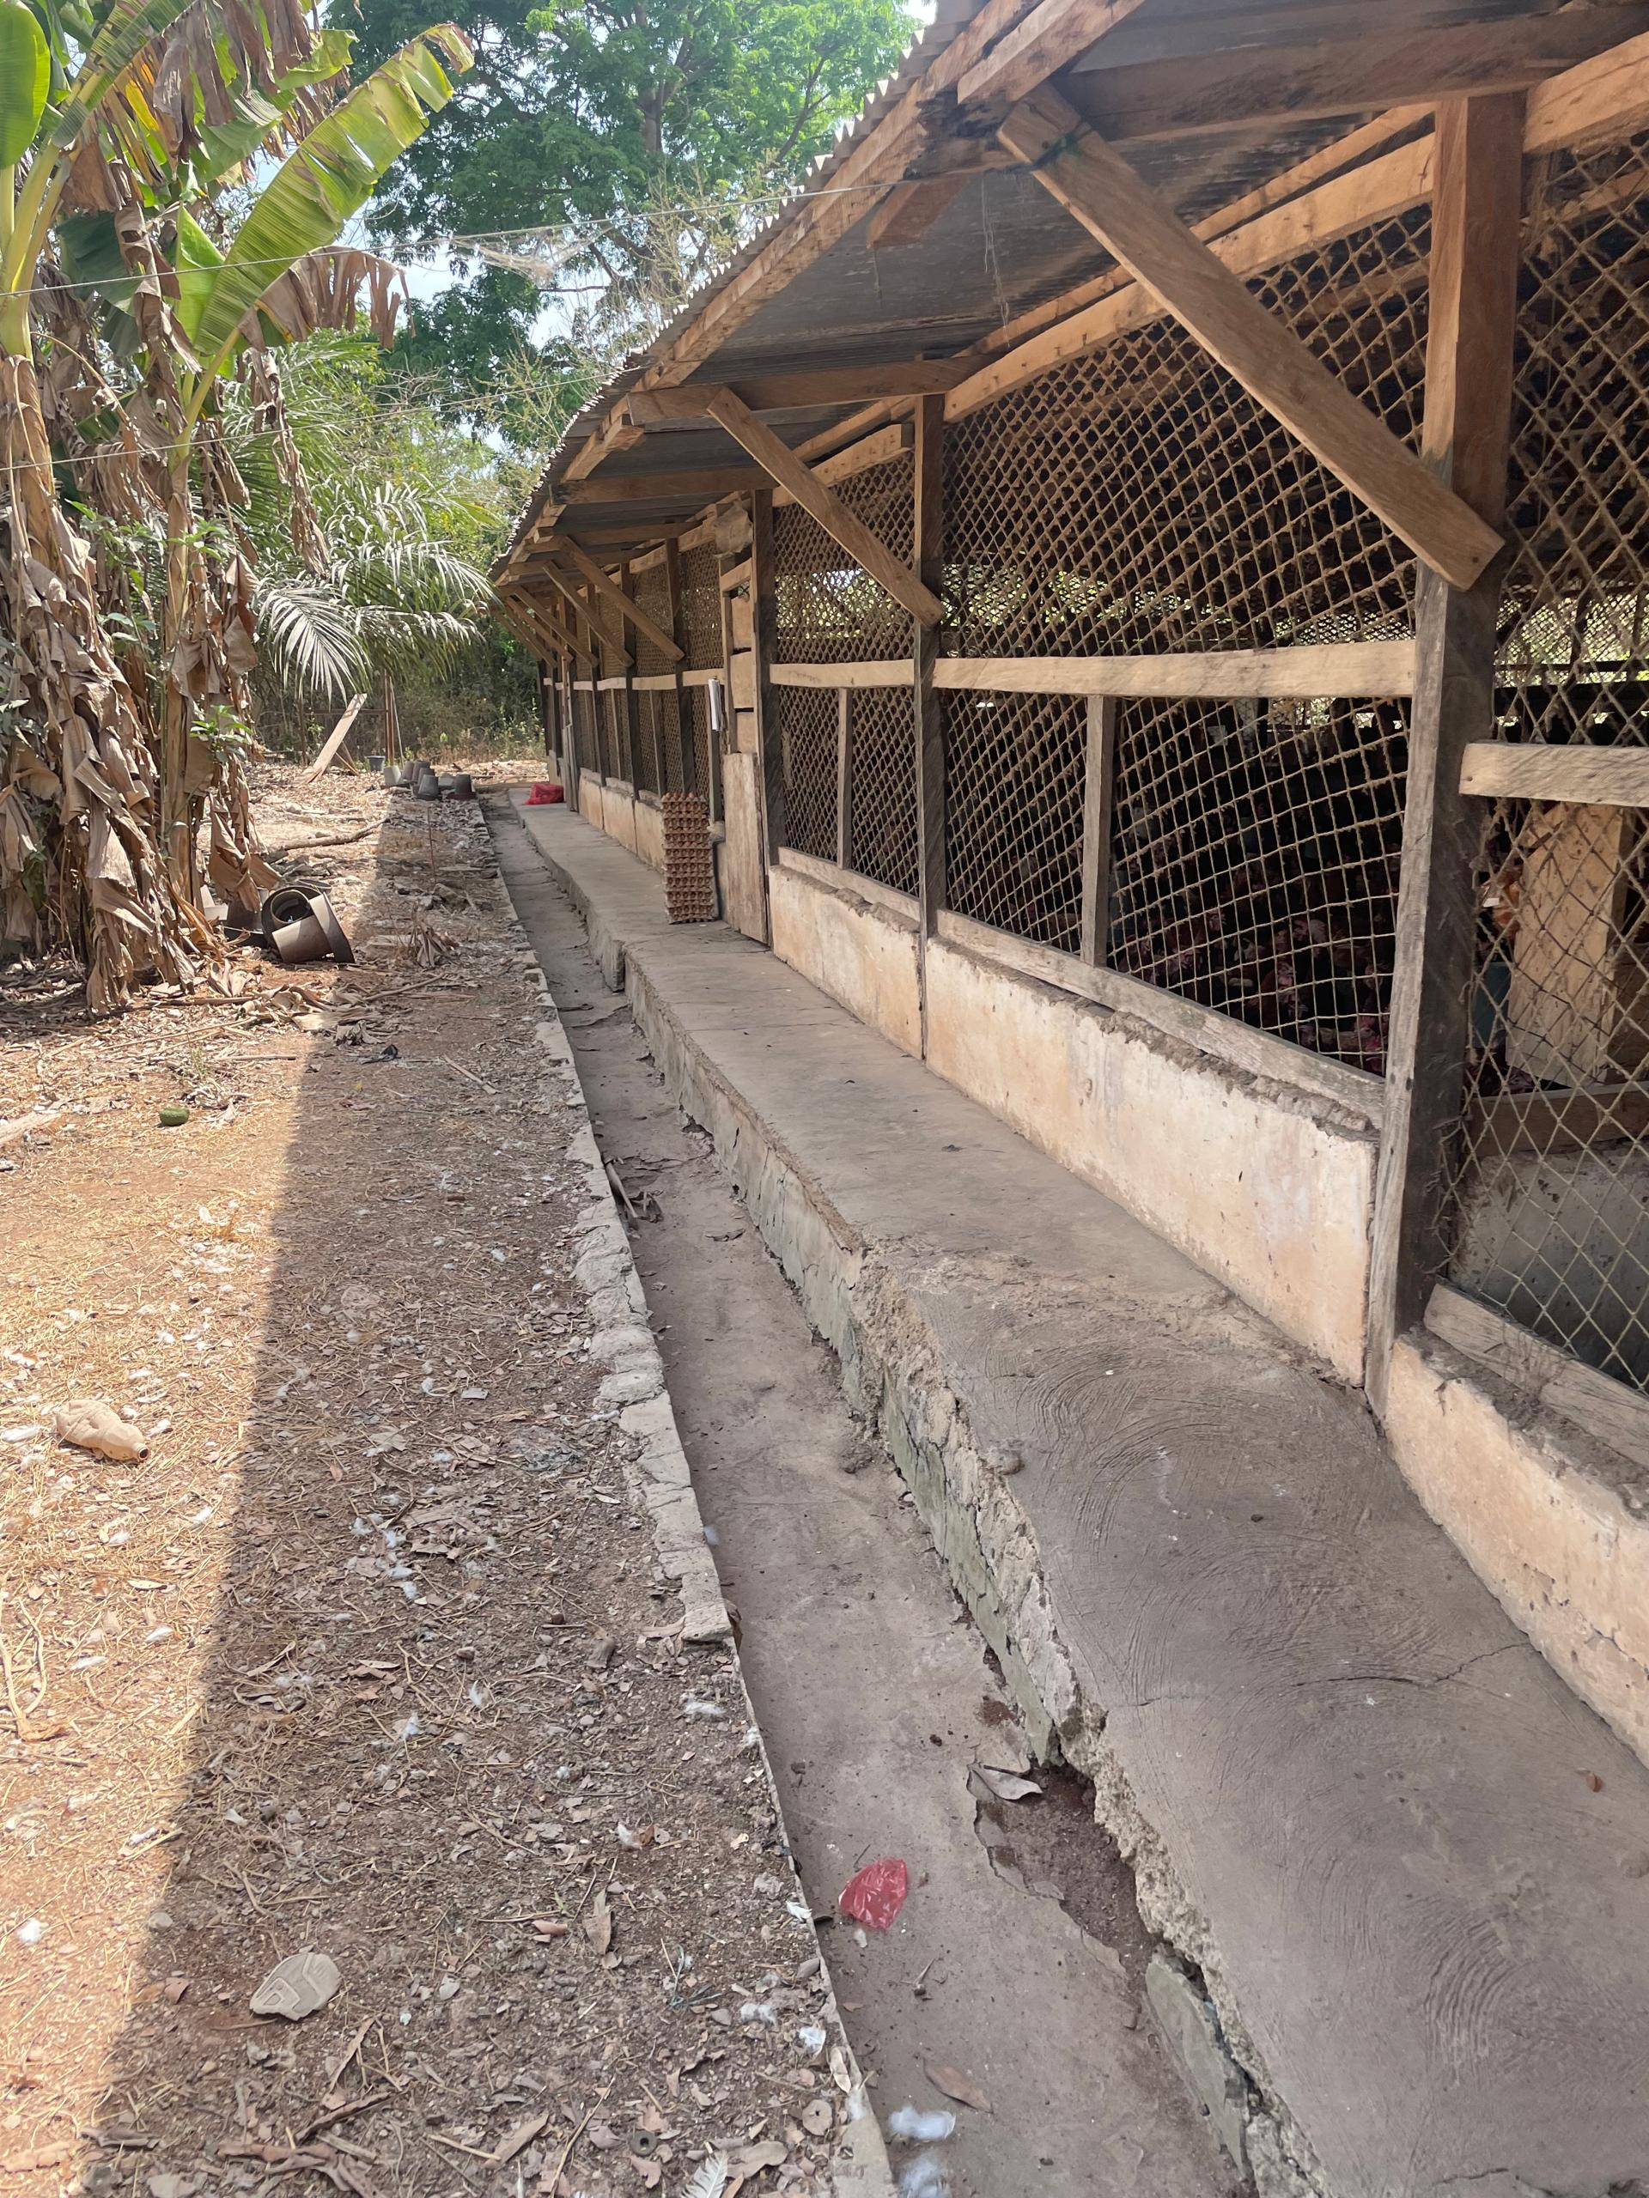
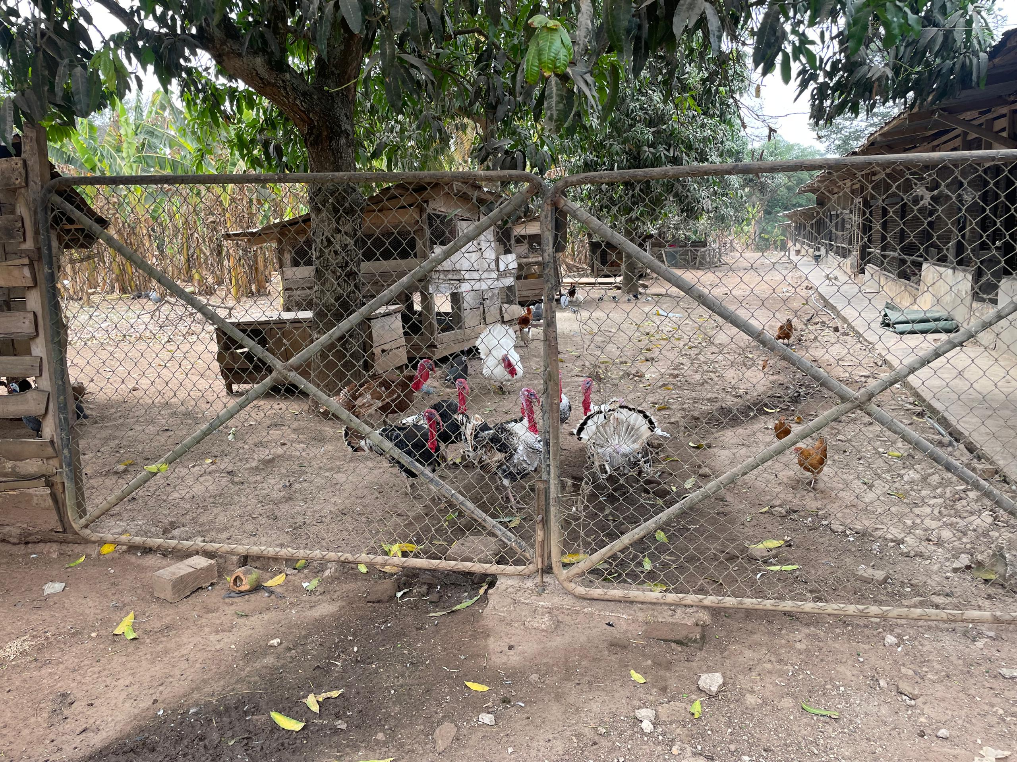
Field Photos
A fence available to control traffic and rearing of other birds on the compound of the pens of layers
Pens without footbath

Slide 17
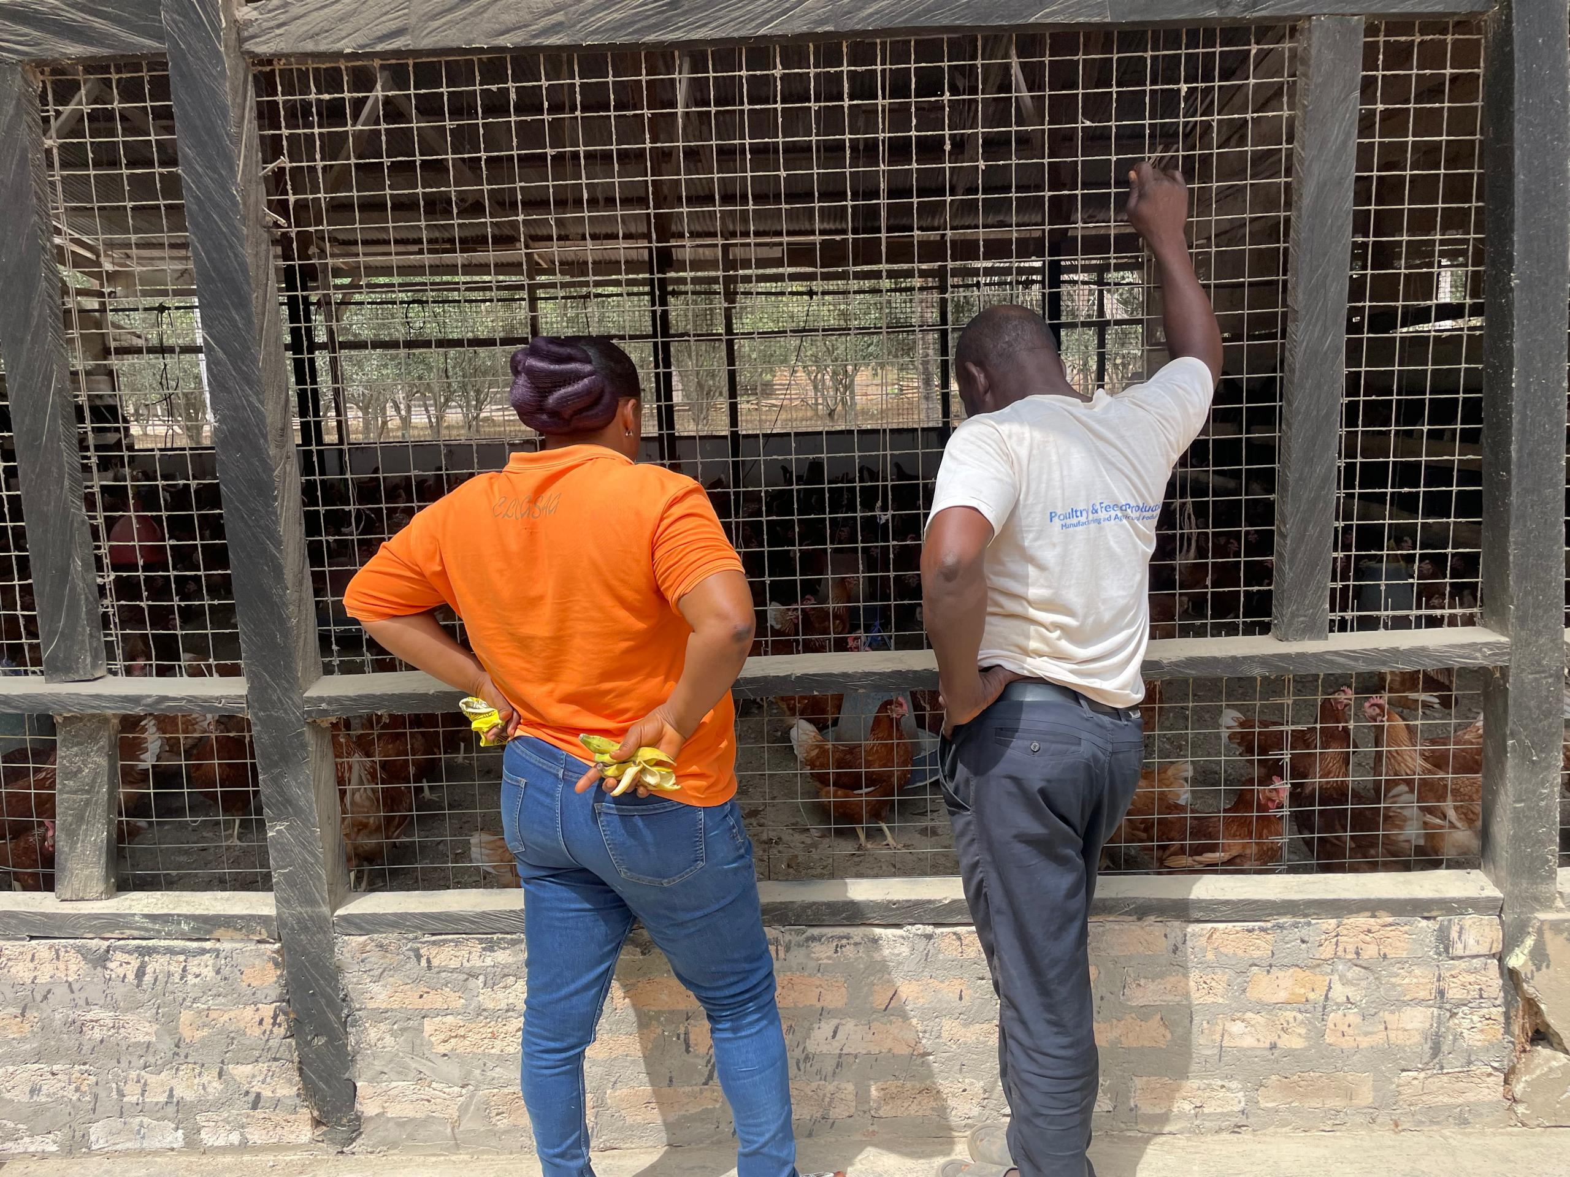
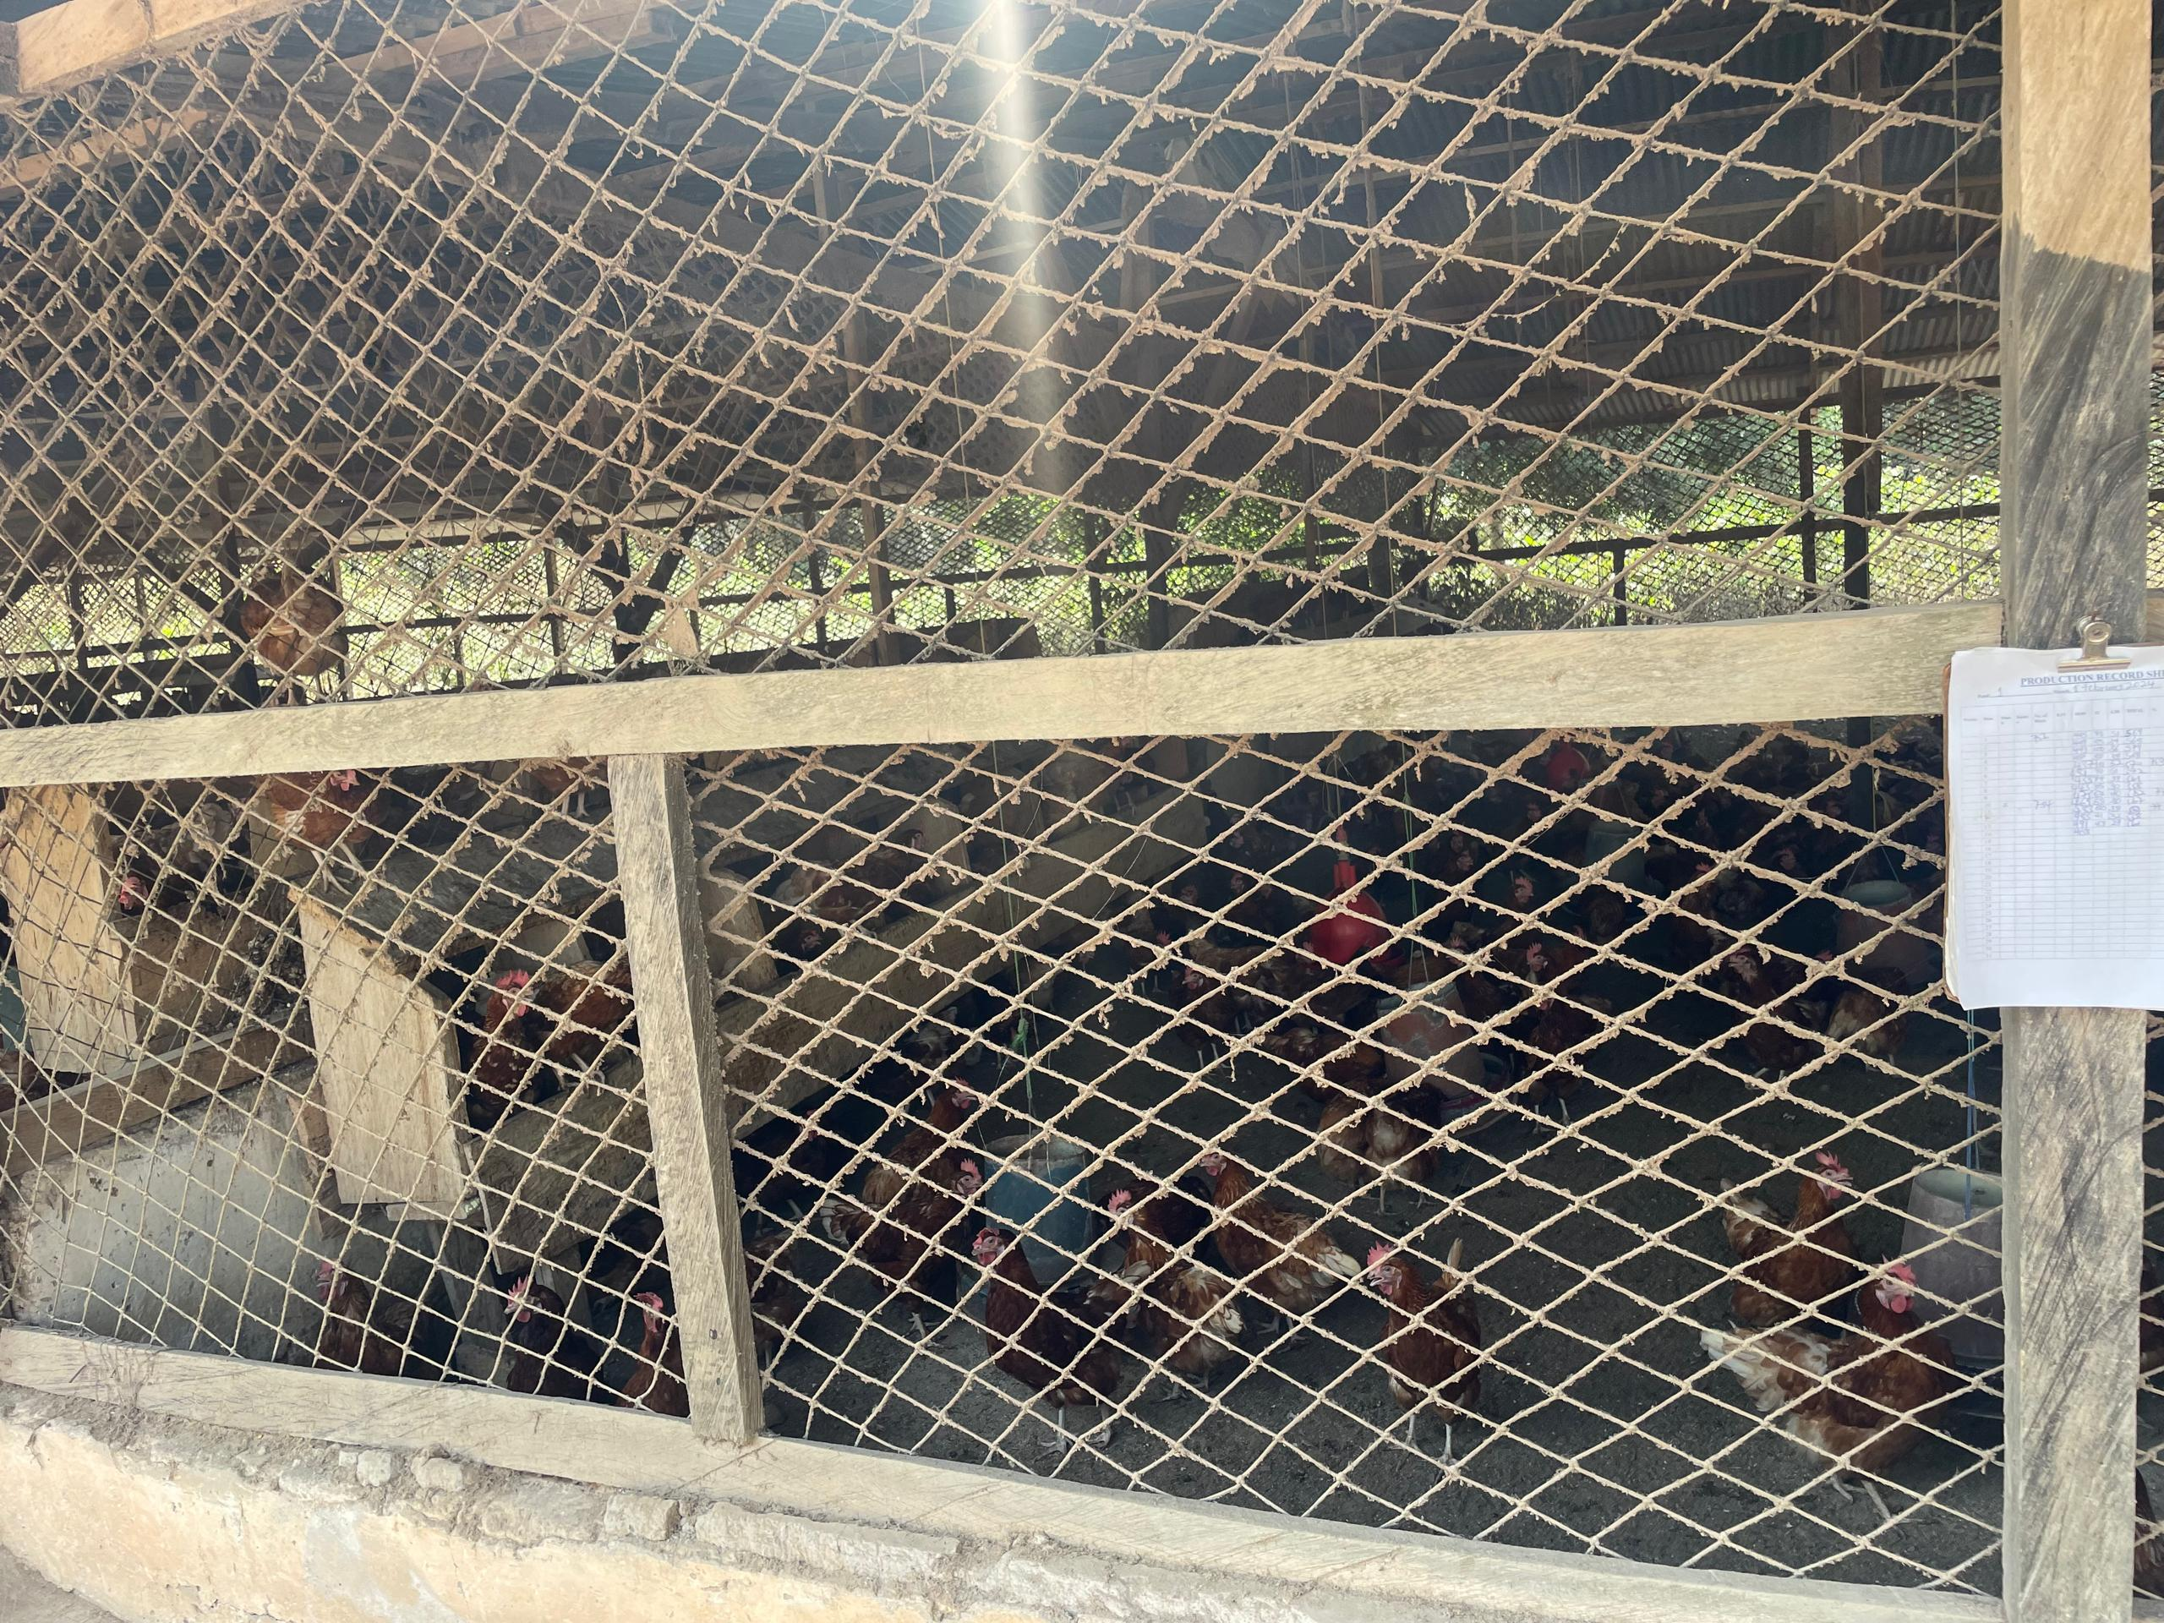
Field Photos
Active and healthy layer chicken
Clean wire netting for proper ventilation

Slide 18
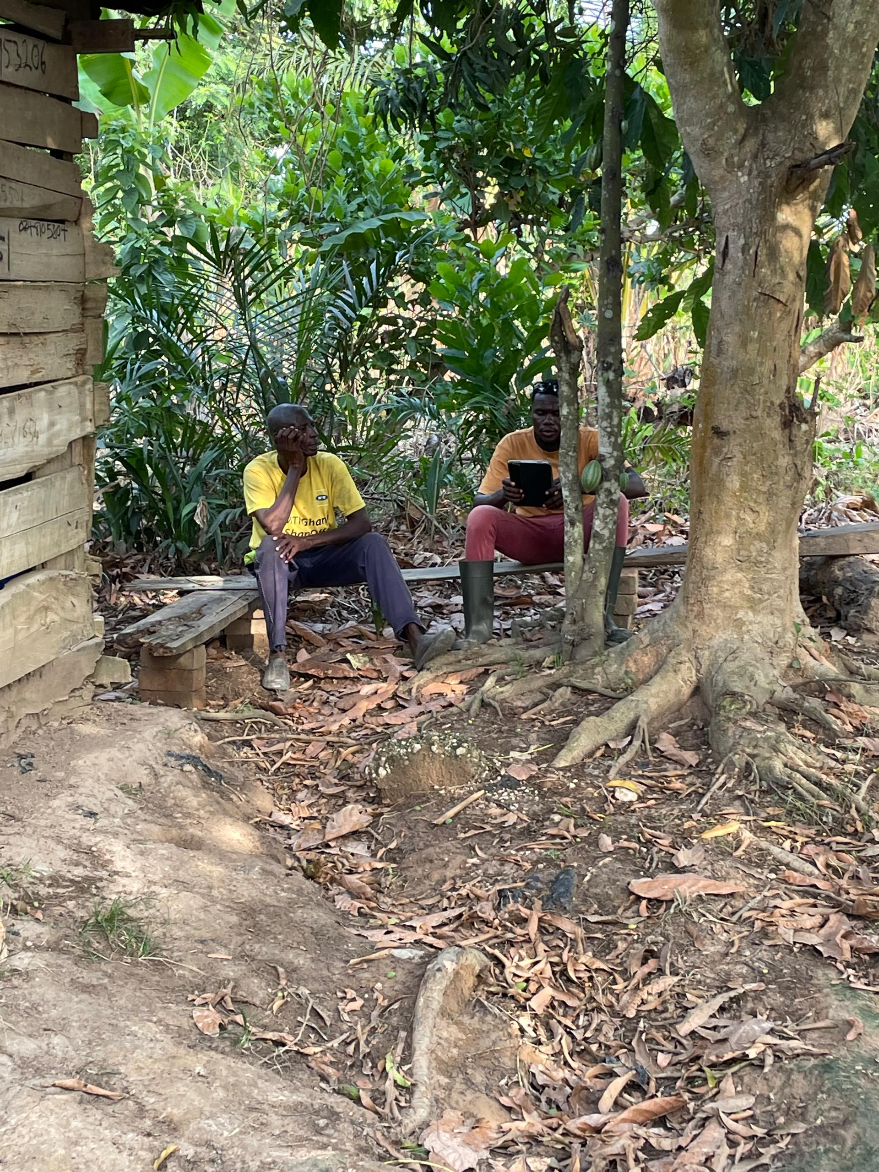
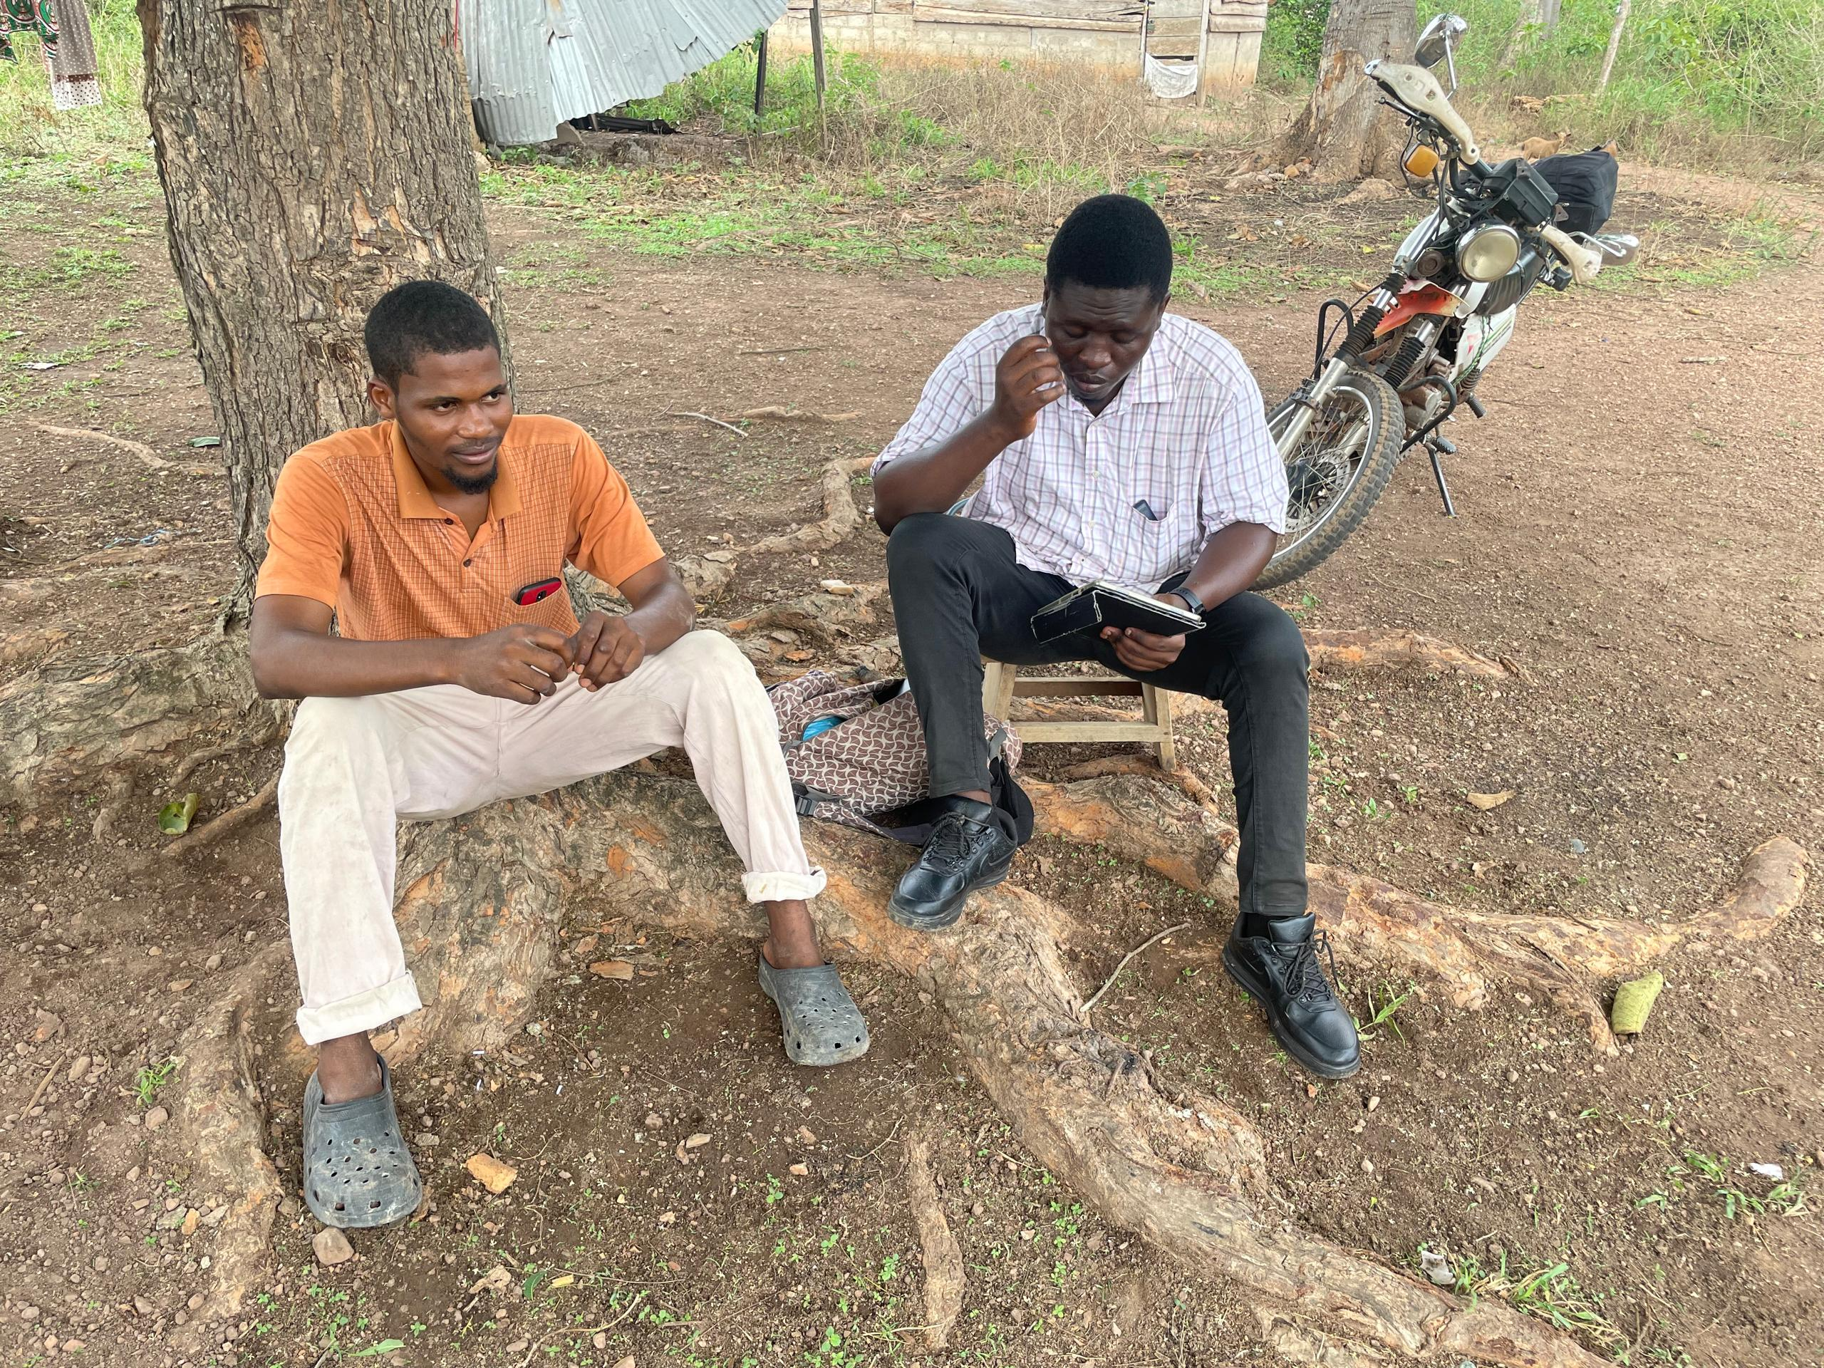
Field Photos
Interviewing farmers

Slide 19
THANK YOU

Slide 20
References
Adei, D., & Asante, B. K. (2012). The Challenges and Prospects of the Poultry Industry in Dormaa District. Journal of Science and Technology , 104-116.
Akintunde, O. K., Agboola, T. O., & Alabi, B. O. (2020). Assessment of Effect of Biosecurity Level on Profit Efficiency in Poultry Egg Production in Southwestern, Nigeria. Nigerian Journal of Animal Science, 22(1), 208–224.
Mpenda, F. N., Schilling, M. A., Campbell, Z., Mngumi, E. B., & Buza, J. (2019). The genetic diversity of local african chickens: A potential for selection of chickens resistant to viral infections. Journal of Applied Poultry Research, 1-12.
Okata, E. O., & Al-Hassan, R. M. (2023). Does publishing poultry vaccination schedule increase awareness and compliance among small-scale farmers? Evidence from Eastern Ghana. https://doi.org/10.1080/23311932.2023.2241709asa
Rozins, C., Day, T., & Greenhalgh, S. (2019). Managing Marek’s disease in the egg industry. Epidemics, 27, 52–58. https://doi.org/https://doi.org/10.1016/j.epidem.2019.01.004

