Slide 1

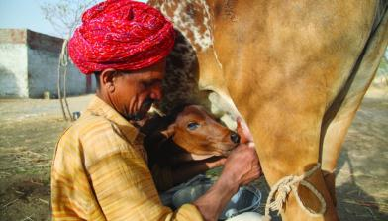
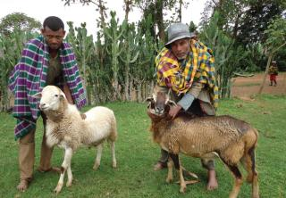


Systematic Literature Review Training:
Searching for Literature
Emmanuel Muunda, ILRI
Online Training on Systematic Literature Review, ILRI Nairobi, 5-6 May 2020
Notes:
There MUST be a CGIAR logo or a CRP logo. You can copy and paste the logo you need from the final slide of this presentation. Then you can delete that final slide
To replace a photo above, copy and paste this link in your browser: http://www.flickr.com/photos/ilri/sets/72157632057087650/detail/
Find a photo you like and the right size, copy and paste it in the block above.

Slide 2
Outline
Understand basic database structure
Use of Boolean Logic
Use Field Searching
Use of Controlled Vocabulary
Specialty techniques (truncation, etc.)
Building your search strategy

Slide 3
Why Literature Search?
To answer a specific question
To learn more about a topic (education)
To determine current best practices (guideline)
To backup your finding
To give the best possible recommendation or answer research questions using evidence-based solutions/findings

Slide 4
Information Overload
Year | # new citations indexed*
2019 | 1,366,447
2018 | 1,329,148
2017 | 1,150,125
2016 | 1,165,957
E.G PubMed contains over 24 million citations going back to ~1950
*statistics from http://www.nlm.nih.gov/bsd/bsd_key.html

Slide 5
Types of Online Databases
List of databases
ACS | Cambridge Online Journals | SciFinder Scholar
Annual Reviews | IEEE Xplore | Science Direct
ASCE | JSTOR | Taylor & Francis
ASME | Nature | Wiley
BioOne | ProQuest | PubMed
CAB Direct | Sage | Google Scholar

Slide 6
So, Before starting search consider;
The keywords
Other ways to spell the keywords
Other words which mean the same thing (synonyms)
Related keywords need to be included
Limits to apply: date, language, age group, publication type
**How do we narrow our search?

Slide 7
Boolean Logic
A British mathematician named George Boole (1815-1864) developed an algebraic system of logic that is now widely used in computer systems including database searching.
While Boole’s algebraic system can be complex, a very simple form of Boolean Logic is used for searching most bibliographic databases.

Slide 8
Boolean Operators
Standard Boolean Logic for database searching uses 3 relationships among search terms.
AND
OR
NOT
It is both simple and powerful.

Slide 9
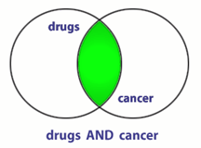
AND
BOTH terms included in any results.
If a record has only one of the two terms, it will not be retrieved.
If the record has neither term, it will not be retrieved.
What does this do to the amount of records retrieved?

Slide 10
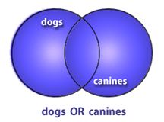
OR
Only one (NOT both) of the terms are in the results
‘OR’ will retrieve the record if both are included.
What does OR do to the amount of records retrieved?

Slide 11
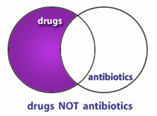
NOT
Excludes any results containing the term
Records containing both will not be retrieved.
What does NOT do to the amount of records retrieved?

Slide 12
Using OR
“OR” groupings contain terms for the same idea/concept and are usually put in parenthesis
(term OR term OR term)
where all terms are difference ways of representing the same concept
(faculty OR teachers OR professors)
(students OR learners OR pupils)

Slide 13
Using AND
“AND” groupings contain terms for different ideas/concepts and can combine OR groupings
Term AND (Term OR Term) where each represents a different concept
Lungs AND smoking
Obesity AND exercise
Cancer AND (treatment OR therapy)

Slide 14
Using NOT
“NOT” statements are usually put last and can contain an “OR” grouping; they are often used to get rid of a common subgroup
Students NOT teacher
Crime NOT juvenile

Slide 15
Putting Them Together
Identify the concepts (Parse the question)
List specific terms for each concept
Put the terms for each concept in an OR statements within parentheses
Combine OR statements with AND
Add any NOT statements to the end

Slide 16
Creating a Boolean Search
QUESTION: Is Vitamin C helpful in treating the flu?
Identify concepts and list terms
Concept 1 Influenza | Concept 2 Vitamin C | Concept 3 Treatment | Concept 4 helpfulness
Influenza | Vitamin C | Treatment | Outcome
Flu | Ascorbic acid | Therapy | Recovery
 | Orange Juice | Management | Success

Slide 17
Step 2
2. Make your OR statements, one per concept
  (influenza OR flu OR orthomyxovirus)
  (vitamin C OR ascorbic acid OR ascorbate)
  (treatment OR therapy OR management)
  (outcome OR recovery OR success)

Slide 18
Steps 3 and 4
3. Put “AND” between each of the OR statements
(influenza OR flu) AND (vitamin C OR ascorbic acid OR orange juice) AND (treatment OR therapy OR management) AND (outcome OR recovery OR success)
4. Consider any NOT statements you might want to add.
Note: NOT isn’t used very often

Slide 19
Parsing a Boolean Search
(emergency OR acute OR critical) AND (treatment OR therapy OR management OR care) AND (motor vehicle accident OR car crash) NOT (pedestrian OR walking)
What are the four concepts?
What terms are used for each concept?
Which three concepts must be included in all records found?
Which concept must not be included in any record found?

Slide 20
Beyond Basic Boolean
Field Searching
Controlled Vocabulary
  Subject vs. Keyword Searching
Specialty Features
  Truncation
  Phrase searching

Slide 21
Field Searching
Majority of databases will provide enable you to search a specific field(s).
Enables faster searching
Enables more accurate searching
Enables Filtering

Slide 22
Search limits
Consider search refinements to limit to specific aspects of a topic, such as:
Meta-Analysis (quantitative summary combining results of independent studies)
human or animal studies
male or female subjects
age groups, for example adolescents, infants
time periods
languages

Slide 23
PubMed Format - The influence of livestock-derived foods on nutrition during the first 1,000 days of life – LMIC
(Infant OR child* OR (pregnan* AND (woman OR women)) OR (lactat* AND (woman OR women)) OR breastfeed*) AND ("trial" OR experiment OR supplementation OR intervention) AND (diet OR supplement OR consumption OR nutrition* OR feed*) AND (meat OR milk OR egg OR dairy OR "animal source food" OR fish OR "animal products" OR "foods of animal origin") AND (Developing Countries OR Africa OR Africa, Northern OR Africa South of the Sahara OR Africa, Central OR Africa, Eastern OR Africa, Southern OR Africa, Western OR Asia OR Asia, South OR Asia, Southern OR Asia, Southeastern OR Afghanistan OR Algeria OR Angola OR Bangladesh OR Benin OR Bhutan OR Botswana OR Brunei Darussalam OR Burkina Faso OR Burundi OR Cambodia OR Cameroon OR Cape Verde OR Central African Republic OR Chad OR Comoros OR Congo OR "Cote d'Ivoire" OR Djibouti OR "Democratic Republic of the Congo" OR East Timor OR Egypt OR Eritrea OR Ethiopia OR Gabon OR Gambia OR Ghana OR Guinea OR Guinea-Bissau OR India OR Indonesia OR Iran OR Kenya OR Laos OR Lesotho OR Liberia OR Libya OR Madagascar OR Malawi OR Malaysia OR Maldives OR Mali OR Mauritania OR Mauritius OR Morocco OR Mozambique OR Myanmar OR Namibia OR Nepal OR Niger OR Nigeria OR Pakistan OR Papua New Guinea OR Philippines OR Rwanda OR Senegal OR Seychelles OR Sierra Leone OR Singapore OR Sri Lanka OR Somalia OR South Africa OR Sudan OR Swaziland OR Tanzania OR Thailand OR Togo OR Tunisia OR Uganda OR Vietnam OR Zambia OR Zimbabwe) https://hdl.handle.net/10568/92907

Slide 24
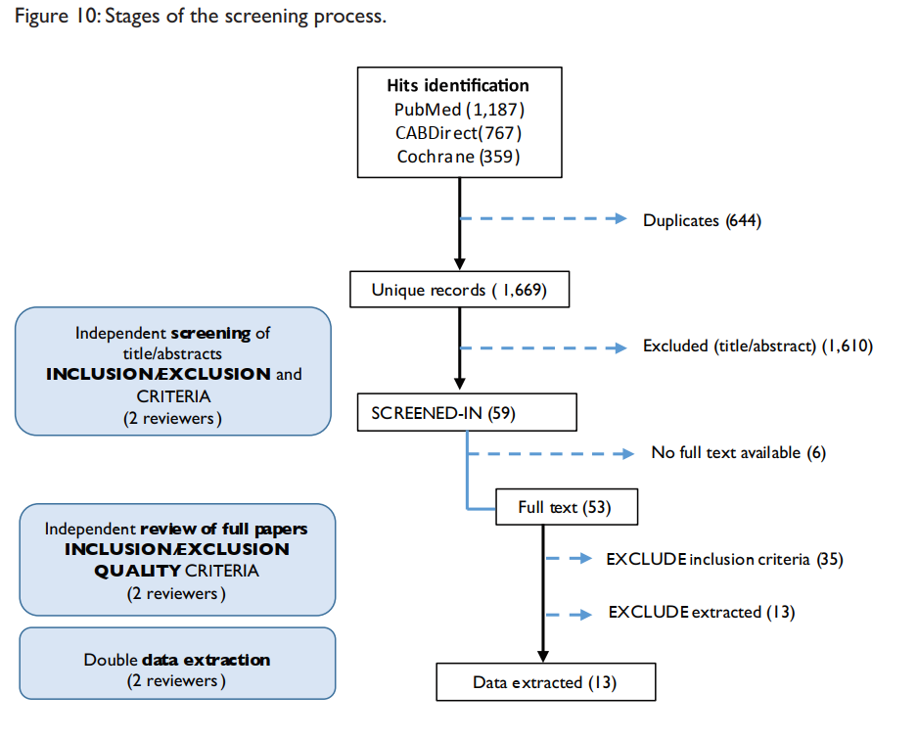
PubMed Outcome - 2016

Slide 25
CAB Direct Format – Food safety interventions in Africa
(title: (foodborne OR "food safety" OR "safety label" OR "food hygiene" OR "food-borne" OR "food borne" OR "kitchen hygiene" OR "street food" OR abattoir OR slaughter* OR "willing* to pay" NOT "organic" NOT "indigenous" NOT "GMO" NOT "exotic") OR ab: (foodborne OR "food safety" OR "safety label" OR "food hygiene" OR "food-borne" OR "food borne" OR "kitchen hygiene" OR "street food" OR abattoir OR slaughter* OR "willing* to pay" NOT "organic" NOT "indigenous" NOT "GMO" NOT "exotic")) AND (title: (intervention OR trial OR experiment OR impact OR evaluation OR effect OR control OR manag* OR improve OR achiev*) OR ab: (intervention OR trial OR experiment OR impact OR evaluation OR effect OR control OR manag* OR improve OR achiev*)) AND ( Africa, Northern OR *sahara* OR Africa, Central OR Africa, Eastern OR Africa, Southern OR Africa, Western OR Algeria OR Angola OR Benin OR Botswana OR "Burkina Faso" OR Burundi OR Cameroon OR "Cape Verde" OR "Central African Republic" OR Chad OR Comoros OR Congo OR "Cote d'Ivoire" OR Djibouti OR "Democratic Republic of the Congo" OR DRC OR Egypt OR Eritrea OR Ethiopia OR Gabon OR Gambia OR Ghana OR Guinea OR Guinea-Bissau OR "Ivory Coast" OR Kenya OR Lesotho OR Liberia OR Libya OR Madagascar OR Malawi OR Mali OR Mauritania OR Mauritius OR Morocco OR Mozambique OR Namibia OR Niger OR Nigeria OR Rwanda OR Senegal OR "western Sahara" OR Seychelles OR "Sierra Leone" OR Somalia OR "South Africa" OR Sudan OR Swaziland OR Tanzania OR Togo OR Tunisia OR Uganda OR Zambia OR Zimbabwe))yr:[2007 TO 2017]

Slide 26


