Slide 1
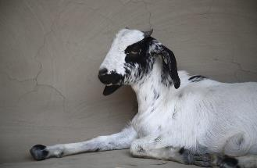




CG Core v2 Schema from the DSpace Perspective
Alan Orth
CGSpace Technical Manager
Monitoring, Evaluation and Learning (MEL) Developers’ Retreat
Nairobi, Kenya
3- 6 December 2019
Notes:
Disclaimer: I am not a metadata expert or ontologist!

Slide 2
Dublin Core Schema Context & Landscape
DC → QDC → DCTERMS
  1995: DC originates at OCLC workshop in Dublin, Ohio
    aka “simple”, consists of fifteen core metadata elements called the Dublin Core Metadata Element Set (DCMES)
  2000: Ongoing process by working groups to develop qualifiers and encoding schemes for the DCMES
  2008: DCTERMS supersedes DC and QDC
    Includes and refines previous schemas, adds new fields
    Each term has a unique URI, all defined as RDF properties
Excellent resource: https://en.wikipedia.org/wiki/Dublin_Core
Notes:
Background context and evolution of Dublin Core, to say nothing of other schemas.

Slide 3
Dublin Core in DSpace
  DSpace implements Qualified Dublin Core
  DSpace partially implements DCTERMS
  Simple Dublin Core, Qualified Dublin Core, and DCTERMS are all available for describing items in a DSpace repository
  Advanced: DSpace can use “crosswalks” to express metadata in other formats (depending on how good you are with XSLT)

Slide 4
Value Proposition for a “CG Core” Schema?
  Is it bad to say “I don’t know”?
  Why not use qualifiers, as permitted by Dublin Core?
    dc.subject.ilri
    dc.coverage.country
    dc.identifier.doi
    dc.creator.affiliation
    dc.date.embargo
    etc...
  See DMCI Grammatical Principles section 2.3
Notes:
Why didn’t we just make use of qualifiers, as permitted by Dublin Core?

Slide 5
DCMI “Dumb-down Principle”
“The qualification of Dublin Core Elements is guided by a rule known colloquially as the Dumb-Down Principle. According to this rule, a client should be able to ignore any qualifier and use the value as if it were unqualified. While this may result in some loss of specificity, the remaining term value (minus the qualifier) must continue to be generally correct and useful for discovery. Qualification is therefore supposed only to refine, not extend the semantic scope of an Element.”
“DCMI: DCMI Grammatical Principles”. www.dublincore.org. Retrieved 4 December 2019.
Notes:
Why didn’t we just stick to dc.subject.ilri, dc.identifier.doi, dc.coverage.country, etc as permitted by Dublin Core?

Slide 6
Value Proposition for a “CG Core” Schema
  Similar to the DC → QDC → DCTERMS evolution
  Introduction of formal schema with RDF data model
    See: agriculturalsemantics.github.io/cg-core/cgcore.rdf
  Standardized guidance about metadata fields and controlled vocabularies
    For example, using ORCID for unique author identifiers
    For example, using ISO 639 alpha 3 for language codes
    See: agriculturalsemantics.github.io/cg-core/cgcore.html
  Enable programmatic validation of data sets using the schema
Notes:
Medha Devare, Carlos Quiros, Martin Mueller, Marie-Angelique.

Slide 7
The “CG Core” Dream
A “core” schema for meaningful metadata interchange between CGIAR centers, CRPs, etc.
  Rise of web-based institutional repositories like DSpace, CKAN, and DataVerse in CG after late 2000s
  Harvesting of repositories as means of syndication (no duplication of content!)
  Increased interest in reporting and impact assessment
  Bonus: build cool things like AReS Explorer and GARDIAN to see all research across the CG in one place!
Notes:
Medha Devare, Carlos Quiros, Martin Mueller, Marie-Angelique.

Slide 8
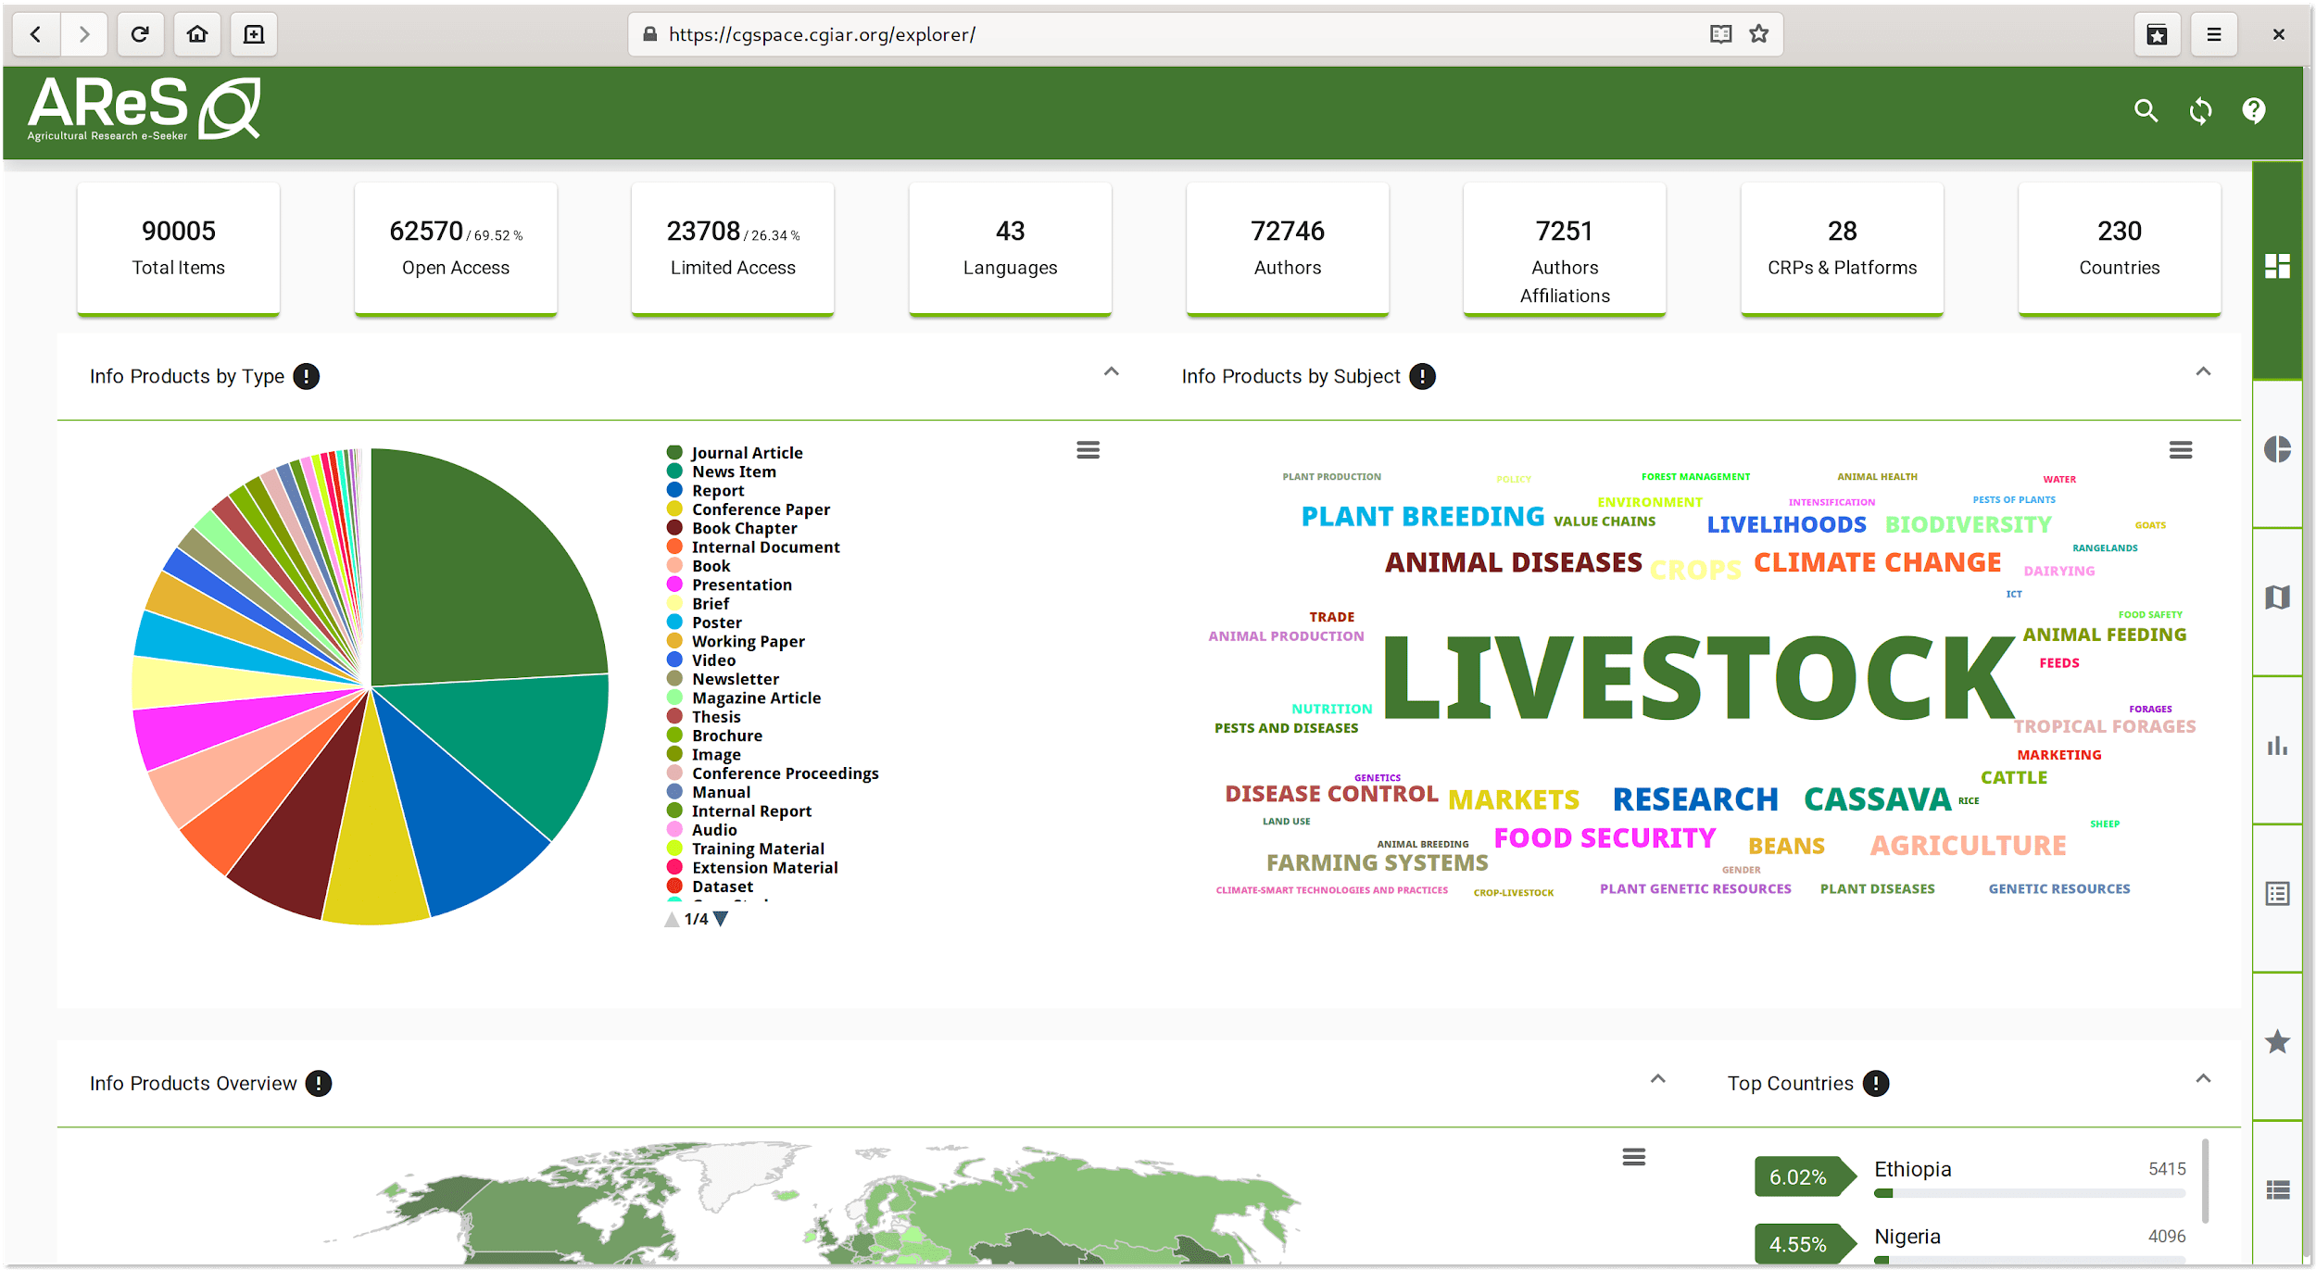
Build Cool Things
“AReS Explorer”. https://cgspace.cgiar.org/explorer. Retrieved 4 December 2019.
Notes:
Medha Devare, Carlos Quiros, Martin Mueller, Marie-Angelique.

Slide 9
Progress on “CG Core” Schema
  “CG Core” initiative undertaken in 2015
  Formation of Metadata Working Group
  CGcore Draft version beta 1 (November, 2016)
  Beta version 1.0 (March, 2017)
  CG Core v2 “soft ratification” at the Big Data Platform meeting in Kenya (October, 2018)
  CG Core v2 review by ILRI, ICARDA, IITA, and WorldFish in Jordan (January, 2019)
  CG Core v2 ongoing review by Alan, Abenet, and Marie-Angelique (mid-to-late 2019)
Notes:
Medha Devare, Carlos Quiros, Martin Mueller, Marie-Angelique.

Slide 10
CG Core v2 Metadata Changes in Practice
  Much of CG Core v2 is simply aligning with DCTERMS
  For example, in the CGSpace context, some fields gain a more appropriate home within DCTERMS:
    cg.identifier.status → dcterms.accessRights
    dc.rights → dcterms.license
    cg.link.reference → dcterms.relation
    dc.description.abstract → dcterms.abstract
  Others merely change places:
    dc.type → dcterms.type
    dc.format.extent → dcterms.extent
    dc.relation.ispartofseries → dcterms.isPartOf
See the full list: https://alanorth.github.io/cgspace-notes/cgspace-cgcorev2-migration
Notes:
Others are more complicated. Need to see reference schema to understand.

Slide 11
Technical Limitations to Adoption in DSpace
  DSpace 5.x and 6.x have many hard-coded references to DC fields (see: IncludePageMeta.java)
  Impossible to migrate away from some fields:
    dc.title
    dc.identifier.uri
    dc.contributor.author
    dc.date.accessioned
    etc…
  DSpace uses a flat schema, so this is not possible:
<dc.creator affiliation="ILRI">Alan Orth</dc.creator>

Slide 12
Progress of CG Core v2 Implementation
  CGSpace public test server is running CG Core v2 as of November, 2019
    Item submission ✓
    Item display ✓
    OAI-PMH ✓
    REST API ✓
  CGSpace-specific DSpace 5.x code modifications are available on GitHub
  Thorough implementation notes also available
  Soon solicit feedback from CGSpace community
  Massive effort for downstream consumers of CGSpace
    How long should the notice period be?
Notes:
As far as I know CGSpace is the only party working to implement CG Core v2 currently.

Slide 13
Acknowledgements
Medha Devare, Carlos Quiros, and Martin Mueller for getting the first few drafts and betas of CG Core out the door.
Marie-Angélique Laporte for being receptive to feedback and for bringing “CG Core v2” into open, accessible development on GitHub.

