Slide 1




Part of a post-graduate course on “Climate Change, Water Security & Nexus” Course Lead: Prof. Vishnu Prasad Pandey, Center for Water Resources Studies, Institute of Engineering, Tribhuvan University, Nepal Email: vishnu.pandey@pcampus.edu.np
Climate Change, Water Security & Nexus Approaches
Notes:
Provide the context of the course development, acknowledgements, people involved, etc.
Prof. Rajesh for Trends & Prof. Vishnu for WEFE Nexus concept

Slide 2
Contributors
Prof. Vishnu Prasad Pandey, Center for Water Resources Studies (CWRS), Institute of Engineering, Tribhuvan University, Nepal
Prof. Rajesh Kumar Rai, Institute of Forestry, Tribhuvan University, Nepal
Dr. Sanju Koirala, International Water Management Institute (IWMI), Nepal Office
Prof. Tri Ratna Bajracharya, Center for Energy Studies, Institute of Engineering, Tribhuvan University, Nepal
Dr. Bharat Kumar Pokharel, GREAT International
Dr. Nisha Onta, Governance Lab
Dr. Rishi Ram Kattel, Agriculture & Forestry University
Mr. Sabin Dangol, Center for Water Resources Studies (CWRS), Institute of Engineering, Tribhuvan University, Nepal
Dr. Manohara Khadka, International Water Management Institute (IWMI), Nepal Office
Dr. Marlène Elias, Alliance of Bioversity International & CIAT

Slide 3
Module 1
Understanding the water-energy-food-ecosystems (WEFE) Nexus
Prof. Vishnu Prasad Pandey
Center for Water Resources Studies, Institute of Engineering, Tribhuvan University, Nepal
Prof. Tri Ratna Bajracharya
Center for Energy Studies, Institute of Engineering, Tribhuvan University, Nepal
Dr. Rishi Ram Kattel
Agriculture & Forestry University, University, Nepal

Slide 4
Understanding Water Security and the WEFE Nexus [3 hrs]
1.1 Trends in WEFE Nexus resources [75 mins]
Unequal endowment of natural resources and demands across scale, space and time
Concept of footprints (water footprint, energy footprint, ecological footprint)
Planetary boundaries (including science with/for people)
1.2 Evolution of the Nexus thinking approach [45 mins]
Limits to growth → sustainability → IWRM → Nexus
1.3 Fundamentals of the WEFE Nexus [60 mins]
Concepts, principles, and added value of the Nexus (trade-offs and synergies)
Entry points to inclusive WEFE interventions
Nexus across scales (temporal and spatial)
WEFE Nexus in the context of climate and market changes

Slide 5
1.1 Trends in WEFE Nexus Resources
Unequal endowment of natural resources and demand over scales, space and time
Concept of footprints (water/energy/ecological footprints, their variation between genders and social class/ethnicity)
Planetary boundaries (including science with/for people)

Slide 6
1.1 Session Delivery Plan [75 minutes]
Time | Activity
5 minutes | Exercise 1-1: Open Discussion – Students’ understanding of characteristics/attributes of a resource
20 minutes | Lecture: Trends in natural resources availability and demand
10 minutes | Exercise 1-2: Open Discussion – Students’ experience around inequity in access to resources
25 minutes | Lecture: Concept of footprint, ecological carrying capacity, planetary boundaries
15 minutes | Exercise 1-3: Open Discussion – Possible approaches to balance our ecological footprint with the Earth’s carrying capacity? Summary of session

Slide 7
1.1 Exercise 1-1 Open Discussion [5 minutes]
Ice-breaker with participants’ views on:
What is a resource? What are the key characteristics/attributes of a resource?
Notes:
Characteristics of resource: 1) Utility, 2) Limited availability; 3) Potential for depletion (or consumption) | Scarcity is the fundamental economic problem.

Slide 8
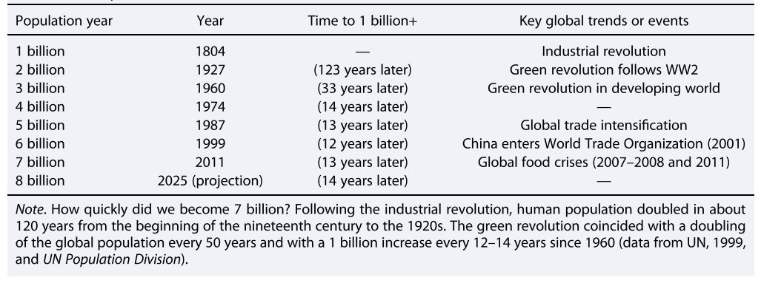
1.1 Trends in Natural Resources | Availability and Demand
Table: Trends of population growth. (Source: D’Odorico et al., 2018)
Notes:
Population growth is a key driver putting pressure on resources…illustrate how the time needed for the global population to increase by 1 billion is decreasing over the years as population growth speeds up (emphasizing the notes below the table).

Slide 9
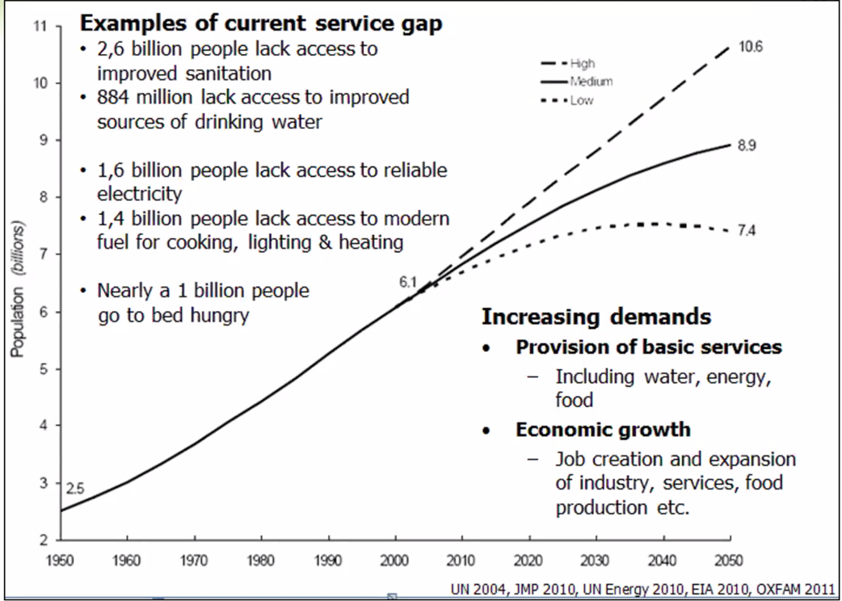
1.1 Trends in Natural Resources | Availability and Demand
Figure: World population growth (depicted on y-axis) as estimated from 2000 to 2050
(Source: Webb, 2013)
Notes:
Link population increase with pressure on resources and highlight service gaps (e.g., people with lack of access to water, sanitation, electricity, food, etc.

Slide 10
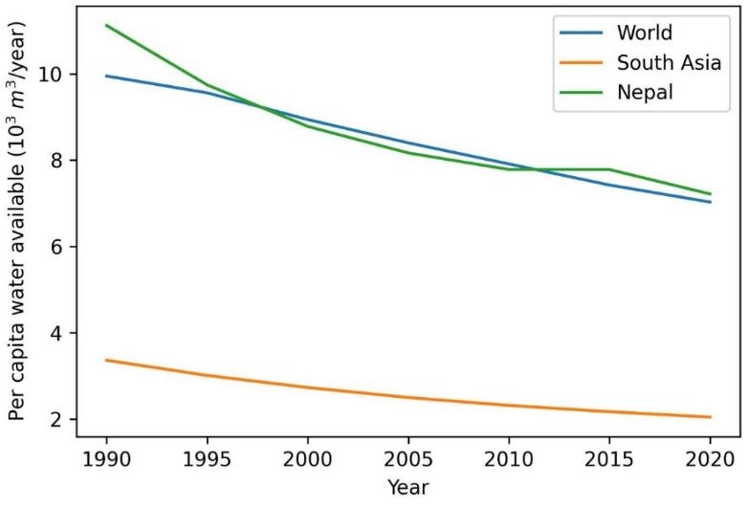
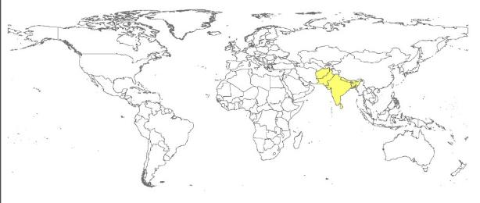
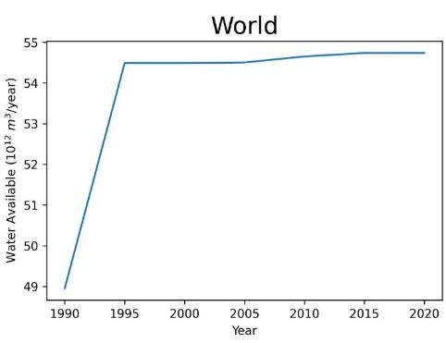
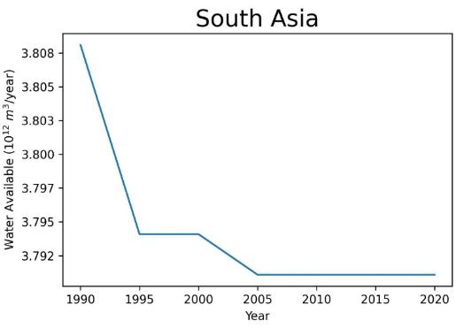
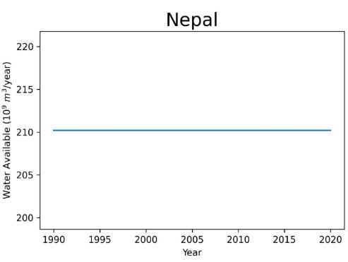
1.1 Trends in Natural Resources | Availability and Demand
WATER RESOURCES AVAILABILITY
World
South Asia
Nepal
(Source: Prepared by the authors with data from AQUASTAT)
Notes:
10¹² = One Trillion
Describe how water availability trends are varying at different scales. Then describe where a given country (in this case, Nepal) stands in terms of per capita water availability compared to global and regional averages.

Slide 11
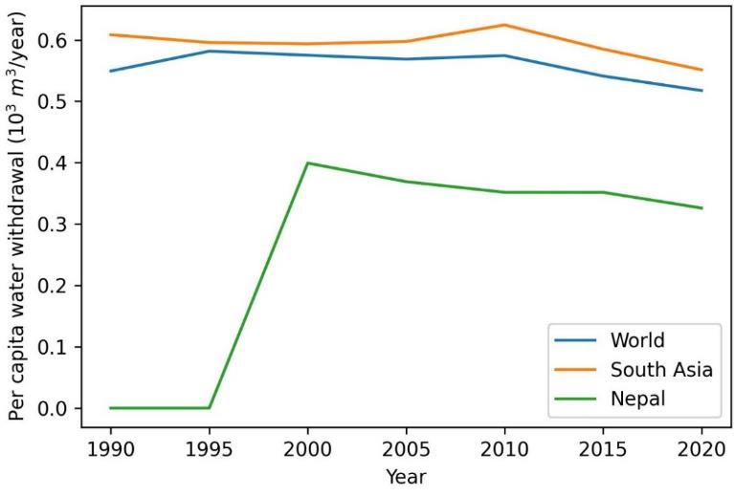
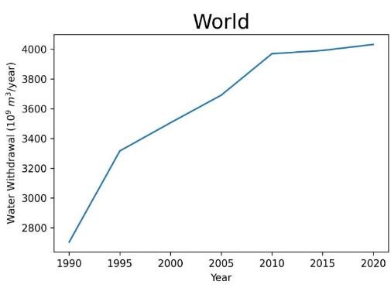
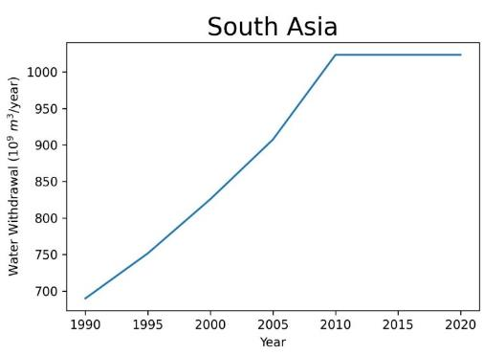
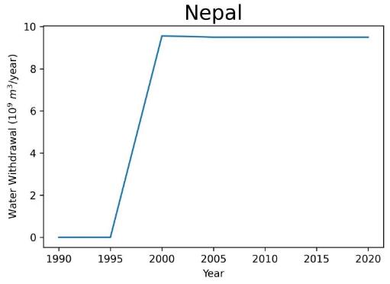
1.1 Trends in Natural Resources | Availability and Demand
WATER USE/ WITHDRAWAL
World
South Asia
Nepal
(Source: Prepared by the authors with data from AQUASTAT)
Notes:
Similar description as water resources availability, but focus on comparative water use/withdrawal.

Slide 12
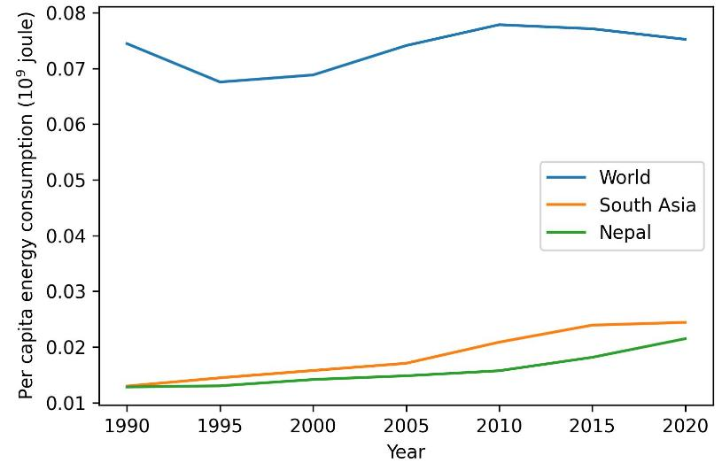
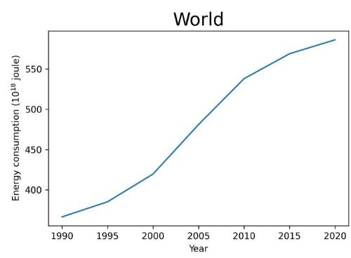
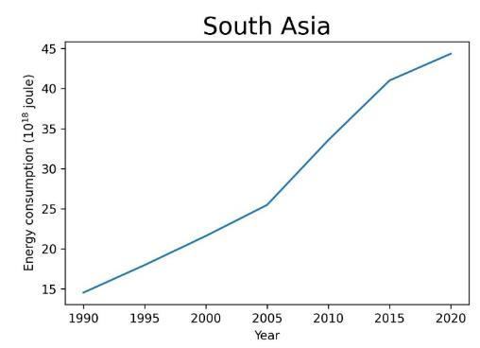
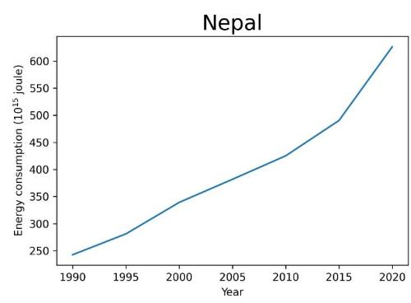
1.1 Trends in Natural Resources | Availability and Demand
ENERGY
USE
World
South Asia
Nepal
(Source: Prepared by the authors with data from AQUASTAT)
Notes:
Similar description as water resources availability, but focus on comparative energy use.

Slide 13
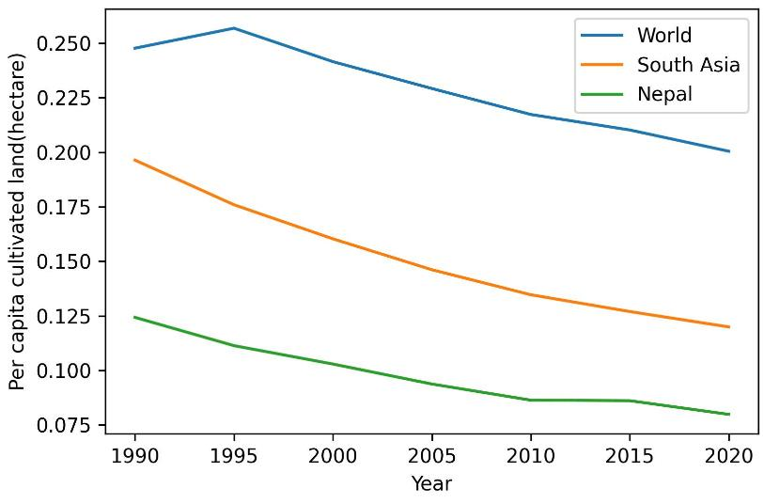
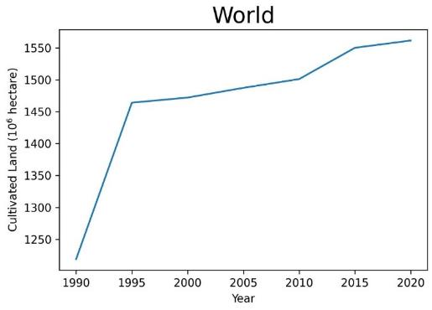
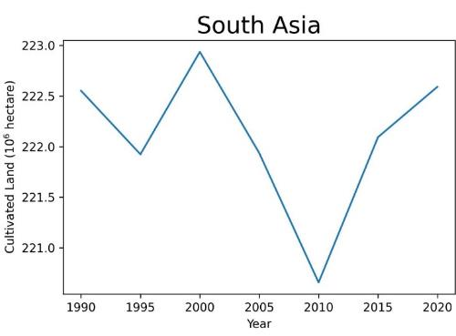
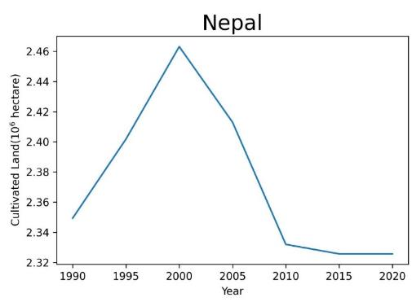
1.1 Trends in Natural Resources | Availability and Demand
LAND RESOURCES AVAILABILITY
World
South Asia
Nepal
(Source: Prepared by the authors with data from AQUASTAT)
Notes:
Similar description as water resources availability, but focus on comparative land resources availability.

Slide 14
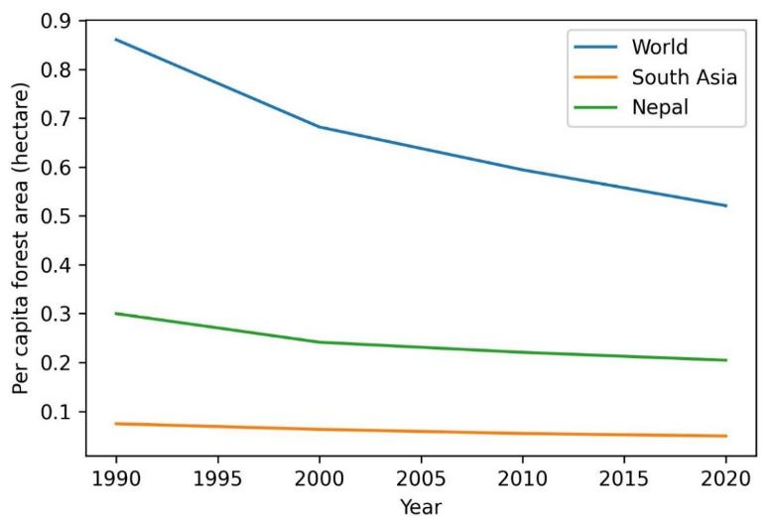
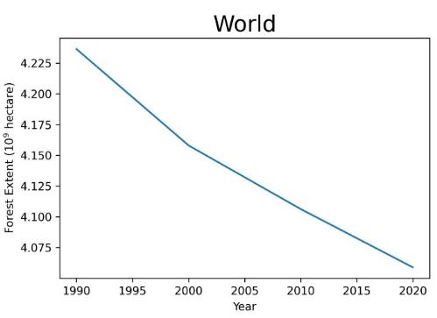
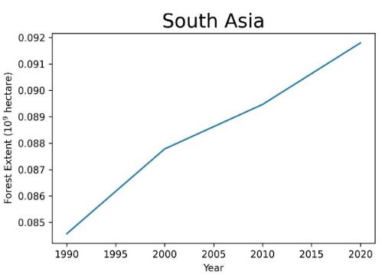
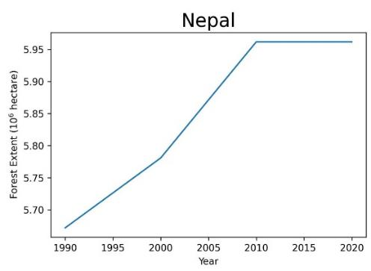
1.1 Trends in Natural Resources | Availability and Demand
FOREST RESOURCES AVAILABILITY
World
South Asia
Nepal
(Source: Prepared by the authors with data from AQUASTAT)
Notes:
Similar description as water resources availability, but focus on comparative forest resources availability.

Slide 15
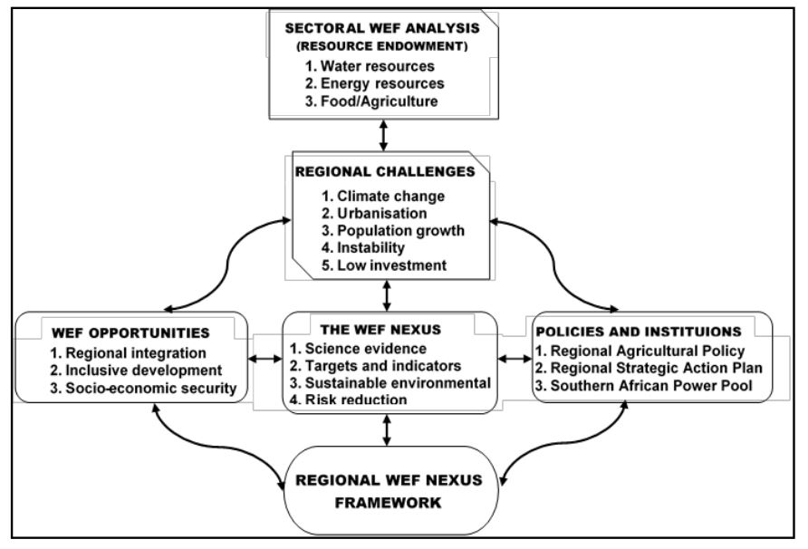
1.1 Inequality in WEFE Nexus Resources | Drivers
Figure: A regional WEF Nexus conceptual and methodological framework. (Source: Nhamo et al., 2018)
Notes:
Use this figure to discuss various drivers of inequality in WEFE resources. Regional challenges are drivers for change in each sector.
Nexus thinking helps us building evidence, set targets, and strategize for sustainable resource management and risk reduction. It also helps us to identify and balance trade-offs and synergies across Nexus sectors and actors. However, full realization of Nexus approaches requires an enabling environment (as shown in the figure).

Slide 16
1.1 Inequality in WEFE Nexus Resources | Access
Inequality in access to natural resources is frequently mediated by gender, social class & economic class.
Gender: Women have major roles in land use for food security, income generation and household resources; however, women make up only 13.8% of landholders globally (IUCN).
Wealth: Wealthy individuals often have greater access to land ownership than the poor, leading to unequal distribution of land-based wealth.
Social hierarchy: Dominant groups (e.g., ethnicity) often have greater control over land & natural resources.
Unequal access can exacerbate existing social inequalities and limit opportunities for vulnerable groups.
Identifying and addressing these disparities is essential for promoting inclusive and sustainable resource management. It may involve:
Implementing legal and policy reforms, promoting gender equality, & addressing underlying social/economic factors.

Slide 17
1.1 Inequality in WEFE Nexus Resources | Access
Social equity:
Addressing access disparities ensures that vulnerable groups have equal opportunities and benefits from resource management interventions.
Targeted interventions:
Considering spatial and temporal heterogeneities allows for customized and efficient resource management strategies in different regions.
Improved Welfare:
Addressing unequal access to resources contributes to broader economic benefits for both nature and people.
01
02
03
Notes:
Addressing inequality can produce benefits in multiple ways.

Slide 18
1.1 Exercise 1-2: Open Discussion [10 mins]
What are your experiences with inequitable access to resources?
Gender-based?
Economic class-based?
Social class-based?

Slide 19
1.1 Inequality in WEFE Nexus Resources | Sources and Further Reading
D’Odorico, P., Davis, K. F., Rosa, L., Carr, J. A., Chiarelli, D., Dell’Angelo, J., Gephart, J., MacDonald, G. K., Seekell, D. A., Suweis, S., & Rulli, M. C. (2018). The Global Food-Energy-Water Nexus. Reviews of Geophysics, 56(3), 456–531. https://doi.org/10.1029/2017RG000591
Food and Agriculture Organization of the United Nations (via World Bank) –processed by Our World in Data (https://datacatalog.worldbank.org/search/dataset/0037712/World-Development-Indicators)
Global Climate Pledge (n.d.) Your (virtual) water footprint: a hidden commodity. https://www.globalclimatepledge.com/your-virtual-water-footprint-a-hidden-commodity/
Nhamo, L., Ndlela, B., Nhemachena, C., Mabhaudhi, T., Mpandeli, S., & Matchaya, G. (2018). The water-energy-food Nexus: Climate risks and opportunities in Southern Africa. Water (Switzerland), 10(5), 1–18. https://doi.org/10.3390/w10050567
Water Footprint Network. (n.d.). www.waterfootprint.org

Slide 20
1.1 Trends in WEFE Nexus Resources
Unequal endowment of natural resources & demand over scale, space and time
Concept of footprints (water/energy/ecological footprints, and their variation between genders and social class/ethnicity)
Planetary boundaries (including science with/for people)

Slide 21
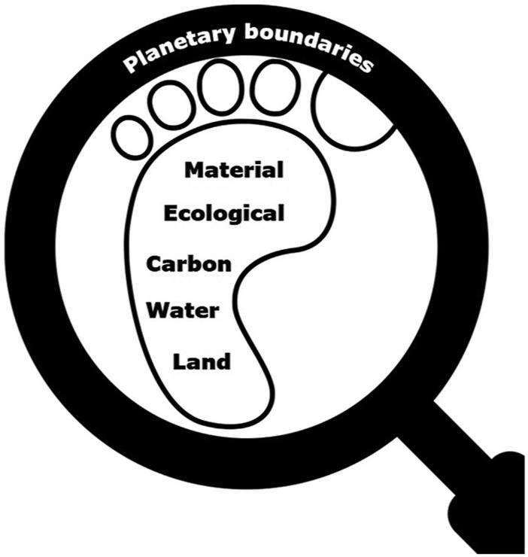
1.1 Trends in Natural Resources | Concept of a Footprint
Footprint
Amount of a given resource used to the produce goods and services consumed per unit (e.g., individual, community, etc.)
Application of resource footprints
To assess the environmental impact of individuals, communities, or nations based on resource consumption
(Source: Matuštík and Kočí, 2021)

Slide 22
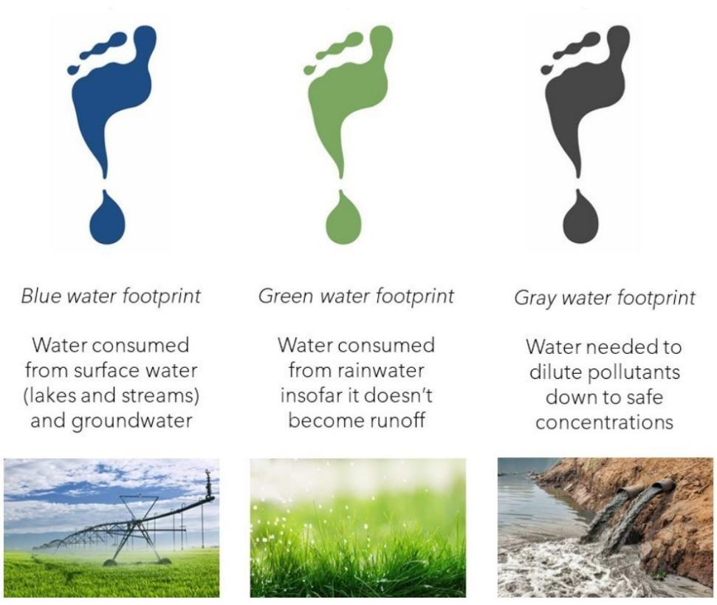
1.1 Trends in Natural Resources | Water Footprint
Water footprint → total volume of freshwater used to produce the goods and services consumed by a given unit (e.g., individual, community, etc.)
A large proportion of the global water footprint is associated with agriculture → 90% of global freshwater resources are solely dedicated to food production (Djehdian et al., 2019)
Three types: blue, green, gray
Direct and indirect water footprints
Indirect footprint → Virtual Water
Figure: Water footprint components
(Source: https://www.greeneconomycoalition.org/news-and-resources/promoting-water-sustainability-of-financial-institutions)

Slide 23
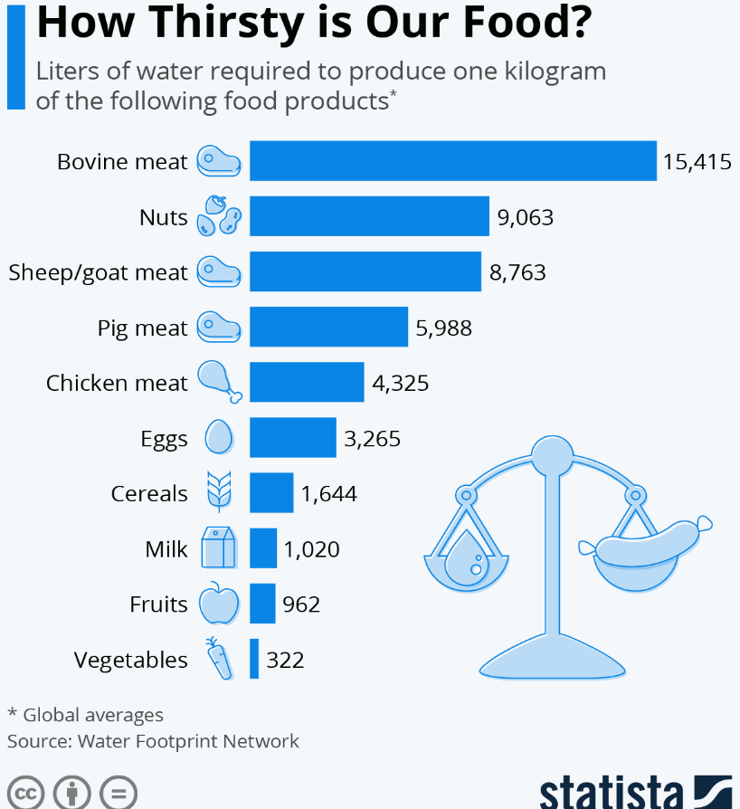
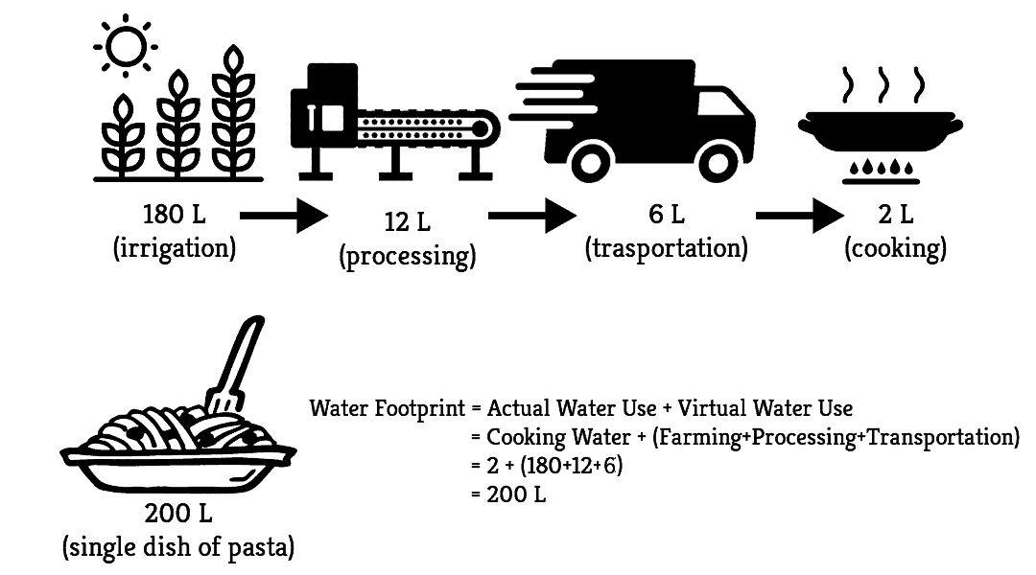
1.1 Trends in Natural Resources | Virtual Water
Virtual Water: the amount of water embedded in a unit of a product or service
Example → How much water is required to make a single dish of Pasta?
(Source: https://images.app.goo.gl/sxcnVvm2z83PqWU96)
Notes:
How thirsty is our food? Discuss about how our food choice affect water footprint. Why is behavioral change required for water security?

Slide 24
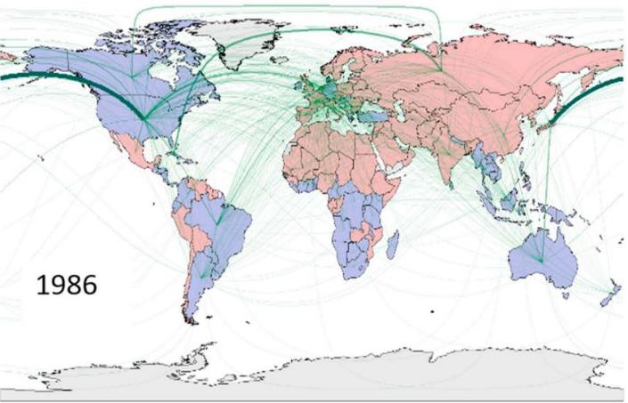
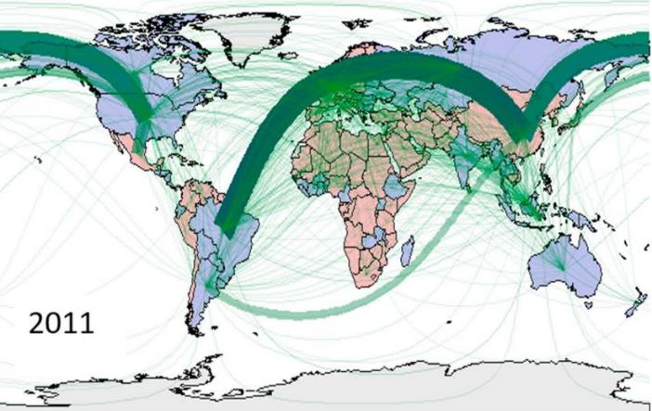
1.1 Trends in Natural Resources | Virtual Water
Water also flows from one location to another in the form of Virtual Water.
Indirect water flows associated with trade (import/export) of food & other products
This enables countries with water scarcity to import water-intensive products and optimize local water use for food production.
Virtual water trade has the potential to reduce global water scarcity by ‘virtually’ distributing water resources from regions with (relative) water surplus to water-scarce regions.
Figure: Global patterns of virtual water trade in 1986 and 2011 (Source: D’Odorico et al., 2018)
Notes:
Example: food grown in Ethiopia greenhouses flown to Gulf countries

Slide 25
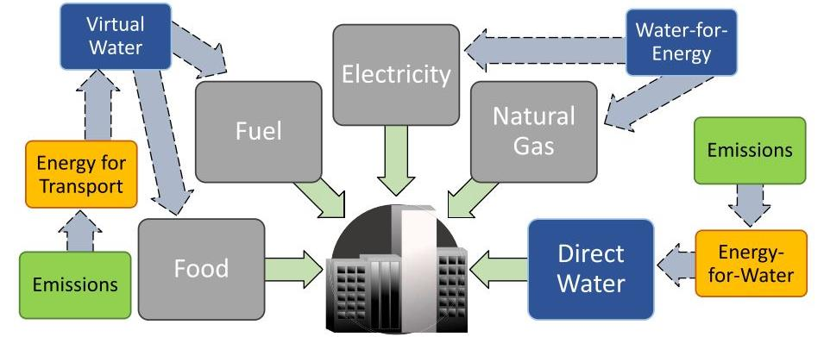
1.1 Trends in Natural Resources | Energy Footprint
Energy footprint → The amount of energy consumed in activities and products throughout their life cycle
Carbon emissions are associated with most energy use
Community
Figure: Schematic of water and energy footprints. Green arrows = direct footprint and blue arrows = indirect footprint. (Source: Chini et al., 2017)
Notes:
A city’s direct water footprint is the physical water consumed by the population within the city boundaries, measured by quantity of outflow from the drinking water treatment plant. Indirect water footprint is water consumed for the procurement of high-flux consumer goods and resources that are then imported into the urban environment (Chini et al., 2017).

Slide 26
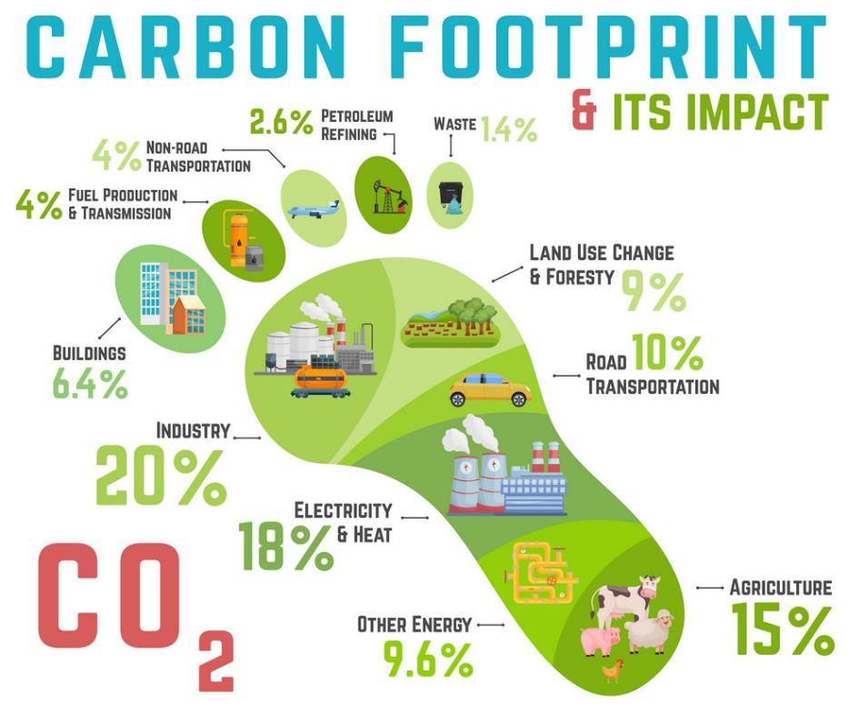
1.1 Trends in Natural Resources | Carbon Footprint
Carbon footprint → Amount of carbon emissions per unit of a given service/product
Multiple sources contribute to carbon footprint (see Figure)
(Source: https://www.123rf.com/photo_180674183_carbon-footprint-ecology-global-warming-concept-vector-illustration.html)

Slide 27
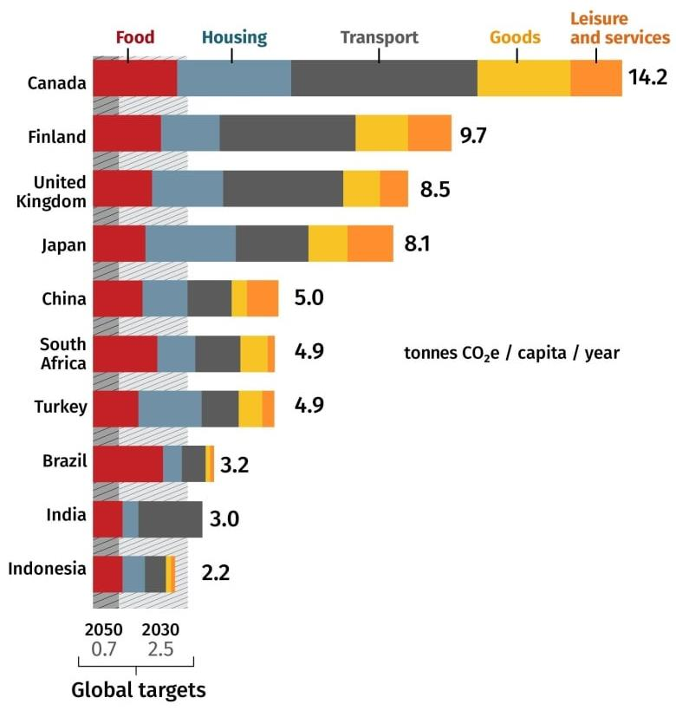
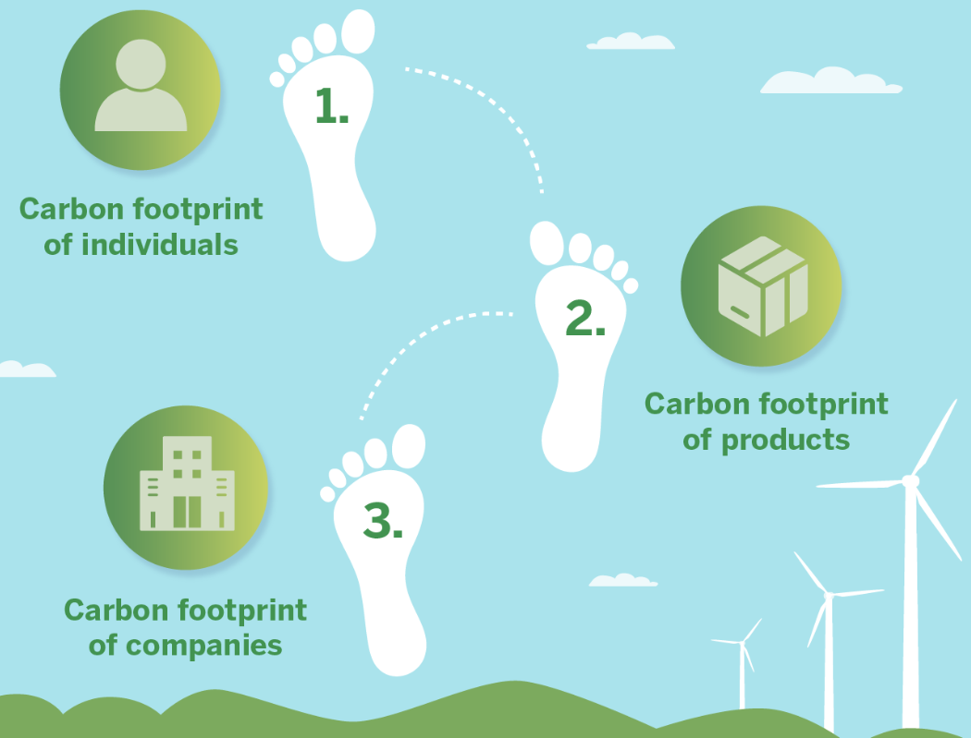
1.1 Trends in Natural Resources | Carbon Footprint
Three Types of Carbon Footprint
Figure: Carbon footprint by country and sectors (Source: CBS News, Oct 2021 https://www.cbc.ca/news/science/how-canadians-can-cut-carbon-footprints-1.6202194)
(Source: https://www.constellation.com/energy-101/energy-innovation/what-is-a-carbon-footprint.html)
Notes:
Three are three types of carbon footprint: of an individual, of a product, or of a company. These footprints are characterized by regional differences, as shown in the figure on the left.

Slide 28
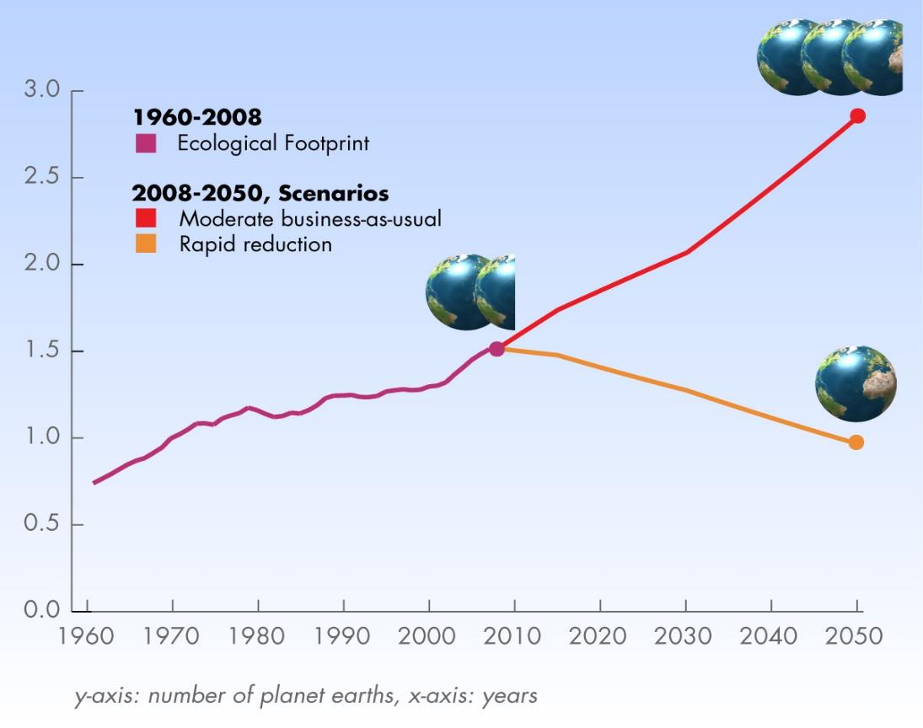
1.1 Trends in Natural Resources | Ecological Footprint
What is an ecological footprint?
The amount of resources needed by a single individual to survive
What is the ecological footprint of the current human population?
1.5 Earths’ worth of resources (data-based model estimate)
If resource consumption continues to grow at the same rate as today, the resource equivalent of 3 Earths may be needed by the end of 2050.
Ecological Footprint of Humanity
Carrying capacity of earth
Figure: Global Ecological Footprint up to 2050 (Source: Shahid, 2013)
Notes:
Does using the resources needed to sustain 1.5 or 3 Earths mean we are putting excessive pressure on natural resources? From where we will bring 3 earths? What could be the strategies to manage resources to meet our future needs? Mining of other planets? How feasible would it be? Rather than that, how about changing our behavior?

Slide 29
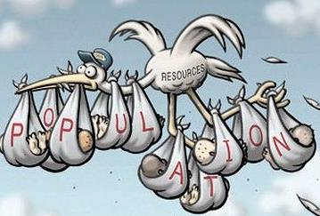
1.1 Trends in Natural Resources | Ecological Carrying Capacity
Ecological carrying capacity: the maximum population or rate of resource use that an ecosystem can sustainably support before becoming irreversibly damaged (McLachlan & Defeo, 2018)
Why is it important to understand the carrying capacity of an ecosystem?
For ensuring sustainable resource use & preventing overexploitation through resource management policies
(Source: https://newbreweress.weebly.com/84-carrying-capacity-and-ecological-footprint.html)
Examples of potential actions?
Limit catch of fish species to levels within their ecological carrying capacity
Limit harvest of timber to levels within the carrying capacity of forest ecosystems
Notes:
Explanation of the figure: The same limited pool of resources is being shared by an ever-growing population. Define ecological carrying capacity and its importance. Then give examples.

Slide 30
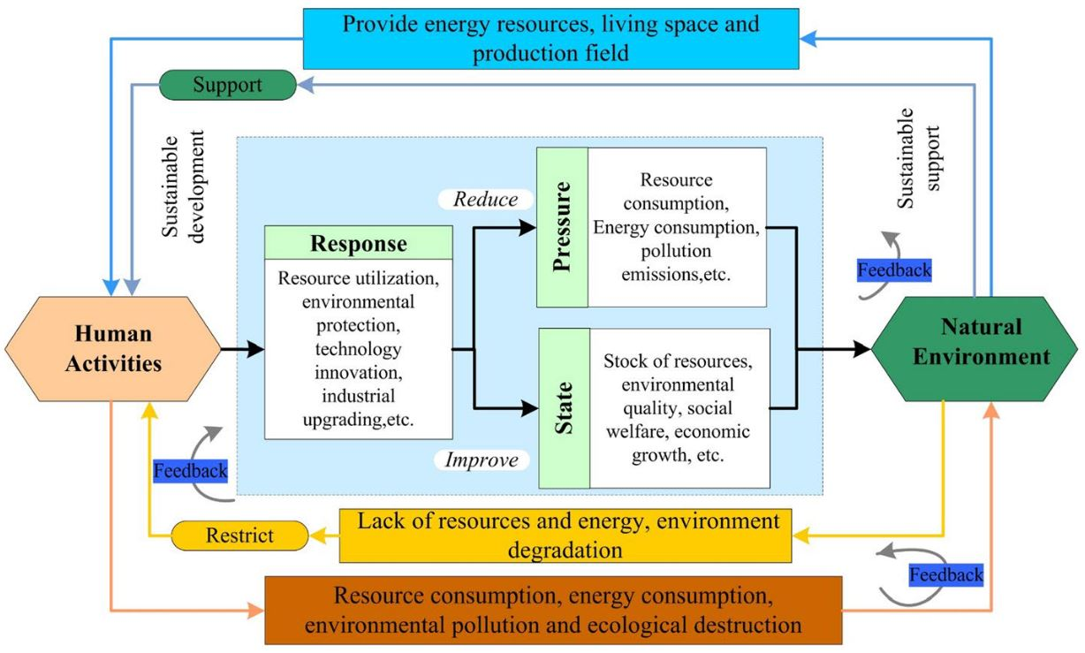
1.1 Trends in Natural Resources | Ecological Carrying Capacity
Key messages
No single-sector solution works
Real & workable solution is highly integrated in nature
Need an integrated approach for understanding the complexities of the real-world system and for designing/ implementing solutions/ interventions
Figure: Conceptual framework for resource and environmental carrying capacity evaluation (Source: Zou & Ma, 2021)
Notes:
Note: This figure is part of a larger DPSIR framework (Driver, Pressure, State, Impact, Response). Only PSR is shown in this slide’s diagram.

Slide 31
1.1 Exercise 1-3: Open Discussion [10 minutes]
How can we balance our ecological footprint with Earth’s carrying capacity?
List five possible ways
ENVIRONMENTAL JUSTICE
(taking care of the environment while fulfilling human needs)

Slide 32
1.1 Trends in WEFE Nexus Resources
Unequal endowment of natural resources & demand over scale, space and time
Concept of footprints (water/energy/ecological footprints, their variation between genders and social class/ethnicity)
Planetary boundaries (including science with/for people)

Slide 33
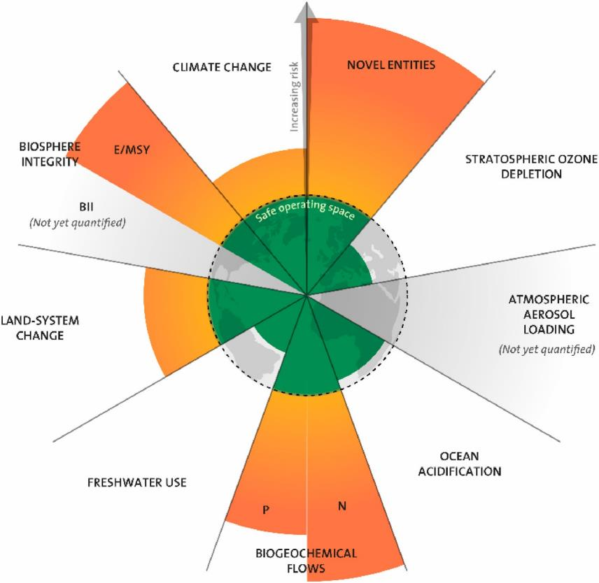
1.1 Planetary Boundaries
Planetary boundaries are the safe limits of the within which humanity can operate while maintaining Earth’s environmental stability, as defined by 9 Earth-system processes (Erlandsson et al., 2023).
Transgression of these boundaries could lead to irreversible & catastrophic environmental changes, threatening well-being of present and future generations (Rockström et al., 2009).
Figure: Illustration of the Planetary Boundaries framework.
(Source: Persson et al., 2022)
Notes:
The concept of planetary boundaries was introduced by Rockström et al. (2009) and refined by Steffen et al. (2015), as per Erlandsson et al. (2023). Steffen et al. (2015) renamed the “chemical pollution” boundary to “novel entities” (NE) (Persson et al., 2022).
Each pie chart section represents one Earth-system process, and the concentric circles depict states of being below the boundary, or in a zone of uncertainty or exceedance, respectively. E/MSY = Extinction per million species-years, BII = Biodiversity Intactness Index, P = Phosphorous, N = Nitrogen

Slide 34
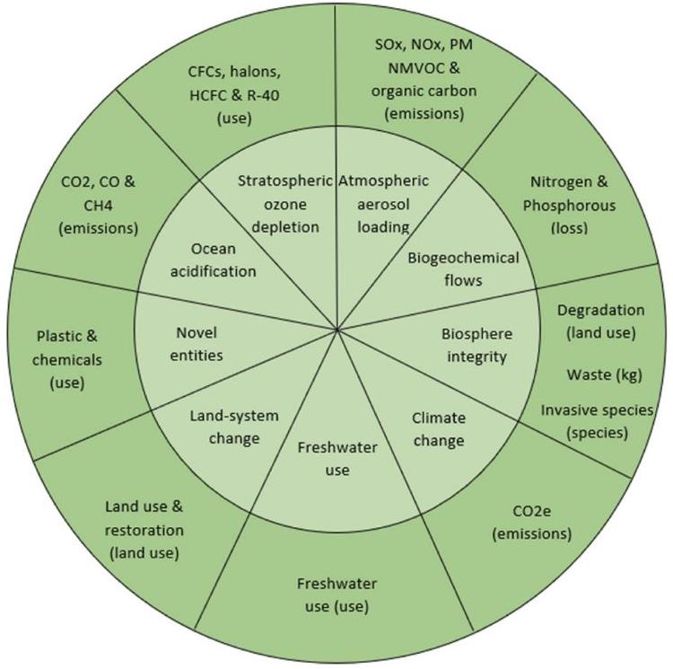
1.1 Proxies of Planetary Boundaries
Two of the planetary boundaries (PBs) — climate change and biosphere integrity — are recognized as “core” PBs based on their fundamental importance for the Earth System (Steffen et al., 2015).
Holocene epoch (state) : A 11,700—year span of Earth’s history able support human life on earth, which is now being destabilized.
Details about the nine PB’s can be found in Steffen et al. (2015).
Figure: An illustration of the Planetary Boundaries and the defined proxies (indicators). (Source: Erlandsson et al., 2023)
Notes:
How do we quantify status of each PB? We need indicators. Proposed proxy indicators are provided in this diagram.
What is missing in this diagram? What about basic needs? Do we only focus on maximum limits or minimum requirements (or do we consider social needs and impacts as well)? There is a need for discourse beyond biophysical (environmental) indicators to also consider investment in social foundations.

Slide 35
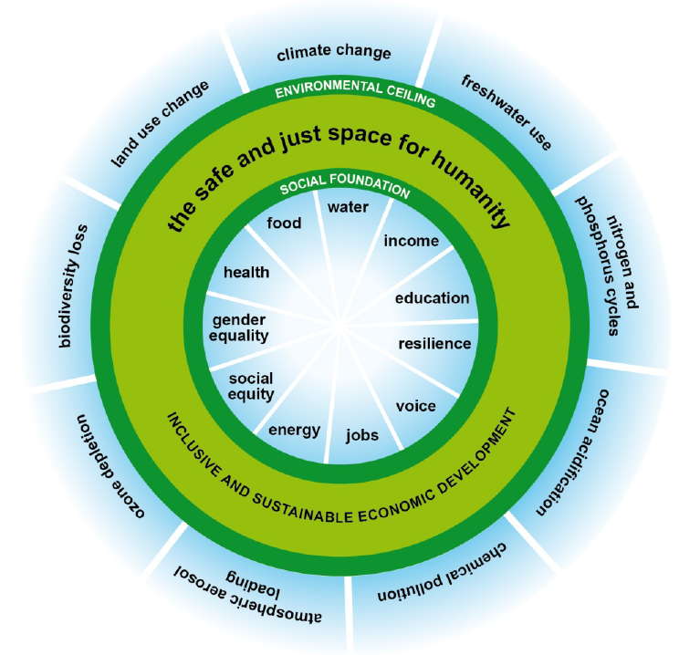
1.1 Planetary Boundaries
An equity dimension expressing a social foundation of planetary boundaries was introduced by Oxfam (Raworth 2012), building on Rockström et al. (2009).
Quantifying planetary and social boundaries turns the framework into a global compass giving an indication of the current state of human & planetary well-being in relation to the boundaries of sustainable development.
Figure: A safe and just space for humanity to thrive in: a first illustration. (Source: Raworth, 2012)

Slide 36
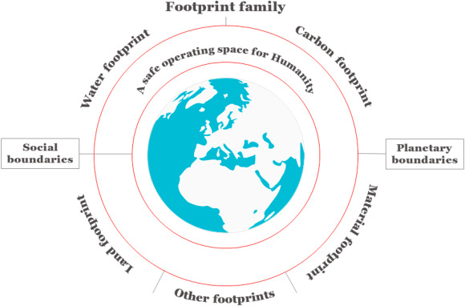
1.1 Trends in Natural Resources | Foundational Concepts
Essence of the concepts → "Science with/for people" → combine scientific knowledge and expertise with the needs, preferences, & traditional knowledge of people for human and environmental well-being
The European Environment Agency’s (EEA) report on “With people and for people: Innovating for sustainability” → integration of local knowledge with scientific knowledge for sustainable societies
(Source: https://doi.org/10.1016/j.jclepro.2020.124833)
Notes:
Footprints should be limited within the planetary boundaries…BUT minimum footprints for a social foundation should also be maintained. Efforts should therefore be towards meeting social boundaries without exceeding the environmental ceiling/ boundaries.

Slide 37
1.1 Sources and Further Reading
Chini, C. M., Konar, M., & Stillwell, A. S. (2017). Direct and indirect urban water footprints of the United States. Journal of the American Water Resources Association, 53, 316–327. https://doi.org/10.1002/ 2016WR019473
D’Odorico, P., Davis, K. F., Rosa, L., Carr, J. A., Chiarelli, D., Dell’Angelo, J., Gephart, J., MacDonald, G. K., Seekell, D. A., Suweis, S., & Rulli, M. C. (2018). The Global Food-Energy-Water Nexus. Reviews of Geophysics, 56(3), 456–531. https://doi.org/10.1029/2017RG000591
Daignault, J., Wallace, C., Watkins, D., Handler, R., Yang, Y., Heaney, D., & Ahamed, S. (2023). A household-scale life cycle assessment model for understanding the food-energy-water Nexus. February, 1–13. https://doi.org/10.3389/fenvs.2023.1059301
Del Borghi, A., Tacchino, V., Moreschi, L., Matarazzo, A., Gallo, M., & Arellano Vazquez, D. (2022). Environmental assessment of vegetable crops towards the water-energy-food Nexus: A combination of precision agriculture and life cycle assessment. Ecological Indicators, 140(June), 109015. https://doi.org/10.1016/j.ecolind.2022.109015
Djehdian, L. A., Chini, C. M., Marston, L., Konar, M., & Stillwell, A. S. (2019). Exposure of urban food–energy–water (FEW) systems to water scarcity. Sustainable Cities and Society, 50(December 2018), 101621. https://doi.org/10.1016/j.scs.2019.101621
Erlandsson, J., Bergmark, P., & Höjer, M. (2023). Establishing the planetary boundaries framework in the sustainability reporting of ICT companies – A proposal for proxy indicators. Journal of Environmental Management, 329(September 2022). https://doi.org/10.1016/j.jenvman.2022.117032
https://www.greeneconomycoalition.org/news-and-resources/promoting-water-sustainability-of-financial-institutions
Mudrakartha, S. (2008). Adaptive Approaches to Groundwater Governance: Lessons from the Saurashtra Recharging Movement. August. http://www.indiawaterportal.org/sites/indiawaterportal.org/files/Adaptive approaches to groundwatergovernance_Srinivas Mudrakartha_IRMA_2008.pdf
Naveed, U., Rozali, N. E. M., & Mahadzir, S. (2022). Energy – Water – Carbon Nexus Study for the Optimal Design of Integrated Energy – Water Systems Considering Process Losses.
Peng, W., Zheng, H., Robinson, B. E., Li, C., & Li, R. (2022). Comparing the importance of farming resource endowments and agricultural livelihood diversification for agricultural sustainability from the perspective of the food – energy – water Nexus. Journal of Cleaner Production, 380(P2), 135193. https://doi.org/10.1016/j.jclepro.2022.135193
Persson, L., Carney Almroth, B. M., Collins, C. D., Cornell, S., de Wit, C. A., Diamond, M. L., Fantke, P., Hassellöv, M., MacLeod, M., Ryberg, M. W., Søgaard Jørgensen, P., Villarrubia-Gómez, P., Wang, Z., & Hauschild, M. Z. (2022). Outside the Safe Operating Space of the Planetary Boundary for Novel Entities. Environmental Science and Technology, 56(3), 1510–1521. https://doi.org/10.1021/acs.est.1c04158
Raworth, K. (2012). Self-Construal and Willingness to Purchase Foreign Products: The Mediating Roles of Consumer Cosmopolitanism and Ethnocentrism. https://www-cdn.oxfam.org/s3fs-public/file_attachments/dp-a-safe-and-just-space-for-humanity-130212-en_5.pdf
Rockström, J., Steffen, W., Noone, K., Persson, Å., Chapin, F. S., Lambin, E., Lenton, T. M., Scheffer, M., Folke, C., Schellnhuber, H. J., Nykvist, B., de Wit, C. A., Hughes, T., van der Leeuw, S., Rodhe, H., Sörlin, S., Snyder, P. K., Costanza, R., Svedin, U., … Foley, J. (2009). Planetary boundaries: Exploring the safe operating space for humanity. Ecology and Society, 14(2). https://doi.org/10.5751/ES-03180-140232
Steffen, W., Richardson, K., Rockström, J., Cornell, S. E., Fetzer, I., Bennett, E. M., Biggs, R., Carpenter, S. R., De Vries, W., De Wit, C. A., Folke, C., Gerten, D., Heinke, J., Mace, G. M., Persson, L. M., Ramanathan, V., Reyers, B., & Sörlin, S. (2015). Planetary boundaries: Guiding human development on a changing planet. Science, 347(6223). https://doi.org/10.1126/science.1259855
Webb, E. C. (2013). The ethics of meat production and quality - a South African perspective. South African Journal of Animal Science, 43(5). https://doi.org/10.4314/sajas.v43i5.1

Slide 38
1.2
Evolution of the Nexus Thinking Approach
Limits to growth
Sustainability
Integrated Water Resources Management (IWRM)
Nexus

Slide 39
1.2 Session Delivery Plan [45 minutes]
Time | Activity | Facilitator
40 minutes | Lecture: Evolution of concepts from limits to growth to Nexus | Prof. Dr. Tri Ratna Bajracharya
5 minutes | Exercise 1-4: What are the differences between IWRM and Nexus approaches? | Prof. Dr. Tri Ratna Bajracharya

Slide 40
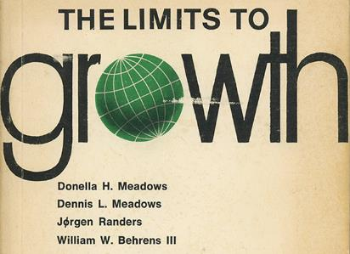
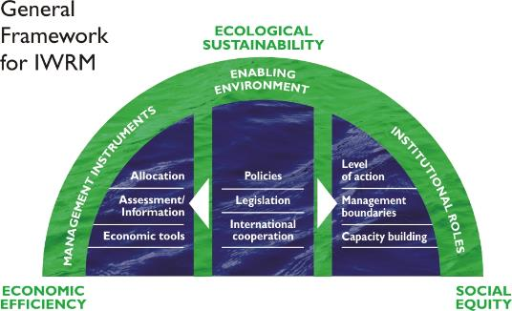
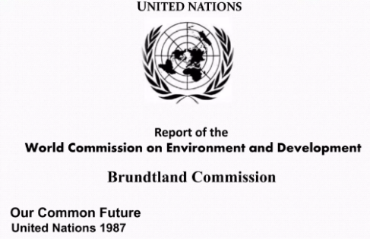
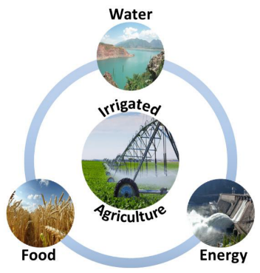
1.2 Evolution of the Nexus Approach
Nexus thinking has evolved over time in response to growing challenges related to resource management and sustainability.​
1972
2000
1997
2008; 2011
Notes:
First coined in 1980 by the International Union for the Conservation of Nature, "sustainable development" came into general usage following publication of the 1987 report of the Brundtland Commission. The concept of sustainable development formed the basis of the United Nations Conference on Environment and Development held in Rio de Janeiro in 1992.

Slide 41
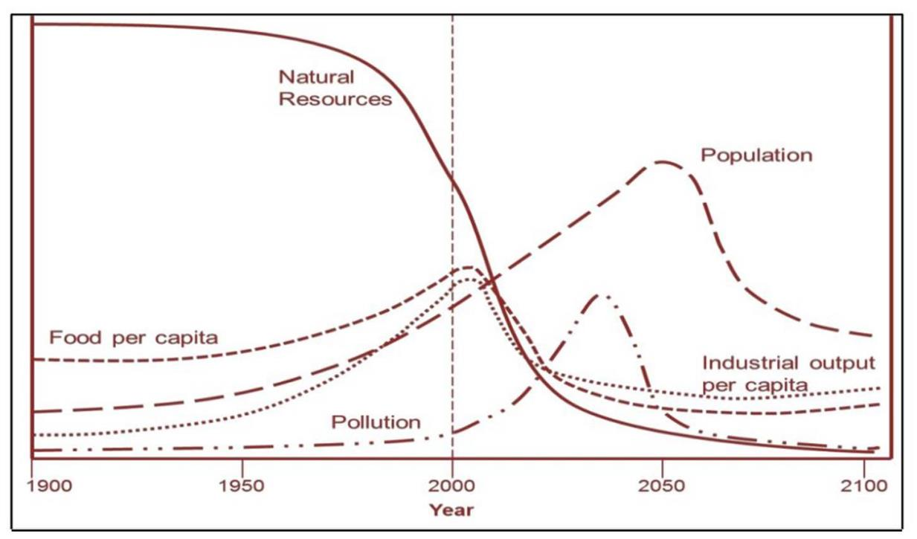
1.2 Evolution of the Nexus Approach | Limits to Growth
The study examined five basic factors that determine and, in their interactions, ultimately limit growth on this planet:
Population growth
Agricultural production
Natural resources
Industrial production
Pollution
Figure: The original projections of the limits-to-growth model
(Source: Yáñez-Arancibia et al., 2013)
What is the essence of this concept/model?
Notes:
Show this figure, ask participants to consider for a few minutes and then ask them: what are key factors that limit growth?

Slide 42
1.2 Evolution of the Nexus Approach | Limits to Growth
The “Limits to Growth” concept → highlighted the finite nature of Earth’s resources and emphasized the need to balance resource consumption with the Earth’s carrying capacity to avoid environmental degradation and the depletion of vital resources.
This concept laid the foundation for understanding the interconnectedness of human activities and their impacts on the environment.
The concept was based on a computer simulation study that used the World3 model to simulate the consequences of interactions between the earth and human systems.
The “Limits to Growth” concept influenced → discussions on sustainable development and resource management, including sustainable ways of living.

Slide 43
1.2 Evolution of the Nexus Approach | Sustainability
“Sustainability or Sustainable Development” → concept was first coined in 1980 by IUCN → came into general usage after 1987 report of the Brundtland Commission → formed the basis of the UN Conference on Environment & Development held in Rio de Janeiro in 1992.
The World Commission on Environment and Development (popularly known as Brundtland Commission) has defined sustainable development as one common future which has the capacity to fulfill present needs without compromising the needs of the future generations.
Sustainable development has since become a major initiative in today’s growing world (Das & Cabezas, 2018).
Notes:
As projected by the United Nations, by 2030 the world population will reach approximately 8.5 billion. As a result, demand for food will increase by 35%, energy by 50% and water by 40% (Mai et al., 2023). By that time, the most critical challenge will be to fulfill water, energy, and food needs for all human beings while staying within environmental limits, as they all are essential elements for human survival, as well as for sustainable development (Das & Cabezas, 2018).

Slide 44
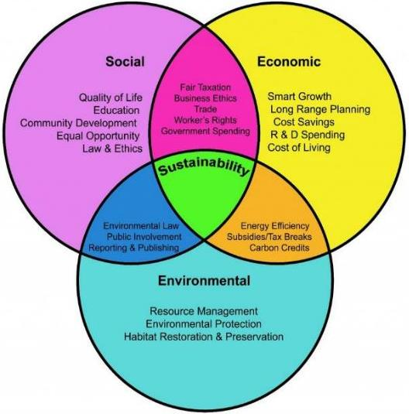
1.2 Evolution of the Nexus Approach | Sustainability
The conception of sustainability is built on three dimensions: economic viability, social values & environmental issues (Bielicki et al., 2019; Das & Cabezas, 2018).
Sustainability can be attained by creating a balance between the three foundations of sustainable development which are social, economic and environmental sustainability (Elkamel et al., 2023).
Figure: Relationships between Social, Environmental and Economic Sustainability (Source: Wanamaker, 2018, as cited in Santos & Serpa 2020)
Notes:
Foster a discussion about the interaction between social & economic, social & environment, economic & environment (ways/actions mentioned in the intersection area). Sustainability is the confluence of all three pillars.

Slide 45
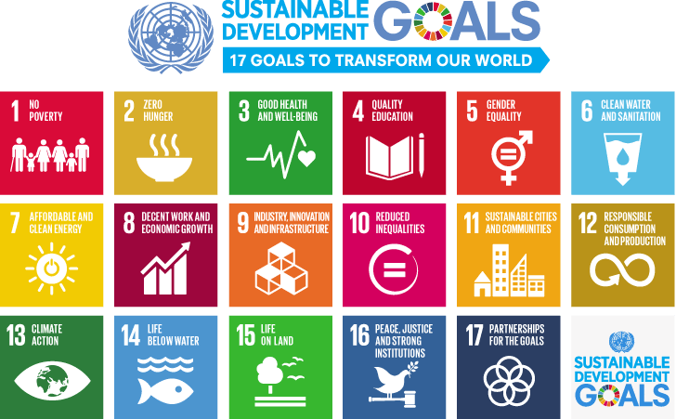
1.2 Evolution of the Nexus Approach | Sustainable Development Goals
The UN has endorsed 17 Sustainable Development Goals (SDGs) & 169 targets to be achieved by all countries with global partnership by 2030 (Mai et al., 2023).
Figure: Seventeen Sustainable Development Goals (SDGs)
(Source: https://www.un.org/sustainabledevelopment/blog/2015/12/sustainable-development-goals-kick-off-with-start-of-new-year/)
Notes:
SDGS (17 Goals & 169 targets) translate the concept of sustainability into global action.

Slide 46
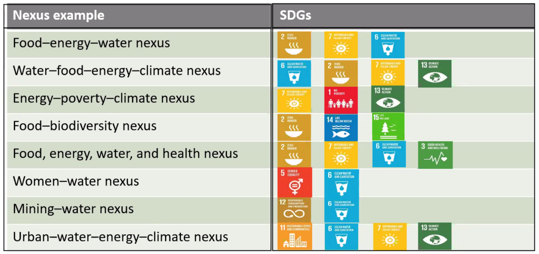
1.2 Evolution of the Nexus Approach | Sustainable Development Goals
Examples of several Nexus configurations and linkages with SDGs:

Slide 47
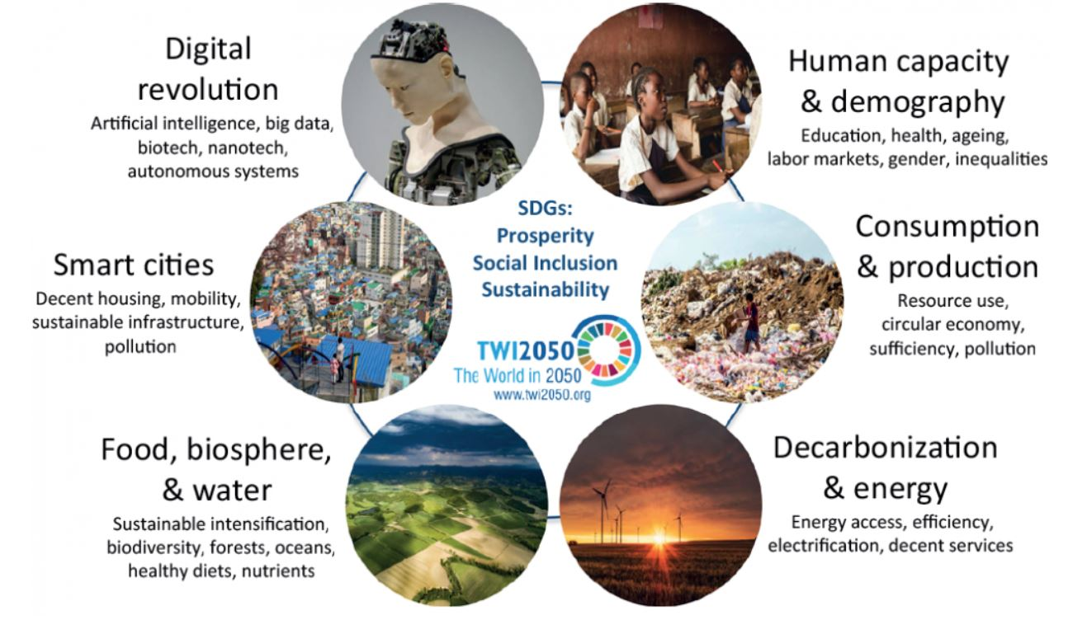
1.2 Evolution of the Nexus Approach | Achieving Sustainability
Figure: Six key transformations needed to achieve the SDGs in a manageable way
(Source: The World in 2050 initiative (TWI2050), 2018)
Notes:
What transformative actions are needed for achieving sustainability/SDGs?

Slide 48

1.2 Evolution of the Nexus Approach | IWRM
Integrated Water Resources Management (IWRM) is “a process which promotes the coordinated development and management of water, land, and related resources in order to maximize the resultant economic and social welfare in an equitable manner without compromising the sustainability of vital ecosystems” (Global Water Partnership, 2000).
IWRM provides a framework for integrating water-related considerations into broader resource management practices.
Figure: Three Es addressed by IWRM
(Source: https://nwa.mah.nic.in/sdmc/iwrm/04_benefits.htm)
Notes:
Start this slide by asking have you heard about this term “IWRM”? What is it?

Slide 49

1.2 Evolution of the Nexus Approach | IWRM
Figure: Cross-Sectoral Integration
(Source: https://www.riversweb.org/monreCBP/index.php/en/training/context/location-topography/57-background)
Notes:
Levers/drivers for cross sectoral integrations – i) enabling environment, ii) institutional roles, iii) management instruments.

Slide 50

1.2 Evolution of the Nexus Approach | Benefits of IWRM
Figure: Benefits of IWRM
(Source: https://nwa.mah.nic.in/sdmc/iwrm/04_benefits.htm)

Slide 51
1.2 Evolution of the Nexus Approach | Limitations of IWRM
IWRM has not been implemented as widely as expected
Critiques of IWRM:
“Recipe for paralysis” (Merrey, 2008)
“The desire to do too much at one time” (Schreiner and Hassan, 2011)
Impact is limited by a lack of innovative approaches (Biswas, 2008)
Unlike the water-focused IWRM, the WEFE Nexus approach is multi-centric, with each sector being treated with equal importance (Cai et al., 2018).
Cai et al. (2018) suggest that the Nexus may be accepted by a broader set of stakeholders than IWRM, especially those within the agricultural and energy sectors.

Slide 52
1.2 Evolution of the Nexus Approach | The Nexus Approach
The Nexus Approach builds upon the concepts of "Limits to Growth," "Sustainability," and "IWRM" to address the interconnected challenges of water, energy, food, and ecosystems.
It acknowledges the interdependencies and trade-offs between these sectors and seeks synergistic solutions for sustainable resource management.
The Nexus Approach promotes the integration of various sectors, policy domains, and stakeholder perspectives in decision-making processes.

Slide 53

1.2 Evolution of the Nexus Approach | The Nexus Approach
Figure: Timeline illustrating the development of food–energy–water Nexus since it was launched (Source: Zhu et al., 2020)

Slide 54
1.2 Evolution of the Nexus Approach | Need for Cross-Sectoral Integration
Potential questions on actions (policy, development interventions, etc.) in one or more sectors?
Were/are these actions necessary?
Who decided on these actions?
Were the actions appropriately targeted?
Were the actors in different sectors the same?
Were all actors aware of the actions?
What are the (intended and unintended) impacts of the action?
Impact on upstream to downstream?
Impact on one sector across other sectors?
Are these impacts significant?
Who was impacted the most?
Integrated Approach is needed to ensure →
All actors are engaged
Actions are appropriately targeted
Benefits are maximized and equitably shared
Negative impacts across sectors/actors are minimized

Slide 55
1.2 Evolution of the Nexus Approach | Benefits of Nexus Approach
Comprehensive solutions: the Nexus approach provides a comprehensive framework to address multiple challenges simultaneously, fostering more effective solutions.
Increased resilience: by recognizing interdependencies, the Nexus approach enhances the resilience of resource systems to various shocks and uncertainties.
Sustainable development: integrating environmental, social, and economic considerations ensures a more sustainable path of development.
Resource use efficiency: the Nexus approach maximizes outcomes while mitigating trade-offs.

Slide 56
1.2 Exercise 1-4: Open Discussion [5 minutes]
Are IWRM and the WEFE Nexus approach the same? If yes, how? If not, what are the key differences?

Slide 57
1.2 Evolution of the Nexus Approach | Sources and Further Reading
Bielicki, J. M., Beetstra, M. A., Kast, J. B., Wang, Y., & Tang, S. (2019). Stakeholder perspectives on sustainability in the food-energy-water Nexus. Frontiers in Environmental Science, 7(FEB), 1–18. https://doi.org/10.3389/fenvs.2019.00007
Biswas, A.K. (2008) Integrated Water Resources Management: Is It Working? International Journal of Water Resources Development, 24, 5-22. https://doi.org/10.1080/07900620701871718
Cai, X., Wallington, K., Shafiee-Jood, M., & Marston, L. (2018). Understanding and managing the food-energy-water Nexus – opportunities for water resources research. Advances in Water Resources, 111(April 2017), 259–273. https://doi.org/10.1016/j.advwatres.2017.11.014
Das, T., & Cabezas, H. (2018). Tools and concepts for environmental sustainability in the food-energy-water Nexus: Chemical engineering perspective. Environmental Progress and Sustainable Energy, 37(1), 73–81. https://doi.org/10.1002/ep.12763
Elkamel, M., Valencia, A., Zhang, W., Zheng, Q. P., & Chang, N. (2023). Multi-agent modeling for linking a green transportation system with an urban agriculture network in a food-energy-water Nexus. Sustainable Cities and Society, 89(December 2022), 104354. https://doi.org/10.1016/j.scs.2022.104354
Global Water Partnership, 2000. Integrated Water Resources Management, Global Water Partnership. Stockholm.
Mai, Q., Yu, D., & Li, X. (2023). Coupling characteristics of China’s food-energy-water Nexus and its implications for regional livelihood well-being. Journal of Cleaner Production, 395(19), 136385. https://doi.org/10.1016/j.jclepro.2023.136385
Merrey, D. J. (2008). Is normative integrated water resources management implementable? Charting a practical course with lessons from Southern Africa. Physics and Chemistry of the Earth, 33(8–13), 899–905. https://doi.org/10.1016/j.pce.2008.06.026
National Integrated Water Resources Management Special Programme (NIWRMSP). (n.d.) IWRM Framework – Background. https://www.riversweb.org/monreCBP/index.php/en/training/context/location-topography/57-background
National Water Academy of India. (n.d.) Benefits of IWRM approach. https://nwa.mah.nic.in/sdmc/iwrm/04_benefits.htm
Santos, A. I., & Serpa, S. (2020). Literacy: Promoting Sustainability in a Digital Society. Journal of Education, Teaching and Social Studies, 2(1), p1. https://doi.org/10.22158/jetss.v2n1p1
Schreiner, B., Hassan, R. (2010). Lessons and Conclusions. In: Schreiner, B., Hassan, R. (eds) Transforming Water Management in South Africa. Global Issues in Water Policy, vol 2. Springer, Dordrecht. https://doi.org/10.1007/978-90-481-9367-7_14
The World in 2050 initiative (TWI2050). (2018). Transformations to Achieve the Sustainable Development Goals Report prepared by The World in 2050 initiative. International Institute for Applied Systems Analysis, July, 1–157.
United Nations. (2015). Sustainable Development Goals to kick in with start of new year. Blog. https://news.un.org/en/story/2015/12/519172
Yáñez-Arancibia, A., Day, J. W., Hall, C. A. S., & Reyes, E. (2013). Diminished resources, energy scarcity and climate change: unsustainable future development. 263599396(July 2014), 557–574. https://doi.org/10.2495/978-1-84564-756-8/030
Zhu, J., Kang, S., Zhao, W., Li, Q., Xie, X., & Hu, X. (2020). A bibliometric analysis of food–energy–water Nexus: Progress and prospects. Land, 9(12), 1–22. https://doi.org/10.3390/land9120504

Slide 58
1.3 Fundamentals
of the WEFE Nexus
Nexus concepts, principles, and added value
Entry points for inclusive WEFE interventions
Nexus across scales (temporal and spatial)
WEFE Nexus in the context of climate and market changes

Slide 59
1.3 Session Delivery Plan [60 minutes]
Time | Activity | Facilitator
15 minutes | Lecture: WEFE Nexus concepts & principles | Prof. Vishnu Prasad Pandey
10 minutes | Exercise 1-5: Inter-linkages between WEFE Nexus components and examples of inclusive WEFE Nexus solutions | Prof. Vishnu Prasad Pandey
30 minutes | Lecture: NEXUS in practice – added value, inclusivity, scales, and contextual challenges | Prof. Vishnu Prasad Pandey
5 minutes | Exercise 1-6: Assignment – Develop WEFE Nexus relationships at different scales | Prof. Vishnu Prasad Pandey

Slide 60
1.3 WEFE Nexus | Concepts
Nexus definitions can be based on:
Connections linking things (ideas, processes, objects)
Number of system elements
Consequences: economical, societal and environmental
Mercurial nature: with nature, without and hybrid
Perspectives: analytical, governance, boundary concept, transdisciplinary
Approaches: analytical, sectoral, systems of system
Figure: Synthesis of definitions and descriptions from various literature review.
(Source: adapted from Anandhi et al., 2023)
Notes:
What are different bases and key words for defining the resource Nexus? → connections; # of systems; consequences/impacts, mercurial nature, perspective, approaches. Then elaborate them briefly.

Slide 61



1.3 WEFE Nexus | Concepts
The WEFE Nexus concept refers to the interdependencies of water, energy, food, and ecosystems in the context of sustainable resource management.
The main objective of the WEFE Nexus approach is to identify synergies and trade-offs among these systems to formulate cross-sectoral policies for utilizing resources efficiently while incorporating social, economic and environmental impacts. (Albrecht et al., 2018)
By understanding the complex interactions between water, energy, food and ecosystems, decision-makers can formulate integrated policies that help optimize resource utilization and minimize negative social, economical and environmental impacts.

Slide 62

1.3 WEFE Nexus | Concepts
Figure: The complex links between Nexus components, driving forces, solutions, and outcomes.
(Source: Adapted from Hoff, 2011; Pandey & Shrestha, 2017)

Slide 63
1.3 WEFE Nexus | Concepts
Other use and loss
Water
Note: % indicates percentage of global consumption
18%
70%
15%
Energy
Food
Other use and loss
Other use and loss
6%
Figure: Water-Energy-Food Security Nexus from World Economic Forum.
(Source: Zhu et al. 2021)
Notes:
According to Machell et al. (2015), water consumption during electricity production accounts for approximately 15% of total global freshwater consumption; energy consumption during fres- water resource treatment accounts for approximately 18% of the total global energy consumption; and food production consumes approximately 70% of global water and 6% of global energy.

Slide 64
1.3 Exercise 1-5: Open Discussion [10 minutes]
Describe the interlinkages between the following:
Water ← → Energy
Water ← → Food
Energy ← → Food
What could be examples of “inclusive WEFE Nexus solutions”?
Notes:
Missing – people & nature (ecosystem)

Slide 65
1.3 WEFE Nexus | Concepts
WEF to WEFE → Why include Environment/Ecosystems?
As discussed in one of the earlier exercises:
Ecological Footprint varies by
Countries
Location with a country
People (individuals and social groups)
Environmental Justice is required
Therefore, WEF was expanded to WEFE to include “Ecosystem/Environment” in the discussion of the resource Nexus.

Slide 66
1.3 WEFE Nexus | Principles
Investing to sustain ecosystem services
Creating more with less (Resource use efficiency)
Accelerating access, integrating the poorest
Investment in terrestrial as well as aquatic ecosystems and wetlands
Higher priority given to the water requirements (‘environmental flow’) of these aquatic systems
Interventions that increase water or land productivity while minimizing negatives impact on energy productivity (& emissions)
Increase overall resource-use efficiency by maximizing synergies and minimizing trade-offs
Nexus solutions should accelerate equitable access and benefits for the poor
This creates high rates of return in terms of development and environmental sustainability
Notes:
Mention 3 principles and describe briefly. Discuss environmental flows (or e-flows) and potential ideas to increase resource use efficiency in all sectors.
Example: Groundwater irrigation farms in Terai, Nepal – measures to maintain soil moisture reduce GW pumping (water-use efficiency), reducing energy required for pumping (energy efficiency), but still produce more with no irrigation limitation (land use efficiency).
How integrating the poorest can help for Nexus gains → investment in social foundation (see discussion on planetary boundary) will draw less from public money and overall economic (NOT financial!) return will be high.

Slide 67

1.3 WEFE Nexus | Principles
Figure: Concept of WEFE Nexus and its benefits
(Source: https://prima-med.org/wefe-Nexus-community-of-practice-a-solution-for-the-mediterranean-future/)
Notes:
Again, human and social considerations (people) are missing in this framework.

Slide 68
1.3 WEFE Nexus | Added value of the Nexus
Trade-off → when addressing one sector's needs negatively impacts another sector (e.g., diverting water for energy production reduces water availability for agriculture).
Synergy → when interventions benefit multiple sectors simultaneously (e.g., promoting agroforestry enhances food production and sequesters carbon, benefiting ecosystems).
Economic benefits
Optimize resource use, trade and innovation
Increase mid- and long-term viability of economic activities
Social and environmental benefits
Promote sustainability: improved public health, employment creation, water and sanitation services
Environmental justice: conservation/recovery of ecosystem and habitats
Regional cooperation and geopolitical benefits
Enhance cooperation in management of shared resources, (e.g., new cross-border agreements, common regulations)
Foster regional markets for goods and services and increase cross-border investments
Notes:
Nexus relationship can create either synergies or trade-offs (or a mix of both).
In the case of transboundary water bodies, the adoption of the Nexus approach ensures that synergies are explored at both an inter-sectoral and cross-country level, improving coordination, cooperation and thus reducing conflicts and trade-offs. Mutual commitments to increasing resource efficiency and eliminating unnecessary waste of water resources benefits all stakeholders. A transboundary Nexus approach can also foster regional political cooperation and provide further economic benefits through the development of regional markets and increased and optimized trade.

Slide 69
1.3 WEFE Nexus | Entry Points for Inclusive Interventions
Inclusive (GESI) WEFE interventions →
consider needs and perspectives of all social groups to promote equity.
Entry points for inclusivity in WEFE Nexus interventions include:
Gender-sensitive policies:
Ensure women’s voices are heard and their needs are addressed.
Accessible infrastructure for differently-abled individuals:
Ensure differently-abled individuals can fully participate in and benefit from WEFE interventions.
Culturally appropriate interventions for different ethnicities:
Ensure different ethnicities can fully participate in and benefit from WEFE interventions.
Economic empowerment for vulnerable socio-economic groups:
Ensure secure livelihoods for all stakeholders.
Notes:
GESI = Gender Equality, and Social Inclusion (sometimes expanded to GEDSI to more explicitly include Disability)
1) Examples of accessible infrastructure: wheelchair-friendly building; sign language interpretation; assistive technologies.
2) Examples of culturally appropriate interventions: culturally sensitive language, respecting local customs and traditions, and involving community leaders.

Slide 70
1.3 WEFE Nexus | Nexus Across Scales
Spatial Scale - Vertical
Household | Farm | Community | River Basin | Country | Landscape
Nexus solutions require tailored strategies to address scale-specific challenges
Spatial Scale – Horizontal
Within countries in different global regions, within different districts within a country, etc.
Nexus solutions require tailored strategies to address region-specific challenges
Arid regions→ water is scarce, focus on strategies to improve water use efficiency and reduce water losses
Regions with abundant water resources → focus on strategies to manage flood risks and protect water quality

Slide 71
1.3 WEFE Nexus | Nexus Across Scales
Temporal Scale: Short-term and long-term
Diurnal (within 24 hours) | Seasonal | Decadal
Decision-making and policy planning for WEFE Nexus solutions is influenced by temporal scales:
Short-term decisions → for immediate needs (e.g., emergency water supplies in drought)
Long-term decisions → for sustainable water management strategies for future water security

Slide 72

1.3 WEFE Nexus in the Context of Climate and Market Changes
Climate change → Shifts in resource availability affecting water availability, energy production, and agricultural yields.
E.g., changes in precipitation patterns and increased evaporation due to higher temperatures can alter water availability for agriculture, energy production, and other uses
Market changes → Shifts in global commodities prices influence resource demand and accessibility, necessitating adaptive and resilient resource management strategies.
E.g., rising food and energy prices can impact global inflation and affect the economy
(Source: Schneiderbauer et al, 2014)
Notes:
Climate change and market dynamics significantly impact the WEFE Nexus.

Slide 73

1.3 WEFE Nexus for National Security and Livelihoods
National Security: WEFE Nexus solutions may help improve regional cooperation and derive geopolitical benefits.
Enhance cooperation in management of shared resources, (e.g., new cross-border agreements, common regulations)
Foster regional markets for goods and services and increase cross-border investments
Livelihoods: WEFE Nexus solutions promote efficient use and sustainable management of resources.
Enhances national resilience to environmental and socio-economic shocks
Better access to resources and opportunities → improved livelihoods; resilient-communities
(Source: NASA)

Slide 74
1.3 Exercise 1-6: Group Work – Assignment
Divide participants into five groups
Groups 1, 2, 3, 4 & 5 will identify Nexus relationships at the following scales in sequence:
Household | Farm | Community | River Basin | Country
Each group will identify/list potential sources of water, energy, food, and priorities for ecosystem/environment (following the worksheet provided in the next slide)
They also will prepare a diagram with potential tradeoffs (-) and synergies (+) with changes in quantity or priority of each resource on others (as qualitative description of trade-off & synergies)
One representative of each group will present their conclusions in plenary [5 min/group=25 min]
Q& A and facilitator’s feedback

Slide 75
1.3 Exercise 1-6: Group Work – Assignment | Worksheet
Sector | Potential Source (“I” – Increase in use) | Impact on
 |  | Water | Energy | Food | Ecosystem
Water | 1.
 | 2.
 | 3.
Energy | 1.
 | 2.
 | 3.
Food | 1.
 | 2.
 | 3.
Ecosystem | 1.
 | 2.
 | 3.
Scale (Please tick mark on right scale)
Household ( )
Farm ( )
Community ( )
River Basin ( )
Country ( )
Impacts: If use of resource from particular source is increased (I), then indicate impact on other resources, as
“+”, if it creates Synergy
“-”, if it creates Trade-off
Notes:
Sample worksheet for this exercise

Slide 76
1.3 Fundamentals of WEFE Nexus | Sources and Further Reading
Abdi, H., Shahbazitabar, M., & Mohammadi-Ivatloo, B. (2020). Food, energy and water Nexus: A brief review of definitions, research, and challenges. Inventions, 5(4), 1–14. https://doi.org/10.3390/inventions5040056
Albrecht, T. R., Crootof, A., & Scott, C. A. (2018). The Water-Energy-Food Nexus: A systematic review of methods for Nexus assessment. Environmental Research Letters, 13(4). https://doi.org/10.1088/1748-9326/aaa9c6
Anandhi, A., Srivastava, P., Mohtar, R. H., Lawford, R. G., Sen, S., & Lamba, J. (2023). Methodologies and principles for developing Nexus definitions and conceptualizations: lessons from FEW Nexus studies. Journal of the ASABE, 66(2), 205–230.
Arthur, M., Liu, G., Hao, Y., Zhang, L., Liang, S., Asamoah, E. F., & Lombardi, G. V. (2019). Urban food-energy-water Nexus indicators: A review. Resources, Conservation and Recycling, 151(February), 104481. https://doi.org/10.1016/j.resconrec.2019.104481
Hoff, H. (2011). Understanding the Nexus. Background paper for the Bonn2011 Nexus Conference: Stockholm Environment Institute, November, 1–52.
Lee, B., Wang, L., Wang, Z., Cooper, N. J., & Elimelech, M. (2023). Directing the research agenda on water and energy technologies with process and economic analysis. Energy and Environmental Science, 16(3), 714–722. https://doi.org/10.1039/d2ee03271f
Newell, J. P., Goldstein, B., & Foster, A. (2019). A 40-year review of food-energy-water Nexus literature and its application to the urban scale. Environmental Research Letters, 14(7). https://doi.org/10.1088/1748-9326/ab0767
Pandey, V. P., & Shrestha, S. (2017). Evolution of the Nexus as a Policy and Development Discourse. Geophysical Monograph Series, 229, 11–20. https://doi.org/10.1002/9781119243175.ch2
Partnership for Research and Innovation in the Mediterranean Area (PRIMA). (2022). WEFE NEXUS Community of Practice: A solution for the Mediterranean future. Blog. https://prima-med.org/wefe-Nexus-community-of-practice-a-solution-for-the-mediterranean-future/
Schlör, H., & Schubert, S. A. (2022). SDG 8 and the food – energy – water Nexus: a two‑country dynamic computable general equilibrium CGE model. Energy, Sustainability and Society, 1–16. https://doi.org/10.1186/s13705-022-00369-x
Vinca, A., Riahi, K., Rowe, A., & Djilali, N. (2021). Climate-Land-Energy-Water Nexus Models Across Scales: Progress, Gaps and Best Accessibility Practices. Frontiers in Environmental Science, 9(July), 1–17. https://doi.org/10.3389/fenvs.2021.691523
Zainali, S., Qadir, O., Parlak, S. C., Lu, S. M., Avelin, A., Stridh, B., & Campana, P. E. (2023). Computational fluid dynamics modelling of microclimate for a vertical agrivoltaic system. Energy Nexus, 9(September 2022), 100173. https://doi.org/10.1016/j.Nexus.2023.100173
Zhu, Q., Sun, C., & Zhao, L. (2021). Effect of the marine system on the pressure of the food–energy–water Nexus in the coastal regions of China. Journal of Cleaner Production, 319(April). https://doi.org/10.1016/j.jclepro.2021.128753

