Slide 1
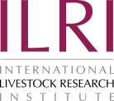

Options of making livestock production in West Africa “climate-smart”
Amole Tunde and Augustine Ayantunde
International Livestock Research Institute
7th All Africa Conference on Animal Agriculture, Accra International Conference Centre, Ghana, 29 July –2 August 2019

Slide 2
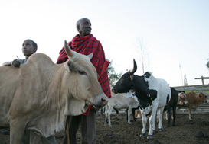
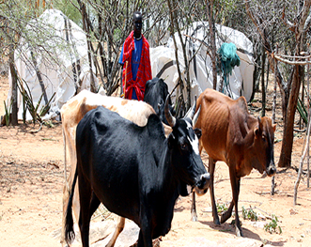
Review summary
Climate change and its impact... Climate change is one of the greatest challenges to food security and sustainable development in general in recent history
Livestock is one of the major contributors in agriculture, by some estimates contributing up to 18% of the global GHG emissions
Its impact…...
Changing the animal feed resources
Indirect: Delay in onset of rainfall, water shortage, poor regeneration of fodder, shortage in diversity and quality
Direct: High temperature, spread of diseases, mortality and morbidity
Its needs…..
Adapting livestock production systems to climate change
is a must for West Africa region, given the
significant contribution to agricultural GDP,
which is about 44%.

Slide 3
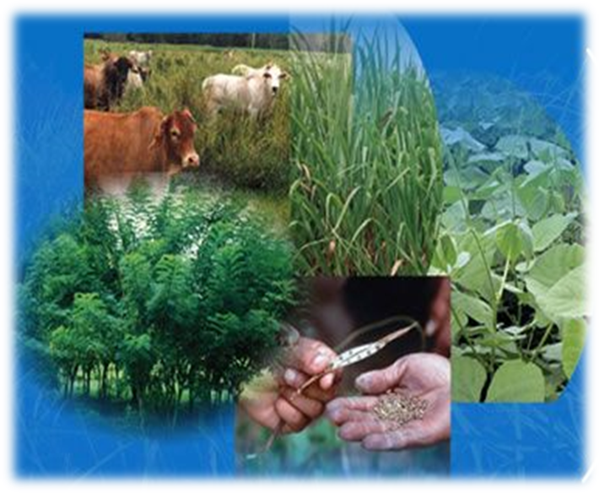
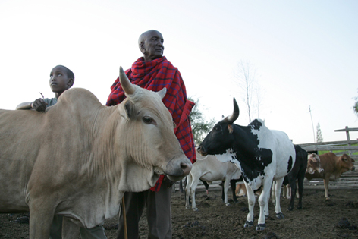
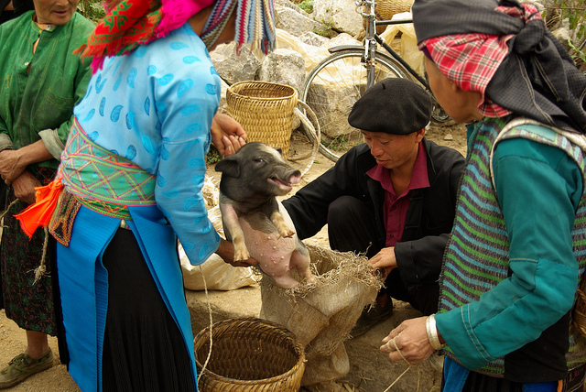
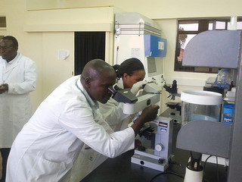
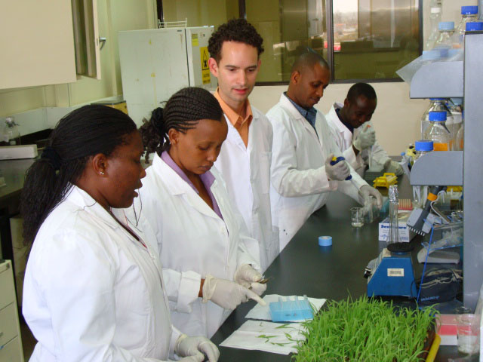
Climate-smart-livestock production system
Livestock production systems are considered to be “climate-smart” by contributing to
Increasing food security,
Adaptation and mitigation in a sustainable way.
Improves productivity or the efficient use of scarce resources

Slide 4
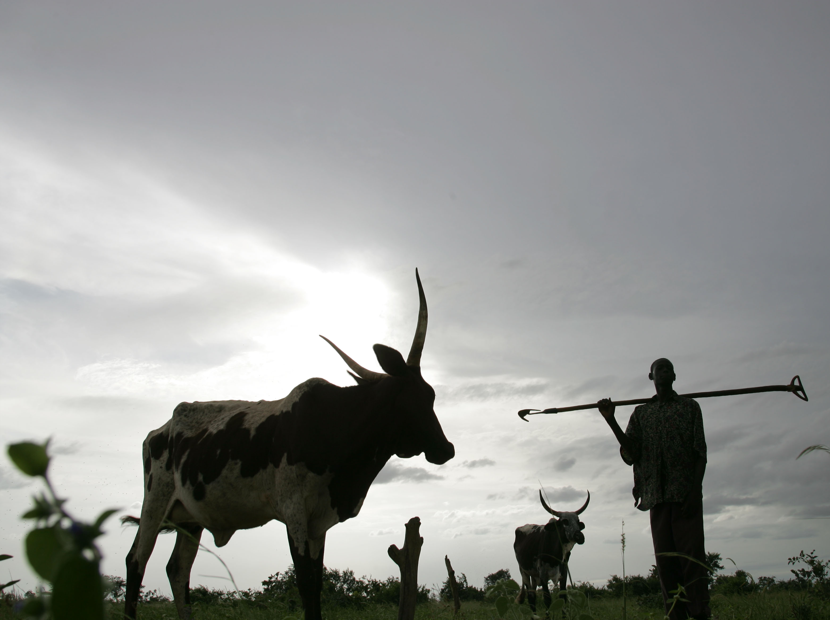
Objective
The study is an attempt to synthesize current knowledge on climate smart (CS) livestock production practices in West Africa and to identify gaps in knowledge.

Slide 5
Summary of Technologies: Feed related interventions
Management objectives | Practices/ Technologies | Knowledge gaps | Suggested ways of improvement
Fodder cultivation | Dual purpose legumes; Forage grass and legume cultivation; Fodder bank | 1. Difficult to assess the impact of these feed improvement intervention in the context of climate smart practices because above interventions were not setup with the initial intention of climate change mitigation 2. Fodder production in most cases requires relatively secured land tenure 3. For farmers who are convinced of the value of improved forages, availability of seeds and planting materials often form a bottleneck 4. The other major challenge to grazing management is the large-scale livestock movements (transhumance) in the region from the dry areas to the wetter zones in search of pasture and water in the dry seasons. Most of reported interventions were not setup with the initial intention of climate change mitigation from livestock perspertive. | Grass-legume mixture will reduce the use of inorganic fertilize, increase sequestration and feed quality
Forage conservation | Harvesting and conservation of natural and cultivated pasture in form of silage and hay |  | Technical training on conservation technique.
Forage quality improvement | Supplementary feeding using concentrate and by-products; Urea treatment of crop residues |  | Improving the feed value chain to facilitate delivery of agricultural by-products from producer to farmers. Improvement of storage facilities for the by-products.
Forage integration | Forage legume incorporation into arable cropping |  | Development of early maturing tree species with high biomass yield
Crop-livestock-tree | Shade trees have impacts on reducing heat stress on animals and contribute to improve productivity, improved forage value |  | Institutional and policy support for the production of tree seedlings adapted to different agro-ecological zones.
Agricultural Water Management solutions | Water storage options (Zaï, demi lune, rainwater harvesting, small reservoirs) |  | Increasing fodder production during wet season and provide dual cropping season to improve feed access and water availability during the dry season

Slide 6
Summary of Technologies: Livestock management interventions
Management objectives | Practices/ Technologies | Knowledge gaps | Suggested ways of improvement
Herd management | Species diversification | 1. Among the Fulani, the principal pastoral ethnic group in West Africa, a shift from cattle to small ruminants will require overcoming a significant cultural barrier since cattle represent such a central part of the group’s identity. 2. Matching type of animal kept and the nature of the livestock production systems remain a major problem most breeding intervention | Institutional and policy support and incentive for farmers
Breeding strategies | Alteration of animal species and breeds |  | Institutional and policy support for animal breeding projects.

Slide 7
Summary of Technologies: Environmental management interventions
Management objectives | Practices/ Technologies | Knowledge gaps | Suggested ways of improvement
Manure management | Anaerobic digesters for biogas and fertilizer. | This option has not been well documented and practiced in West Africa unlike the other parts of Africa Appropriate interventions need to focus on improving manure management to ensure that manure quality is not loss before applying it. | Efficient treatment of manure can reduce the emission of GHGs and raise agricultural productivity
 | Composting, improved manure handling and storage, application techniques |  | Its contribution to climate change adaptation can be improved associating the practice of Zaï, micro-irrigation, stone bunds and filter bunds

Slide 8
Conclusion
Livestock climate smart practices are highly context specific, and at times involve trade-offs between productivity, adaptation and mitigation. As such, stakeholder consultation is important when deciding which climate smart practice to implement.
Successful CSA strategies will require investment in infrastructure that support smallholder farmers in understanding climate change, developing and refining strategies and evaluating CSA options.
Strengthen farmers’ access to and understanding of information, through improved communication approaches and better extension services.
Policy and institutional support is crucial to produce an enabling environment for smallholder farmers to implement livestock-related climate smart agriculture.

