Slide 1


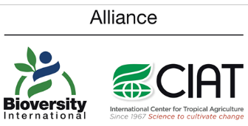

Climate Change, Water Security & Nexus Approaches
Part of a post-graduate course on “Climate Change, Water Security & Nexus” Course Lead: Prof. Vishnu Prasad Pandey, Center for Water Resources Studies, Institute of Engineering, Tribhuvan University, Nepal
Email: vishnu.pandey@pcampus.edu.np
Notes:
Provide the context of the course development, acknowledgements, people involved, etc.
Prof. Rajesh for Trends & Prof. Vishnu for WEFE Nexus concept

Slide 2
Contributors
Prof. Vishnu Prasad Pandey, Center for Water Resources Studies (CWRS), Institute of Engineering, Tribhuvan University, Nepal
Prof. Rajesh Kumar Rai, Institute of Forestry, Tribhuvan University, Nepal
Dr. Sanju Koirala, International Water Management Institute (IWMI), Nepal Office
Prof. Tri Ratna Bajracharya, Center for Energy Studies, Institute of Engineering, Tribhuvan University, Nepal
Dr. Bharat Kumar Pokharel, GREAT International
Dr. Nisha Onta, Governance Lab
Dr. Rishi Ram Kattel, Agriculture & Forestry University
Mr. Sabin Dangol, Center for Water Resources Studies (CWRS), Institute of Engineering, Tribhuvan University, Nepal
Dr. Manohara Khadka, International Water Management Institute (IWMI), Nepal Office
Dr. Marlène Elias, Alliance of Bioversity International & CIAT
l

Slide 3
Module 3
Managing the WEFE Nexus for Future Security
Prof. Vishnu Prasad Pandey
Center for Water Resources Studies, Institute of Engineering, Tribhuvan University, Nepal
Dr. Rishi Ram Kattel
Agriculture & Forestry University, Nepal
Prof. Tri Ratna Bajracharya
Center for Energy Studies, Institute of Engineering, Tribhuvan University, Nepal

Slide 4
3. Managing the WEFE Nexus for Future Security [1 hr, 45 mins]
3.1 Strengthening cooperation and coordination [30 mins]
Government cooperation and coordination across sectors and scales for future WEFE security
Diplomacy in transboundary contexts
Institutional arrangements, shared goal setting, and regular review/monitoring in federal context
Capacity strengthening
3.2 Streamlining the WEFE Nexus as a common agenda [35 mins]
Promoting dialogues (between science, policy, practice/industry, private sector) on WEFE Nexus gains
Nexus solutions in achieving national goals and Sustainable Development Goals (SDGs)
3.3 Addressing bottlenecks for implementing inclusive solutions for WEFE Nexus gains [40 mins]
Technical/engineering challenges and solutions
Nature-based challenges and solutions
Governance challenges and solutions
Ensuring equitable sharing of benefits
Market-based challenges and solutions
Demand-based challenges and solutions

Slide 5
3.1 Strengthening Cooperation and Coordination
Role of cooperation and coordination across sectors and scales (national and sub-national) of the governments
Different tracks of diplomacy in transboundary contexts
Institutional arrangements, shared goal setting, and regular review in a federal context
Capacity strengthening

Slide 6
3.1 Session Delivery Plan [30 minutes]
Time | Activity
10 minutes | Lecture: Role of coordination and cooperation; different diplomacy tracks
10 minutes | Exercise 3-1: How can we improve coordination/cooperation in Nepal?
10 minutes | Lecture: Institutional arrangement, capacity strengthening

Slide 7



3.1 Role of Cooperation & Coordination
Achieving Security:
Cooperation and coordination among sectors and governments are crucial for ensuring the security of water, energy, food, and environmental resources.
Integrated Decision-Making:
Integrated decision-making across sectors fosters synergistic approaches that address interdependencies and minimize trade-offs.
Sustainable Outcomes:
Collaboration helps optimize resource use and promote sustainable outcomes that benefit communities and ecosystems.

Slide 8
3.1 Different Tracks of Diplomacy
Track 1 Diplomacy
Means: Official discussions, typically involving high-level political and military leaders
Activities: Heads of states meet, discuss issues and release joint statements
Actors: Government and political elites
Track 2 Diplomacy
Means: Unofficial dialogue and problem-solving activities aimed at building relationships
Actors: Influential academic, religious and NGO leaders and other civil society actors
Track 3 Diplomacy
Means: People-to-people diplomacy undertaken by individuals and private groups
Actors: Community/grass-roots individuals or role models
Notes:
Diplomacy in Transboundary Rivers

Slide 9
3.1 Different Diplomacy Tracks
Diplomacy tracks: Different diplomacy tracks, such as bilateral and multilateral dialogues, are instrumental in addressing transboundary challenges.
Shared interests: Identifying shared interests and common goals among countries with shared and/or overlapping resources and needs can promote mutual benefits and foster cooperation.
Conflict resolution: Diplomatic approaches are vital for conflict resolution and promoting stability in shared water, energy, and food resources.
01
02
03
Notes:
Addressing inequality can produce benefits in multiple ways.

Slide 10
3.1 Exercise 3-1: Open Discussion [15 mins]
How do you characterize the current status of Nexus cooperation and coordination in Nepal?
How could coordination and cooperation be improved?
Horizontal cooperation/coordination?
Vertical cooperation/coordination?
Transboundary cooperation/coordination?

Slide 11
3.1 Institutional Arrangements
Effective Mechanisms
Establishing effective institutional mechanisms facilitates intersectoral and intergovernmental coordination.
Cross-Sectoral Platforms
Multi-stakeholder platforms (MSPs) provide spaces for dialogue and collaboration among diverse actors in the WEFE Nexus.
International Agreements
Transboundary cooperation is often supported by international agreements and treaties that outline shared responsibilities.

Slide 12
3.1 Institutional Arrangement | Shared Goals, Regular Review
Shared vision
Establishing shared goals and visions among stakeholders encourages collective action towards a sustainable WEFE Nexus.
How can we establish shared goals and visions?
Monitoring and review
Regular monitoring and review processes ensure progress tracking and help in adapting strategies as needed.
Adaptive management
Flexibility and adaptive management enable responses to changing circumstances and emerging challenges.

Slide 13
3.1 Capacity Strengthening
Building capacities:
Investing in capacity strengthening enhances the ability of stakeholders to engage effectively in Nexus cooperation and coordination.
Knowledge exchange:
Facilitating knowledge exchange and learning fosters better decision-making and promotes best practices.
Empowering local communities:
Empowering local communities to participate in decision-making enhances ownership and sustainability.

Slide 14
3.1 Role of Cooperation and Coordination | Sources and Further Reading
Abdi, H., Shahbazitabar, M., & Mohammadi-Ivatloo, B. (2020). Food, energy and water Nexus: A brief review of definitions, research, and challenges. Inventions, 5(4), 1–14. https://doi.org/10.3390/inventions5040056
Bleischwitz, R., Spataru, C., VanDeveer, S. D., Obersteiner, M., van der Voet, E., Johnson, C., Andrews-Speed, P., Boersma, T., Hoff, H., & van Vuuren, D. P. (2018). Resource Nexus perspectives towards the United Nations Sustainable Development Goals. Nature Sustainability, 1(12), 737–743. https://doi.org/10.1038/s41893-018-0173-2
Caldarice, O., Tollin, N., & Pizzorni, M. (2021). The relevance of science-policy-practice dialogue. Exploring the urban climate resilience governance in Italy. City, Territory and Architecture, 8(1). https://doi.org/10.1186/s40410-021-00137-y
Das, T., & Cabezas, H. (2018). Tools and concepts for environmental sustainability in the food-energy-water Nexus: Chemical engineering perspective. Environmental Progress and Sustainable Energy, 37(1), 73–81. https://doi.org/10.1002/ep.12763
Mabhaudhi, T., Nhamo, L., Chibarabada, T. P., Mabaya, G., Mpandeli, S., Liphadzi, S., Senzanje, A., Naidoo, D., Modi, A. T., & Chivenge, P. P. (2021). Assessing progress towards sustainable development goals through Nexus planning. Water (Switzerland), 13(9), 1–13. https://doi.org/10.3390/w13091321
Mai, Q., Yu, D., & Li, X. (2023). Coupling characteristics of China ’ s food-energy-water Nexus and its implications for regional livelihood well-being. Journal of Cleaner Production, 395(19), 136385. https://doi.org/10.1016/j.jclepro.2023.136385
Platts, E. J., Kerner, B., Adams, N., & Archer, J.-M. M. (2022). FEW and Far Between: Rebalancing Research and Training Priorities at the Food-Energy-Water Nexus. Science and Education, 31(5), 1383–1397. https://doi.org/10.1007/s11191-022-00344-0
Zhang, J., Wang, S., Pradhan, P., Zhao, W., & Fu, B. (2022). Mapping the complexity of the food-energy-water Nexus from the lens of Sustainable Development Goals in China. Resources, Conservation and Recycling, 183(April), 106357. https://doi.org/10.1016/j.resconrec.2022.106357

Slide 15
3.2
Streamlining the WEFE Nexus as a Common Agenda
Promoting dialogue (science, policy, practice/ industry, private sector) on WEFE Nexus solutions
Contribution of Nexus solutions in achieving national goals, targets, and SDGs

Slide 16
3.2 Session Delivery Plan [35 minutes]
Time | Activity | Facilitator
10 minutes | Exercise 3-2: What could be an entry point for making the WEFE Nexus a common agenda? | Prof. Dr. Vishnu Pd. Pandey
25 minutes | Lecture: Promoting dialogue; Nexus contribution to achieving various goals (e.g., SDGs) | Prof. Dr. Vishnu Pd. Pandey

Slide 17
3.2 Exercise 3-2: Discussion [15 minutes]
What could be some entry points to make the WEFE Nexus a central part of a common resource management agenda? How can we materialize it?
Notes:
Entry points could be: i) climate action; ii) SDGs – as all related sectors and actors are integrated in this endeavor.

Slide 18
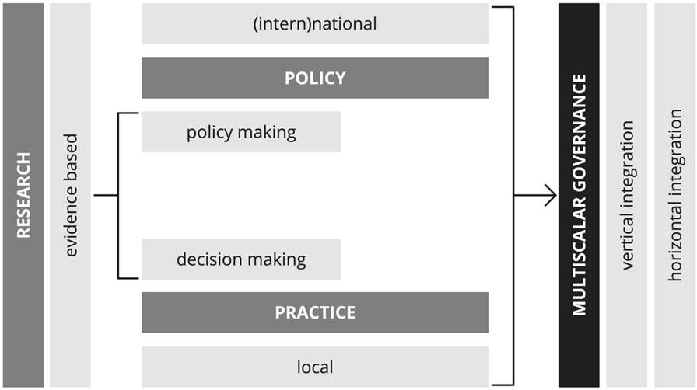
3.2 Promoting Dialogue
Streamlining a concept or approach starts with generating evidence [SCIENCE], adoption in policy [POLICY], translation into action [PRACTICE]
A schematic of potential integration of these three components is shown in the context of multi-scalar governance
Figure: Multiscalar governance (Source: Caldarice et al., 2021)
Notes:
Proper functioning of these three components in close coordination/cooperation can help streamline a new approach/concept.

Slide 19
3.2 Promoting Dialogue
Vertical integration must answer to two questions:
1. How does local action contribute to achieving (int)national policy objectives (e.g., specific targets for emission reduction)?
2. How do national governments support local action (e.g., through financial, technology and institutional capacity)?
Horizontal integration must ensure:
Consistent cooperation between national governments ministries and related departments (e.g., environment/climate, finance, etc.)
Key message:
Dialogue among science, policies and practice spheres should not be horizontal but circular to function properly and achieve sustainable impact.

Slide 20



3.2 Dialogue – Science, Policy, Practice, Industry and Private Sector
Knowledge integration:
Fostering dialogue between scientists, policymakers, practitioners, industries, and the private sector promotes the integration of diverse knowledge and expertise.
Co-designing solutions:
Collaborative dialogue helps co-design and implement effective WEFE Nexus solutions that are informed by both scientific insights and practical realities.
Addressing trade-offs:
Engaging multiple stakeholders enables identifying and addressing trade-offs between water, energy, food, and ecosystem needs.
Notes:
Multi-sectoral dialogue is required for: i) knowledge integration, ii) co-designing solutions, iii) addressing trade-offs.

Slide 21
3.2 Contribution of Nexus Solutions to National Goals and SDGs
Projected population by 2030 → ~ 8.5 billion → demands for food will increase by 35%, energy by 50% and water by 40% (Mai et al., 2023)
Critical challenge: fulfill water, energy, & food needs for all human beings while staying within environmental limits (Das & Cabezas, 2018)
The WEFE Nexus has gained global recognition as a viable strategy to solve the complicated interdependencies of these challenges (Platts et al., 2022).
WEFE Nexus approach → solution for reaching SDG targets, ensuring security and sufficiency of resources (e.g., water, energy, food) and upgrading quality of ecosystems alongside human societies (Abdi et al., 2020)
Out of 17 SDGs, the WEFE Nexus has a direct link with: SDG2 (Zero Hunger)
SDG6 (Clean water and sanitation)
SDG7 (Affordable and clean energy)
As well as indirect links to most other SDGs

Slide 22
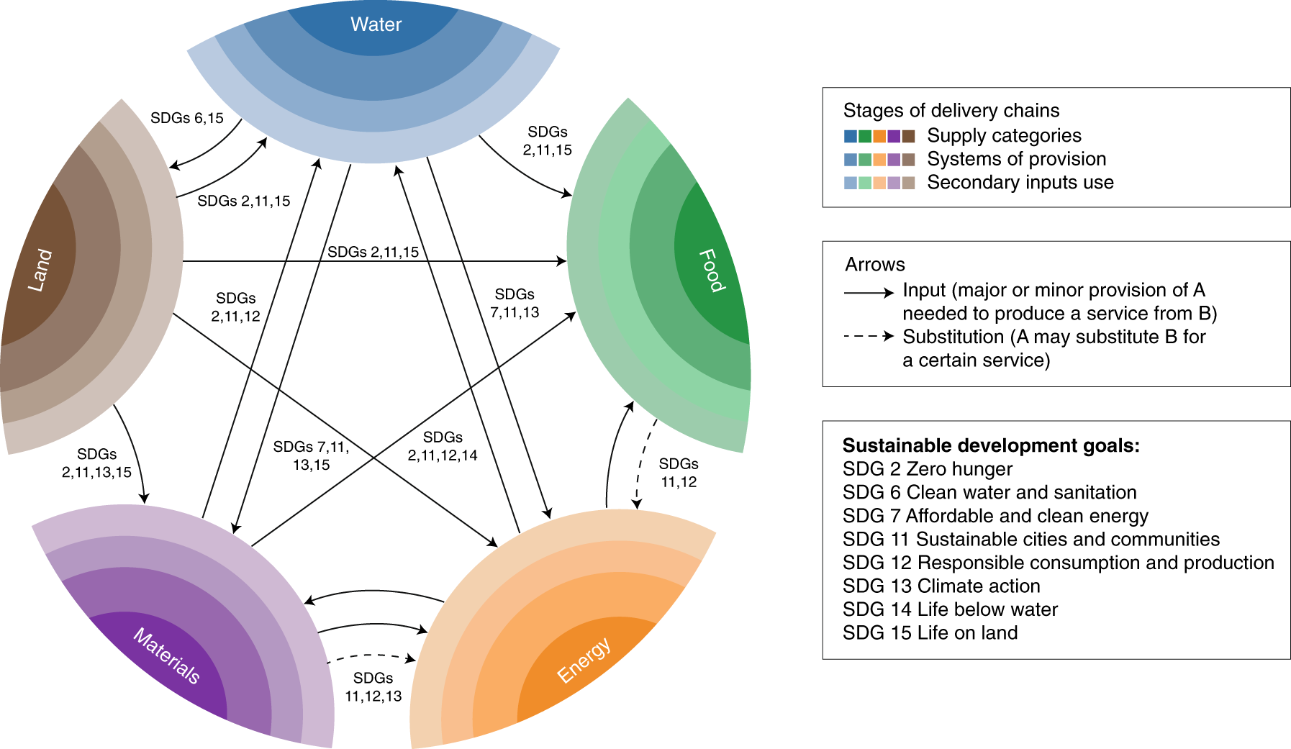
3.2 Contribution of Nexus Solutions to National Goals and SDGs
Figure: The Nexus: interlinkages across resources and the SDGs (Source: Bleischwitz et al., 2018)

Slide 23
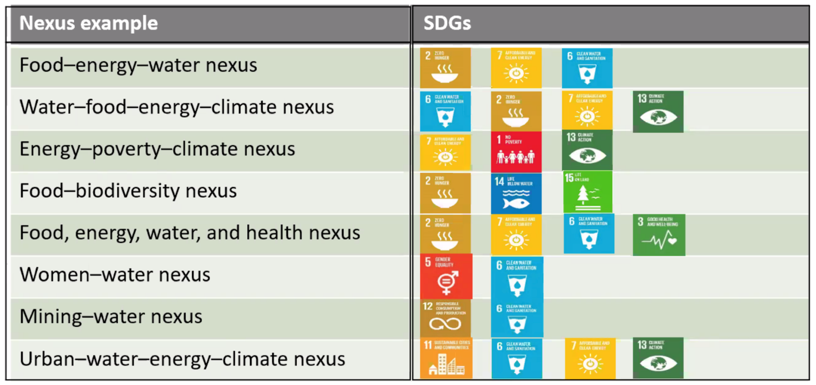
3.2 Contribution of Nexus Solutions to National Goals and SDGs
Examples of several Nexus configurations and linkage with SDGs

Slide 24
3.2 Contribution of Nexus Solutions to National Goals and SDGs
SDGs acknowledge the inter-linkages between human wellbeing, economic prosperity, and a healthy environment → this covers a wide range of topical issues including water, energy and food security, poverty eradication, economic development, climate change, health, among others (Mabhaudhi et al., 2021).
Linking Nexus planning and SDGs has many advantages, and Nexus planning is proposed as a “fitting approach” for integrating and assessing SDG implementation (Mabhaudhi et al., 2021).
5 key areas of Nexus/SDG integration (Mabhaudhi et al., 2021):
Description of Nexus analytical tool
Defining WEFE Nexus sustainability indicators
Linking Nexus planning and related SDG indicators
Periodic assessment and monitoring of SDG performance
Benefits of periodic SDG monitoring

Slide 25
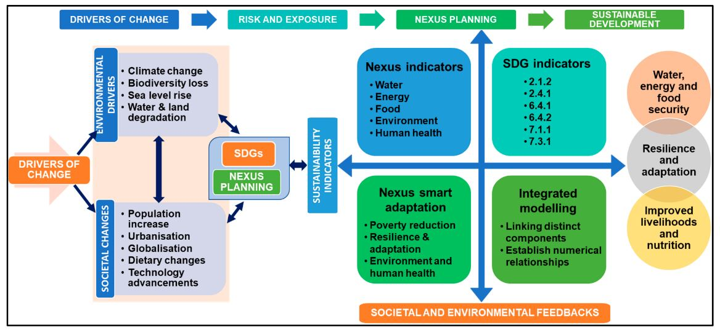
3.2 Contribution of Nexus Solutions to National Goals and SDGs
Figure: A conceptual framework linking Nexus processes with SDGs (Source: Mabhaudhi et al., 2021)

Slide 26
3.2 Contribution of Nexus Solutions to National Goals and SDGs
National priorities:
Aligning WEFE Nexus solutions with national development goals ensures their relevance and contribution to the country's broader priorities.
SDG alignment:
WEFE Nexus solutions can directly contribute to achieving various SDGs, including those related to poverty eradication, clean water, renewable energy, and sustainable agriculture.
Co-benefits:
Implementing Nexus solutions often results in co-benefits, where actions to improve water, energy, and food security also enhance ecosystem health and social well-being.

Slide 27
3.2 Advancing Integrated Policies & Strategies
Nexus thinking:
Promoting Nexus thinking encourages policymakers and practitioners to consider interlinkages between sectors while developing policies and strategies.
Policy coherence:
Integrated policies and strategies foster policy coherence, minimizing conflicts between different sectors and maximizing synergies.
Adaptive approaches:
Flexible and adaptive policy approaches allow for adjustments to emerging challenges and changing circumstances.

Slide 28


3.2 Public-Private Partnership​
Leveraging the private sector:
Engaging the private sector in the WEFE Nexus fosters innovative and sustainable solutions, leveraging their resources and expertise.
Investment opportunities:
Public-private partnerships can unlock investment opportunities for projects that contribute to the Nexus goals while supporting economic growth.
Sustainable business practices:
Collaboration with the private sector encourages the adoption of sustainable business practices that benefit society and the environment.

Slide 29
3.2 Streamlining WEFE Nexus | Reading Materials
Abdi, H., Shahbazitabar, M., & Mohammadi-Ivatloo, B. (2020). Food, energy and water Nexus: A brief review of definitions, research, and challenges. Inventions, 5(4), 1–14. https://doi.org/10.3390/inventions5040056
Bleischwitz, R., Spataru, C., VanDeveer, S. D., Obersteiner, M., van der Voet, E., Johnson, C., Andrews-Speed, P., Boersma, T., Hoff, H., & van Vuuren, D. P. (2018). Resource Nexus perspectives towards the United Nations Sustainable Development Goals. Nature Sustainability, 1(12), 737–743. https://doi.org/10.1038/s41893-018-0173-2
Caldarice, O., Tollin, N., & Pizzorni, M. (2021). The relevance of science-policy-practice dialogue. Exploring the urban climate resilience governance in Italy. City, Territory and Architecture, 8(1). https://doi.org/10.1186/s40410-021-00137-y
Das, T., & Cabezas, H. (2018). Tools and concepts for environmental sustainability in the food-energy-water Nexus: Chemical engineering perspective. Environmental Progress and Sustainable Energy, 37(1), 73–81. https://doi.org/10.1002/ep.12763
Mabhaudhi, T., Nhamo, L., Chibarabada, T. P., Mabaya, G., Mpandeli, S., Liphadzi, S., Senzanje, A., Naidoo, D., Modi, A. T., & Chivenge, P. P. (2021). Assessing progress towards sustainable development goals through Nexus planning. Water (Switzerland), 13(9), 1–13. https://doi.org/10.3390/w13091321
Mai, Q., Yu, D., & Li, X. (2023). Coupling characteristics of China ’ s food-energy-water Nexus and its implications for regional livelihood well-being. Journal of Cleaner Production, 395(19), 136385. https://doi.org/10.1016/j.jclepro.2023.136385
Platts, E. J., Kerner, B., Adams, N., & Archer, J.-M. M. (2022). FEW and Far Between: Rebalancing Research and Training Priorities at the Food-Energy-Water Nexus. Science and Education, 31(5), 1383–1397. https://doi.org/10.1007/s11191-022-00344-0
Zhang, J., Wang, S., Pradhan, P., Zhao, W., & Fu, B. (2022). Mapping the complexity of the food-energy-water Nexus from the lens of Sustainable Development Goals in China. Resources, Conservation and Recycling, 183(April), 106357. https://doi.org/10.1016/j.resconrec.2022.106357

Slide 30
3.3
Addressing Implementation Bottlenecks for Inclusive WEFE Nexus Solutions
Technical/engineering solutions
Nature-based solutions
Governance solutions
Ensuring equitable sharing of benefits, etc.)
Market-based solutions
Demand-based solutions

Slide 31
3.3 Session Delivery Plan [40 minutes]
Time | Activity | Facilitator
10 minutes | Exercise 3-3: Open Discussion – What could be potential solutions for inclusive WEFE Nexus gains and bottlenecks for implementing them? How can these bottlenecks can be addressed? | Prof. Dr. Vishnu Pd. Pandey
25 minutes | Lecture: Various ways of addressing bottlenecks in implementing inclusive WEFE Nexus solutions | Prof. Dr. Vishnu Pd. Pandey
5 minutes | Exercise 3-4: Open Discussion – Is the WEFE Nexus a problem or a solution? | Prof. Dr. Vishnu Pd. Pandey

Slide 32
3.3 Exercise 3-3: Open Discussion [10 mins]
What could be potential solutions for inclusive WEFE Nexus gains?
What could be the bottlenecks for implementing them?

Slide 33

3.3 Technical/Engineering Solutions
Innovative technologies:
Leveraging advanced technologies can enhance water efficiency, renewable energy generation, sustainable agriculture, waste management, and ecosystem restoration.
Smart water management:
Implementing smart water infrastructure, real-time monitoring, precision agriculture, efficient irrigation systems, and water reuse technologies.
Energy-efficient systems:
Adopting energy-efficient lighting, appliances, industrial processes, combined heat and power systems, and renewable energy integration.

Slide 34



3.3 Nature-Based Solutions
Ecosystem restoration:
Restoring and conserving wetlands, forests, mangroves, and green spaces to improve water quality, regulate water flow, sequester carbon, and enhance biodiversity
Sustainable agriculture:
Promoting agroforestry, organic farming, agroecology, and soil conservation practices to support ecosystem health while ensuring food security
Green infrastructure:
Implementing green roofs, permeable pavements, rain gardens, and natural flood management techniques to manage storm-water runoff and reduce flooding

Slide 35


3.3 Governance Solutions
Policy alignment:
Harmonizing policies and regulations across sectors; integrating the WEFE Nexus approach into national and regional policies
Cross-sectoral coordination:
Strengthening coordination mechanisms among different government agencies, ministries, and stakeholders
Transparent decision-making:
Ensuring transparency in decision-making processes and engaging the public in resource management discussions

Slide 36
3.3 Market-Based Solutions
Sustainable investment:
Encouraging investment in sustainable water, energy, and food projects through green bonds, impact investing, and sustainable finance mechanisms
Carbon markets:
Implementing carbon trading and pricing mechanisms to incentivize businesses to reduce emissions and invest in green technologies
Water and energy pricing:
Implementing progressive pricing models for water and energy to encourage efficient resource usage and discourage wasteful consumption
01
02
03
Notes:
Addressing inequality can produce benefits in multiple ways.

Slide 37
3.3 Demand-Based Solutions
Behavioral change:
Raising awareness and promoting behavioral change among consumers to foster responsible resource use and conservation
Education and capacity building:
Enhancing public awareness and knowledge about the Nexus through educational campaigns, workshops, and capacity-building programs
Integrated education:
Integrating Nexus concepts into educational curricula to foster a future generation committed to sustainable resource management and conservation
01
02
03
Notes:
Addressing inequality can produce benefits in multiple ways.

Slide 38
3.3 Ensuring Equitable Sharing of Benefits
Gender equity:
Promoting gender-sensitive policies and programs to ensure equal participation and benefits for women and girls in water, energy, and agriculture sectors
Social inclusion:
Addressing the needs of differently-abled individuals, ethnic minorities, and other vulnerable communities to promote social justice
Socio-economic status:
Equitably distributing resources and opportunities to empower marginalized groups and reduce inequalities in access to water, energy, and food

Slide 39
3.3 Exercise 3-4: Open Discussion [10 mins]
Is the WEFE Nexus a problem or a solution?

