Slide 1







Under the High Patronage of His Majesty King Mohammed VI
From Ponds to Plates: The Role of Crop-Aquaculture Farming Systems in Building Household Food Security
in Myanmar.
Pacem Kotchofa, Marie-Charlotte Buisson, Shelly Win.
International Water Management Institute (IWMI) Southeast Asia.
Marrakech, Morocco, December 4th, 2025.

Slide 2


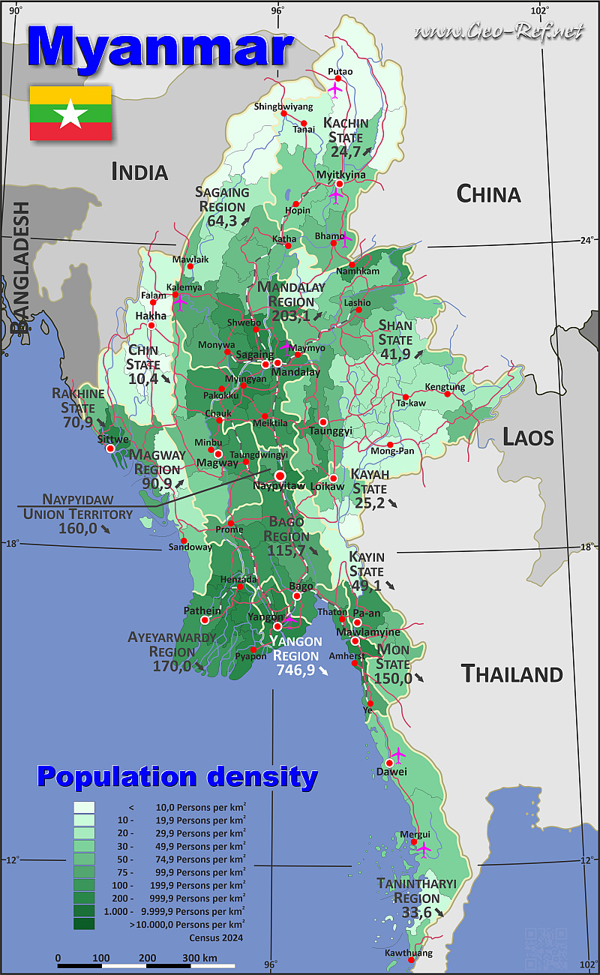
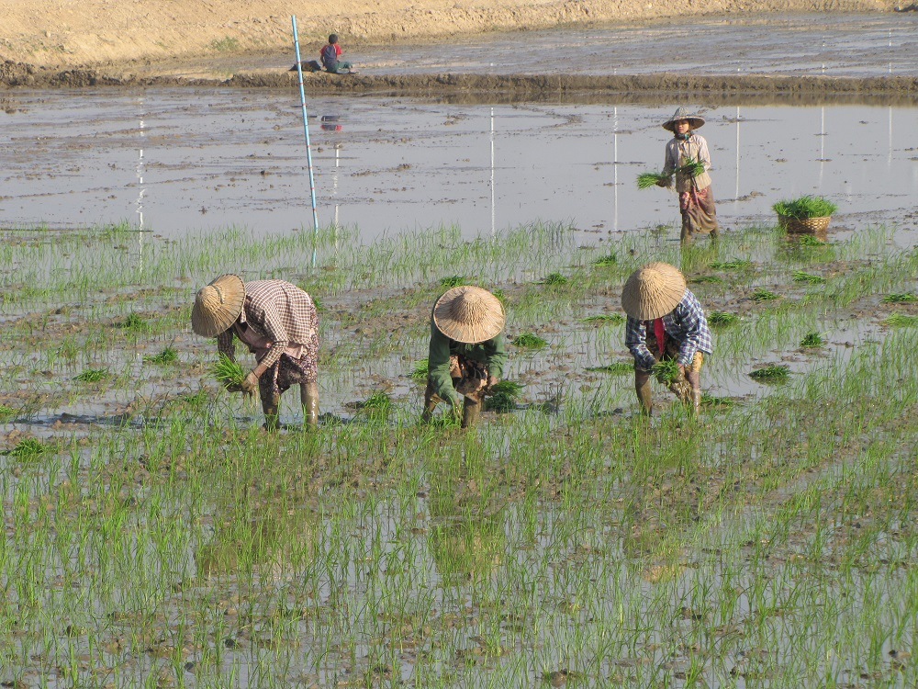
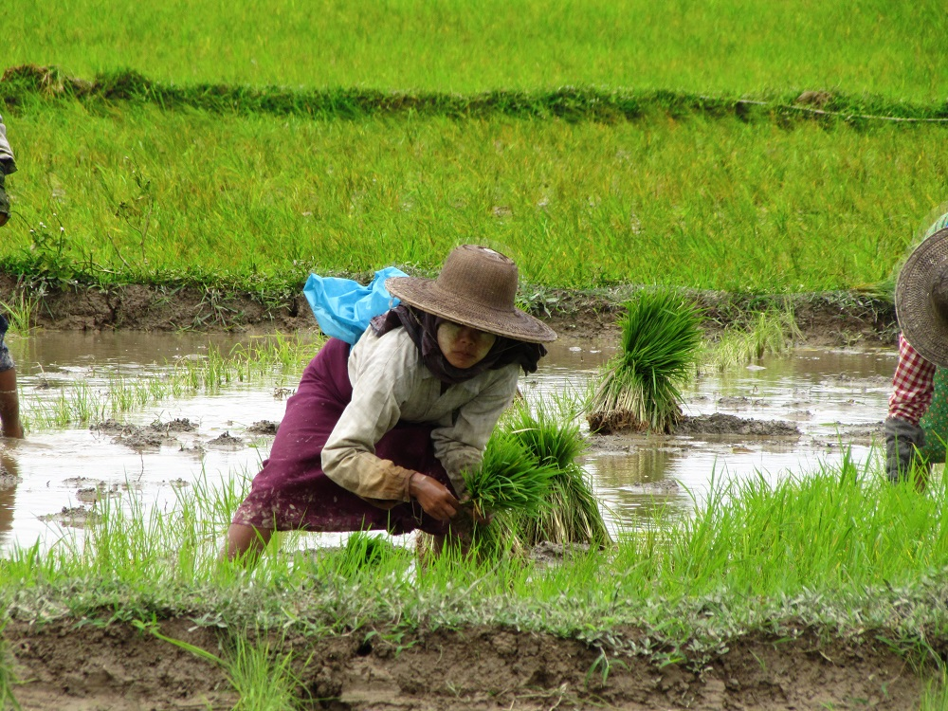


Myanmar: Demographics & Food Systems
Population: + 50 million inhabitants (50% to 70%) relying on agriculture for their livelihoods (World Bank, 2024).
Agriculture: Highly vulnerable to climate shocks and water scarcity.
Monoculture systems are low-resilient, less productive, and water-intensive, jeopardizing the livelihoods of millions of smallholder farmers, leading to widespread food insecurity and hunger in both rural and urban areas ​(IFPRI Myanmar, 2024)​.
XIX World Water Congress | Marrakech, Morocco | 1-5 December 2025 | www.worldwatercongress.org
Notes:
Monocropping or the overreliance on a single crop…

Slide 3
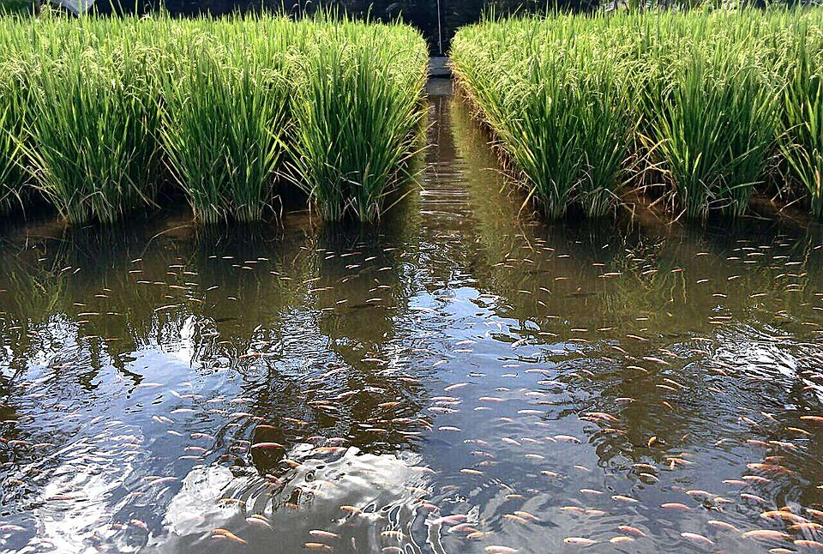
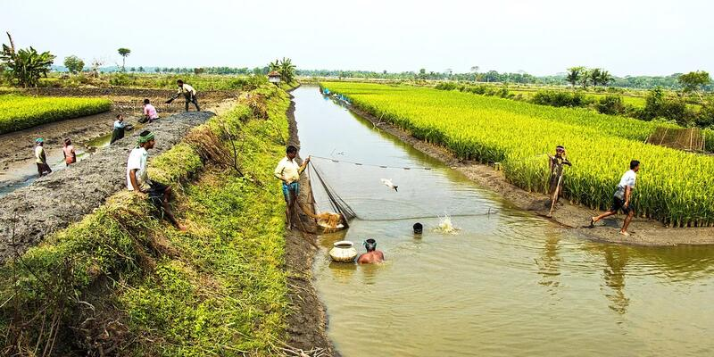
Integrated Food Systems: Potential pathway
Crop and Aquaculture Farming (CAF): A synergetic environment where crops and aquaculture can thrive.
  Increase agricultural productivity (yield) & Efficient use of resources (water and land) while bridging seasonal food gaps during dry seasons when crop harvests are critically low ​(Wang et al., 2023; Myo et al., 2024)​.
  Increase incomes (additional products, i.e., fish, seaweed, shrimps, or crustaceans) while serving as a vital source of protein and micronutrients for HH food consumption ​(Mekonnen et al., 2019; Dubey et al., 2024).
  Increase resilience against climate variability, ultimately strengthening the livelihoods of farming HH, especially in rural areas where poverty rates are often the highest ​(Wang et al., 2024).
XIX World Water Congress | Marrakech, Morocco | 1-5 December 2025 | www.worldwatercongress.org
Notes:
Integrated food system: An approach to combining multiple food production sustainably.
Beyond increasing crop yields

Slide 4

CAF: Policy Gap & Research Questions
Policymakers lack rigorous, causal evidence on which sustainable practices truly work.
RQ1: Could CAF adoption contribute to lowering food security?
RQ2: What are the primary factors that influence households' decision to adopt a CAF system?
RQ3: To what extent does the CAF adoption, causally, improve the livelihoods and food security of farming households in Myanmar?
XIX World Water Congress | Marrakech, Morocco | 1-5 December 2025 | www.worldwatercongress.org

Slide 5
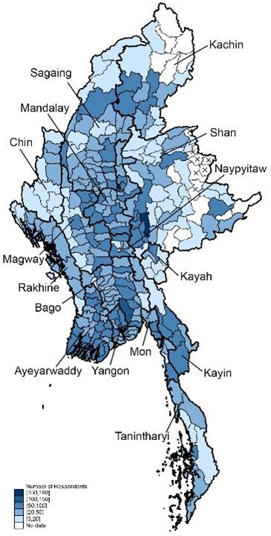
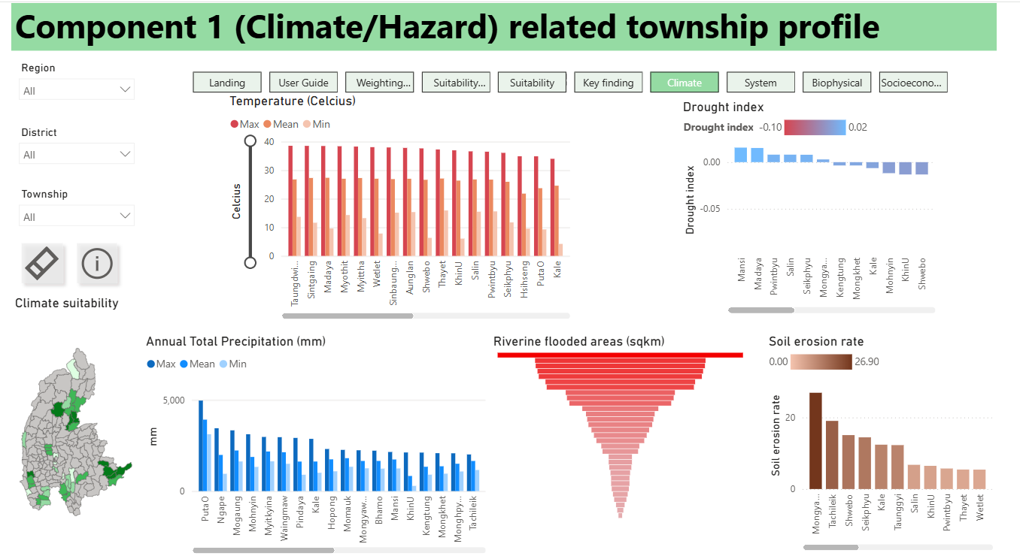
Data & Methods
Two data sources:
Myanmar Household Welfare Survey (MHWS) Round 6 ​:
A nationally and regionally representative dataset with information on household characteristics, welfare, food security, and farming practices, including CAF, and shocks (IFPRI Myanmar, 2024).
Sample size of 12,898 households.
August and November 2023.
The Aquaculture Development Support Tool (Aqua-DST)​:
Tool with information on climate hazards, aquaculture systems, biophysical conditions, and socioeconomic factors (Win S. et al., 2024)​.
Upper Ayeyarwady River Basin, and limited to regions such as Kachin, Magway, Mandalay, Sagaing, and Southern and Eastern Shan states
XIX World Water Congress | Marrakech, Morocco | 1-5 December 2025 | www.worldwatercongress.org

Slide 6
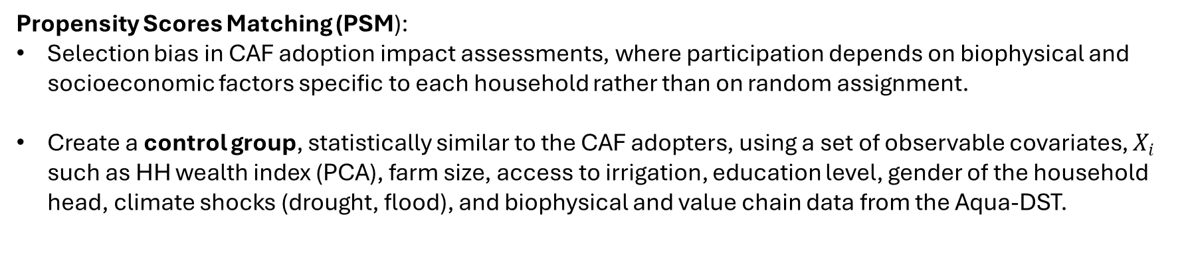
Data & Methods
Key variables of interest:
Treatment variable CAF Adoption dummy variable (1, 0): practice both crop and aquaculture.
Outcome variable FI dummy variable (1, 0) derived from the Household Hunger Scale/HFIAS tools.
Food Secure (0)
Mild (1-2)
Moderate (3-4)
Report no food access disruption.
Worry about food. Go to bed hungry.
Spend an entire day and night without food.
Propensity Scores Matching (PSM):
Selection bias in CAF adoption impact assessments, where participation depends on biophysical and socioeconomic factors specific to each household rather than on random assignment.
Create a control group, statistically similar to the CAF adopters, using a set of observable covariates, $X_{i}$ such as HH wealth index (PCA), farm size, access to irrigation, education level, gender of the household head, climate shocks (drought, flood), and biophysical and value chain data from the Aqua-DST.
XIX World Water Congress | Marrakech, Morocco | 1-5 December 2025 | www.worldwatercongress.org
Notes:
Synthetic group.

Slide 7
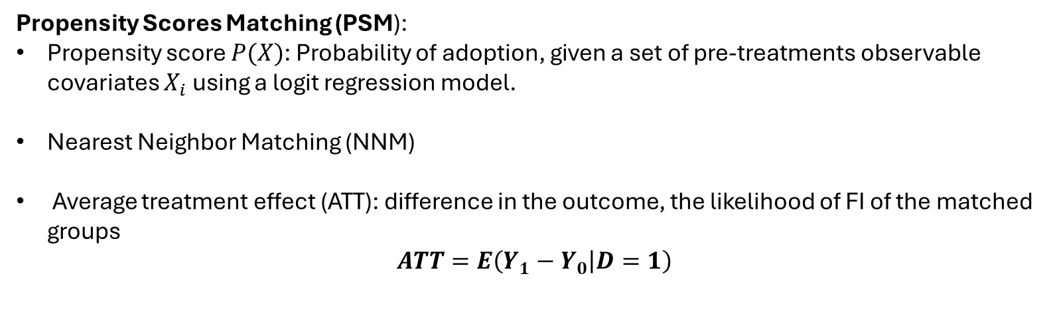
Data & Methods
Propensity Scores Matching (PSM):
Propensity score $P(X)$: Probability of adoption, given a set of pre-treatments observable covariates $X_{i}$ using a logit regression model.
Nearest Neighbor Matching (NNM)
Average treatment effect (ATT): difference in the outcome, the likelihood of FI of the matched groups
$$ATT=E\left(Y_{1}−Y_{0} | D=1\right)$$
XIX World Water Congress | Marrakech, Morocco | 1-5 December 2025 | www.worldwatercongress.org
Notes:
NN to match each CAF (treatment group) with the control group that has the most similar propensity score.

Slide 8
Key Findings
Table 1: Summary Statistics: Treated Group vs. Untreated Group
 | CAF Households (N = 211/ 12,898) | Non-CAF HH (5,502)
Household head gender (male) | 63.03% | 55.13%
Marital Status (Married) | 76.78 % | 70.85%
Age (mean) | 42 (12.59) | 40 (13.07)
Education (Below average) | 35.07% | 35.21%
Location: (rural) | 90.52% | 91.94%
Sagaing | 16.11% | 13.67%
Ayeyarwady | 12.80% | 12.23%
Mon/Mandalay | 12.80% | 11.65%
Drought (Yes) Flooding (Yes) H. Temperature (Yes) | 2.84% 14.69% 1.4% | 3.24% 11.60% 1.56%
Food Insecurity (FI = 1) | 18.96% | 24.72%
XIX World Water Congress | Marrakech, Morocco | 1-5 December 2025 | www.worldwatercongress.org
Notes:
Most of the CAF HH are male headed based in rural areas across Sagaing, …Mon
The major climate shock reported is flooding

Slide 9
RQ1: Key Findings
Table 2: Association between household FI status and CAF adoption: $FI=f(X_{i}, CAF)$
Variables | CAF Households |  | All Sample
 | Coeff. | Std. Error | Coeff. | Std. Error
Demographics and socioeconomics
Gender (Female) | 0.550 | (0.445) | 0.207*** | (0.040)
Age | -0.006 | (0.018) | 0.005*** | (0.002)
Urban Areas | 1.13* | (0.64)
High Education | -0.27 | 0.484) | -0.35*** | (0.044)
Agricultural and climatic conditions
Land tenure: No | - | - | 0.731*** | (0.046)
CAF (Yes) | - | - | -0.38** | (0.182)
Drought | 0.078 | (1.22) | 0.409*** | (0.149)
Flood | 1.235** | (0.546) | 0.679*** | (0.063)
High Temp. | 2.55 | (1.67) | 0.608*** | (0.164)
LR Chi2 | 30.79** |  | 712.31***
Pseudo R2 | 0.162 |  | 0.045
XIX World Water Congress | Marrakech, Morocco | 1-5 December 2025 | www.worldwatercongress.org
Notes:
Female HH heads are associated with an increased odds of FI compared to their male counterparts.

Slide 10
RQ1: Key Findings
Graph 1: Association between household FI status and CAF adoption: $FI=f(X_{i}, CAF)$
Test Statistics:
Ho: No difference in Mean (FI) Scores between CAF and non-CAF Households.
Ho: Mean (FI) CAF > Mean FI nonCAF Households.
RHo
XIX World Water Congress | Marrakech, Morocco | 1-5 December 2025 | www.worldwatercongress.org
Notes:
The unconditional logit model shows a strong negative association between CAF adoption and FI
Conclude that the CAF system significantly improves farmers’ resilience, i.e., lowers their food insecurity scores compared to those in non-CAF

Slide 11
RQ2: Key Findings
Table 3: PSM household FI status and CAF adoption: $CAF=f(X_{i})$
Variables | Coeff. | Std. Error
Gender (Female) | 0.046 | (0.255)
Age | 0.006 | (0.01)
Urban Areas | -0.662 | (0.492)
High Education | -0.085 | (0.265)
Farm Size (ha) | 0.02*** | (0.009)
Drought (Yes) | -0.423 | (0.795)
Flood | -0.546 | (0.435)
PC 1 (Wealth Index) | 0.11** | (0.05)
High Temp. | -0.806*** | (0.729)
Rainfall – Increase (mm) | -0.51** | (-0.233)
Rainfall – Decrease (mm) | -0.18 | (0.147)
Flooding Area (km2) | -0.01 | (0.006)
Wetlands (ha) | 0
Irrigated Areas (ha) | 0
XIX World Water Congress | Marrakech, Morocco | 1-5 December 2025 | www.worldwatercongress.org

Slide 12
RQ2: Key Findings
Table 3: PSM household FI status and CAF adoption: $CAF=f(X_{i})$
Variables | Coeff. | Std. Error
Number of fish markets | 0.035 | (0.043)
Number of hatcheries | 1.27*** | (0.443)
Number of fish nurseries | 0.016 | (0.141)
N. of fingerling distributors | -2.7*** | (0.471)
Number of fish feed suppliers | -0.148 | (0.125)
F. consumption kg/per capita | 0.06*** | (0.019)
N. of fishery officers (DoF) | 0.16** | (0.065)
Number of fish farmers | 0.01*** | (0.002)
Accessibility to roads (miles) | 0.01*** | (0.002)
LR chi² | 106.92
Prob > chi² | 0
Pseudo R² | 0.059
N. Observation | 2,598
XIX World Water Congress | Marrakech, Morocco | 1-5 December 2025 | www.worldwatercongress.org

Slide 13
RQ3: Key Findings
PSM household FI status and CAF adoption: $CAF=f(X_{i})$
Table 4: Regression summaries of the treatment effects.
Variables | Sample | Treated | Controls | Difference | S.E. | Tstat
FI | Unmatched | 0.2247 | 0.2351 | - 0.010 | 0.046 | -0.23
 | ATT | 0.221 | 0.226 | - 0.007 | 0.054 | -0.12
Variables | Sample | Treated | Controls | Difference | S.E. | Tstat
FI | ATT | 0.328 | 0.249 | -0.071* | 0.04 | -1.79
Graph 2: PS distribution by HH status
Rosenbaum bounds sensitivity test: Robustness of results.
XIX World Water Congress | Marrakech, Morocco | 1-5 December 2025 | www.worldwatercongress.org
Notes:
ATT showed a 7.1 percentage-point reduction in food insecurity (FI) scores among households practicing CAF compared to similar households that do not practice CAF.

Slide 14
Implications of the study
Female household heads are still at a higher risk of food insecurity than their male counterparts.
Better knowledge (extension services) to handle adverse weather can improve farmers’ ability to prevent or reduce food insecurity in Myanmar.
Households engaged in integrated CAF systems experienced, on average, a statistically significant reduction in food insecurity compared to similar households that did not participate.
The adoption of CAF systems may be more influenced by the value chains and biophysical factors associated with aquaculture expansion than by households’ demographic or financial means.
Policy support for CAF uptake should allocate resources to developing gender sensitive aquaculture expansion infrastructures.
XIX World Water Congress | Marrakech, Morocco | 1-5 December 2025 | www.worldwatercongress.org
Notes:
From Evidence to Action.

Slide 15
Conclusion
Integrated food systems, e.g., Crop-Aquaculture Farming (CAF), can be a pathway to increase household resilience against food insecurity and climate variability.
Major barriers to CAF expansion can be addressed through public and private investments in aquaculture value chains and in extension services for managing adverse climate shocks.
Next Steps (From region to agroecological zone): Disaggregate the results and policy formulation per agroecological zones: Wet, Dry, and uplands/hilly as water and climate challenges are different.
CAF can improve livelihoods and support the achievement of SDGs related to hunger, water, land, and poverty reduction, especially among female farmers.
XIX World Water Congress | Marrakech, Morocco | 1-5 December 2025 | www.worldwatercongress.org

Slide 16
Acknowledgement
The authors express their gratitude to the IWMI Economics and Impact Assessment (ECIA) Research Group for their valuable insight and inputs.
“The Myanmar Household Welfare Survey and Myanmar Agriculture Production Survey was undertaken as part of the Feed the Future Myanmar Agricultural Policy Support Activity (MAPSA) led by the International Food Policy Research Institute (IFPRI) in partnership with Michigan State University (MSU) and made possible by the support of the American people through the United States Agency of International Development (USAID).
The opinions expressed here belong to the author(s) and do not necessarily reflect those of IFPRI, MSU, CGIAR, or USAID.”
XIX World Water Congress | Marrakech, Morocco | 1-5 December 2025 | www.worldwatercongress.org

Slide 17


Under the High Patronage of His Majesty King Mohammed VI
Thank you!
Contact me: p.kotchofa@cgiar.org

