Slide 1
One Health operationalization through workforce development
Hung Nguyen-Viet
with contributions from Ekta Patel, Eric Fèvre, Bernard Bett, Theo Knight-Jones, Siobhan Mor
Health Program Leader (a.i.), International Livestock Research Institute (ILRI)
Lead, CGIAR initiative on One Health, Member of OHHLEP II
World Organisation for Animal Health–led Africa Veterinary Workforce Development Conference
One Health session
Nairobi, 28 November 2024

Slide 2
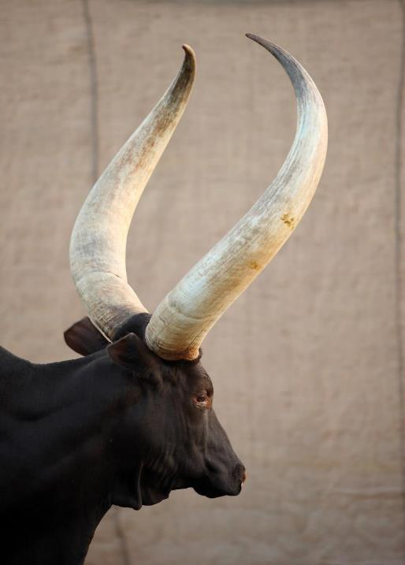
Overview
One Health Quadripartite and OHHLEP
One Health perspective - workforce development for One Health by ILRI
Strengthening partnership with WOAH and others
Key take aways
Notes:
Slide deck overview

Slide 3
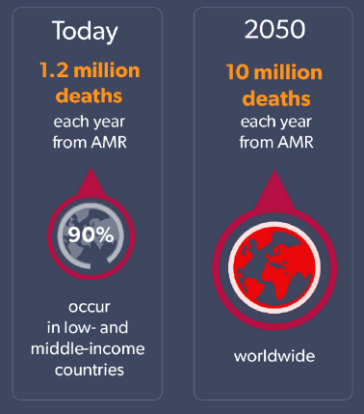
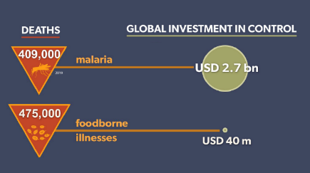
Global challenges
Zoonoses
Emergence and impact
Food safety: large burden comparable to tuberculosis, malaria, and HIV/AIDS, but small investment
Antimicrobial Resistance (AMR) is a growing problem

Slide 4
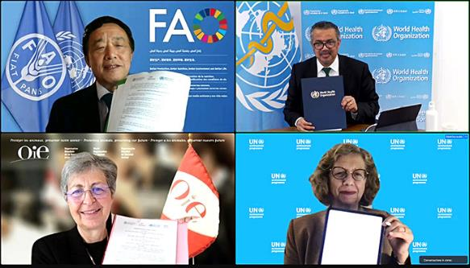
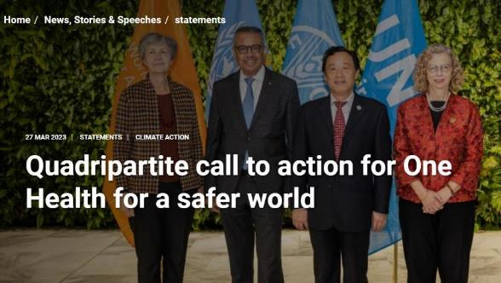
In October 2021 the QPT organizations signed the OH-JPA:
For a world better able to prevent, predict, detect, and respond to health threats and improve the health of humans, animals, plants, and the environment while contributing to sustainable development.
1st Quadripartite Executive Annual Meeting on One Health, March 2023
2nd Quadripartite Executive Annual Meeting on One Health, In Nairobi in February 2024

Slide 5
Advancing One Health throught the Quadripartite: 4 Strategic Priorities
Implementation of the One Health Joint Plan of Action (JPA)
Political Engagement and Advocacy
Secretariat Functions
Science and Evidence

Slide 6
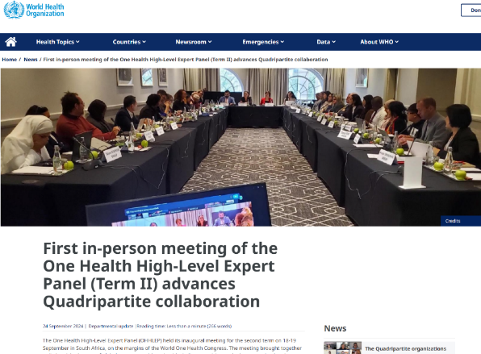
OHHLEP: One Health High Level Expert Panel

Slide 7

What does OHHLEP II do?
Term II April 2024
Advisory role to the Quadripartite on science-based policy interventions on the emergence of health crises arising from human-animal-ecosystem interface
Development of long-term strategy to implement the One Health approach
New panel, new ToR to better balance across the six action tracks of the One Health Joint Plan of Action.
Human Health Specialists
Animal health Specialists
Environment Specialists
Law, Policy
and Governance Specialists
One
Health
Economics and Finance Specialists
One Health Generalists
Data scientists
Food systems and agriculture Specialists

Slide 8
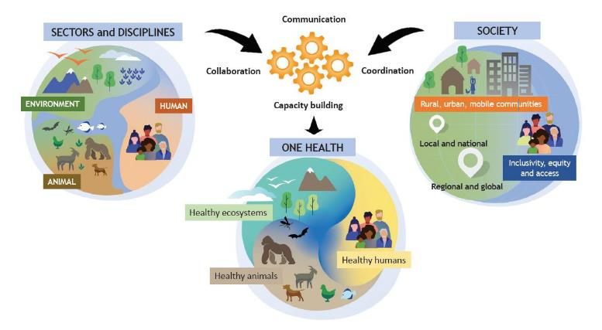
Global One Health: Quadripartite and OHHLEP
One Health is an integrated, unifying approach that aims to sustainably balance and optimize the health of people, animals and ecosystems.
OHHLEP I - One Health High Level Expert Panel (2021)

Slide 9
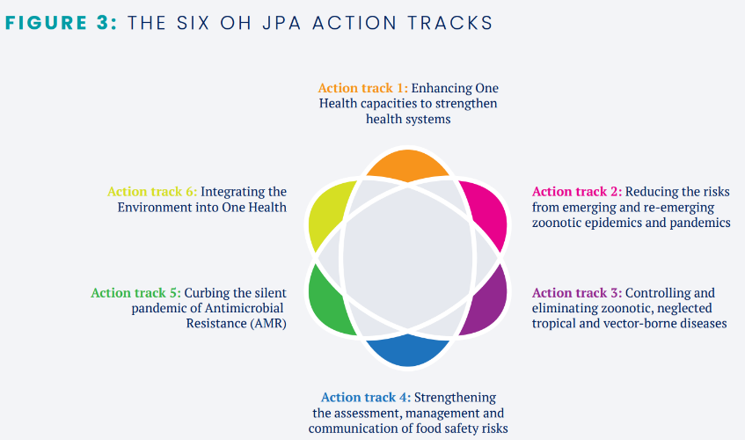
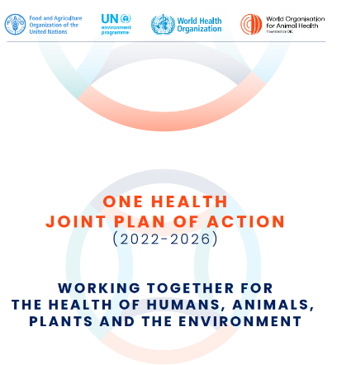
Six Action Tracks of the OH JPA

Slide 10
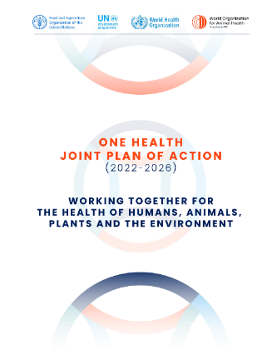
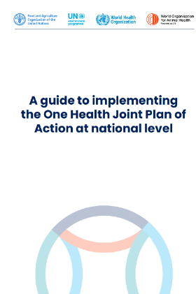
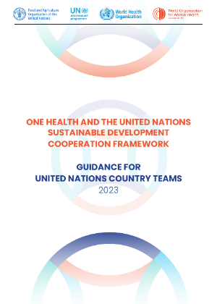
OH JPA implementation guide
Following the launch of the OH JPA, complimentary implementation guide was developed to support and translate the objectives and high-level activities into practical guidance that can be adapted to national level contexts.

Slide 11
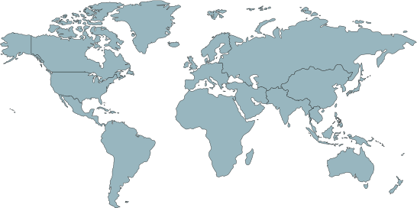

The CGIAR: filling a unique global gap
CGIAR System Organization Montpellier
Alliance Bioversity International-CIAT Rome, Cali
The world's largest publicly funded agricultural research network committed to agriculture innovation for Farmers and Food Systems in the developing world.
Global presence across four continents with nearly 10,000 staff of 128 nationalities
Local presence in nearly 90 countries
3000+ partners
50 years’ experience
10-fold return on investment
IFPRI Washington, D.C.
ICARDA Beirut
IWMI Colombo
IRRI Los Baños
ICRISAT Hyderabad
WorldFish Penang
CIMMYT Mexico City
CIP Lima
AfricaRice Bouaké
ILRI Nairobi
Addis Ababa
CIFOR-ICRAF Nairobi
Bogor
IITA Ibadan

Slide 12

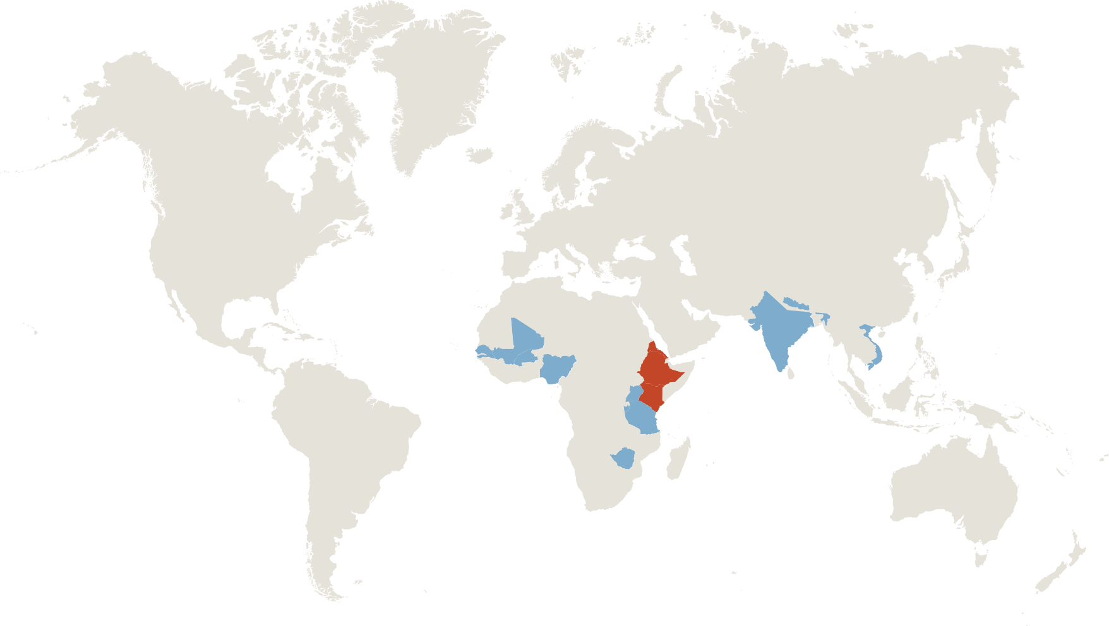

ILRI offices and staff worldwide
ILRI is co-hosted by both the governments of Ethiopia and Kenya, with offices in 8 other countries in Africa (Burkina Faso, Burundi, Mali, Nigeria, Senegal, Tanzania, Uganda and Zimbabwe); 4 countries in Asia (India, Nepal and Vietnam).
ILRI has over 700 permanent staff (with a gender breakdown of 40% female and 60% male).
ILRI established in 1994 based on merger of the two centres
International Laboratory for Research on Animal Diseases–ILRAD (est. 1973)
International Livestock Centre for Africa –ILCA (est.1974)
Mali
Ethiopia
Nepal
Senegal
Burundi
Vietnam
Kenya
Burkina Faso
India
Nigeria
Tanzania
Uganda
Zimbabwe

Slide 13

Taking stock:
Importance of livestock in global development

Slide 14
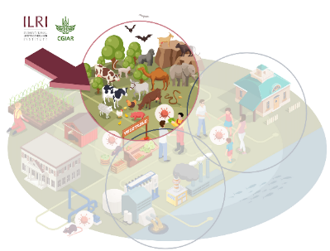
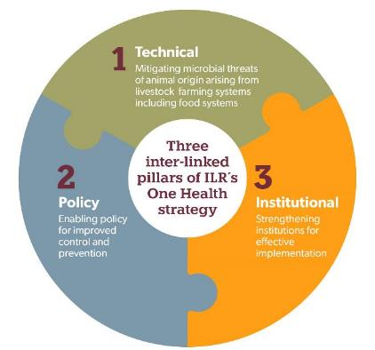
ILRI One Health strategy
A holistic approach to preventing pandemics/epidemics and other microbial threats from animals/environment
Vision
To improve the lives, livelihoods and well-being of people in the global south by building healthy, sustainable and resilient systems at the intersection of humans, animals and the environment.
Key thematic areas
Epidemics and pandemics
Endemic zoonoses
Food-borne diseases
Antimicrobial Resistance
wildlife

Slide 15
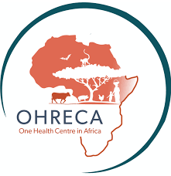
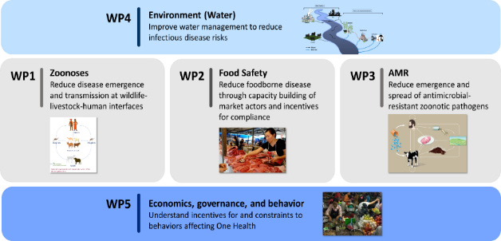


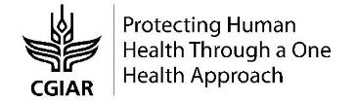

Major projects: One Health science, capacity building and operationalization
ICT4Health Vietnam, Korea MAFRA
Co-Infection, DTRA
Covid-19 genomic surveillance, RF
MoreMilk BMGF
SafePORK, ACIAR, Vietnam
APART, WorldBank, India
AMR, Fleming Fund
JPI AMR: “SEFASI” funded,
POLOH Poulty &One Health, LSIL
And others…
More on One Health @ILRI: ilri.org/one-health

Slide 16



Highlights of One Health work at CGIAR
One Health research to strengthen country capacities to control neglected and emerging zoonotic diseases in several countries in the LMICs including COVID 19
Two decades of holistic One Health diagnosis & interventions in traditional markets & meat/ fish processing sectors
Innovative successful approaches based on improving policy, technology & training for market actors and motivation & incentives for behavior change
Cultivating an environment of improved food safety & reduced foodborne diseases benefiting million consumers
Interventions to reduce antimicrobial use (AMU) and resistance (AMR)
Behavioral nudges for semi-intensive poultry farmers and good animal husbandry practices and vaccination

Slide 17



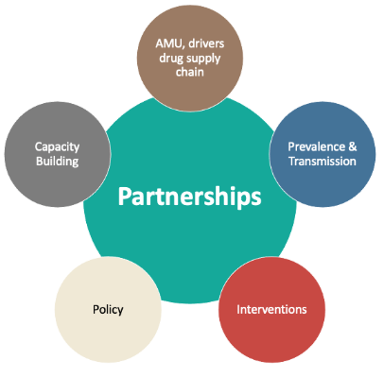







CGIAR AMR Hub – mitigating agricultural AMR risks
Quantification on farm antimicrobial consumption
Drivers of use: disease vs protection vs growth promotion
Veterinary antibiotic value chain mapping
Quality of antimicrobials and vaccines
AMR diagnostic capacity
Surveillance systems
Mentorship
AMR in clinical animal pathogens
Farm resistomes
Environmental dimensions - climate change
AMR at wildlife-livestock interfaces
Mapping policies & regulations
Treatment guidelines
Gender responsiveness & impacts
Cost-benefit of farm-level interventions
Behavioural nudges for desired change
Vaccine efficacy
Non-antibiotic alternatives

Slide 18
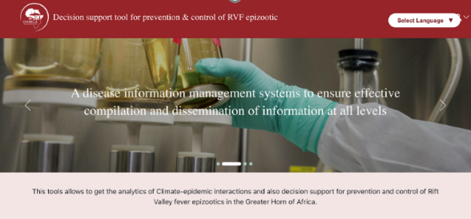
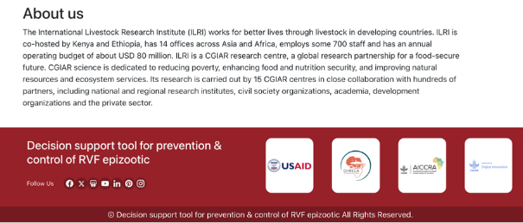
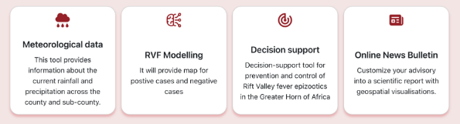
Digital Innovations: Development of a decision support tool for prevention and control of Rift Valley Fever
Highlights of One Health work at CGIAR
CGIAR innovation process
Uses a bottom-up approach enabling higher resolution environment data for prediction purposes
Includes modules to aid decision making and dissemination of information to local

Slide 19
Workforce development for One Health

Slide 20
Capacity Development @ILRI
CapDev is INTEGRAL to ILRI’s research, anchored in projects and CGIAR initiatives Theory of Change.
Trainees propel ILRI’s research to be understood, implemented and adopted – accelerated impact.
Graduate fellowships- Early career training MSc and PhD (150-200 hosted per year)
Research fellowships- Mid- advanced career researchers from NARIS (80-100) hosted per year
Internships – Focusing on undergraduates, nurturing young minds about careers in livestock agri-food systems (30-50 hosted per year)
Tailor made short courses – Technical/livestock science courses and soft skills enhancement courses (CapDev Grand Challenge)
Mentorship Seminars and Grand Challenge- Soft skills development Breaking the barrier between research evidence and impact
Alumni relations
NEW: Capdev hub – Jameel Observatory
14 interns of 2023-2024 cohort of the Department of Veterinary Services (DVS) interns. One year at ILRI Health program

Slide 21

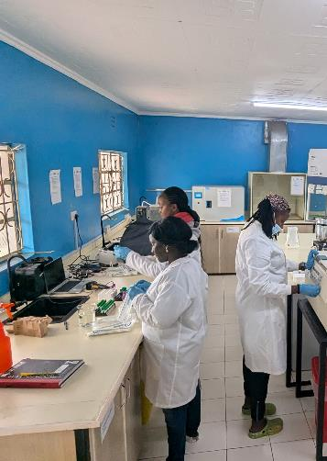
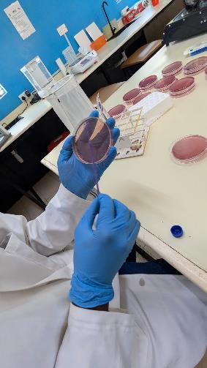



Fostering national investment in One Health research and surveillance capacity
Oloitoktok lab
The One Health Initiative, with the Kajiado County government in Kenya, manages a zoonoses surveillance lab established by ILRI with bilateral funding
Kajiado County has funded a position to work in the lab in collaboration with the Initiative

Slide 22
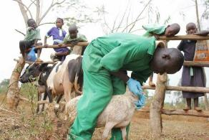

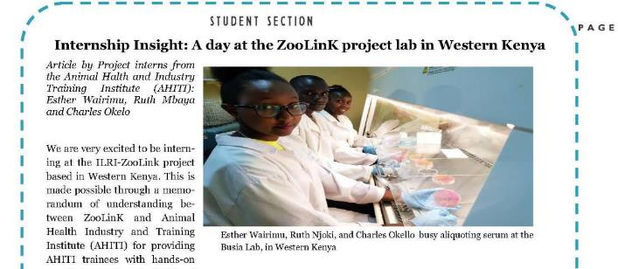











AHITI interns experience in ZooLink Project
Provide AHA labor force on graduation, for field based one health training programme for extension workers
Acquire skills used in field diagnostic systems
Exposed to state-of-the-art methods for field data collection and real-time processing
Acquire skills in demographic and social surveys

Slide 23
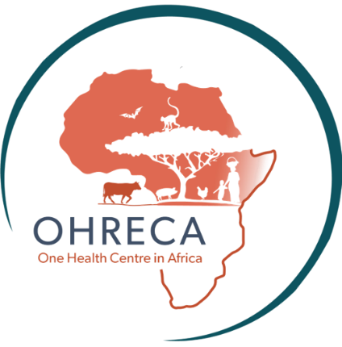
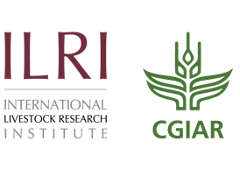









Capacity development

Slide 24
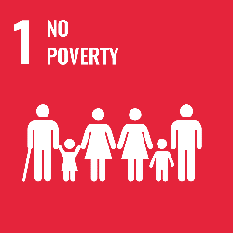
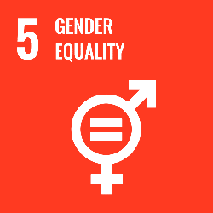
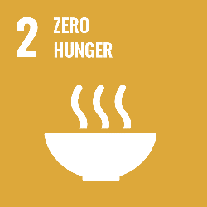
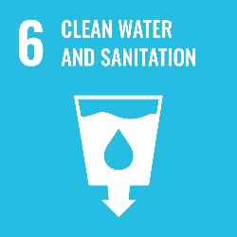
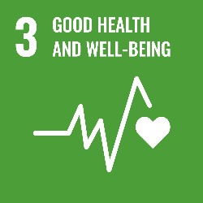
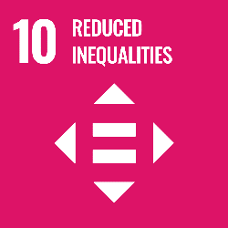
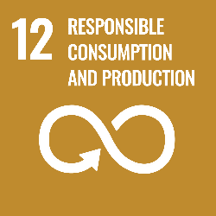
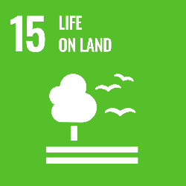
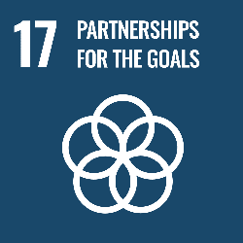
OHRECA Overview
In Africa, human pressure on the environment is jeopardizing the health of humans, livestock and wildlife, a problem worsened by ineffective authorities, underfunded and poorly performing health services.
OUTCOME
IMPACT
WP1
Evidence generated on hazards of interest, quantification, prevalence, risk-based control
Hazards: Evidence that counts
Strengthen evidence-based policies and practices in 8 countries in Sub-Saharan Africa implemented through improved national and regional One Health capacities in sub-Saharan Africa
Technical interventions using a One Health approach are tested and documented by OHRECA and partners
WP2
Interventions, implementations and assessments
CAPACITY DEVELOPMENT
Enter text here
Public and private sector cooperative mechanisms are reviewed and improved, enabling the adoption of evidence based One Health policies and practices
WP3
Networks and Partnerships
CAPACITY DEVELOPMENT

Slide 25
Capacity development objectives
Build One Health competencies among scientists, graduate fellows, One Health actors and policy makers
Promote uptake and utilization of tools and strategies developed for the management of One Health problems (communities, general public, policy makers etc)
Promote collaboration and coordination between projects,programs and other initiatives on One Health
OHRECA’s capacity development activities
One Health platforms
Graduate fellows – 22 PhDs and 11 MSc
Community training
Development of training curricula
Others

Slide 26
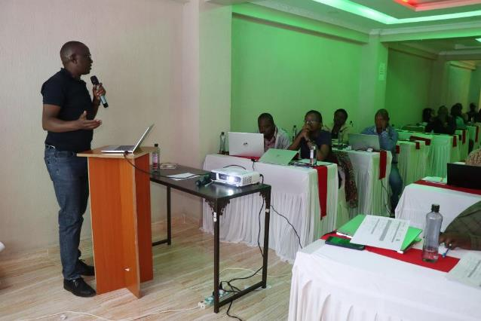
Technical support for Samburu County One Health platform and Community training in Isiolo
Samburu County convened a meeting to develop a plan for community training
Training conducted in partnership with the One Health platform, Isiolo County
To enhance knowledge for the surveillance and control of six zoonotic diseases including Rift Valley fever, brucellosis, rabies, hydatidosis, salmonellosis and Q fever
The training reached 120 community leaders who were to serve as TOTs in Isiolo county
Community trained participated more effectively in RVF surveillance during the recent outbreak
Isiolo County’s One Health training tools refined
Moyale Kenya 30th September - 4th October 2024

Slide 27
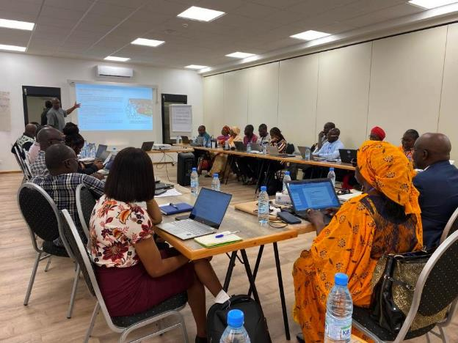
Training #1: Mali, Senegal, Burkina Faso, Cote d’Ivoire
Sessions
Definition of One Health and competencies of the One Health platforms in the region based on the recent reviews
Presentations demonstrating evidence on One Health, identification of priorities and capacity needs
Further discussions on coordination, integration, leadership and partnerships
Engagement and collective action
One Health situational analysis/ ongoing regional trends
Theory of change
General report, closing ceremony and way forward
Saly, Mbour, Senegal on 22 - 26th July 2024

Slide 28
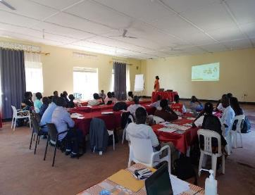
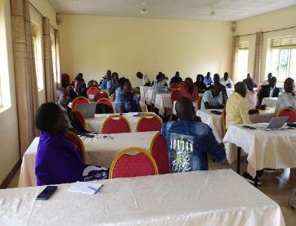
Community training: Northern Uganda
A farmer feedback session was held in 4 districts in northern Uganda, participated in the pig value chain mapping and baseline epidemiological study on porcine cysticercosis
A total of 65 stakeholders attended including the DVOs, DHOs, meat inspectors, community educators, district environmental officer, commercial officers, farmers, traders and representatives from NGOs working on WASH activities in the districts
Results on the prevalence of the parasite in their districts and their implications for health of the people and the connection with epilepsy discussed
Northern Uganda, July 22 - 26, 2024

Slide 29
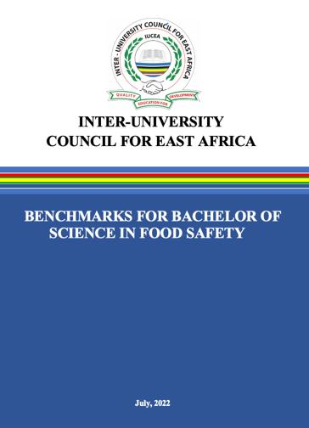



Food safety curriculum benchmarks in IUCEA – Capacity development
The challenge
Tertiary training does not well equip African professionals to manage food safety in mass domestic markers when foodborne disease is a huge health problem.
Solution:
Introduction of Benchmarks to ensure high quality and pro-poor education as well as facilitate graduate employment and mobility.
Results/Outcome
The Inter-University Council for East Africa (IUCEA) is a strategic institution of the East African Community, responsible for the development and coordination of higher education and research in the region. July 2022 Benchmarks for Bachelor of Science in Food Safety were introduced.
WP1
WP3

Slide 30

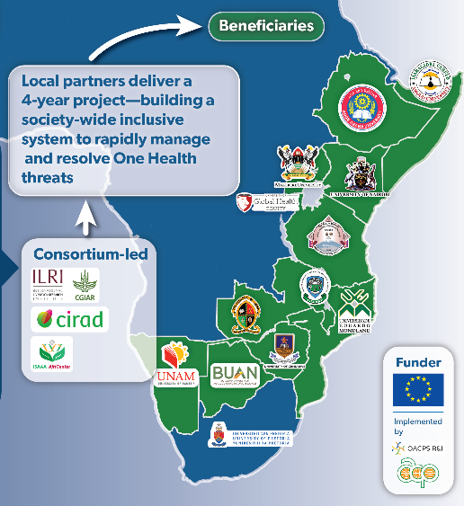
Operationalizing One Health
One Health Education and professional capacity a key element
Developed IUCEA One Health MSc Benchmark curriculum for Africa with IUCEA
Face-to-face training of government professionals (e.g. training of 5 County One Health Units in Kenya, also in Zimbabwe, Rwanda, Tanzania, Ethiopia...)
Supported online delivery of FAO OH training 326 participants from 21 countries in Eastern and Southern Africa, and FAO Women leaders in OH course to 449 people from 20 countries – many of them vets
Notes:
e.g. https://www.cabidigitallibrary.org/doi/full/10.1079/cabionehealth.2023.0002

Slide 31
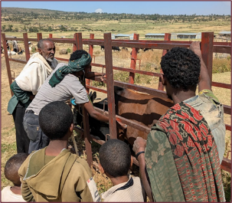

Operationalizing One Health
Ethiopia – As well as developing PPP delivery for animal health, the project HEARD with the Ethiopian Veterinary Association worked to strength the vet profession in Ethiopia and developed CPD for the veterinary sector, including OH – CPD
This is important as people need to update their skills to meet current needs – OH a good example, to continue this in RESTORE
---------------------------
Practicing One Health and intersectoral collaboration going beyond trained technical skills to form Community One Health Units – Developed and delivering ToT training to community and district level officers
Notes:
e.g. https://www.cabidigitallibrary.org/doi/full/10.1079/cabionehealth.2023.0002

Slide 32
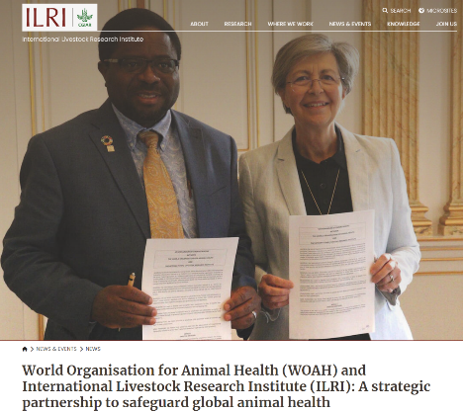
Strengthening partnership with WOAH and others
25 May 2023 –ILRI & WOAH signed a memorandum of understanding (MoU) for the welfare and health of animals where this strategic partnership marks a new era of collaboration to protect animal health and promote sustainable livestock production systems across the globe
ILRI-WOAH engagements include significant contributions through technical working groups and other contributions
WOAH’s AMR technical working group
WOAH’s ad hoc group on emerging disease
Contributing to reports on countering disinformation & misinformation in animal health emergencies
Technical meetings on Rabies, PPR, Fortifying Institutional resilience against biological threats
We look forward to continue to strengthen the collaboration between the two organizations

Slide 33
Key take aways
Quadripartite and OHHLEP – good enabling environment for One Health operationalization at country and global level.
ILRI has contributed to One Health workforce in LMICs through research, training, labs, capacity building, both from individual to institutional level (DVS, ZDU…).
ILRI is open to working with other partners to strengthen operationalization of One Health.
Recognize that Vets are One Health champions and there is a challenge to get One Health to public and environmental human health which are less developed.
Countries need to invest in operationalization of One Health challenges and future investment needs to be integrated.

Slide 34
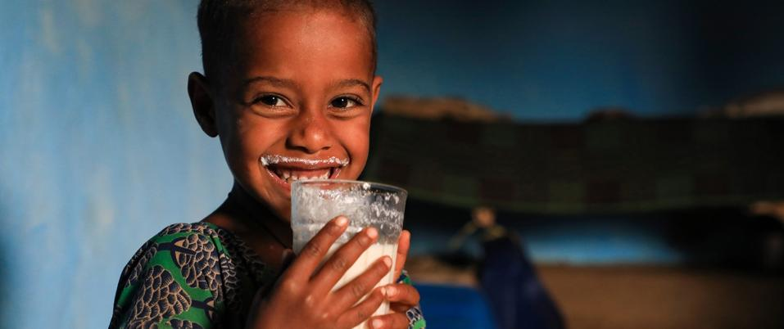
THANK YOU

