Slide 1




Part of a post-graduate course on “Climate Change, Water Security & Nexus”
Climate Change, Water Security & Nexus Approaches
Course Lead: Prof. Vishnu Prasad Pandey, Center for Water Resources Studies, Institute of Engineering, Tribhuvan University, Nepal
Email: vishnu.pandey@pcampus.edu.np
Notes:
Provide the context of the course development, acknowledgements, people involved, etc.
Prof. Rajesh for Trends & Prof. Vishnu for WEFE Nexus concept

Slide 2
Contributors
Prof. Vishnu Prasad Pandey, Center for Water Resources Studies (CWRS), Institute of Engineering, Tribhuvan University, Nepal
Prof. Rajesh Kumar Rai, Institute of Forestry, Tribhuvan University, Nepal
Dr. Sanju Koirala, International Water Management Institute (IWMI), Nepal Office
Prof. Tri Ratna Bajracharya, Center for Energy Studies, Institute of Engineering, Tribhuvan University, Nepal
Dr. Bharat Kumar Pokharel, GREAT International
Dr. Nisha Onta, Governance Lab
Dr. Rishi Ram Kattel, Agriculture & Forestry University
Mr. Sabin Dangol, Center for Water Resources Studies (CWRS), Institute of Engineering, Tribhuvan University, Nepal
Dr. Manohara Khadka, International Water Management Institute (IWMI), Nepal Office
Dr. Marlène Elias, Alliance of Bioversity International & CIAT

Slide 3
Module 2
Operationalizing the WEFE Nexus
Prof. Vishnu Prasad Pandey
Center for Water Resources Studies, Institute of Engineering, Tribhuvan University, Nepal
Prof. Rajesh Kumar Rai
Institute of Forestry, Tribhuvan University, Nepal
Dr. Sanju Koirala
International Water Management Institute (IWMI), Nepal Office

Slide 4
Contributors
Prof. Vishnu Prasad Pandey, Center for Water Resources Studies (CWRS), Institute of Engineering (IoE), Tribhuvan University (TU), Nepal
Prof. Rajesh Kumar Rai, Institute of Forestry, Tribhuvan University, Nepal
Dr. Sanju Koirala, International Water Management Institute (IWMI), Nepal Office

Slide 5
2. Operationalizing the WEFE Nexus [4 hrs, 15 mins]
2.1 WEFE Nexus quantification/assessment [2 hrs, 30 mins]
Theoretical framework
Inclusivity analysis framework
Nexus database
Nexus modeling (approaches, tools)
WEFE Nexus assessment challenges and solutions
2.2 Case studies [45 mins]
Illustrative case studies related to Nexus challenges and interventions
2.3 Nexus decision support system (NDSS) [60 mins]
Framework and features
Communication
Uptake and challenges
Operationalization of WEFE Nexus

Slide 6
2.1 WEFE
Nexus Assessment
Conceptual framework – components, indicators
Framework for WEFE Nexus inclusivity analysis
WEFE Nexus database
WEFE Nexus modeling
WEFE Nexus assessment challenges and solutions

Slide 7
2.1 Session Delivery Plan [2 hrs, 30 mins]
Time | Activity
20 minutes | Lecture: Nexus assessment frameworks
35 minutes | Lecture: WEFE Nexus inclusivity analysis
15 minutes | Exercise 2-1: Open Discussion – Consider a dam project case study. How do you recognize, represent and redistribute (benefits) to those affected by the project?
15 minutes | Lecture: Nexus database
20 minutes | Lecture: Nexus modeling
20 minutes | Exercise 2-2: Demonstration of a Nexus Modeling Tool
10 minutes | Lecture: Practical challenges of Nexus modeling
15 minutes | Lecture: Nexus assessment challenges

Slide 8
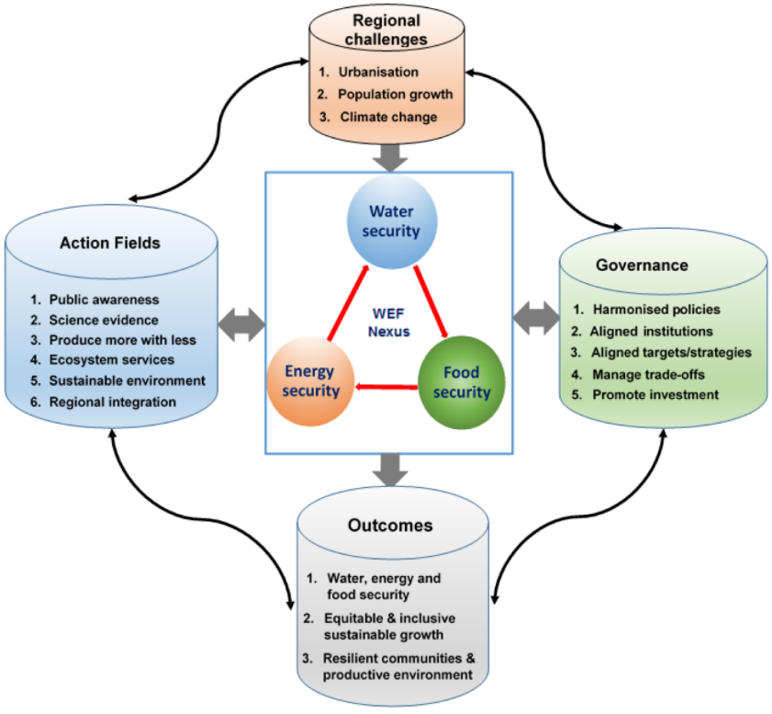
2.1 Conceptual Framework for WEFE Nexus Assessment
Conceptual models/frameworks serve as a theoretical foundation for understanding the interconnectedness of WEFE resources.
They provide key system specifics such as the changes in model state, scope/boundary, how the simulated system should work, the entities that it contains, and the interactions, rules, and equations that determine its behavior (Anandhi et al., 2023).
Why conceptual models?
to collate, visualize, understand, and explain problems and their potential solutions through bringing together and summarizing information in a standard, logical, and hierarchical way (Anandhi et al., 2023).
Figure: Regional framework for resource Nexus assessment (Source: Nhamo et al., 2018)
Notes:
Visualize overall context of the Nexus and outcomes from the figure – regional challenges (drivers) that influence sectoral actions; action fields related to the Nexus; role of governance; and outcomes…Nexus assessment should be able to quantify all those aspects.

Slide 9
2.1 Conceptual Framework for WEFE Nexus Assessment
Frameworks guide research to deliver the necessary insights into multiple key system aspects (Anandhi et al., 2023).
Effectiveness of a conceptual framework depends on a comprehensive understanding and translation of indicators, framings, and concepts used by different research traditions (Anandhi et al., 2023).
There is no single cookbook method for “modeling the Nexus”. Therefore, no common conceptual model/framework for the Nexus has emerged (Anandhi et al., 2023).
Examples of existing conceptual frameworks are:
World Economic Forum, 2011
Bonn2011
Food and Agriculture Organization (FAO)
WEF-PIK
Texas A&M University (Daher & Mohtar)
International Centre for Integrated Mountain Development (ICIMOD)
International Institute for Sustainable Development (IISD)
Footprint framework
Water Evaluation and Planning Model (WEAP)
Global Policy Dialogue Model
Notes:
Anandhi et al. (2023) and Shannak et al. (2018) contain details about these frameworks.

Slide 10
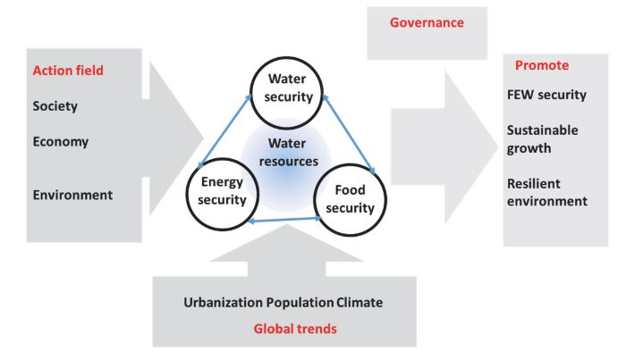
2.1 Conceptual Framework for WEFE Nexus Assessment | Example
Figure: Bonn2011 Nexus framework adapted from Bizikova et al. (2013) (Source: Anandhi et al., 2023)

Slide 11
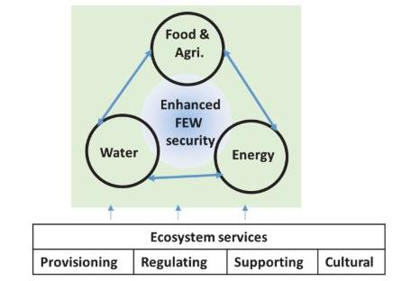
2.1 Conceptual Framework for WEFE Nexus Assessment | Example
Figure: Food and Agriculture Organization (FAO) framework (Source: Anandhi et al., 2023)

Slide 12
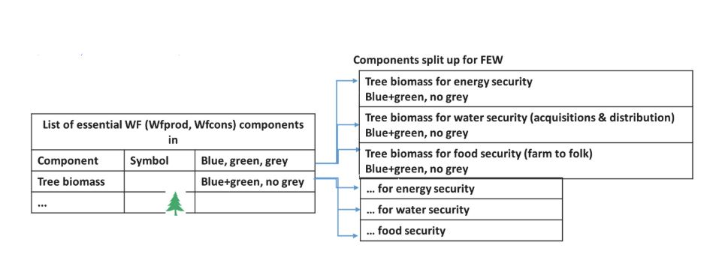
2.1 Conceptual Framework for WEFE Nexus Assessment | Example
Figure: Water footprint approach framework adapted from Vanham (2016) (Source: Anandhi et al., 2023)

Slide 13
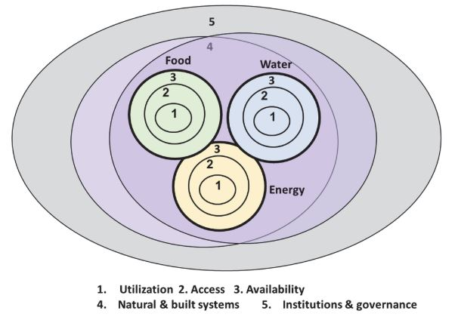
2.1 Conceptual Framework for WEFE Nexus Assessment | Example
Figure: International Institute for Sustainable Development (IISD) framework adapted from Lawford et al. (2019) (Source: Anandhi et al., 2023)
Notes:
Priority → focus from 1-5

Slide 14
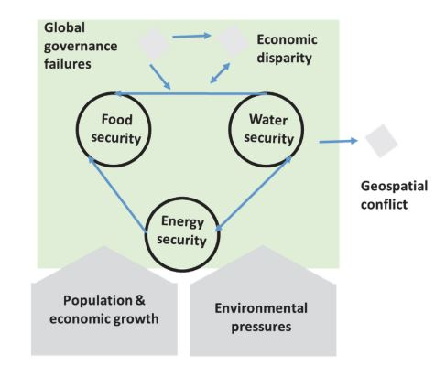
2.1 Conceptual Framework for WEFE Nexus Assessment | Example
Figure: World Economic Forum 2011 framework adapted from Bizikova et al. (2013) (Source: Anandhi et al., 2023)

Slide 15
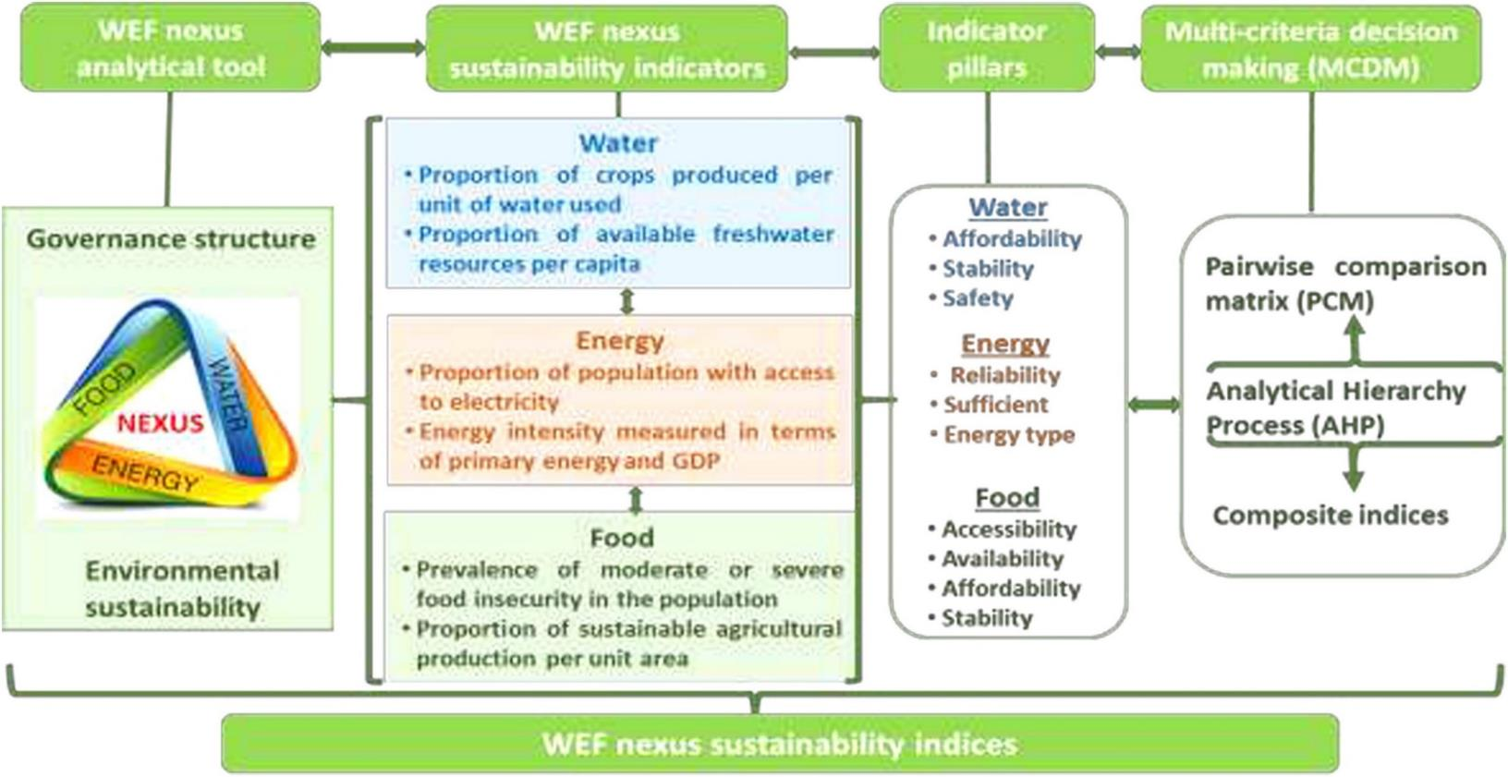
2.1 Conceptual Framework for WEFE Nexus Assessment|Example
Figure: Conceptual framework to develop WEF Nexus indicators and indices
(Source: Nhamo et al., 2020)

Slide 16
2.1 Conceptual Framework for WEFE Nexus Assessment
Existing Nexus conceptualizations and frameworks often include elements such as:
1. Overall information
e.g., purpose, focus, starting point, overall approach
2. People/organizations involved
e.g., developers, users/stakeholders
3. Scales and disciplines used
e.g., spatial and temporal scales, disciplines and their interactions
4. WEF(E) Nexus definition elements
e.g., processes, ideas and/or objects, properties, perspectives, consequences
5. Assessment methods
e.g., modeling approach, tools, data
Figure: Elements currently included in Resource Nexus conceptualizations and frameworks (Source: Anandhi et al., 2023)
Notes:
Details in Anandhi et al., 2023

Slide 17
2.1 Conceptual Framework | Indicators/Parameters
Indicators/parameters provide information for evaluation or assessment and predict future conditions of a given phenomenon (Arthur et al., 2019).
Nexus indicators quantify the interdependencies between WEFE sectors and their related impacts at various scales (Arthur et al., 2019).
Types of indicators used in Nexus assessment as per Arthur et al. (2019):
Resource flux indicators:
Flow indicators to quantify/analyze movement of resources within a defined system
Used to analyze the flows between two or more interdependent resources
Tend to analyze the intensity of resources entering and leaving each system

Slide 18
2.1 Conceptual Framework | Indicators/Parameters
Types of indicators used in Nexus assessment as per Arthur et al. (2019), continued:
Efficiency indicators
Account resource use per unit inflows in a system
Analyze the proficiency level of productive resources in the system
Assess and compare WEF resources’ inputs and outcomes at the end of a production/processing cycle by economic sector
Environmental indicators
Analyze environment and health impacts associated with resource production/consumption within an urban system
Serve as parameters to quantify negative externalities of the production or processing system (development, industrial activities) and use of environmental resources
Investigate the consequences of human activities on the environment and human health
Other indicators
Indicators capturing population characteristics, dependency ratio, number and type of resources used in production, etc.

Slide 19
2.1 Conceptual Framework | Indicators/Parameters
The WEFE Nexus Index
Composite index of indicators/parameters under different components/categories by normalizing indicator values and using proper weights to each index/component
Easy to translate various aspects of a system into a single, easy to visualize value
Easy to monitor/measure progress over time
May include: pillars (water, energy, & food), sub-pillars (access and availability), and constituent indicators
Data Integration
Emphasizes data integration from diverse sources
Integration of ICT, hydro-climate modeling, energy, agriculture, ecosystem data for comprehensive insights
Supports evidence-based decision-making

Slide 20
2.1 WEFE Nexus Assessment | Sources and Further Reading
Anandhi, A., Srivastava, P., Mohtar, R. H., Lawford, R. G., Sen, S., & Lamba, J. (2023). Methodologies and principles for developing Nexus definitions and conceptualizations: lessons from FEW Nexus studies. Journal of the ASABE, 66(2), 205–230.
Arthur, M., Liu, G., Hao, Y., Zhang, L., Liang, S., Asamoah, E. F., & Lombardi, G. V. (2019). Urban food-energy-water Nexus indicators: A review. Resources, Conservation and Recycling, 151(February), 104481. https://doi.org/10.1016/j.resconrec.2019.104481
Bizikova, L., Roy, D., Swanson, D., Venema, H. D., & McCandless, M. (2013). The water-energy-food security Nexus: Towards a practical planning and decision-support framework for landscape investment and risk management. Winnipeg, MB, Canada: International Institute for Sustainable Development.
Lawford, R., Pahl-Wostl, C., & Boisvert, A.-A. (2019). Synthesis report for the future earth water-energy-food (W-E-F) Nexus cluster project: Assessing the contributions of improved governance and integrated data and information to the sustainability of the W-E-F Nexus. Winnipeg, MB, Canada: Self- published by Lawford’s Environmental Consulting.
Nhamo, L., Mabhaudhi, T., Mpandeli, S., Dickens, C., Nhemachena, C., Senzanje, A., Naidoo, D., Liphadzi, S., & Modi, A. T. (2020). An integrative analytical model for the water-energy-food Nexus: South Africa case study. Environmental Science and Policy, 109(December 2019), 15–24. https://doi.org/10.1016/j.envsci.2020.04.010
Nhamo, L., Ndlela, B., Nhemachena, C., Mabhaudhi, T., Mpandeli, S., & Matchaya, G. (2018). The water-energy-food Nexus: Climate risks and opportunities in Southern Africa. Water (Switzerland), 10(5), 1–18. https://doi.org/10.3390/w10050567
Vanham, D. (2016). Does the water footprint concept provide relevant information to address the water-food-energy-ecosystem Nexus? In Ecosystem Services (Vol. 17, pp. 298–307). https://doi.org/10.1016/j.ecoser.2015.08.003

Slide 21
2.1 WEFE
Nexus Assessment
Conceptual framework – components, indicators
Framework for inclusivity analysis in WEFE Nexus
WEFE Nexus database
WEFE Nexus modeling
WEFE Nexus assessment challenges and solutions

Slide 22
2.1 Framework for Inclusivity Analysis in WEFE Nexus
Equitable interventions
Considers differential inclusion and impact based on gender, ability, socio-economic status, and vulnerable group status
Collects and analyzes socially disaggregated data on access to resources, involvement in decision-making, etc., on various aspects of WEFE resources
Integrates Gender Equity and Social Inclusion (GESI) in WEFE approaches
CGIAR learning module focuses on integrating GESI in WEFE approaches
Shift from resource-centric to “people-centric” approach for equitable outcomes
Resources for whom? Which group? Which category? (Intersectional analysis!)
Collaboration/cooperation
Engage with a diverse range of stakeholders, conceptualize their (intersectional) voices/views to integrate with analysis
Collaborate across groups for optimizing input resources (financial, human)

Slide 23
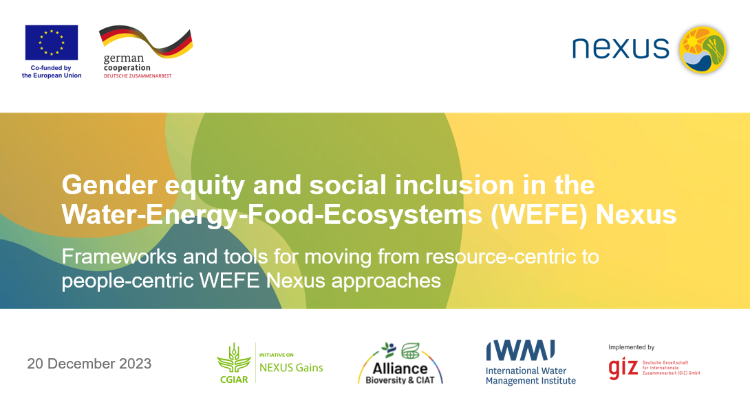
2.1 Framework for Inclusivity Analysis in WEFE Nexus
GESI-Inclusivity Analysis in the WEFE Nexus (Learning Module Developed by the Nexus Gains Initiative)

Slide 24
2.1 Inclusivity Analysis | Terminologies
Sex:
Biological traits that society associates with being male or female
Gender:
Socially constructed roles, behaviors, expressions and identities of girls, women, boys, men and gender-diverse persons (e.g., transgender, intersex, genderqueer)
Gender equality and social inclusion (GESI)
Aims to foster equal rights, responsibilities and opportunities for men and women and others, independent of age, ethnicity, social status or other characteristics
WEFE Nexus
Refers to the interactions between people and ecosystems across WEFE sectors
Notes:
Gender is not only about women, nor is it a synonym for women. Gender refers to socially constructed roles, behaviors, expressions and identities of girls, women, boys, men and gender-diverse persons.
From yesterday to today you must have heard of WEFE Nexus several times.
However, it’s important to note: the WEFE Nexus is not just about the Nexus between water, energy, food and environment sectors. It is also the interactions between people and these sectors.

Slide 25
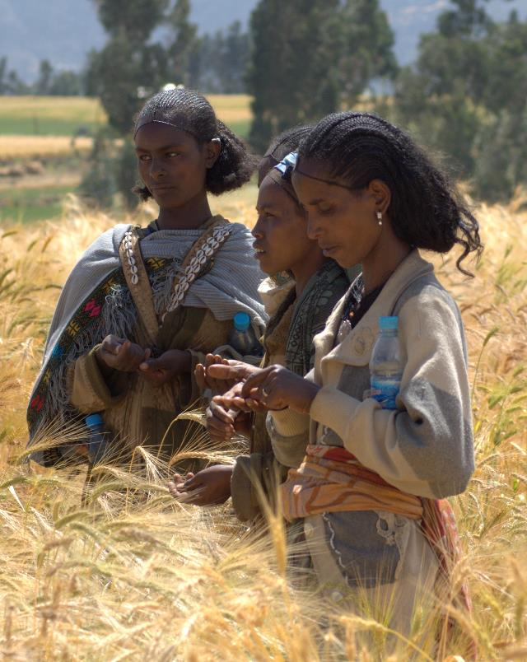
2.1 Inclusivity Analysis | Focus
1: From resource- to people-centered WEFE Nexus approaches
Current WEFE Nexus thinking
Gender equality and social inclusion
© J.van de Gevel Bioversity International
Notes:
Let‘s now look at WEFE Nexus thinking and what it means for considering gender equality and social inclusion in designing and implementing Nexus interventions.

Slide 26



2.1 Inclusivity Analysis | Focus
Current WEFE Nexus thinking focuses on resources > people.
WEFE Nexus approaches seek to manage trade-offs, reduce inefficiencies and increase synergies at a systems level among water, energy, food, ecosystems and other land use sectors.
Notes:
By now you all are clear that Nexus approaches differ from traditional, sector-specific policies and practices because they do not focus on gains within individual sectors.

Slide 27
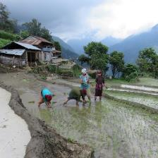
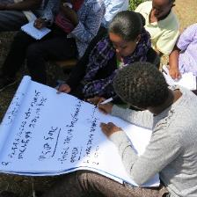
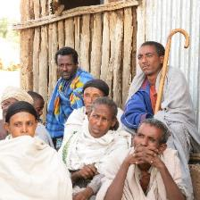
2.1 Inclusivity Analysis | Focus
Gender equity and social inclusion: the missing links in WEFE Nexus approaches
Around the world, we see persistent gender inequalities in access to resources and decisions over how to use and manage these.
Too often, women are left out of development and environmental initiatives, since they are not seen as legitimate stakeholders.
By addressing these inequalities across sectors in policy and practice, Nexus approaches can enable more equitable access to WEFE decisions, services and benefits for all.
Women (and men) are heterogeneous groups and may have vastly different experiences based on other social factors.
Many categories of men also experience marginalization.
Left: © Subedi LI-BIRD. Middle and right: © CGIAR Research Program on Water, Land and Ecosystems
Notes:
Gender equity and social inclusion are currently the missing links in many WEFE Nexus approaches.
Around the world, we see persistent gender inequalities in access to resources and decisions over how to use and manage these. Rural women and men particularly rely on land and other natural resources for their livelihoods. But often, only men are recognized as the authorities, providers, farmers and resource managers of their households and communities – even though women, too, are responsible for providing and managing food, water, fuel, cash and other resources on a daily basis.
Too often, women are also left out of development and environmental initiatives, since they are not seen as legitimate stakeholders.
In reality, women have unique knowledge of and priorities for the management of resources in their communities. However, there are many gender- or inclusion-specific barriers that make it difficult for women to access and progress in decision-making spaces, for instance, time availability and mobility outside of the home hinder many rural women’s ability to participate in user groups. Likewise, in the workplace, the water, energy and food sectors are considered very technical and, thus, due to societal norms, these sectors are typically associated with men.
We should also know that-women (and men) are heterogeneous groups and may have vastly different experiences based on other social factors. For example, Dalit (low-caste) women from poor households in rural areas have different needs and realities with respect to energy or water use than better-off women in the cities. Or even, poor and better-off women in cities may have different needs and realities on these resources.
But overall, women (in all their diversity) have limited control over management decisions at all levels compared to men.
That said, many categories of men also experience marginalization. Men in disadvantaged groups (such as ethnic minorities, lower castes or landless men) may struggle to have their voices heard in their communities and in higher-level governance spaces that shape their local opportunities and resource access in significant ways.

Slide 28
2.1 Inclusivity Analysis | Focus
Disability
Location
Ethnicity
Gender
Occupation
Community standing
Gender equity and social inclusion
Culture
Caste
Land ownership status
Marital status
Parenthood
Age
Wealth
Notes:
This web shows many different aspects of a person’s identity that, together, can lead to their exclusion or inclusion in decision-making and benefit-sharing related to water, energy, food and ecosystems. Gender, in addition to the multiple identities such as caste, ethnicity, age, disability etc., can lead to an individual’s exclusion. Advancing gender equity and social inclusion in the WEFE Nexus requires recognizing who is excluded and on what basis, to challenge that discrimination.
By addressing these inequalities across sectors in policy and practice, Nexus approaches can enable more equitable access to resource decisions, services and benefits for all.

Slide 29
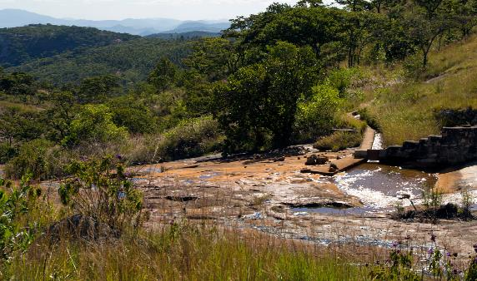

2.1 Inclusivity Analysis | Focus
2: A social equity framework for addressing gender equity and social inclusion in the WEFE Nexus
© David Brazier IWMI
© Tom van Cakenberghe IWMI
Notes:
Next, let‘s look at a social equity framework that helps understand what the key considerations are for integrating gender and social inclusion considerations in WEFE Nexus interventions.

Slide 30

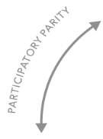
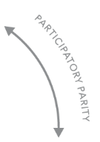


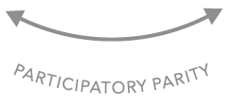
2.1 Inclusivity Analysis | Focus
A social equity framework has three pillars
A) Recognition
Recognition refers to when people or social groups have equal opportunities to be valued as legitimate, respected and dignified participants in society.
WEFE Nexus initiatives must identify which social groups can affect, and be affected by, planned interventions. This helps design interventions to enable more equal participation and benefits.
RECOGNITION
Who is entitled to dignity and prestige?
REDISTRIBUTION
Who is entitled to capital and assets – natural, physical, human, financial, social?
REPRESENTATION
Who is entitled to claims of injustice?
Notes:
Gender equity and social inclusion strategies can help identify entry points for fostering equitable and sustainable resource access for diverse Nexus stakeholders at different scales. A social equity framework can help guide this process by drawing attention to “who”, “how” and “why” to achieve equitable outcomes in Nexus initiatives.
The first pillar, Recognition, refers to when people or social groups have equal opportunities to be valued as legitimate, respected and dignified participants in society.
For example, many rural women do as much or more farm work than their spouse but are not recognised as farmers in their own right, and their knowledge and skills are undervalued. As such, they are frequently not considered legitimate (justified or valued) stakeholders in agricultural interventions.
Nexus initiatives must identify which social groups will affect, and be affected by, Nexus interventions. This broad range of stakeholders may include:
Policymakers
Staff of national and local government agencies participating in the implementation of interventions
Intended beneficiaries in all their diversity
Persons or groups who may be affected adversely by the interventions in the short- or long-term, which includes private sector actors, interest groups, civil society organisations and donors.
Understanding the stakeholders, and their needs and roles, helps design interventions that enable more equal participation and benefits.

Slide 31



2.1 Inclusivity Analysis | Focus
A) Recognition (continued)
Among stakeholder groups, there are highly unequal power relations. This means that the knowledge and priorities of some may be perceived as having more legitimacy than those of others.
Importantly, from the perspective of social equity, the needs, rights, knowledge systems and priorities of different groups– particularly those most marginalized – must be recognised and legitimized.
LOCAL RIGHTS-HOLDERS
LOCAL STAKEHOLDERS
NATIONAL STAKEHOLDERS
INTERNATIONAL STAKEHOLDERS
Notes:
Social equity principles dictate that the needs, rights, knowledge systems and priorities of different groups must be recognized and legitimized.
The stakeholders come from many levels – from local to national and international – and are not all usually present in the same water, energy, food and ecosystem decision-making spaces. Power relations among stakeholder groups can be highly unequal. This means that the knowledge and priorities of some may be perceived as having more legitimacy than those of others.
Typically, stakeholders with less social and financial capital are the ones who are left out. For example, a decision made in a capital city about rural resources may not include any spokespeople from the impacted rural area. If interventions do not intentionally seek to recognize all stakeholders genuinely, they risk ignoring specific communities and benefit other, more powerful groups.
From a rights-based perspective, those who live near the resources and whose livelihoods are directly linked to them deserve particular recognition and protection. This often includes Indigenous peoples and marginalized groups in local communities.
The initiatives must ensure a ‘do-no-harm’ principle – at a minimum – so that they do not pose undue risks to local people and marginalized community members (that is, rights-holders) and do not jeopardize their livelihoods and well-being.
Nexus initiatives will also have to be accountable to these rights-holders.

Slide 32

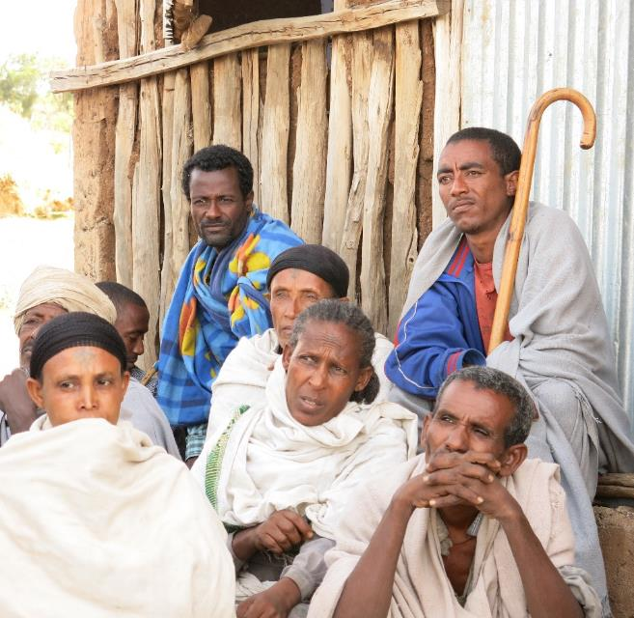
2.1 Inclusivity Analysis | Focus
Recognition – Stakeholder Analysis
To make sure that all relevant groups are included in WEFE Nexus decision-making, intervention planning, start with a stakeholder analysis.
Stakeholder analysis = identifying social groups who may affect and be affected by WEFE Nexus interventions.
Consider all potential stakeholders, including those who may be affected negatively by the WEFE Nexus plans.
© CGIAR Research Program on Water, Land and Ecosystems
Notes:
To make sure that all relevant groups are included in WEFE Nexus decision-making, planning of interventions should begin with a stakeholder analysis.
It is important to consider all potential stakeholders, including who may be affected negatively by the WEFE Nexus interventions, and how. Even well-intended interventions typically have some negative impacts on some stakeholder groups, and overlooking these can undermine the implementation and the positive impacts of the interventions.
A basic stakeholder analysis should be done before interventions are designed. It should then be revisited and updated throughout the design process as more information is gained.

Slide 33
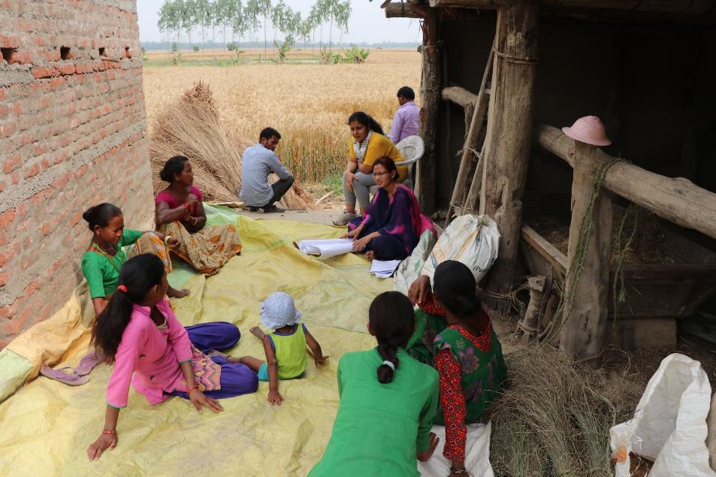
2.1 Inclusivity Analysis | Focus
B) Representation
Representation relates to how different stakeholders can shape agendas and influence the critical decisions that impact their lives.
© Patrick Drown IWMI
Notes:
The second pillar of the social equity framework, Representation, relates to how different stakeholders can shape agendas in the community or society, and can influence the critical decisions that impact their lives.
Measures are needed in Nexus initiatives to ensure that the diverse stakeholders we were just discussing are adequately represented across all phases, from planning to implementation and monitoring. Again, this includes particularly the communities and their members whose livelihoods depend directly on WEFE resources.

Slide 34



2.1 Inclusivity Analysis | Focus
B) Representation
A GESI approach should ensure that marginalized groups can have influence in decision-making at different levels.
Those with the most to gain or lose from WEFE Nexus interventions often have the most limited influence.
Notes:
A gender equity and social inclusion approach should ensure that women and marginalized social groups can have a voice and influence in the processes shaping resource access and use at the household, community and higher decision-making levels.

Slide 35
2.1 Inclusivity Analysis | Focus
B) Representation: recognising and fostering higher forms of participation
Six levels of participation (adapted from Agarwal, 2001)
Form of participation | Characteristic features
Interactive (empowering) participation | Having voice and influence in the group’s decisions
Active participation | Expressing opinions, whether solicited or not, or taking other forms of initiative
Activity-specific participation | Being asked to (or volunteering to) undertake specific tasks
Consultative participation | Being asked an opinion in specific matters without guarantee of influencing decisions
Passive participation | Being informed of decisions ex post facto; or attending meetings and listening in on decision-making, without speaking up
Nominal participation | Membership in the group
Notes:
Not all participation in decision-making is equal in nature. There are many forms or levels of participation.
We should remember that achieving interactive or empowering participation requires ongoing negotiation and management of unequal power relations and conflicting interests. This is a challenging process, particularly as there are often limited resources, skills and trust among different participants.
Typology of participation adapted from:
Agarwal, B. (2001). Participatory exclusions, community forestry, and gender: An analysis for South Asia and a conceptual framework. World Development, 29(10), 1623-1648. https://doi.org/10.1016/S0305-750X(01)00066-3

Slide 36

2.1 Inclusivity Analysis | Focus
B) Representation: recognizing and fostering higher forms of participation
Meaningful participation requires addressing context-specific barriers.
Empowering participation and bottom-up learning requires continuously asking…
What voices are being heard at the different stages of decision-making processes, and what is the weight and legitimacy given to diverse voices?
Notes:
Enabling marginalized groups to meaningfully participate in Nexus initiatives requires addressing the barriers they face, which depend on the group, place and time. To understand and lift these barriers, interventions must carefully consider the local context, including power relations and the history of water, energy, agriculture and environment sectors in the project area.
Targeted measures are needed to ensure that women and other less powerful actors can express their voices and priorities and that their views are meaningfully considered. Inviting these groups to attend a multi-stakeholder meeting is not enough, as they may not be able to express their views, influence the agenda, or engage on equal footing with other, more powerful groups. Participation then remains nominal, passive or consultative only. This happens in many irrigation user committees in Nepal., in which many women members participate only passively.
Empowering participation and bottom-up learning requires continuously asking: What voices are being heard at the different stages of decision-making processes, and what is the weight and legitimacy given to diverse voices?
Interactive (or empowering) participation can be supported, for example, by a combination of:
Centering meetings on issues that are important to women and other marginalized groups
Establishing quotas for women’s and men’s participation, consultation, decision-making and voting
Selecting safe and easily accessible meeting venues, organizing childcare and hygienic sanitary facilities
Giving enough space and time for collective learning, including in informal settings, smaller and single-gender groups, with safe space for expressing opinions and ideas
Allocating adequate financial and technical resources to supporting inclusion from the beginning
Strengthening local capacities for conflict mediation and negotiating power imbalances

Slide 37







2.1 Inclusivity Analysis | Focus
C) Redistribution
Redistribution refers to an intentional effort to bring more equity to how rights and goods, as well as costs, risks and responsibilities, are distributed in a society. These rights and goods give power (including power over others) to those who control them.
Gender,
class structures & other social differences & inequalities
Resource access and control
Empower or marginalize
Notes:
Redistribution is the third and final pillar of the social equity framework. It refers to an intentional effort to bring more equity to how rights and goods, as well as costs, risks and responsibilities, are distributed in a society.
Rights to access and control resources shape - and are shaped by - gender, class structures and other social differences and inequalities that empower some people and groups while marginalising others. These rights over resources and goods give power (including power over others) to those who control them, and so they can feel either further marginalization or empowerment for different stakeholders.

Slide 38



2.1 Inclusivity Analysis | Focus
C) Redistribution: understanding different types of livelihood assets
A Sustainable Livelihoods Framework can be used to examine the distribution of costs, benefits and risks in WEFE Nexus interventions, and help identify ways to achieve a more equal distribution.
Natural
Political
ASSETS
Human
Financial
Social
Physical
Notes:
The Sustainable Livelihoods Framework illustrates the different types of tangible and intangible assets that resource users can draw upon to secure their livelihoods, and how these assets interact with each other.
Assets can take many forms, including:
Natural capital such as land, water, fuelwood, wild food sources, or genetic resources
Physical capital such as irrigation and road infrastructure, transport, electricity, tools and machinery, storage, or production inputs like seed, fertilisers, and pesticides
Financial capital such as regular income, savings, liquid assets, or formal and informal credit facilities
Human capital such as knowledge and skills, education and training, health, nutrition, or capacity to work
Social capital such as membership in formal and informal groups like Water User Associations and producer groups, collaboration, or access to opportunities through social networks
Political capital such as citizenship, enfranchisement, or effective participation in governance
The framework helps understand how costs, benefits, and risks are distributed among different stakeholder groups. It also helps grasp the trade-offs and synergies among assets that may result from Nexus interventions.

Slide 39
2.1 Inclusivity Analysis | Focus
C) Redistribution
Which groups would gain which types of assets or resources?
How do the planned interventions affect the availability, flows and distribution of different types of assets among diverse social groups?
Which groups would lose access to and control over assets or resources as a result of interventions?
To identify how WEFE Nexus interventions may affect the distribution of costs and benefits among different social groups, key questions include:
How do history and context (policies, norms, other institutions and markets) influence the distribution of costs, risks and benefits among social groups?
What structures, processes, checks and balances are needed to level the playing field and improve opportunities for women and marginalized social groups?
Notes:
We should ask these questions at the planning stage of an intervention, to shape intervention design. These questions should also be asked throughout the intervention to identify how WEFE Nexus interventions may affect the distribution of costs and benefits among different social groups.

Slide 40
2.1 Exercise 2-1: Open Discussion [15 minutes]
Open Discussion – Consider a case of dam project.
How do you recognize, represent and redistribute (benefits) to the project affected people?

Slide 41
2.1 WEFE
Nexus Assessment
Conceptual framework – components, indicators
Framework for inclusivity analysis in WEFE Nexus
WEFE Nexus database
WEFE Nexus modeling
WEFE Nexus assessment challenges and solutions

Slide 42
2.1 Data Requirements and Typologies
Data used in a WEFE Nexus assessment depends on the elements (W-E, W-F, W-E-F, W-E-F-E, etc.) chosen for the study (Anandhi et al., 2023).
Data for WEFE Nexus assessment can be obtained by various means:
In-situ observations
Interviews
Focus group discussions
Model outputs
Survey data
Expert knowledge
Meta-analysis of published literature
Global data repositories

Slide 43
2.1 Examples of Existing Databases
Joint Research Centre Data Catalogue of the European Commission includes WEFE Nexus (Joint Research Centre Data Catalogue).
Covers energy projections, power system flexibility, water-power Nexus analysis
The Nexus Resource Platform is a global knowledge hub for Water, Energy, and Food Security (Water-Energy-Food) .
Features a wide range of resources, tools, and databases to support the WEFE Nexus approach
FAOSTAT (https://www.fao.org/faostat/en/#home)
Free access to food and agriculture data for over 245 countries and territories covering all regional groupings from 1961 to the most recent year available
World Input-Output Database (WIOD)
Initiated by the European Commission under the seventh Framework Program and developed by eleven European research organizations (Egilmez et al., 2020)
Advantages → created specifically for time-series studies containing high-quality data; publicly available free of charge (Egilmez et al., 2020)

Slide 44
2.1 Examples of Existing Databases
Three major sources of data:
Multinational statistical databases
World Bank, FAO, WMRI, AQUASTAT, USDA, EUROSTAT, etc.
National statistical books
Chinese Government Yearbooks
Ministry of Economic Affairs of Egypt
National Bureau of Statistics of China
US Energy Information Administration, etc.
Survey data
Field investigations, following specific designs from different research projects

Slide 45
2.1 Examples of Existing Databases | Multinational
Data Source | Domain |  |  | Frequency
 | Food | Energy | Water | Frequency
Central Agency for Public Mobilization and Statistics (CAPMAS) 2010. https://edirc.repec.org/data/capgveg.html | √ |  |  | 1
AQUASTAT – (http://www.fao.org/nr/water/aquastat/water_use_agr/index.stm) | √ |  | √ | 1
FAO- (www.fao.org/faostat/) | √ | √ |  | 6
World Bank database (http://data.worldbank.org/indicator/) | √ |  |  | 1
Eurostat (https://ec.europa.eu/eurostat) | √ |  | √ | 1
Multinational statistical databases (https://www.gtap.agecon.purdue.edu/databases/v9/), Municipal livestock statistics | √ |  |  | 1
Water Footprint Network – (www.waterfootprint.org/) |  | √ | √ | 1
World Bank database (http://data.worldbank.org/indicator/AG.CON.FERT.ZS). |  | √ |  | 2
Central Agency for Public Mobilization and Statistics (CAPMAS) 2010. https://edirc.repec.org/data/capgveg.html |  |  | √ | 1
Multinational statistical databases (http://www.tongji.cnki.net/kns55/Navi/YearBook) |  | √ |  | 3
USDA database - (https://www.agcensus.usda.gov/) | √ | √ | √ | 2
Multinational statistical databases. (www.stats.gov.cn/english/statisticaldata/annualdata/) |  |  | √ | 1
US Geological Survey data- (https://data.usgs.gov/datacatalog) |  |  | √ | 2
International life cycle inventory databases- Eco invent- (https://www.ecoinvent.org/) |  | √ |  | 8
Water Management Research Institute (WMRI) - (https://edirc.repec.org/data/capgveg.html) |  |  | √ | 3

Slide 46
2.1 Examples of Existing Databases | National
Data Source | Domain |  |  | Frequency
 | Food | Energy | Water | Frequency
National Bureau of Statistics of China (http://www.stats.gov.cn/english/) | √
National Agricultural Statistics Service (NASS)- (https://www.nass.usda.gov/Publications/) | √ |  |  | 1
Agricultural Ministry of Iran. (https://theiranproject.com/blog/tag/irans-minister-of-agriculture/) | √ |  |  | 1
Council of Agriculture (COA) (https://eng.coa.gov.tw/) | √ |  |  | 1
Ministry of Economic Affairs of Egypt |  | √ |  | 1
Chinese Government Yearbooks (https://www.ncbi.nlm.nih.gov/pmc/articles/PMC6080495/) | √ | √ | √ | 8
National Bureau of Statistics of China (http://www.stats.gov.cn/english/) |  | √ |  | 5
US Energy Information Administration (www.eia.gov) |  | √ |  | 1
National Electrical System Operator – ONS |  | √ |  | 2
Department of Environmental Protection – (www.nyc.gov/html/dep/pdf/hwqs2012.pdf) |  | √ |  | 1
Statistical reports from local Government (https://www.statista.com) |  | √ |  | 3
Statistics Bureau (http://data.cma.cn/) |  | √ |  | 7
The Department of Environmental Protection, (www.nyc.gov/html/dep/pdf/hwqs2012.pdf) |  |  | √ | 1
Central Weather Bureau- https://www.cwb.gov.tw/V7e/ |  |  | √ | 1
National Environnemental Sanitation Secrétariat database (SNSA) (www.sanitationandwaterforall.org/) |  |  | √ | 1
National Department for Mineral Production |  | √ |  | 1

Slide 47
2.1 Examples of Existing Databases | Survey Sources
Data Source | Domain
 | Food | Energy | Water | Frequency
Goiás’ Input-Output table (https://opus.lib.uts.edu.au/handle/10453/125670) | √ | √ | √ | 1
Survey data (from local investigations) | √ | √ |  | 18
Report of Water Supply Department (https://www.wsd.gov.hk/filemanager/common/) |  |  | √ | 1
[Source, for all three types of data sources: Arthur et al., (2019)]

Slide 48
2.1 Data Acquisition and Pre-Processing
Data acquisition
Date integration
Data pre-processing
Techniques: Remote sensing, Field surveys, Official statistics, research paper (data extraction from reports, papers)
Sources: Gather information from multiple sources/disciplines
Integrate data from different disciplines and ensure dataset compatibility
Prepare metadata: parameter name, their description, units, data source etc.
Data Cleaning: Remove duplicates, errors and inconsistencies for accuracy
Data Transformation: Convert data into a uniform format for compatibility
Feature Extraction: Identify relevant characteristics for analysis

Slide 49
2.1 Data Management
What is data management?
Acquiring, storing, harmonizing, organizing and maintaining collected data
Ensuring data integrity or quality control with regular updates and version control
Metadata should be included for better understanding
Data sharing and collaboration
Sharing data and collaborating with stakeholders are vital for WEFE Nexus success
Data sharing agreements and protocols for smooth exchange between organizations and sectors
Data security and privacy
Data security and privacy are essential for building trust in the WEFE Nexus approach
Appropriate security measures to protect against unauthorized access and disclosure of sensitive information

Slide 50
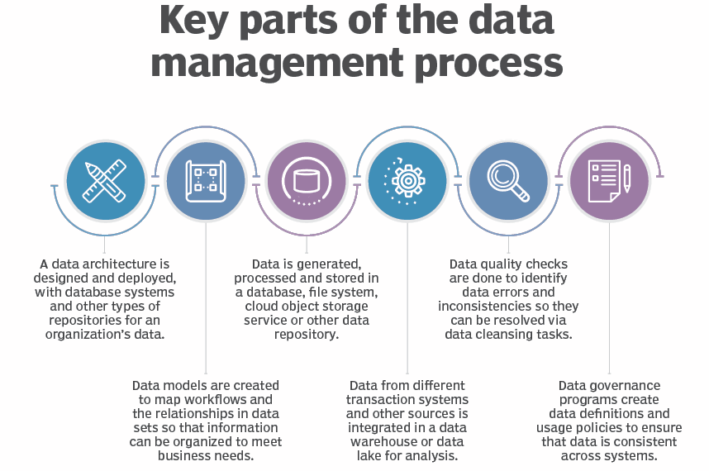
2.1 Data Management
Figure: Key parts of the data management process
(Source: https://www.techtarget.com/searchdatamanagement/definition/data-management)

Slide 51
2.1 Data Dissemination | Key Components
Establish
Define
Select
Market
Evaluate
Establish communication message:
Clearly define the message to be communicated.
Ensure that the message is concise, accurate, and relevant to the target audience.
Use clear and straightforward language to convey the information effectively.
Define the audience:
Identify the target audience for the data dissemination.
Understand their needs, interests, and level of understanding.
Tailor the message to suit the specific characteristics of the audience.
Select communication channel:
Choose the appropriate communication channel to reach the target audience.
Consider various platforms such as websites, social media, emails, workshops, or public events.
Ensure that the selected channel aligns with the preferences and accessibility of the audience.
Market the message:
Promote the data dissemination through various means to increase visibility.
Use marketing strategies to create awareness and interest in the information being shared.
Collaborate with relevant stakeholders to amplify the reach of the message.
Evaluate the impact:
Measure the effectiveness of the data dissemination efforts.
Assess whether the message reached the intended audience and if it was understood.
Use feedback and data analytics to improve future data dissemination strategies.

Slide 52
2.1 WEFE Nexus Database| Reading Materials
Anandhi, A., Srivastava, P., Mohtar, R. H., Lawford, R. G., Sen, S., & Lamba, J. (2023). Methodologies and principles for developing Nexus definitions and conceptualizations: lessons from FEW Nexus studies. Journal of the ASABE, 66(2), 205–230.
Arthur, M., Liu, G., Hao, Y., Zhang, L., Liang, S., Asamoah, E. F., & Lombardi, G. V. (2019). Urban food-energy-water Nexus indicators: A review. Resources, Conservation and Recycling, 151(February), 104481. https://doi.org/10.1016/j.resconrec.2019.104481
Egilmez, G., Oztanriseven, F., & Gedik, R. (2020). The Energy Climate Water Nexus: A Global Sustainability Impact Assessment of U.S. Manufacturing. EMJ - Engineering Management Journal, 32(4), 298–315. https://doi.org/10.1080/10429247.2020.1758539
TechTarget. (2022). What is data management and why is it important? Blog. https://www.techtarget.com/searchdatamanagement/definition/data-management

Slide 53
2.1 WEFE
Nexus Assessment
Conceptual framework – components, indicators
Framework for inclusivity analysis in WEFE Nexus
WEFE Nexus database
WEFE Nexus modeling
WEFE Nexus assessment challenges and solutions

Slide 54
2.1 Nexus Modeling | Concepts
The main objective of Nexus modeling is to minimize resource consumption and maximize the gains from those depleting resources
Quantify trade-offs and synergies
In general, Nexus modeling tools should be able to support (Miralles-Wilhelm, 2016):
Policy assessments/evaluation (trade-offs and synergies)
Technology assessment
Scenario evaluation/assessment
Information/evidence for decision-making on sustainable resource management
Modeling frameworks should be able to:
Identify limits of resource consumption along with environmental, technical and social impacts that may arise during operation (Rodríguez-Gutiérrez et al., 2022).

Slide 55
2.1 Nexus Modeling | Approaches
Nexus modeling involves using various approaches, tools, & techniques to analyze trade-offs and synergies between water, energy, food, and ecosystems.
Approach depends upon scale: system scale, stakeholder scale, etc.
Some considerations required on models/tools selection are (Albrecht et al., 2018):
Potential for capturing interactions among WEFE resources
Capability to integrate both quantitative and qualitative approaches
Capability to calculate quantitative results for both biophysical and socio-economic aspects (i.e., no disciplinary silos)
Specific and reproducible methods for assessment

Slide 56
2.1 Nexus Modeling | Approaches
Some of Nexus modeling approaches include (Anandhi et al., 2023):
Assessment using mathematical modeling
Assessment using ontology-based modeling
Assessment using indicator-based approach
Assessment using scenario-based approach
Assessment using footprint analysis, Life Cycle Assessment (LCA), supply chains
Assessment using trade-offs analysis
Integrated modeling approach

Slide 57
2.1 Nexus Modeling | Tools & Techniques
Optimization models
Mathematical models that find the best solution within given constraints
Optimization models to help identify the most efficient allocation of resources
Considering trade-offs and synergies of different allocation strategies
System dynamics models
Capture feedback loops and interactions in complex systems
Useful for understanding long-term behavior and policy effects
Agent-based models
Can model individual entities and their interactions in the system
Particularly useful for the Institutional Change perspective

Slide 58
2.1 Nexus Modeling | Tools & Techniques
Integrated assessment models
Integrate various sectors to analyze synergies and trade-offs
Provide a comprehensive view of Nexus dynamics
Scenario analysis
Explores and evaluates different future scenarios
Helps assess impacts of resource management strategies
Decision-makers can analyze various scenarios to make informed choices
Geospatial analysis
Uses GIS and other tools to analyze spatial data
Helps map and visualize interconnections and trade-offs in the WEFE Nexus
Offers insights at different scales for effective resource management

Slide 59
2.1 Nexus Modeling | Tools & Techniques
Life Cycle Assessment (LCA)
Systematic set of procedures for compiling and examining the inputs and outputs of materials and energy and the associated environmental impacts directly attributable to the functioning of a product or service system throughout its life cycle
Hybrid models
Integrate high-level models with sub-sectoral level models to better capture interconnections among WEFE sectors and provide useful and practical decisions for stakeholders
Input-output models
Describe physical flows of materials within an economy, including material extraction from nature, material processing, waste to nature, and stock changes

Slide 60
2.1 Nexus Modeling | Tools & Techniques
World Trade Model (WTM)
Instrumental in developing and analyzing scenarios of global production, trade, consumption, technologies, environmental threats, use and endowment of resources, and constraints
WTM-based studies have shed light on the economic and environmental implications stemming from challenges of food, energy, and water security
A useful model, not only to study trade flows, but also to explore population needs and pressures on WEFE under different scenarios, both for the present and the future
Mannschatz et al. (2016) have developed a Nexus tools platform allowing users to:
search through existing Nexus tools and models
to determine which tools may be best suited for their problem
to avoid recreating an existing tool

Slide 61
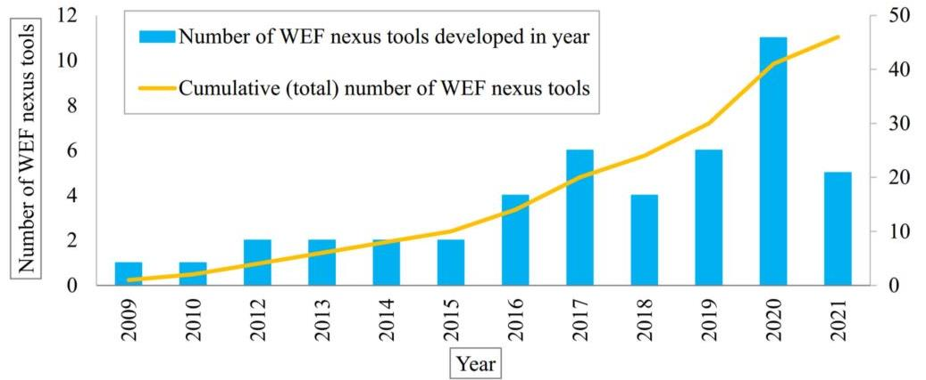
2.1 Nexus Modeling | Tools & Techniques
46 Modeling tools (Taguta et al., 2022)
General availability: 39% available to public users while 61% cannot be found on public domain
Figure 1: Trend in the development of WEF Nexus tools. (Source: Taguta et al., 2022)

Slide 62
2.1 Nexus Modeling | Tools & Techniques | Q Nexus Model
Nexus modeling tool: Q-Nexus model (Karnib, 2017)
Capabilities:
Evaluation of scenarios based on changing demand, technology and resource allocation
Input data requirements (inflows):
Total water, energy and food use
Intensities and allocation ratios

Slide 63
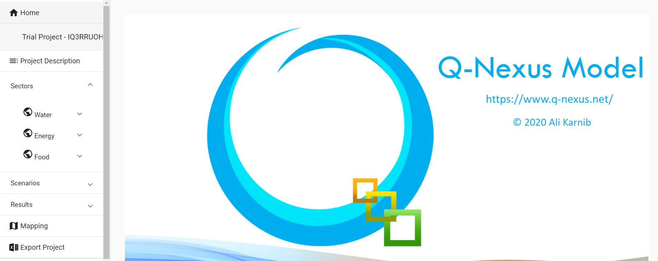
2.1 Nexus Modeling | Tools & Techniques | Q Nexus Model
Figure: Interface of Q-Nexus Modeling Tool (Source: https://www.q-Nexus.net/)

Slide 64
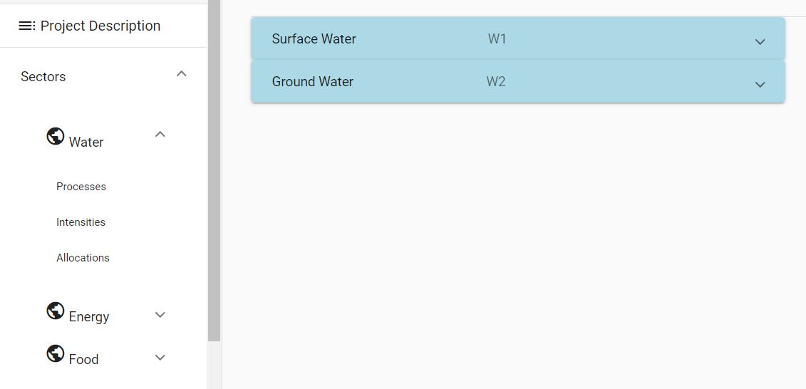
2.1 Nexus Modeling | Tools & Techniques | Q Nexus Model
Notes:
Figure: Interface of Q-Nexus Modeling Tool (Source: https://www.q-Nexus.net/)

Slide 65
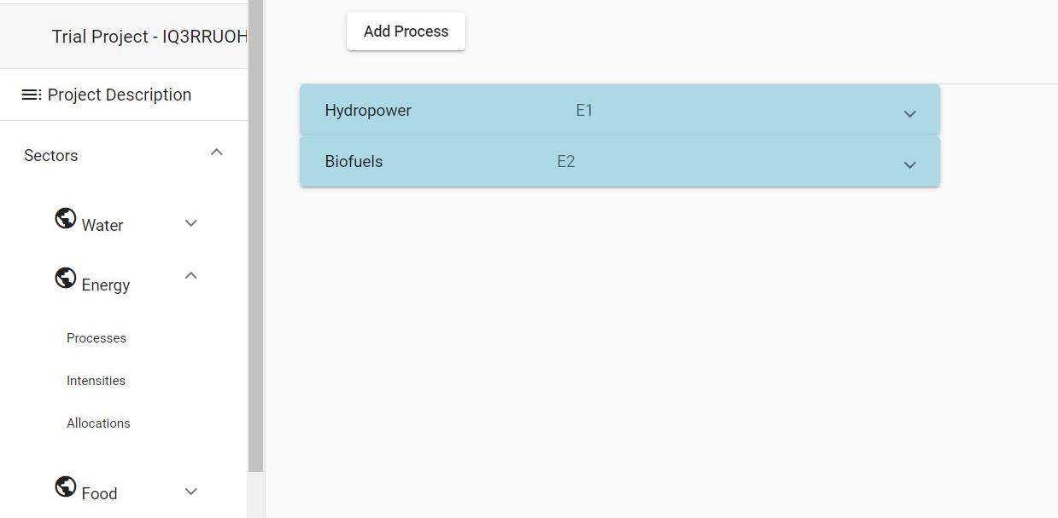
2.1 Nexus Modeling | Tools & Techniques | Q Nexus Model
Notes:
Figure: Interface of Q-Nexus Modeling Tool (Source: https://www.q-Nexus.net/)

Slide 66
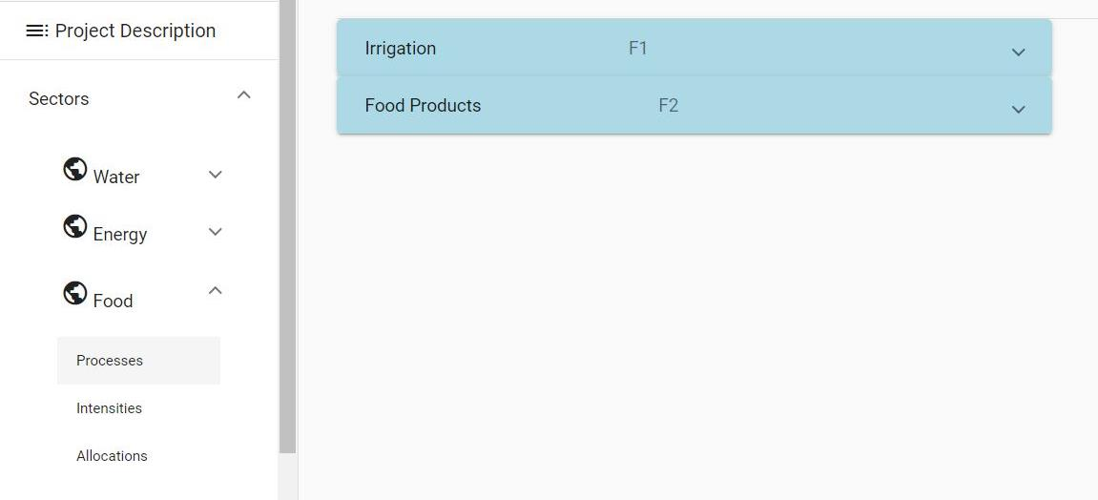
2.1 Nexus Modeling | Tools & Techniques | Q Nexus Model
Notes:
Figure: Interface of Q-Nexus Modeling Tool (Source: https://www.q-Nexus.net/)

Slide 67
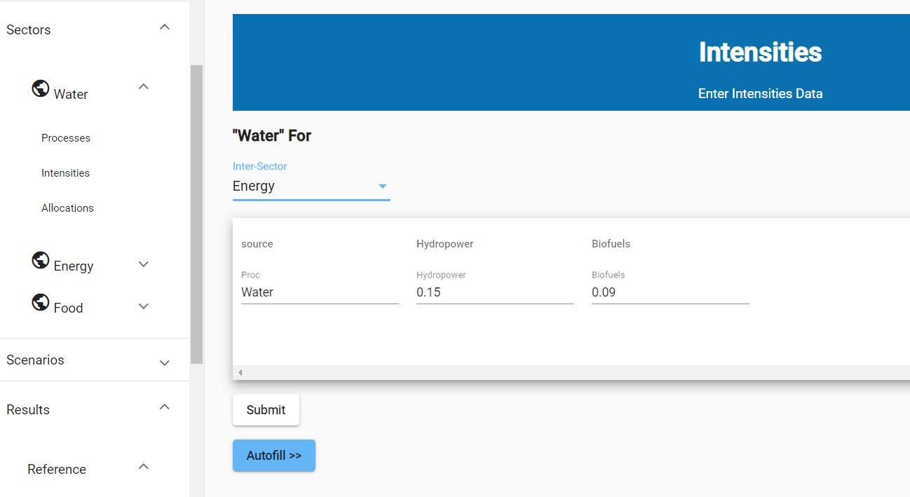
2.1 Nexus Modeling | Tools & Techniques | Q Nexus Model
Notes:
Figure: Interface of Q-Nexus Modeling Tool (Source: https://www.q-Nexus.net/)

Slide 68
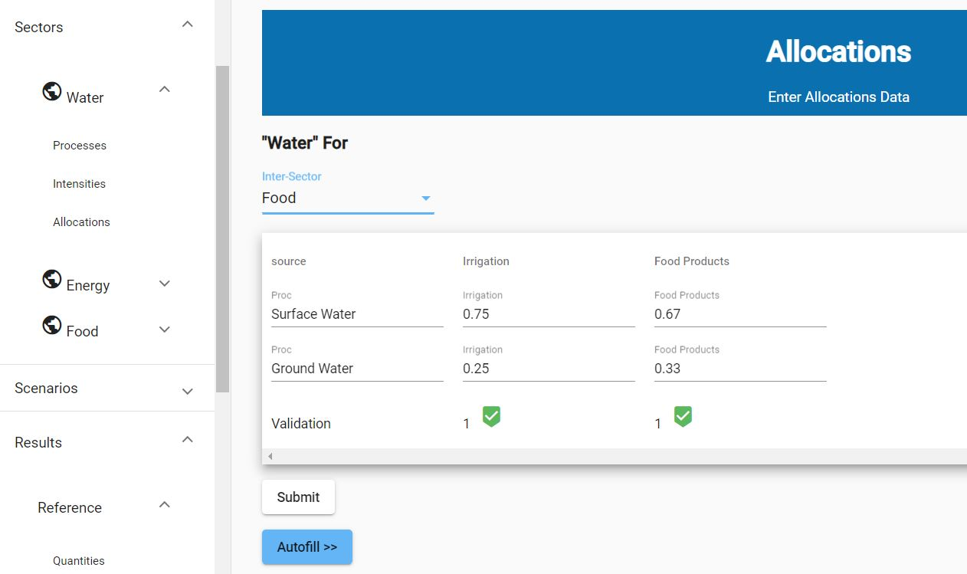
2.1 Nexus Modeling | Tools & Techniques | Q Nexus Model
Notes:
Figure: Interface of Q-Nexus Modeling Tool (Source: https://www.q-Nexus.net/)

Slide 69
2.1 Nexus Modeling | Tools & Techniques | Q Nexus Model
Outputs:
Inter-sectoral use (W-E, W-F, E-W, E-F, F-E, F-F) and quantities (direct and/or indirect)
Estimation of deficit in direct/indirect water and energy resources to fulfil new demand requirement
Limitations:
Only 3-day trial version is available with limited function
Could be extended towards resource efficacy and analyzing sustainable development policies in more effective way

Slide 70
2.1 Nexus Modeling | Tools & Techniques
Nexus modeling tool: WEF Nexus Tool 2.0 (Daher and Mohtar, 2015)
Capabilities:
Creation and assessment of different scenarios and consists of inputs that reflect national food, water and energy strategic options of Qatar
Input data requirements (inflows):
% of self-sufficiency of food products
% of food products grown in open agriculture conditions
% for each of the different water sources for the given scenario
% of energy sources for the scenario
% of the imported food products and respective country
Notes:
‘Self-sufficiency’ is used as a representation of the ratio of a specific food product produced locally to the total national consumption of the same food product.

Slide 71
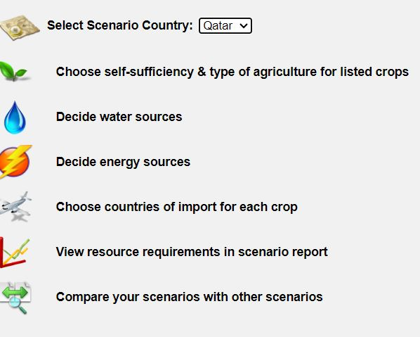
2.1 Nexus Modeling | Tools & Techniques | WEF Nexus Tool 2.0
Figure: Interface of WEF Nexus Tool 2.0 (Source: http://hf.wefnexustool.org/login.php)

Slide 72
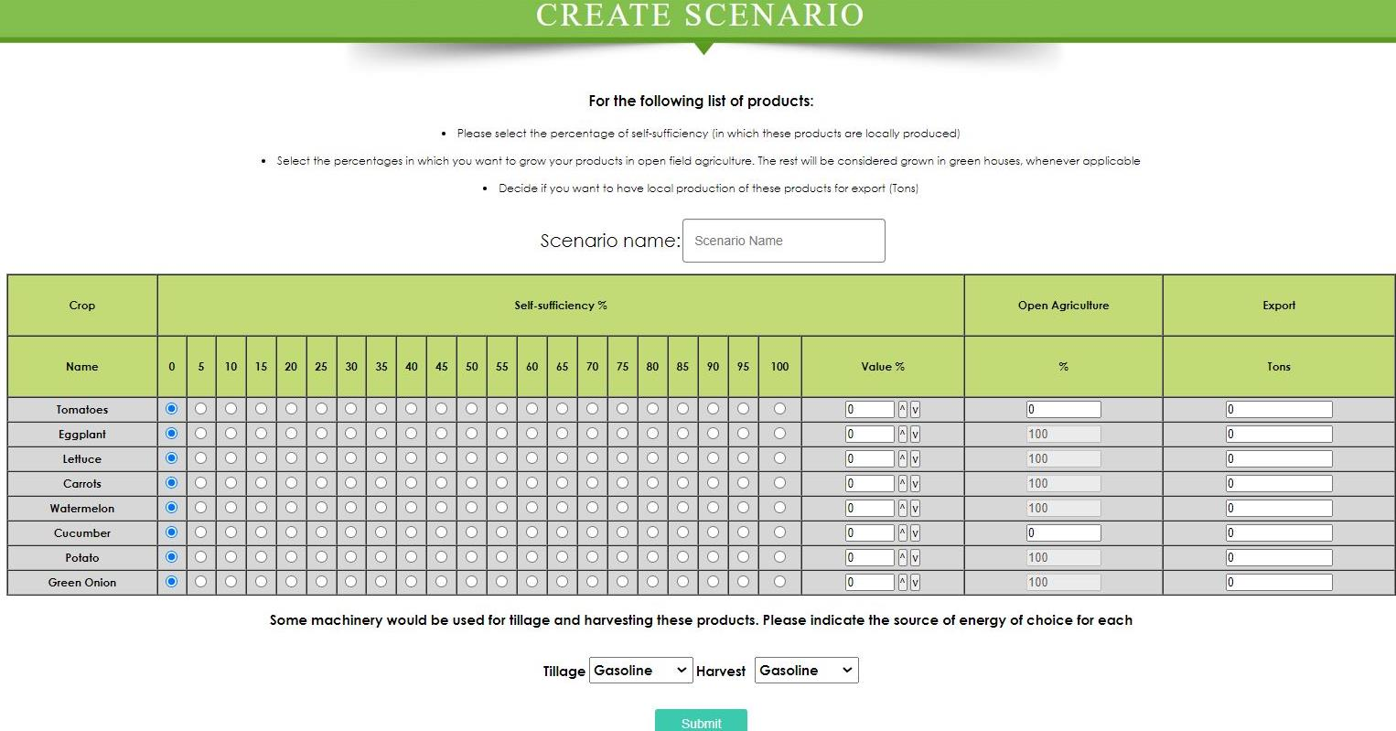
2.1 Nexus Modeling | Tools & Techniques | WEF Nexus Tool 2.0
Notes:
Figure: Interface of WEF Nexus Tool 2.0 (Source: http://www.wefNexustool.org/)

Slide 73
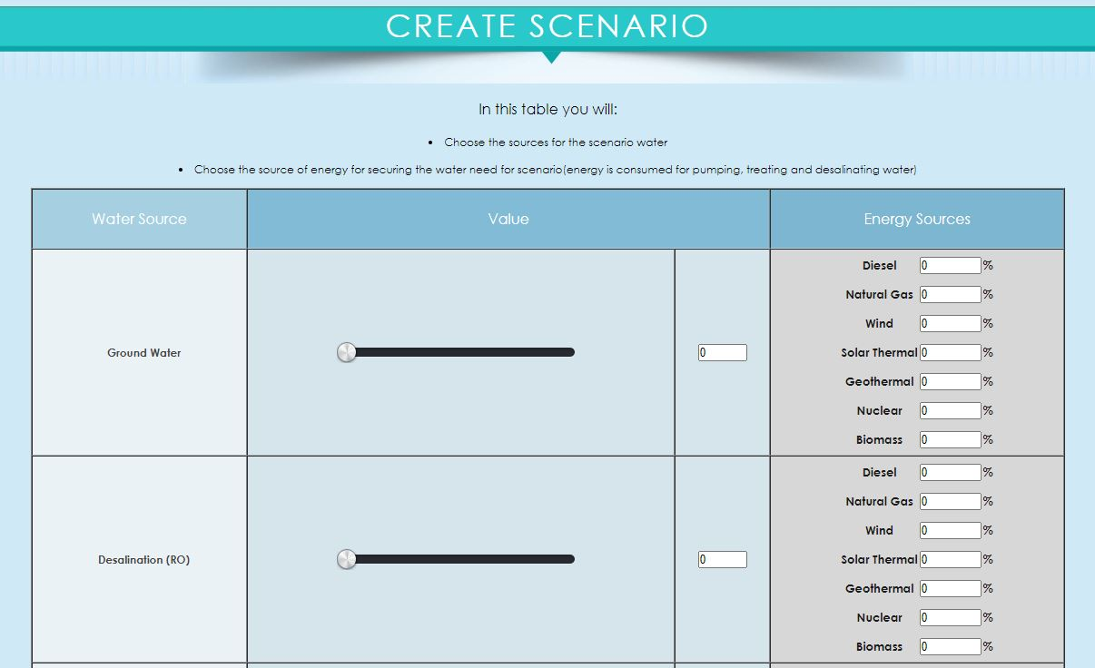
2.1 Nexus Modeling | Tools & Techniques | WEF Nexus Tool 2.0
Notes:
Figure: Interface of WEF Nexus Tool 2.0 (Source: http://www.wefNexustool.org/)

Slide 74
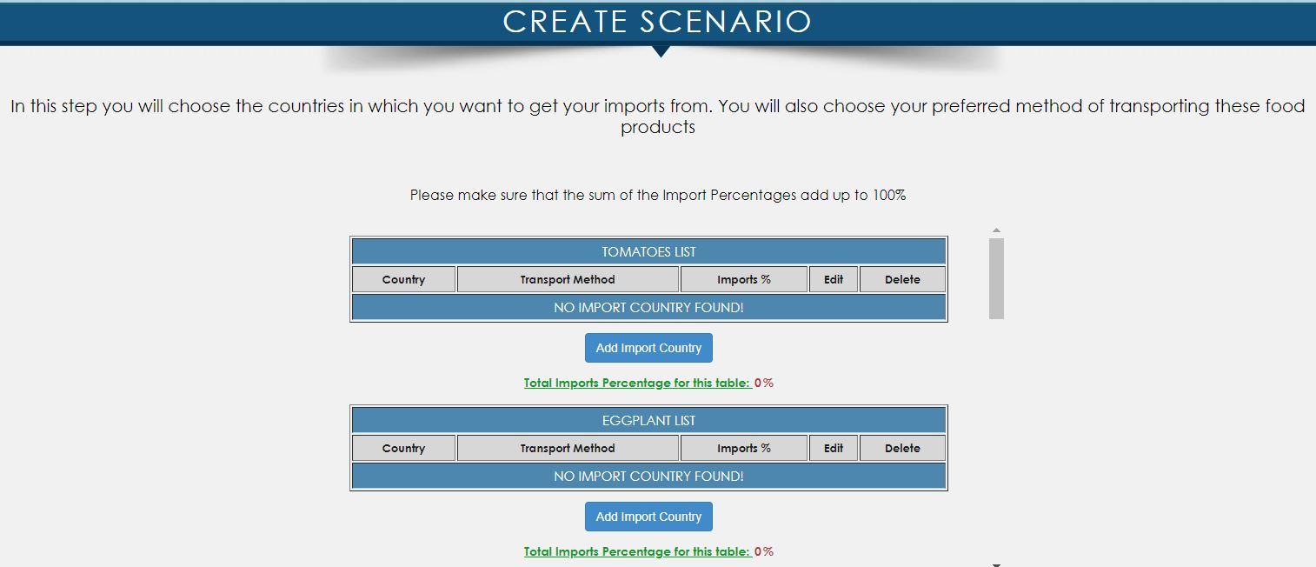
2.1 Nexus Modeling | Tools & Techniques | WEF Nexus Tool 2.0
Notes:
Figure: Interface of WEF Nexus Tool 2.0 (Source: http://www.wefNexustool.org/)

Slide 75
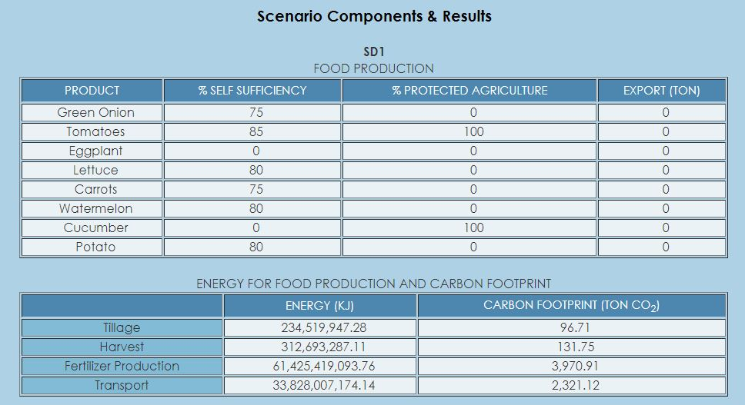
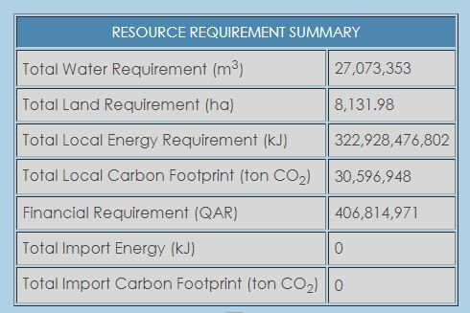
2.1 Nexus Modeling | Tools & Techniques | WEF Nexus Tool 2.0
Notes:
Figure: Interface of WEF Nexus Tool 2.0 (Source: http://www.wefNexustool.org/)

Slide 76
2.1 Nexus Modeling | Tools & Techniques | WEF Nexus Tool 2.0
Outputs:
Total water requirement W (m3) | Total land requirement L (ha)
Local energy requirement E (kJ) | Local carbon footprint (ton CO2)
Financial cost F (US$)
Energy consumed through import EIMP (kJ) | Carbon emissions through import CIMP (ton CO₂)
Limitations:
Limited agricultural crops; does not include meat, dairy products, processed foods, etc.
Assesses a scenario of carbon emissions only
Current tool assumes linear relationships between systems, which may not reflect reality
Current tool does not capture future projections of prices, population increase, demand and resources; simulates a static point in time with defined attributes
Current framework addresses resources needed for a proposed strategy from a national context only

Slide 77
2.1 Exercise 2-2: Demonstration of Nexus Modeling [20 mins]
Identify one of the Nexus modeling tools (e.g., WEF Nexus Tool 2.0)
Demonstrate the tool’s capabilities, limitations, input data requirements, ways of extracting outputs, etc.
Then:
Show selected results and their interpretation
Scenario analysis
Ask participants on which aspects of the Nexus are visualized and which are not?

Slide 78
2.1 Nexus Modeling | Practical Challenges
The WEFE Nexus involves intricate interdependencies and trade-offs
Scale and scope of analysis
Stakeholder engagement
Representing these complex systems in a model is a challenge, and a degree of simplification is required.
Understanding interconnections is crucial for effective resource management.
Nexus modeling can be challenging due to scale and scope variations.
Analysis can range from local to global levels.
The scope depends on the research question or policy under consideration.
Engaging stakeholders is vital for successful Nexus modeling.
Stakeholders' involvement from problem formulation to analysis is crucial.
Challenges include reconciling differing perspectives and interests.

Slide 79
2.1 Nexus Modeling | Practical Challenges
Data availability, quality, and access
Model uncertainty
Interdisciplinary collaboration
Accessing reliable and comprehensive data can be challenging.
Ensuring data accuracy and compatibility across sectors is essential.
Data must be shared for sectors to cooperate.
Models might involve uncertainties due to complex interdependencies.
Acknowledging and addressing uncertainties is crucial for robust analysis.
Nexus modeling requires expertise from multiple disciplines.
Collaborating across sectors can be challenging but vital for holistic insights.

Slide 80
2.1 Nexus Modeling | Practical Challenges
Some of the challenges and solutions for implementing Nexus systems are (Abdi et al., 2020):
Challenges | Solutions
Lack of integrated policy and legislation for the system | Integrated policy-making, such as integrated pricing in water and energy fields, developing a model of agricultural complex and industry proper allocation
Data uncertainty | Implementing the appropriate uncertainty modeling such as stochastic programming, scenario generation, etc.
Large numbers of data for subsystems | Applying data-mining techniques
System boundary | Accurate detection of cases using precise and rapid identification of subsystems
Lack of sufficient standards and laws | Forming committees comprising sub-discipline specialists to address this gap
Lack of efficient software platforms | Presenting multi-domain software

Slide 81
2.1 Nexus Modeling | Sources and Further Reading
Abdi, H., Shahbazitabar, M., & Mohammadi-Ivatloo, B. (2020). Food, energy and water Nexus: A brief review of definitions, research, and challenges. Inventions, 5(4), 1–14. https://doi.org/10.3390/inventions5040056
Albrecht, T. R., Crootof, A., & Scott, C. A. (2018). The Water-Energy-Food Nexus: A systematic review of methods for Nexus assessment. Environmental Research Letters, 13(4). https://doi.org/10.1088/1748-9326/aaa9c6
Anandhi, A., Srivastava, P., Mohtar, R. H., Lawford, R. G., Sen, S., & Lamba, J. (2023). Methodologies and principles for developing Nexus definitions and conceptualizations: lessons from FEW Nexus studies. Journal of the ASABE, 66(2), 205–230.
Howarth, C., & Monasterolo, I. (2016). Understanding barriers to decision making in the UK energy-food-water Nexus: The added value of interdisciplinary approaches. In Environmental Science and Policy (Vol. 61, pp. 53–60). https://doi.org/10.1016/j.envsci.2016.03.014
Mannschatz, T., Wolf, T., & Hülsmann, S. (2016). Nexus Tools Platform: Web-based comparison of modeling tools for analysis of water-soil-waste Nexus. Environmental modeling and Software, 76, 137–153. https://doi.org/10.1016/j.envsoft.2015.10.031
Miralles-Wilhelm, F. (2016). Development and application of integrative modeling tools in support of food-energy-water Nexus planning—a research agenda. In Journal of Environmental Studies and Sciences (Vol. 6, Issue 1, pp. 3–10). https://doi.org/10.1007/s13412-016-0361-1
Rodríguez-Gutiérrez, J. E., Castillo-Molar, A., & Fuentes-Cortés, L. F. (2022). A multi-objective assessment for the water-energy-food Nexus for rural distributed energy systems. Sustainable Energy Technologies and Assessments, 51(January). https://doi.org/10.1016/j.seta.2022.101956

Slide 82
2.1 WEFE
Nexus Assessment
Conceptual framework – components, indicators
Framework for inclusivity analysis in WEFE Nexus
WEFE Nexus database
WEFE Nexus modeling
WEFE Nexus assessment challenges and solutions

Slide 83




2.1 Nexus Assessment Challenges and Solutions | Data/Information
A lack of comprehensive and updated data on water, energy, food and ecosystems can limit the accuracy and effectiveness of decision-making. Limited data on social and policy aspects is another challenge.
Addressing these challenges requires investing in research, data collection, and monitoring efforts to support informed resource management.
Data can be derived from observations, remote sensing, field study, and from literature/ reports.
Reliable spatial and temporal data can ensure the sustainability of vital ecosystems while also promoting economic and social welfare.
Notes:
Data as a challenge – limited availability, reliable quality, limited investment on data, etc.

Slide 84
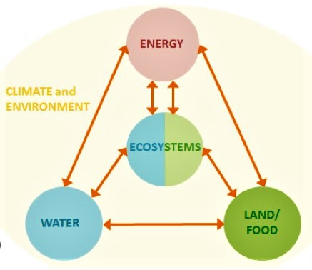
2.1 Nexus Assessment Challenges and Solutions | Harmonization
Harmonizing sectoral planning approaches (e.g. formulating plans/programs in isolation) is a challenge, due to sectoral goals/targets.
Solution: Plan together (in consideration of Nexus-ed relationship) & implement in silos?
Harmonizing actions of sectors, actors and vectors through an enabling environment is a challenge.
Solution: Promoting cross-sectoral collaboration and communication; consideration of cultural/religious sensitivity in designing and implementing interventions.
Harmonizing GESI in policy, planning, designing and implementing interventions.
PEOPLE
PEOPLE
Figure: A diagram showing the different Nexus sectors and how they are interlinked. (Source: de Strasser et al., 2016)
Notes:
People and nature (ecosystem) and promoting/ensuring social and environmental justice are central to harmonization.
A proper enabling environment is essential for harmonization/synchronization of actions of sectors, actors and vectors.
Gender Equality and Social Inclusion (GESI) considerations are at the core of this approach.
Harmonizing GESI → changing peoples’ mindsets; however, radical change is not possible.

Slide 85




2.1 Nexus Assessment Challenges and Solutions | Data/Information
Appropriate communications products are needed for dissemination on value of inclusive WEFE Nexus solutions.
Misconceptions and misinformation about the WEFE Nexus and its interconnections can lead to a lack of understanding and engagement among stakeholders.
Inadequate sensitization of policymakers, communities, and stakeholders can limit their ability to effectively participate in Nexus decision-making processes.
Designing targeted education and awareness-raising programs, including the development of accessible and engaging educational materials, and the use of media to reach a wider audience.
Notes:
Data as a challenge – limited availability, reliable quality, limited investment on data, etc.

Slide 86
2.1 Nexus Assessment Challenges and Solutions | Enabling Environment
Lack of political will/commitment can hinder the development and implementation of supportive policies and regulations for integrated resource management.
Inadequate funding and resources can limit the ability of institutions to effectively coordinate and collaborate on cross-sectoral planning and decision-making.
The absence of clear and transparent governance mechanisms can impede stakeholder participation and engagement in decision-making processes.
Need to establish such mechanisms
Addressing these challenges requires the development of coherent policies and regulatory frameworks that support integrated resource management, as well as the allocation of adequate funding and resources to support institutional coordination and collaboration.

Slide 87
2.1 Nexus Assessment Challenges and Solutions | Capacity
Training and education: Offering programs to individuals and institutions to develop expertise in integrated resource management. Includes WEFE Nexus principles, project management, and stakeholder engagement.
Collaboration and knowledge-sharing: Encouraging cooperation and information exchange between sectors and institutions to leverage expertise. Establish networks for sharing best practices and lessons learned.
Incentives for capacity building: Providing financial and non-financial incentives for investing in capacity building. This includes funding for training and career advancement opportunities.
Monitoring and evaluation: Implementing systems to assess the effectiveness and targeted impact of capacity building efforts. Track progress towards goals and assess the impact on WEFE Nexus implementation.

Slide 88

2.1 Nexus Assessment | Overcoming Challenges
Innovative financing: Utilize public-private partnerships and green bonds to mobilize resources.
Technology and innovation: Leverage technology for resource use efficiency and resource conservation.
Adaptive management: Adopt a flexible approach to learning and adjusting strategies for harmonization.
Stakeholder engagement: Involve diverse perspectives for informed decisions from the right set of stakeholders.
A multi-faceted approach, including research, collaboration, education, policies, capacity building, and innovation, for sustainable WEFE resource management.

Slide 89
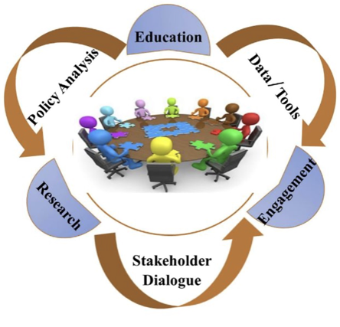
2.1 Nexus Assessment | Nexus Community of Science and Practice
The Nexus Community of Practice (CoP) should be built from the bottom up and have a distributed organization structure that promotes the Nexus community and practice while also promoting equity and social wellbeing.
The CoP should be managed by an executive team who will be responsible for engaging dialogue between all the members.
The process addresses the community’s current and future needs for long-term, sustainable development that is not going to compromise later generations.
Figure: The Nexus community of science and practice
(Source: Mohtar et al., 2022)

Slide 90

2.1 Nexus Assessment Challenges and Solutions| Summary
Implementing inclusive solutions for Nexus gains requires overcoming various challenges.
By addressing data gaps, harmonizing sectors, raising awareness, and fostering an enabling environment, we can achieve more sustainable and equitable resource management.
Capacity building and collaborative efforts are vital for building resilience and achieving successful outcomes in the WEFE Nexus.
Application of an inclusive approach is required for achieving intended outcomes from inclusive WEFE Nexus solutions.

Slide 91
2.1 Nexus Assessment Challenges | Sources and Further Reading
Abdi, H., Shahbazitabar, M., & Mohammadi-Ivatloo, B. (2020). Food, energy and water Nexus: A brief review of definitions, research, and challenges. Inventions, 5(4), 1–14. https://doi.org/10.3390/inventions5040056
de Strasser, L., Lipponen, A., Howells, M., Stec, S., & Bréthaut, C. (2016). A methodology to assess thewater energy food ecosystems Nexus in transboundary river basins. Water (Switzerland), 8(2). https://doi.org/10.3390/w8020059
Hoolohan, C., Larkin, A., McLachlan, C., Falconer, R., Soutar, I., Suckling, J., Varga, L., Haltas, I., Druckman, A., Lumbroso, D., Scott, M., Gilmour, D., Ledbetter, R., McGrane, S., Mitchell, C., & Yu, D. (2018). Engaging stakeholders in research to address water–energy–food (WEF) Nexus challenges. Sustainability Science, 13(5), 1415–1426. https://doi.org/10.1007/s11625-018-0552-7
Liu, J., Yang, H., Cudennec, C., Gain, A. K., Hoff, H., Lawford, R., Qi, J., de Strasser, L., Yillia, P. T., & Zheng, C. (2017). Challenges in operationalizing the water–energy–food Nexus. Hydrological Sciences Journal, 62(11), 1714–1720. https://doi.org/10.1080/02626667.2017.1353695
Mohtar, R. H., Sharma, V. K., Daher, B., Laspidou, C., Kim, H., Pistikopoulos, E. N., Nuwayhid, I., Lawford, R., Rhouma, A., & Najm, M. A. (2022). Opportunities and Challenges for Establishing a Resource Nexus Community of Science and Practice. Frontiers in Environmental Science, 10(May), 1–4. https://doi.org/10.3389/fenvs.2022.880754

Slide 92
2.2 Case Studies – Nexus in Practice
Case 1: Pakistan textile industry
Case 2: Drinking water treatment plant
Case 3: Urban WEF Nexus in Beijing
Case 4: Water management in Phoenix, Arizona

Slide 93
2.2 Session Delivery Plan [45 minutes]
Time | Activity | Facilitator
30 minutes | Lecture: Presentation of 4 case studies | Prof. Dr. Rajesh K. Rai
15 minutes | Exercise 2-3: Open Discussion – Participant reflection on the case studies | Prof. Dr. Rajesh K. Rai

Slide 94
2.2 Case 1: Pakistani Textile Industry
Context:
The Pakistani textile industry is one of the largest in the international market, as Pakistan is a major cotton-growing country with an extensive labour market (Abbas et al., 2020).
Issues:
Climate change and population growth have affected this industry due to:
a decline in cotton production
power outages
unavailability of adequate water
Proposed solution for stability of this industry:
Sustainability of natural resources, including cotton, energy, and water
Based on the Nexus concept using a system dynamics approach, a study has developed a resource-energy-water (REW) comprehensive model to quantify trade-offs and synergies of potential solutions/interventions
Abbas et al., 2020

Slide 95
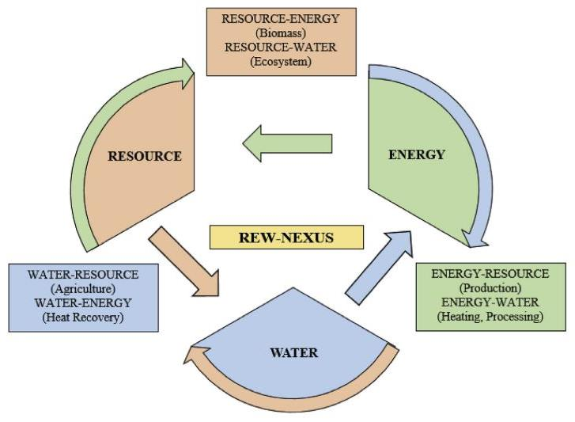
2.2 Case 1: Pakistani Textile Industry
Methodology:
Fig 1 shows a simplified flowchart of the resource-energy-water Nexus in the textile industry. Clockwise and counter-clockwise arrows define a two-way relationship.
Resource, energy, and water (R-E-W) consumptions were calculated for various textile production processes.
A system dynamics approach was used to illustrate interaction between R-E-W, to maximize the resource use efficiency.
Systems dynamics determines how structures and flows of industrial input components can influence overall output and production.
Figure: A simplified resource-energy-water Nexus for a textile industry (Source: Abbas et al., 2020)
Notes:
Resource refers to “Cotton Resource”

Slide 96
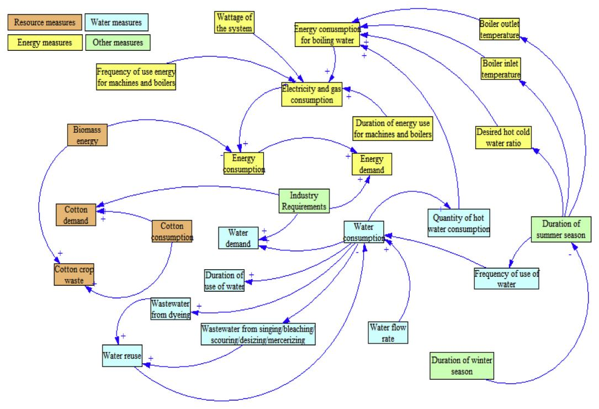
2.2 Case 1: Pakistani Textile Industry
CALCULATIONS
Energy consumption
For electrical systems (motors, lighting, pumps and fans, compressors, chillers)
For boiler to heat water
Water consumption
Resource (cotton) consumption
Seasonality of R-E-W consumptions
Figure : Interactions between R-E-W processes & external factors in a textile industry (Source: Abbas et al., 2020)

Slide 97
2.2 Case 1: Pakistani Textile Industry
Nexus uncertainty analysis:
Monte Carlo simulation technique was used to determine the uncertainty
Sensitivity analysis:
Performed to add confidence in the results of the sustainability of R-E-W
Helps to understand/quantify changes in output with one-unit change in input parameters
Conclusions:
Availability of energy and water is more important to the textile industry than the resource (cotton).
Implementation of renewable energy and wastewater treatment technologies can make each factory more self-sufficient and manage its daily production, as emphasized by the two-way relationships between R-E-W.

Slide 98
2.2 Case 2: Drinking Water Treatment Plant
Bukhary et al., 2020
Context:
Drinking water treatment is energy-intensive and contributes to carbon emissions.
This case study aims to synthesize the energy-water-carbon Nexus of a large-scale drinking water treatment plant (DWTP) in southwestern United States that treats 1 Mm³/day of raw water and utilizes fossil fuels for energy.
Issues:
Energy requirements for DWTPs are met through fossil fuel-based technologies; which along with other environmental disruptions are the leading contributors of carbon emissions.
Potential solutions energy costs and carbon emissions:
Using renewables sources (e.g., solar) as an energy source can reduce use of fossil fuels, minimize cost of operation, and offset carbon emissions.
Notes:
photovoltaics (PV)

Slide 99
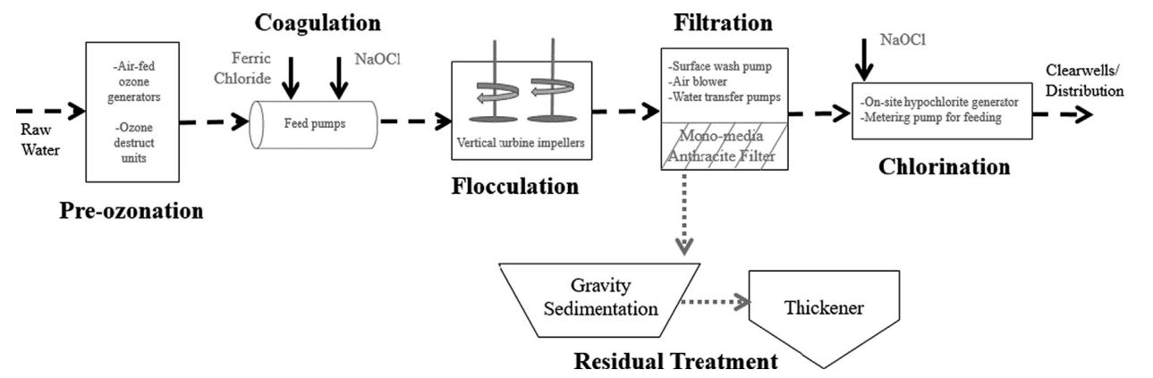
2.2 Case 2: Drinking Water Treatment Plant
Figure: Process flow diagram for the drinking water treatment plant
(Source: Bukhary et al., 2020)

Slide 100
2.2 Case 2: Drinking Water Treatment Plant
Methodology:
Energy consumption for the various energy driving units of the DWTP was determined first, and then used as inputs for the System Advisor Model (SAM):
Pre-ozonators
Feed system for coagulation
Vertical turbine flocculator
Filtration backwash system
On-site sodium hypochlorite generator
Additional pump operations
The SAM model is used to calculate of land requirements and cost analysis of the photovoltaic (PV) system to offset the energy requirements of the DWTP.
Net reduction in carbon emissions due to PV deployment was estimated.
Finally, sensitivity analysis of inputs and scenario analysis was also performed.

Slide 101
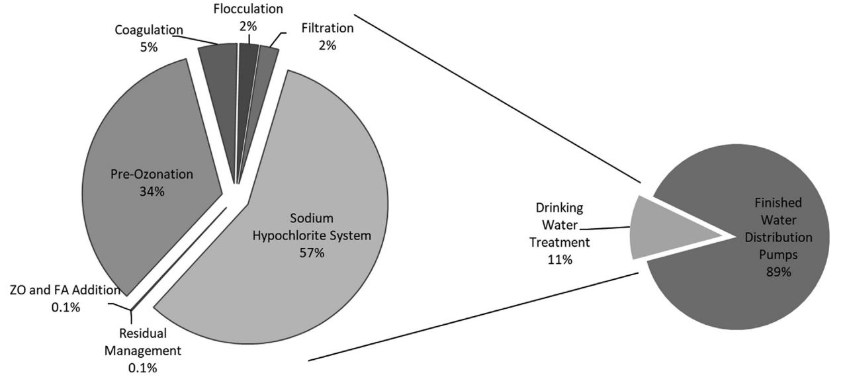
2.2 Case 2: Drinking Water Treatment Plant
Figure: Energy consumption (%) for the drinking water treatment plant
(Source: Bukhary et al., 2020)

Slide 102
2.2 Case 2: Drinking Water Treatment Plant
Conclusions:
Use of renewable energy (e.g., PV) can reduce energy consumption and offset carbon emission from DWTPs.
Initial investments are typically high for solar projects, but can be offset by low operating and maintenance costs during the operational life of the solar facility.
The efficiency of PV panels has increased significantly, with a marked decrease in price, a trend projected to continue over the coming years.
However, as shown by this case study, governmental support/subsidies are still required for solar PV projects to be cost-effective.
Reduction in current battery storage prices can significantly alter the way energy is generated today, as PV coupled with battery storage can lead to a reliable supply of electricity throughout 24h of the day.

Slide 103
2.2 Case 3: Urban WEF Nexus of Beijing
Li et al., 2021
Context:
Cities have become active hubs of resource consumption and production.
Globally, food security, freshwater shortage and fossil fuel exhaustion have become the greatest challenge for sustainable development of cities in the future.
Issues:
Beijing, the capital city of China, serves as a microcosm of China’s rapid urbanization process, and its unique location and mega-city status have increased pressure on the City to ensure the availability of resources.
Potential solutions:
Systematic analysis and simulation of the dynamic evolution of urban WEF demand, supply and their Nexus would add significant and practical value for macro-management such as ensuring the security of urban resources.

Slide 104
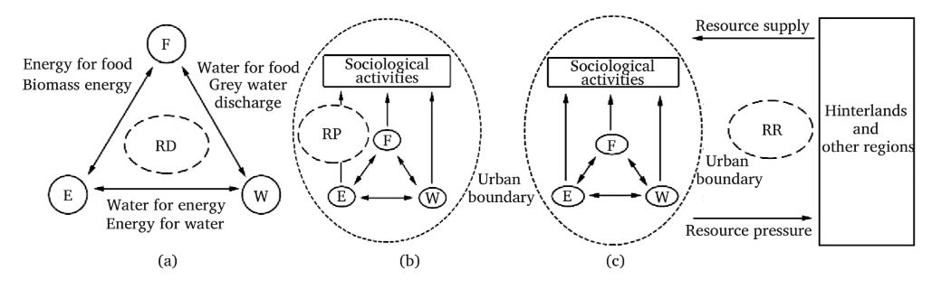
2.2 Case 3: Urban WEF Nexus of Beijing
Figure: Schematic diagram of urban food-energy-water Nexus
(Source: Li et al., 2021)
RD: Resource dependence; RP: Resource provision; RR: Resource cross Region

Slide 105
2.2 Case 3: Urban WEF Nexus of Beijing
Methodology:
The Stella modeling platform was used to simulate the supply and demand of WEF resources
Model construction
Module I: socioeconomic module containing two important parameters (permanent resident population and gross domestic product)
Module II: Urban food supply and demand
Module III: Urban energy supply and demand
Module IV: Urban water supply and demand
Construction of Nexus indicators (for trade-off and synergies)
Data and validation

Slide 106
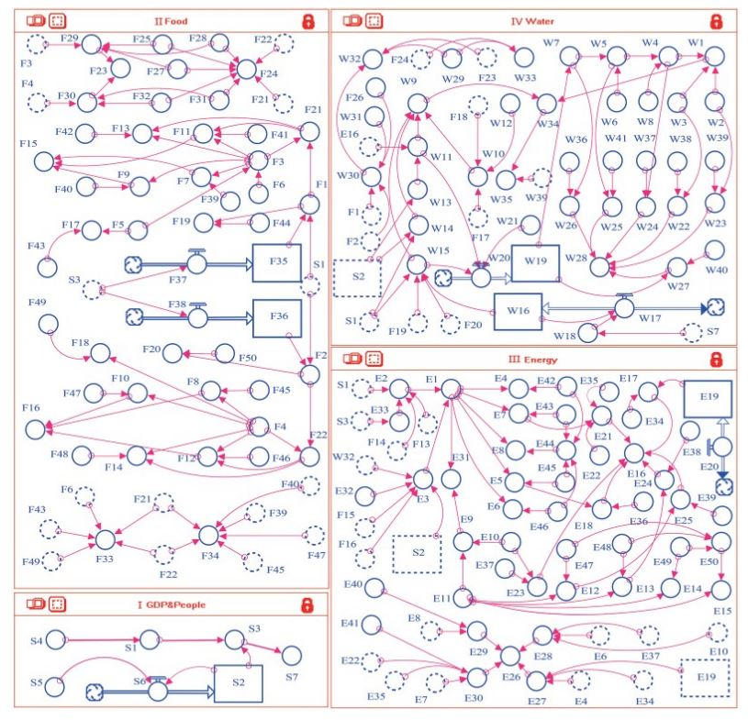
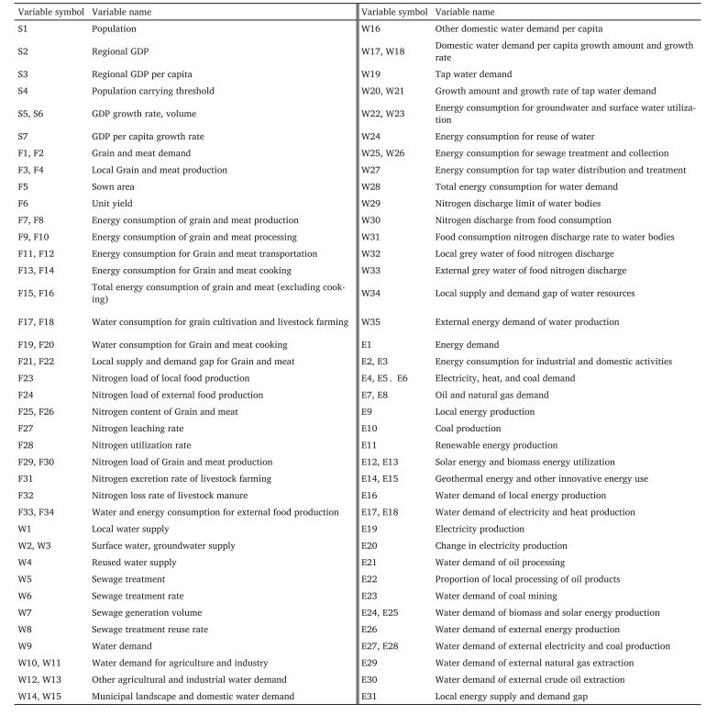
2.2 Case 3: Urban WEF Nexus of Beijing
Figure: Stella model for the urban FEW system.
(Source: Li et al., 2021)
Table: Definitions of variables in the model.
(Source: Li et al., 2021)

Slide 107
2.2 Case 3: Urban WEF Nexus of Beijing
Conclusions:
As urbanization progressed in Beijing, the limited local supply of resources was not sufficient to meet the high demand → the resources gap will continue to increase; therefore, Beijing will have to draw on cross-boundary production of the resources.
The change of Nexus indexes are mainly affected by the mutual and strong dependence between food and water.
Food and energy depend more and more on each other; in contrast, the inter-relationship between water and energy is more stable.
To improve systematic management of urban resources, we need to comprehensively capture multi-tradeoffs of the WEF system and establish a multi-regional and multi-factor integrated and collaborative resource management mechanism.

Slide 108
2.2 Case 4: Water Management in Phoenix, Arizona
Guan et al., 2021
Context:
The Phoenix metropolitan area aims to achieve safe-yield of groundwater by 2025, i.e., balancing annual water withdrawal and recharge to the aquifer.
Issues:
The desert region relies on energy-intensive water supply sources that heavily depend on climate variability and change.
Farmlands have declined by ~50% over the last three decades to construct new houses for accommodating ~3 million new residents → Increase in municipal water and energy demand.
Potential solution:
Modify the energy generation portfolio by reducing the use of fossil fuels and increasing renewable sources, with a focus on solar.

Slide 109
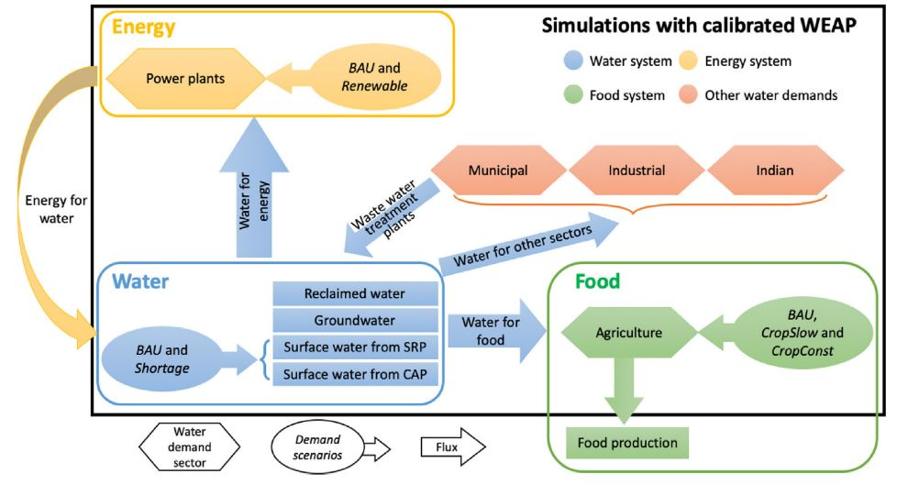
2.2 Case 4: Water Management in Phoenix, Arizona
Figure: Schematic of the modeling approach adopted to simulate the interactions among FEW sectors in the Phoenix Region.
(Source: Guan et al., 2020)

Slide 110
2.2 Case 4: Water Management in Phoenix, Arizona
Methodology:
The WEAP model was used for managing water allocation by controlling water flux transfers among supply and demand nodes that can include operating rules for infrastructure elements such as canals, reservoirs, diversions, etc.
Various scenarios were simulated and analyzed
Business as usual (BAU)
CropSlow
CropConst
Renewable
Shortage
Metrics for scenario comparison and quantification of WEF interactions prepared

Slide 111
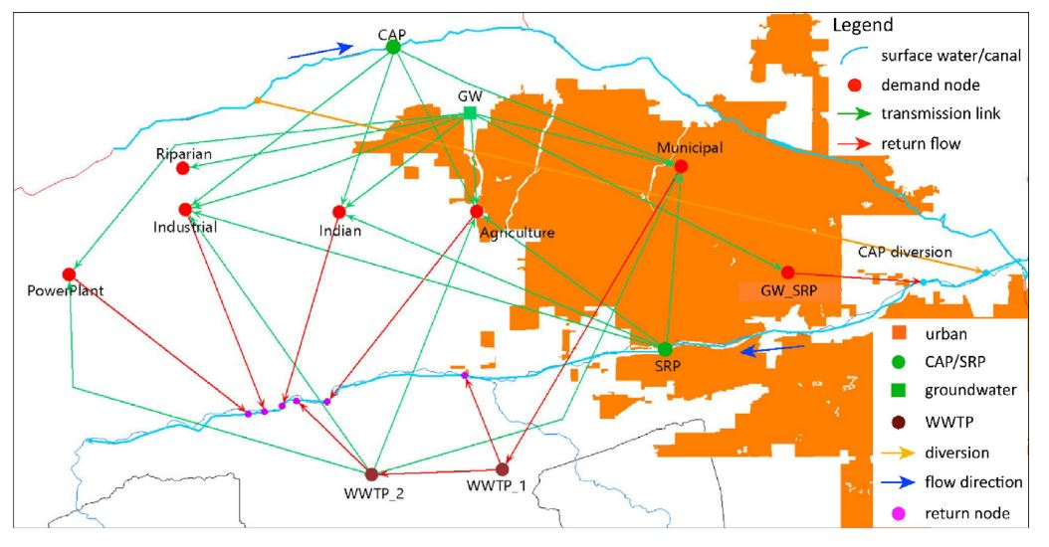
2.2 Case 4: Water Management in Phoenix, Arizona
Figure: Configuration of the network in WEAP simulating the water allocation from the supply sources to the main demand nodes in the Phoenix Region (Source: Guan et al., 2020)

Slide 112
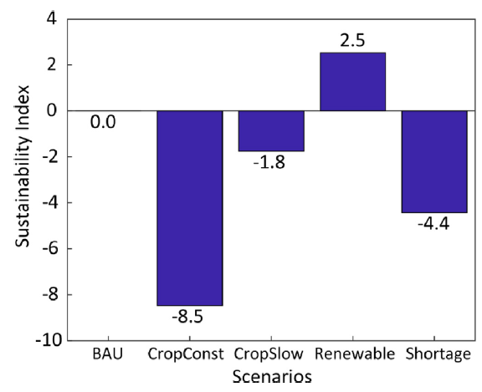
2.2 Case 4: Water Management in Phoenix, Arizona
Conclusions:
A transition to an energy portfolio with a larger ratio of renewable sources will reduce fossil-fuel based energy, increase probability of reaching safe-yield, and decrease energy demand for water to 2%.
Occurrence of a mega-drought under BAU demand conditions will cause shortages in surface water resources that will be largely compensated by groundwater, leading to the need of additional energy (5%) and significant groundwater overdraft.
Figure: Sustainability index (SI) for different scenarios
(Source: Guan et al., 2020)

Slide 113
2.2 Exercise 2-3: Open Discussion – Participant Reflection [15 mins]
What are the key messages represented by these case studies in terms of the WEFE Nexus?
How could Nexus interventions have been designed in better, more inclusive ways?

Slide 114
2.2 Nexus Case Studies | Sources and Further Reading
Abbas, S., Chiang Hsieh, L. H., Techato, K., & Taweekun, J. (2020). Sustainable production using a resource–energy–water Nexus for the Pakistani textile industry. Journal of Cleaner Production, 271, 122633. https://doi.org/10.1016/j.jclepro.2020.122633
Bukhary, S., Batista, J., & Ahmad, S. (2020). Water -energy -carbon Nexus approach for sustainable large-scale drinking water treatment operation. Journal of Hydrology, 587(April), 124953. https://doi.org/10.1016/j.jhydrol.2020.124953
Guan, X., Mascaro, G., Sampson, D., & Maciejewski, R. (2020). A metropolitan scale water management analysis of the food-energy-water Nexus. Science of the Total Environment, 701, 134478. https://doi.org/10.1016/j.scitotenv.2019.134478
Li, X., Zhang, L., Zhang, P., Hao, Y., & Xiong, X. (2021). Urban food-energy-water Nexus: a case study in Beijing. Chinese Journal of Population Resources and Environment, 19(3), 274–282. https://doi.org/10.1016/j.cjpre.2021.12.030

Slide 115
2.3 Nexus Decision Support System (DSS)
Framework and features of Nexus DSS
Communication and uptake
Challenges for uptake of NDSS

Slide 116
2.3 Session Delivery Plan [60 minutes]
Time | Activity | Facilitator
15 minutes | Lecture – Operationalizing the WEFE Nexus and contextualizing the need for a NDSS | Prof. Dr. Vishnu Prasad Pandey
15 minutes | Lecture: Introduce a Nexus DSS framework | Prof. Dr. Rajesh Kumar Rai
15 minutes | Exercise 2-4: What should be the key components of an inclusive Nexus DSS? | Prof. Dr. Rajesh Kumar Rai
15 minutes | Lecture: Challenges for uptake of NDSS | Prof. Dr. Rajesh Kumar Rai

Slide 117
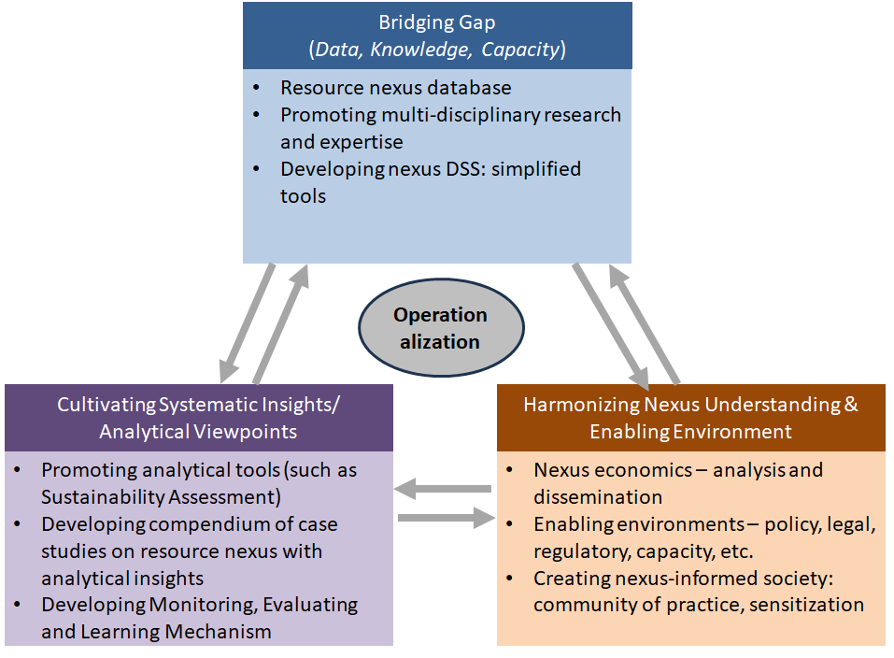
2.3 Operationalizing the WEFE Nexus | Framework
The resource Nexus is an inter-disciplinary, cross-cutting and multi-sectoral approach containing considerable complexities, challenges & opportunities for operationalization (Howarth & Monasterolo, 2016).
A framework for operationalizing the WEFE Nexus may be organized as shown here:
Figure: A framework for operationalizing resource Nexus, as a sample
(Source: Chapagain et al., under review)

Slide 118
2.3 Operationalizing the WEFE Nexus | Framework
Bridging the gap
Data gap, knowledge gap, capacity gap
Cultivating systematic insights/analytical viewpoints
Analytical tools
Compendium of case studies
Monitoring, Evaluation & Learning (MEL) mechanism
Harmonizing Nexus understanding & enabling environment
Nexus economics (analysis, dissemination)
Enabling environment (policy, legal, regulatory, etc.)
Creating Nexus-aware society
Appropriate system design and economic viability plays a major role for making new technologies scalable and commercializable (Lee et al., 2023).
Operationalization requires mainstreaming the Nexus, operationalizing coordination, multi-stakeholder platform (MSP), capacity strengthening, etc.

Slide 119
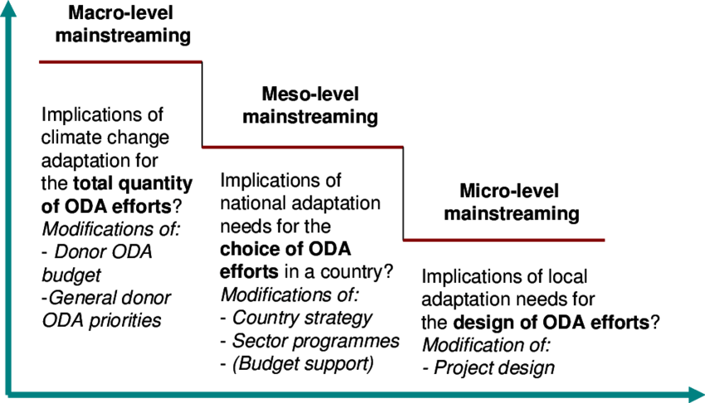
2.3 Operationalizing the WEFE Nexus | Nexus Mainstreaming
Definition:
Nexus mainstreaming involves integrating the WEFE Nexus approach into policies and practices across various sectors.
Goal:
To promote coordinated decision-making and resource management
Approach:
Partnerships, evidence-based approaches, scenario development, and multi-stakeholder dialogues
Figure: Different levels & interpretation of mainstreaming (with an example of CC Adaptation) (Source: Persson, 2008)
Notes:
Mainstreaming can be considered as a sub-set of operationalization. Mainstreaming of a concept indicates that its widely adopted by a government’s policies and programs, with regular and sufficient budget allocation.

Slide 120
2.3 Operationalizing the WEFE Nexus | Coordination – Sectors & Scales
Effective implementation of the WEFE Nexus necessitates seamless coordination among diverse sectors and government levels to achieve common goals.
Strategies to operationalize coordination across sectors and government scales:
Inter-ministerial committees and programs:
Minimize administrative barriers — facilitate effective communication and collaboration among sectors and government levels
Enhance coordination — jointly develop and implement strategies for water, energy, food, and ecosystem management
2. Strategic frameworks for infrastructure investment:
Aligning objectives — ensure harmony between infrastructure investments across departments and government levels
Coordinated resource allocation — optimize resource use for sustainable WEFE Nexus outcomes

Slide 121
2.3 Operationalizing the WEFE Nexus | Coordination – Sectors & Scales
3. Effective instruments for government coordination:
Identify opportunities and bottlenecks — recognize investment potentials and challenges for collaborative solutions
Managing joint competencies — foster cooperation to leverage expertise for comprehensive resource management
4. Incentives for regional and local government coordination:
Geographic relevance — provide incentives to align regional and local investments with Nexus objectives
Efficient resource utilization — ensure optimal utilization of resources based on local needs
5. Strengthening capacities for public investment:
Effective vertical and horizontal coordination — enhance institutional capacity for coordinated decision-making
Promote policy learning — support knowledge exchange and learning for improved governance and management

Slide 122
2.3 Operationalizing the WEFE Nexus | MSP & Coordination Mechanisms
Multi-Stakeholder Platforms (MSPs) in the WEFE Nexus serve as dynamic forums that engage diverse stakeholders, including government, civil society, private sector, and communities.
Ensuring diversity of representation includes: people (women, Dalits (low-caste individuals), different ethnicities), geographical representation of participants/stakeholders, etc.
How MSPs can be utilized in the context of the WEFE Nexus:
Facilitating stakeholder engagement:
MSPs provide a platform for dialogue and collaboration among diverse actors in the WEFE Nexus.
Example: Multi-Stakeholder & User Platform (MSUP) tailored for WEFE Nexus stakeholder engagement can foster participatory decision-making.
Promoting information sharing:
MSPs enable stakeholders to exchange data, knowledge, and best practices in the WEFE Nexus.
Enhanced information sharing leads to more informed and evidence-based decisions, resulting in improved decision-making.
Notes:
MSP – Multi-Stakeholder Platforms

Slide 123
2.3 Operationalizing the WEFE Nexus | MSP & Coordination Mechanisms
3. Building consensus:
MSPs foster dialogue and negotiation among stakeholders to reach consensus in the WEFE Nexus.
Promote conflict resolution by addressing conflicts and competing interests through open dialogue and understanding.
4. Supporting multi-stakeholder actions:
MSPs facilitate collaboration and coordination among various WEFE Nexus actors.
Promote resilient food systems through coordinated actions towards sustainable and resilient food systems.

Slide 124
2.3 Operationalizing the WEFE Nexus | Participatory Policy-Making
How can participatory policy-making be applied in the context of the WEFE Nexus?
Identifying and engaging key stakeholders
Identify and involve key stakeholders in the WEFE Nexus, including government agencies, civil society organizations, private sector actors, and local communities.
Holistic representation: Diverse stakeholder engagement (assuming representation of social diversity within a group) ensures holistic representation of interests and perspectives.
Facilitating dialogue and collaboration
Foster dialogue and collaboration among stakeholders through gender & socially inclusive multi-stakeholder platforms, workshops, and engagement mechanisms.
Open communication: Creating spaces for dialogue fosters an inclusive and open exchange of ideas.
Incorporating stakeholder perspectives into decision-making
Use gender & socially inclusive participatory methods like surveys, focus groups, and public consultations to incorporate stakeholder perspectives into decision-making.
Inclusive Decision-Making: Involving stakeholders promotes inclusive and informed policy choices.
Promoting transparency and accountability
Emphasize transparency and accountability in decision-making through mechanisms like open data and public reporting adopted to diversity of audiences.
Building Trust: Transparent decision-making builds trust and fosters credibility in the policy-making process.

Slide 125
2.3 Operationalizing the WEFE Nexus | Capacity Strengthening
Capacity strengthening initiatives play a vital role in enhancing the knowledge, skills, and capabilities of WEFE Nexus stakeholders.
These initiatives aim to build expertise and empower stakeholders to address challenges and opportunities in the Nexus.
How can capacity strengthening be applied in the context of the WEFE Nexus?
Developing training programs:
Design and implement training programs to enhance stakeholders' knowledge and skills in the WEFE Nexus and promote critical reflection.
Cover a wide range of topics, including water management, energy efficiency, sustainable agriculture, ecosystem conservation and good governance.
Empower stakeholders with necessary knowledge for informed decision-making.

Slide 126
2.3 Operationalizing the WEFE Nexus | Capacity Strengthening
2. Promoting knowledge sharing:
Foster knowledge sharing (including best practices) through platforms/networks.
Encourage collaboration and cooperation among stakeholders for collective learning and problem-solving.
3. Providing technical assistance:
Offer technical assistance to support stakeholders in implementing WEFE Nexus initiatives.
Provide support for project design, implementation, monitoring, and evaluation to enhance project success.
4. Strengthening institutional capacities:
Focus on initiatives that enhance the ability of organizations to manage and govern resources in the WEFE Nexus in a collaborative way.

Slide 127
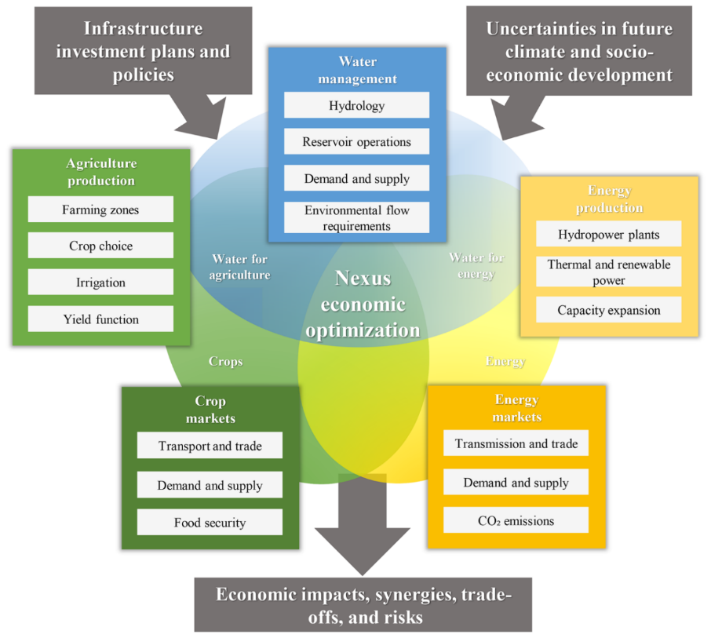
2.3 Nexus DSS | Framework
Frameworks for a Nexus Decision Support System (DSS) may vary (or can be customized) depending upon intended use, priority of region/area, data availability, etc.
However, it should have various WEFE Nexus components, including:
Data input, processing and integration
Data analysis tools
Data/result visualization interface
Output customization (for communication) flexibility
Others (as needed)
One example is shown here:
Figure: Conceptual framework of the decision support tool (Source: Payet-Burin et al., 2019)
Notes:
A decision support system (DSS) helps organizations make decisions by analyzing data to provide insights and recommendations. DSSs can be fully computerized, human-powered, or a combination of both. They can be used at the management, operations, and planning levels of an organization.
NDSS is required to facilitate the process of operationalization in the face of various WEFE Nexus operational issues.
NDSS should have scenario analysis capability for optimizing economic impacts, synergies and minimizing trade-offs & risks.
Discuss with the participants: What aspects are missing? How can it be made more robust?

Slide 128

2.3 Nexus DSS | Framework & Features
Framework:
Integrating water, energy, food & ecosystem for interconnections (trade-offs, synergies)
Will have Features such as
advanced analytics
visualization
scenario simulations for evidence-based decision-making
Data integration:
Integrates data from multiple sources, including remote sensing and ground-based monitoring
Provides comprehensive understanding of interconnections between resources

Slide 129
2.3 Nexus DSS | Framework & Features
User-friendly interface:
Easy access and analysis of data through intuitive navigation and customizable dashboards
Interactive visualizations enhance user experience
Real-time monitoring:
Monitors key indicators (e.g., water levels, energy consumption, crop yields) in real-time
Enables swift response to emerging challenges and opportunities
Collaborative decision-making:
Supports stakeholder collaboration through data sharing and consensus-based solutions
Online forums and decision support tools foster collective input

Slide 130
2.3 Nexus DSS | Communication and Uptake
Effective communication and uptake of NDSS is crucial for promoting understanding and adoption among stakeholders. Focus should be given to:
Tailored communication strategies
Reach stakeholders through various channels like social media and community meetings.
Demonstration projects
Showcase NDSS benefits through pilot projects to build support and encourage uptake.
Capacity building
Enhance stakeholders' understanding and ability to use NDSS through training and technical assistance.
Incentives for uptake
Encourage adoption with financial and non-financial incentives like grants and recognition.
Notes:
Nexus Decision Support System (NDSS)

Slide 131
2.3 Exercise 2-4: Open Discussion [15 mins]
What should be some key components of an Inclusive WEFE Nexus DSS?

Slide 132
2.3 Nexus DSS | Challenges for Uptake
Uptake of NDSS involves integrating it into existing resource management practices. Focus should be given to:
Integration with existing systems:
Integrate NDSS with water and energy management systems for seamless operation.
Stakeholder engagement:
Involve policymakers and communities in the design and implementation of NDSS.
Monitoring and evaluation:
Establish systems to track NDSS progress and assess resource management impact.
Continuous improvement:
Regularly update NDSS to incorporate new data and technologies.

Slide 133
2.3 Nexus DSS | Challenges for Uptake
Making NDSS people-focused → addressing diverse user needs and ensuring inclusivity
Ensuring continuous data availability and updates
Securing buy-in from stakeholders and decision-makers
Fostering integrated knowledge synthesis across disciplines, technologies, and stakeholders
Limited application as current tools lack real-world relevance for WEFE Nexus challenges; many approaches are discipline-specific and theoretical, lacking practical grounding
Difficult decision contexts: model-aided trade-off analysis aims to support decision-making.
Recommendations must be understandable and tailored to decision-makers' needs.
Group decisions require consideration of participant heterogeneity, conflicting preferences, proximity, group size, and duration.

Slide 134


2.3 Nexus DSS | Summary
The Nexus Decision Support System (NDSS) is a powerful framework for addressing WEFE Nexus challenges.
Effective communication and uptake are vital for maximizing the impact of NDSS on resource management.
By operationalizing NDSS and making it people-focused, we can work towards a more sustainable and integrated management of water, energy, food, and ecosystems.

Slide 135
2.3 NDSS & Operationalizing WEFE Nexus | Reading Materials
Payet-Burin, R., Kromann, M., Pereira-Cardenal, S., Marc Strzepek, K., & Bauer-Gottwein, P. (2019). WHAT-IF: An open-source decision support tool for water infrastructure investment planning within the water-energy-food-climate Nexus. Hydrology and Earth System Sciences, 23(10), 4129–4152. https://doi.org/10.5194/hess-23-4129-2019
Abdi, H., Shahbazitabar, M., & Mohammadi-Ivatloo, B. (2020). Food, energy and water Nexus: A brief review of definitions, research, and challenges. Inventions, 5(4), 1–14. https://doi.org/10.3390/inventions5040056
Albrecht, T. R., Crootof, A., & Scott, C. A. (2018). The Water-Energy-Food Nexus: A systematic review of methods for Nexus assessment. Environmental Research Letters, 13(4). https://doi.org/10.1088/1748-9326/aaa9c6
Driessen, P. P., & Glasbergen, P. (2002). Greening Society. The paradigm shift in Dutch environmental politics.
Howarth, C., & Monasterolo, I. (2016). Understanding barriers to decision making in the UK energy-food-water Nexus: The added value of interdisciplinary approaches. In Environmental Science and Policy (Vol. 61, pp. 53–60). https://doi.org/10.1016/j.envsci.2016.03.014
Lee, B., Wang, L., Wang, Z., Cooper, N. J., & Elimelech, M. (2023). Directing the research agenda on water and energy technologies with process and economic analysis. Energy and Environmental Science, 16(3), 714–722. https://doi.org/10.1039/d2ee03271f
Newell, J. P., Goldstein, B., & Foster, A. (2019). A 40-year review of food-energy-water Nexus literature and its application to the urban scale. Environmental Research Letters, 14(7). https://doi.org/10.1088/1748-9326/ab0767
Persson, Å. (2008). EPIGOV Papers No . 36 Mainstreaming Climate Change Adaptation into Official Development Assistance : A Case of International Policy Integration. Sustainable Development, October, 2006–2008.
van den Belt, M. (2004). Mediated Modeling: A System Dynamics Approach to Environmental Consensus Building (Washington, DC: Island Press)

