Slide 1
Antimicrobial
Resistance
Hub
Arshnee Moodley
AMR Team Leader- Nov 2019
a.moodley@cgiar.org

Slide 2
CGIAR Antimicrobial Resistance Strategy
CGIAR AMR research portfolio has grown in recent years
  projects focusing on antimicrobial use and AMR in hot spots incl. interface of people, animals, and environment
    CGIAR Research Programs
      CRP Livestock, led by ILRI
      CRP Agriculture for Nutrition and Health led by International Food Policy Research Institute (IFPR)
      CRP Fish led by World Fish
      CRP Water Land and Ecosystems led by the International Water Management Institute (IWMI)
CGIAR Antimicrobial Resistance Strategy prioritizes:
  generating evidence of links between agriculture and public health
  based on the evidence, develop solutions that are locally relevant and applicable
Notes:
Recently adopted CGIAR AMR strategy
tackle AMR challenges in low and middle-income countries and ensure the sustainability of food and health systems

Slide 3
CGIAR AMR Hub
CGIAR AMR Hub led by ILRI was launched Feb 2019
  Implementation of the CGIAR AMR strategy
  Convene and facilitate interactions between different stakeholders , incl. CGIAR partners and national and international partners
  Establishing Centre of Excellence on AST (incl. basic microbiology ) together with EUCAST Development Lab (Växjö, Sweden) and the new International Centre AMR Solutions (ICARS)
    MOA with ICARS
Focus: Not only antibiotics but other antimicrobials (e.g. acaricides and parasitic drugs) in the different agricultural systems, and in relation to resistance
Notes:
Recently adopted CGIAR AMR strategy
tackle AMR challenges in low and middle-income countries and ensure the sustainability of food and health systems

Slide 4






One Health as the foundation
Strategy comprises R&D activities in 5 critical areas
Transdisciplinary
Partnerships
AM use and value chains
Prevalence, Transmission dynamics
Interventions
Enabling policy dialogue
Capacity Development

Slide 5
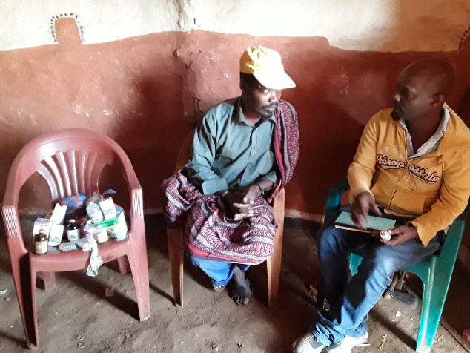
Antimicrobial use, behaviour and value chains
Behaviour around antimicrobials use
Distribution networks of veterinary drugs
Role of formal and informal markets in perpetuating cycles of inequity
Outputs:
Metrics for AMU in different systems
Better understanding of systems influencing AM use behaviour

Slide 6
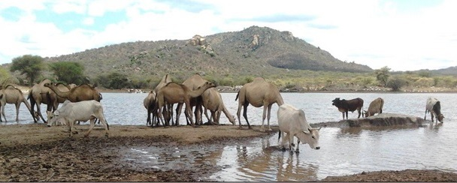
Prevalence and Transmission dynamics
Better understand AMR risks for people (residues and resistant bacteria)
biology, ecology, and epidemiology of resistant microbes at the animal, human and environment interface
Outputs
evidence on the extent of antimicrobial-resistant bacteria and antimicrobial residues in livestock, fish, humans, environment, water and food
transmission and genetic mechanisms of resistance in agriculture and health implications

Slide 7
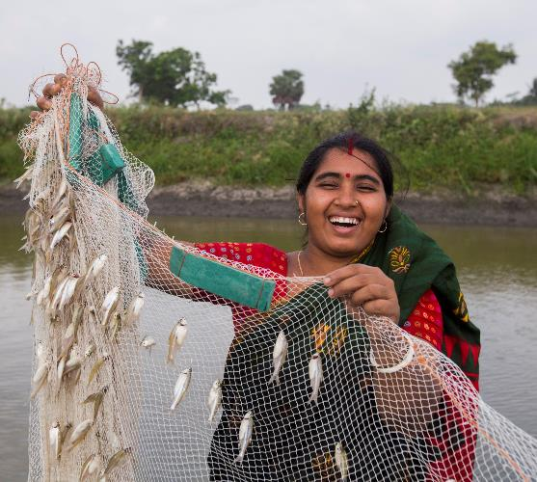
Interventions and incentives
Based on One Health approaches, design, test and evaluate interventions and incentives that lead to behavioural change that can lead to reduction of agriculture-associated AMR
Outputs
Typologies of interventions
Decision support tools to identify best-bet interventions
Gender sensitive interventions to mange drivers of AM use
Cost and benefits of interventions from a One Health perspective

Slide 8
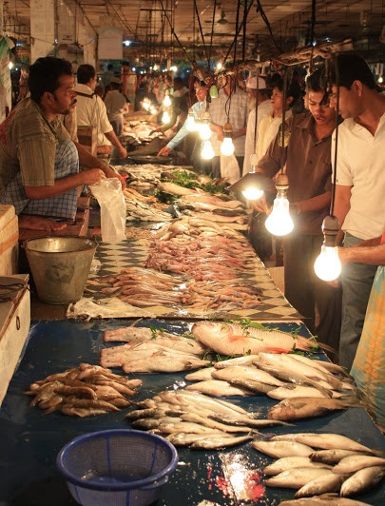
Enabling evidence based policy dialogue
Translate evidence into convincing arguments to engage policymakers and other stakeholders in the AMR discussion.
Accepted and feasible policies key for sustainable solutions that achieve impact.
Outputs
Synthesized evidence for policy makers
Advocacy materials
Integrated policy approaches towards One Health solutions
Notes:
Support evidence-based policy dialogue

Slide 9
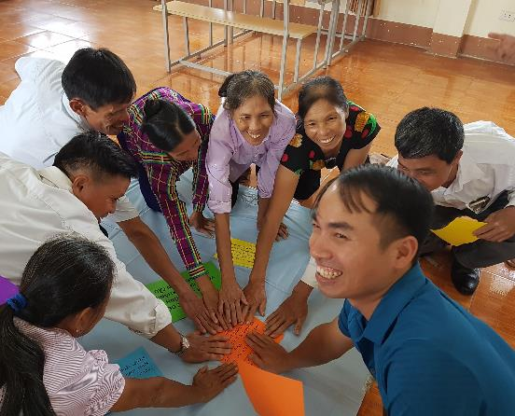
Capacity development and scaling
How solutions can be brought to scale and capitalizing on the network of AMR experts to support capacity building
Outputs
Guidance for scaling of interventions
Training, mentorship and exchange programs
Training materials
Facilitate access to state of the art research

Slide 10
Geographical reach
  Aims to support efforts in low and middle-income countries globally, drawing on the lessons from high-income countries
  The current research partnership has a strong presence in Africa and Asia, with links in South America currently under development.
Benefits of the CGIAR AMR-hub
  State-of-the-art technological platforms and storage possibilities (biobank and data)
  Trusted partner to facilitate development of policies, incentives, regulations, and practices with governments
  Convene stakeholders to discuss AMR (like this meeting)
  New partnerships such as ICARS

Slide 11

Antimicrobial
Resistance
Hub
Thank you!
a.moodley@cgiar.org
https://amr.cgiar.org/

