Slide 1





KAZNET: Crowdsourcing Information for Climate Resilience in the Drylands
Kelvin Shikuku, PhD
Economist, ILRI
k.m.shikuku@cgiar.org

Slide 2
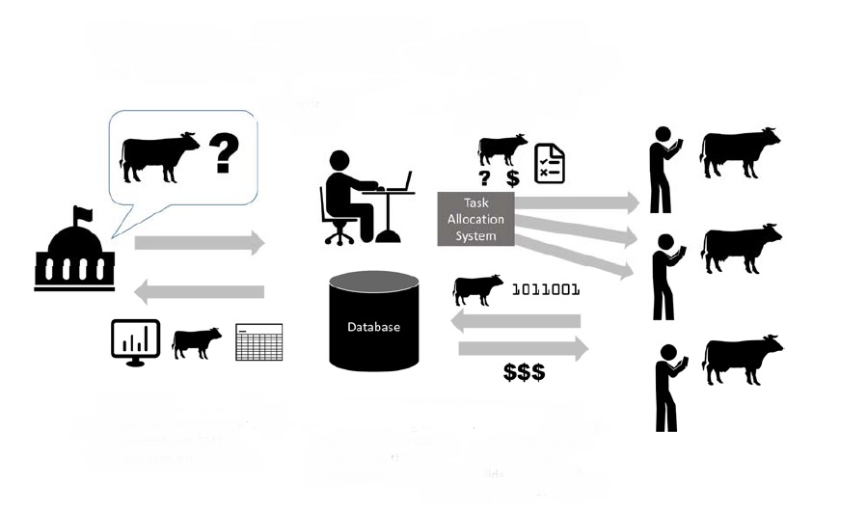
What is KAZNET?
KAZNET is a digital platform for dynamic monitoring of climatic shocks, informing early and anticipatory action, and enabling the dissemination of climate information services.
2. System administrator develops tasks with rewards ($) and controls to ensure data quality.
3. KAZNET allows contributors access to the tasks in the field.
1. Client with information needs.
4. Contributors see a menu of available tasks with related rewards and complete them at will.
5. Data is validated and processed according to clients’ needs
6.2 Processed data and appropriate rewards are disseminated to contributors.
6.1 Processed data are disseminated to clients

Slide 3
KAZNET indicators monitored
Level | Indicators
Rangeland | Vegetation availability and suitability for consumption by livestock.
Markets | Livestock price and body condition by type, gender, and age of animal. The number of animals sold, by type. Prices for selected food commodities.
Household | Production Livestock birth and death rates. Livestock milk productivity. Human nutrition Reduced coping strategy index (rCSI). Household Dietary Diversity (HDDS). Mid-Upper Arm Circumference (MUAC).

Slide 4
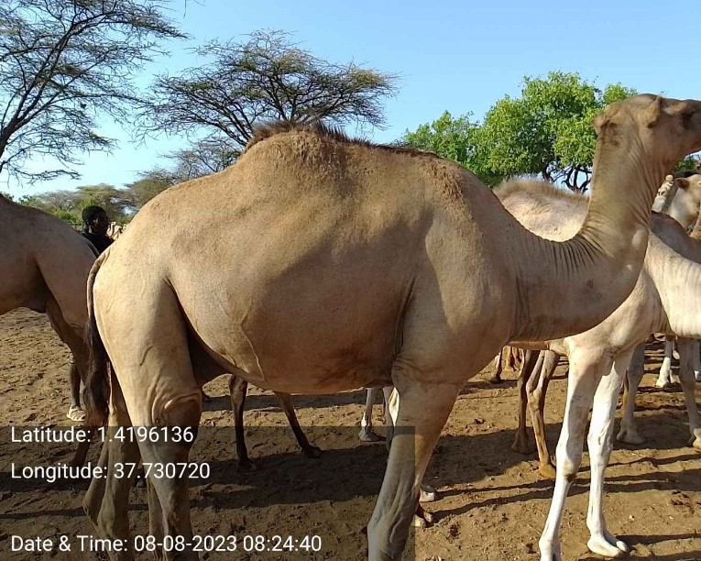
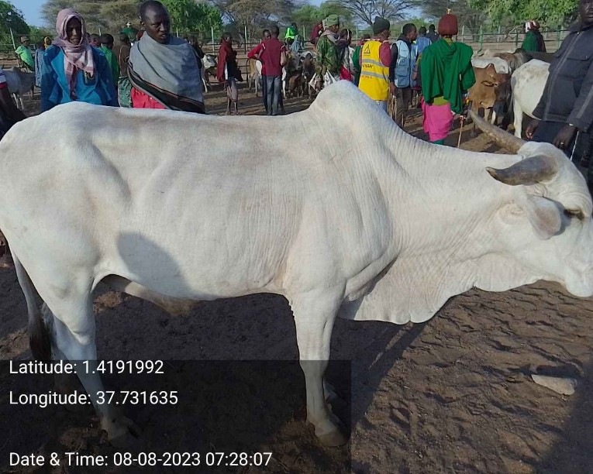
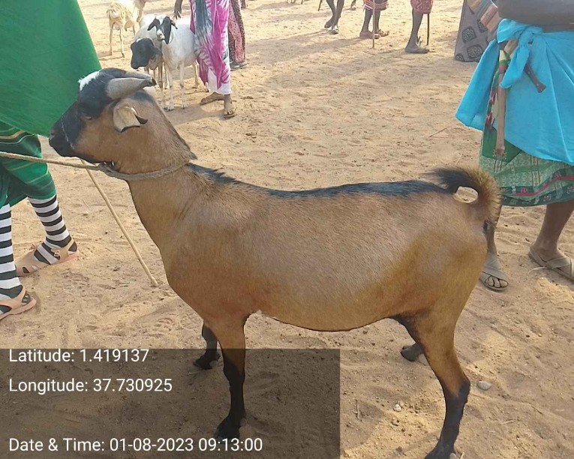
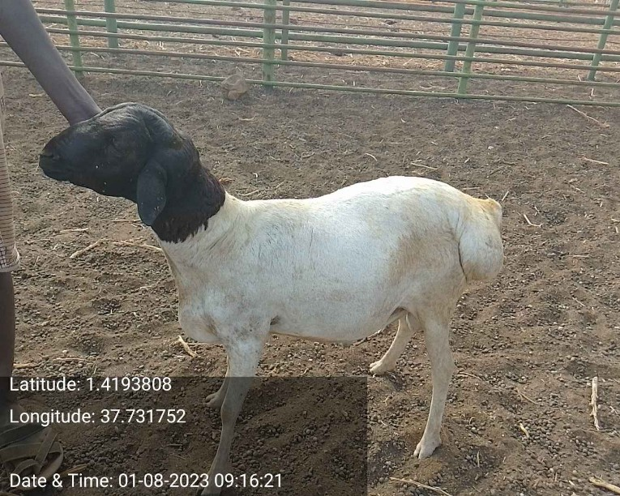
KAZNET data quality
Training of contributors.
Community engagement to minimize attrition.
Geofencing (spatial restrictions).
Temporal constraints.
Rewards.
Value limits and front-end validations.
Manual checks and validation activities.
Photographic evidence.

Slide 5
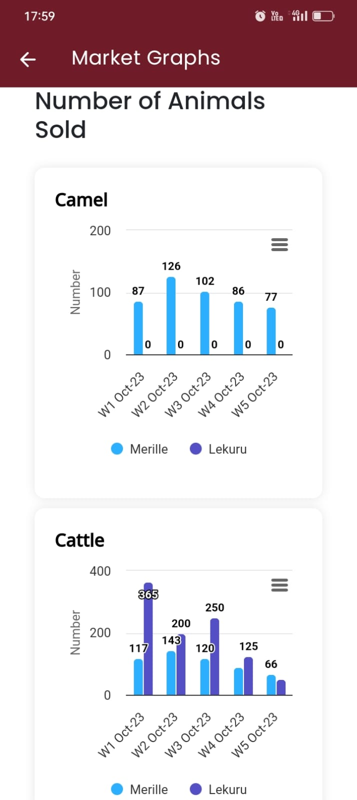
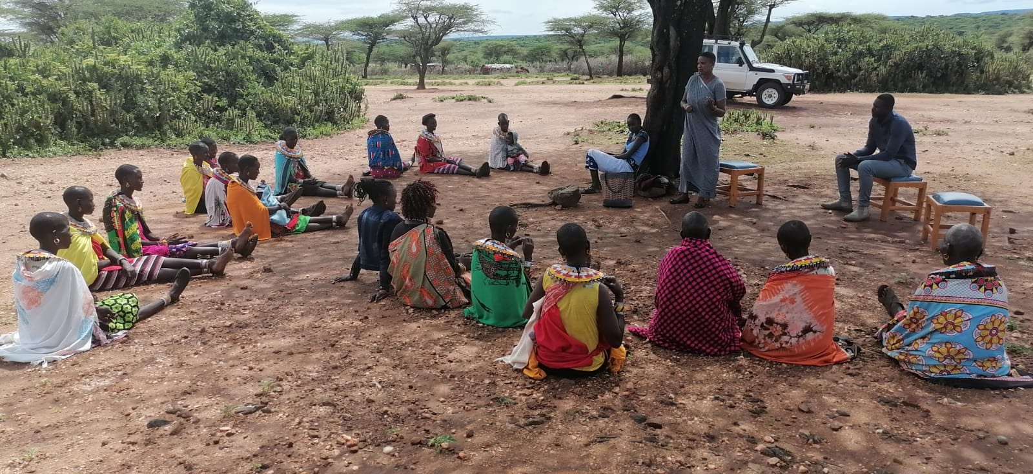
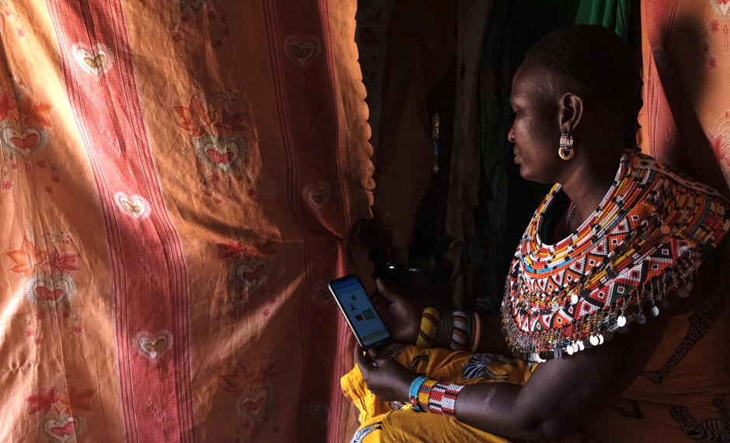
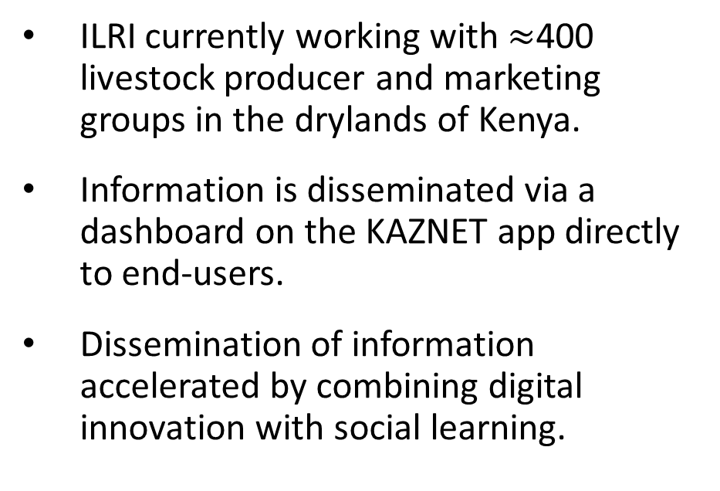
Dissemination of information to pastoralists
ILRI currently working with $≈$400 livestock producer and marketing groups in the drylands of Kenya.
Information is disseminated via a dashboard on the KAZNET app directly to end-users.
Dissemination of information accelerated by combining digital innovation with social learning.

Slide 6
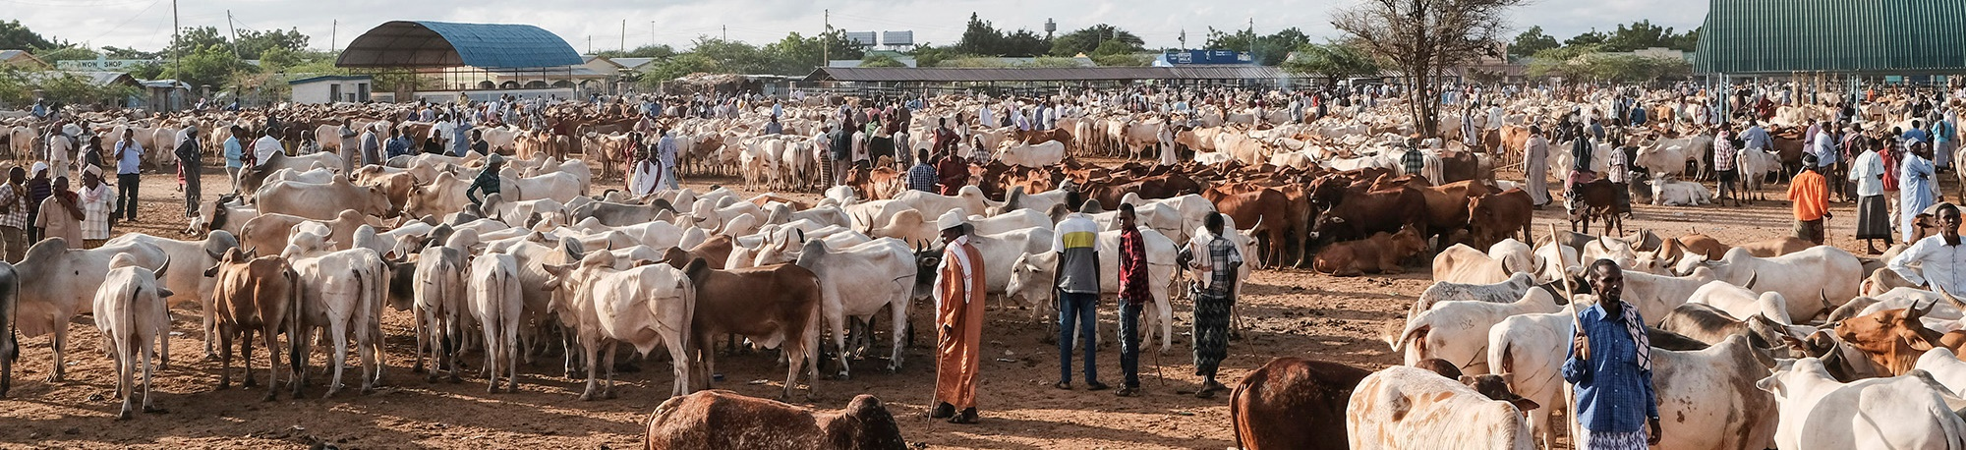
Partners
County governments.
Kenya Livestock Marketing Council – livestock marketing associations (LMAs).
KALRO - KAOP
State Department for Livestock Development.
National Drought Management Authority.
Catholic Relief Services.
Mercy Corps

Slide 7
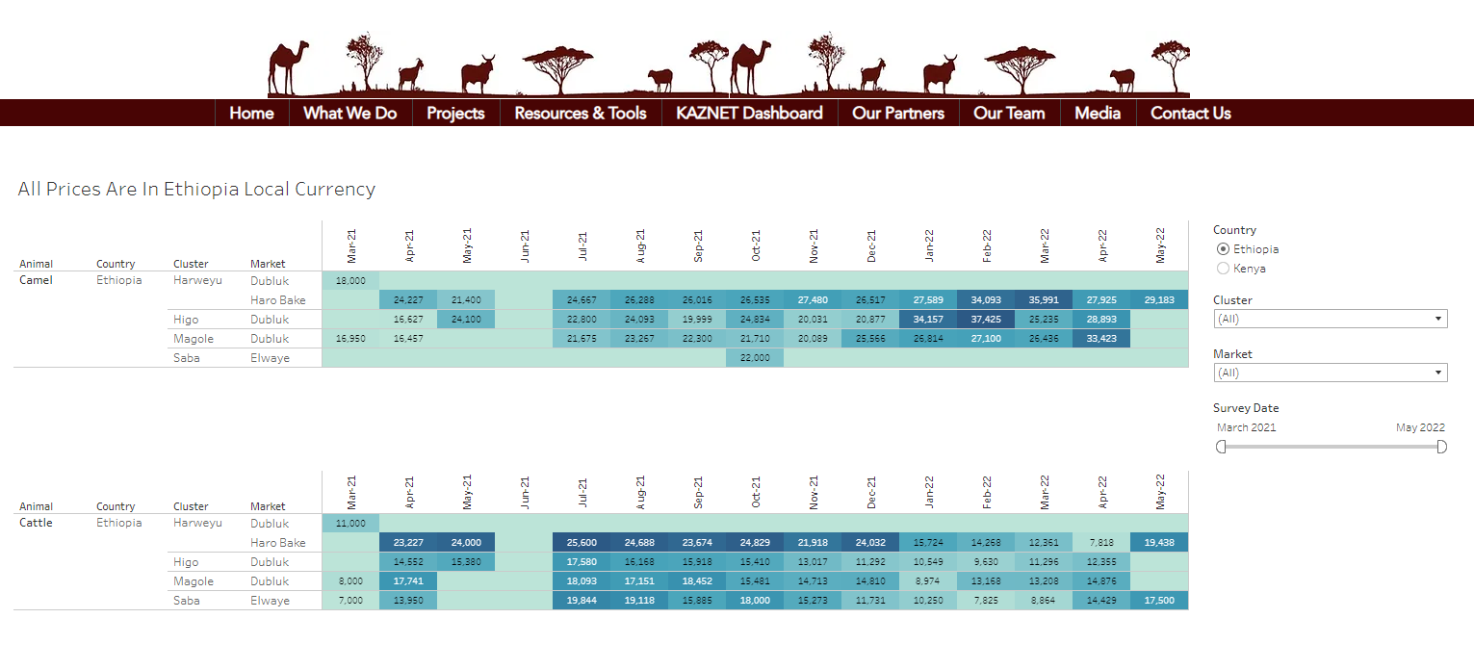
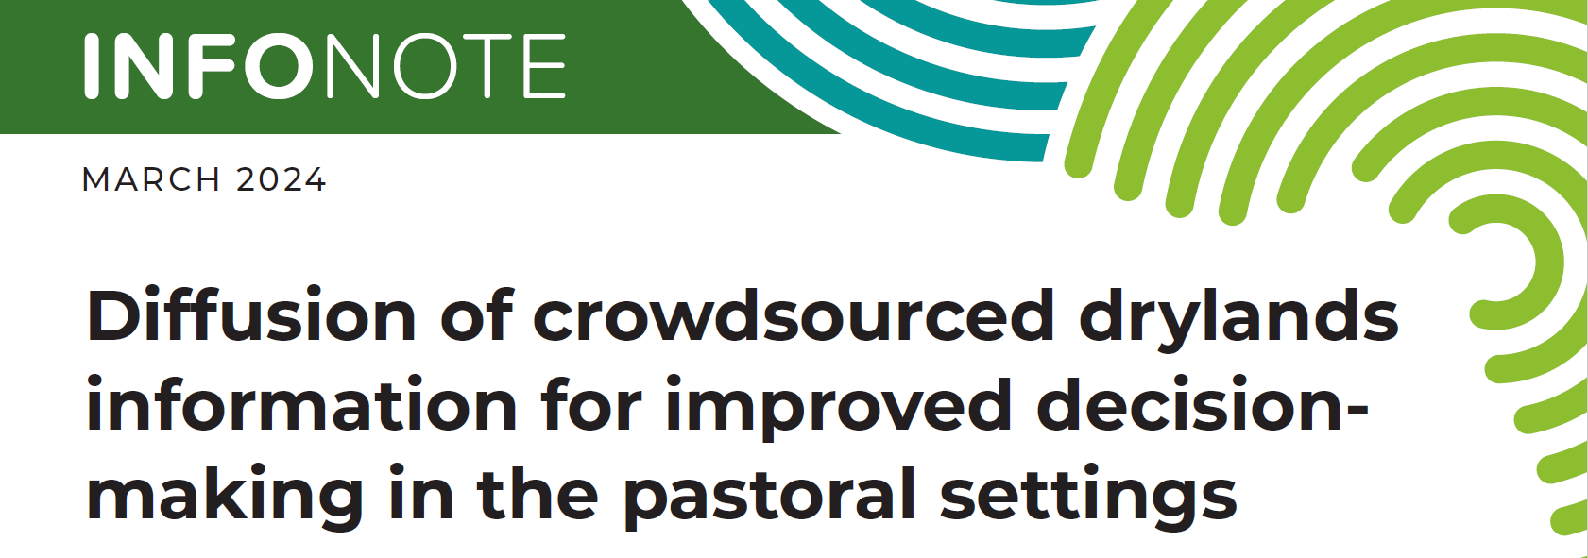
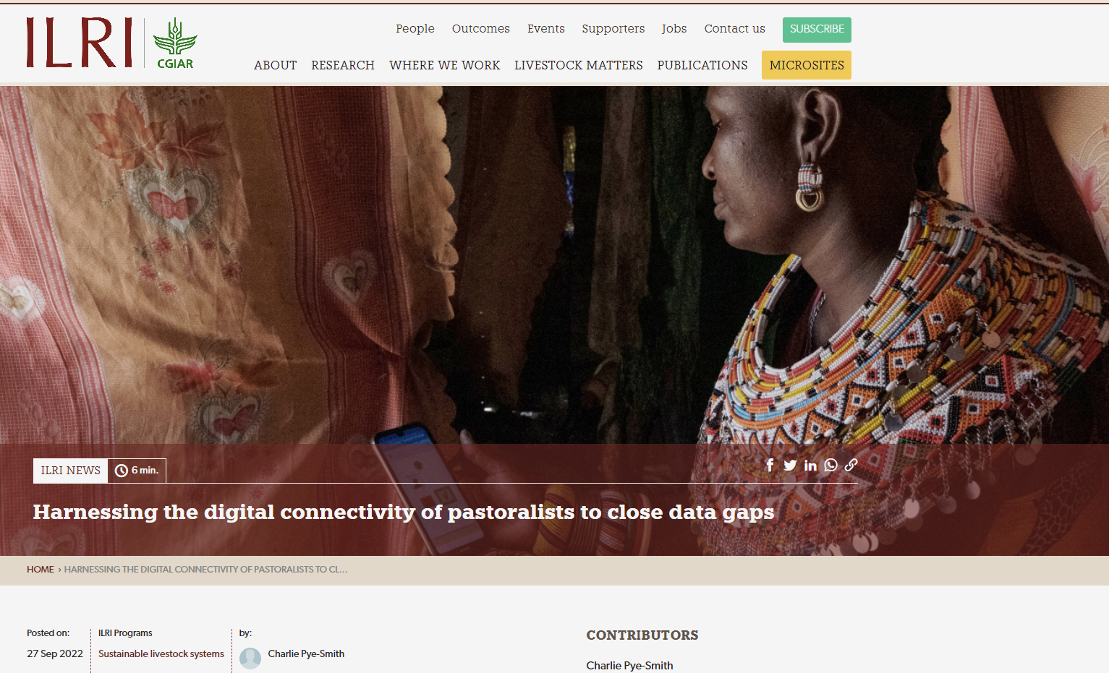
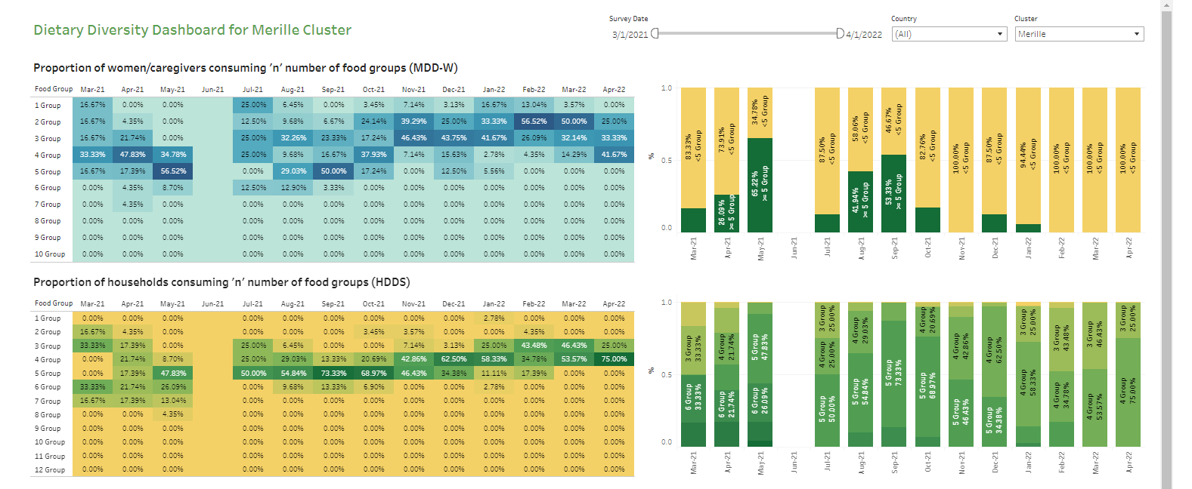
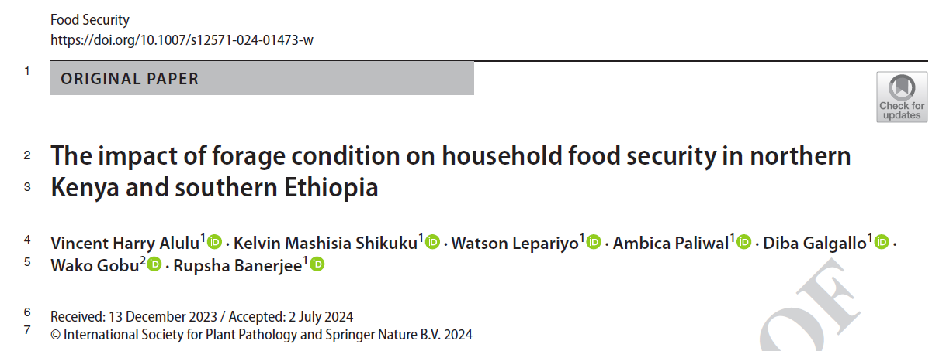
Data are accessible
Dashboard: https://www.drylandinnovations.com/
Brief: https://www.ilri.org/news/harvesting-data-drylands-help-close-information-gap-pastoralists
Infonote: https://hdl.handle.net/10568/140568

Slide 8

THANK YOU

