Slide 1

Rangeland data gaps
Fiona Flintan, Senior Scientist,
International Livestock Research Institute (ILRI)
A presentation made at the meeting organised by ILRI and IUCN for the launch of the GEF-funded project STELAR (Sustainable Investments for Large Scale Rangelands Restoration), Rome 25 October 2023

Slide 2
Resolutions at UNEA
UNEA2 Combating desertification, land degradation and drought and promoting sustainable pastoralism and rangelands (2016) including a call for a gap analysis of environmental and socioeconomic information and the provision of technical support for promoting pastoralism and rangelands.
UN declared IYRP 2026

Slide 3
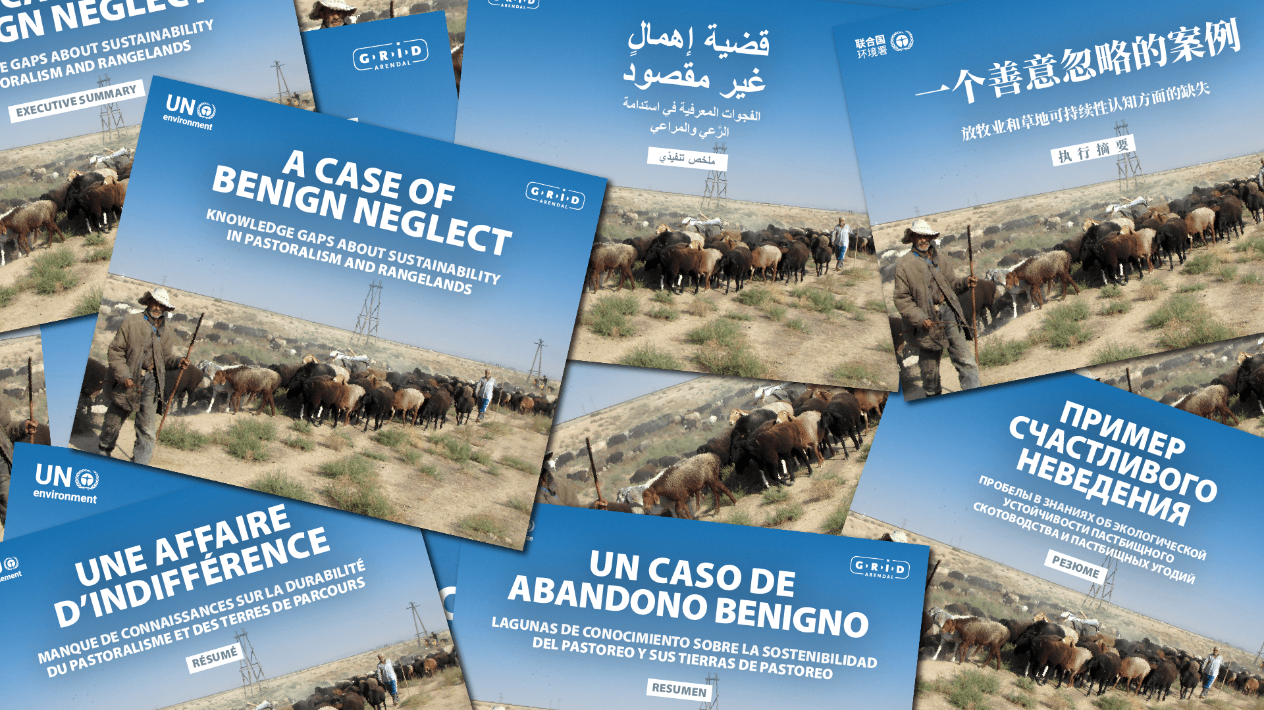

Slide 4

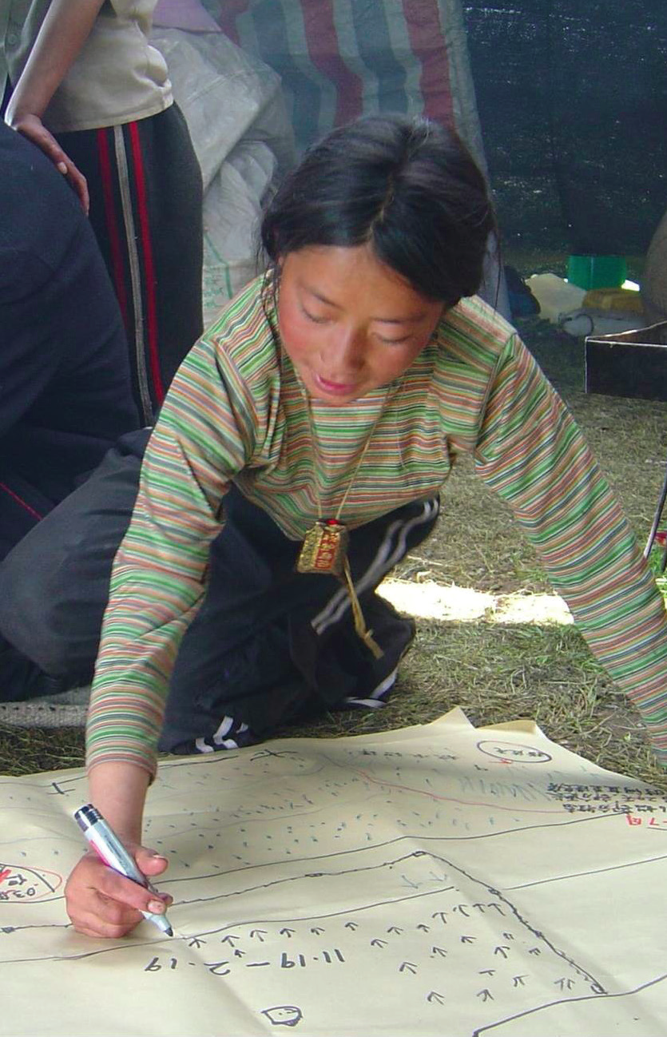
Analysis of online, publicly available information since 2000 in:
13 global environmental assessments
100 global, regional and national databases
71 million academic and research peer reviewed publications
Analysis of provision of technical support for pastoralism and rangelands in:
Projects of 13 multilateral agencies and international research organizations
336 Stakeholder questionnaires (18% response)

Slide 5
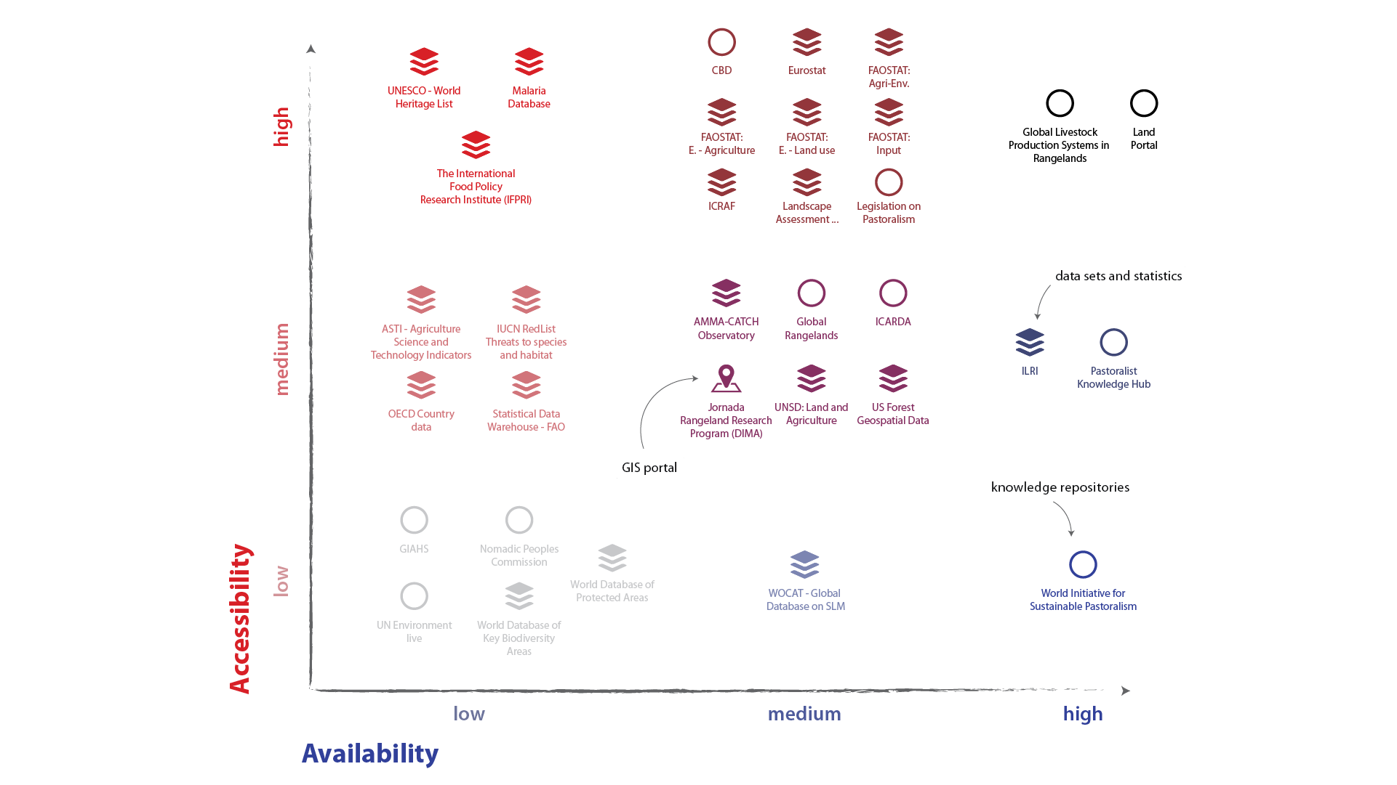
Highly available, highly accessible
34 relevant global data bases
out of 100
Notes:
None of the 13 global environmental assessments reviewed disaggregate their information on pastoralists or rangelands
Only one third of the 100 databases reviewed have some information about pastoralism and rangelands, and only two provide the information in a manner that could help inform decision makers on sustainable livelihoods and ecosystem management.

Slide 6
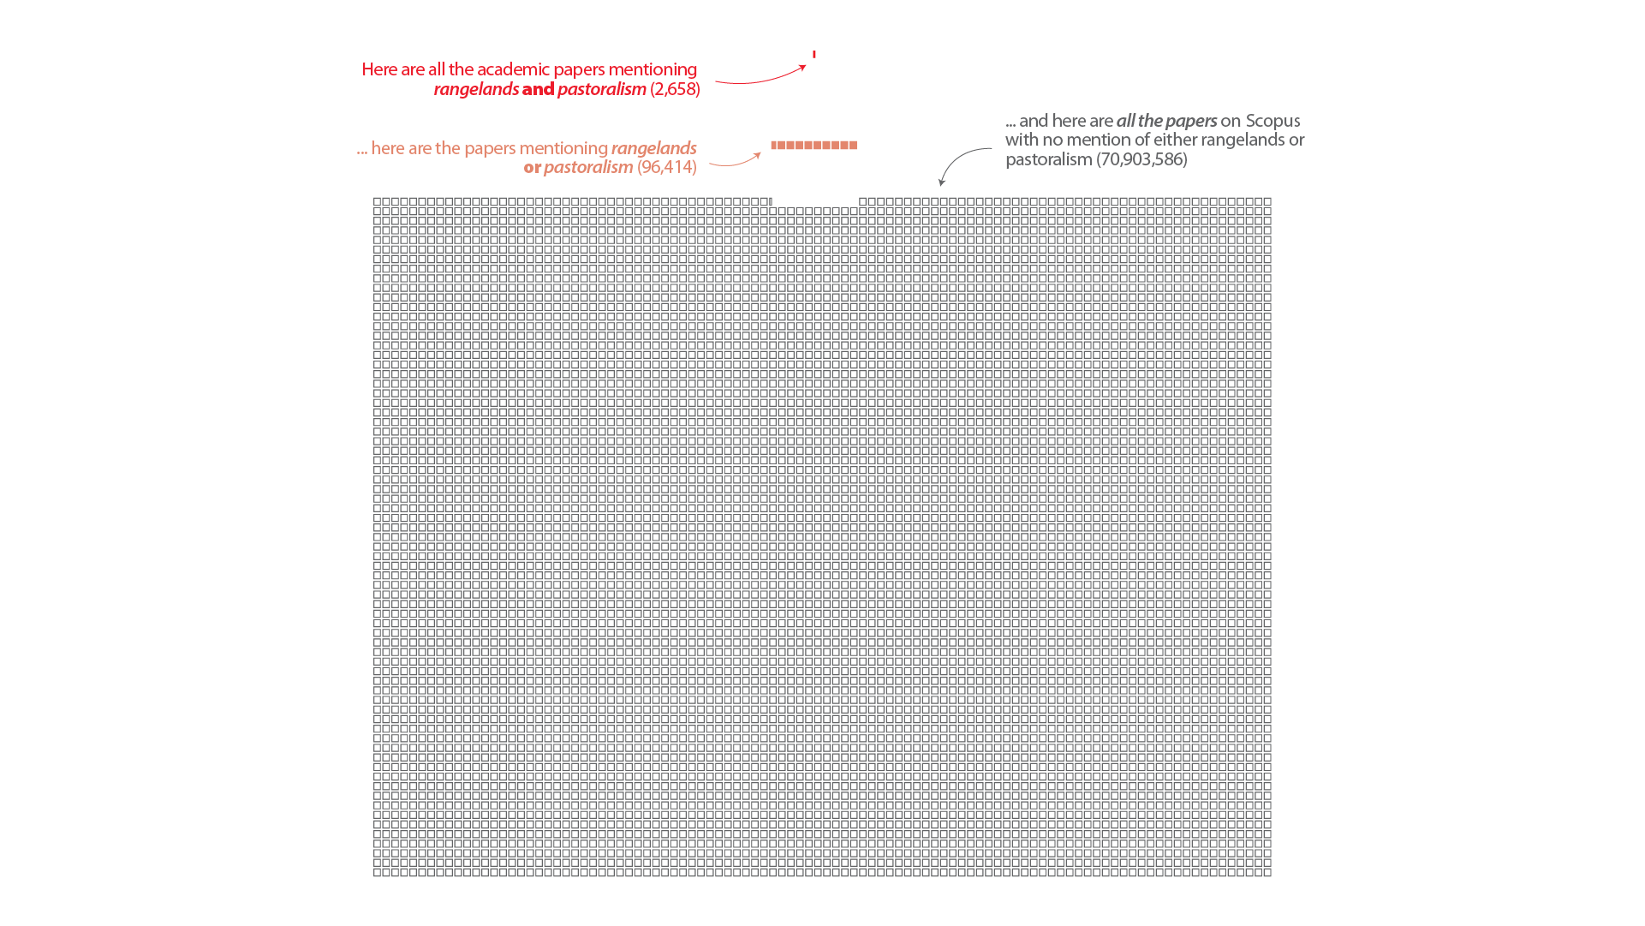

Slide 7
Rangeland data gaps identified
Figures on rangelands go back 1o 1960s
To start filling data gaps in terms of maps and key data/figures
To raise awareness on the enormous environmental, economic and social value of rangelands as well as their different ecosystems.
To start exploring the different changes taking place in rangelands, including those being monitored at global levels such as land degradation neutrality and climate change.
To provide a platform for local voices to describe what they are doing to respond to these changes and the challenges that they face.
To strengthen global collaboration on rangelands.

Slide 8
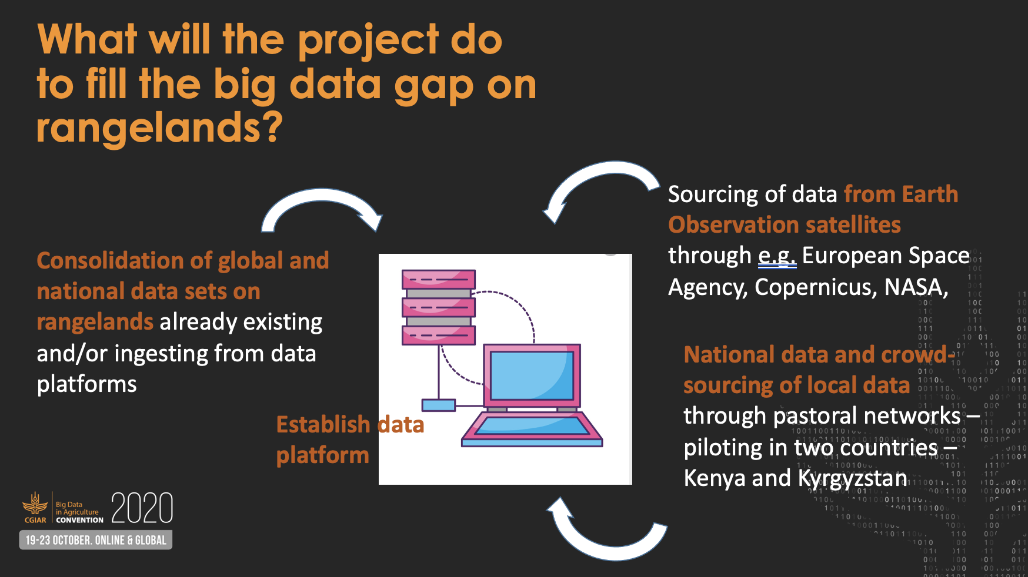
Global rangelands data platform

Slide 9
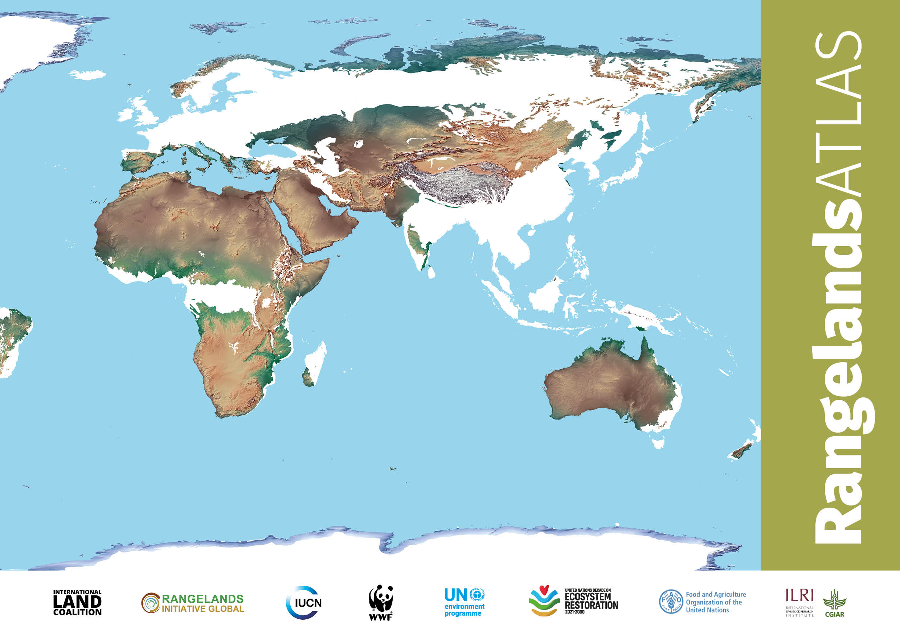

Slide 10
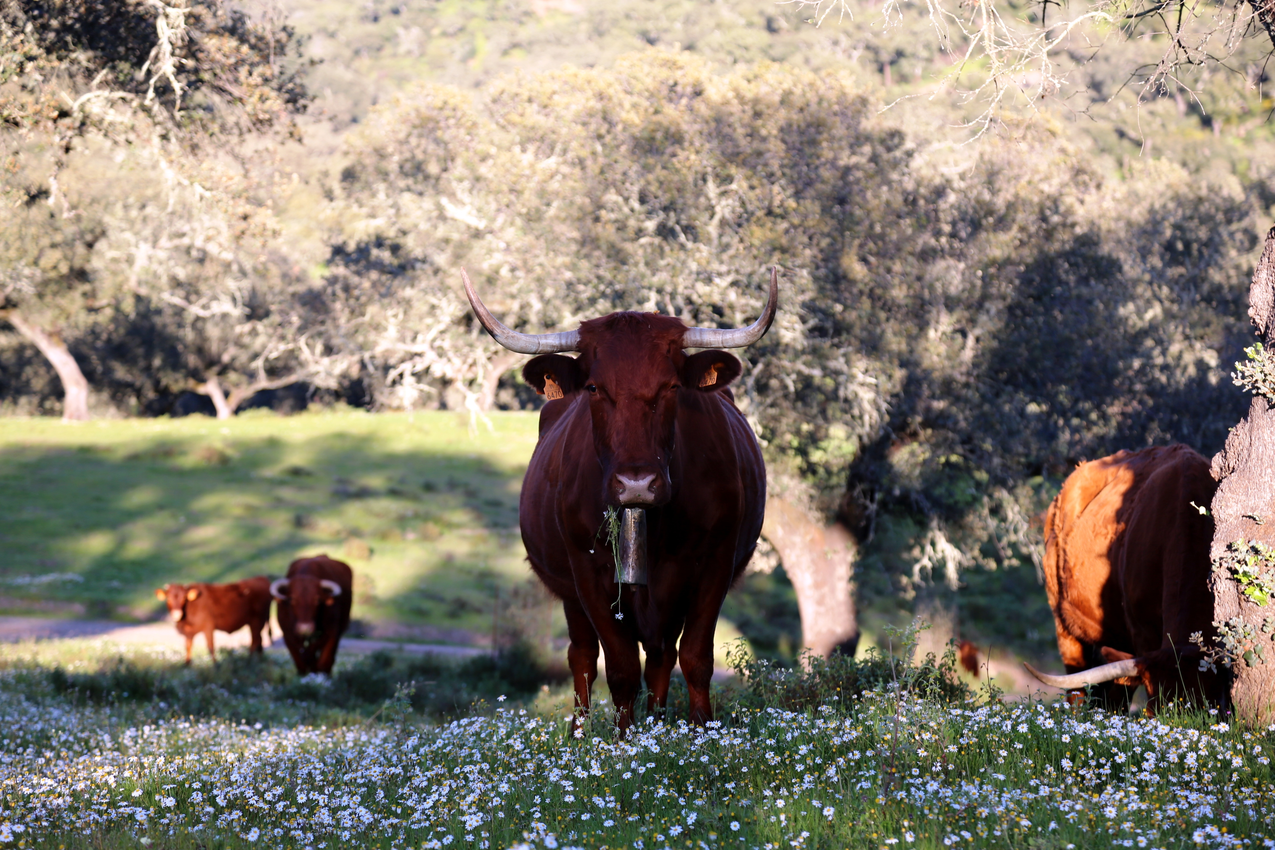
How was the Atlas produced?
The spatial mapping of rangelands was produced by focusing on seven of the 14 global biomes categorised by WWF in their mapping of terrestrial ecoregions around the world.
The map of rangelands is combined with other existing global datasets on different themes, to produce a mapping of that data “for rangelands.”
Credit: Marco Buemi

Slide 12
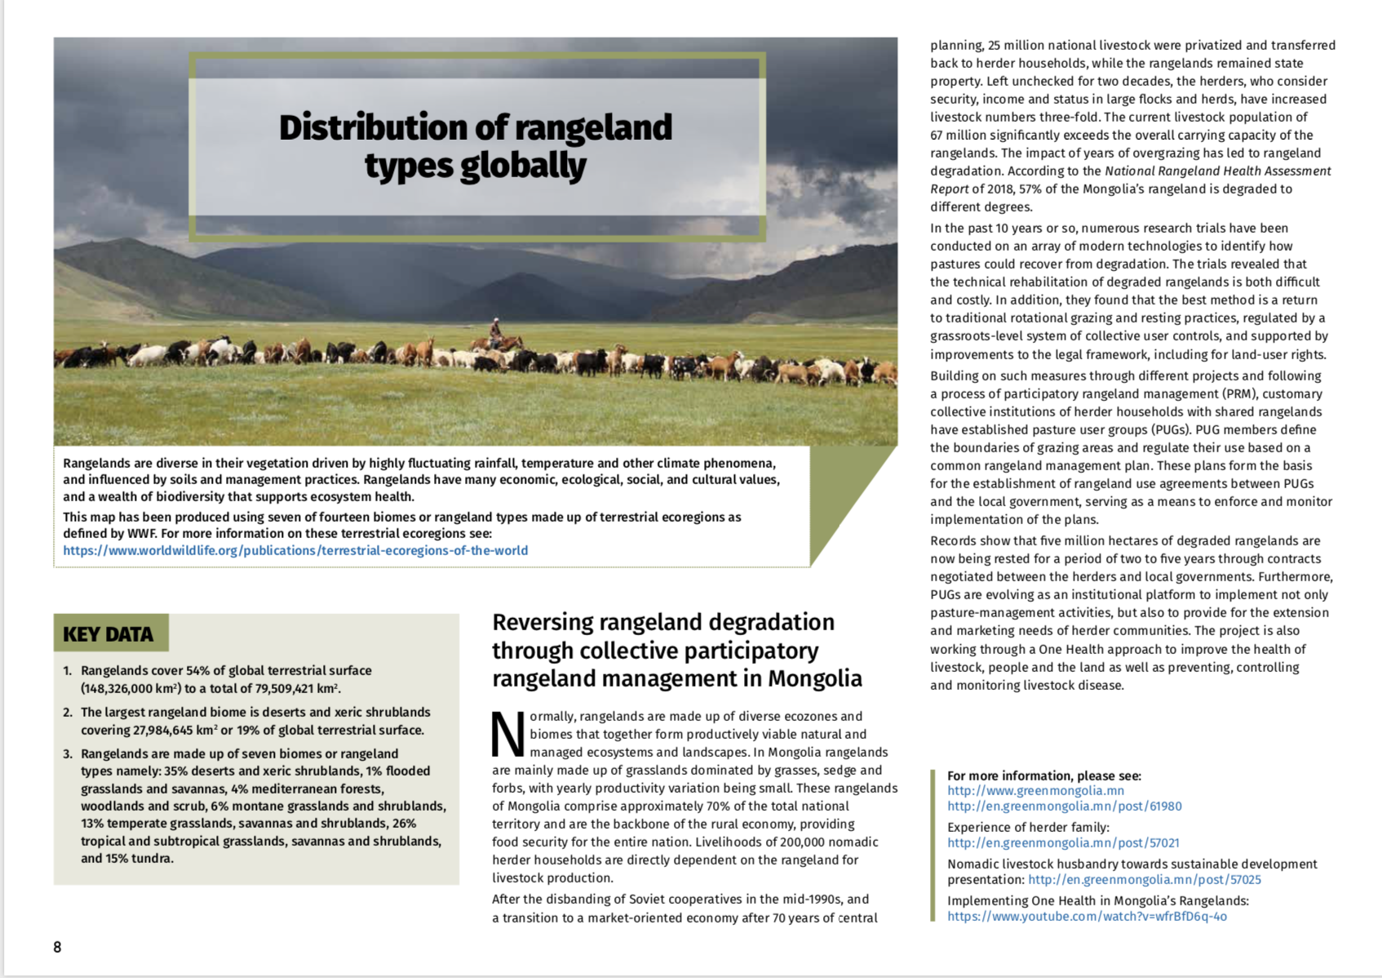
What is the Atlas?
Currently 16 sets of maps covering different themes.
Key data; a story from the field; explanation of terminologies.
We are reliant on the accuracy of the datasets we have accessed: the data have not been verified on the ground, and we will be looking for ways to do this.
The Atlas is work in progress: a living document!

Slide 13
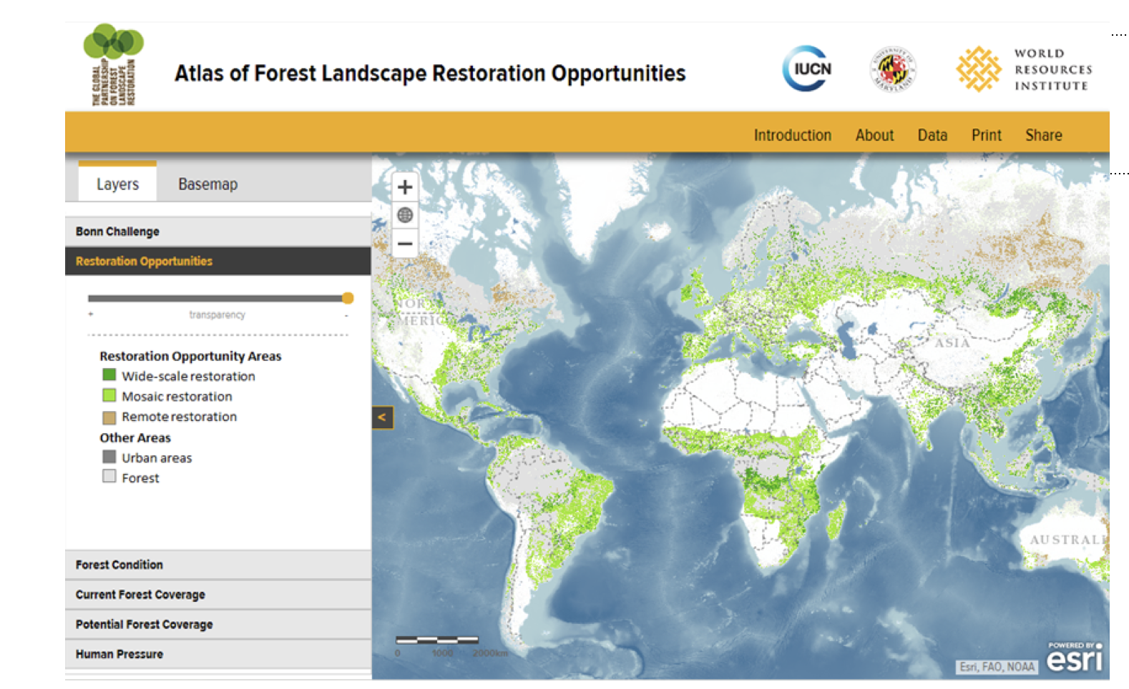
Activities – output 3.1 Global monitoring system for LVCD for SRR developed and tested
-
- Definitions and indicators for sustainable rangeland restoration elaborated
- Measurement protocols established and tested in project’s LVCs

Slide 14
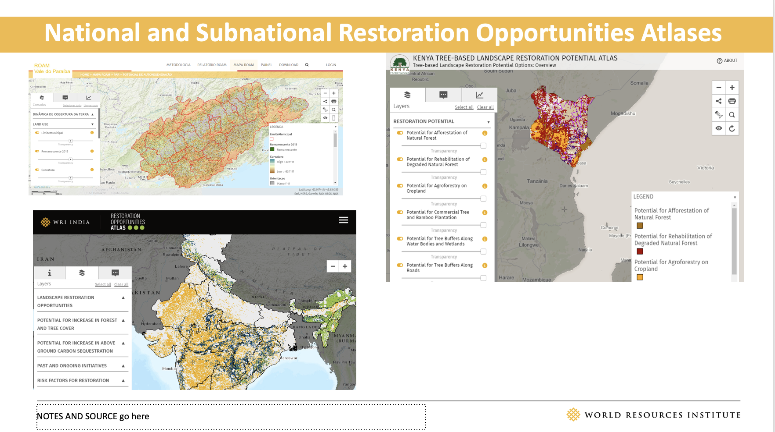
Activities – output 3.2 Global Monitoring Framework developed and tested
-
-Monitoring framework on LVCD for SRR developed and tested in project’s LVCs and bankable projects
Global monitoring framework peer reviewed and accepted by relevant stakeholders as a basis for a global standard for LVCD for SRR

Slide 15
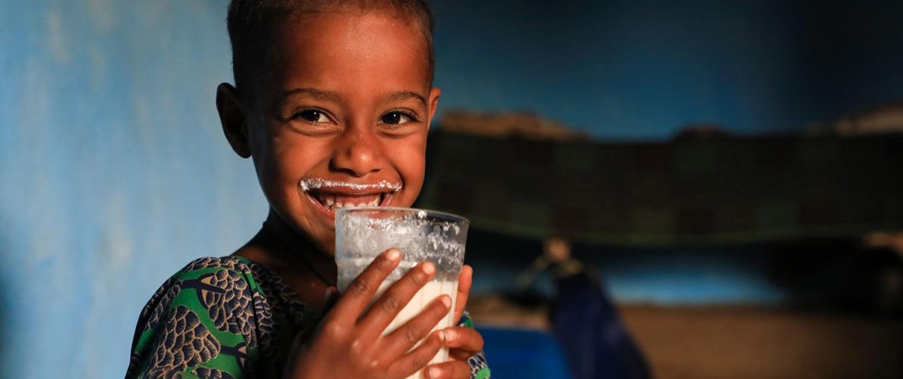
THANK YOU

